Slide 1
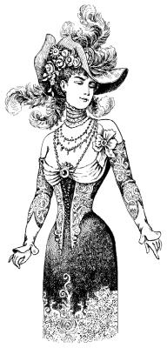
The Ruined Maid
By Thomas Hardy

Slide 2
What do you think ‘ruined maid’ might imply or mean?
When might such a term have been used?
Read the quotes from the poem you have been given – what impression do these give you?
What do you think the poem is about?

Slide 3
Prostitution in Thomas Hardy’s England
Although we may think of Victorian England as very strict and moral there was probably just as much behaviour that would still be considered shocking then as there is now, if not more.
Drug taking, violent crime, prostitution, adultery and pornography all went on but were hidden under a more genteel surface leading to hypocrisy and double standards. In Hardy’s time, there was also much less equality in England than there is today so there were different expectations and treatment for the poor and the rich, and for men and women.
In the 19th century (as in some cultures and societies today) there was a double standard whereby it was usually accepted or even expected that men had sex outside marriage but women who did this were called ‘fallen women’ and considered ‘ruined’. They were often shunned by polite society, banished from their families, or worse, left without support, money or connections.
Opportunities, rights and support for women were so limited that many poor women felt they had no option but to turn to prostitution to make enough money to live. However, there wasn’t usually much sympathy or understanding for their circumstances. Prostitution was seen as a big problem, not only as a nuisance in society, but as a threat to morality.
Although prostitution was not spoken about in polite society, prostitutes and adulterous and otherwise ‘fallen’ women were popular subjects for Victorian art and literature. This sort of art and literature often conveyed a message or lesson which aimed to reinforce Victorian values and warn against sexual temptation.

Slide 4
‘O ’Melia, my dear, this does everything crown!
Who could have supposed I should meet you in Town?
And whence such fair garments, such prosperi-ty?’ –
‘O didn’t you know I’d been ruined?’ said she.
– ‘You left us in tatters, without shoes or socks,
Tired of digging potatoes, and spudding up docks;
And now you’ve gay bracelets and bright feathers three!’ –
‘Yes: that’s how we dress when we’re ruined,’ said she.
– ‘At home in the barton you said “thee” and “thou”,
And “thik oon”, and “theäs oon”, and “t’other”; but now
Your talking quite ﬁts ’ee for high compa-ny!’ –
‘Some polish is gained with one’s ruin,’ said she.
– ‘Your hands were like paws then, your face blue and bleak
But now I’m bewitched by your delicate cheek,
And your little gloves ﬁt as on any la-dy!’ –
‘We never do work when we’re ruined,’ said she.
– ‘You used to call home-life a hag-ridden dream,
And you’d sigh, and you’d sock; but at present you seem
To know not of megrims or melancho-ly!’ –
‘True. One’s pretty lively when ruined,’ said she.
– ‘I wish I had feathers, a fine sweeping gown,
And a delicate face, and could strut about Town!’ –
‘My dear – a raw country girl, such as you be,
Cannot quite expect that. You ain’t ruined,’ said she.

Slide 5
This poem is a form of dramatic dialogue. In the poem, Hardy presents a conversation between two women. One of the women is called ‘Melia. She has moved away and has changed in many ways. As they talk, the role and treatment of women during the Victorian era reveals itself as a major theme within the poem. At the time, women were not treated equally to men. They were forced to project an image of morality, and if they deviated away from that image, they were seen as being tainted or soiled.
In ‘The Ruined Maid’, Hardy uses irony and satire.
Irony: This is a device writers use to express something different from and often opposite to their literal meaning.
Satire: Satire aims to show the reader the absurdity of human follies and vices. Writers who use satire want the reader to acknowledge such wrongs in society.
The poet mocks Victorian attitudes to morality and ‘fallen’ women.

Slide 6
ballad-like form
aabb rhyming pattern = lighthearted tone
the strict rhyme scheme mirrors the strict moral codes of the time
4th line of every stanza is Melia’s sarcastic reply
the ‘clean living’ girl speaks the most, which makes her seem childlike, chatty and unrefined
repetition of ‘ruined’ in every stanza contrasts with Melia’s fine appearance
Vocabulary:
Whence: from where
Spudding: weeding with a sharp spade
Docks: dock leaves
Barton: barn
Hag-ridden: tormented; troubled
Megrims: depression

Slide 7
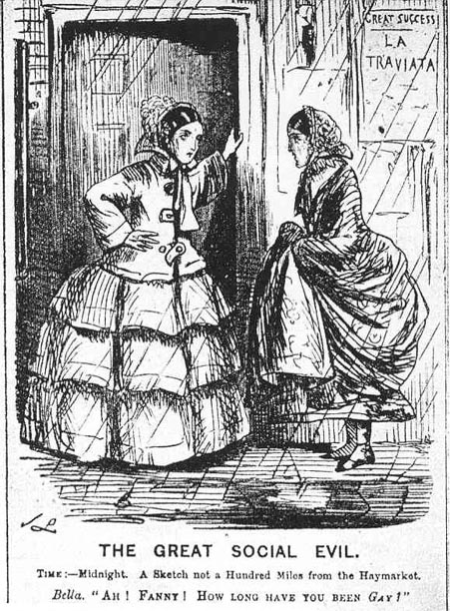
How has Melia changed? Use your worksheet to find out.

Slide 8
Why might this be shortened?
Matter of fact tone – Melia’s ‘ruin’ seems to be common knowledge
‘O ’Melia, my dear, this does everything crown!
Who could have supposed I should meet you in Town?
And whence such fair garments, such prosperi-ty?’ –
‘O didn’t you know I’d been ruined?’ said she.
– ‘You left us in tatters, without shoes or socks,
Tired of digging potatoes, and spudding up docks;
And now you’ve gay bracelets and bright feathers three!’ –
‘Yes: that’s how we dress when we’re ruined,’ said she.
Mocking her friend’s use of ‘O’ (genuine shock) – sarcasm?
Alliteration adds to ‘bouncing’ rhythm/ light-hearted tone
Colloquialism/ dialect used by friend
‘spudding up docks’ = digging up weeds
Use of ‘we’ to identify with larger group
Alliteration draws attention to contrast of ‘shoes’/’socks’ and ‘bracelets’ / ‘bright feathers’
How has Melia gained such prosperity? Why is this ironic?

Slide 9
Dover dialect: contrasts with more refined speech of Melia
What impression does it give of the country girl?
barton = barn/ farmyard
Speaks in a more formal way
– use of impersonal pronoun
– ‘At home in the barton you said “thee” and “thou”,
And “thik oon”, and “theas oon”, and “t’other”; but now
Your talking quite ﬁts ’ee for high compa-ny!’ –
‘Some polish is gained with one’s ruin,’ said she.
– ‘Your hands were like paws then, your face blue and bleak
But now I’m bewitched by your delicate cheek,
And your little gloves ﬁt as on any la-dy!’ –
‘We never do work when we’re ruined,’ said she.
Contrast with the previous use of alliteration (bracelets/ bright)
Is this an implied criticism/suggestion of wrongdoing?
Animalistic simile (contrast this with ‘little gloves’)
Why is it ironic that Amelia is fit for ‘high company’?

Slide 10
Metaphor: her previous life was a nightmare, but her current life surely seemed like an impossible dream
megrim = migraine
– ‘You used to call home-life a hag-ridden dream,
And you’d sigh, and you’d sock; but at present you seem
To know not of megrims or melancho-ly!’ –
‘True. One’s pretty lively when ruined,’ said she.
– ‘I wish I had feathers, a fine sweeping gown,
And a delicate face, and could strut about Town!’ –
‘My dear – a raw country girl, such as you be,
Cannot quite expect that. You ain’t ruined,’ said she.
Alliteration: sounds reflect the mood
‘strut’ suggests her friend thinks Melia is arrogant
2 lines for her final retort
‘ain’t’: her dialect creeps in, revealing her humble origins and connecting her to her friend
Direct address; again mocking the words used by her old friend (stanza 1)
Caesura places the emphasis on ‘you’. The tables are turned; she is judging the ‘clean living’ girl.
Repetition of ‘said she’ creates emphatic tone to highlight ’Melia’s consistent lack of remorse

Slide 11
On your tables, split into two groups.
Group 1: Dialect and dialogue: ‘The Ruined Maid’
Group 2: Tone and attitude: ‘The Ruined Maid’
Each group should complete the questions on their side of the worksheet, then share their ideas with the other group. By the end of the session, both groups should have all the questions answered, with answers written down.

Slide 12
‘Melia is short for Amelia
‘Melior’ means ‘better’
To ‘ameliorate’ is to make something bad better
A ‘meliorist’ is someone who believes that society can be improved by people making an effort
Why do you think the poet called the ruined maid Amelia?
What do you think the poet’s message is?

Slide 13
Discussion Time!
What is your overall impression of the poem?
Do you think Hardy is a feminist? Do you think he really feels that the young girl is ‘ruined’?
Is her new life better than her old life?
What will be the final outcome for Amelia, once her beauty and youth have faded?

Slide 14
It’s time to summarise! We’re going to make a note of the poem’s VITALS.

Slide 15
Poetry VITALS…
Voice: Who is speaking in the poem?
Imagery: What imagery is being created? How is it effective?
Theme: What are the main themes featured in the poem?
Address: Who is the poem addressed to? Why?
Language (Features): What type of language/ devices are used?
What is their effect?
Structure: How is the poem laid out? What is the effect of this?
Notes:
This is the acronym that we will use on each poem to look at all the different aspects

