Slide 1
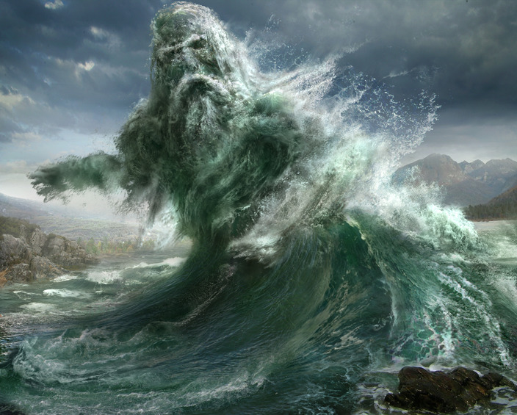
The River God
Stevie Smith

Slide 2
This is the poem ‘The River God’ but with the words blocked out. To start with, I want you to think about the way the poem is set out on the page.
1. In pairs, make a note about the way that the poem is structured. In particular, think about the number of verses in the poem and the lengths of the lines. Note anything else you think is relevant.
2. Using a blue pencil or pen, trace and mark the pattern and structure of the poem’s line endings by following the right-hand side of the silhouette above.
What does the line look like?
What might the poem be about?
Why, do you think, the poem is one verse long?
What is the effect of the different line lengths? That is, what do they seem to capture?
What might the pace of the poem be during short lines? Long lines? What might this reflect?

Slide 3
“I may be smelly and I may be old,
Rough in my pebbles, reedy in my pools,
But where my fish float by I bless their swimming
And I like the people to bathe in me, especially women.”
These are the opening lines of the poem.
Who do you think is speaking?
Fill in the gaps for the next section of the poem, then discuss your choices with your partner.
“But I can __________ the fools
Who __________ too close to the weir, contrary to __________.
And they take a long time __________
As I throw them up now and then in the spirit of clowning.”

Slide 4
What adjectives would you use to describe the attitude and personality of the speaker?

Slide 5
I may be smelly and I may be old,
Rough in my pebbles, reedy in my pools,
But where my fish float by I bless their swimming
And I like the people to bathe in me, especially women.
But I can drown the fools
Who bathe too close to the weir, contrary to rules.
And they take a long time drowning
As I throw them up now and then in the spirit of clowning.
Hi yih, yippity-yap, merrily I flow,
O I may be an old foul river but I have plenty of go.
Once there was a lady who was too bold
She bathed in me by the tall black cliff where the water runs cold,
So I brought her down here
To be my beautiful dear.
Oh will she stay with me will she stay
This beautiful lady, or will she go away?
She lies in my beautiful deep river bed with many a weed
To hold her, and many a waving reed.
Oh who would guess what a beautiful white face lies there
Waiting for me to smooth and wash away the fear
She looks at me with. Hi yih, do not let her
Go. There is no one on earth who does not forget her
Now. They say I am a foolish old smelly river
But they do not know of my wide original bed
Where the lady waits, with her golden sleepy head.
If she wishes to go I will not forgive her.
Listen to the poem and think of something to say about:
The tone of the poem
The meaning of the poem
The techniques used in the poem

Slide 6
The poem is a dramatic monologue. The river is personified (made human) by being given a voice to speak to us.
This is one, continuous dramatic monologue. There is rhyme embedded in the poem, mainly in an a-a-b-b rhyme scheme but it changes at the end. What is interesting in this poem are the irregular line lengths combined with the lack of breaks.
The poem uses enjambment throughout to emphasise key ideas. The form could represent the uninterrupted ‘flow’ and natural shape of a river.
• The rhyme scheme appears to be rhyming couplets although this is deceptive, possibly like the surface appearance of the river. The number of beats in each line is inconsistent.
• Dramatic monologue form relies heavily on the use of personal pronouns to suggest the self-obsession – or possibly isolation and loneliness – of the River God. No other perspective is allowed.

Slide 7
Argumentative / defensive
tone. Self-deprecation
suggests false humility
Shows ownership/ control
Personal pronoun introduces idea of self-absorption
Light-hearted rhyme
contrasts with a sinister,
seedy undertone
I may be smelly and I may be old,
Rough in my pebbles, reedy in my pools,
But where my fish float by I bless their swimming
And I like the people to bathe in me, especially women.
But I can drown the fools
Who bathe too close to the weir, contrary to rules.
Play on ‘rough and ready’?
Enjambment = a link between the conflict and the flow of the river
Whose ‘rules’ does the River God play by?
What does the word ‘fools’ tell us about his attitude to these swimmers? (Contrast this with the fish who ‘float by’ and are blessed.)
Alliteration: ‘rough’ ‘reedy’/ ‘fish’ ‘float’

Slide 8
Does this show a lack of morals?
Sinister juxtaposition of
ideas: ‘drowning’/ ’clowning’
And they take a long time drowning
As I throw them up now and then in the spirit of clowning.
Hi yih, yippity-yap, merrily I flow,
O I may be an old foul river but I have plenty of go.
Complete contrast of tone with previous couplet emphasises his lack of empathy
Light-hearted colloquialisms
contrast with sinister actions
Onomatopoeia – trying to mimic the sounds of the river?
What different impressions of the speaker does the word ‘clowning’ create?

Slide 9
Sense of cause and effect, as if to justify his actions by
blaming the woman for not
following his ‘rules’
Alliteration of qualities used to describe the ‘lady’.
Once there was a lady who was too bold
She bathed in me by the tall black cliff where the water runs cold,
So I brought her down here
To be my beautiful dear.
An allusion to the underworld/ Hades. (Cf. Persephone; Eurydice)
Contrast to the adjectives used to describe himself.

Slide 10
Repetition of ‘beautiful’ – does this suggest a lack of eloquence? A simple world view?
What significance might this pairing have?
Oh will she stay with me will she stay
This beautiful lady, or will she go away?
She lies in my beautiful deep river bed with many a weed
To hold her, and many a waving reed.
Question = self-doubt/ uncertainty
What is the effect of the
repetition?
What different meanings might ‘to hold her’ have? What different qualities of the River God does it suggest?

Slide 11
Sinister suggestion that her
face is being eroded
Enjambment places stress on the words ‘go’ and ‘now’ – why?
Has she been dead a long time?
Oh who would guess what a beautiful white face lies there
Waiting for me to smooth and wash away the fear
She looks at me with. Hi yih, do not let her
Go. There is no one on earth who does not forget her
Now. They say I am a foolish old smelly river
But they do not know of my wide original bed
Where the lady waits, with her golden sleepy head.
If she wishes to go I will not forgive her.
Repetition of ‘her’ suggests his obsession
This line emphasises ruthless
lack of empathy and equates
him with the gods of Greek
mythology: remorseless,
selfish and vengeful.
Circular nature of poem (and the river). We’re back to the start: ‘they say’.
What is the effect of the rhyme scheme changing at the end of the poem? (Look at the last four lines)
‘they say’; ‘they do not know’ = he feels misunderstood.

Slide 12
The speaker of this poem – The River God – shows different attitudes and different aspects of his personality at certain points in the poem. Identify examples and evidence from the poem which captures the attitudes and personalities listed below:
Playful and humorous
Loving and caring
Selfish, spiteful and powerful

Slide 13
In pairs, work on one of the tasks below. Be prepared to share your ideas with the rest of the class!
In lines 11 – 26 the tone and content of the poem is more complex. Are there any words or phrases that make you feel sympathy for the speaker? Look for contrasts and look at the words the speaker uses to describe himself. (You can look at the entire poem, too.)
In addition to words related to rivers and water, the poem also contains many words that could be linked to love, marriage, loss and / or the breakdown of a relationship. Find the words in the poem. Do these offer any new interpretations? Think about the narrator’s power. How powerful is he? Identify moments where his voice changes.
Many words in this poem have a double vowel. Identify these words in the poem (e.g. reedy; too). Consider both the meaning and effect of these words within the context of the poem. It might help if you think about how the words affect the pace and rhythm of the lines.

Slide 14
In pairs, work on one of the tasks below. Be prepared to share your ideas with the rest of the class!
What other poetic techniques does the poet use to create the sound of water? Identify and explain as many examples as you can.
a) Have you noticed that there are no names in this poem? Instead Stevie Smith uses pronouns (‘he’; ‘she’; ‘they’). Why do you think she does this?
b) There are various features that give this poem the sense of a spoken voice. Find and label examples of these.
Some of the sentences in the poem are structured ‘I may be… but…’ and one is structured ‘They say I am… but…’.
Find and highlight these sentences.
This sort of sentence construction is often used when presenting an argument or challenging someone else’s point of view, e.g. ‘My homework might be messy but I tried my best.’ Why might Stevie Smith have used this sentence construction for ‘The River God’?

Slide 15
Let’s quickly revisit the structure of the poem now you fully understand it. Do you agree with either, both or neither of the statements below?
a)The shape of the poem represents the shape of the river: sometimes it flows quickly and sometimes it meanders.
b) The poem is not broken into separate stanzas to emphasise the importance of the River God’s spoken voice: the River God is expressing his thoughts without interruption.

Slide 16
‘The River God’ - Themes
Below are four different interpretations of the poem.
Which do you agree with most and why?
Are there any comments that you disagree with? Why?
Do you have your own interpretation of the poem which is different from any of the thoughts below?
Discuss your ideas on your tables.

Slide 17
It’s time to summarise! We’re going to make a note of the poem’s VITALS.

Slide 18
Poetry VITALS…
Voice: Who is speaking in the poem?
Imagery: What imagery is being created? How is it effective?
Theme: What are the main themes featured in the poem?
Address: Who is the poem addressed to? Why?
Language (Features): What type of language/ devices are used?
What is their effect?
Structure: How is the poem laid out? What is the effect of this?
Notes:
This is the acronym that we will use on each poem to look at all the different aspects

