Slide 1
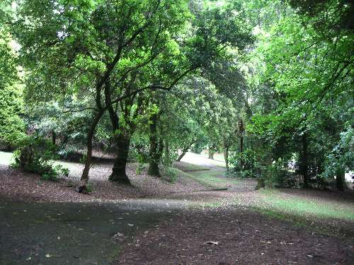
The Hunchback in the Park
By Dylan Thomas

Slide 2
Past lake and rockery
Laughing when he shook his paper
Hunchbacked in mockery
Through the loud zoo of the willow groves
Dodging the park keeper
With his stick that picked up leaves.
And the old dog sleeper
Alone between nurses and swans
While the boys among willows
Made the tigers jump out of their eyes
To roar on the rockery stones
And the groves were blue with sailors
Made all day until bell time
A woman ﬁgure without fault
Straight as a young elm
Straight and tall from his crooked bones
That she might stand in the night
After the locks and chains
All night in the unmade park
After the railings and shrubberies
The birds the grass the trees the lake
And the wild boys innocent as strawberries
Had followed the hunchback
To his kennel in the dark.
The hunchback in the park
A solitary mister
Propped between trees and water
From the opening of the garden lock
That lets the trees and water enter
Until the Sunday sombre bell at dark
Eating bread from a newspaper
Drinking water from the chained cup
That the children filled with gravel
In the fountain basin where I sailed my ship
Slept at night in a dog kennel
But nobody chained him up.
Like the park birds he came early
Like the water he sat down
And Mister they called Hey mister
The truant boys from the town
Running when he had heard them clearly
On out of sound

Slide 3
And the park itself was a world within the world of the sea town. Quite near where I lived, so near that on summer evenings I could listen in my bed to the voices of older children playing ball on the sloping, paper-littered bank; the park was full of terrors and treasures. Though it was only a little park, it held within its borders of old tall trees, notched with our names and shabby from our climbing, as many secret places, caverns and forests, prairies and deserts, as a country somewhere at the end of the sea.
And that park grew up with me. That small world widened as I learned its secrets and boundaries, as I discovered new refuges and ambushes in its woods and jungles, hidden homes and lairs for the multitudes of imagination, for cowboys and Indians and the tall, terrible half-people who rode on nightmares through my bedroom. We knew every regular visitor, every nursemaid, every gardener, every old man. The face of the old man who sat summer and winter on the bench looking over the reservoir. I can see clearly now and I wrote a poem long after I’d left the park and the sea-town called: ‘The Hunchback in the Park’.
- Dylan Thomas
Dylan Thomas remembers the tramp and the park from childhood. How does he express the child’s idea that the park only exists during the day? e.g. ‘... the opening of the garden lock/ lets the trees and water enter’.

Slide 4
7 x 6 line stanzas – each moves the poem along
There is little punctuation (only three full stops – can you find them?) which adds to the sense of movement through the poem
The repetition of words throughout the poem echoes the repetition of the hunchback’s daily routine.
Repeated words:
‘trees and water’
‘dark’
‘kennel’
‘lock’ ‘chained’ (repeated later as ‘locks and chains’)
How do some of the repeated words contribute to the poem’s themes or ideas? (Find out later)

Slide 5
‘park’/ ‘dark’ rhyming couplet – opens and ends the poem. This adds to the cyclical nature of each day and night in the park
The poet uses contrasts throughout the poem – these set the hunchback apart from his surroundings (nature/ the boys) even as the rest of the poem makes connections between them
The poem is structured like a series of memories and observations from the narrator’s past. This gives it a dreamlike quality; these are visual snapshots not events

Slide 6
Contrast with the group of boys. The shortest line highlights his isolation.
Implication that these somehow sustain him/ hold him up
The hunchback in the park
A solitary mister
Propped between trees and water
From the opening of the garden lock
That lets the trees and water enter
Until the Sunday sombre bell at dark
Personification – they enter like everyone else
Alliteration; suggests seriousness of the world outside the park; contrast with the laughter of the boys
What picture does the second line of the poem suggest?
How does the length of the line help create this image?

Slide 7
Rhyme makes a link between the ‘chained cup’ and the not-chained hunchback.
This also links to the ‘lock’ (stanza 1) on the park gates.
Is the poet suggesting the hunchback is free?
Eating bread from a newspaper
Drinking water from the chained cup
That the children filled with gravel
In the fountain basin where I sailed my ship
Slept at night in a dog kennel
But nobody chained him up.
What is the effect of the comparison between the hunchback and a dog? Think about status.
Notice the first full stop (1/3). Why do you think the poet uses it here?
The poet inserts himself into the poem. Is he an observer? One of the boys? How does he feel?

Slide 8
Link to ‘free’ birds/water; they are bodily free – is he? Is he free in a different way? Is he part of nature?
Like the park birds he came early
Like the water he sat down
And Mister they called Hey Mister
The truant boys from the town
Running when he heard them clearly
On out of sound
Rhyme and alliteration give a musical rhythm to the stanza:
established routine/rhythm to the day
mischievous tone
Tone changes here: the boys bring excitement, agility and cruelty; they break the stillness – ‘truant’ suggests danger

Slide 9
comedic rhyme, but is it really funny?
Past lake and rockery
Laughing when he shook his paper
Hunchback in mockery
Through the loud zoo of the willow graves
Dodging the park keeper
With his stick that picked up leaves.
The first animal metaphor: what is making the quiet willow trees zoo-like?
How does the poet create a fast pace in this stanza? Think about letter sounds, punctuation and line lengths.
Notice the second full stop (2/3). Why do you think the poet uses it here?

Slide 10
No rhyming = freedom of imagination
Again, his solitary nature is stressed
And the old dog sleeper
Alone between nurses and swans
While the boys among willows
Made the tigers jump out of their eyes
To roar on the rockery stones
And the groves were blue with sailors
What do these refer to? What is the effect of this line?
Link to ‘chains’ and ‘kennel’
Energy and imagination of the boys – the park is a place of magic and possibility for them
‘roar’ is an onomatopoeia which brings to mind the sound of tigers – danger?
alliteration increases the effect of the sound
‘blue with sailors’ – transformed by imagination (Swansea was a port town; the boys would see sailors arriving/leaving for foreign adventures)

Slide 11
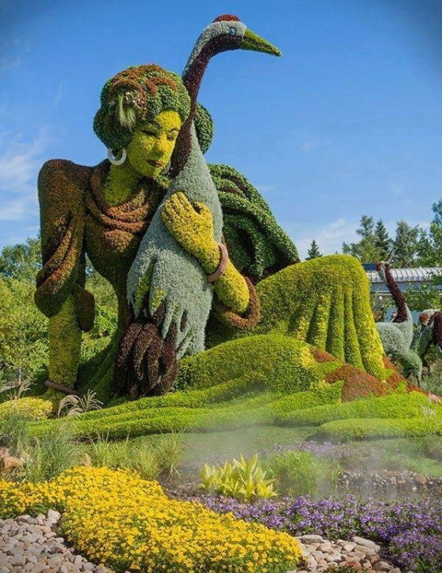
2nd mention of the bell. What does it represent?
How does it help structure the poem?
Does it remind you of another hunchback?
No rhyming = freedom of imagination
Made all day until bell time
A woman figure without fault
Straight as a young elm
Straight and tall from his crooked bones
That she might stand in the night
After the locks and chains
She is part of nature; is she created from a tree by his imagination?
She seems perfect
His opposite
She protects the park? What else?
What does the hunchback’s creation of the woman tell us about the hunchback himself?
She represents:
beauty
freedom
companionship
How does she represent each of these things?

Slide 12
Again, the idea that the park doesn’t exist when unpopulated
All night in the unmade park
After the railings and shrubberies
The birds the grass the trees the lake
And the wild boys innocent as strawberries
Had followed the hunchback
To his kennel in the dark.
All the impressions the hunchback takes with him from the park are to do with beauty/space
List; no commas: all the memories become one
Why do you think the poet describes the boys as ‘innocent as strawberries’?
harmless
childlike
part of nature
The hunchback uses his imagination in the same way the boys used theirs. What does this serve to remind us?
Notice the third full stop (3/3). Why do you think the poet uses it here?

Slide 13
Look through the following list of words. Which would you use to describe the old man?
friendly |  | familiar | isolated
despised |  | neglected
lonely | irritable |  | helpless
self-pitying | poor |  | imaginative
ugly | frightening |  | still
proud | sad |  | humble
Which details in the poem suggest them to you? Match the word(s) you have chosen with a brief quote.

Slide 14
The hunchback is compared to nature in the poem. This:
highlights his isolation from other humans
highlights his wildness
suggests he has more in common with animals
suggests he is a part of nature, just like the trees and birds
makes him seem unpredictable and odd
Pick the statements you agree with out of the list above. Why do you agree with them?

Slide 15
Repeated words:
‘trees and water’
‘dark’
‘kennel’
‘lock’ ‘chained’ (repeated later as ‘locks and chains’)
How do some of the repeated words contribute to the poem’s themes or ideas?

Slide 16
Complete your sheet and share your answers with your partner.

Slide 17
It’s time to summarise! We’re going to make a note of the poem’s VITALS.

Slide 18
Poetry VITALS…
Voice: Who is speaking in the poem?
Imagery: What imagery is being created? How is it effective?
Theme: What are the main themes featured in the poem?
Address: Who is the poem addressed to? Why?
Language (Features): What type of language/ devices are used?
What is their effect?
Structure: How is the poem laid out? What is the effect of this?
Notes:
This is the acronym that we will use on each poem to look at all the different aspects

