Slide 1
Writing to Describe
What techniques do we use when writing to describe?
Language
Structure
Content

Slide 2
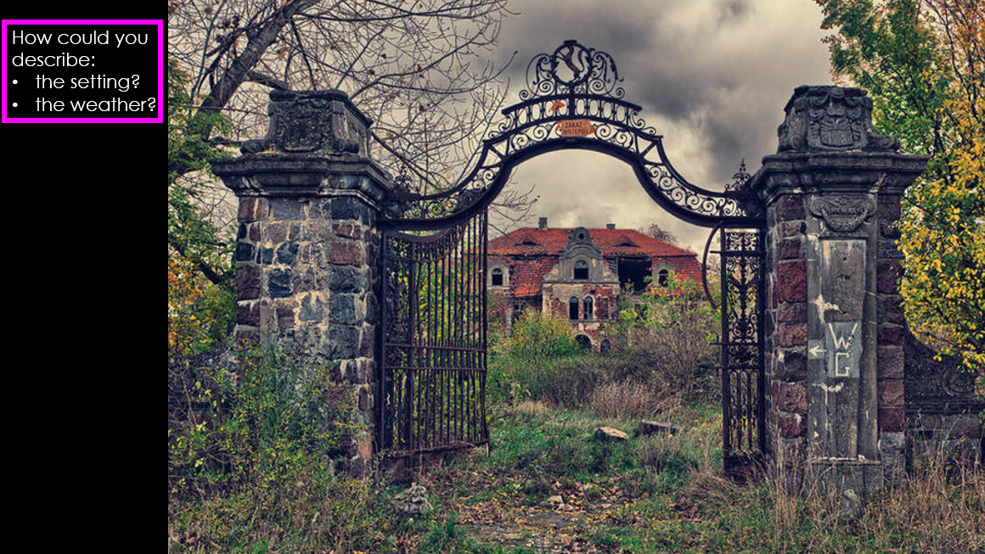

Slide 3
Dark: gloomy, opaque, obscure.
Evil: sinister, threatening, ominous, menacing
Untidy: dense, thick, unkempt, barren, uninhibited, harsh
Broken: fragmented, ruined, shattered, fractured
An opaque cloud loomed overhead. The grass that had once bloomed was now thick with weeds. The uninhibited house had shattered windows. The shards of glass lay amongst the leaves.
What WWW/EBI would you give this paragraph?

Slide 4
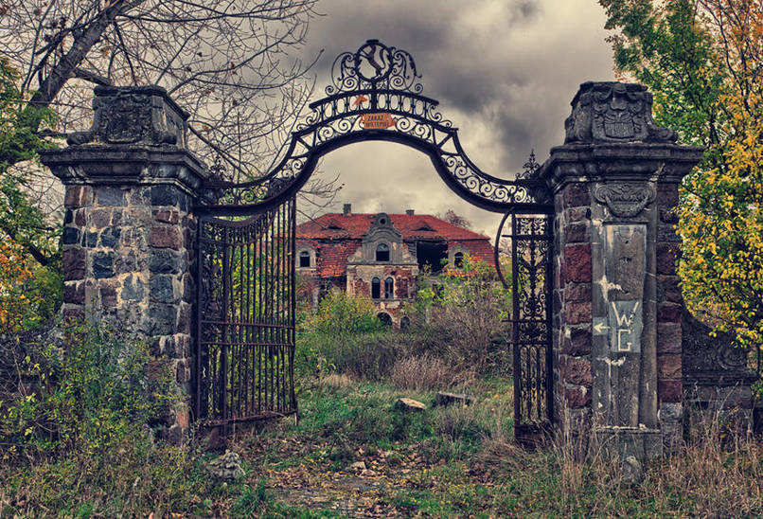
Look beyond the language choices…
An opaque cloud loomed overhead. The grass that had once bloomed was now thick with weeds. The uninhibited house had shattered windows. The shards of glass lay amongst the leaves.
Sentence starters = ‘an’ or ‘the’ → far too simplistic.
There is no development of ideas → new sentence, new idea.
The only punctuation used is full stops.
Each sentence is the same length.
There are no techniques.

Slide 5
HOW could we improve this response?

Slide 6
Thinking about what we’ve already discussed, how would you describe the setting?

Slide 7
How would your description change if you could only focus on one of these boxes?
ZOOMING IN AND OUT IS A KEY SKILL.

Slide 8
The BIG
Question:
Can I create a clear image when describing?
Keywords:
Structure, punctuation, zoom.

Slide 9
Paragraphs of varied length
A . , ! ? ;
Varied sentence structure
Extended vocab
Devices – metaphor / simile/ personification / alliteration, etc.
Zoom in and out of detail
Development of ideas
It all needs to work together to create a clear image in the mind of the reader.

Slide 10
Vocabulary

Slide 11
Crash
Smash
Devour
Consume
Demolish
Engulf
Dark
Murky
Bleak
Sombre
Can you use any of this vocab to create a descriptive sentence?

Slide 12
PARAGRAPH | IDEAS
1
2
3
4
5
We need to think about an overview so you can show that you’ve purposefully used paragraphs.

Slide 13
PARAGRAPH | IDEAS
1 | Time of day Weather – a storm is brewing. Dark. Cold. Clouds. Rumble of thunder.
2 | The boat as a whole & how vulnerable it is from the wind / sea. Waves smashing into the side.
3 | Zoom in to the first crash of thunder. The noise. The lightness that it creates.
4 | Back to the boat and the man who is frantically trying to steer. Alone. Scared. Overview of him and the waves coming over the side of his boat. Zoom in to him gripping the steering wheel.
5 | The ship beginning to sink.
Crash
Smash
Devour
Consume
Demolish
Engulf
Dark
Murky
Bleak
Sombre

Slide 14
The moonless sky …
Darkness encircled the ship …
The callous clouds …
Thunder growled …

Slide 15
PARAGRAPH | IDEAS
1 | Time of day Weather – a storm is brewing. Dark. Cold. Clouds. Rumble of thunder.
2 | The boat as a whole & how vulnerable it is from the wind / sea. Waves smashing into the side.
3 | Zoom in to the first crash of thunder. The noise. The lightness that it creates.
4 | Back to the boat and the man who is frantically trying to steer. Alone. Scared. Overview of him and the waves coming over the side of his boat. Zoom in to him gripping the steering wheel.
5 | The ship beginning to sink.
Crash
Smash
Devour
Consume
Demolish
Engulf
Dark
Murky
Bleak
Sombre

Slide 16
Paragraphs → of varying length
A . , ! ? ;
Varied sentence structure → don’t overuse short simple sentences
Extended vocab → use a thesaurus
Devices → metaphor / simile/ personification / alliteration, etc.
Zoom in and out of detail
Development of ideas → look at your paragraph length & how many sentences you’ve actually included
It all needs to work together to create a clear image in the mind of the reader.

Slide 17
Creative Writing Toolkit: A*
Content
Original and creative
Character/ ideas are convincing and sustained
Well organised, well paced
Confident and assured
Vocabulary
Adjectives and adverbs
Adverbial phrases/ sentences
Repetition of significant words
Juxtaposition of key words for effect
Connectives
Pronouns
Comparatives
Superlatives
Modal verbs
Techniques
Simile
Metaphor
Hyperbole
Paradox/ oxymoron
Repetition
Pathetic fallacy
Emotive language
Onomatopoeia
Personification
The ‘5 senses’
Sibilance
Assonance
Plosive sounds
Foreshadowing
Dialogue
Structure/ puncutation/ sentence length
Mixed chronology/ flashback
Varied sentence/ paragraph length
Ellipsis
Semi-colon
Repetition
Juxtaposition
Syntax
Patterns of language (images, phrases, symbols)
Switch between internal/external action/dialogue
Pace

