Slide 1
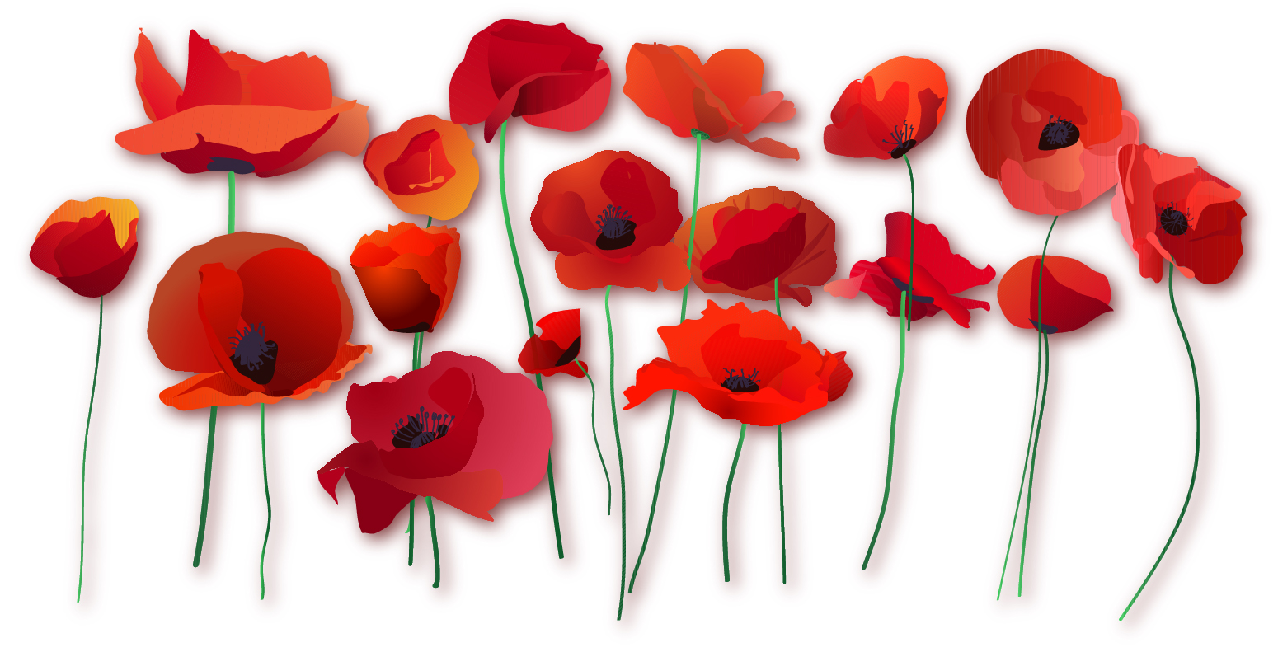
Poppies
By Jane Weir

Slide 2
Learning Objective To understand the context and subject matter of the poem.

Slide 3
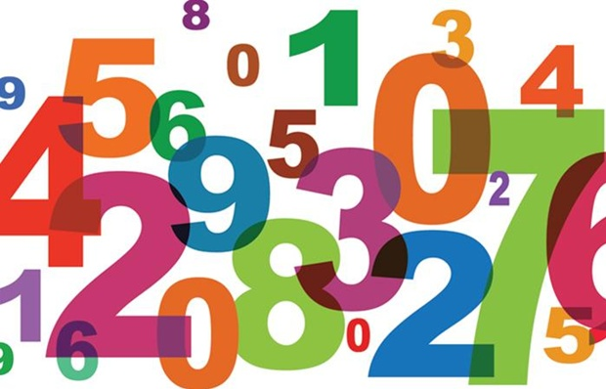
A series of numbers relating to recent conflicts will appear on the following slides. Your task, as a group, is to suggest what you think the numbers might represent.

Slide 4
94,279
Estimated number of civilians who were killed in Iraq due to violence between the beginning of the war in 2003 and 18 October 2009
Source: iraqbodycount.org
3

Slide 5
£3.2 billion
Cost of war in Iraq and Afghanistan to Britain (up to March 2008)
Source: 10 March 2008, timesonline.co.uk/tol/news/world/iraq/article3522202.ece
4

Slide 6
1,500
Estimated civilian casualties in war in Afghanistan (January–August 2009)
Source: UN/wikipedia
5

Slide 7
44 and 79
Life expectancy in Afghanistan (44) compared to life expectancy in Britain (79)
Sources: Unicef and Wikipedia
6

Slide 8
56
Percentage of people in a UK poll who said they were against the war in Afghanistan (in October 2009)
Source: BBC News 12 October 2009
7

Slide 9
414
Number of British servicemen and women killed in Iraq and Afghanistan (2002–October 2009)
Source: guardian.co.uk/news/datablog/2009/sep/17/afghanistan-casualties-dead-wounded-british-data
8

Slide 10
50–70 million
Total estimated dead as a consequence of World War Two
Source: en.wikipedia.org/wiki/World_War_II_casualties
9

Slide 11
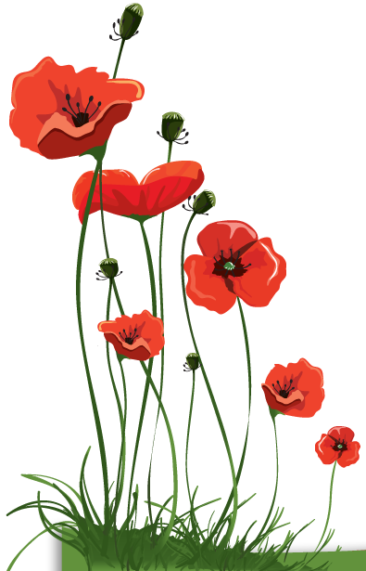
What AND who is represented by the poppy?
Based on your understanding of the poppy and its connotations, what do you anticipate this poem will be about?

Slide 12
This poem is about the human cost of conflict.
As we read, listen out for any words which convey a sense of loss or pain.

Slide 13
Weir’s poem ‘Poppies’ was commissioned as part of a collection of ten contemporary war poems which were published in the Guardian in 2009, as part of a response to the escalating conflict in Afghanistan and the Iraq inquiry.
Weir describes being surprised by the ‘overwhelming response’ she had from readers across Europe to ‘Poppies’. Many of the readers who contacted her were mothers of soldiers killed in action in recent conflicts. She commented in an interview that, ‘I wrote the piece from a woman's perspective, which is quite rare, as most poets who write about war have been men. As the mother of two teenage boys, I tried to put across how I might feel if they were fighting in a war zone.’

Slide 15
I wanted to graze my nose
across the tip of your nose, play at
being Eskimos like we did when
you were little.
I listened, hoping to hear
your playground voice catching on the wind.
hat-less, without
a winter coat or reinforcements of scarf, gloves
I pinned one onto your lapel, crimped petals,
spasms of paper red
my stomach busy
making tucks, darts, pleats
Sellotape bandaged around my hand,
I rounded up as many white cat hairs
as I could, smoothed down your shirt’s
upturned collar, steeled the softening
of my face.
I resisted the impulse
to run my fingers through the gelled
blackthorns of your hair.
This poem is about the mother’s emotions, shown through sensory details and other images… What does each detail or image represent?

Slide 16
Learning Objective To explore how the writer uses theme, language and structure to present war.

Slide 17
Re-read the poem, matching lines to the images…
‘I applied the technique of felt making to this poem because it seemed apt to the process of grief. The slow remembrance of layering, the think wadding, which over time creates a density that’s almost impenetrable, the muffled deadness of the texture of felt and its ability to denote dumbness, padding and the impossibility of the open expression of grief, how the felt merges and melts, and how if one is to grieve one has to, at some point, allow this to dissolve. And the poem does this; it breaks when the mother goes into her son’s empty bedroom.’ (Jane Weir)

Slide 18
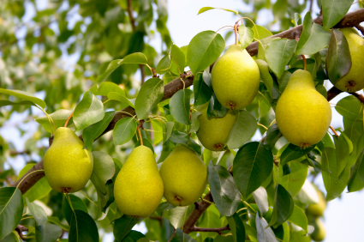
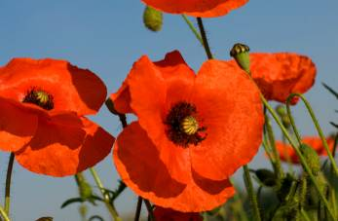
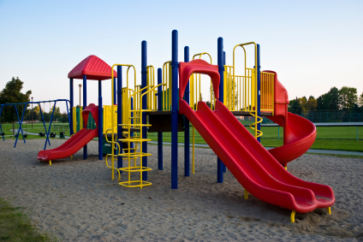
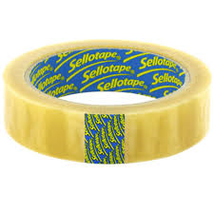
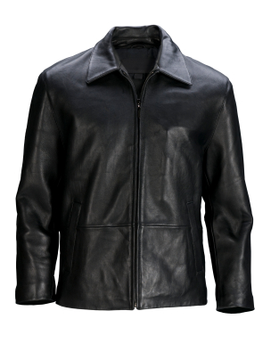
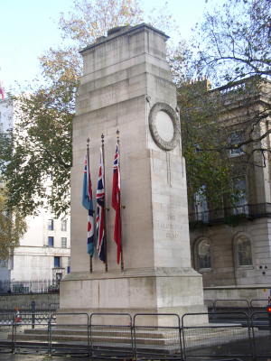
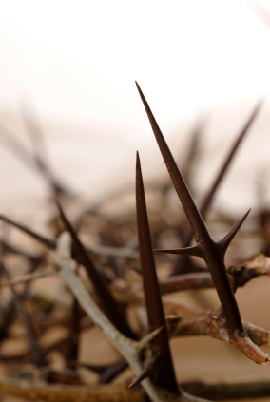
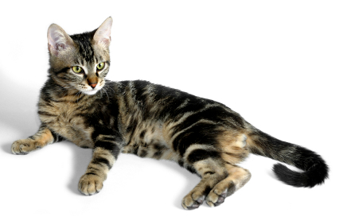
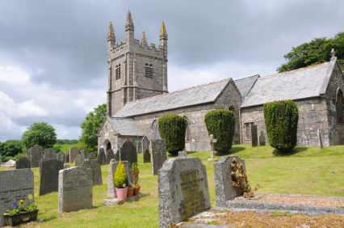
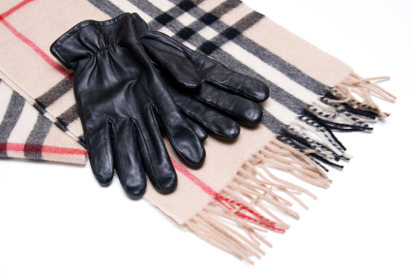
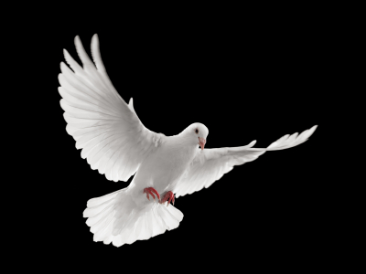
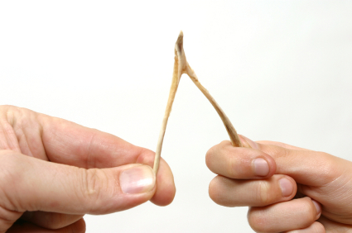
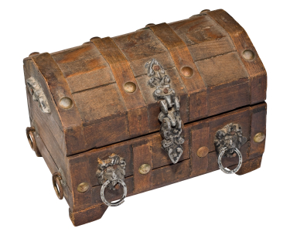
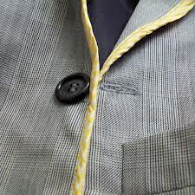

Slide 19
Poppies
Three days before Armistice Sunday
and poppies had already been placed
on individual war graves. Before you left,
I pinned one onto your lapel, crimped petals,
spasms of paper red, disrupting a blockade
of yellow bias binding around your blazer.
Sellotape bandaged around my hand,
I rounded up as many white cat hairs
as I could, smoothed down your shirt’s
upturned collar, steeled the softening
of my face. I wanted to graze my nose
across the tip of your nose, play at
being Eskimos like we did when
you were little. I resisted the impulse
to run my fingers through the gelled
blackthorns of your hair. All my words
flattened, rolled, turned into felt,
slowly melting. I was brave, as I walked
with you, to the front door, threw
it open, the world overflowing
like a treasure chest. A split second
and you were away, intoxicated.
After you’d gone I went into your bedroom,
released a song bird from its cage.
Later a single dove flew from the pear tree,
and this is where it has led me,
skirting the church yard walls, my stomach busy
making tucks, darts, pleats, hat-less, without
a winter coat or reinforcements of scarf, gloves.
On reaching the top of the hill I traced
the inscriptions on the war memorial,
leaned against it like a wishbone.
The dove pulled freely against the sky,
an ornamental stitch. I listened, hoping to hear
your playground voice catching on the wind.
JANE WEIR

Slide 20
Poppies
Three days before Armistice Sunday
and poppies had already been placed
on individual war graves. Before you left,
I pinned one onto your lapel, crimped petals,
spasms of paper red, disrupting a blockade
of yellow bias binding around your blazer.
Sellotape bandaged around my hand,
I rounded up as many white cat hairs
as I could, smoothed down your shirt’s
upturned collar, steeled the softening
of my face. I wanted to graze my nose
across the tip of your nose, play at
being Eskimos like we did when
you were little. I resisted the impulse
to run my fingers through the gelled
blackthorns of your hair. All my words
flattened, rolled, turned into felt,
slowly melting. I was brave, as I walked
with you, to the front door, threw
it open, the world overflowing
like a treasure chest. A split second
and you were away, intoxicated.
After you’d gone I went into your bedroom,
released a song bird from its cage.
Later a single dove flew from the pear tree,
and this is where it has led me,
skirting the church yard walls, my stomach busy
making tucks, darts, pleats, hat-less, without
a winter coat or reinforcements of scarf, gloves.
On reaching the top of the hill I traced
the inscriptions on the war memorial,
leaned against it like a wishbone.
The dove pulled freely against the sky,
an ornamental stitch. I listened, hoping to hear
your playground voice catching on the wind.
JANE WEIR
Highlight words linked to…
□ Sewing
□ Clothes
□ Injury
□ Childhood
□ War

Slide 21
Armistice Day/Remembrance Sunday is traditionally linked to WWI, but this is a poem set in modern day. Why might the poet evoke such imagery?
Repetition: emphasises the parallel between national and personal mourning and remembrance.
What does this image remind us of regarding war?
Three days before Armistice Sunday
and poppies had already been placed
on individual war graves. Before you left,
I pinned one onto your lapel, crimped petals,
spasms of paper red, disrupting a blockade
of yellow bias binding around your blazer.
What does this word suggest about the mother’s involvement in the son’s decision to leave?
What connotations does the word ‘spasms’ hold?
What might this foreshadow?
Under what circumstances could the son be wearing a blazer? Could there be more than one? What does this suggest about the mother’s view of her son?

Slide 22
Another image which allows foreshadowing – of what? Who else might be wounded in this poem?
Caesura: reflects the mother’s attempt to stay in control. She doesn’t let her emotions ‘run away’ with her.
Sellotape bandaged around my hand,
I rounded up as many white cat hairs
as I could, smoothed down your shirt’s
upturned collar, steeled the softening
of my face. I wanted to graze my nose
across the tip of your nose, play at
being Eskimos like we did when
you were little. I resisted the impulse
to run my fingers through the gelled
blackthorns of your hair. All my words
flattened, rolled, turned into felt,
A domestic, motherly image.
Alliteration: what does this emphasise?
What does this reference to the sense of touch suggest about the mother’s emotions? What does she long for?
The ‘blackthorns’ allude to Jesus, who wore a crown of thorns when he was crucified as a sacrifice for the sins of humanity. What does this suggest may happen to the son?
What else might this hair suggest about the son?
Suggests she speaks softly
Another domestic image
A pun on the word ‘felt’, i.e. she must suppress her feelings until later

Slide 23
Enjambment continues the idea of the mother’s composure disappearing with the ‘melting’ of her words. What kind of emotions would melt?
But this is followed by caesura: what does this suggest about the speaker? [Hint: look at the words which follow.]
slowly melting. I was brave, as I walked
with you, to the front door, threw
it open, the world overflowing
like a treasure chest. A split second
and you were away, intoxicated.
What does this verb suggest?
This simile shows the world from the son’s perspective – what does it suggest?
What are the connotations of this word?
How does Weir create a contrast between the mother and the son at their moment of parting?

Slide 24
Symbolism hint: Doves represent peace but also mourning.
Pear trees are symbolic of human salvation and longevity of life.
What does this metaphor symbolise?
After you’d gone I went into your bedroom,
released a song bird from its cage.
Later a single dove flew from the pear tree,
and this is where it has led me,
skirting the church yard walls, my stomach busy
making tucks, darts, pleats, hat-less, without
a winter coat or reinforcements of scarf, gloves.
And this one?
Sewing imagery: what does this suggest about her state of mind?
These are images associated with war, again reminiscent of WWI.
How does this battle imagery make the mother seem?

Slide 25
Another link to WWI: what does the memorial suggest to the mother? To us?
Another reference to touch. The memorial is a solid object, unlike her memories.
On reaching the top of the hill I traced
the inscriptions on the war memorial,
leaned against it like a wishbone.
The dove pulled freely against the sky,
an ornamental stitch. I listened, hoping to hear
your playground voice catching on the wind.
What does this simile represent?
A strong visual image of something small and beautiful in a vast space – represents her son.
What does the alliteration suggest?
“your playground voice” – what meanings might this last line have?

Slide 26
You are going to work in groups to prepare a handout for the rest of the class on one aspect of the poem.

Slide 27
Group 1
The poet explores the speaker’s emotional journey.
Identify the different emotions of the speaker in the poem. Do these emotions change in different stanzas?
Is there anything else in the poem that suggests the idea of a journey?
Write a paragraph of analysis (using quotations) to explain your ideas.
Produce a handout for the class
Challenge: Link this to the themes of power and conflict

Slide 28
Group 2
The poet makes use of emotive and sensory imagery. (Stanzas 1 and 2)
Make a list of all the metaphors and similes in the poem, and then group them according to whether they are related to emotions or senses.
Choose the metaphor or simile that you think is most effective, and explain why. (Its effect on the reader)
Write a paragraph of analysis (using quotations) to explain your ideas.
Produce a handout for the class
Challenge: Link this to the themes of power and conflict

Slide 29
Group 3
The poet makes use of emotive and sensory imagery. (Stanzas 3 and 4)
Make a list of all the metaphors and similes in the poem, and then group them according to whether they are related to emotions or senses.
Choose the metaphor or simile that you think is most effective, and explain why. (Its effect on the reader)
Write a paragraph of analysis (using quotations) to explain your ideas.
Produce a handout for the class
Challenge: Link this to the themes of power and conflict

Slide 30
Group 4
The poem is an elegy or lament (a poem of mourning, grief or regret, usually associated with the death of someone).
What tense is the poem written in? How does this contribute to the elegiac tone?
Some of the symbols and references in the poem are associated with death – make a list of them.
Identify any words, phrases, lines or stanzas from the poem that you think are relevant.
Write a paragraph of analysis (using quotations) to explain your ideas.
Produce a handout for the class
Challenge: Link this to the themes of power and conflict

Slide 31
Group 5
The poet describes the poem as a narrative journey through memory, and the poem’s structure reflects this.
Identify the different ‘memories’ the speaker refers to in the poem. Do these memories change in different stanzas?
The poem is very much like a narrative or story. How does Weir achieve this effect?
Write a paragraph of analysis (using quotations) to explain your ideas.
Produce a handout for the class
Challenge: Link this to the themes of power and conflict

Slide 32
Group 6
The poet makes effective use of enjambment and caesura (a pause that breaks up a line of verse) throughout the poem.
Now look at the line and stanza structure. Does the use of enjambment or caesura contribute to the idea of a journey, for example? Why are the stanzas of different lengths?
Look at the rhyme scheme. Can you find any rhyming patterns? What is the effect?
Write a paragraph of analysis (using quotations) to explain your ideas.
Produce a handout for the class
Challenge: Link this to the themes of power and conflict

Slide 33
Feedback
Pick a spokesperson for your group.
Tell us one thing you have included on your handout.

Slide 34
Form, structure and tone: ‘Poppies’
The first person narrative means that the reader gets a strong impression of the mother’s emotions. There is no regular rhyme or rhythm which makes it sound like the narrator’s thoughts and memories. Long sentences and enjambment give the impression that the narrator is absorbed in her own thoughts and memories, whilst caesura show how she tries to hold her emotions together.
The poem is chronological, describing preparations for the son leaving, his departure and then what his mother does afterwards, however the time frame is ambiguous – memories of the son’s childhood are intermingle with memories of him leaving, and they’re not always distinguished.

Slide 35
It’s time to summarise! We’re going to make a note of the poem’s VITALS.

Slide 36
Poetry VITALS…
Voice: Who is speaking in the poem?
Imagery: What imagery is being created? How is it effective?
Theme: What are the main themes featured in the poem?
Address: Who is the poem addressed to? Why?
Language (Features): What type of language/ devices are used?
What is their effect?
Structure: How is the poem laid out? What is the effect of this?
Notes:
This is the acronym that we will use on each poem to look at all the different aspects

