Slide 1
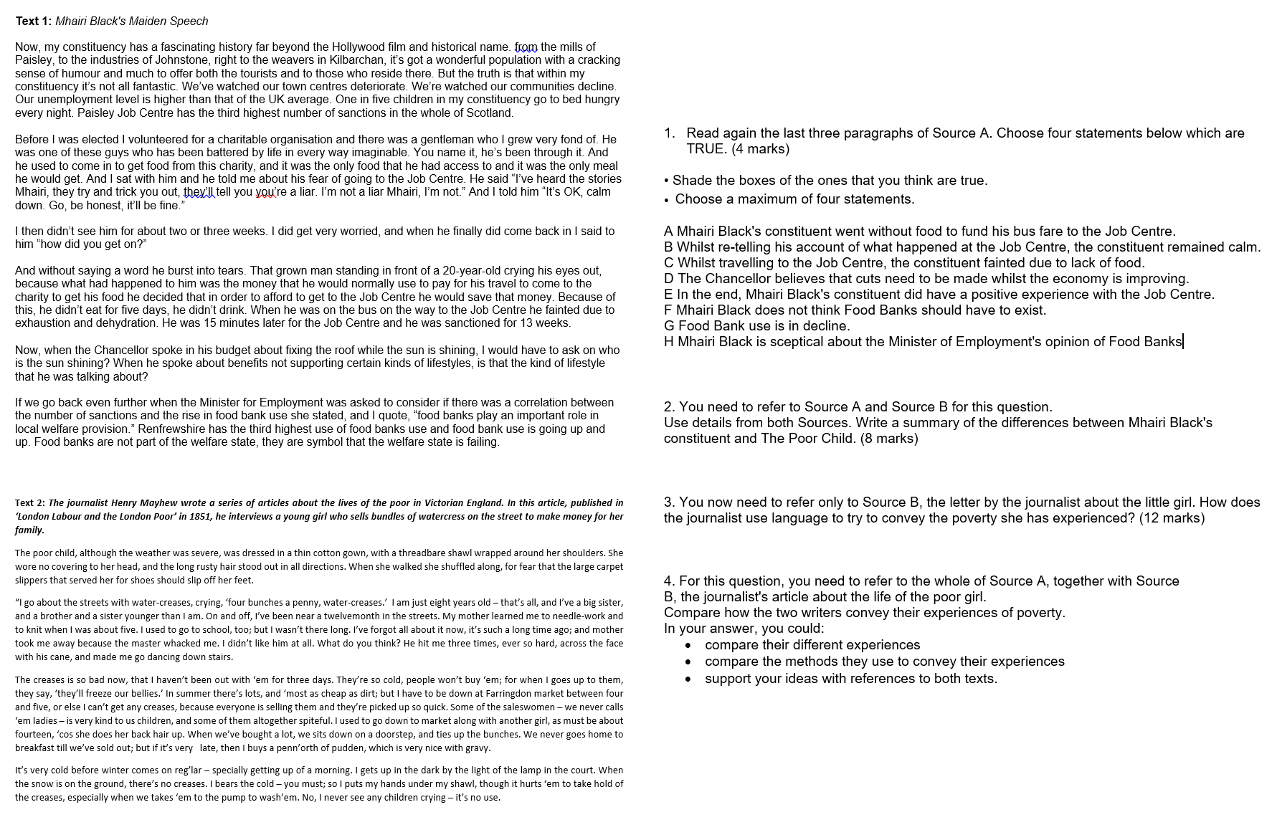
Paper 2 – Poverty
15 mins: Read and complete Q1

Slide 2
PAPER 1
PAPER 2

Slide 3
AO1: Identify and interpret explicit and implicit information and ideas.
Select and synthesise evidence from different texts.
AO3: Compare writers’ ideas and perspectives, as well as how these are conveyed across two or more texts
AO2: Explain, comment on and analyse how writers use language to achieve effects and influence readers, using relevant subject terminology to support their views

Slide 4
SECTION A: READING
4 marks
Read the text
Q1
Q2
Q3
Q4
16 marks
8 marks
12 marks

Slide 5
Question 2: Write a summary of the differences between…
Q
E
One thing we learn…
The writer says…
…which suggests…
Y
LINK
Q
One thing we learn…
The writer describes…
This suggests…
E
Y
Note! These all show differences.
To make sure you synthesize, you will need to use linking words such as ‘whereas’, ‘unlike’, ‘but’, ‘however’, ‘on the other hand’…

Slide 6
Question 2: Write a summary of the differences between…
Both the texts talk about people being poor, but one is a long time ago and one is today. One doesn't get benefits and the other one does. One is a child and one is an adult. One is a speech from parliament and the other is a story in a newspaper.
How many marks would this answer get out of 8?
Level 1: Simple and limited- 1-2 marks

Slide 7
Question 2: Write a summary of the differences between…
How many marks would this answer get out of 8?
In the article, the journalist writes about a little girl who doesn't have much money for food, she sells watercress and doesn't wear clothes that fit her or that you should wear in winter. She did go to school but then she stopped going because they hit her.
In the speech, Black talks about a man who is really poor and doesn't have enough money to be able to get the bus to the food bank and to get to the benefits office. Black is giving him help and talks about him to prove a point that she thinks there isn't enough to done to help the poor.
The poor girl is able to work, but the constituent doesn't work. The poor girl is just a little girl, but the constituent is a grown man.
Level 2: Some, attempts – 3-4 marks

Slide 8
Question 2: Write a summary of the differences between…
How many marks would this answer get out of 8?
One thing we learn is that the poor girl has accepted her poverty. She says, “it’s no use” when asked if she sees children crying which suggests that they are used to living this way. The constituent, however, does cry. The writer tells us, “he burst into tears” because he couldn’t get to the Job Centre, which suggests the man would like to change his way of life.
Another thing we learn is the poor girl “never goes home to breakfast until we’ve sold out”, so she doesn’t eat until she’s sold her watercress. In contrast, the constituent is able to get food from a “charity”. The man seems to be in a better position than the girl simply because he lives in a more modern time where charity exists.
Level 3: Clear, relevant – 5-6 marks

Slide 9
Question 2: Write a summary of the differences between…
How many marks would this answer get out of 8?
One thing we learn is that the poor girl has accepted her poverty. She says, “it’s no use” when asked if she sees children crying and “I’ve forgot all about it now” when talking about school, which suggests that a different way of life is something she has given up on. The constituent, however, has asked for help and is trying to get a better life for himself. The writer tells us, “he burst into tears” because he couldn’t get to the Job Centre and he has gone to a food bank for a meal, which suggests the man is trying to change his life.
Another thing we learn is that although both subjects of each text experience poverty, the poor girl “never goes home to breakfast until we’ve sold out”, suggesting that she doesn’t eat unless she earns money. In contrast, the constituent is able to get food from a food bank – but this is “the only meal he would get”, which suggests he is dependent on charity to survive. The man seems to be in a better position than the girl simply because he lives in a more modern time.
Level 4: Detailed, perceptive – 7-8 marks

Slide 10
Question 3:
You now need to refer only to Source B, the letter by the journalist about the little girl. How does the journalist use language to try to convey the poverty she has experienced?
(12 marks)
Q
W
E
R
T
The sources may be descriptive or persuasive.
For this question, you need to have a secure bank of technical terminology
Y

Slide 11
Question 3: How does the journalist use language to try to convey…
How many marks would this answer get out of 12?
The girl has experienced poverty because she is really poor and hungry and is homeless. This is all evidence that she has been poor, and that she is poor. She feels sad about this. We know his because she doesn't have much food and she is hungry and doesn't go to school. It is really sad and I feel really sad when I read it because being poor isn't fair, and when you read it the writer wants you to think it's sad. There is statistics where she says she hasn't eaten for three days. This statistic proves that she is hungry and that it makes the reader feel sorry for her because today we don't get hungry because people have jobs or benefits.
Level 1: Simple and limited- 1-3 marks

Slide 12
Question 3: How does the journalist use language to try to convey…
How many marks would this answer get out of 12?
The journalist describes the girl's life of poverty that she experiences everyday.
On her feet there are "carpet slippers" this shows that she is too poor to buy shoes.
She hasn't eaten for "three days" this shows that she has no money for food.
It says she lives on the "streets" we can see from this that she means she is homeless. That is because she is poor. This suggests that she isn't properly looked after by her parents, as she is only 8 years old.
At school the teacher "whacked" her. The word "whacked" is an example of onomatopoeia. It makes you wince when you read it as it sounds so painful. As the girl is only eight, it makes you feel really sorry for her.
Level 2: Some, attempts – 4-6 marks

Slide 13
Question 3: How does the journalist use language to try to convey…
How many marks would this answer get out of 12?
The journalist describes the girl's life of poverty that she experiences everyday. By including the reported speech of the girl herself, it gives the text a level of authenticity.
On her feet there are "for fear that the large carpet slippers" this shows that she is too poor to buy shoes. This image where the slippers might "slip off" her feet creates a sympathetic figure.
At school the teacher "and my mother took me away because the master whacked" her. The onomatopoeic verb "whacked" creates a vicious image of a small girl being beaten by a teacher, and emphasise her sad life and vulnerability. We can see how poverty has made her suffer, and what a sad life she has led because she is poor.
The journalist ends with the words "I never see children crying- it's no use." This bleak sentiment ends the text on a very negative note, and emphasises the despair she feels about her poverty.
Level 3: Clear, relevant – 7-9 marks

Slide 14
Question 3: How does the journalist use language to try to convey…
How many marks would this answer get out of 12?
The journalist describes the girl's life of poverty that she experiences everyday. By including the reported speech of the girl herself, it gives the text a level of authenticity. The majority of the text is reported speech, but the journalist has made careful decisions about what to include.
On her feet there are "large carpet slippers" that "serve" as shoes. This verb "serve" symbolises how for this poor girl, she is unable to have items for their own purpose, instead she has to make do with whatever she has been given. The slippers are clearly totally unsuitable, as they cause her to "shuffle" lest they "slip off". Symbolising how her poverty holds her back in her life. Similarly, her clothes are "threadbare" and "thin" fabrics that are unsuitable for the weather.
Education is another area that is affected by the girl's poverty. At school the teacher "whacked" her. The onomatopoeic verb "whacked" creates a vicious image of a small girl being beaten by a teacher, and emphasise her vulnerability at the hands of the richer people around her. We can see how poverty has made her suffer, and what a sad life she has led because she is poor; she has been denied an education and a chance to better herself.
The journalist ends with her words "I never see children crying- it's no use." This bleak sentiment ends the text on a very negative note, and emphasises the despair she feels about her poverty. There is no solution within her means, she must simply keep trying to sell her product, keep warm and try and feed herself
Level 4: Detailed, perceptive – 10-12 marks

Slide 15
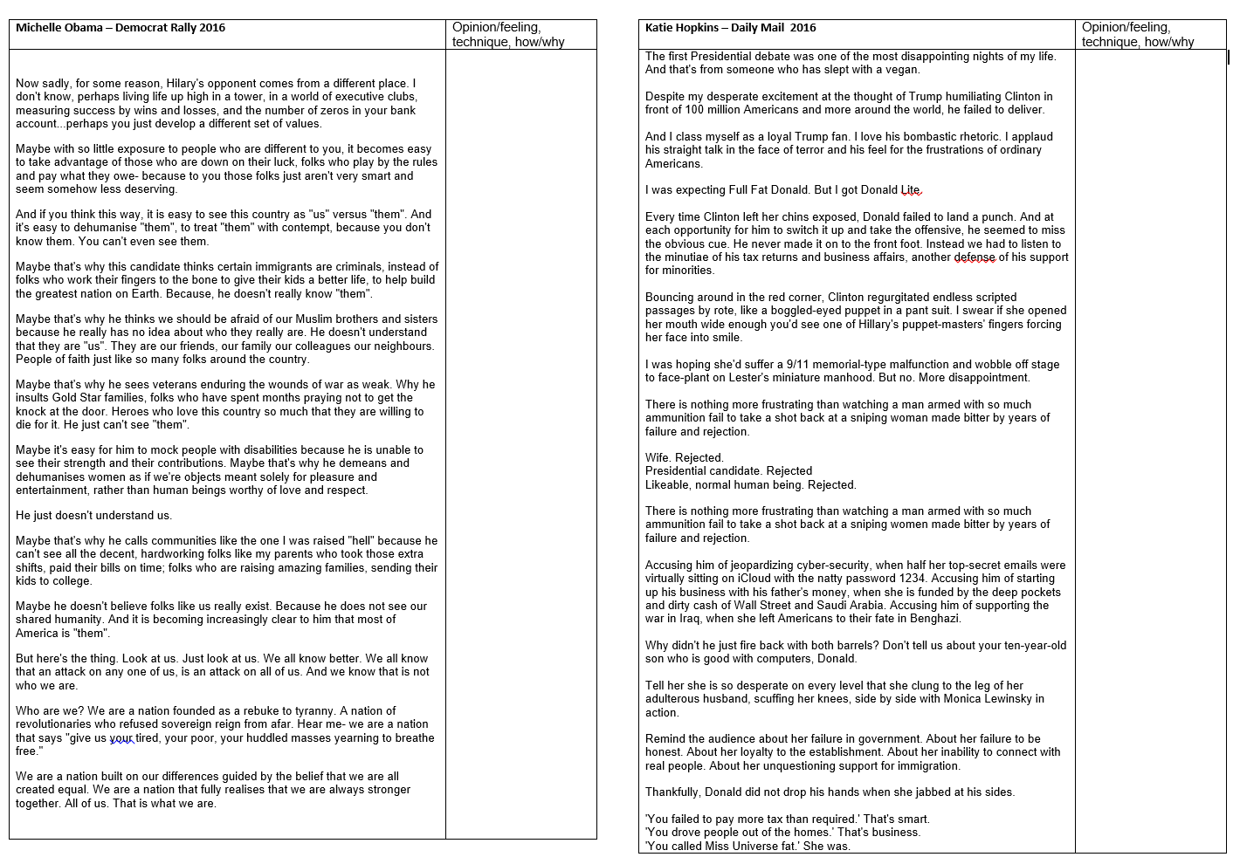
15 mins – read and annotate the articles

Slide 16
Question 4: For this question, you need to refer to the whole of Source A, together with Source
B.
Compare how the two writers convey their different perspectives on the presidential candidates.
In your answer, you could:
compare their different perspectives
compare the methods they use to convey their perspectives
support your ideas with references to both texts.

Slide 17
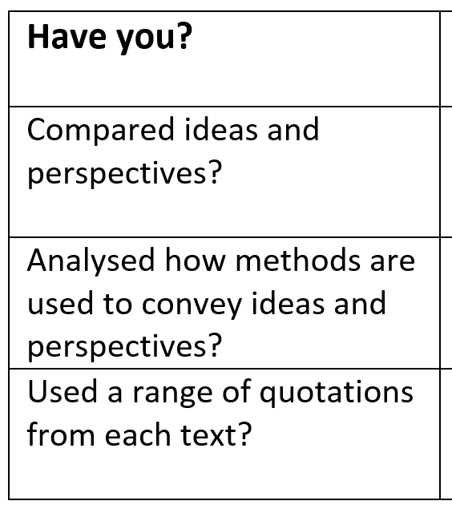
Q
W
E
R
T
Y
W
E
R
T
Y
Level 4 Perceptive, Detailed 13-16 marks | Shows a detailed understanding of the differences between the ideas and perspectives • Compares ideas and perspectives in a perceptive way • Analyses how methods are used to convey ideas and perspectives • Select a range of judicious quotations from both texts
Level 3 Clear, relevant 9-12 marks | Shows a clear understanding of the differences between ideas and perspectives • Compares ideas and perspectives in a clear and relevant way • Explains clearly how methods are used to convey ideas and perspectives • Selects relevant quotations to support from both texts
Level 2 Some, attempts 5-8 marks | Identifies some differences between the ideas and perspectives • Attempts to compare ideas and perspectives • Some comment on how methods are used to convey ideas and perspectives • Selects some quotations/references, not always supporting (from one or both texts)
Level 1 Simple, limited 1-4 marks | Simple awareness of different ideas and/or perspectives • Simple cross reference of ideas and/or perspectives • Simple identification of how differences are conveyed • Simple references or textual details from one or both texts

Slide 18
Question 4: Compare how the two writers convey their different perspectives…
How many marks would this answer get out of 16?
Both writers think that the presidential candidate has made mistakes, but Hopkins thinks he is a good candidate and she likes him, we know this because she says she likes him. Obama doesn't like him, we know she thinks this because we know she doesn't like him because she doesn't like him. This has a strong effect on the reader because they both don't like him, but one likes him more than the other.
Obama uses repetition and Hopkins use repetition. The repetition has a good effect as it keeps it in the reader's mind.
Hopkins doesn't like Clinton, but Obama does like Clinton. She uses lots of short dramatic sentences. This shows how she feels about it.
Level 1: Simple and limited- 1-4 marks

Slide 19
Question 4: Compare how the two writers convey their different perspectives…
How many marks would this answer get out of 16?
Hopkins has the perspective that Trump is a good candidate, and Obama has the perspective that Trump is a bad candidate.
Hopkins thinks he has done badly in the debate, but Obama doesn't talk about the debate.
Hopkins wants Trump to win. We know this because she quotes "I am a loyal Trump fan". The word "loyal" tells us that she wants him to win. It suggests she will support him no matter what. Obama doesn't want him to win, we know this because she says he has a "different set of values". This means she doesn't like the way he behaves.
Hopkins uses words like "bombastic" to describe Trump, this shows she really likes him as it is a positive word. Obama uses words like "attack" which means she thinks Trump is dangerous. Hopkins focuses on positives and Obama focuses on the negatives.
Hopkins thinks Trump could have done better in the speech. We know this because she says he has "ammunition". This means she thinks he has lots of things he could say about Hilary. This is a metaphor. This is when one thing stands for another.
Level 2: Some, attempts – 5-8 marks

Slide 20
Question 4: Compare how the two writers convey their different perspectives…
How many marks would this answer get out of 16?
Although both candidates express disappointment or dislike towards Trump, Hopkins is disappointed because she likes him and he has let her down, whereas Obama is disappointed in what he believes in and the way he treats people. Hopkins declares herself a "loyal" fan in the very beginning of the text, this is a clear message to the audience that although she is going to be critical, she still will support him. Obama also begins with a very clear opinion, she however begins with the adverb "sadly", this conveys a very different tone to Hopkins, one that implies she feels regret that Trump doesn't share her views and is so negative about people. She then goes on to suggest it is because Trump has "so little exposure" to people "down on their luck".
Hopkins and Obama both use a type of question and answer to emphasise their opinions. Hopkins compares Clinton and Trump 'Wife. Rejected.' and then '"You failed to pay more tax than required." "That's smart"'. By contrasting these two people using similar techniques, Hopkins is emphasising her admiration for Trump. Similarly, Obama states her opinions as fact to demonstrate her feelings about Trump. She repeatedly suggests that Trump has formed his opinion because he "doesn't know us", and then at the end of the speech suggests that the "we" is a strong nation, and "we know better". This opinion stated as fact reveals Obama's dedication to her own candidate and her low opinion of Trump.
Level 3: Clear, relevant – 9-12 marks

Slide 21
Question 4: Compare how the two writers convey their different perspectives…
How many marks would this answer get out of 16?
Although both candidates express disappointment or dislike towards Trump, Hopkins is disappointed because she likes him and he has let her down, whereas Obama is disappointed in what he believes in and the way he treats people. Hopkins declares herself a "loyal" fan in the very beginning of the text, this is a clear message to the audience that although she is going to be critical, she still will support him. The adjective "loyal" implies a sense of respectability and faithfulness, and the reader can infer that Hopkins would always support Trump no matter what he said or did. Obama also begins with a very clear opinion, she however begins with the adverb "sadly“; this conveys a very different tone to Hopkins, one that implies she feels regret that Trump doesn't share her views and is so negative about people. She then goes on to suggest it is because Trump has "so little exposure" to people "down on their luck". This suggests Trump is very different to her, and the word "so" emphasises how little exposure he has had.
Hopkins and Obama both use a type of question and answer to emphasise their opinions. Hopkins uses two lists of three to compare Clinton and Trump 'Wife. Rejected.' and then '"You failed to pay more tax than required." "That's smart"'. By contrasting these two people using similar techniques, Hopkins is emphasising her admiration for Trump. The abrupt sentences convey the idea that she thinks this is the obvious opinion to have on his actions. Similarly, Obama states her opinions as fact to demonstrate her feelings about Trump. She repeatedly begins her paragraphs with "Maybe" and maintains a polite dignity as she criticises Trump, rather than the rudeness of Hopkins when she criticised Hilary as a "failed" wife.
Level 4: Detailed, perceptive – 13-16 marks

Slide 22
Question 4: For this question, you need to refer to the whole of Source A, together with Source
B.
Compare how the two writers convey their different perspectives on poverty.
In your answer, you could:
compare their different perspectives
compare the methods they use to convey their perspectives
support your ideas with references to both texts.

