Slide 1
Learning Objective To understand Q3: explain, comment on and analyse how writers use language…

Slide 2
Paper 2, Question 3 (AO2) 12 marks Looks something like this:
Learning Objective: Q3: explain, comment on and analyse how writers use language…
You now need to refer only to source B.
How does Henry use language to try to influence his father?
Worth 12 marks
Explain, comment on and analyse language and structure.

Slide 3
Learning Objective: Q3: explain, comment on and analyse how writers use language…
Level 4 Perceptive, Detailed 10-12 marks | Shows detailed and perceptive understanding of language: • Analyses the effects of the writer’s choices of language • Selects a judicious range of quotations • Uses a range of subject terminology appropriately
Level 3 Clear, relevant 7-9 marks | Shows clear understanding of language: • Clearly explains the effects of the writer’s choices of language • Selects relevant quotations • Uses a subject terminology accurately
Level 2 Some, attempts 4-6 marks | Shows some understanding of language: • Attempts to comment on the effect of language • Selects some relevant quotations • Uses some subject terminology, not always appropriately
Level 1 Simple, limited 1-3 marks | Shows simple awareness of language: • Offers simple comment on the effects of language • Simple references or textual details • Simple mention of subject terminology

Slide 4
Learning Objective: Q3: explain, comment on and analyse how writers use language…
Q
W
The sources may be descriptive or persuasive.
For this question, you need to have a secure bank of technical terminology
E
R
T
Y

Slide 5
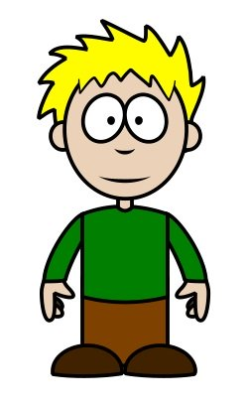
Learning Objective: Q3: explain, comment on and analyse how writers use language…
The sources may be descriptive…
Person A: List all the techniques you would look for in descriptive writing
…or persuasive.
Now share your lists! These will be a useful resource as we look at different texts.
Person B: List all the techniques you would look for in persuasive writing

Slide 6
Learning Objective: Q3: explain, comment on and analyse how writers use language…
First person pronoun
Superlative Adjectives
Lists
Past tense
Adverbs
What are the key language techniques?
Match each of these language techniques to the definition column on your grid
Simile
Questions
Proper Nouns
Repetition
Verbs
Adjectives
Statistics, figures and measurements
Adverbial Phrases

Slide 7
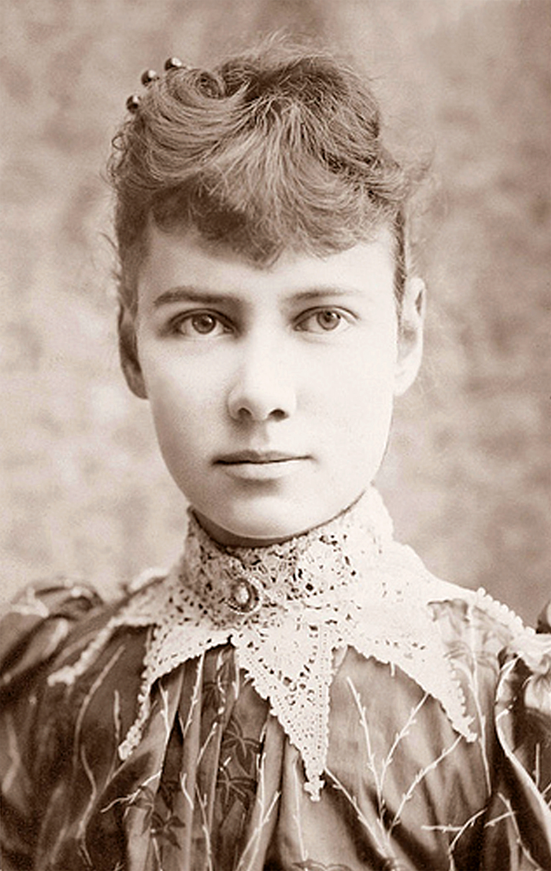
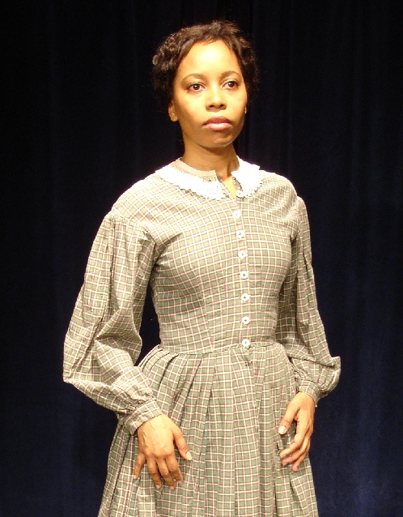
Learning Objective: Q3: explain, comment on and analyse how writers use language…
We’re going to read two texts: are they descriptive or persuasive? Which techniques has the writer used?
Select examples for each of the techniques on the grid and explain the effect on the reader.

Slide 8
Learning Objective: Q3: explain, comment on and analyse how writers use language…
I flew out of the house, and concealed myself in a thicket of bushes. There I remained in an agony of fear for two hours. Suddenly, a reptile of some kind seized my leg. In my fright, I struck a blow which loosened its hold, but I could not tell whether I had killed it; it was so dark, I could not see what it was; I only knew it was something cold and slimy. The pain I felt soon indicated that the bite was poisonous. I was compelled to leave my place of concealment, and I groped my way back into the house.
Descriptive or persuasive?
Life of a Slave Girl,
Harriet Ann Jacobs

Slide 9
Extract from ‘Girl of the Period’ by Eliza Lynn Linton, 1883
The liberty allowed to young girls grows yearly more and more unchecked. They walk alone, travel alone, visit alone; and the gravest evils have been known to arise from the habit which modern mothers have of sending their daughters of sixteen and upwards unaccompanied in London to colleges and classes. Mamma has grown stout and lazy, and has always some important matter on hand that keeps her at home, half asleep in the easy-chair, while the girls go to and fro, and take the exercise befitting their youthful energies. Of course no harm can befall them. They are her daughters, and the warnings given by the keener- eyed, who have had experience, are mere inventions of the enemy and slanders against the young. So they parade the streets, dressed in the most startling and meretricious costumes and that fatal doctrine of self-protection counts its victims by the score as the consequence.
Descriptive or persuasive?

Slide 10
Learning Objective: Q3: explain, comment on and analyse how writers use language…
Summarise your ideas: try to talk for 30 seconds without stopping!
How does the writer use language to describe her experiences?
Or
How does the writer use language to persuade the reader that girls are given too much freedom by their mothers?

Slide 11
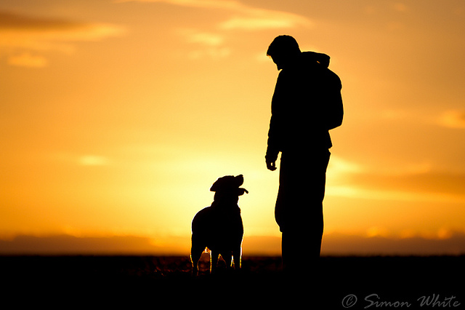
Learning Objective: Q3: explain, comment on and analyse how writers use language…
How does the writer use language to influence the jury’s view of the relationship between a dog and its owner?
George Graham Vest was a US lawyer. This speech was given in court while representing a man who sued another for the killing of his dog. During the trial, Vest ignored the testimony, and when his turn came to present a summation to the jury, he made the following speech and won the case.

Slide 12
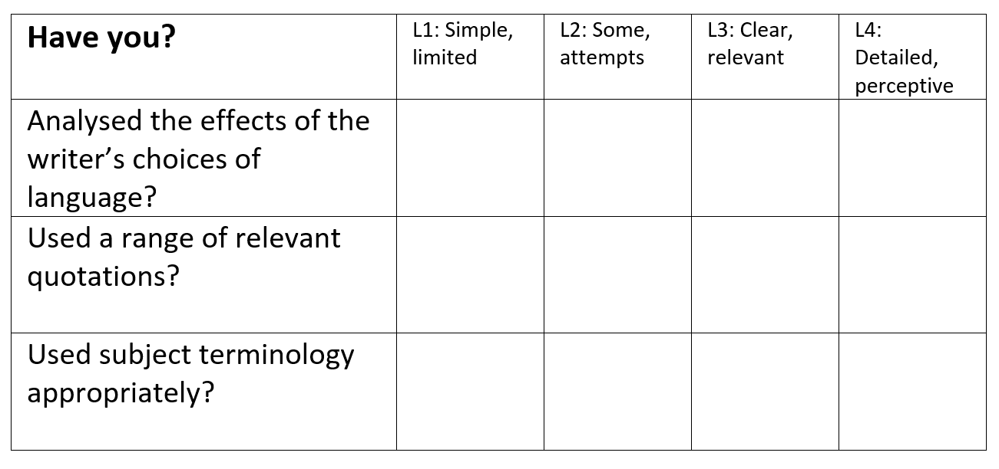
Learning Objective: Q3: explain, comment on and analyse how writers use language…
Vest begins his speech by not talking about dogs at all. Instead, he lists all the ways that a man can be betrayed. He makes each example sound as awful as possible – his ‘best friend…in the world’ becomes ‘his enemy’ and when he describes the children ‘that he has reared with loving care’ we see a picture of family happiness. But then it says they are ‘ungrateful’ so that makes it seem like the happiness has been destroyed. In the next sentence, he uses the words ‘nearest and dearest’ to describe friends and family and he builds up this picture of ‘trust’ and ‘happiness’. Then the word ‘traitors’ is used, which sounds very harsh and violent. The next two sentences about money are short and use commas to create rhythm. In the example about reputation he uses the word ‘sacrificed’ which makes loss of reputation seem like a sort of death.
?

Slide 13
Learning Objective: Q3: explain, comment on and analyse how writers use language…
Vest begins his speech by not talking about dogs at all. Instead, he lists all the ways that a man can be betrayed. He makes each example sound as awful as possible – his ‘best friend…in the world’ becomes ‘his enemy’ and when he describes the children ‘that he has reared with loving care’ we see a picture of family happiness. But then it says they are ‘ungrateful’ so that makes it seem like the happiness has been destroyed. In the next sentence, he uses the words ‘nearest and dearest’ to describe friends and family and he builds up this picture of ‘trust’ and ‘happiness’. Then the word ‘traitors’ is used, which sounds very harsh and violent. The next two sentences about money are short and use commas to create rhythm. In the example about reputation he uses the word ‘sacrificed’ which makes loss of reputation seem like a sort of death.
x
x
x

Slide 14
Learning Objective: Q3: explain, comment on and analyse how writers use language…
Vest begins his speech by not talking about dogs at all. Instead, he lists all the ways that a man can be betrayed. He makes each example sound as awful as possible – his ‘best friend…in the world’ becomes ‘his enemy’ and when he describes the children ‘that he has reared with loving care’ we see a picture of family happiness. But then it says they are ‘ungrateful’ so that makes it seem like the happiness has been destroyed.
What’s the effect of this? What will the jury be waiting for?
This adds suspense because the jury is waiting for him to refer to ‘the dog’.
What kind of words are ‘friends’ and ‘enemies’? What is the relationship between these words?
The nouns ‘friend’ and ‘enemy’ are juxtaposed and in direct opposition to each other. This presents the idea that turning against the man in this way is cruel and irreversible.

Slide 15
Learning Objective: Q3: explain, comment on and analyse how writers use language…
In the next sentence, he uses the words ‘nearest and dearest’ to describe friends and family and he builds up this picture of ‘trust’ and ‘happiness’. Then the word ‘traitors’ is used, which sounds very harsh and violent. The next two sentences about money are short and use commas to create rhythm. In the example about reputation he uses the word ‘sacrificed’ which makes loss of reputation seem like a sort of death.
What kind of words are used in the quotations?
What is the effect of this rhythm?
How does this affect the jury?

Slide 16
Learning Objective: Q3: explain, comment on and analyse how writers use language…
?

Slide 17
Learning Objective: Q3: explain, comment on and analyse how writers use language…
x
x
x

Slide 18
Learning Objective: Q3: explain, comment on and analyse how writers use language…
Choose three other quotations from the text and do a quotation explosion.
Use your notes to write three QWERTY paragraphs to answer this Q3.
[Remember to show off your use of terminology!]
How does the writer use language to influence the jury’s view of the relationship between a dog and its owner?

Slide 19
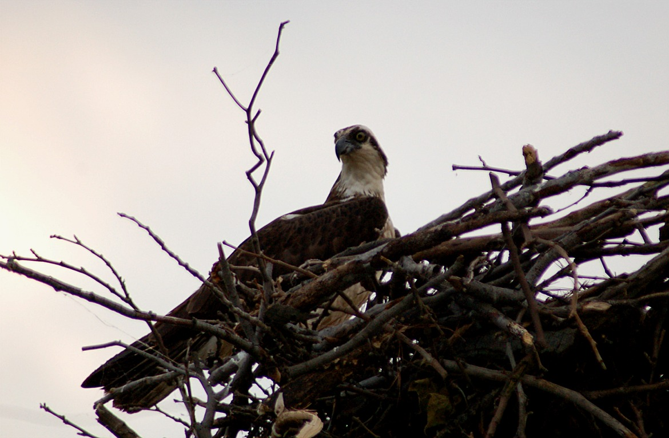
Learning Objective: Q3: explain, comment on and analyse how writers use language…
The Egg Hunters

Slide 20
TRUE OR FALSE? Write A-H in your books; write true or false next to it after you have read the questions below.
Vultures and eagles lay their eggs in summer.
Egg hunting can be dangerous.
Eagles will peck at anyone who comes near their nest.
Some eagles build their nests on the ground.
One egg hunter found a skeleton in a tree.
It was the body of an egg hunter.
The man had probably got stuck up the tree after a difficult climb.
He starved to death.
FALSE
TRUE
FALSE
TRUE
TRUE
FALSE
FALSE
TRUE

Slide 21
Learning Objective: Q3: explain, comment on and analyse how writers use language…
The Egg Hunters
How does the writer use language to make his account interesting?

Slide 22
Learning Objective: Q3: explain, comment on and analyse how writers use language…
Barcley shows some sympathy for the birds and the man, repeating the adjective ‘poor’ to comment on the mother of the birds and the shepherd who died stranded in a tree. He also comments on the soft, ‘downy’ young birds and then juxtaposes this with the image of their potential savagery: ‘fierce, angry-looking eyes’. Furthermore, the writer makes the narrative gripping by using adjectives to emphasise the horror of the falling bones: ‘the horrified nester’ who runs after his ‘ghastly discovery’.
What three improvements could the student make?

Slide 23
Learning Objective: Q3: explain, comment on and analyse how writers use language…
Barcley shows some sympathy for the birds and the man, repeating the adjective ‘poor’ to comment on the mother of the birds and the shepherd who died stranded in a tree. He also comments on the soft, ‘downy’ young birds and then juxtaposes this with the image of their potential savagery: ‘fierce, angry-looking eyes’. Furthermore, the writer makes the narrative gripping by using adjectives to emphasise the horror of the falling bones: ‘the horrified nester’ who runs after his ‘ghastly discovery’.
Using this as your starting point, re-write the paragraph and put your three improvements in place!

Slide 24
Learning Objective: Q3: explain, comment on and analyse how writers use language…
Self-Assess

Slide 25
Learning Objective: Q3: explain, comment on and analyse how writers use language…
How confident are you with Q3 skills?
Skills | I am confident that I can do this | I think I can do this but I need a bit more practice | This is one of my weaker areas, so I need more practice.
I can select effective words, phrases and language features in a non-fiction text.
I can comment on and analyse them.
I can support my ideas with relevant quotations.
I can use a range of correct subject terminology.

