Slide 1
Name (Form)
English Language
Miss Nordon

Slide 2
Do you want to know what the questions on your GCSE exam paper will be?

Slide 3
PAPER 1
PAPER 2

Slide 4
English Language Paper 2
Writers’ Viewpoints and Perspectives
Today’s Title
(Remember to underline it!)

Slide 5
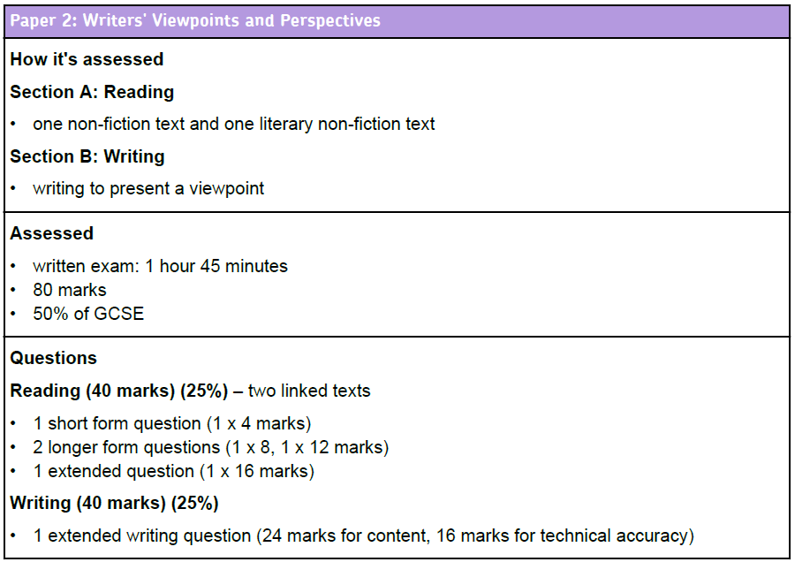
One text will be modern and one will be from the 1800s.
You will be asked to find differences between them.

Slide 6
AO1: Identify and interpret explicit and implicit information and ideas.
Select and synthesise evidence from different texts.
AO3: Compare writers’ ideas and perspectives, as well as how these are conveyed across two or more texts
AO2: Explain, comment on and analyse how writers use language to achieve effects and influence readers, using relevant subject terminology to support their views

Slide 7
SECTION A: READING
4 marks
Read the text
Q1
Q2
Q3
Q4
16 marks
8 marks
12 marks

Slide 8
Learning Objective To be able to identify viewpoints and perspectives

Slide 9
Learning Objective: To be able to identify viewpoints and perspectives
What are viewpoints and perspectives?

Slide 10
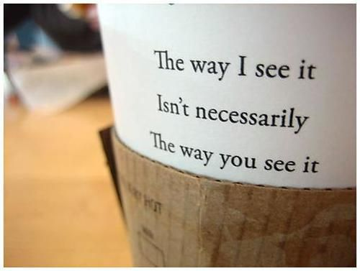

Slide 11
Learning Objective: To be able to identify viewpoints and perspectives
Viewpoint:
The way a writer thinks or feels about a topic. This may be explicit (clearly stated) or implicit (implied by the tone or language used).

Slide 12
Learning Objective: To be able to identify viewpoints and perspectives
I hate Las Vegas. It is a terrible, tacky place and the casinos are only interested in encouraging visitors to lose all their money.
How does the writer feel about Las Vegas?
Is this explicit or implicit?

Slide 13
Learning Objective: To be able to identify viewpoints and perspectives
When you have been to one or two casinos and seen how the money just pours into them, like gravel off a dump truck, it is hard to believe that there could be enough spare cash in the world to feed still more of them, yet more are being built all the time. The greed of mankind is practically insatiable, mine included.
How does the writer feel about Las Vegas?
Is this explicit or implicit?

Slide 14
Learning Objective: To be able to identify viewpoints and perspectives
When you have been to one or two casinos and seen how the money just pours into them, like gravel off a dump truck, it is hard to believe that there could be enough spare cash in the world to feed still more of them, yet more are being built all the time. The greed of mankind is practically insatiable, mine included.
In pairs, annotate the words and phrases that tell us how the writer (Bill Bryson) feels about Las Vegas. What techniques can you identify?

Slide 15
Did you get?
The verb ‘pours’ suggests a torrent of money, almost like a stream or a river.
This simile is striking but ugly. ‘Gravel’ is used instead of ‘gold’; ‘dump’ suggests something of no worth.
The intensifier ‘just’ adds emphasis.
When you have been to one or two casinos and seen how the money just pours into them, like gravel off a dump truck, it is hard to believe that there could be enough spare cash in the world to feed still more of them, yet more are being built all the time. The greed of mankind is practically insatiable, mine included.
‘Feed’ is personification, making the casinos seem like greedy monsters.
The adjective ‘spare’ makes the ‘cash’ sound worthless.
He uses first person to include himself, suggesting he too will be tricked into losing money.
This metaphor widens the significance of the casinos.

Slide 16
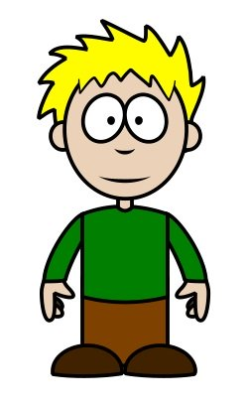
Learning Objective: To be able to identify viewpoints and perspectives
He obviously hates Las Vegas.
I’m not so sure. I think he finds the casinos fascinating.

Slide 17
Learning Objective: To be able to identify viewpoints and perspectives
Yes, but kind of evil.
…but it’s because we’re all greedy. Otherwise they wouldn’t make any money.

Slide 18
Learning Objective: To be able to identify viewpoints and perspectives
He makes them sound ugly, though, as well as fascinating.
Maybe he’s divided. He thinks they’re evil but he’s also attracted to them.

Slide 19
Q
W
E
R
T
Y
How does Bryson convey his attitude to Las Vegas?
Bryson suggests that he thinks that the casinos of Las Vegas are awful. He describes how the money ‘pours into them… like gravel off a dump truck’.
The verb ‘pours’ implies that the money goes into the casinos quickly- as if out of control- and the simile, ‘like gravel off a dump truck’ is an ugly image, reducing precious money to worthless stone.
This suggests to the reader that he thinks that the casinos make people waste their money.

Slide 20
Q
W
E
R
T
Y
How does Bryson convey his attitude to Las Vegas?
Bryson feels…
This is suggested when it says…
This [technique] tells the reader…

Slide 21
Learning Objective: To be able to identify viewpoints and perspectives
Perspective:
For this paper, the way a writer might view a topic differently depending on when they are writing.

Slide 22
Learning Objective: To be able to identify viewpoints and perspectives
e.g. A c19th writer might have a different view of the way a young woman should behave when compared to a modern writer. In this paper, you should expect to see a topic viewed from two different perspectives: a modern one and a historical one.

Slide 23
Extract from ‘Girl of the Period’ by Eliza Lynn Linton, 1883
The liberty allowed to young girls grows yearly more and more unchecked. They walk alone, travel alone, visit alone; and the gravest evils have been known to arise from the habit which modern mothers have of sending their daughters of sixteen and upwards unaccompanied in London to colleges and classes. Mamma has grown stout and lazy, and has always some important matter on hand that keeps her at home, half asleep in the easy-chair, while the girls go to and fro, and take the exercise befitting their youthful energies. Of course no harm can befall them. They are her daughters, and the warnings given by the keener- eyed, who have had experience, are mere inventions of the enemy and slanders against the young. So they parade the streets, dressed in the most startling and meretricious costumes and that fatal doctrine of self-protection counts its victims by the score as the consequence.
Meretricious: superficially attractive but actually worthless, flashy or vulgar

Slide 24
Learning Objective: To be able to identify viewpoints and perspectives
What does this writer think of the behaviour of young women?
Are there any comments that she makes that sound familiar to a 21st century reader?
Are there any comments that she makes that sound strange to a 21st century reader?

Slide 25
Learning Objective: To be able to identify viewpoints and perspectives
Annoyed
Sir, I am getting increasingly annoyed at the barrage of articles about teenagers, and the adults who keep trying to explain our behaviour (“Moods and meltdowns: what’s inside the teenage brain?”, Mar 1).
I am 16 and a straight-A student, like most of my friends. We are not as irrational and immature as adults seem to think. We’ve grown up with financial crises and accept that most of us will be unemployed. We no longer flinch at bloody images of war because we’ve grown up seeing the chaos in the Middle East and elsewhere. Most of us are cynical and pessimistic because of the environment we’ve grown up in — which should be explanation enough for our apparent insolence and disrespect, without “experts” having to write articles about it.
Has no one ever seen that we are angry at the world we live in? Angry that we will have to clean up your mess, while you hold us in contempt, analysing our responses as though we were another species?
I would like adults to treat us not as strange creatures from another world but as human beings with intelligent thought—a little different from yours, perhaps, but intelligent thought nonetheless.
Stop teaching adults how to behave around us and instead teach them to respect us.
Jenni Herd
Letter to The Times March 2014
What view of young people do we get from this letter?

Slide 26
Learning Objective: To be able to identify viewpoints and perspectives
Compare these two texts.
Are there any aspects that you think the young people share? What makes them different?

Slide 27
Learning Objective To understand Q1: identify and interpret explicit and implicit information and ideas

Slide 28
Question 1 (AO1) 4 marks Looks something like this:
Able to find explicit and implicit ideas/ information.
Read again source A, from lines 1 to 15.
Choose four statements below which are TRUE. Shade the boxes of the ones that you think are true. Choose a maximum of four statements.
A Jay Rayner has good memories of his time in school.
B Jay Rayner was happy to help his son with his homework.
C As a boy, Jay Rayner worried about handing in his homework on Monday mornings.
D Jay Rayner could not think of a food metaphor to help his son.
E Jay Rayner was very able in school.
F As a boy, Jay Rayner did not enjoy doing homework.
G Jay Rayner looked forward to receiving feedback from his teachers.
H Jay Rayner makes a joke to cover up his own real exam fears.
You will need to read the text carefully to discover which statements are true and which are false: it may not always be explicitly obvious!

Slide 29
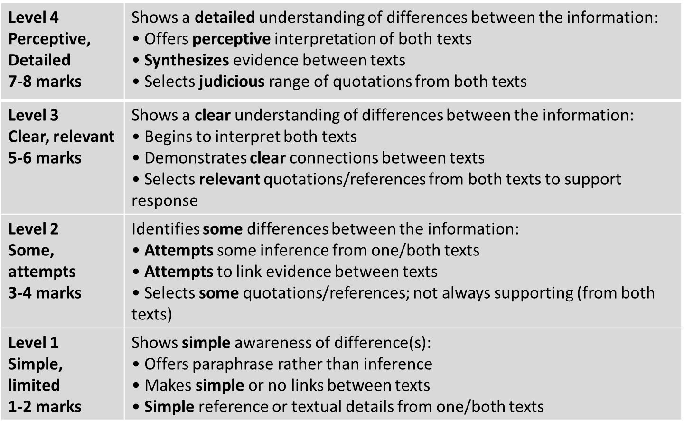
Learning Objective: Q1: identify and interpret explicit and implicit information and ideas

Slide 30
Learning Objective: Q1: identify and interpret explicit and implicit information and ideas
Toast by Nigel Slater
My mother is scraping a piece of burned toast out of the kitchen window, a crease of annoyance across her forehead. This is not an occasional occurrence, a once-in-a-while hiccup in a busy mother’s day. My mother burns the toast as surely as the sun rises each morning. In fact, I doubt if she has ever made a round of toast in her life that failed to fill the kitchen with plumes of throat-catching smoke. I am nine now and have never seen butter without black bits in it.
It is impossible not to love someone who makes toast for you. People’s failings, even major ones such as when they make you wear short trousers to school, fall into insignificance as your teeth break through the rough, toasted crust and sink into the doughy cushion of white bread underneath. Once the warm, salty butter has hit your tongue, you are smitten. Putty in their hands.

Slide 31
Learning Objective: Q1: identify and interpret explicit and implicit information and ideas
Slater hated his mother because she burnt the toast.
True or False?
Explicit evidence:
“It is impossible not to love someone who makes toast for you.”

Slide 32
Learning Objective: Q1: identify and interpret explicit and implicit information and ideas
Slater’s mother doesn’t like burning the toast.
True or False?
Implicit evidence:
“My mother is scraping a piece of burned toast out of the kitchen window, a crease of annoyance across her forehead.”

Slide 33
Learning Objective: Q1: identify and interpret explicit and implicit information and ideas
Slater hated his mother because she burnt the toast.
Slater’s mother doesn’t like burning the toast.
In pairs, come up with a further six statements about this text.
Three must be true. Three must be false.

Slide 34
Learning Objective: Q1: identify and interpret explicit and implicit information and ideas
Slater hated his mother because she burnt the toast.
Slater’s mother doesn’t like burning the toast.
Try your statements out on another pair. Were they clear enough to enable someone to decide if they are true or false?

Slide 35
Learning Objective: Q1: identify and interpret explicit and implicit information and ideas
From The Guardian, January 2005
Keep a diary by Julie Meyerson
To anyone who feels young, uncertain or adrift, I'd warmly recommend diary writing. Start your diary now and remember it's the small, ordinary details, the phrases overheard, the nuance of feelings, that are most worth recording. They, more than anything more epic, are what will pin down your present self and allow you to reclaim it sometime in the distant future. When I was 13, my new stepfather presented me with a Halifax building society page-a-day diary. In the front, I listed my ambitions for 1973:
- finish novel & get it published
- write to some famous people
- sleep out in the open air
- stop biting nails!!
(this last underlined three times).
Then I turned the page and began writing. Every day for the next six years, I recorded in smudged ballpoint everything I thought and felt, ate for tea, what day my period was expected (discreet asterisk) and what day it actually came (larger asterisk with exclamation mark).
Hopeless constants emerge. My period was never on time. I was obsessed with a boy called Jeremy (a family friend several years older) who had no interest in me. I was always trying to stop biting my nails. I was precocious, optimistic, passionate, priggish - and determined to be a Famous Writer. Big dramas sit sandwiched between banalities. On July 6 1975: 'Helped Libby rearrange the posters in her bedroom. Today we all had a horrible shock. Daddy has accused Mummy of stealing money from the firm, of course he is lying but if he can "prove" it Mummy might go to jail. As long as I eat, sleep and breathe upon this earth, I will not see that happen. This has been the most frightening day of my life.
Reading these pages now doesn't really bring back the events themselves so much as that madly impatiently optimistic girl living entirely in her head and waiting for her life to start. Writing a diary then was a way of anchoring myself, of gazing inwards and trying to find the bits that felt good and real. I know I write fiction for similar reasons now. I'm glad to say I ticked off almost all of those 1973 ambitions. Just please don't ask me about the nail biting.

Slide 36
Learning Objective: Q1: identify and interpret explicit and implicit information and ideas
Complete the Q1 on your sheet. Remember, you may need to infer!

Slide 37
Learning Objective: Q1: identify and interpret explicit and implicit information and ideas
How confident are you with Q1 skills?
Skills | I am confident that I can do this | I think I can do this but I need a bit more practice | This is one of my weaker areas, so I need more practice.
I understand what is meant by a writer’s ‘viewpoint’.
I understand what is meant by a writer’s ‘perspective’.
I can identify explicit information and ideas in a text.
I can identify implicit information and ideas in a text.

