Slide 1
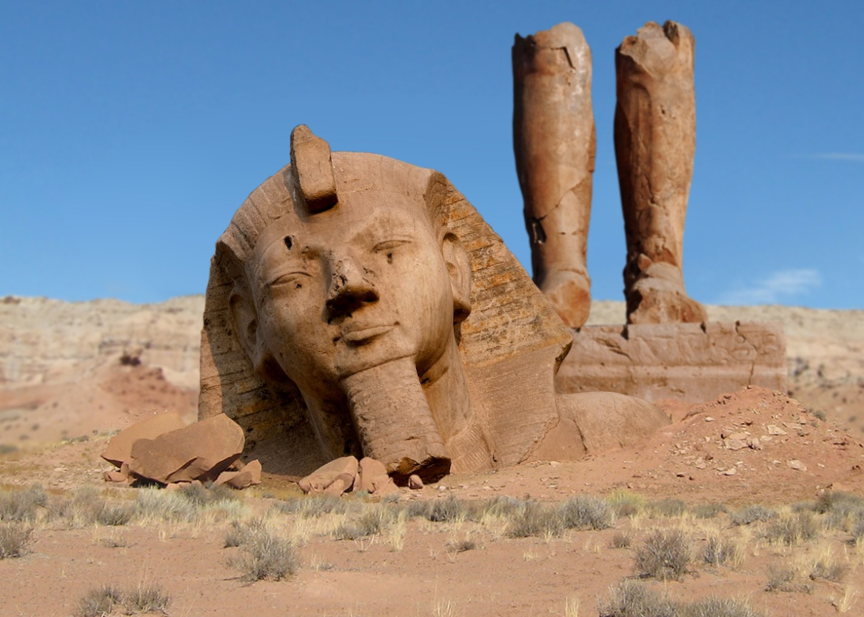
Ozymandias
Percy Bysshe Shelley

Slide 2
‘Pride comes before a fall’
What does this mean?

Slide 3
Ozymandias
Ozy comes from the Greek “ozium” which means either, ‘to breathe’ or ‘air’.
Mandias comes from the Greek “mandate” which means ‘to rule’.
What do you think the poem is going to be about?

Slide 4
I met a traveller from an antique land
Who said: Two vast and trunkless legs of stone
Stand in the desert. Near them on the sand,
Half sunk, a shatter’d visage lies, whose frown
And wrinkled lip and sneer of cold command
Tell that its sculptor well those passions read
Which yet survive, stamp’d on these lifeless things,
The hand that mock’d them and the heart that fed;
And on the pedestal these words appear:
‘My name is Ozymandias, king of kings:
Look on my works, ye Mighty, and despair!’
Nothing beside remains. Round the decay
Of that colossal wreck, boundless and bare,
The lone and level sands stretch far away.
What are your first impressions of the tone and meaning of the poem?

Slide 5
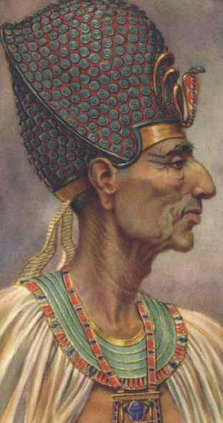
Ozymandias is another name for one of Egypt’s most famous pharaohs – Ramses II or Ramses the Great. He was a warrior king and a builder of temples, statues and monuments.
The gods had a little help, in the form of pharaohs. Pharaohs were the kings of Ancient Egypt. In hieroglyphics, pharaoh means “great house” or “palace”, a word that was eventually used to describe the king himself. The ancient Egyptians saw their pharaoh as a god, more specifically as the god Horus. They thought that when the pharaoh died, a new Horus was born to rule on earth, thus achieving eternal life. In reality, the pharaohs headed the government, the army, set taxes, judged criminals and were high priests of all the temples. All this was in theory, of course. Appointed officials did most of the work, in his name.
Shelley was critical of the royal family and monarchical government in England and sympathised with the ideals behind the French Revolution. ‘Ozymandias’ has been read by some as a condemnation of undemocratic or tyrannical government, reflecting Shelley’s radical views.

Slide 6
Form and Structure:
‘Ozymandias’ is a sonnet: a 14 line poem.
Each line is an iambic pentameter (the underlying rhythm is like five heart beats – di-dum di-dum di-dum di-dum di-dum) and there are 10 syllables in each line.
But
It is not about love (does loving yourself count?) and it does not have the traditional final rhyming couplet.

Slide 7
What does this adjective suggest? Positive/negative/both?
The voice of the ‘traveller’ gives “I” a distance from the poem
I met a traveller from an antique land
Who said: Two vast and trunkless legs of stone
Stand in the desert. Near them on the sand,
Half sunk, a shatter’d visage lies, whose frown
And wrinkled lip and sneer of cold command
Tell that its sculptor well those passions read
Which yet survive, stamp’d on these lifeless things,
The hand that mock’d them and the heart that fed;
Why ‘vast’ rather than ‘big’?
Alliteration: hard sound suggests lack of human emotion
‘frown’ and ‘wrinkled lip’ add to this negative impression of the ruler
Line 6: shift in focus from the image of the statue to the sculptor who created it.
Adds to sense of violence from the ruler

Slide 8
Ambiguous: imitation or ridicule? The power to do either is in the hand of the sculptor. Irony.
The hand that mock’d them and the heart that fed;
Whose hand/heart is referred to?
Ozymandias – ‘hand’ of a ruler, ‘mocking’ his subjects?/ ‘heart’ of a ruler providing for his subjects
The sculptor – his ‘hand’ ‘mocks’ Ozymandias rather than glorifies him (he ‘read those passions well – is this a flattering portrayal of the ruler?); his hand ‘mocks’ him in the sense that it imitates his likeness/passions; in what sense does his ‘heart’ feed the ruler?

Slide 9
Who does this refer to?
Imperatives: ‘Look’/’despair’ contrasted with ‘nothing beside remains’ underneath – creates irony
And on the pedestal these words appear:
‘My name is Ozymandias, king of kings:
Look on my works, ye Mighty, and despair!’
Nothing beside remains. Round the decay
Of that colossal wreck, boundless and bare,
The lone and level sands stretch far away.
Alliteration: stresses endless wasteland
Shift in tone in the final three lines
Enjambment: throughout the poem – unnatural pauses – things are out of balance
How does this fit with the theme of the poem?

Slide 10
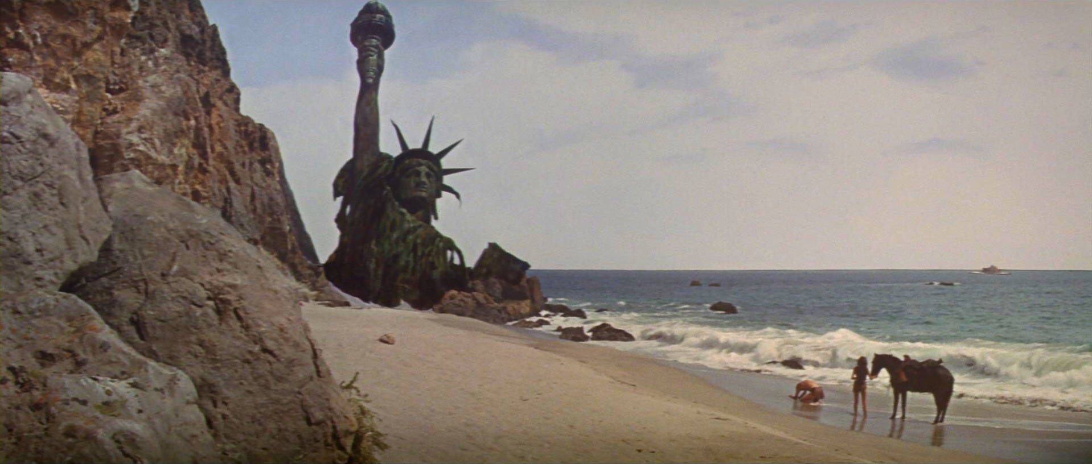
Whose work has lasted? The sculptor’s or the ruler’s?
What is Shelley suggesting about the significance of human power over time?
Does art outlast human power?
Which is more powerful: human power or nature?

Slide 11
Discussion time... pick the statements you agree with.
The poem explores power and status.
The poet admires Ozymandias.
Ozymandias was once a proud, tyrannical ruler.
The poem suggests we have all the time in the world.
The poem is about legacies and what we leave behind after we die.
The poet suggests that pride comes before a fall.
The poem is about time and nature and how man cannot conquer either.
Shelley suggests that art and language will outlast humans and other legacies of power.
The reader is left to imagine the sculptor as well as Ozymandias’ character.
It is ironic that it is the sculptor’s legacy that will last and not Ozymandias’ power.

Slide 12
It’s time to summarise! We’re going to make a note of the poem’s VITALS.

Slide 13
Poetry VITALS…
Voice: Who is speaking in the poem?
Imagery: What imagery is being created? How is it effective?
Theme: What are the main themes featured in the poem?
Address: Who is the poem addressed to? Why?
Language (Features): What type of language/ devices are used?
What is their effect?
Structure: How is the poem laid out? What is the effect of this?
Notes:
This is the acronym that we will use on each poem to look at all the different aspects

