Slide 1
English Language Exam: Unit 1
Understanding and producing non-fiction texts

Slide 2
2 hour exam + 15 minutes reading time
1 hour on each section
60% of your GCSE grade
Mock exam w/c 24th Nov: Full paper (Sections A and B)
(This is to help us focus our preparation for the second mock and real exam later in the year.)

Slide 3
Section A – Reading
1 hour 15 mins, to include 15 mins of reading time.
You will have three texts to read and should read them all before you start answering the questions.
You will be asked four questions and should answer them all.
Q1: Retrieval – Q2: Presentation – Q3: Inference – Q4: Analysis and comparison of language
Q1: (Retrieval) Tests your ability to select information from texts. Source 1. 8 marks.
Q2: (Presentation) Tests your ability to explain how presentational devices are used and their impact on the reader, linking them to the content of the text. Source 2. 8 marks.
Q3: (Inference) Tests your ability to explain the ways in which writers present ideas or arguments and to select appropriate evidence from the text to support your ideas. Source 3. 8 marks.
Q4: (Analysis and comparison of language) Tests your ability to analyse and compare texts, focusing on language. Source 3 plus one of your choice. 16 marks.

Slide 4
SECTION A: READING – Assessment Objectives
Read and understand texts, selecting material appropriate to purpose, collating from different sources and making comparisons and cross-references as appropriate.
Explain and evaluate how writers use linguistic, grammatical, structural and presentational features to achieve effects and engage and influence the reader.
These skills are the same as those needed to produce your CAs!
Understanding what you read
Selecting quotations
Comparing texts
Explaining how a writer uses language and structure to effect and influence a reader
The only new element is presentational devices.

Slide 5
What do you learn from Elisabeth Hyde’s article about where she has been and what
she has been doing?
(8 marks)
Q1: Retrieval
Q2: Presentation Q3: Inference
Q4: Analysis and comparison of language
Explain which parts of Pete Boardman’s story of the return to Camp 6 you find tense
and exciting.
(8 marks)
Step 1: Read the questions
Explain how the headline, sub-headline and picture are effective and how they link with
the text.
(8 marks)
Now you need to refer to Source 3, Everest The Hard Way and either Source 1 or Source 2.
You are going to compare the two texts, one of which you have chosen.
Compare the different ways in which language is used for effect in the two texts.
Give some examples and analyse what the effects are.
(16 marks)

Slide 6
Section A: Questions
What: (8 marks)
e.g. What do you learn...?
Information retrieval from source 1 with some interpretation of the information you find.
Three part answer: (1) what we know (2) quote (3) what this quotation shows us. [WEE]

Slide 7
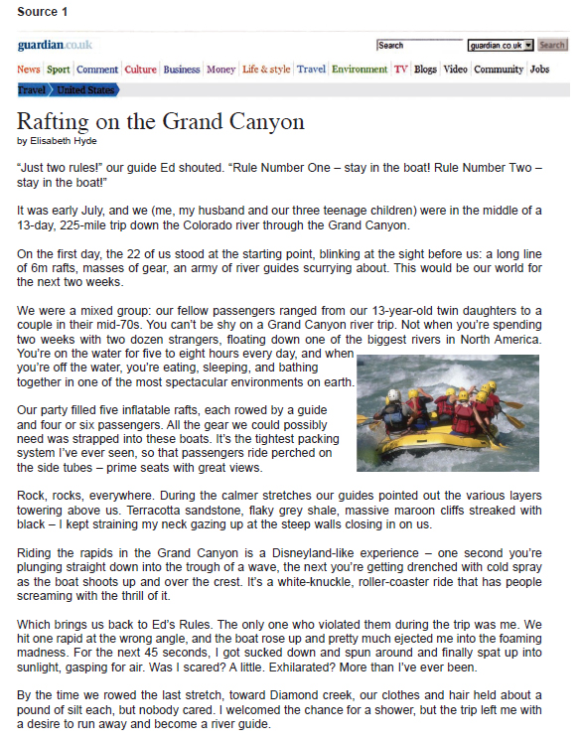
What do you learn from Elisabeth Hyde’s article about where she has been and what
she has been doing?
(8 marks)

Slide 8
Example response:
The first thing that the reader learns is that the guide, called Ed, gives them two rules which are both to stay in the boat. We later learn that Elizabeth violates these rules: “We hit one rapid at the wrong angle and the boat rose up and pretty much ejected me.” This sounds like a very scary experience but the reader later finds out about Elizabeth’s character, and that she was more exhilarated than scared.
Identify the three part structure in the response above. [WEE]
How could the response above be improved?

Slide 9
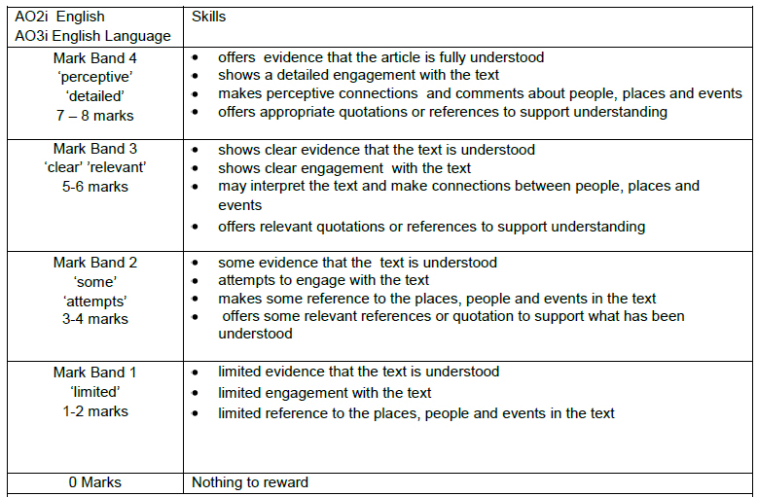

Slide 10
3. Try writing your own response to this question, using the mark scheme to help.

Slide 11
Peer-assessment:
Include one praise comment and one target for improvement.

Slide 12
Section A: Questions
2. Explain: (8 marks)
e.g. Explain how... are effective and how they link with the text.
Presentational features in source 2. Emphasis on how they link to the content of the article, i.e. How do they help the article to communicate its message?
Three part structure: (1) interpretation of the effect (2) link between feature and text (3) evidence/quote to support your link [ILE]

Slide 13
Explain how the headline, sub-headline and picture are effective and how they link with
the text.
(8 marks)

Slide 14
Example response:
The headline ‘Fearsome Tyrannosaurus rex Sue may have died of a sore throat’ uses the word ‘fearsome’ to reinforce the reader’s view: we might view such a large predator as fearless and immune to disease but this is contrasted with the end of the sentence where she is described as being killed by a ‘sore throat’. We would not expect this to kill such an animal. This links with the article where it described her injuries: ‘ a damaged shoulder’ and ‘three broken ribs’. Yet she survived these and was, surprisingly, killed by something seemingly as common and harmless as a sore throat.
Identify the following structure in the above response:
An interpretation of the message and effect of the headline;
Links between the headline and the text;
Appropriate quotation to support comment.
How could the response above be improved?

Slide 15
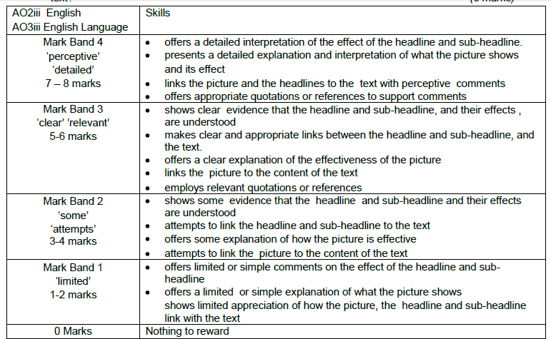

Slide 16
3. Try writing your own response to this question, using the mark scheme to help.

Slide 17
Self-assessment:
Include one praise comment and one target for improvement.

Slide 18
Section A: Questions
3. Explain: (8 marks)
e.g. Explain which parts...
Comment on an aspect of source 3, showing your ability to understand and interpret meaning. Identify sections you feel meet the topic, select quotations from these and interpret the ideas and meanings within them.
Three part structure: (P) pick a suitable part of the text (E) quote (W) what this quotation shows us. [PEW]

Slide 19
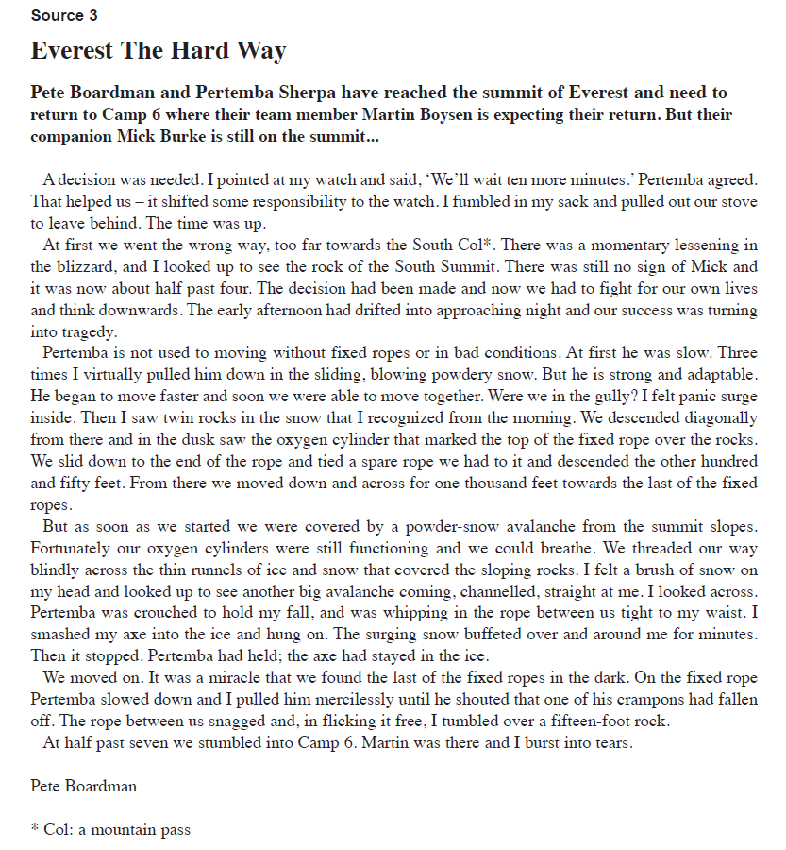
Explain which parts of Pete Boardman’s story of the return to Camp 6 you find tense
and exciting.
(8 marks)

Slide 20
Example response:
The question, ‘were we in the gully?’ is very effective and very tense. By this point in the story, we have realised that they are on a mountain-side and are trying to get to a camp. This is a dangerous situation and the fact they do not know where they are suggests they are in trouble. The question here makes the reader doubt the safety of the characters. ‘Panic’ implies that Pete has seen something which means he is in the wrong place; he might not make it. This is all very tense and exciting to read and makes you want to know what will happen to them.
In the paragraph above, identify where the answer shows interpretation and understanding of the quotations.
How could the response above be improved?

Slide 21
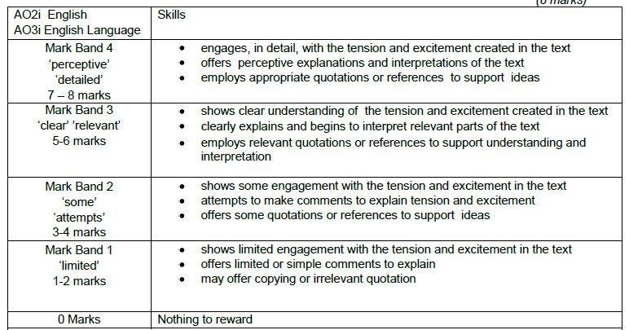

Slide 22
3. Try writing your own response to this question, using the mark scheme to help.

Slide 23
Peer-assessment:
Include one praise comment and one target for improvement.

Slide 24
Section A: Questions
4. Compare and analyse: (16 marks)
e.g. Compare the different ways... Analyse the effects...
Comparing language in two of the three texts (one specified; you choose the other). Identify purpose and audience then word choices/sentence lengths etc.
QWERTY

Slide 25
Now you need to refer to Source 3, Everest The Hard Way and either Source 1 or Source 2.
You are going to compare the two texts, one of which you have chosen.
Compare the different ways in which language is used for effect in the two texts.
Give some examples and analyse what the effects are.
(16 marks)

Slide 26
Example response:
Source 1 and Source 3 are both documenting extreme journeys. However, the mood and the way they present their thoughts and feelings are very different. Source 1 has a more mainstream audience, perhaps travel writers or extreme sports enthusiasts. This means that the language used has to be accessible and more informal, so Hyde uses words like ‘gear’ to describe the equipment used and ‘a Disneyland-like experience’ which could appeal to a wider range of people and not just to those who know a lot about over-rafting. Source 3, however, uses many more words specific to the sport: ‘South Cal’; ‘runnels of ice’. The audience of this piece is different. They may be readers who would be interested in and more knowledgeable of mountaineering, therefore the writer has used more specialist language.
Emotive language and a series of questions are used in Source 1 to convey the writer’s feelings and engage the reader: ‘Was I scared? A little. Exhilarated? More than I’d ever been.’ The writer is clearly positive about her experience and the word ‘exhilarated’ indicates this. In this case, the questions are used to show the reader’s potential reaction and how life-changing the experience was. Questions are also used in Source 3 but this time they show very different emotions. In Source 3 we might begin to see the writer’s panic and disorientation through his use of the question ‘were we in the gully?’. This question could suggest...
1. How effective is the above response? Identify places where the answer: a) comments on audience/purpose; b) compares the two texts.

Slide 27
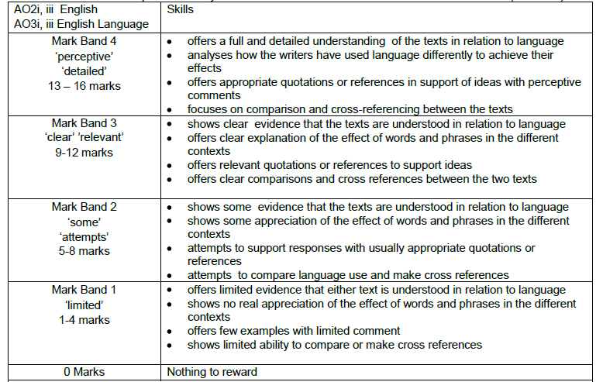

Slide 28
3. Try writing your own response to this question, using the mark scheme to help.

Slide 29
Self-assessment:
Include one praise comment and one target for improvement.

Slide 30
Useful words and phrases for comparison
However On the other hand
In the first text… while in the second text…
Both writers use… in order to….
The texts use….. differently / in a similar way …..

Slide 31
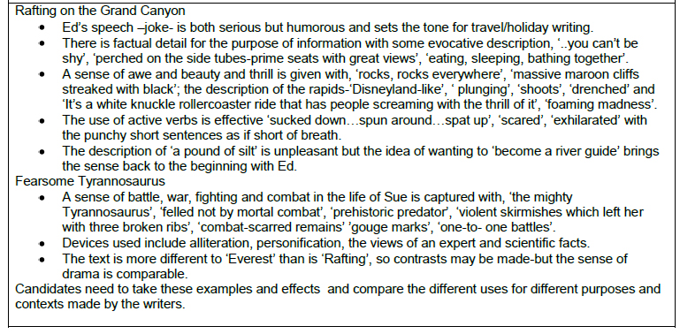

Slide 32
Section A – Top Tips
Read the questions before you read the texts
Highlight key words in the questions to make sure that you understand what the question is asking you to do
Make sure you highlight / annotate relevant parts of the texts as you are reading
Make sure you explain your ideas about the techniques used – remember the impact on the reader.
WEE ILE PEW QWERTY

Slide 33
Section B: Writing
1 hour.
You will be asked two questions and should answer them both.
Q5: Inform / explain / describe, based on personal details: 16 marks. 25 minutes.
Q6: Argue / persuade / create a viewpoint which must be sustained: 24 marks. 35 minutes.

Slide 34
Assessment Objectives for Section B:
(i) Write to communicate clearly and effectively using and adapting forms and selecting VOCABULARY appropriate to task and purpose in ways that engage the reader.
(ii) Organise information and ideas into structured and sequenced sentences, PARAGRAPHS and whole texts, using a variety of structural features to support cohesion and overall coherence.
(iii) Use a range of SENTENCE STRUCTURES for clarity, purpose and effect, with accurate SPELLING and PUNCTUATION.
These are the same skills you have practised in your controlled assessments.

Slide 35
Make sure that you…
Show that you have understood the Type, Audience and Purpose for the writing
Use appropriate language, structure and presentational devices for the genre you have been given
Use appropriate and interesting vocabulary
Use a variety of appropriate connectives to link your ideas, sentences, and paragraphs
Use a variety of sentences effectively, varying your sentence openings
Make sure your work is accurate, using a full range of punctuation
Use paragraphs to help make your meaning clear

Slide 36
Learning Objective: To understand the format and overall structure of the writing section of the Unit 1 exam
Q5: Inform / explain / describe, based on personal details: 16 marks. 25 minutes.
10 marks – use of language and detail; writing appropriately for audience and purpose; use of paragraphs
6 marks – spelling, punctuation, and sentence structure; use of standard English

Slide 37
Learning Objective: To understand the format and overall structure of the writing section of the Unit 1 exam
Q6: Argue / persuade / create a viewpoint which must be sustained: 24 marks. 35 minutes.
16 marks – use of language and detail; writing appropriately for audience and purpose; use of paragraphs
8 marks – spelling, punctuation, and sentence structure; use of standard English

Slide 38
5. Write a brief article for a website of your choice telling your readers about an interesting or unusual journey or travel experience you have had. Explain why it was memorable.
(16 marks)
6. Your school or college is inviting entries for a writing competition. The topic is: “Dangerous sports activities and pastimes are selfish, often put others at risk and should be discouraged.”
Write your entry arguing for or against this view.
(24 marks)

Slide 39
We’re not going to worry too much about the writing section at this point, other than have a quick look at the mark scheme. Later in the year, we’ll revise the different writing styles you need to know and will practise producing exam-based pieces of writing.
For now, focus on Section A.

Slide 40
Write a brief article for a website of your choice telling your readers about an interesting or unusual journey or travel experience you have had. Explain why it was memorable.
(16 marks)

Slide 41
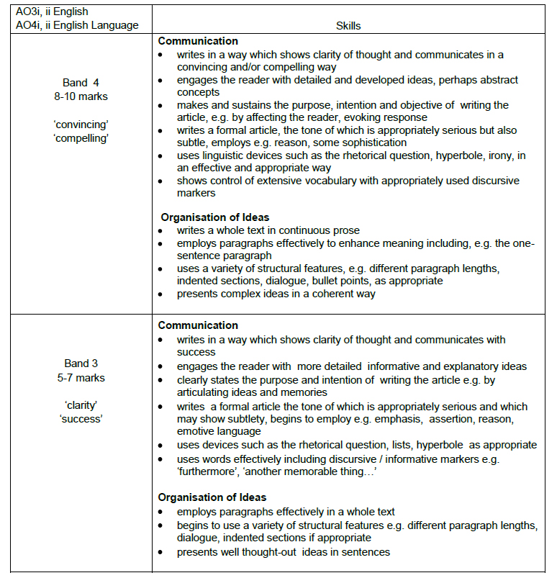

Slide 42
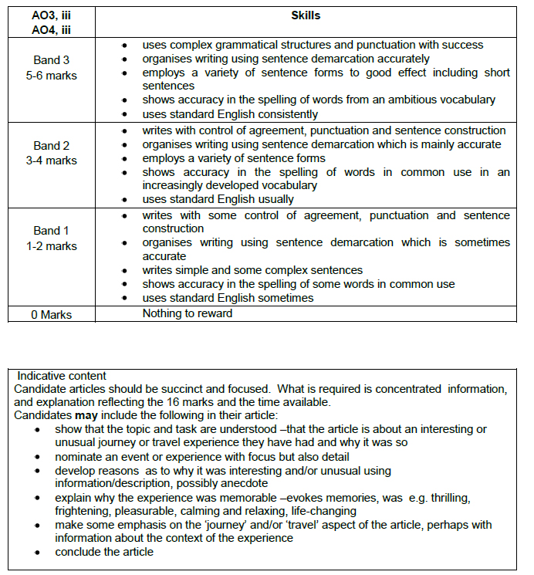

Slide 43
Your school or college is inviting entries for a writing competition. The topic is: “Dangerous sports activities and pastimes are selfish, often put others at risk and should be discouraged.”
Write your entry arguing for or against this view.
(24 marks)

Slide 44
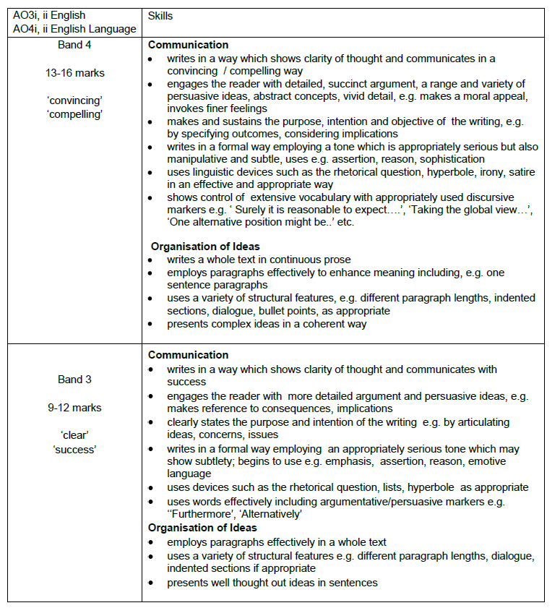

Slide 45
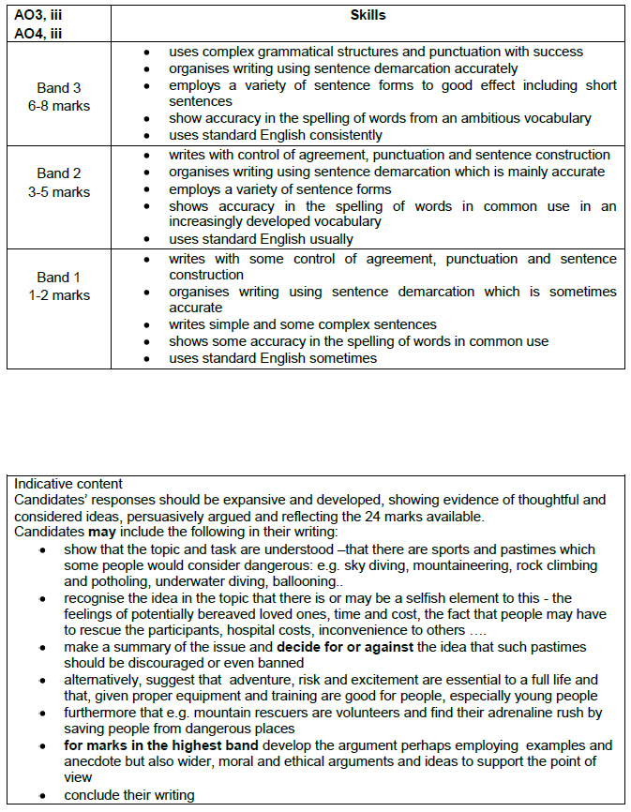

Slide 46
Tackling Section B
Read the question carefully.
Underline key words. Identify Genre, Audience and Purpose.
Plan your answer to make sure you use appropriate structure, presentational devices and language.
Write your response, using your plan, and keep purpose, audience and form in mind.
Check your answer carefully – look for errors in sentences, paragraphing, spelling and punctuation.

Slide 47
Raw Mark (/80) | June 2011 | June 2012 | Grade
71-80 | 64-80 | 61-80 | A*
63-70 | 57-63 | 55-60 | A
55-62 | 50-56 | 49-54 | B
48-54 | 43-49(H) | 44-48(H) | C
40-47 | 33-42(H) | 39-43(H) | D
32-39 | 26-32(H) | 30-40 | E
24-31 | 18-25 | 19-29 | F
16-23 | 10-17 | 8-18 | G
0-15 | 0-9 | 0-7 | U

