Slide 1
My Last Duchess
Robert Browning

Slide 2
My Last Duchess What do these words imply?

Slide 3
First Impressions
What is the poem about?
Who are the characters in the poem?
Who is speaking? (voice)
(This is quite a difficult poem to understand)

Slide 4
The Duke is talking about his dead wife, the Duchess.
Her portrait hangs on the wall.
The Duke is speaking to an envoy for the ‘Count’, a man whose daughter he wishes to marry. The envoy is there to discuss a dowry.

Slide 5
The poem is a dramatic monologue. This means the poem is written in the voice of a character, a male narrator - an imaginary Italian Duke.
When? Browning wrote the poem in 1842. However, it seems likely that his idea for the poem was based on Alfonso II, Duke of Ferrara, whose first wife died after three years of marriage in 1561. The subject matter of the poem – the ‘marriage market’ - would have ensured that the poem was topical in 1850s Britain.
What? The Duke now wants to marry the Count’s daughter. He is discussing this with the Count’s representative. As he does so, he shows his guest around his palace. During the conversation and tour, he reveals a portrait of his previous wife – his ‘last duchess’.

Slide 6
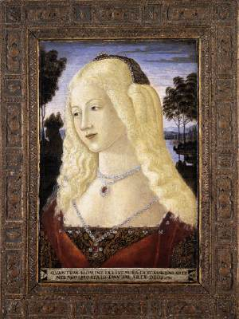
“That's my last Duchess painted on the wall,
Looking as if she were alive.”
First reading for meaning. Make notes on your paper copy of the poem!

Slide 7
What might this suggest? Is there more than one interpretation?
That’s my last Duchess painted on the wall,
Looking as if she were alive. I call
That piece a wonder, now: Frà Pandolf’s hands
Worked busily a day, and there she stands.
Will’t please you sit and look at her?
Why do you think the painting is ‘a wonder’?
Who is Fra Pandolf?
How does the Duke feel about his dead wife?

Slide 8
What is a ‘pictured countenance’? What has the envoy seen in it?
I said
‘Frà Pandolf’ by design, for never read
Strangers like you that pictured countenance,
The depth and passion of its earnest glance,
But to myself they turned (since none puts by
The curtain I have drawn for you, but I)
And seemed as they would ask me, if they durst,
How such a glance came there; so, not the ﬁrst
Are you to turn and ask thus.
What response do ‘strangers’ have when they first see the portrait?
i.e. what do they ask the Duke?
Why do you think they ask this?
What does this suggest about the Duke’s attitude towards his wife (both now and when she was alive)?

Slide 9
When the Duke draws back the curtain the envoy
sees in the Duchess’expression:
“The depth and passion of its earnest glance,”

Slide 10
We can see from the line below that the Count’s envoy
has asked how “the glance” or
“spot of joy” came to be there.”
“so, not the first are you to turn and ask thus.”

Slide 11
It wasn’t just me, her husband, who brought pleasure to her face.
What else made the Duchess flush with joy?
Sir, ‘twas not
Her husband’s presence only, called that spot
Of joy into the Duchess’ cheek: perhaps
Frà Pandolf chanced to say ‘Her mantle laps
Over my lady’s wrist too much,’ or ‘Paint
Must never hope to reproduce the faint
Half-ﬂush that dies along her throat’: such stuff
Was courtesy, she thought, and cause enough
For calling up that spot of joy.
Does the Duke consider ‘such stuff’ as ‘courtesy’?
How do you think the Duke feels about his wife’s relationship with the painter?

Slide 12
She had
A heart – how shall I say? – too soon made glad,
Too easily impressed; she liked whate’er
She looked on, and her looks went everywhere.
Sir, ‘twas all one! My favour at her breast,
The dropping of the daylight in the West,
The bough of cherries some ofﬁcious fool
Broke in the orchard for her, the white mule
She rode with round the terrace – all and each
Would draw from her alike the approving speech,
Or blush, at least.
What does this suggest about the Duke’s wife? Are there different ways of interpreting this characteristic?

Slide 13
She probably thought the painter
was being courteous.
But she was “too easily impressed”
And “her looks went everywhere”
What does this suggest about the Duke’s wife? Are there different ways of interpreting this characteristic?
Notes:
You can see the Duke was jealous.

Slide 14
“Sir, 'twas all one!”
Everything was the same to her-
of equal importance.
“My favour at her breast.”
“Favour” - the Dukes presence alongside her. “Favour” was literally a ribbon in the Duke’s colours.

Slide 15
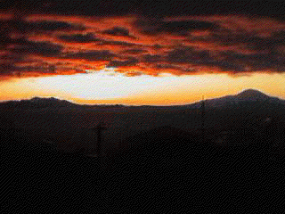
Other things that were on equal importance were:
A sunset.
“The dropping of the daylight in the West”

Slide 16
“The bough of cherries”

Slide 17
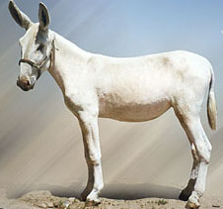
“the white mule she rode with round the terrace”

Slide 18
These things were all the same to her.
“………………………………………all and each
Would draw from her alike the approving speech,
Or blush, at least.
Notes:
Refers back to the “blush” in the portrait”: this has sparked off this train of thought.

Slide 19
What do the dashes in the middle of the
lines suggest?
She thanked men, – good! but thanked
Somehow – I know not how – as if she ranked
My gift of a nine-hundred-years-old name
With anybody’s gift. Who’d stoop to blame
This sort of triﬂing?
What does this mean? How does the Duke feel about his wife’s response to gifts from others?
How does the Duke feel about his wife’s social standing before she married him?
Did the Duchess appreciate this ‘gift’?

Slide 20
The Duke considers telling his wife
how she has offended him but this is difficult
even if you were skilled with words.
“if” – this is all hypothetical. He didn’t tell his wife she was upsetting him. Why not?
The speech here is what he would have said to his wife had he said anything – he didn’t
Even had you skill
In speech – (which I have not) – to make your will
Quite clear to such an one, and say, ‘Just this
Or that in you disgusts me; here you miss,
Or there exceed the mark’ – and if she let
Herself be lessoned so, nor plainly set
Her wits to yours, forsooth, and made excuse,
– E’en then would be some stooping; and I choose
Never to stoop.
What sort of impression do you get of the Duke in this section?

Slide 21
But to tell her “here you disgust me”
or
“exceed the mark.”
involves stooping and
“I choose never to stoop.”
Notes:
He uses the word “stoop” or “stooping” three times, which suggests he is proud of his aristocratic position. What other lines in the poem tell us that the Duke is a proud man?
How the would the Duke say “I choose never to stoop?”
Does he reveal what he is like intentionally or unintentionally?

Slide 22
She smiled at him, but also at everyone else.
What do you think this means?
Oh sir, she smiled, no doubt,
Whene’er I passed her; but who passed without
Much the same smile? This grew; I gave commands;
Then all smiles stopped together. There she stands
As if alive. Will’t please you rise? We’ll meet
The company below, then.
How is the placement of this line significant?

Slide 23
Will't please you rise? We’ll meet
The company below, then.
The Duke signals that this part of the conversation is over. Why now?

Slide 24
The Duke has moved on. He’s saying that the Count’s ‘munificence’ (vast wealth) is ‘ample warrant’ (a guarantee) that his dowry demands will be met.
I repeat,
The Count your master’s known muniﬁcence
Is ample warrant that no just pretence
Of mine for dowry will be disallowed;
Though his fair daughter’s self, as I avowed
At starting, is my object.
Nay, we’ll go
Together down, sir. Notice Neptune, though,
Taming a sea-horse, thought a rarity,
Which Claus of Innsbruck cast in bronze for me!
...but it’s not the money he wants, it’s the Count’s daughter
He moves the envoy away from the painting of MLD and towards the next piece of art in his collection
How does the Duke view women?
Are you worried for the Count’s daughter?

Slide 25
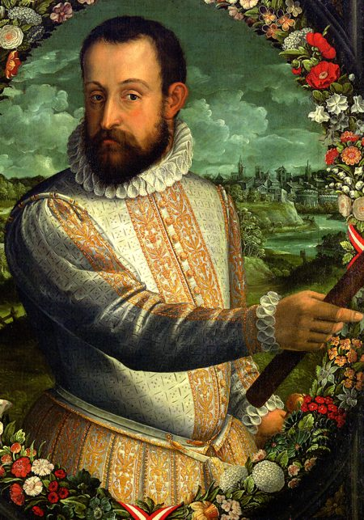
The Duke
What kind of man is the Duke?
What is your initial reading?
What other interpretations exist?
Use your ‘different interpretations’ sheet to help you consider different ways of thinking about the Duke.

Slide 26
 Read and then cut out the statements about the Duke.
⬧ Work in pairs to try and rank the statements. Place the most appropriate at the top and the least appropriate at the bottom. You might decide to give some statements equal weighting.
 Together, select ten statements that you feel really capture the character of the Duke within the poem. Find a quotation to support each of the ten statements.
 Team up with another pair. Take it in turns to explain and prove your choices.

Slide 27
A Picture... of the Duke
The Duke spends most of the poem talking about his wife, but in lines 32-43 he talks about himself directly.
Look at and complete the worksheet you have been given: ‘the Duke paints a picture of himself’.

Slide 28
She thanked men, -- good! but thanked
Somehow -- I know not how -- as if she ranked
My gift of a nine-hundred-years-old name
With anybody’s gift. Who’d stoop to blame
This sort of trifling? Even had you skill
In speech -- (which I have not) -- to make your will
Quite clear to such an one, and say, "Just this
Or that in you disgusts me; here you miss,
Or there exceed the mark" -- and if she let
Herself be lessoned so, nor plainly set
Her wits to yours, forsooth, and made excuse,
--E'en then would be some stooping, and I choose
Never to stoop.
Notes:
Mention caesura.
Discuss the idea of the Duke struggling to find the words, as he tries to make sense of what happened.
Mention enjambement. How thoughts rush out, and accelerate, almost uncontrollably, rather then finishing at the end of a line.

Slide 29
But to tell her “here you disgust me”
or
“exceed the mark.”
involves stooping and
“I choose never to stoop.”
What other lines in the poem tell us that the Duke is a proud man?
How the would the Duke say “I choose never to stoop?”
Notes:
He uses the word “stoop” or “stooping” three times, which suggests he is proud of his aristocratic position. What other lines in the poem tell us that the Duke is a proud man?
How the would the Duke say “I choose never to stoop?”
Does he reveal what he is like intentionally or unintentionally?

Slide 30
Does the Duke reveal what he’s like
intentionally or unintentionally?

Slide 31
“The mad duke...cannot love without so possessing
and destroying the identity of his wife
that he literally kills her
and lives with her dead substitute, a work of art."
Isobel Armstrong
Do you agree?

Slide 32
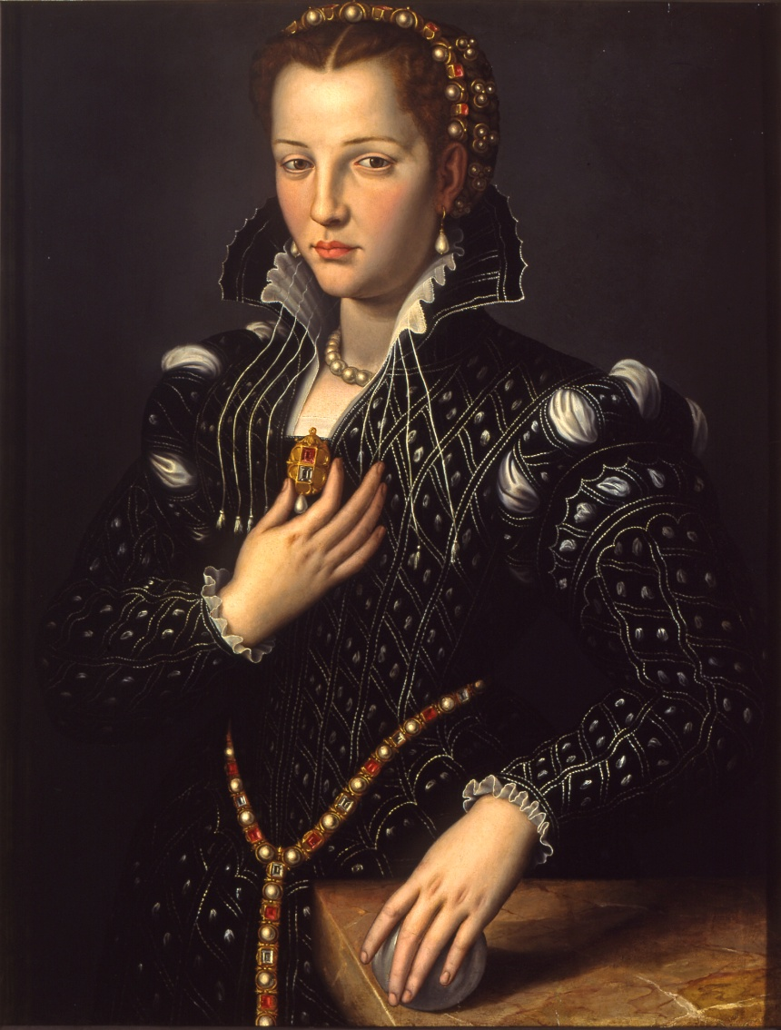
The Duchess
The majority of the Duke’s monologue is spent telling the Count’s envoy about his former wife – his ‘last Duchess’.

Slide 33
During this monologue, he talks about her actions and personality and this, in turn, explains his jealousy and anger. Work in pairs to list the reasons he gives. What does the Duchess do which causes the Duke to become jealous and angry? What aspects of her personality upset him?

Slide 34
There are a number of word sets and / or phrases within the poem. Work in small groups to collate evidence linked to the area you have been given on your worksheet. Be prepared to share your ideas with the rest of the class!
The Duchess’ beauty
The Duchess – dead or alive?
The Duchess as art
Looking
Uncertainty

Slide 35
Beauty:
When people gave the Duchess compliments, the Duke says:
“such stuff/ Was courtesy, she thought, and cause enough For calling up that spot of joy.”
What does that imply about both the Duchess and the Duke?

Slide 36
Alive or Dead?
Did the Duke murder his wife?
“I gave commands; / Then all smiles stopped together”
What evidence is there for either argument?

Slide 37
The Duchess as an object:
The portrait of the last Duchess is behind a curtain. The Duke states in lines 9-10: “(since none puts by / The curtain I have drawn from you but I)”
Does the Duke let many people see his last Duchess?
Why or why not?
What does that tell us about the Duke?
Why is this in brackets?

Slide 38
Looking:
The Duke states that: “her looks went everywhere” and that it: “’twas all one!”
Why is he so angry? What didn’t she do?

Slide 39
Uncertainty:
What do the following lines imply?
“Sir, ’twas not Her husband’s presence only, called that spot Of joy into the Duchess’ cheek”

Slide 40
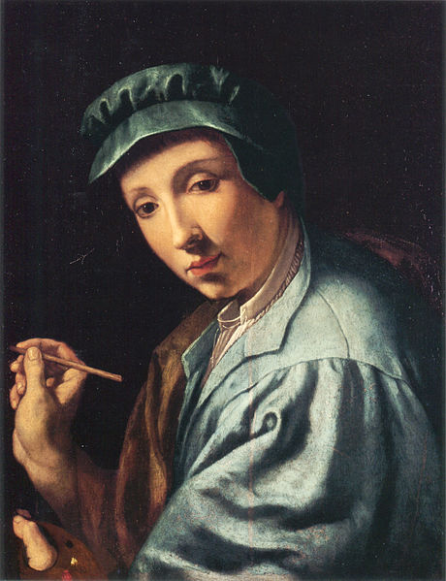
Fra Pandolf
The Duke seems particularly jealous and angered by the possible relationship that developed between the artist and the Duchess. What is the Duke’s attitude to Fra Pandolf?
Lines 3-4
Lines 5-7
Lines 15-21

Slide 41
 In lines 15 – 19, the Duke speaks what he imagines Fra Pandolf has said to his wife, the Duchess. Read the lines carefully.
Discuss the following questions in small groups:
Which words make it clear that the Duke is guessing at what might have happened (or not) between the Duchess and Fra Pandolf?
What is significant about the two lines of dialogue that the Duke gives Fra Pandolf. Consider the tone and content. How would the Duke speak these lines?
What do you make of the use of the possessive pronoun ‘her’ in this section?

Slide 42
Structure and Form
Throughout the poem, there are rhyming couplets. Highlight some effective examples of these on your copy of the poem.
What kind of pace and rhythm does this lend to the poem?
Steady galloping stately
faltering regular monotonous

Slide 43
Select three of the following:
The pace and rhythm of the couplets is appropriate and effective because:
it gives the poem a lively, musical feel;
the structured form is elegant, and suits the Duke’s status;
it gives the poem a chant-like beat;
the structured form echoes the Duke’s masculine need to control;
it shows that the Duke is trying to order his confused and complex thoughts about his wife;
it makes the content of each line very predictable and boring.

Slide 44
Enjambment
Enjambment is used throughout the poem.
It creates a more natural-sounding, flowing voice.
It causes deliberate and significant pauses at key moments within the poem.
It sometimes signals a change in tone of voice.
Can you find some examples of this?

Slide 45
Iambic Pentameter
The poem is written in iambic pentameter. This means that there are five feet in each line. Each foot contains two syllables. Traditionally, iambic pentameter is written in the following pattern of unstressed and stressed syllables.
da-dum da-dum da-dum da-dum da-dum

Slide 47
da-dum da-dum da-dum da-dum da-dum
Iambic pentameter often follows the natural rhythm of speech, a little like a heartbeat. If we apply this to pattern to Browning’s opening line, it would be as follows.
That’s my last duchess painted on the wall

Slide 48
Does the above rhythm sound natural?
Not really.
Poets played with the form of iambic line, using the pattern but allowing the reader of the poem some freedom in the way they read the lines aloud.
Do any of the lines sound better when using the traditional stress pattern of iambic pentameter?

Slide 49
Why is this worth knowing?
When the poem’s enjambment is considered alongside the poem’s use of rhyming couplets and iambic pentameter, it suggests ‘breaks’ in the Duke’s train of thought, and his thoughts about his wife. In this way, the Duchess’ playfulness and free spirit permeates the form and structure – not just the content – of the poem. Or perhaps the Duke has reason to falter?
Bearing this in mind...

Slide 50
There are two half rhymes within the poem. The first comes from lines 27 – 28 and the second from lines 41 – 42.
“Sir, ’twas all one! My favour at her breast,
The dropping of the daylight in the West,
The bough of cherries some officious fool
Broke in the orchard for her, the white mule
She rode with round the terrace - …”
“ - and if she let
Herself be lessoned so, nor plainly set
Her wits to yours, forsooth, and made excuse,
- E’en then would be some stooping; and I choose
Never to stoop.”
Poets often use half rhymes in order to drawn attention to the lines, or in order to create a particular effect.
Consider the content of these lines. Why might these half rhymes be significant?
fool
mule
excuse
choose

Slide 51
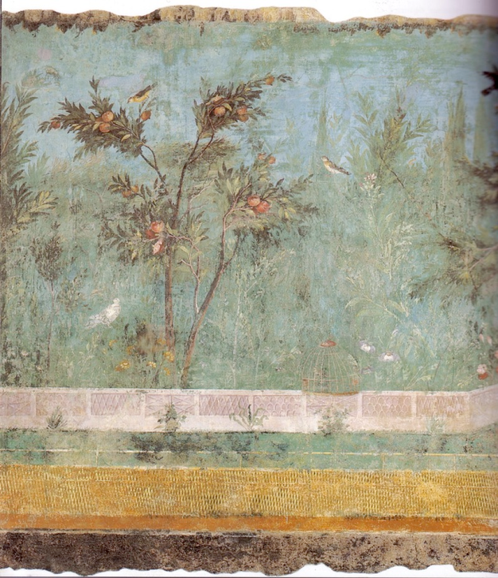
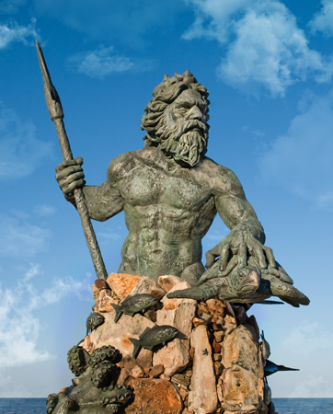
The Ending
“… Notice Neptune, though,
Taming a sea-horse, thought a rarity,
Which Claus of Innsbruck cast in bronze for me!”
Why does the poem end with these lines?
What is being suggested about the Duke, the Duchess and their relationship?
What might it suggest to the Count’s envoy?

Slide 52
Themes and issues
First read through the list of themes below and give each one a score to reflect the importance you think it has in the poem. Use these scorings:
0 – No Significance
5 – The theme features in a minor way
10 – The theme features in a major way
15 – It is the poem’s central, most important theme
Now share your ideas with a partner. Discuss your scores and then together make a list of the top three themes according to your negotiations. Be prepared to share your ideas with the whole class.
As a whole class, decide on the top three themes in this poem.

Slide 53
It’s time to summarise! We’re going to make a note of the poem’s VITALS.

Slide 54
Poetry VITALS…
Voice: Who is speaking in the poem?
Imagery: What imagery is being created? How is it effective?
Theme: What are the main themes featured in the poem?
Address: Who is the poem addressed to? Why?
Language (Features): What type of language/ devices are used?
What is their effect?
Structure: How is the poem laid out? What is the effect of this?
Notes:
This is the acronym that we will use on each poem to look at all the different aspects

