Slide 1
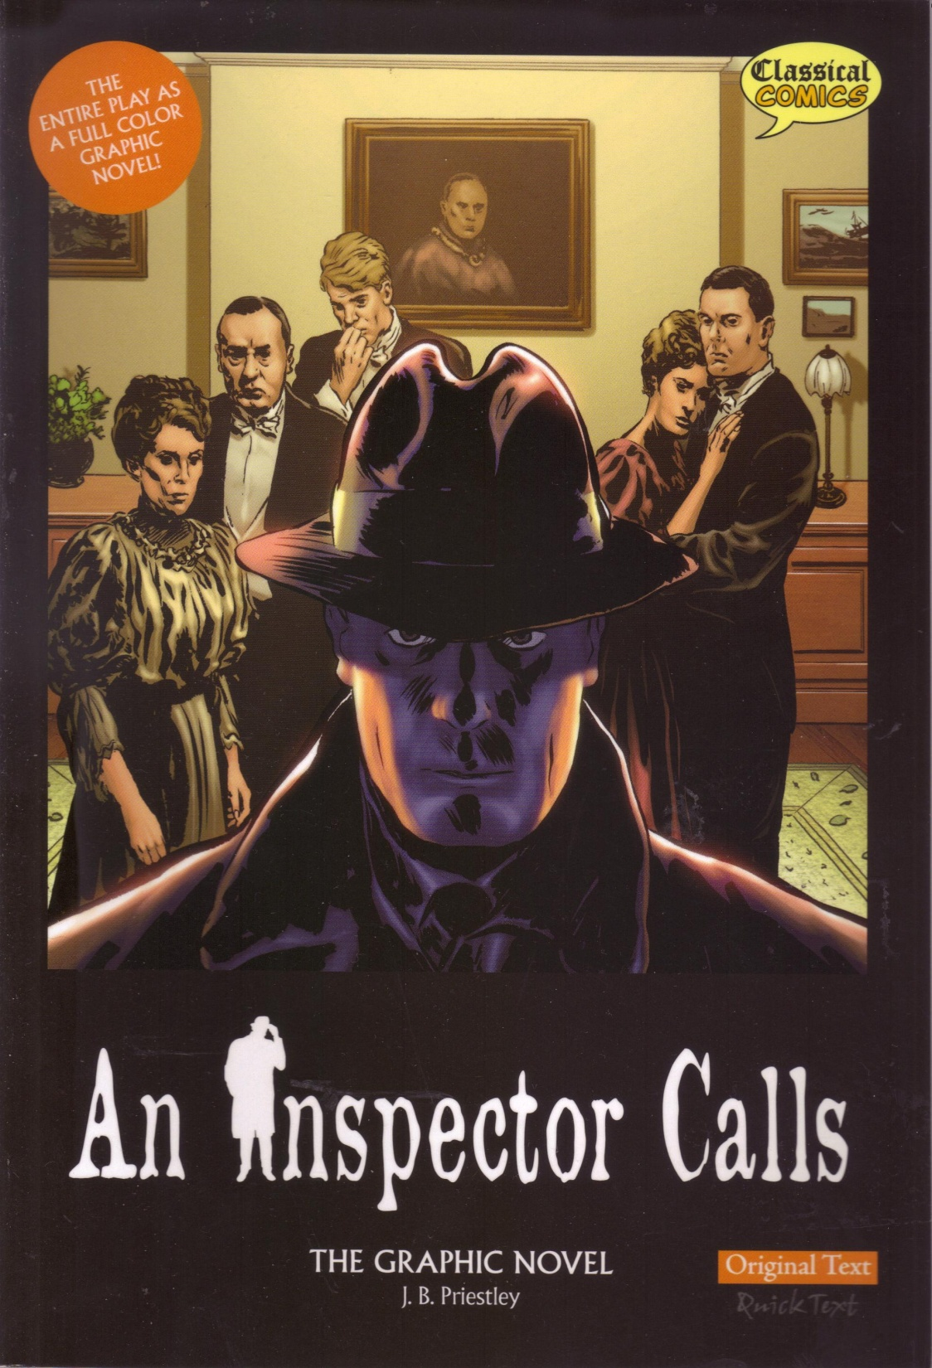
An Inspector Calls
By J.B. Priestley
English Literature
Paper 2, Section A
‘Modern Texts’

Slide 2
Learning Objective To know what this section of the exam is all about and understand the AOs. To read and engage with the play itself

Slide 3
English Literature Paper 2, Section A
‘Modern Texts’
You will have 45 minutes to answer one question from a choice of two
This section of the exam is worth about 20% of your final GCSE
This is the same criteria as your poetry assessment.

Slide 4
As we read/watch ‘An Inspector Calls’, try to keep these questions in mind...
What kind of person is the Inspector?
Which characters are powerful? Which are weak?
What would this look like on stage?
What is the writer trying to say?

Slide 5
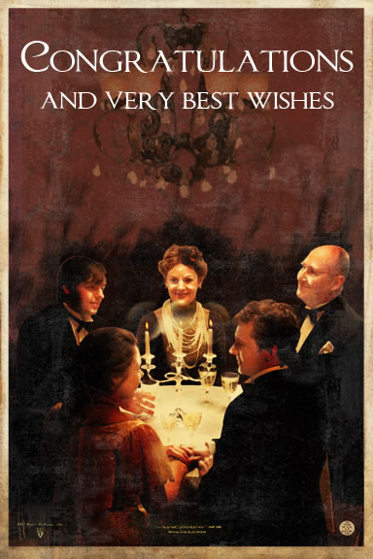
Pick a Part! – Act 1
Stage directions:
Mr Birling:
Mrs Birling:
Gerald:
Sheila:
Eric:
Edna:
The Inspector:

Slide 6
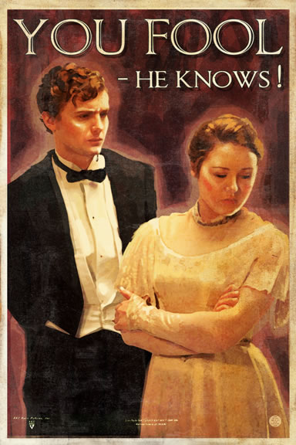
Pick a Part! – Act 2
Stage directions:
Mr Birling:
Mrs Birling:
Gerald:
Sheila:
Eric:
Edna:
The Inspector:

Slide 7
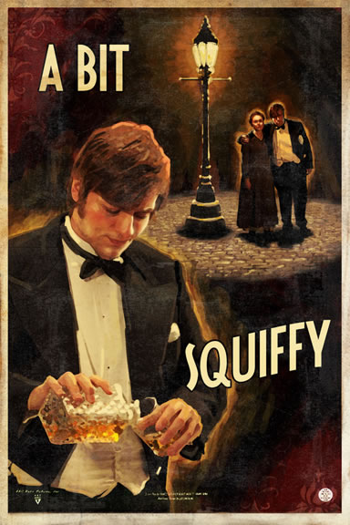
Pick a Part! – Act 3
Stage directions:
Mr Birling:
Mrs Birling:
Gerald:
Sheila:
Eric:
Edna:
The Inspector:

Slide 8
Learning Objective To understand the context of the play ‘An Inspector Calls’

Slide 9
Develop and sustain interpretations of writers’ ideas and perspectives
Who was J B Priestley?
To understand how Priestley used his characters to express ideas and attitudes about society, we need to know something about the writer himself – and the society he lived in.
You will all be given a paper ‘domino’, on which is a question and an answer to (another) question. You task is to find a) the question that you can answer and b) the answer to your question.
The first question is ‘When was John Boynton Priestley born?’. Whomever has the answer to this question should come and stand next to me! That person will then read out his/her question, and so on...

Slide 10
Develop and sustain interpretations of writers’ ideas and perspectives
Who was J B Priestley?
To understand how Priestley used his characters to express ideas and attitudes about society, we need to know something about the writer himself – and the society he lived in.
You have been given a copy of the answers to the dominoes task. Stick this in your book and highlight any details which you can link to the ideas and attitudes in ‘An Inspector Calls’. Which details of Priestley’s life might have influenced this play?

Slide 11
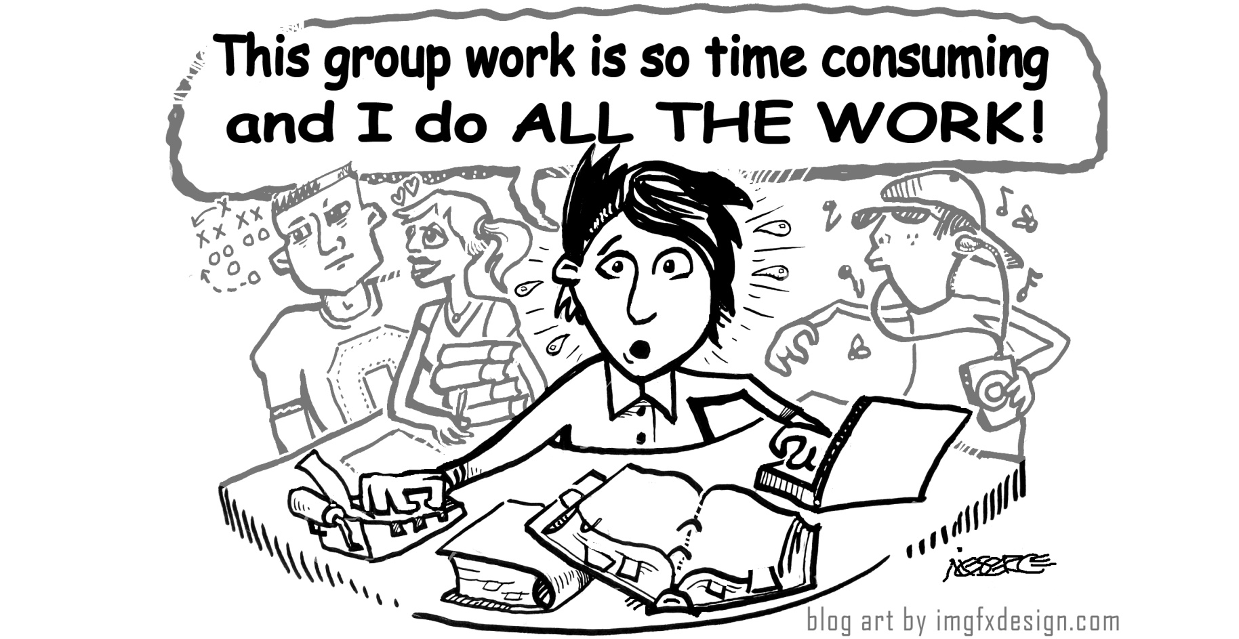
Develop and sustain interpretations of writers’ ideas and perspectives
You have been given a pack of information about the time and society that Priestley lived in. As a group, you should divide the sources and collect information to help you answer the questions on your ‘Ideas and Perspectives’ sheet. Make sure that everyone takes their fair share and that all sources are read and explained to the rest of the group.

Slide 12
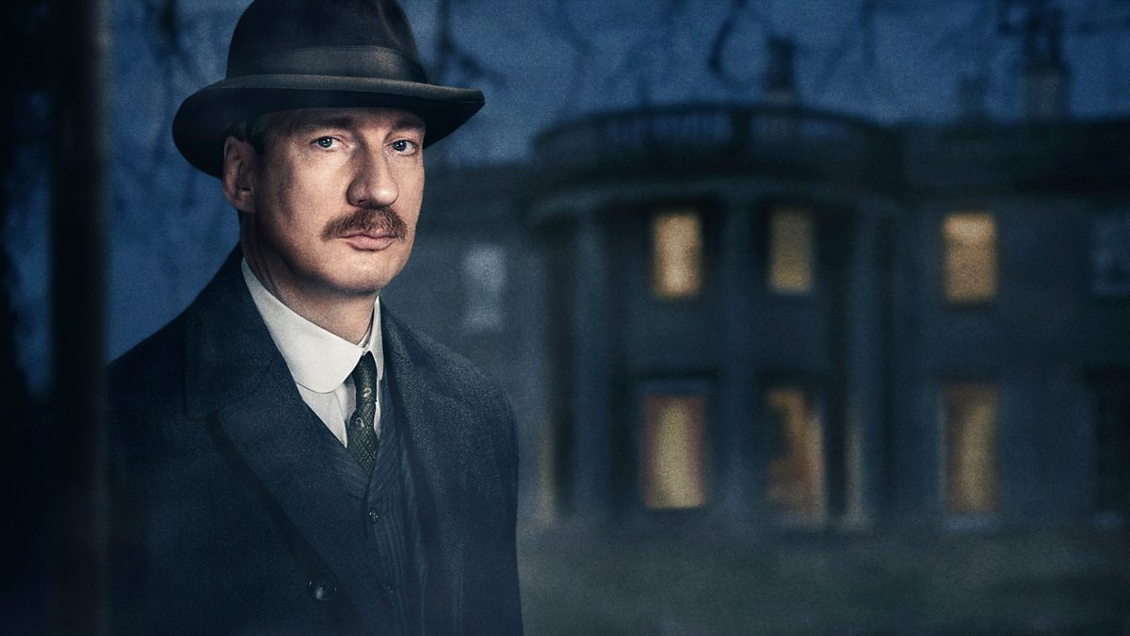
Develop and sustain interpretations of writers’ ideas and perspectives
Share your information with the rest of your group.
You will then use this information to produce a poster or mood board for display.
Reduce the information to key points and use these to write detailed notes for your own revision later...

Slide 13
Develop and sustain interpretations of writers’ ideas and perspectives
Life in 1912
Life in 1945
The differences between 1912 and 1945
The class divide
The welfare state
Key events linked to or referenced in the play
Priestley’s ideas and views

Slide 14
Learning Objective To analyse how Priestley uses the set and setting of the play to present the characters, ideas and message.

Slide 15
Learning Objective: to analyse how Priestley uses the set and setting of the play to present the characters, ideas and message.
Priestley’s First Impressions…

Slide 16
Learning Objective: to analyse how Priestley uses the set and setting of the play to present the characters, ideas and message.
The dining room of a fairly large suburban house, belonging to a prosperous manufacturer. It has good solid furniture of the period. The general effect is substantial and heavily comfortable, but not cosy and homelike.
The lighting should be pink and intimate until the INSPECTOR arrives, and then it should be brighter and harder.
The kitchen of a fairly small urban house, belonging to a factory worker. It has cheap, mismatched furniture. The general effect is simple and modest, but homely. The lighting should be dim and soft.
A room in a poky one bed-roomed flat, belonging to a factory worker. It has some furniture: one chair at a table, one armchair. The general effect is lonely and uncared for. The lighting should be dull.
Select 5 key words from each stage direction…

Slide 17
Learning Objective: to analyse how Priestley uses the set and setting of the play to present the characters, ideas and message.
What do his stage directions tell us about the characters, ideas and messages of the play? Let’s find out…

Slide 18
The dining room of a fairly large suburban house
Adverb- To an extent.
Formal
occasion
Wealthy, extravagant
‘house’ not ‘home’- property, status
Close to town- involved in industry- but luxury of space and less pollution. Implies wealth.
For your quotation from the stage direction, dig!
Explore how Priestley is creating the audience’s impression of the Birling family.

Slide 19
The dining room of a fairly large suburban house, belonging to a prosperous manufacturer. It has good solid furniture of the period. The general effect is substantial and heavily comfortable, but not cosy and homelike.
The lighting should be pink and intimate until the inspector arrives, and then it should be brighter and harder.
Arthur Birling is a heavy-looking, rather portentous man in his middle fifties with fairly easy manners but rather provincial in his speech.
Sheila is a pretty girl in her early twenties, very pleased with life and rather excited.
Gerald... attractive chap, about thirty, rather too manly to be a dandy, but very much the easy well-bred man-about-town.
They have all had a good dinner, are celebrating a special occasion, and are pleased with themselves.

Slide 20
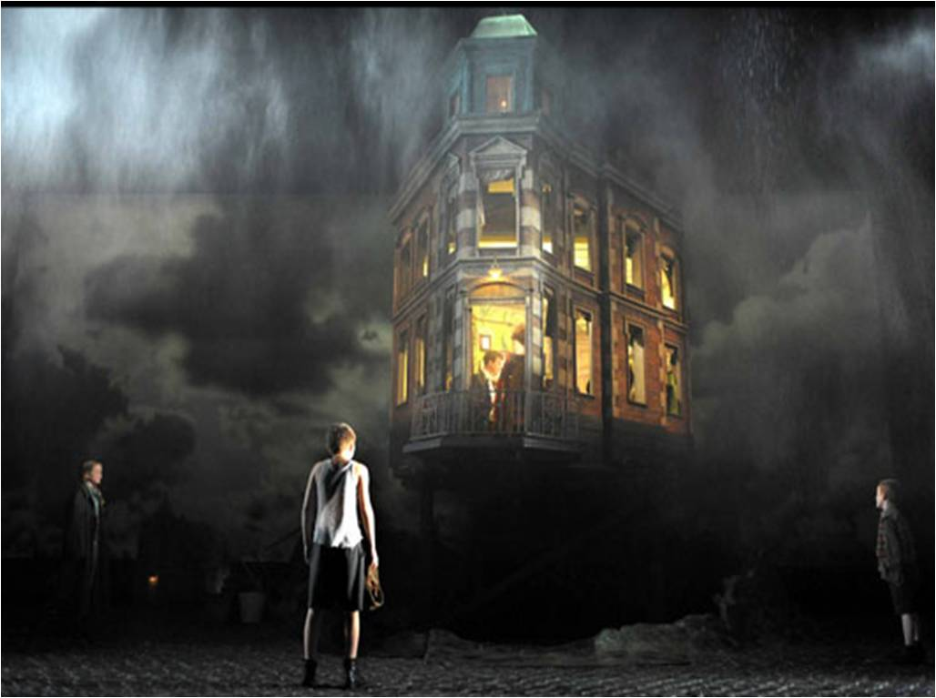
Learning Objective: to analyse how Priestley uses the set and setting of the play to present the characters, ideas and message.
Now consider the National Theatre production…

Slide 21
Learning Objective: to analyse how Priestley uses the set and setting of the play to present the characters, ideas and message.

Slide 22
Learning Objective How does Priestley present the Birlings in the opening of the play?

Slide 23
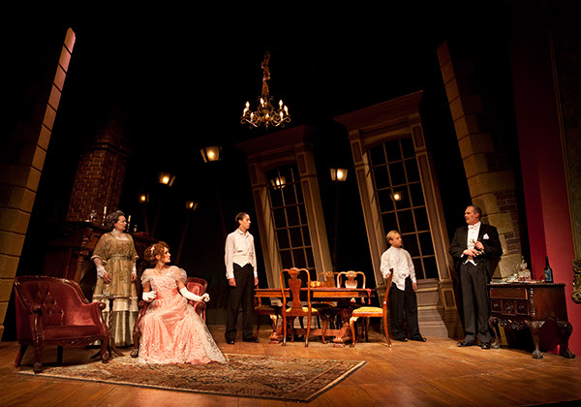
How does Priestley present the Birlings in the opening of the play?
Look again at your notes on the opening stage directions, particularly at your ideas about the Birlings.
How do you think Priestley wants the audience to feel about the Birlings at the opening of the play?

Slide 24
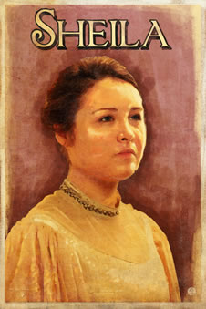
How does Priestley present the Birlings in the opening of the play?
Let’s take a closer look at Sheila.

Slide 25
How does Priestley present the Birlings in the opening of the play?
Sheila: (gaily, possessively) I should jolly well think not, Gerald, I'd hate you to know all about port – like one of these purple-faced old men.
Arthur Birling: here , I’m not a purple-faced old man.
Sheila: no, not yet. But then you don't know all about port – do you?
Birling: (noticing that his wife has not taken any) N ow then, Sybil, you must a take a little tonight. Special occasion, y'know, eh?
Sheila: Yes, go on, mummy. You must drink our health.

Slide 26
How does Priestley present the Birlings in the opening of the play?
Sheila: (with mocking aggressiveness) Go on, Gerald – just you object!
Gerald: (smiling) Wouldn't dream of it. In fact, I insist upon being one of the family now. I've been trying long enough, haven't I? (as she does not reply, with more insistence.) Haven't I? You know I have.
Mrs Birling: (smiling) Of course she does.
Sheila: (half serious, half playful) Yes – except for all last summer, when you never came near me, and I wondered what had happened to you.
Gerald: And I’ve told you – I was awfully busy at the works all that time.
Sheila: (same tone as before) Yes,that's what you say.
Mrs Birling: Now, Sheila, don't tease him. When you're married you'll realize that men with important work to do sometimes have to spend nearly all their time and energy on their business. You'll have to get used to that, just as I had.
Sheila: I don't believe I will. (half playful, half serious, to Gerald.) So you be careful.

Slide 27
How does Priestley present the Birlings in the opening of the play?
Sheila: (severely) Now – what's the joke?
Eric: I don't know – really. Suddenly I felt I just had to laugh.
Sheila: You're squiffy.
Eric: I’m not.
Mrs Birling: What an expression, Sheila! Really the things you girls pick up these days!
Eric: If you think that's the best she can do-
Sheila: Don't be an ass, Eric.

Slide 28
How does Priestley present the Birlings in the opening of the play?
Eric: (rather noisily) All the best! She's got a nasty temper sometimes – but she's not bad really. Good old Sheila!
Sheila: Chump! I can't drink to this, can I? When do I drink?
Gerald: You can drink to me.
Sheila: (quite and serious now) All right then. I drink to you, Gerald.
//for a moment they look at each other//
Gerald: (quietly) Thank you. And I drink to you – and hope I can make you as happy as you deserve to be.
Shelia: (trying to be light and easy) You be careful – or I’ll start weeping.

Slide 29
How does Priestley present the Birlings in the opening of the play?
Gerald: (smiling) Well, perhaps this will help to stop it. (he produces a ring case.)
Sheila: (excited) Oh – Gerald – you’ve got it – is it the one you wanted me to have?
Gerald: (giving the case to her) Yes – the very one.
Sheila: (taking out the ring) Oh – it's wonderful! Look – mummy – isn't it a beauty? Oh – darling -
(she kisses Gerald hastily.)
Eric: steady the buffs!
Sheila: (who has put the ring on, admiringly) I think it's perfect. Now I really feel engaged.
Mrs Birling: So you ought, darling. It's a lovely ring. Be careful with it.
Sheila: careful! I'll never let it go out of my sight for an instant.

Slide 30
How does Priestley present the Birlings in the opening of the play?
Mrs Birling: (smiling) Well, it came just at the right moment. That was clever of you, Gerald. Now, Arthur, if you've no more to say, I think Sheila and I had better go into the drawing room and leave you men-
Birling: (rather heavily) I just want to say this.(noticing that Sheila is still admiring her ring.) are you listening, Sheila? This concerns you too. And after all I don't often make speeches at you -
Sheila: I’m sorry, daddy. Actually I was listening.

Slide 31
How does Priestley present the Birlings in the opening of the play?
What are your first impressions of Sheila?
Create a spider diagram to record your ideas.
Include quotations from the text.
Consider what she says and what others say about her, e.g. Eric says “She’s got a nasty temper”. This might imply that she is rather spoilt.

Slide 32
How does Priestley present the Birlings in the opening of the play?
Let’s put Sheila in the hot seat.
Write down four questions that you would like to ask Sheila. Try to make them open and challenging.
N.B. Your questions and answers must be true to the text!

Slide 33
How does Priestley present the Birlings in the opening of the play?
How does Priestley present Sheila in the opening of the play? Preparation questions.
How does Priestley use language to show the audience that Sheila is wealthy, attractive and intelligent?
Write down three quotations that suggest Sheila’s life might be rather restricted.
Write a short paragraph summing up what Eric thinks of his sister. Include quotations from the text to support your interpretation.
Priestley writes the stage direction ‘For a moment they look at each other’. What do you think this detail means?
Write three bullet points to explain what the dramatic device of the ring tells us about the relationship between Gerald and Sheila.
What do you think Sheila’s reaction to the ring suggests about the kind of young woman she is?
Sheila describes the ring as ‘perfect’. What does the language Sheila uses tell us about her character at this point in the play?
Write a short paragraph about Sheila’s relationship with her father. Support your opinions with evidence from the text.

Slide 34
How does Priestley present the Birlings in the opening of the play?
How does Priestley present Sheila in the opening of the play?
Using your ideas and work so far, you are going to write up an answer to the above question.
I will mark this and give you an EBI target to help you with your main assessment question: How does Priestley present Mr Birling/ Mrs Birling/ Eric in the opening of the play?

Slide 35
How does Priestley present the Birlings in the opening of the play?
A basic answer shows that you are familiar with what the characters say and do, e.g.
Mr Birling thinks he is very important. He keeps telling the others that he is a ‘hard headed businessman’ and has ‘been on the bench’ and a ‘mayor’.
A good answer shows that you can use quotations to explain why they are interesting, e.g.
Mr Birling is shown to be someone who likes people to know that he is successful and has held some high-status positions. This is because he is ‘provincial’ and his wife is his ‘social superior’ so he needs to draw attention to his achievements.
The best answers show that you understand how characters have been created, referring to the writer’s ideas and purposes, e.g.
Priestley makes Birling an arrogant, self-made man who is anxious to get on with upper-class people like the Crofts and to raise his social status. Priestley does this by his use of stage directions to the actor and by writing speech that is full of self-praise. For example, when Birling talks to Gerald, Priestley writes, ‘(Confidentially) By the way, there’s something I’d like to mention – in the strictest confidence – while we’re by ourselves’. The playwright is showing us that Birling is very pleased that he can speak to a member of the aristocracy in such an equal way. He believes he has moved up in the world.

Slide 37
One of the ways Priestley... Another way... Sheila is also shown to be... The writer suggests... When Mr Birling is first described...
Q
}
W
E
This is shown when it says, “___”... An example of this is when Priestley writes, “___”... For example, “___”
R
This makes the reader think... This suggests to the reader... The reader will think... This implies... This suggests...
T
The use of the closed question... The writer’s word choice... The stage direction “___”... The repetition of... This word has strong connotations of...
Y
This suggests... This implies... This links to...

Slide 38
How does Priestley present Sheila in the opening of the play?
How does Priestley present the Birlings in the opening of the play?
Refer to:
The stage directions.
What Sheila says.
What is said about Sheila.
Sheila’s relationships with other characters.
Use and analyse quotations from the opening scene.
Remember:
Basic = what
Good = why
Best = how
Q
W
E
R
T
Y

Slide 39
How does Priestley present the Birlings in the opening of the play?
How does Priestley present Sheila in the opening of the play?
Swap your response with a partner and read each other’s work. Write your partner a WWW/EBI statement using the below criteria:
commented on relevant selected textual detail
made some personal interpretation of characters and relationships
xplored Priestley’s ideas and attitudes

Slide 40
How does Priestley present the Birlings in the opening of the play?
How does Priestley present Mr Birling/ Mrs Birling/ Eric in the opening of the play?
You are aiming to write at least three paragraphs in which you explain how Priestley introduces your character.
As you plan:
consider the techniques Priestley uses to create his characters
back up your ideas with evidence from the text, using relevant quotations

Slide 41
How does Priestley present Mr Birling/ Mrs Birling/ Eric in the opening of the play?
How does Priestley present the Birlings in the opening of the play?
Refer to:
The stage directions.
What your chosen character says.
What is said about your chosen character.
Your chosen character’s relationships with others.
Use and analyse quotations from the opening scene.
Remember:
Basic = what
Good = why
Best = how
Q
W
E
R
T
Y

Slide 43
One of the ways Priestley... Another way... Sheila is also shown to be... The writer suggests... When Mr Birling is first described...
Q
}
W
E
This is shown when it says, “___”... An example of this is when Priestley writes, “___”... For example, “___”
R
This makes the reader think... This suggests to the reader... The reader will think... This implies... This suggests...
T
The use of the closed question... The writer’s word choice... The stage direction “___”... The repetition of... This word has strong connotations of...
Y
This suggests... This implies... This links to...

Slide 44
How does Priestley present Mr Birling/ Mrs Birling/ Eric in the opening of the play?
How does Priestley present the Birlings in the opening of the play?
Refer to:
The stage directions.
What your chosen character says.
What is said about your chosen character.
Your chosen character’s relationships with others.
Use and analyse quotations from the opening scene.
Remember:
Basic = what
Good = why
Best = how
Q
W
E
R
T
Y

Slide 45
Learning Objective How does Priestley deliberately create an uneasy atmosphere before the Inspector arrives?

Slide 46
“One of the happiest nights of my life-”
Diamond 9
Priestley is deliberately creating an uneasy atmosphere.
Rank the statements, with those which create the greatest sense of unease at the top of the diamond and those causing the least at the bottom
Once you’ve put them in order, find a quotation to support each statement. Remember to keep your quotations short and concise!

Slide 47
How does Priestley deliberately create an uneasy atmosphere before the Inspector arrives?
Reread Act 1 -up to p10 when the doorbell rings
In groups of 5 (or 6 if someone is to be Edna!), reread the opening of the play.

Slide 48
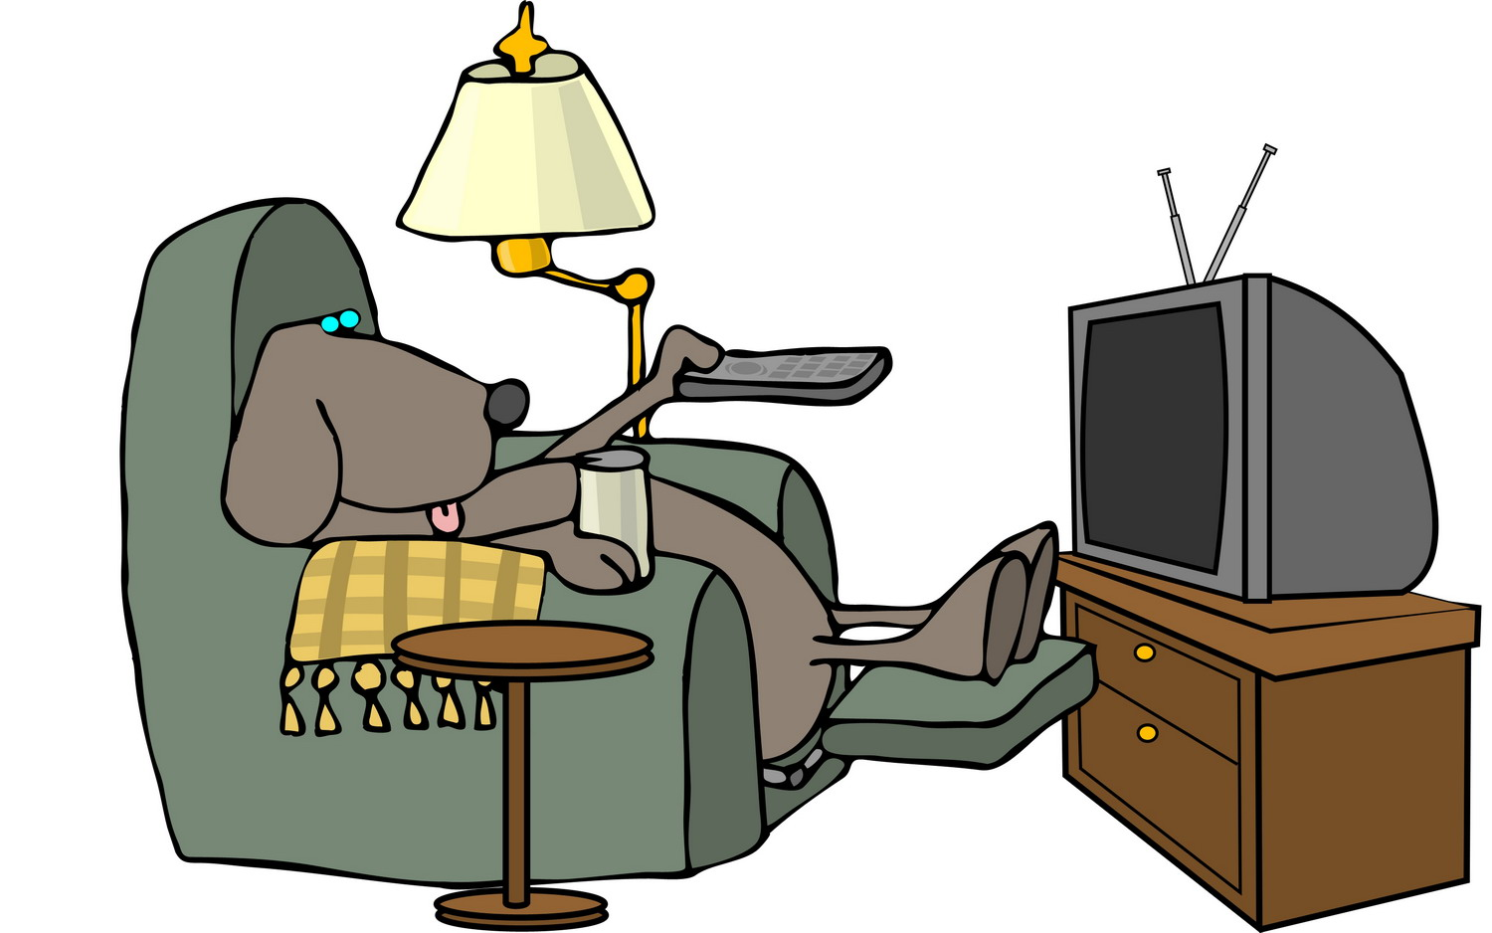
How does Priestley deliberately create an uneasy atmosphere before the Inspector arrives?
Look at the key quotations from Act 1 whilst you watch the video about the play’s context. Make a note of any significant events next to the relevant speech.

Slide 49
How does Priestley deliberately create an uneasy atmosphere before the Inspector arrives?
Why has Priestley used dramatic irony in this way?

Slide 50
Learning Objective The Inspector’s Entrance: how and why does Priestley create a sense of conflict?

Slide 51
The Inspector’s Entrance: how and why does Priestley create a sense of conflict?
JB Priestley creates a sense of conflict between the Inspector and the Birlings from the beginning of the play.
Ideas: why? Quotes: when? Analysis: how?
The Inspector’s sense of timing is important throughout the play. He arrives in the middle of Mr Birling’s speech. What is the last thing Mr Birling says before he arrives?
“a man has to mind his own business and look after himself and his own – and –”
Why is this significant? What effect does this have on the audience?

Slide 52
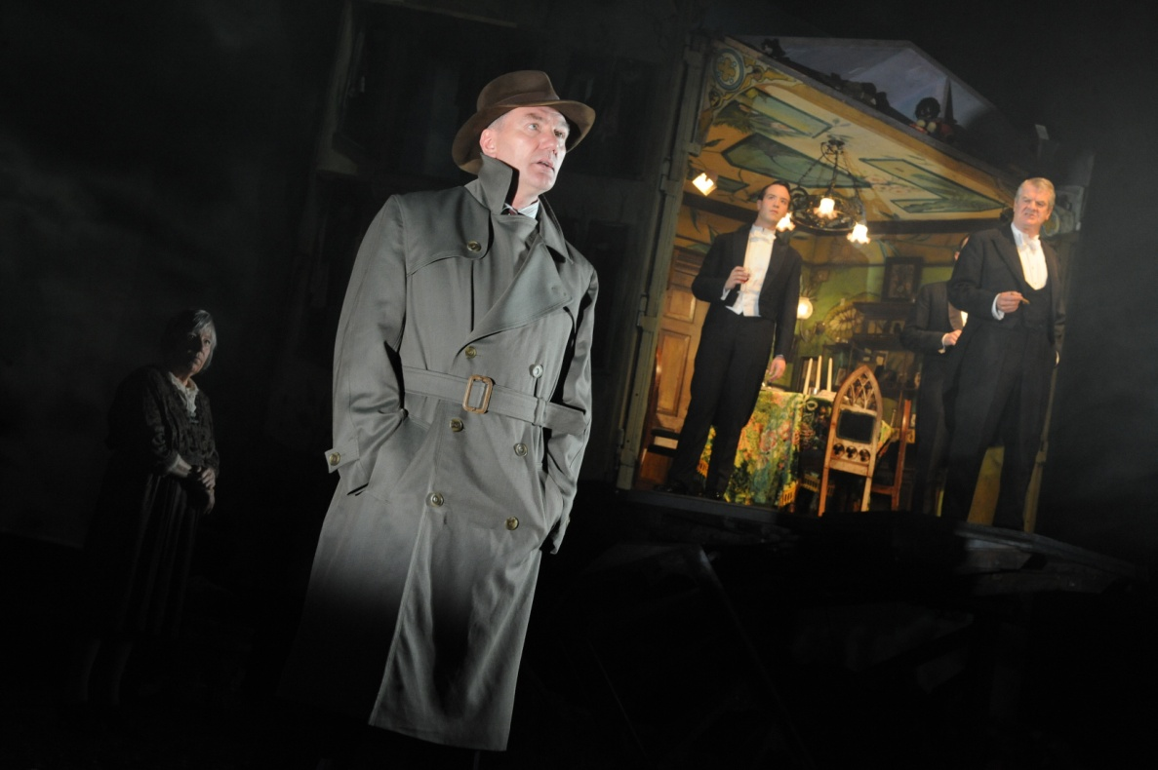
The Inspector’s Entrance: how and why does Priestley create a sense of conflict?
From the moment the Inspector arrives, he seems different. His sombre appearance and the news he brings are a contrast with the happy and elegant air of celebration.

Slide 53
The Inspector’s Entrance: how and why does Priestley create a sense of conflict?
Look at the stage directions surrounding his entrance. How does Priestley create a sense of difference?
Write down your ideas on your sheet. Think about:
class/status
power

Slide 54
The Inspector’s Entrance: how and why does Priestley create a sense of conflict?
‘sharp ring of a front door bell’
“Give us some more light”
‘an impression of massiveness, solidity and purposefulness’
‘a disconcerting habit of looking hard at the person he addresses before actually speaking’
How do these stage directions create a sense of difference/ conflict/ separation between the Inspector and the Birlings?
What is the Inspector there for?

Slide 55
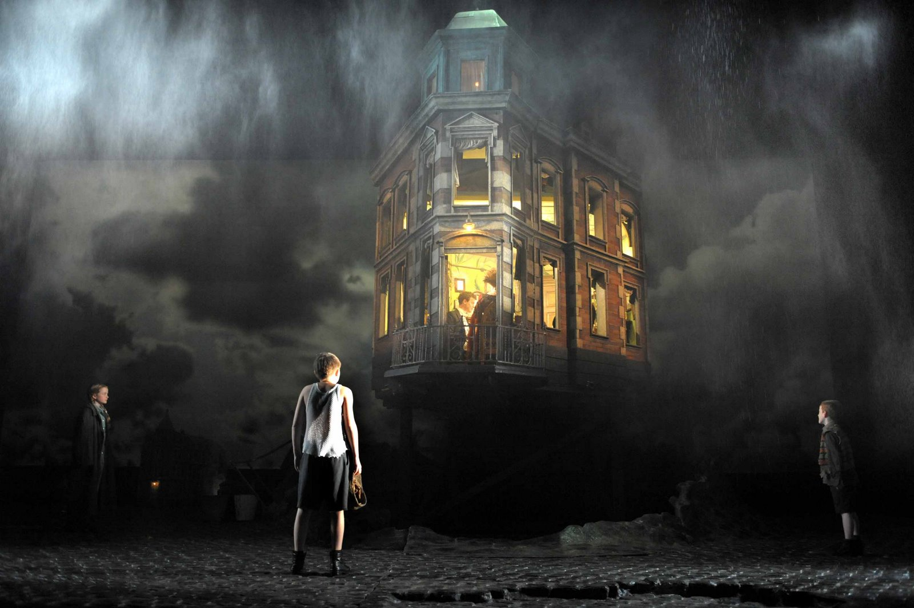
The Inspector’s Entrance: how and why does Priestley create a sense of conflict?
How was this contrast/arrival shown in the stage version of the play?
Make notes as you watch.

Slide 56
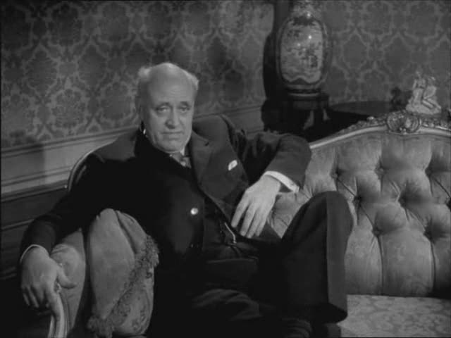
The Inspector’s Entrance: how and why does Priestley create a sense of conflict?
How was this contrast/arrival shown in the film version of the play?
Make notes as you watch.

Slide 57
The Inspector’s Entrance: how and why does Priestley create a sense of conflict?
How was this contrast/arrival shown in the BBC version of the play?
Make notes as you watch.

Slide 58
The Inspector’s Entrance: how and why does Priestley create a sense of conflict?
Birling: It may be something about a warrant.
Gerald [lightly]: Sure to be. Unless Eric’s been up to something. [Nodding confidentially to Birling] And that would be very awkward, wouldn’t it?
Birling [humorously]: Very.
Eric [who is uneasy, sharply]: Here, what do you mean?
Gerald [lightly]: Only something we were talking about when you were out. A joke, really.
Eric [still uneasy]: Well, I don’t think it’s very funny.
Birling [sharply, staring at him]: What’s the matter with you?
Eric [defiantly]: Nothing.
Edna [opening door and announcing]: Inspector Goole.
Priestley could easily have had the Inspector right behind Edna when she announced him, so he would have walked straight into the room as she left. Why do you think Priestley put in this piece of dialogue?

Slide 59
The Inspector’s Entrance: how and why does Priestley create a sense of conflict?
A How and why does Mr Birling try to intimidate the Inspector? How does the Inspector respond?
Consider social class- an Inspector would normally be expected to defer to a man of Birling’s social status.
List some of the ways in which Birling tries to assert his own importance and to belittle the Inspector.
B How does the Inspector speak to the Birlings?
Consider social class- an Inspector would normally be expected to defer to a man of Birling’s social status.
In what tone/manner does he speak to the family?
In what way does he present the details of Eva’s death? Why does this create a sense of conflict?
Write down some quotes, annotating them for ideas and picking out significant words and/or phrases to analyse. Have at least one quote to share with the people on your table.

Slide 60
The Inspector’s Entrance: how and why does Priestley create a sense of conflict?
Consider the questions you have discussed and the quotes chosen by your group. Now use these to answer the following questions:
1. Why do you think it’s important to create a sense of conflict/tension from the Inspector’s first appearance?
2. What is the effect of this on the audience?
3. What is the purpose of the conflict? i.e. what message is Priestley setting out to convey in the conflict between the two men? [Hint: consider the society the play is set in, the society it was first shown in, and the way the inspector fits in with the ideas of the time. What is he there to do? How is this shown?]

Slide 61
The Inspector’s Entrance: how and why does Priestley create a sense of conflict?
You have been given the job of directing a new version of An Inspector Calls. Your producer wants you to bring out a sense of conflict between the Birlings and the Inspector from the start of the play.
How would you stage the Inspector’s entrance?
Consider:
When/how he arrives
What he wears, how he moves, how he speaks etc.
Setting, lighting, sound etc.
How the other characters respond to him
The original stage directions (these should be included)

Slide 62
Learning Objective The Inspector’s Methods – Sheila’s interview

Slide 63
The Inspector’s Methods – Sheila’s interview
“somehow he makes you”
- Sheila
Despite the importance in the local community of people like Gerald and the Birlings, the Inspector controls the development of events: who will speak and when; who may or may not leave; who will or will not see the photograph. He even seems to control what people say. He uses this control to create a sense of conflict or distance between himself and those he interviews.
Recap: why is this conflict or distance important in allowing Priestley to express his ideas and attitudes about class and society?

Slide 64
The Inspector’s Methods – Sheila’s interview
Looking at the Inspector’s interview with Sheila, analyse his use of language:
The Inspector’s Methods:
1. What questions does he ask? (open/closed, tone etc.)
2. What is the effect of these questions?
3. What type of language does he use?
4. How does he respond to what is said by Sheila?
Harsh/kind?
Rude?
Disregards social conventions?
Does he focus on what is moral or what is legal?
5. Does the way he responds change at all? Why?
The Birlings:
1. How does Sheila respond to the Inspector?
2. What emotions does she display (e.g. anger, guilt, remorse...)
3. How does this add to/resolve the conflict?
4. How does this affect the Inspector’s methods?
Staging:
1. How do stage directions and props add to the sense of conflict?
Think about:
the Inspector’s use of the photograph
doors slamming
entrances and exits
other stage directions in the text
Make sure you note down ideas and quotes as well as your analysis.

Slide 65
The Inspector’s Methods – Sheila’s interview
Ideas: Summarise your findings about the way the Inspector interviews Sheila.
Quotes: Pick out five key quotes to back up and illustrate your ideas.
Analyse: What is the effect of these on the audience? How do they make us respond to the Inspector and to Sheila?
Purpose: Why has Priestley done this? How does this interview represent his attitudes and ideas about society?

Slide 66
Q
W
E
R
T
Y
QUESTION - link your answer to the focus of the task
WRITER - remember that the characters only do what the writer makes them do!
EVIDENCE - Use quotations from the text
READER - what effect do the events/ issues have on the reader?
TECHNIQUES - language/ structure
YOUR RESPONSE - explore your own ideas/ your reaction to the text

Slide 67
Q
W
E
R
T
Y
Have a go at writing a QWERTY paragraph, using your notes so far.
How does Priestley use the character of the Inspector to present his ideas about society?
Answer using some key quotes from Sheila’s interview. You could include:
The way he creates conflict/ distance
His focus on what is moral over what is legal
His regard (or disregard!) for social conventions

Slide 68
One of the ways Priestley... Another way... Sheila is also shown to be... The writer suggests... When the Inspector is first described...
Q
}
W
E
This is shown when it says, “___”... An example of this is when Priestley writes, “___”... For example, “___”
R
This makes the reader think... This suggests to the reader... The reader will think... This implies... This suggests...
T
The use of the closed question... The writer’s word choice... The stage direction “___”... The repetition of... This word has strong connotations of...
Y
This suggests... This implies... This links to...

Slide 69
Learning Objective The Inspector’s Methods – Mrs Birling’s interview

Slide 70
The Inspector’s Methods – Mrs Birling’s interview
Looking at the Inspector’s interview with Mrs Birling, analyse his use of language:
The Inspector’s Methods:
1. What questions does he ask? (open/closed, tone etc.)
2. What is the effect of these questions?
3. What type of language does he use?
4. How does he respond to what is said by Mrs Birling?
Harsh/kind?
Rude?
Disregards social conventions?
Does he focus on what is moral or what is legal?
5. Does the way he responds change at all? Why?
The Birlings:
1. How does Mrs Birling respond to the Inspector?
2. What emotions does she display (e.g. anger, guilt, remorse...)
3. How does this add to/resolve the conflict?
4. How does this affect the Inspector’s methods?
Staging:
1. How do stage directions and props add to the sense of conflict?
Think about:
the Inspector’s use of the photograph
doors slamming
entrances and exits
other stage directions in the text
Make sure you note down ideas and quotes as well as your analysis.

Slide 71
The Inspector’s Methods – Mrs Birling’s interview
Ideas: Summarise your findings about the way the Inspector interviews Mrs Birling.
Quotes: Pick out five key quotes to back up and illustrate your ideas.
Analyse: What is the effect of these on the audience? How do they make us respond to the Inspector and to Mrs Birling?
Purpose: Why has Priestley done this? How does this interview represent his attitudes and ideas about society?

Slide 72
Learning Objective How do the different generations respond differently?

Slide 73
What is one difference between the way the Inspector interviews Sheila and the way he interviews Mrs Birling?

Slide 74
Why has the Inspector treated Sheila and Mrs Birling differently?

Slide 75
How has Sheila’s response to the Inspector made her different to her mother?

Slide 76
Why is this important when considering Priestley’s attitudes and ideas? What is he saying?
[Hint: think about age and society.]
“You began to learn something. And now you’ve stopped. You’re ready to go on in the same old way.”
Look at the reactions of the Birlings when they find out that Goole isn’t a real Inspector. How does this add to your ideas?

Slide 77
How do the different generations respond differently?
Why is it important for the play that Sheila and Mrs Birling respond differently to the Inspector’s questioning? Think about:
The effect on audience
The way it creates tension/drama
JB Priestley’s own views: what was he trying to say?

Slide 78
How do the different generations respond differently?

Slide 80
How do the different generations respond differently?
Find a quotation to back up each of these points.

Slide 81
How do the different generations respond differently?
Read the extract you have been given and answer the following questions in your book:
Find two quotations that suggest Mr Birling has not been changed by the events of the last hour.
‘Going to bed, young woman?’ What are Birling’s reasons for calling Sheila this? What does it suggest about their relationship?
‘And I must say, Gerald, you’ve argued this very cleverly and I’m most grateful.’ What does this quotation reveal about Mrs Birling’s attitude to change?
Why do you think Mrs Birling finds it so hard to accept what she did was wrong?
Look at the Birlings’ last words to their children. What do these tell us about what they have learned from the Inspector’s visit?
Gerald only says one line in this extract. What does it suggest about the effect the Inspector’s visit has had on him?
Sheila says she wants to ‘get out of this’. What does this line reveal about the thoughts that are going through her mind?
Sheila uses the words ‘fire and blood and anguish’. Why do you think Priestley has given her these words?

Slide 82
Using your answers, decide on a rank order of the characters under the following headings:
The character most willing to accept responsibility
The character most willing to accept joint responsibility
The character most ready to blame others
The character most affected by the death of Eva Smith/Daisy Renton
The character most interested in preserving his/her own public position
The character most interested in proving that the Inspector wasn’t real and that there was more than one girl
The character whose response is most sympathetic whilst still being logical and considered
Who do you think has truly understood the Inspector’s message and purpose?

Slide 83
How do the different generations respond differently?
... so what about Gerald?
Using the topic you have been given, identify moments where Gerald allies himself with the old Birlings and moments where he allies himself with the young Birlings.
Sympathy and guilt
Eva as an employee
Business and profits
Eva at Milwards
Eva as a mistress
Eva’s plea for charity
Eva as a victim
Eva as a young woman
Cover up?
Sense of responsibility
The Inspector
You should collect examples and quotes for each character, illustrating the different views and reactions of the old and young Birlings, and also the views of Gerald.

Slide 84
How do the different generations respond differently?
Which generation shows the greatest sense of responsibility in ‘An Inspector Calls’?
To help you prepare for this essay, answer these questions in your book:
‘Just remember your own position, young man.’ Write a short paragraph explaining why Birling is so keen to shift the responsibility onto Eric. What does this suggest about his own sense of responsibility?
What evidence can you find to suggest Birling’s own attitudes have remained unchanged since the start of the play?
What do you think Mrs Birling means by, ‘behaving badly’?
How does Eric’s attitude change when the Inspector’s authenticity is called into question?
Sheila says, ‘And it’s what they don’t seem to understand.’ Why is her use of the word ‘they’ significant?
Sheila says, ‘And it’s the best thing any one of us has said tonight.’ What does she mean by this?
What evidence can you find in the extract to suggest that Eric’s ideas and perspectives have been changed by what happened?
Find two quotations to suggest what has happened to Mrs Birling’s attitudes in the course of the play.

Slide 85
How do the different generations respond differently?
Which generation shows the greatest sense of responsibility in ‘An Inspector Calls’?
Refer to:
What the characters say and do, including their response to the Inspector’s identity in Act 3.
How the Inspector treats each generation.
The role of Gerald.
Use and analyse quotations.
Remember:
Basic = what
Good = why
Best = how
Q
W
E
R
T
Y

Slide 87
One of the ways Priestley... Another way... Sheila is also shown to be... The writer suggests... When Mr Birling is first described...
Q
}
W
E
This is shown when it says, “___”... An example of this is when Priestley writes, “___”... For example, “___”
R
This makes the reader think... This suggests to the reader... The reader will think... This implies... This suggests...
T
The use of the closed question... The writer’s word choice... The stage direction “___”... The repetition of... This word has strong connotations of...
Y
This suggests... This implies... This links to...

Slide 88
How do the different generations respond differently?
Which generation shows the greatest sense of responsibility in ‘An Inspector Calls’?
Refer to:
What the characters say and do, including their response to the Inspector’s identity in Act 3.
How the Inspector treats each generation.
The role of Gerald.
Use and analyse quotations.
Remember:
Basic = what
Good = why
Best = how
Q
W
E
R
T
Y

Slide 89
How do the different generations respond differently?
Which generation shows the greatest sense of responsibility in ‘An Inspector Calls’?
Swap your response with a partner and read each other’s work. Write your partner a WWW/EBI statement using the below criteria:
commented on relevant selected textual detail
made some personal interpretation of characters and attitudes
explored Priestley’s ideas and attitudes

Slide 90
Learning Objective The Inspector’s Methods – a summary

Slide 91
[SUMMARY TASK] THE INSPECTOR AS A MORAL FIGURE
The way that the Inspector uses the information he has creates an impression of someone who is both an outsider and an all-knowing creature. This makes him appear mysterious and powerful. Yet Priestley can only use him as a catalyst, as someone who creates the possibility for others to face up to what they have done. They must decide for themselves whether to change or not. He is a character who represents Priestley’s strong moral view. His comments show a compassion which extends to those who recognise the wrong they have done. He does not forgive what they have done, but when they freely admit their faults he allows them to see that they can find forgiveness through future good behaviour. This moral dimension makes him different from an ordinary policeman. He is more concerned with right and wrong than with what is or is not legal. His lack of fear or favour, his determined question and control of events may be what is expected of a policeman, but towards the end of the play it is those same qualities (which Mrs Birling identifies as ‘rudeness’) which fuel suspicions about him. He is perhaps too abrasive, and he is clearly someone for whom social conventions count for nothing when weighed against the desire for truth and justice.
Try to find some places in the play where the Inspector focuses more on what is right than what is legal.
What sort of language does he use? When is he harsh or kind to the person he is interviewing?
Does he say anything which could be classed as rude?
When does he show a disregard for social conventions (consider status/class) or a lack of fear?

Slide 92
[SUMMARY TASK] THE INSPECTOR’S LANGUAGE
We are told that the Inspector speaks ‘carefully, weightily’ (Act 1, p.10). Find some examples of the Inspector speaking this way.
The Inspector uses a lot of questions and instructions. What effect do you think this has on his position of power/control? Find some examples of the Inspector speaking this way.
The Inspector frequently interrupts characters who are not going in the direction he wishes them to go in. How does this help the Inspector stay in control and shape the interviews? Find some examples of the Inspector speaking this way.
There are times when the Inspector produces dramatic results by the use of a short and isolated sentence – or even a single word. Find some examples of the Inspector speaking this way.
What is the effect of this way of speaking? How does it help to show the Inspector’s role in the play?

Slide 93
Learning Objective The Inspector’s Speech: how does this communicate ideas and attitudes to the audience?

Slide 94
The Inspector’s Speech
“But just remember this. One Eva Smith has gone – but there are millions and millions and millions of Eva Smiths and John Smiths still left with us, with their lives, their hopes and fears, their suffering and chance of happiness, all intertwined with our lives, with what we think and say and do. We don’t live alone. We are members of one body. We are all responsible for each other. And I tell you that the time will come when, if men will not learn that lesson, then they will be taught it in fire and blood and anguish. Good night.”
Try different ways of reading it aloud and annotate the speech to show what you would do to make this last speech powerful and memorable. Think about:
- speed
- volume
- pauses
- tone of voice and where they might change
- gestures, expression, stance, gaze etc.

Slide 95
The Inspector’s Speech
“But just remember this. One Eva Smith has gone – but there are millions and millions and millions of Eva Smiths and John Smiths still left with us, with their lives, their hopes and fears, their suffering and chance of happiness, all intertwined with our lives, with what we think and say and do. We don’t live alone. We are members of one body. We are all responsible for each other. And I tell you that the time will come when, if men will not learn that lesson, then they will be taught it in fire and blood and anguish. Good night.”
How many persuasive techniques can you find in this speech?
- lists of three
- use of contrasting pairs (e.g. one small step for man, one giant leap for mankind)
- talking about ‘we’ or ‘us’ (often positively)
- using powerful or memorable words and phrases
- talking about ‘them’ (often negatively)
- the use of ‘I’
- the rhythm of language used (e.g. length of sentences, pauses)

Slide 96
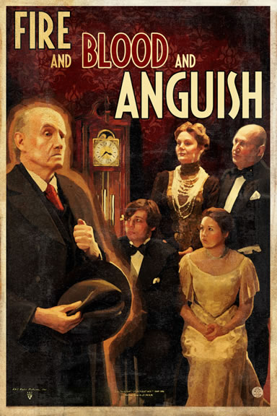
What might ‘fire and blood and anguish’ refer to?
Why has Priestley included this phrase?
What does it suggest about the Inspector’s role in the play?

Slide 97
Mr Birling’s Speech
How does the Inspector’s speech compare to Mr Birling’s speech earlier on in the play (the one the Inspector interrupts as he arrives)?
How does the Inspector’s speech create a conflict between Mr Birling’s belief system and that of the Inspector/JB Priestley?
What effect does the conflict between these two belief systems have on the audience?

Slide 98
What does Priestley want the audience to leave the theatre thinking/feeling?

Slide 99
Q
W
E
R
T
Y
Have a go at writing a QWERTY paragraph, using your notes so far.
How does Priestley use the Inspector’s final speech to present his ideas about society?
Answer using some key quotes from the Inspector’s speech. You could include:
His use of persuasive language
His shocking imagery
The intended response of the audience

Slide 100
One of the ways Priestley... Another way... Sheila is also shown to be... The writer suggests... When the Inspector is first described...
Q
}
W
E
This is shown when it says, “___”... An example of this is when Priestley writes, “___”... For example, “___”
R
This makes the reader think... This suggests to the reader... The reader will think... This implies... This suggests...
T
The use of the closed question... The writer’s word choice... The stage direction “___”... The repetition of... This word has strong connotations of...
Y
This suggests... This implies... This links to...

Slide 101
Learning Objective The Inspector – who is he?

Slide 102
So...
who is the Inspector?

Slide 103
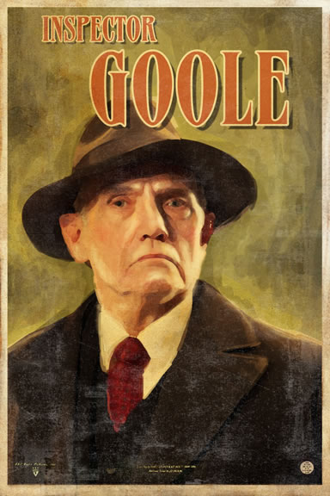
Who is the Inspector?
“...he’s giving us the rope – so that we’ll hang ourselves.”
We don’t know where the Inspector came from, and by the end of the play we’re not even sure if he’s real. We are told that he “need not be a big man but he creates at once an impression of massiveness, solidity and purposefulness”. The stage directions tell us he speaks “carefully, weightily, and has a disconcerting habit of looking hard at the person he addresses before actually speaking.”
Based on his questioning techniques and his treatment of the family, Sheila is the first to realise that there is more to the Inspector than meets the eye. At the beginning of Act 2 she says, “I don’t understand about you”. Who is he?
More importantly than who he is, or whether or not he’s a real inspector, what is his purpose in the play?

Slide 104
Questions to consider:
What is the role of the Inspector?
Who is he?
What does he represent?
What is his importance in the play?
How does Priestley use him?
Starting point: the Inspector’s name.
What does the title of ‘Inspector’ suggest that his role within the play will be?
‘Goole’ is a seaport town at the mouth of the River Humber, in East Yorkshire. Why might this be relevant to the Inspector? What does it suggest about his possible role? (Hint: think of the verbs ‘fish’ and ‘trawl’)
The Inspector’s name sounds like ‘ghoul’. Why might this be relevant? What does it suggest about the reasons behind the Inspector’s presence at the Birling household?

Slide 105
The mystery of the Inspector’s identity is one that the play never answers. One answer, of course, is that he is a dramatic device; without him the play could not happen. But given that the other characters are all believable and realistic, audiences often want to ask about the reality of the Inspector too.
It is Gerald who discovers that the Inspector is not who he claims to be. He helps the Birlings unpick the Inspector’s story of the girl until there seems to be nothing left of it. Sheila and Eric hang on to the conviction that it was ‘anything but a joke’ while accepting that there may have been more than one girl and that no girl may have committed suicide.
Some possibilities:
He’s a mouthpiece for Priestley’s ideas – or even Priestley himself
He’s God
He’s the voice of conscience, there to teach the audience of 1947 not to repeat the mistakes of the past (1912)
He’s the child Eva Smith was pregnant with
He’s a dream
He’s a time traveller
He’s a real police inspector

Slide 106
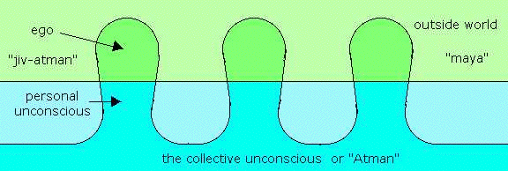
Some of the Inspector’s parting words are ‘We do not live alone. We are all members of one body’. Priestley himself was particularly interested in the ideas of the famous psychologist Jung, who believed that in our dreams we lose our identity and enter the world of the ‘collective unconscious’ where we all share ancient, universal experiences and the things we dream of have a common significance.
A particular passage in Jung struck Priestley because of a dream he himself had had. Jung stated that ‘dreams may give expression to… telepathic visions’. Priestley had dreamt of being shot in the person of a much younger man – “a student or something of that kind” – by uniformed officers. Describing this experience he said, “I will swear that… the blind weakness that washed over me there was somebody’s last moments and that my consciousness had relived them”.
It’s not a great step from such ideas to the notion of time and space travelling telepathically, but the more important idea is that telepathy is possible because, in our collective subconscious, we are “all members of one body”. The idea of an individual’s identity becomes more shadowy and less definite.

Slide 107
It is clear on a number of occasions that the Inspector knows what is going to happen.
Look again at these moments in the play and note down what they reveal about the Inspector:
at the end of Act 2 he says he is “waiting”, just before Eric enters.
from the beginning of Act 3 to his exit, it is quite clear that the Inspector is working under terrific time pressure, often looking at his watch or stating that he “hasn’t much time”. Is this because he knows that news of a girl’s suicide is about the reach the household? Or something else?
But he claims there are limits to his knowledge:
when he has shown Sheila the photograph he professes not to know why she is upsetting herself over it. “That’s something I have to find out”, he says.
has he ever actually lied to them about what he knows and how he knows it? Or about the identity of the girl?

Slide 108
Who do you think the Inspector is?

Slide 109
Learning Objective To create character profiles

Slide 110
Creating a character profile:
1. Use these notes to help you create a character profile sheet.
3. Find six key quotes and annotate them to show how they reveal your character’s development throughout the play. Don’t forget to include stage directions and actions as well as dialogue.
4. Using everything you have brought together, plan an answer to the exam-style question about your character.
2. Annotate your given quote with two ideas re: what it shows about your character.

Slide 111
1. Know the key episodes in which the character is involved; select episodes that typify the character and show different sides of him/her.
2. Study what the character says and does, and what others say about him/her. Particularly think about how the character responds to, and is treated by, the Inspector.
3. Think about the character’s relationship with others, including the Inspector.
4. Think about what Priestley makes the reader feel about the character – how does he do that? (Consider: what the character does/says; the language (s)he uses; the language used to describe him/her; stage directions and actions)
5. Think about the character’s purpose in the novel (e.g. Sheila represents the younger generation who are willing to change their ways).

Slide 112
In your revision, consider the differences between:
Sheila and Mrs Birling
Sheila and Mr Birling
Eric and Mr Birling
Gerald and Eric
Gerald and Sheila
how they respond to the Inspector
how they respond to what happened to Eva
how they respond to each other
their reaction to the end of the play
what they have learned
the way they act and speak
the way other characters act towards and speak to them

Slide 113
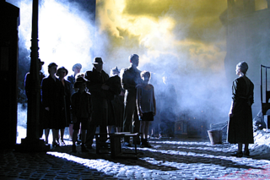
What about Edna?
Edna is the housekeeper
She lets the Inspector in and “give[s] us some more light” – in a way, she is responsible for ‘letting him in’ to their lives
She is ordered around on stage, and never given any gratitude by her employers
She is off-stage more than on-stage – we know very little about her
She is a character whom it is easy to ignore
She is potentially another vulnerable character and does have some links to Eva Smith (their names start with the same letter; they both have little (or no) voice of their own; they are both working class and at the mercy of the Birlings)
She represents the working class in the same way as Eva Smith does (“there are millions and millions of Eva Smiths...”)
Think about the National Theatre Production – Edna was on stage for a lot of the play. Why did Steven Daldry give her such significance?

Slide 114
Edna the maid has so few lines in Priestley’s script, why does she have
such a significant role in your production?
“My thinking about Edna is that she is past, present and future. If anybody is
aware of everything, and if anybody has a spiritual dimension, it would be Edna
rather than the Inspector. She has somehow always been in this landscape.
“Edna, for me, is a bridge between the two time zones that we’re using on stage.
She’s usually played as a young maid and I felt it was more powerful to have a
much older woman, someone who has been with the family a long time so you
got a sense of the past, of her seeing from 1912 the potential of the future.”
Exam-style question:
What is the significance of Edna in An Inspector Calls?
theme – class, responsibility
links to Eva Smith
role in letting the Inspector ‘in’
stage directions, actions and dialogue (inc. reference to NT production)

Slide 115
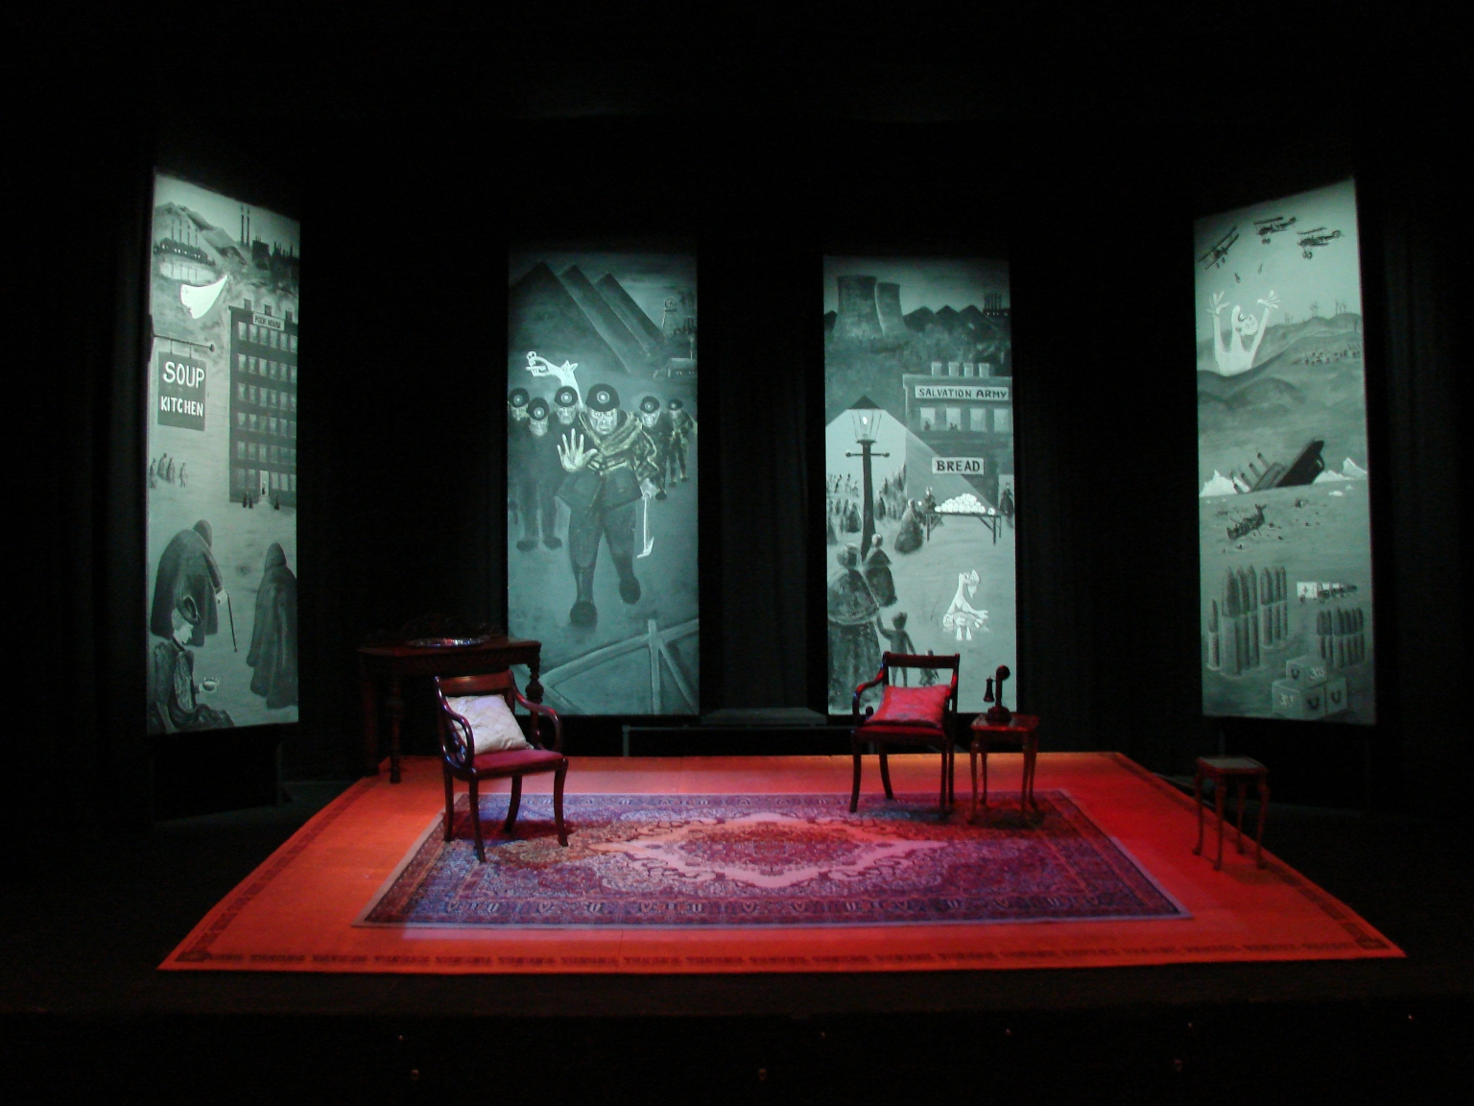

Slide 116
Jan 2011

Slide 117
June 2011

Slide 118
Jan 2012

Slide 119
June 2012

Slide 120
Jan 2013

Slide 121
Character
“How does Priestley present...”
“Write about the differences between [Character A] and [Character B]...”
“How do you respond to...”
“What do you think is the importance of...”
“How does Priestley show, in his presentation of [Character] that...”
2. Theme
“How does Priestley present ideas about...”
“Write about how Priestley presents...”
“How important is...”
“How does [x] reflect some of Priestley’s ideas...”
Technique [included in questions on character and theme]
“How does Priestley present and develop some of the ideas shown in...”
“Write about the methods Priestley uses to present...”
“How does Priestley make you respond as you do by the way he writes?”
“How does Priestley...”

