Slide 1
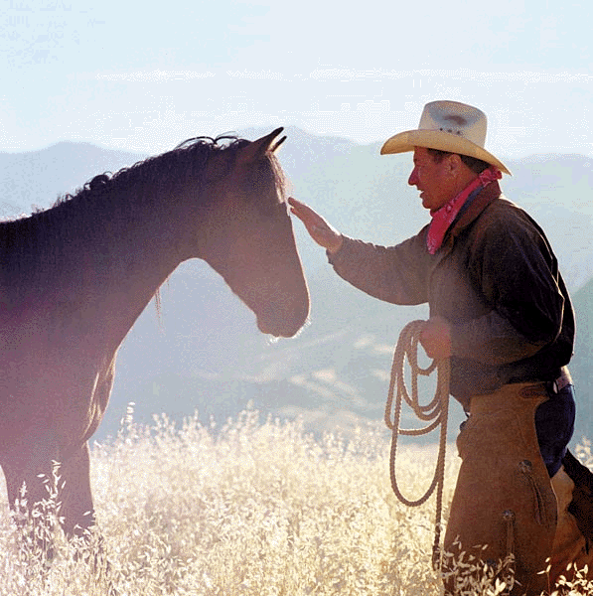
Horse Whisperer
By Andrew Forster

Slide 2
What is a horse whisperer?
When do you think they were most needed?
Notes:
C18-c20 → respect turned to suspicion; methods seem as witchcraft/evil; hounded and rejected by communities

Slide 3
They shouted for me when their horses snorted, when restless hooves traced circles in the earth and shimmering muscles refused the plough. My secret was a spongy tissue, pulled bloody from the mouth of a just-born foal, scented with rosemary, cinnamon, a charm to draw the tender giants to my hands.
They shouted for me when their horses reared at the burning straw and eyes revolved in stately heads. I would pull a frog’s wishbone, tainted by meat, from a pouch, a new fear to fight the fear of fire, so I could lead the horses, like helpless children, to safety.
I swore I would protect this legacy of whispers but the tractor came over the fields like a warning. I was the life-blood no longer. From pulpits I was scorned as demon and witch. Pitchforks drove me from villages and farms.
My gifts were the tools of revenge. A foul hex above a stable door so a trusted stallion could be ridden no more. Then I joined the stampede, with others of my kind, to countries far from our trade.
Still I miss them. Shire, Clydesdale, Suffolk. The searing breath, glistening veins, steady tread and the pride, most of all the pride.
What is the poem about?
Notes:
Pupils to read poem as prose – what is it about? Comprehension/basic understanding.

Slide 4
What do you notice about the way the poet has set out the poem?
There are five stanzas
Stanza 1 has 9 lines
Stanza 2 has 8 lines
Stanza 3 has 7 lines
Stanza 4 has 6 lines
Stanza 5 has 4 lines
Notes:
First response and ideas re: form. This will be revisited later.

Slide 5
They shouted for me
when their horses snorted, when restless
hooves traced circles in the earth
and shimmering muscles refused the plough.
My secret was a spongy tissue, pulled bloody
from the mouth of a just-born foal,
scented with rosemary, cinnamon,
a charm to draw the tender giants
to my hands.
They shouted for me
when their horses reared at the burning straw
and eyes revolved in stately heads.
I would pull a frog’s wishbone,
tainted by meat, from a pouch,
a new fear to fight the fear of fire,
so I could lead the horses,
like helpless children, to safety.
I swore I would protect
this legacy of whispers
but the tractor came over the fields
like a warning. I was the life-blood
no longer. From pulpits
I was scorned as demon and witch.
Pitchforks drove me from villages and farms.
My gifts were the tools of revenge.
A foul hex above a stable door
so a trusted stallion could be ridden
no more. Then I joined the stampede,
with others of my kind,
to countries far from our trade.
Still I miss them. Shire, Clydesdale, Suffolk.
The searing breath, glistening veins,
steady tread and the pride,
most of all the pride.
On your copy of the poem identify and label where the poet has used:
capitalisation
end-stopped lines
enjambment
mid-line full stops and commas (caesura)
Notes:
Develop

Slide 6
After stumbling across a book on ‘strange phenomena’ while visiting a friend, Forster became fascinated by the techniques employed by whisperers and by the changing public perception of their skills.
In the poem, Forster exploits his narrative skills to create the evocatively scented world of the horse whisperer whose skills fall foul of accusations of witchcraft and demonism. The visual qualities of his writing are revealed in his descriptions of the horse’s ‘shimmering muscles’ and ‘glistening veins’. The earliest drafts of the poem included a lot of ‘technical’ language, obscuring the meaning of the poem. This language was replaced with descriptions in subsequent drafts to enable the meaning to become clearer.
The voice in the poem is an individual voice but represents the experience of all horse whisperers.
The poem is written in free verse reflecting the different aspects of the narrative, with different tones for different periods. The elegiac tone of the last stanzas was a result of the same drafting process that saw the technical language replaced with something more accessible.
The content of the poem is structured around a story: the first two stanzas describe the time when the horse whisperer was valued for his work with horses; the third (central stanza) provides a pivotal moment when people turn against him; the final two stanzas show his revenge, escape and longing for the horses he's left behind.

Slide 7
Repetition of this phrase suggests urgency
‘shouted’ contrasts with the quiet assured actions of the whisperer himself
They shouted for me
when their horses snorted, when restless
hooves traced circles in the earth
and shimmering muscles refused the plough.
My secret was a spongy tissue, pulled bloody
from the mouth of a just-born foal,
scented with rosemary, cinnamon,
a charm to draw the tender giants
to my hands.
Oxymoron: stresses the ‘magical’ effect he has on them
Magical connotations: this becomes a ‘foul hex’ in stanza 4
They shouted for me
when their horses reared at the burning straw
and eyes revolved in stately heads.
I would pull a frog’s wishbone,
tainted by meat, from a pouch,
a new fear to fight the fear of fire,
so I could lead the horses,
like helpless children, to safety.
Alliteration: sense of urgency; adds to the impact/ mystery of the bone
Simile: the incredible effect of the wishbone

Slide 8
Links between stanza 1 and stanza 2
They shouted for me
when their horses snorted, when restless
hooves traced circles in the earth
and shimmering muscles refused the plough.
My secret was a spongy tissue, pulled bloody
from the mouth of a just-born foal,
scented with rosemary, cinnamon,
a charm to draw the tender giants
to my hands.
They shouted for me
when their horses reared at the burning straw
and eyes revolved in stately heads.
I would pull a frog’s wishbone,
tainted by meat, from a pouch,
a new fear to fight the fear of fire,
so I could lead the horses,
like helpless children, to safety.
Suggests he is summoned in emergencies
Describes horses’ actions
Describes one of the whisperer’s methods for calming horses and links to the senses
Describes the effect on the horses

Slide 9
Why do stanzas 1 and 2 follow the same pattern?
Pick out the statement you agree with:
The first two stanzas begin in the same way so we recognise the words.
The first two stanzas begin in the same way and show that, at one time, the whisperer was relied on.
The first two stanzas begin in the same way because the stanzas describe events that happened many times.
The first two stanzas begin in the same way because the repetition makes the whisperer sound angry.

Slide 10
Reducing his fortunes, like the lines of the poem are reducing
What does this suggest about the way the narrator sees his skills/role?
I swore I would protect
this legacy of whispers
but the tractor came over the fields
like a warning. I was the life-blood
no longer. From pulpits
I was scorned as demon and witch.
Pitchforks drove me from villages and farms.
My gifts were the tools of revenge.
A foul hex above a stable door
so a trusted stallion could be ridden
no more. Then I joined the stampede,
with others of my kind,
to countries far from our trade.
Simile: he knows his time is up
Enjambment: emphasises ‘no longer’/ ‘no more’ – his days are numbered
Compare with ‘charm’ from stanza 1
Use of this word (rather than ‘rush’ or ‘charge’ etc emphasises the narrator’s link to the horses/his bond with them; he has more in common with them than the humans who have rejected him
Metaphor: ‘tools’ links with coming machines; he has his own

Slide 11
“Pitchforks drove me from villages and farms.”
1. How is this image different to the final image of stanzas 1 and 2?
2. What does this contrast emphasise?
“a charm” / “a foul hex”
How does the word ‘hex’ in line 26 link with the word ‘charm’ in stanza 1? Read the following explanations and decide which one you agree with.
Both the words are associated with magic but ‘hex’ is linked to black magic and ‘charm’ is linked to good magic so they are not really similar at all.
The words ‘hex’ and ‘charm’ are linked to magic and show that the horse whisperer has changed. At first he used his skills for good, now he uses them to punish the owners for treating him badly.
The words show us that the whisperer has always used magic to control the horses.
The words show us that the owners do not understand the whisperer’s skills.

Slide 12
The tone of the final stanza is more elegiac (mournful and melancholy) than the rest of the poem. How is this tone created?
Short/honest opening line
Still I miss them. Shire, Clydesdale, Suffolk.
The searing breath, glistening veins,
steady tread and the pride,
most of all the pride.
Punishing/physical work
Repetition: stresses honour and dignity of these hard working horses
This ‘pride’ is at the heart of the whisper’s skill/relationship with the horses
What tense is this stanza written in?
How does this differ to the other stanzas?
Why is this significant?
Notes:
Language Questions sheet to add to understanding

Slide 13
A close look at language: ‘Horse Whisperer’

Slide 14
Whole poem:
heavy use of enjambment gives the poem a conversational style
the poet uses lots of visual pictures which create a vivid picture of the horses and allows the reader to admire their grandeur, e.g.
‘shimmering muscles’ (line 4)
‘stately heads’ (line 12)
‘searing breath, glistening veins’ (line 32)
Why do you think the poem is set out like this? →

Slide 15
It’s time to summarise! We’re going to make a note of the poem’s VITALS.

Slide 16
Poetry VITALS…
Voice: Who is speaking in the poem?
Imagery: What imagery is being created? How is it effective?
Theme: What are the main themes featured in the poem?
Address: Who is the poem addressed to? Why?
Language (Features): What type of language/ devices are used?
What is their effect?
Structure: How is the poem laid out? What is the effect of this?
Notes:
This is the acronym that we will use on each poem to look at all the different aspects

