Slide 1
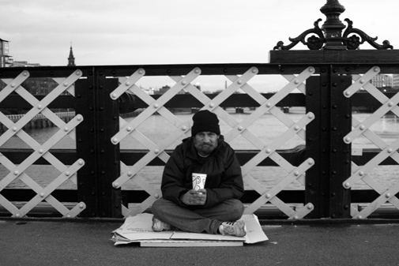
Give
By Simon Armitage

Slide 2
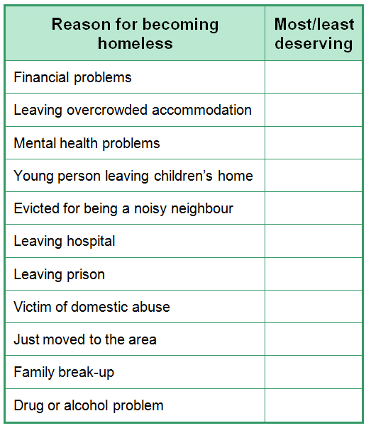
What is your opinion of homeless people? Do you think they deserve to be in the position they are in or do you feel sympathy for them?
2. If someone is begging on the streets, is it right to give them some money?
Look at the list opposite. Who is the most (1)/least (10) deserving of help?

Slide 3
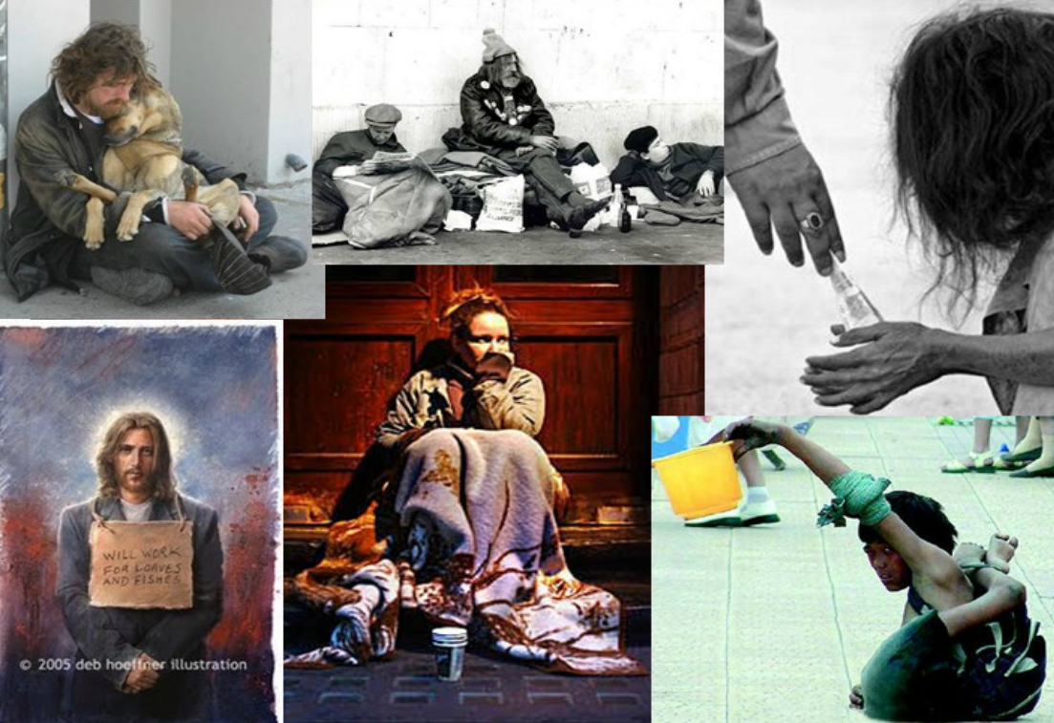
How do these pictures make you feel?

Slide 4
Give
Of all the public places, dear, to make a scene, I've chosen here.
Of all the doorways in the world to choose to sleep, I’ve chosen yours. I'm on the street, under the stars.
For coppers I can dance or sing. For silver - swallow swords, eat fire. For gold - escape from locks and chains.
It's not as if I'm holding out for frankincense or myrrh, just change.
You give me tea. That's big of you. I'm on my knees. I beg of you.
Listen to the poem and think of something to say about:
The tone of the poem
The meaning of the poem
The techniques used in the poem
How do you think the speaker is feeling?

Slide 5
This poem is a dramatic monologue. A dramatic monologue is a piece of verse that gives the speaker a voice to EXPRESS his / her feelings to a silent audience.
In the case of ‘Give’, Simon Armitage is giving a voice to homeless people who are often ‘voiceless’. In this poem, the beggar expresses his / her bitter feelings about being on the street and being neglected. He is desperate and perhaps bitter about his situation; this is expressed through his TONE and SARCASM
written in first person – focuses our attention on the speaker
fragmented stanzas (2 or 3 lines) – suggests the speaker is talking to different passers-by at different times
breaks in the middle of lines (caesura) – affects the pace of the poem: we absorb each idea separately before we view the poem as a whole
iambic – regular pattern = regular pattern of life on the street

Slide 6
Find an example of each of the following in the poem. What is the purpose and effect of each?
alliteration
assonance
personal pronoun, ‘you’
short phrases
repetition
sarcasm
rhyme
enjambment
dash
use of commas and full stops

Slide 7
‘dear’ links with
the romantic clichés used
throughout – ‘make a scene’,
‘I’m on my knees’ − possibly
for satirical effect
Of all the public places, dear, to make a scene, I've chosen here.
Introductory rhyming couplet; addresses the reader as ‘dear’ – a term of affection. Is this sarcastic?
Figuratively to create a spectacle
but he is literally on display
* Romantic language: what other situation could ‘to make a scene’ refer to?

Slide 8
Repetition of ‘choose’ ‘chosen’ etc = repetition of life on the street. Is it also an ironic contrast with the reality of homeless person’s situation, suggesting a control they don’t actually have?
Who is ‘you’?
What does the word ‘choose’ suggest about the speaker? Think about attitudes towards homelessness.
What tone is the speaker taking?
Of all the doorways in the world to choose to sleep, I’ve chosen yours. I'm on the street, under the stars.
Half rhyme
How does the use of ‘dear’ in the first stanza change
now it’s clear this isn’t a marriage proposal?

Slide 9
A list, exaggerating what he will do for money
Humiliating?
Do members of the public expect something for their money?
For coppers I can dance or sing. For silver - swallow swords, eat fire. For gold - escape from locks and chains.
Dangerous
Requires expertise
1. Categorise the nouns and verbs in this stanza using the following headings:
Captivity Metal Performance Money/Wealth
2. Underline every verb in the stanza. Why has the poet chosen these verbs?
3. Why is the noun ‘coppers’ effective? What different meanings can it have?

Slide 10
* Romantic language: what other situation could ‘I’m holding out’ refer to?
figuratively and literally
It's not as if I'm holding out for frankincense or myrrh, just change.
What two meanings does the noun ‘change’ have?
What is the effect of this double meaning?
(Note the similarity in sound between ‘change’ and ‘chains’ in the previous stanza.)
Gifts that were brought to Jesus. Why is this significant?
Consider:
link to ‘gold’ in previous stanza
‘create a scene’ – like a nativity scene
‘on my knees’ – like the wise men
what are ‘Christian values’?

Slide 11
Repetition of ‘you’ – the poem ends on this word. Why? Who is ‘you’?
You give me tea. That's big of you. I'm on my knees. I beg of you.
Figuratively and literally.
What does this image convey?
This links thematically to the previous stanza.
Alliteration links these two words – why?
How does the tone of ‘big’ differ to the tone of ‘beg’?
* Romantic language: what other situation could ‘I’m on my knees’ refer to?
Monosyllabic words + caesura = slow rhythm. This conveys the speaker’s desperation.
The tone shifts from sarcasm to honesty. The use of ‘you’ targets the reader, almost accusing them.
What is the speaker’s attitude towards the ‘tea’? Towards the giver of the tea? Why?

Slide 12
It could be argued that this poem is an unfinished sonnet. A sonnet is a love poem, written in 14 lines and ending in a rhyming couplet. Sonnets often use iambic pentameter.
It is two lines short of a sonnet (it has 12)
It ends in a rhyming couplet
Each line is two syllables short of iambic pentameter but the beat of the poem is iambic
The poem uses romantic language in a sarcastic way
Why do you think the poet might have (almost) used this form of poem?

Slide 13
Exploring language and style: ‘Give’
You will be working in groups. Each group will become an ‘expert’ on one aspect of the poem. When you have sorted out your ideas, your group will set questions to test the understanding of the rest of the class.
Group 1: Choice of language in ‘Give’
Group 2: Sound in ‘Give’
Group 3: Multiple meanings in ‘Give’
Group 4: Patterns in ‘Give’
Use your worksheets to help you!

Slide 14
What does the speaker of the poem want us to ‘give’?
Is this the same attitude as the poet himself?
Different interpretations:
You have been given some statements about the theme of the poem.
Read each of the statements.
Look for any evidence in the text that could be used to support the statement.
Discuss the different ideas and place them in rank order based on how much you agree with each statement.

Slide 15
This poem successfully captures the desperation of the homeless by painting a picture of someone who will do absolutely anything for money.
This poem is really about the embarrassment we feel when confronted by people whose lifestyle and circumstances are so different from our own.
This is the poetry of self pity. It tries to make the reader feel responsible for the suffering of the beggar who could clearly help himself instead of sponging off others. Armitage encourages laziness and dependence on charity with this portrayal of a weak and sorry character.
If you read this poem carefully, the speaker does not actually ask for money. Coppers, silver or even gold are not what he really wants: he is asking to be given something quite different.
At the heart of this poem is grim humour, designed to shock the reader with sarcasm and mocking references to the Nativity story.

Slide 16
Discussion Time!
What is your overall impression of the poem?
Do you feel any sympathy for the speaker? Why/why not?
Have your thoughts changed from your original ideas about the homeless?
Do you feel the beggar has a right to feel the way he does?
Discuss your ideas on your tables.
Notes:
Theme cards sheet in folder – what is Armitage trying to say?

Slide 17
It’s time to summarise! We’re going to make a note of the poem’s VITALS.

Slide 18
Poetry VITALS…
Voice: Who is speaking in the poem?
Imagery: What imagery is being created? How is it effective?
Theme: What are the main themes featured in the poem?
Address: Who is the poem addressed to? Why?
Language (Features): What type of language/ devices are used?
What is their effect?
Structure: How is the poem laid out? What is the effect of this?
Notes:
This is the acronym that we will use on each poem to look at all the different aspects

