Slide 1
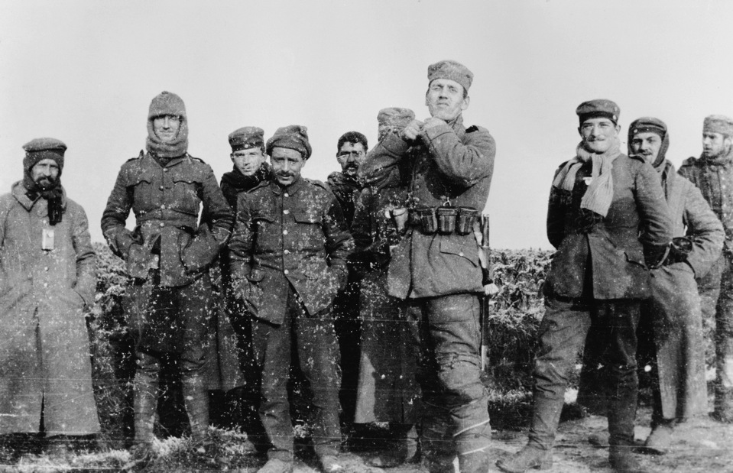
Exposure
By Wilfred Owen

Slide 2
Learning Objective To understand the context and subject matter of the poem.

Slide 3
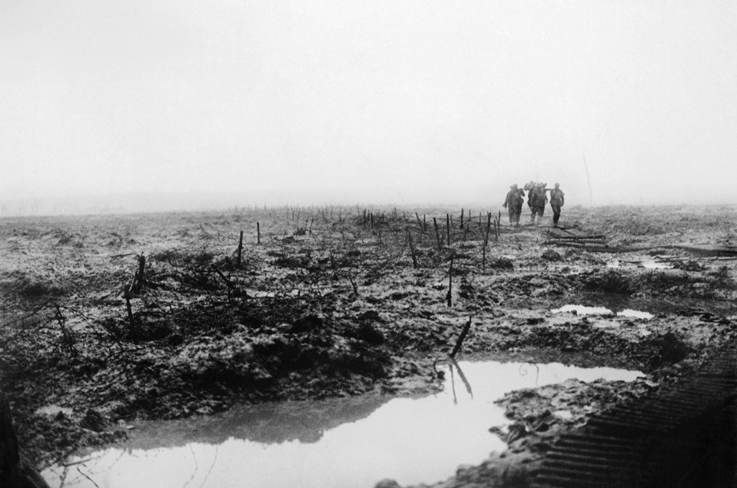
© IWM
What do you know about WWI?
The main British offensive in 1917 was at Ypres against the Passchendaele Ridge. Unusually heavy rain fell. Stretcher bearers, like these Canadians on 14 November, struggled to bring back the wounded. © IWM (CO 2252)

Slide 4
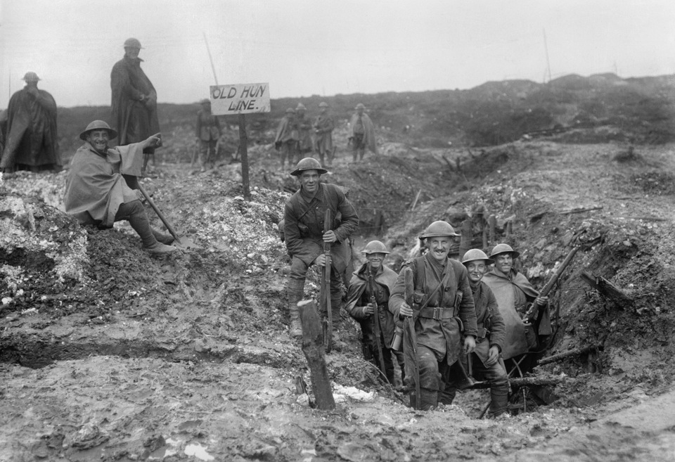
What do you know about WWI?
British troops at Serre, France, 1917 © IWM (Q 1787)

Slide 5
What do you know about WWI?
British soldiers (from the Royal Warwickshire Regiment) and German soldiers (from the 134th Saxon Regiment) together. Photograph taken December 26, 1914 by Second Lieutenant Cyril Drummond © IWM (HU 35801)

Slide 6
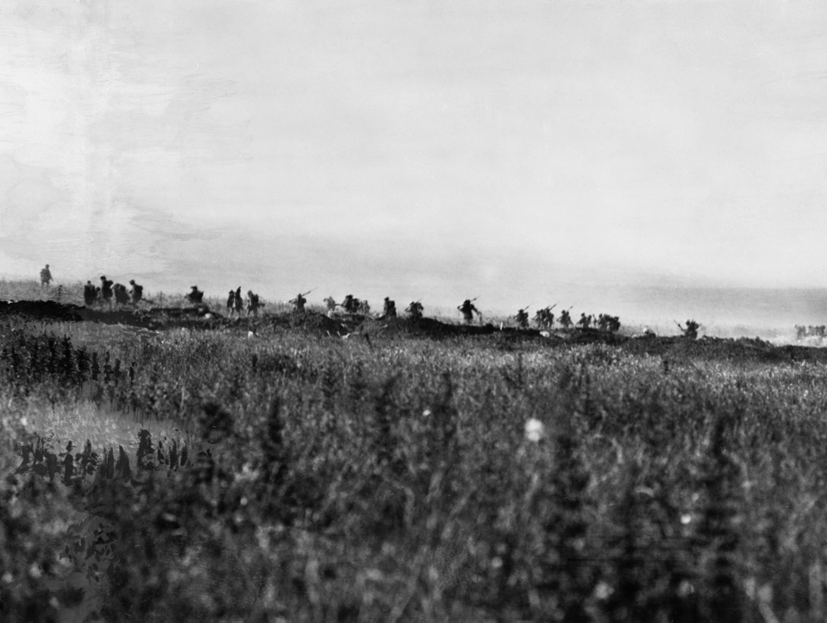
Exposure
What are the connotations of this title?
© IWM (Q 52)

Slide 7
Exposure by Wilfred Owen – first verse
Our brains ache, in the merciless iced east winds that knife us...
Wearied we keep awake because the night is silent...
Low drooping flares confuse our memory of the salient...
Worried by silence, sentries whisper, curious, nervous,
But nothing happens.

Slide 8
Our brains ache, in the merciless iced east winds that knife us...
Wearied we keep awake because the night is silent...
Low drooping flares confuse our memory of the salient...
Worried by silence, sentries whisper, curious, nervous,
But nothing happens.
1. Who do you think is narrating this poem?
2. Where do you think they are? What is happening around them?
3. How are they feeling? How do you know?

Slide 9
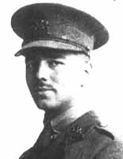
Who was Wilfred Owen?
Owen was a brave soldier; he won the Military Cross by seizing a German machine-gun and using it to kill a number of Germans. He was blown up, concussed and suffered shell-shock.
On 4th November 1918, during the last week of the year, he was shot and killed near the village of Ors. The news of his death reached his parents’ home as the Armistice bells were ringing on 11 November.

Slide 10
Read the biography of Wilfred Owen and answer the questions in your book. You have ten minutes to complete the questions and should write in full sentences.

Slide 11
Answers:
Owen was 25 years old when he died. 1 mark
In the summer of 1917, after meeting and being influenced by the poet Siegfried Sassoon (paragraphs 1-2). 1 mark
Owen experienced shell shock after active service at Serre and St. Quentin in January-April 1917 and as a result, returned to Britain for treatment. Whilst receiving treatment, Owen met Siegfried Sassoon, who “provided him with guidance, and encouragement to bring his war experiences into his poetry” (para.2). 2 marks
Owen was awarded the Military Cross in October 1918 “in recognition of his courage and leadership” (para.3). 2 marks
The ‘Pity of War’ refers to the anguish and anger at the suffering experienced by the soldiers and the violence and waste of human life. It also implies that the tragedy of war, and humans’ desire for it, is doomed to be re-enacted repeatedly in the future. 2 marks
Rhyming patterns (para.1), bleak realism, energy, indignation, compassion, technical skill (para.4). 2 marks
/10

Slide 12
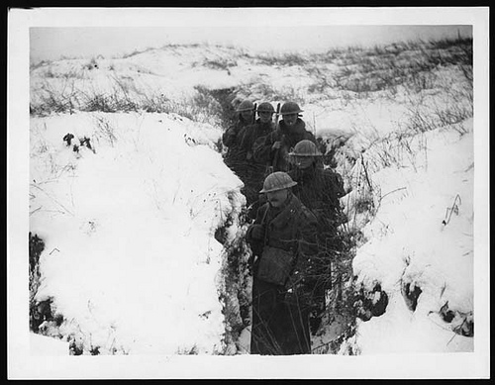
Let’s read the poem…

Slide 13
Learning Objective To explore how the writer uses theme, language and structure to present war.

Slide 14
I
Our brains ache, in the merciless iced east winds that knife us...
Wearied we keep awake because the night is silent...
Low drooping flares confuse our memory of the salient...
Worried by silence, sentries whisper, curious, nervous,
But nothing happens.
Watching, we hear the mad gusts tugging on the wire.
Like twitching agonies of men among its brambles.
Northward incessantly, the flickering gunnery rumbles,
Far off, like a dull rumour of some other war.
What are we doing here?
The poignant misery of dawn begins to grow...
We only know war lasts, rain soaks, and clouds sag stormy.
Dawn massing in the east her melancholy army
Attacks once more in ranks on shivering ranks of gray,
But nothing happens.
Sudden successive flights of bullets streak the silence.
Less deadly than the air that shudders black with snow,
With sidelong flowing flakes that flock, pause and renew,
We watch them wandering up and down the wind's nonchalance,
But nothing happens.

Slide 15
II
Pale flakes with lingering stealth come feeling for our faces -
We cringe in holes, back on forgotten dreams, and stare, snow-dazed,
Deep into grassier ditches. So we drowse, sun-dozed,
Littered with blossoms trickling where the blackbird fusses.
Is it that we are dying?
Slowly our ghosts drag home: glimpsing the sunk fires glozed
With crusted dark-red jewels; crickets jingle there;
For hours the innocent mice rejoice: the house is theirs;
Shutters and doors all closed: on us the doors are closed -
We turn back to our dying.
Since we believe not otherwise can kind fires burn;
Now ever suns smile true on child, or field, or fruit.
For God's invincible spring our love is made afraid;
Therefore, not loath, we lie out here; therefore were born,
For love of God seems dying.
To-night, His frost will fasten on this mud and us,
Shrivelling many hands and puckering foreheads crisp.
The burying-party, picks and shovels in their shaking grasp,
Pause over half-known faces. All their eyes are ice,
But nothing happens.

Slide 16
Let’s look at the first stanza together.
What is personified here? What is the effect of this?
Why does the poet use the plural pronoun ‘Our’?
Our brains ache, in the merciless iced east winds that knife us...
Wearied we keep awake because the night is silent...
Low drooping flares confuse our memory of the salient...
Worried by silence, sentries whisper, curious, nervous,
But nothing happens.
What do the ellipses suggest? [Hint: the night is ‘silent’ – is this unusual?]
Assonance: hard ‘i’ sounds reflect the cutting wind.
What does this short, simple half-line emphasise?
Highlight any emotions mentioned in this stanza. How would you summarise the state of mind of the soldiers?

Slide 17
Language Feature | Quotation | Effect
1. Use of the senses. What can you see, feel and hear? What colours are used? | “drooping flares” and “merciless iced east winds”
2. Verbs. Are there any new, unusual or interesting verbs? | “...winds that knife us”
3. Adjectives. Are there any new, unusual or interesting adjectives? | “merciless iced east winds”
4. References to death. What language is used to convey the idea of death? Are there any images that stand out? | The image of the wind as a murderous enemy. The silent, whispering sentries.
5. Any other features. Is there anything else that you find interesting or striking, e.g. use of rhyme or repetition? Do you notice any other themes e.g. nature, religion in the poem? | “worried by silence, sentries whisper, curious, nervous”

Slide 18
Language Feature | Quotation | Effect
1. Use of the senses. What can you see, feel and hear? What colours are used? | “drooping flares” and “merciless iced east winds” | The reader can almost feel the intensity of the wind, drawing them into the scene and inviting them to empathise with the soldiers.
2. Verbs. Are there any new, unusual or interesting verbs? | “...winds that knife us” | A vivid and brutal action / visual image that shocks the reader.
3. Adjectives. Are there any new, unusual or interesting adjectives? | “merciless iced east winds” | The wind is given human characteristics, emphasising the cruelty of nature and suffering of the soldiers.
4. References to death. What language is used to convey the idea of death? Are there any images that stand out? | The image of the wind as a murderous enemy. The silent, whispering sentries. | The silence and stillness of the soldiers, presented against the treacherous weather conditions builds a sense of tension and foreboding.
5. Any other features. Is there anything else that you find interesting or striking, e.g. use of rhyme or repetition? Do you notice any other themes e.g. nature, religion in the poem? | “worried by silence, sentries whisper, curious, nervous” | Repetition of the ‘s’ sound (‘sibilance’) creates a sense of being ‘hushed’.

Slide 19
Your turn!
You have been given a group of three stanzas to analyse. Use the questions (and hint sheets if you need them!) to help you annotate your stanzas clearly.
Your first task is to divide up the stanzas in your group. Each stanza needs to be analysed and then reported back to the whole group. You will then fill in a table together, using all of your answers.
You will then be sharing your findings with the other half of the class so be prepared to speak up!
Group(s) A: Group(s) B:
Stanzas 2-4 Stanzas 5-7

Slide 20
What does this metaphor refer to? What is its effect? [Hint: think about the effect of natural imagery in this context.]
Watching, we hear the mad gusts tugging on the wire.
Like twitching agonies of men among its brambles.
Northward incessantly, the flickering gunnery rumbles,
Far off, like a dull rumour of some other war.
What are we doing here?
Pick out the assonance and onomatopoeia here. What effect do they create?
This is a Biblical reference to Matthew 24:6, where Jesus foretells the end of the world. He says, “You will hear of wars and rumours of wars.”
Why has the poet included this reference?
What technique has the poet used here? Why?

Slide 21
What is the effect of the ellipsis at the end of this line?
How is the personification of Dawn different to what we might usually expect?
The poignant misery of dawn begins to grow...
We only know war lasts, rain soaks, and clouds sag stormy.
Dawn massing in the east her melancholy army
Attacks once more in ranks on shivering ranks of grey,
But nothing happens.
How does this description of dawn approaching mirror the soldiers in the trenches?
What is the significance of dawn being ‘grey’?
[Hint: grey was also the colour of the German uniforms. Does this add another possible meaning?]

Slide 22
What is the significance of the snow’s colour? What might it signify? [Hint: white symbolises purity.]
What technique is this? (Repeated ‘s’ sound.)
What sound does it recreate for us?
Sudden successive flights of bullets streak the silence.
Less deadly than the air that shudders black with snow,
With sidelong flowing flakes that flock, pause and renew,
We watch them wandering up and down the wind's nonchalance,
But nothing happens.
What does this alliteration emphasise?

Slide 23
Language Feature | Quotation | Effect
1. Use of the senses. What can you see, feel and hear? What colours are used?
2. Verbs. Are there any new, unusual or interesting verbs?
3. Adjectives. Are there any new, unusual or interesting adjectives?
4. References to death. What language is used to convey the idea of death? Are there any images that stand out?
5. Any other features. Is there anything else that you find interesting or striking, e.g. use of rhyme or repetition? Do you notice any other themes e.g. nature, religion in the poem?

Slide 24
How are the snowflakes personified? What other technique does the poet use to add to the effect created?
Pale flakes with lingering stealth come feeling for our faces -
We cringe in holes, back on forgotten dreams, and stare, snow-dazed,
Deep into grassier ditches. So we drowse, sun-dozed,
Littered with blossoms trickling where the blackbird fusses.
Is it that we are dying?
These lines are half-rhymes. What link is being made between them?
The soldiers here are reminiscing about old times (blossoms/ blackbirds). How does this increase the impact of the final line?

Slide 25
What effect does the assonance in these three words have? [Hint: think about the journey the words describe – what sort of journey is it?]
Slowly our ghosts drag home: glimpsing the sunk fires glozed
With crusted dark-red jewels; crickets jingle there;
For hours the innocent mice rejoice: the house is theirs;
Shutters and doors all closed: on us the doors are closed -
We turn back to our dying.
The first four lines of this stanza all contain caesura, creating a division on each line. What does this reflect in terms of the soldiers’ relationship with home?
These ‘jewels’ in the fire look nice but offer no real warmth. What is the poet suggesting about the soldier’s memories of home?

Slide 26
What do the soldiers feel they were born to do?
What are the men sacrificing themselves for? [Hint: where are the children, fields and fruit?]
Since we believe not otherwise can kind fires burn;
Now ever suns smile true on child, or field, or fruit.
For God's invincible spring our love is made afraid;
Therefore, not loath, we lie out here; therefore were born,
For love of God seems dying.
What different meanings might this have?

Slide 27
Language Feature | Quotation | Effect
1. Use of the senses. What can you see, feel and hear? What colours are used?
2. Verbs. Are there any new, unusual or interesting verbs?
3. Adjectives. Are there any new, unusual or interesting adjectives?
4. References to death. What language is used to convey the idea of death? Are there any images that stand out?
5. Any other features. Is there anything else that you find interesting or striking, e.g. use of rhyme or repetition? Do you notice any other themes e.g. nature, religion in the poem?

Slide 28
To-night, His frost will fasten on this mud and us,
Shrivelling many hands and puckering foreheads crisp.
The burying-party, picks and shovels in their shaking grasp,
Pause over half-known faces. All their eyes are ice,
But nothing happens.
Who is the narrator talking about when he writes “His frost”?
What are the soldiers doing? How do you know?
Do you think this is a good ending? Why, or why not?

Slide 29
What is this image describing?
Tonight, His frost will fasten on this mud and us,
Shrivelling many hands and puckering foreheads crisp.
The burying-party, picks and shovels in their shaking grasp,
Pause over half-known faces. All their eyes are ice,
But nothing happens.
What different things might this metaphor refer to? What does it suggest?
The final stanza ends in the same way as the first stanza. What does this suggest about death in this war?

Slide 30
Form, structure and tone: ‘Exposure’
The poem is written in present tense, using the first person plural (e.g. ‘we’, ‘our’ and ‘us’). This collective voice shows how the experience was shared by soldiers across the war. It also involves the reader in the poem, making us imagine that we too are with the soldiers.
The rhyme scheme throughout the poem is ABBAC. This coupled with the continuous stanzas replicates the continuous suffering and monotonous nature of the soldiers’ life. The rhymes are often half rhymes ("Silent/Salient", "brambles/rumbles" , "snow-dazed/sun-dozed"). The rhyme scheme offers no comfort or satisfaction – the rhymes are jagged like the reality of the men’s experience and reflect their confusion and fading energy. Each stanza ends with a half line, leaving a gap which mirrors the lack of activity or hope for the men. There is no real progression: ‘nothing happens’.

Slide 31
Form, structure and tone: ‘Exposure’
Each of Owen’s eight stanzas ends with a short half line. In the first, third, fourth and final verses Owen creates the burden: ‘But nothing happens’. Each of the short, last lines in the remaining stanzas has a story of its own to tell. When written or read out these lines read:
‘What are we doing here?’
‘Is it that we are dying?’
‘We turn back to our dying.’
‘For love of God is dying.’
The first question is answered by the second, which prompts the action of the third. The penultimate verse ends poignantly and perhaps ambiguously. Here on the field of battle the men make Christ-like sacrifices for those they love. Yet Owen suggests the love of God for them, and their faith in God, seems to have died.

Slide 32
Since we believe not otherwise can kind fires burn; Now ever suns smile true on child, or field, or fruit. For God's invincible spring our love is made afraid; Therefore, not loath, we lie out here; therefore were born, For love of God seems dying.
These lines have been subject to many interpretations over the years. The majority view seems to be that God’s love is absent and that they, the soldiers, are born to die in a sacrifice so that kind fires can burn and that the sun can shine on child, field or fruit. The suggestion is that they are not loth or unwilling to do this – partly because their actions will have defended their country or partly because in dying, their suffering will end.
Do you agree with this interpretation?

Slide 33
What feelings does the poem evoke? With a partner, discuss these terms and arrange them in order of how appropriate you think they are:
Hopelessness Innocence Despair
Endurance Suffering Misery
Bitterness Survival Fear

Slide 34
It’s time to summarise! We’re going to make a note of the poem’s VITALS.

Slide 35
Poetry VITALS…
Voice: Who is speaking in the poem?
Imagery: What imagery is being created? How is it effective?
Theme: What are the main themes featured in the poem?
Address: Who is the poem addressed to? Why?
Language (Features): What type of language/ devices are used?
What is their effect?
Structure: How is the poem laid out? What is the effect of this?
Notes:
This is the acronym that we will use on each poem to look at all the different aspects

