Slide 1
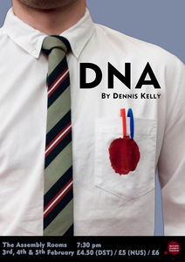
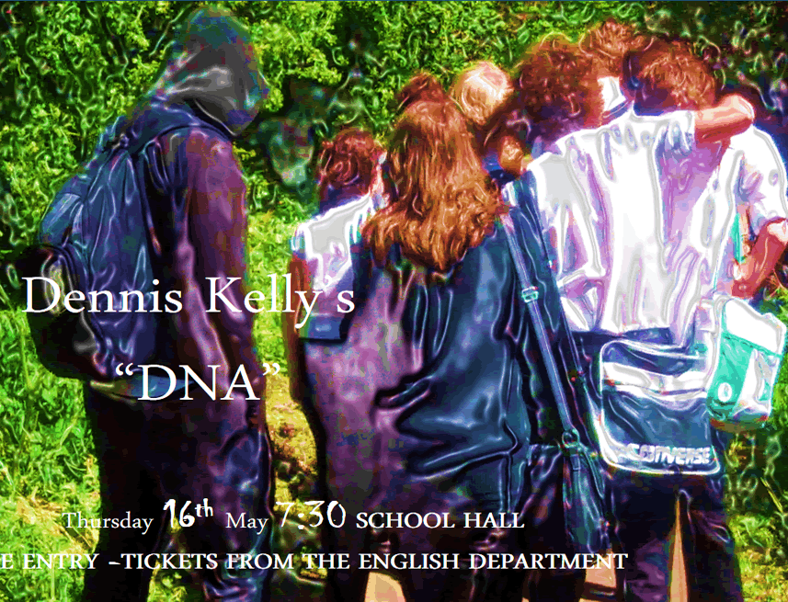

Slide 2
Learning Objective To identify and discuss some of the themes and ideas in DNA by Dennis Kelly.

Slide 3
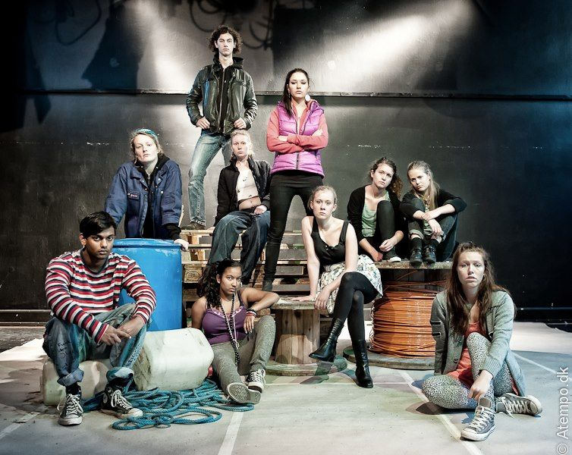
What do you think DNA by Dennis Kelly might be about?

Slide 4
What do you think DNA by Dennis Kelly might be about?

Slide 5
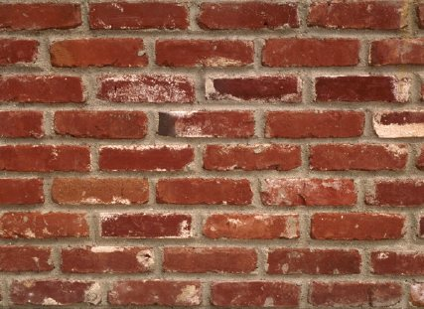
What is a gang?

Slide 6
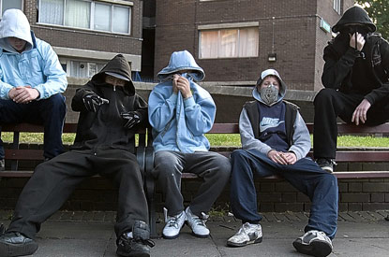
Is this a gang?

Slide 7
What about this?

Slide 8
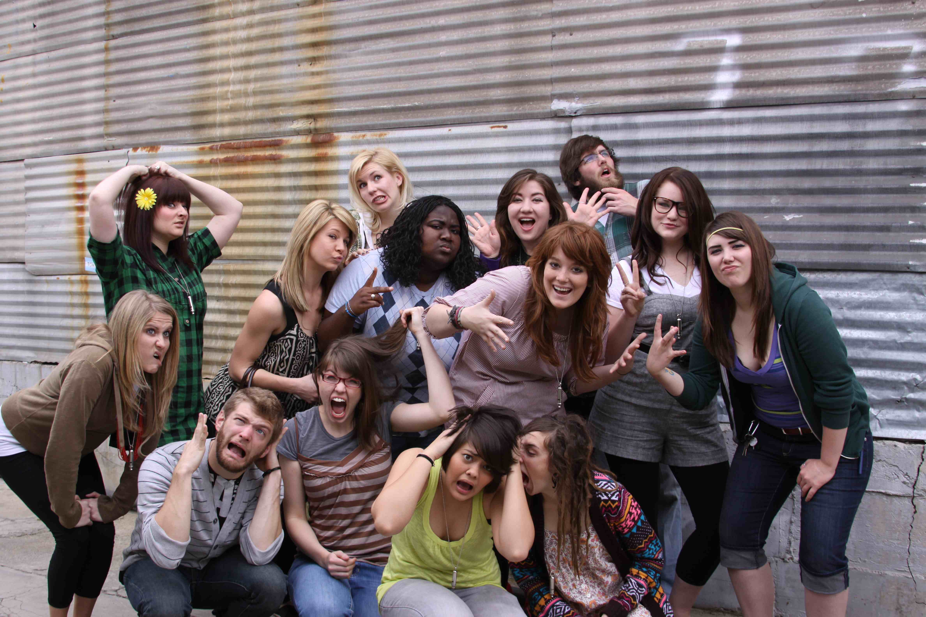
What about this?

Slide 9
Create a mind map on gangs. You should think of words and ideas you associate with gangs.

Slide 10
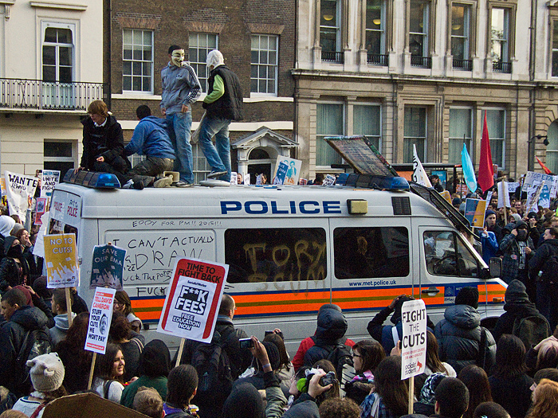
Dec 2010 Student riots

Slide 11
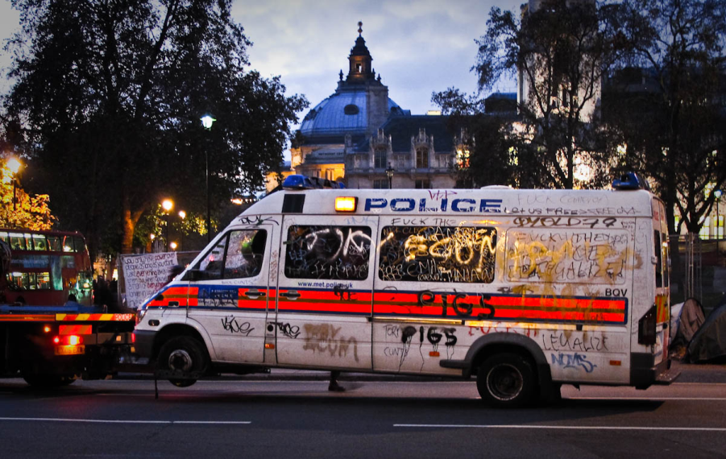
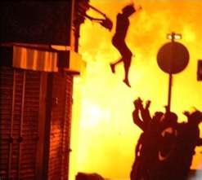
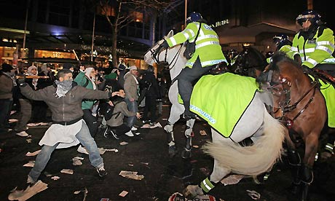
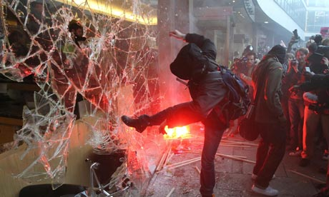
August 2011 riots

Slide 12
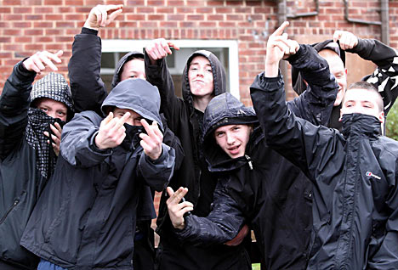
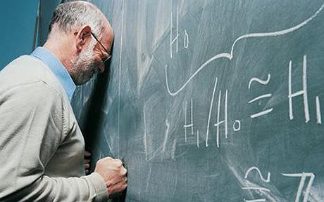
“I wish that people would stop calling these youths gangs. It gives them more power than they have. They are not gangs. They are just groups of bored youth”
How far do you agree with this statement? Do some people do things that they never would have done alone because they are led by others? Are the morals of a group different to individual interpretations of morality?

Slide 13
Look at the discussion cards in front of you.
Take it in turns to read out a prompt and share your opinion with the rest of your group. As a group, discuss your ideas and try to arrive at some sort of conclusion before moving on to the next prompt.
You will be assessed on your ability to discuss the prompts in an effective and supportive manner. Use the Speaking and Listening: Discussion criteria to help.

Slide 14
How did you do?
Did anyone stand out as a particularly effective group leader?
What made them so good?

Slide 15
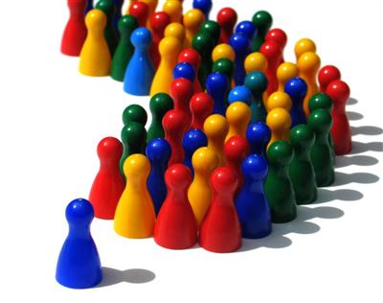
Leadership
What makes a ‘good’ leader of a group?
Can you think of examples of good leaders? What qualities do they have?
Do some people always have to be led?
Do some people do things that they never would have done alone because they are led by others?
Are the morals of a group different to individual interpretations of morality?
Have your ideas changed?

Slide 16
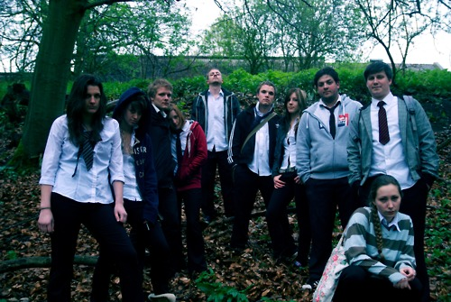
What do you think DNA by Dennis Kelly might be about?
Any new ideas?

Slide 17
Learning Objective To know what this CA is all about and understand the AOs. To read and engage with the play itself.

Slide 18
Controlled Assessment Tasks for GCSE English Language Unit 3 part a:
Understanding Written Texts (extended reading)
You will have up to 4 hours controlled assessment time
Aim for an upper word limit of 1200 words
The piece is worth 15% of your English GCSE
The writer’s ideas and attitudes (i.e. what is he saying?)
AO3
(i) Read and understand texts, selecting material appropriate to purpose.
(ii) Develop and sustain interpretations of writers’ ideas and perspectives.
(iii) Explain and evaluate how writers use linguistic, grammatical, structural and presentational features to achieve effects and engage and influence the reader.
Include and analyse quotations and support your points with detailed textual evidence.
How the writer uses language and structure to achieve effects and engage the audience.

Slide 19
As we read DNA by Dennis Kelly, try to keep these questions in mind...
What kind of leaders are there in this play?
Which characters are powerful? Which are weak?
What would this look like on stage?
What is the writer trying to say?

Slide 20
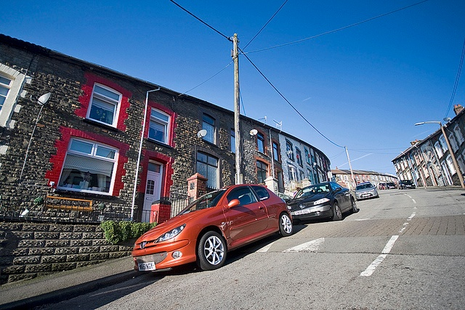
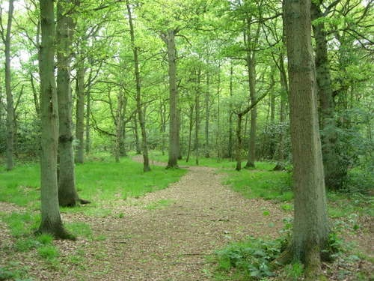
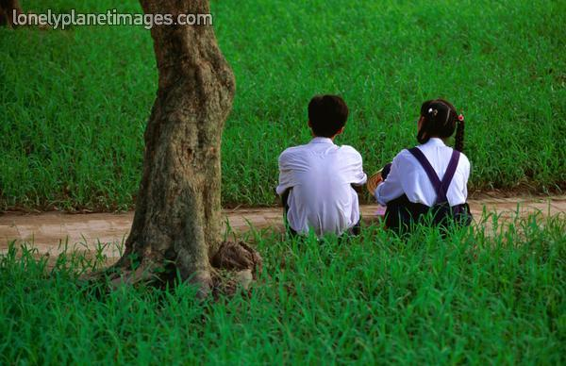
Pick a Part! – Act 1
A street
A wood
A field
Stage directions:
Mark:
Jan:
Lou:
John Tate:
Danny:
Richard:
Cathy:
Brian:
Leah:
Phil:

Slide 21
Pick a Part! – Act 2
A street
A wood
A field
Stage directions:
Mark:
Jan:
Lou:
Danny:
Richard:
Cathy:
Brian:
Leah:
Phil:

Slide 22
Pick a Part! – Act 3
A street
A wood
A field
Stage directions:
Mark:
Jan:
A Boy:
Lou:
Cathy:
Brian:
Leah:
Phil:

Slide 23
Pick a Part! – Act 4
A street
A wood
A field
Stage directions:
Richard:
Phil:

Slide 24
Learning Objective To analyse the first section of Act 1 and identify its effects and meanings.

Slide 25
Pick a Part! – Act 1
A street
A wood
A field
Stage directions:
Mark:
Jan:
Lou:
John Tate:
Danny:
Richard:
Cathy:
Brian:
Leah:
Phil:

Slide 26
Act One
You have been given some questions on pages 7-17 of the first act of DNA. Answer your assigned question(s) on your own, then share them a) with your table, and b) with the class. Be prepared to take notes on what they have to share with you as well!

Slide 27
Q1: Pages 7-8
One
A Street.
Characters:
JAN
MARK
How does Kelly interest the audience from the start?
The conversation is written in brief, incomplete sentences and questions. What is the dramatic effect of this opening? What is the effect of the last line?

Slide 28
Qs 2 & 3: Pages 8-10
One
A Field.
Characters:
LEAH & PHIL
JAN & MARK
How does Phil react towards Leah (body language/facial expressions) and what does this show about him?
What do we learn about Leah? What is the relationship between her and Phil?

Slide 29
Q4: Page 10
One
A Field.
Characters:
LEAH & PHIL
JAN & MARK
Why is there a pause after Jan and Mark enter?
Look at the end of the section on page 10. What is the effect of this dramatic line?

Slide 30
Q5: Pages 10-17
One
A Wood.
Characters:
LOU, JOHN TATE AND DANNY
RICHARD, CATHY AND BRIAN
How do learn that John Tate is the leader?
How do we know he is not coping with the pressure?
Why does he not like the word ‘dead’?
How does he turn the situation into a ‘divide and rule’ situation?

Slide 31
Qs 6 & 7: Pages 10-17
One
A Wood.
Characters:
LOU, JOHN TATE AND DANNY
RICHARD, CATHY AND BRIAN
How is Danny different from the other members of the gang?
What do learn about Cathy and the way she inflames the situation between Richard and John Tate? What is different about her in the way she reacts to what has happened?

Slide 32
Qs 8, 9 & 10: Pages 10-17
One
A Wood.
Characters:
LOU, JOHN TATE AND DANNY
RICHARD, CATHY AND BRIAN
Is Richard really interested in a confrontation with John Tate?
What kind of group member is Lou?
How does John Tate react to Brian saying he wants to “tell someone”?

Slide 33
Qs 8, 9 & 10: Pages 10-17
One
A Wood.
Characters:
LOU, JOHN TATE AND DANNY
RICHARD, CATHY AND BRIAN
Is Richard really interested in a confrontation with John Tate?
What kind of group member is Lou?
How does John Tate react to Brian saying he wants to “tell someone”?

Slide 34
Pages 7-17 – Key Quotes
Leah: I’m not the only one, Phil. I’m just the only one saying it, the fear that everyone here lives in, the brutal terror...
John Tate: Lou, are you scared of anyone in this school?
Lou: You?
John Tate: Apart from me.
Lou: No.
John Tate: Exactly.
Danny: I can’t get mixed up in this. I’m gonna be a dentist.
John Tate: Alright, new rule. That word is banned. [...] and if anyone says it I’m going to have to, you know, bite their face. Or something.
Richard: You shouldn’t threaten me, John.
Cathy: He’s on Richard’s side.
John Tate: That just leaves you, Brian. You crying little piece of filth.
Brian: I think we should tell someone.
JOHN TATE begins to walk towards BRIAN.
Why are these quotes significant?

Slide 35
Learning Objective To analyse the nature of Leah and Phil’s relationship.
To make a judgement on Leah as a character.

Slide 36
A Closer Look: Leah’s Monologue

Slide 37
A Closer Look: Leah’s Monologue
What do we learn about her
insecurities?
How does the text show that
Phil’s lack of reaction makes her
try different approaches to
provoke one?
How are her own worries shown
in her monologue?
Key Question:
What is the significance of her
saying ‘the fear that everyone
here lives in, the brutal terror’?
Quotes
Feelings

Slide 38
Leah and Phil Their relationship
What kind of relationship do they have?
Are they close? Is it one sided? Does he care?
You need to justify your answer with clear evidence from the text.

Slide 39
Q
W
E
R
T
Y
QUESTION - link your answer to the focus of the task
WRITER - remember that the characters only do what the writer makes them do!
EVIDENCE - Use quotations from the text
READER - what effect do the events/ issues have on the reader?
TECHNIQUES - language/ structure
YOUR RESPONSE - explore your own ideas/ your reaction to the text

Slide 40
Q
W
E
R
T
Y
Have a go at writing a QWERTY paragraph, using your notes so far.
What kind of relationship do Leah and Phil have?
Are they close? Is it one sided? Does he care?

Slide 41
One of the ways Kelly... Another way... Leah is also shown to be... The writer suggests... When he is first described...
Q
}
W
E
This is shown when it says, “___”... An example of this is when Kelly writes, “___”... For example, “___”
R
This makes the reader think... This suggests to the reader... The reader will think... This implies... This suggests...
T
The use of the simile... The writer’s word choice... The repetition of the word “___”... The alliteration of... This word has strong connotations of...
Y
This suggests... This implies... This links to...

Slide 42
What is your opinion of Leah, and why?

Slide 43
Learning Objective To analyse pages 17-21 in more detail.
To make a judgement on John Tate’s leadership.

Slide 44
The Qualities of a Leader? Do you remember what we said?

Slide 45
Pages 17-21
Re-read Jan and Mark’s account of the attack on Adam. This is the news that they were discussing in the first scene and that the audience have been wondering about – especially as it caused all the tension in John Tate.
Create two columns with the headings ‘SELF_JUSTIFYING/ INNOCENT’ and ‘SADISTIC/ NEGATIVE’
Pick out examples of words and phrases used by Jan and Mark to justify what happened e.g. ‘having a laugh’
Contrast this with the other words they use intermingled with those words, e.g. ‘You know what he’s like’, ‘trying to be part of’.
What is the effect of the contrasting language?

Slide 46
Pages 17-21 – Key Quotes
JOHN TATE places a finger on her lips. She is silent.
Mark: Oh, he was terrified, he was completely, but like you know, pretending, you know...
Mark: ... you know, you’re having a laugh, together, what’s this nutter gonna do next, we can make him do, we can make him do –
John Tate: Dead. He’s dead.
Why are these quotes significant?

Slide 47
Is John Tate a good leader?
Consider:
How effective is he?
Is he in control?
What sort of control is it?
Is he uncertain at all?
How does he deal with challenges or dissent?
Use textual evidence to back up your ideas.
Group presentation!

Slide 48
Learning Objective To analyse the rest of Act 1 in more detail.
To make a judgement on the group’s power dynamics.

Slide 49
Qs 1 & 2: Pages 21-24
One
A Wood.
Characters:
LOU, JOHN TATE AND DANNY
RICHARD, CATHY AND BRIAN
MARK AND JAN, PHIL AND LEAH
What is Phil’s plan? What might the audience think of it?
John Tate speaks his last lines just before this point ‘Cathy says you’re clever. So, what do we do?’ – What is the significance?

Slide 50
Q3: Pages 24-26
One
A Wood.
Characters:
LOU, JOHN TATE AND DANNY
RICHARD, CATHY AND BRIAN
MARK AND JAN, PHIL AND LEAH
How does this scene compare to the earlier scene with both of them?
What can you say about Phil’s lack of interaction?
Why is he so quiet when he has just been
outspoken in his leadership of the cover-up?

Slide 51
Q4: Pages 24-26
One
A Wood.
Characters:
LOU, JOHN TATE AND DANNY
RICHARD, CATHY AND BRIAN
MARK AND JAN, PHIL AND LEAH
Look at Leah’s speech about the anthropology of chimpanzees. She tells Phil that chimps ‘murder each other’ whereas she praises bonobos for their ability to empathise.
What is she saying to Phil – ‘I sometimes think you’re not human’?

Slide 52
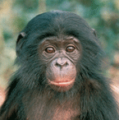
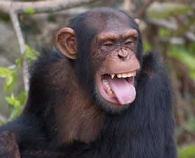
Q5: Pages 24-26
One
A Wood.
Characters:
LOU, JOHN TATE AND DANNY
RICHARD, CATHY AND BRIAN
MARK AND JAN, PHIL AND LEAH
What is the writer asking us to think about through Leah saying that chimps are closely related to bonobos? ‘A chimp’ll just find itself on the outside of the group and before he knows it’s happening it’s being hounded to death by the others, sometimes for months’. What is the writer saying about humanity?

Slide 53
Find some quotes to match each picture.
Bonobo
Chimp

Slide 54
Does the group more closely resemble bonobos or chimps? Why do you say that?
‘a chimp’ll just find itself on the outside of a group and before he knows it’s happening it’s being hounded to death by the others, sometimes for months’

Slide 55
Q
W
E
R
T
Y
QUESTION - link your answer to the focus of the task
WRITER - remember that the characters only do what the writer makes them do!
EVIDENCE - Use quotations from the text
READER - what effect do the events/ issues have on the reader?
TECHNIQUES - language/ structure
YOUR RESPONSE - explore your own ideas/ your reaction to the text

Slide 56
Q
W
E
R
T
Y
Have a go at writing a QWERTY paragraph, using your notes so far.
Does the group more closely resemble bonobos or chimps? Why do you say that?
Extension: Keep on writing! Each paragraph you produce should use QWERTY.

Slide 57
One of the ways Kelly... Another way... Leah is also shown to be... The writer suggests... When he is first described...
Q
}
W
E
This is shown when it says, “___”... An example of this is when Kelly writes, “___”... For example, “___”
R
This makes the reader think... This suggests to the reader... The reader will think... This implies... This suggests...
T
The use of the simile... The writer’s word choice... The repetition of the word “___”... The alliteration of... This word has strong connotations of...
Y
This suggests... This implies... This links to...

Slide 58
Learning Objective To identify key quotes for Act 1.
To analyse the characters of John Tate, Leah and Phil in Act 1.

Slide 59
Pages 21-26 – Key Quotes?
Over to you...
Why are these quotes significant?

Slide 60
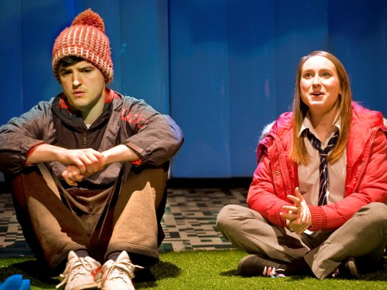
Add notes to the character pages for John Tate, Phil and Leah.

Slide 61
Learning Objective To analyse the first section of Act 2 and identify its effects and meanings.
To use drama to explore pages 28-30 further.

Slide 62
Pick a Part!
A street
A wood
A field
Stage directions:
Mark:
Jan:
Lou:
Danny:
Richard:
Cathy:
Brian:
Leah:
Phil:

Slide 63
Q1: Pages 27-30
Two
A Street.
Characters:
MARK
JAN
Who are Mark and Jan talking about?

Slide 64
Qs 2 & 3: Pages 27-30
Two
A Field.
Characters:
LEAH AND PHIL
MARK AND JAN
What does Leah see as the ‘beauty’ of life? How does she feel when she realises Phil doesn’t feel the same?
Why does Leah admit (or lie about) killing her pet? What does this tell us about her?

Slide 65
Qs 4 & 5: Pages 27-30
Two
A Field.
Characters:
LEAH AND PHIL
MARK AND JAN
What do we learn about John Tate? (We don’t see him again.)
What does it say about Phil that he can calmly eat sweets as the others are falling apart with the guilt?

Slide 66
Work in pairs to present the end of this scene (p28-30)

Slide 67
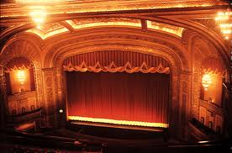
Work in pairs to present the end of this scene (p28-30)
Focus especially on Leah’s attempt to make Phil
react by talking about killing the pet – with no
reaction. However, the mention of Adam’s
appeal makes him look
up.

Slide 68
Learning Objective To analyse the rest of Act 2 and identify its effects and meanings.
To analyse Phil’s actions in more detail.

Slide 69
Pages 31-39
Two
A Wood.
Characters:
LEAH AND PHIL
LOU AND DANNY
RICHARD AND CATHY
JAN, MARK AND BRIAN
(p33)
How does Leah calm Danny down?
What does Richard reveal?

Slide 70
Pages 31-39
Two
A Wood.
Characters:
LEAH AND PHIL
LOU AND DANNY
RICHARD AND CATHY
JAN, MARK AND BRIAN
(p33-36)
What does Cathy admit? What does the audience think of her?

Slide 71
Pages 31-39
Two
A Wood.
Characters:
LEAH AND PHIL
LOU AND DANNY
RICHARD AND CATHY
JAN, MARK AND BRIAN
(p37)
How does Brian react to what he is asked to do? Look back at his line on page 17 ‘I think we should tell someone’.
Is he the weak link? Why?

Slide 72
Pages 31-39
Two
A Wood.
Characters:
LEAH AND PHIL
LOU AND DANNY
RICHARD AND CATHY
JAN, MARK AND BRIAN
(p38)
How does Phil persuade Brian?
Compare his methods with John Tate’s threat to ‘hurt’ Richard (p14).

Slide 73
Pages 31-39
Two
A Wood.
Characters:
LEAH AND PHIL
LOU AND DANNY
RICHARD AND CATHY
JAN, MARK AND BRIAN
(p39)
Is Phil calculating and callous?
Is he trying to keep them out of trouble or is he enjoying the power?

Slide 74
Pages 27-39 – Key Quotes
Leah: Why do you think I did that?
Leah: Phil? Any... any thoughts? Any words, any comments, any... ideas, any, any, any...thing? At all?
Danny: Well, there’s the teeth as well.
Cathy: Richard, we showed initiative.
Brian: I can’t go in there, don’t make me go in there...
PHIL walks over to Brian and lays a hand on his shoulder.
Phil: You’ll land on Adam’s corpse and you’ll rot together.
Phil: Richard’ll take you.
Why are these quotes significant?

Slide 75
Pages 39-41
Two
A Field.
Characters:
LEAH AND PHIL
“we’re doomed to behave like people before us did” – what is the significance of this quote?
What is the effect of her calling his name ten times? Is this the beginning of the end for their relationship? Or does your knowledge of Phil in Act 4 suggest something in him is changing?

Slide 76
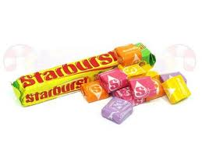
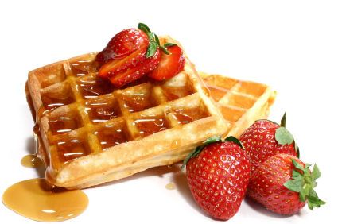
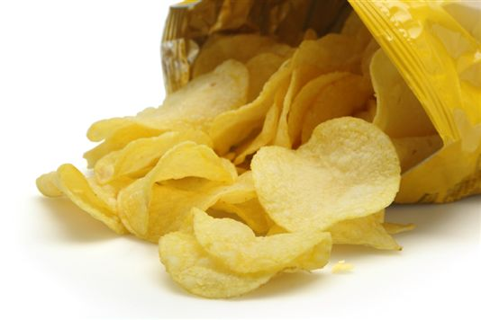
Phil’s Food
Why is Phil always eating?
What does it represent?

Slide 77
Q
W
E
R
T
Y
QUESTION - link your answer to the focus of the task
WRITER - remember that the characters only do what the writer makes them do!
EVIDENCE - Use quotations from the text
READER - what effect do the events/ issues have on the reader?
TECHNIQUES - language/ structure
YOUR RESPONSE - explore your own ideas/ your reaction to the text

Slide 78
Q
W
E
R
T
Y
Have a go at writing a QWERTY paragraph, using your notes so far.
Why is Phil always eating?
What does it represent?
Extension: Keep on writing! Each paragraph you produce should use QWERTY.

Slide 79
One of the ways Kelly... Another way... Leah is also shown to be... The writer suggests... When he is first described...
Q
}
W
E
This is shown when it says, “___”... An example of this is when Kelly writes, “___”... For example, “___”
R
This makes the reader think... This suggests to the reader... The reader will think... This implies... This suggests...
T
The use of the simile... The writer’s word choice... The repetition of the word “___”... The alliteration of... This word has strong connotations of...
Y
This suggests... This implies... This links to...

Slide 80
Learning Objective To analyse the Act 3 and identify its effects and meanings.
To analyse the final scene of Act 3 in more detail and understand its significance.

Slide 81
Pick a Part!
A street
A wood
A field
Stage directions:
Mark:
Jan:
A Boy:
Lou:
Cathy:
Brian:
Leah:
Phil:

Slide 82
Pages 42-44
Three
A Street.
Characters:
JAN AND MARK
Once again the audience are left guessing. Who are Jan and Mark talking about?

Slide 83
Pages 44-46
Three
A Field.
Characters:
LEAH AND PHIL
MARK AND JAN
Why does Leah say she is leaving in so many different ways? Why does she stay?

Slide 84
Q1: Pages 47-53
Three
A Wood.
Characters:
LEAH AND PHIL
MARK AND JAN
CATHY, BRIAN AND LOU
‘A BOY’
What do we learn from Adam’s account?
How is portrayed as a rebirth/resurrection as a ‘new me’ (52)?
How is his name significant?

Slide 85
Q2: Pages 47-53
Three
A Wood.
Characters:
LEAH AND PHIL
MARK AND JAN
CATHY, BRIAN AND LOU
‘A BOY’
What does Adam’s reappearance mean for the group and the future?

Slide 86
Q3: Pages 47-53
Three
A Wood.
Characters:
LEAH AND PHIL
MARK AND JAN
CATHY, BRIAN AND LOU
‘A BOY’
Adam says ‘I’m not coming back’. How does this foreshadow what happens next?

Slide 87
Qs 4 & 5: Pages 47-53
Three
A Wood.
Characters:
LEAH AND PHIL
MARK AND JAN
CATHY, BRIAN AND LOU
‘A BOY’
How has Brian reacted to Adam’s reappearance?
What seems to have changed in Cathy? How is she Brian’s opposite?

Slide 88
Pages 42-53 – Key Quotes
Mark: Cathy found him in the woods
Leah: Did you know that they’ve put Brian on medication?
Brian: I found him.
Brian: Don’t they eat earth somewhere? Shall we eat the earth?
Cathy: I used violence.
Suddenly CATHY slaps him.
Adam: ... a new me.
Adam: I’m... dead?
Why are these quotes significant?

Slide 89
Pages 53-59
Three
A Wood.
Characters:
LEAH AND PHIL
MARK AND JAN
CATHY, BRIAN AND LOU
ADAM
Leah takes control of the questioning. When she asks the question ‘what are we going to do?’ Phil steps in. How quickly does the audience realise what he is suggesting?

Slide 90
Pages 53-59
Three
A Wood.
Characters:
LEAH AND PHIL
MARK AND JAN
CATHY, BRIAN AND LOU
ADAM
(page 54)
What do you think of Phil’s body language and facial expressions here?
(page 55) Why does he send the others away? Is he threatening?

Slide 91
Pages 53-59
Three
A Wood.
Characters:
LEAH AND PHIL
MARK AND JAN
CATHY, BRIAN AND LOU
ADAM
(page 55)
Why does Leah openly argue with Phil, ‘we can’t just leave him up here’? Is this the end of their relationship? What does Phil’s line: ‘I’m in charge’ tell us?

Slide 92
Pages 53-59
Three
A Wood.
Characters:
LEAH AND PHIL
MARK AND JAN
CATHY, BRIAN AND LOU
ADAM
(page 56-7)
How has Cathy’s role changed?
(page 58)
Why is Brian sent with Cathy?

Slide 93
Pages 58-59
Three
A Field.
Characters:
LEAH AND PHIL
Why is there ‘complete silence’?
Why does Leah leave when Phil tries to show physical affection?
What is the significance of Phil speaking to Leah but getting no response?

Slide 94
Q
W
E
R
T
Y
QUESTION - link your answer to the focus of the task
WRITER - remember that the characters only do what the writer makes them do!
EVIDENCE - Use quotations from the text
READER - what effect do the events/ issues have on the reader?
TECHNIQUES - language/ structure
YOUR RESPONSE - explore your own ideas/ your reaction to the text

Slide 95
Q
W
E
R
T
Y
Have a go at writing a QWERTY paragraph to answer one of the below questions on pages 58-59.
Why is there ‘complete silence’?
Why does Leah leave when Phil tries to show physical affection?
What is the significance of Phil speaking to Leah but getting no response?
Extension: Pick another questions and keep on writing! Each paragraph you produce should use QWERTY.

Slide 96
One of the ways Kelly... Another way... Leah is also shown to be... The writer suggests... When he is first described...
Q
}
W
E
This is shown when it says, “___”... An example of this is when Kelly writes, “___”... For example, “___”
R
This makes the reader think... This suggests to the reader... The reader will think... This implies... This suggests...
T
The use of the simile... The writer’s word choice... The repetition of the word “___”... The alliteration of... This word has strong connotations of...
Y
This suggests... This implies... This links to...

Slide 97
Learning Objective To identify key quotes for Act 3.
To analyse the characters of John Tate, Leah and Phil in Act 3.

Slide 98
Pages 53-59 – Key Quotes?
Over to you...
Why are these quotes significant?

Slide 99
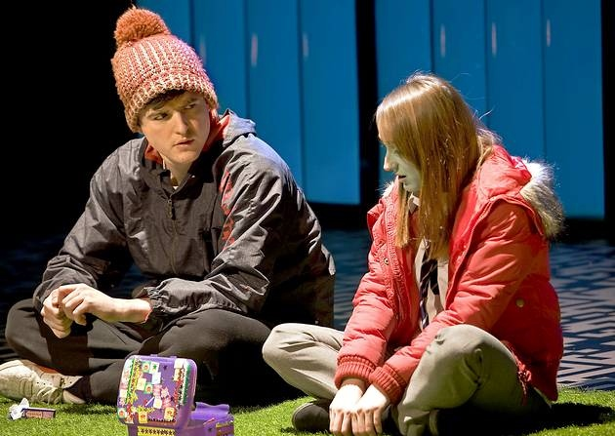
Add notes to the character pages for John Tate, Phil and Leah.

Slide 100
Learning Objective To understand the role of Jan and Mark as a chorus.
To analyse the final scene of the play and understand its significance.

Slide 101
Pick a Part!
A street
A wood
A field
Stage directions:
Richard:
Phil:

Slide 102
Pages 60-61
Four
A Street.
Characters:
JAN AND MARK
Jan and Mark act as the chorus commenting on the action that has taken place and bringing the audience up to the moment. Who has left, and how do they feel about it?

Slide 103
The Greek Chorus
The ‘chorus’ in Greek theatre were people who would come on stage between acts- when the actors had to leave the stage, the chorus would come on.
They were supposed to be a representation of society and spoke as the ‘ideal spectator’ by providing advice, opinions, questions to the audience and actors.
Their main function, however, was as a narrator – to tell stories and provide information about events that had happened off-stage.
They were there to bridge the gap between the audience and the actors, and to intensify the emotions of the play.
How does this fit the characters of Jan and Mark?

Slide 104
Pages 61-64

Slide 105
Pages 61-64
Four
A Field.
Characters:
RICHARD
PHIL
How has Phil changed?
Why does Richard shake Phil by the shoulders? Does he really want him back?
What does Richard mean when he says: ‘There are more stars in the universe than there are grains of sand on Brighton beach’?

Slide 106
Q
W
E
R
T
Y
QUESTION - link your answer to the focus of the task
WRITER - remember that the characters only do what the writer makes them do!
EVIDENCE - Use quotations from the text
READER - what effect do the events/ issues have on the reader?
TECHNIQUES - language/ structure
YOUR RESPONSE - explore your own ideas/ your reaction to the text

Slide 107
Q
W
E
R
T
Y
Have a go at writing a QWERTY paragraph to answer one of the below questions on pages 61-64.
How has Phil changed?
Why does Richard shake Phil by the shoulders? Does he really want him back?
What does Richard mean when he says: ‘There are more stars in the universe than there are grains of sand on Brighton beach’?
Extension: Pick another questions and keep on writing! Each paragraph you produce should use QWERTY.

Slide 108
One of the ways Kelly... Another way... Leah is also shown to be... The writer suggests... When he is first described...
Q
}
W
E
This is shown when it says, “___”... An example of this is when Kelly writes, “___”... For example, “___”
R
This makes the reader think... This suggests to the reader... The reader will think... This implies... This suggests...
T
The use of the simile... The writer’s word choice... The repetition of the word “___”... The alliteration of... This word has strong connotations of...
Y
This suggests... This implies... This links to...

Slide 109
Learning Objective To identify key quotes for Act 4.
To analyse the characters of John Tate, Leah and Phil in Act 4.

Slide 110
Pages 60-64 – Key Quotes
Richard: Phil! Phil, watch this! Phil, watch me, watch me, Phil!
‘wasn’t it good when Phil was running the show?’
John Tate’s found God.
Cathy doesn’t care. She’s too busy running things.
Dangerous game. I feel sorry for Lou.
PHIL goes back to staring at nothing.
How do you think they’re living, Phil?
How do you think they’re living?
Why are these quotes significant?

Slide 111
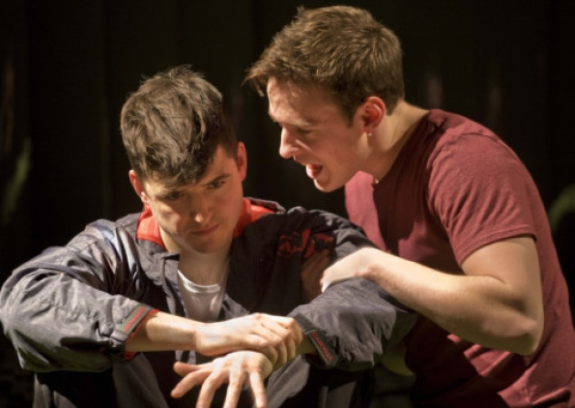
Add notes to the character pages for John Tate, Phil and Leah.

Slide 112
Learning Objective To review the Assessment Objectives for this CA.
To understand the three options for this CA.
To identify which characters are powerful and which are weak in different scenes.

Slide 113
Controlled Assessment Tasks for GCSE English Language Unit 3 part a:
Understanding Written Texts (extended reading)
You will have up to 4 hours controlled assessment time
Aim for an upper word limit of 1200 words
The piece is worth 15% of your English GCSE
The writer’s ideas and attitudes (i.e. what is he saying?)
AO3
(i) Read and understand texts, selecting material appropriate to purpose.
(ii) Develop and sustain interpretations of writers’ ideas and perspectives.
(iii) Explain and evaluate how writers use linguistic, grammatical, structural and presentational features to achieve effects and engage and influence the reader.
Include and analyse quotations and support your points with detailed textual evidence.
How the writer uses language and structure to achieve effects and engage the audience.

Slide 114
Can you answer these questions now?
What kind of leaders are there in this play?
Which characters are powerful? Which are weak?
What would this look like on stage?
What is the writer trying to say?

Slide 115
[Explore different parts of a text to show the development of an idea or theme.]
You have a choice of three questions:
Explore the ways the writer presents power and weakness in characters in DNA. How do different characters show their power or lack of it? Refer to the play as a whole to develop your analysis. (lower level)
Explore the ways the writer presents the nature of leadership in DNA, focusing particularly on the power and/or weakness of the characters. (intermediate level)
Explore the ways the writer presents the relationship between Leah and Phil in DNA, focusing particularly on their power over one another. Consider how their relationship changes through the play. (higher level)

Slide 116
Power and Weakness
Using the ‘hierarchy’ cards you have been given, decide who is at the top and who is at the bottom of the ‘power pyramid’ at different points in the play, i.e. who has power and who is weak.
Act 1 – start: Act 2 – start :
Act 1 – end: Act 2 – end:
Act 3 – start : Act 4 – start :
Act 3 – end: Act 4 – end:

Slide 117
Power and Weakness
Which characters are powerful? Which are weak? How does Kelly show this power or weakness? Think about:
what they say (language)
what they do (stage directions)
how they interact with the other characters
their differences and similarities to the other characters
Work in small groups to track your given character through the play. Make notes on each of the above areas and prepare a presentation and handout to deliver to the class.
These notes will form the basis of all three essays!

Slide 118
Learning Objective To choose a question to answer.
To start to plan an answer.

Slide 119
Time to choose a question!
You have a choice of three questions:
Explore the ways the writer presents power and weakness in characters in DNA. How do different characters show their power or lack of it? Refer to the play as a whole to develop your analysis. (lower level)
Explore the ways the writer presents the nature of leadership in DNA, focusing particularly on the power and/or weakness of the characters. (intermediate level)
Explore the ways the writer presents the relationship between Leah and Phil in DNA, focusing particularly on their power over one another. Consider how their relationship changes through the play. (higher level)

Slide 120
Power and Weakness – Your Resources for Planning
The handouts from the ‘power presentations’ last lesson
The question handout + theme, language & character sheets
Your notes from previous lessons
The assessment objectives and mark scheme
Leadership – Your Resources for Planning
The handouts from the ‘power presentations’ last lesson
Social hierarchy task
The question handout + theme, language & character sheets
Your notes from previous lessons
The assessment objectives and mark scheme
Phil and Leah – Your Resources for Planning
The handouts from the ‘power presentations’ last lesson
The question handout + theme, language & character sheets (Leah and Phil)
Your notes from previous lessons
The assessment objectives and mark scheme

Slide 121
How does this help us to write a higher level response?
QUESTION - link your answer to the focus of the task
WRITER - remember that the characters only do what the writer makes them do!
EVIDENCE - Use quotations from the text
READER - what effect do the events/ issues have on the reader?
TECHNIQUES - language/ structure
YOUR RESPONSE - explore your own ideas/ your reaction to the text

Slide 122
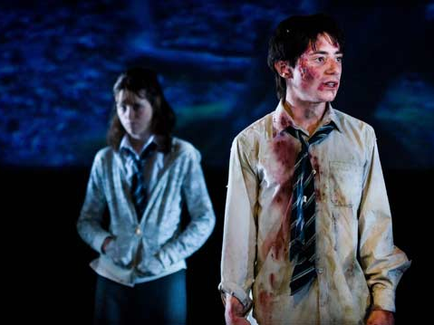
Success Criteria: D grade: C grade: B grade:
USING QWERTY TO WRITE A HIGHER LEVEL RESPONSE
Q
W
E
R
T
Y
Q
W
E
R
T
Y
Q
W
E
R
T
Y

Slide 123
One of the ways Kelly... Another way... Leah is also shown to be... The writer suggests... When he is first described...
Q
}
W
E
This is shown when it says, “___”... An example of this is when Kelly writes, “___”... For example, “___”
R
This makes the reader think... This suggests to the reader... The reader will think... This implies... This suggests...
T
The use of the simile... The writer’s word choice... The repetition of the word “___”... The alliteration of... This word has strong connotations of...
Y
This suggests... This implies... This links to...

Slide 124
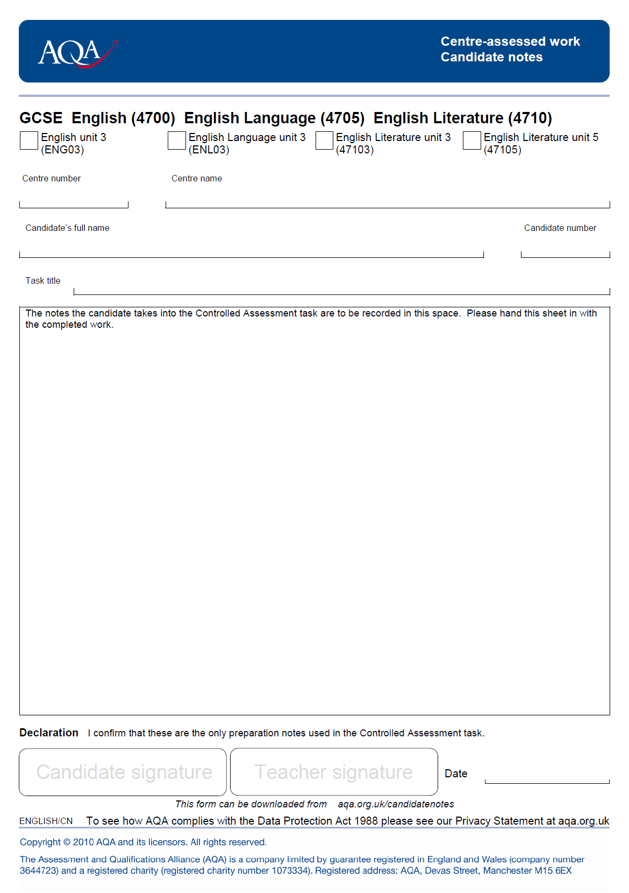
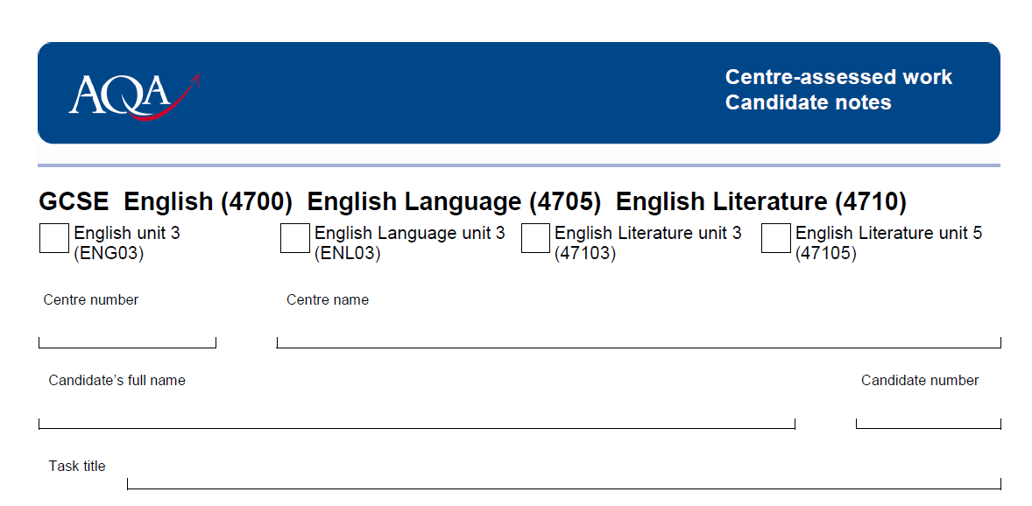
✓
42217
KESWICK SCHOOL
FULL NAME
YOUR QUESTION HERE

