Slide 1
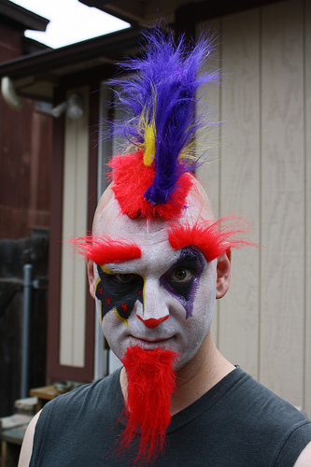
Clown Punk
By Simon Armitage

Slide 2
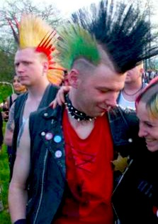
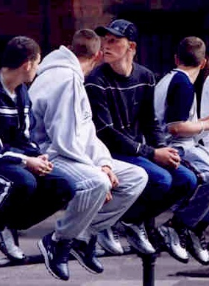
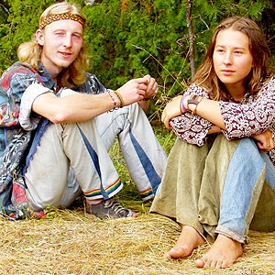
Look at the pictures below and state your initial reaction(s) to the person / people in the photo. Do not spend more than 5 seconds on each picture.
What do these people have in common? What are their differences? Whom do we judge? Whom do we fear? Why?

Slide 3
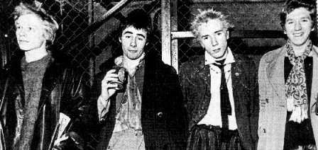
Who are these men?

Slide 4
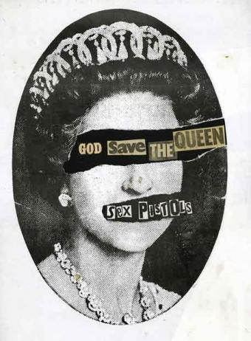
“The Sex Pistols were a revolutionary English punk rock band of the mid-1970's. Led by Johnny Rotten, they sought to convey a political message that the music industry and western society in general were exploiting and conning young people. Using outrageous clothing, including Nazi emblems, outrageous song lyrics and obscene slang language they sought to pervade the atmosphere of apathy and reach the minds of the young.”
Sex Pistols are the true originators of punk; no one else had their attitude, balls, or honesty. The Pistols were inspired by anger and poverty, not art and poetry.
-Sex Pistols official website

Slide 5
Driving home through the shonky side of town, three times out of ten you’ll see the town clown, like a basket of washing that got up and walked, towing a dog on a rope. But don’t laugh: every pixel of that man’s skin is shot through with indelible ink; as he steps out at the traffic lights, think what he’ll look like in thirty years’ time – the deflated face and shrunken scalp still daubed with the sad tattoos of high punk. You kids in the back seat who wince and scream when he slathers his daft mush on the windscreen, remember the clown punk with his dyed brain, then picture windscreen wipers, and let it rain.
Read the prose version of the poem. On your copy, divide the text into lines and stanzas wherever you feel is appropriate. What do you think this poem will look like on the page? Why?

Slide 6
‘shonky’ → ‘pixel’ → ‘indelible’ → ‘deflated’ → ‘daubed’ → ‘mush’ → | Translator  | rundown small bit permanent depressed smeared face

Slide 7
Driving home through the shonky side of town,
three times out of ten you’ll see the town clown,
like a basket of washing that got up
and walked, towing a dog on a rope. But
don’t laugh: every pixel of that man’s skin
is shot through with indelible ink;
as he steps out at the traffic lights,
think what he’ll look like in thirty years’ time –
the deflated face and shrunken scalp
still daubed with the sad tattoos of high punk.
You kids in the back seat who wince and scream
when he slathers his daft mush on the windscreen,
remember the clown punk with his dyed brain,
then picture windscreen wipers, and let it rain.
Does it look how you predicted?
Why might it look like this?

Slide 8
The Clown Punk
Listen to the poem and think of something to say about:
The tone of the poem
The meaning of the poem
The techniques used in the poem
What is the poem about?

Slide 9
Form and Structure:
This poem is set out like a sonnet; as the poem goes on the rhyme scheme starts to fall apart – like the punk will fall apart over the years?
Unconventional rhyme scheme = punk’s eccentricity.
Is the use of the sonnet form ironic? The punk is subverting traditional ideas of beauty.

Slide 10
Contrasts comfort of driving home with the discomfort of finding oneself in the ‘shonky’ side of town – a challenge
What does the phrase, ‘the shonky side of town’, suggest about the Clown Punk’s status?
Full rhyme and repetition of
‘town’ draws attention to key
idea as well as creating a
humorous tone
Driving home through the shonky side of town,
three times out of ten you’ll see the town clown,
like a basket of washing that got up
and walked, towing a dog on a rope. But
½ rhyme
Direct address
Enjambment: sense of tension/drama. Makes us pause.
Stereotypical image creates a sense of pathos (sympathy)
Verbs of movement:
‘driving’
‘got up’
‘walked’
‘towing’
Why is this significant? Think about the punk ‘movement’ as political or revolutionary.
Is this a stereotype of homelessness? Or is he clown-like? Is this a threat or humour?

Slide 11
“a basket of washing that got up
and walked”
What is Armitage saying about the punk? Is it a flattering or unflattering description?
Now look carefully at how the simile is put together:
An object (a basket of washing) that did something unexpected (got up and walked).
Does this change or add to your ideas at all?

Slide 12
To be ‘shot’:
to be exhausted
violence/injury
Imperative: links to ‘think’ and ‘remember’ (verse 4)
Enjambment draws attention to the expected reaction,
negating the automatic
reaction
Is he ‘image only’/ surface level?
don’t laugh: every pixel of that man’s skin
is shot through with indelible ink;
as he steps out at the traffic lights,
think what he’ll look like in thirty years’ time –
½ rhyme
Why is this hyphen used?
What are imperative verbs and what are the effects of Armitage’s use of them?

Slide 13
Direct address: ‘in the back seat’ isolates us/ tells us our response (to ‘wince and scream’: ironic as clowns should make children laugh)
word ‘sad’ creates
both pathos and criticism: he
is pathetic as well as tragic
the deflated face and shrunken scalp
still daubed with the sad tattoos of high punk.
You kids in the back seat who wince and scream
when he slathers his daft mush on the windscreen,
Suggests childish painting
Colloquial, informal language to provoke laughter rather than fear
Why are ‘deflated’ and ‘shrunken’ effective descriptions?
Why does the poet use the words ‘you’ and ‘you’ll’?
Contrast the poetic language and tone of lines 9/10 with lines 11/12. What is the effect of this?

Slide 14
Link to ‘indelible ink’ (line 6)
More imperatives: ‘remember’, ‘picture’, ‘let’
remember the clown punk with his dyed brain,
then picture windscreen wipers, and let it rain.
‘picture’ highlights the power
of the imagination: that
children can create images of
their own to combat their fear
‘Rain’ will wash the memory of the punk away; will it wash away his symbols and force him to conform?

Slide 15
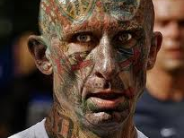
When asked about this poem, Armitage said that a man he used to see on the street influenced him. He stated: ‘”I used to see a man around town quite a lot, who once pressed his face up against the windscreen of my car while I was stopped at the traffic lights. There's a tradition in English Literature of writing such poems, where one type of person stands eyeball to eyeball with another type, and something passes between them.’”
What could be the ‘something’ that passes between strangers when they are confronted with their differences?

Slide 16
Statement | True, false or debatable?
The speaker is an objective recorder of events.
The punk conforms to our expectations.
The children are frightened by the punk’s appearance alone.
The speaker reduces the punk to a series of images so that he can understand him better.
The poem asks us to judge the punk.
The speaker is an adult, and his words are aimed at the children in the car and not at adult readers.
The punk is merely playing up to our expectations.
The speaker’s views and language show he has sympathy for the punk.

Slide 17
Discussion Time!
What is the poet trying to say?
Is he sad or disapproving of the punk?
Does he use the clown punk as a warning to society or does he use him as a sympathetic character?
Is this poem a warning about what people can become or a message about having sympathy for the disadvantaged?

Slide 18
It’s time to summarise! We’re going to make a note of the poem’s VITALS.

Slide 19
Poetry VITALS…
Voice: Who is speaking in the poem?
Imagery: What imagery is being created? How is it effective?
Theme: What are the main themes featured in the poem?
Address: Who is the poem addressed to? Why?
Language (Features): What type of language/ devices are used?
What is their effect?
Structure: How is the poem laid out? What is the effect of this?
Notes:
This is the acronym that we will use on each poem to look at all the different aspects

