Slide 1
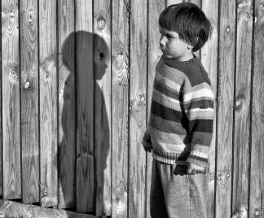
Brendon Gallacher
By Jackie Kay

Slide 2
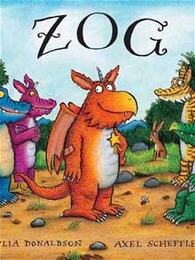
What are the characteristics of songs, nursery rhymes and young children’s books?
Rhyme
Repetition
Simple grammar
Alliteration
Strong rhythm

Slide 3
Brendon Gallacher
Listen to the poem and think of something to say about:
The tone of the poem
The meaning of the poem
The techniques used in the poem
http://youtu.be/CxDl9jWgLRk
What is the poem about?

Slide 4
Brendon Gallacher
He was seven and I was six, my Brendon Gallacher.
He was Irish and I was Scottish, my Brendon Gallacher.
His father was in prison; he was a cat burglar.
My father was communist party full-time worker.
He had six brothers and I had one, my Brendon Gallacher.
He would hold my hand and take me by the river
where we'd talk all about his family being poor.
He'd get his mum out of Glasgow when he got older.
A wee holiday some place nice. Some place far.
I'd tell my mum about my Brendon Gallacher.
How his mum drank and his daddy was a cat burglar.
And she'd say, 'why not have him round to dinner?'
No, no, I'd say he's got big holes in his trousers.
I like meeting him by the burn in the open air.
Then one day after we'd been friends for two years,
One day when it was pouring and I was indoors,
my mum says to me, 'I was talking to Mrs Moir
who lives next door to your Brendon Gallacher
Didn't you say his address was 24 Novar?
She says there are no Gallachers at 24 Novar
There never have been any Gallachers next door.'
And he died then, my Brendon Gallacher,
flat out on my bedroom floor, his spiky hair,
his impish grin, his funning flapping ear.
O Brendon. Oh my Brendon Gallacher.
Jackie Kay
What is the poem about?

Slide 5
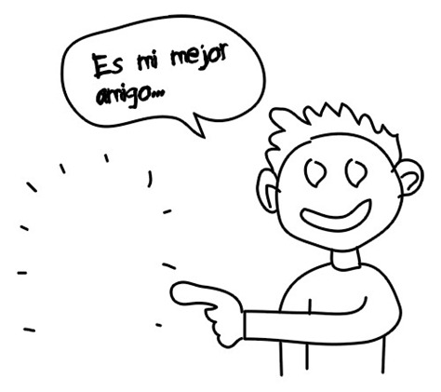
What is the poem about?
The narrator tells us about a friendship she had when she was younger. However, the friendship was imaginary. She allowed her fantasies to provide her comfort and joy – until they were swept away by her mother.

Slide 6
What are the differences between the narrator and Brendon Gallacher?
Get into a group of three – a ‘scribe’ and two ‘runners’.
The runners must find the statements hidden around the room and give them to the scribe, who writes them in the given table.
Runners are not allowed to pick up the statements or shout them across the room.
Runners must give only one statement at a time.
Scribes must remain seated at all times.

Slide 7
How many did you get?

Slide 8
In your groups, discuss why you think the narrator made Brendon Gallacher have a mum who ‘drank’ and a father who was a ‘cat burglar’? Why was he so different to her family and life?

Slide 9
Form
Ballad: 5 equal stanzas; tells a story; sad ending
Repetition of ‘Brendan Gallacher’ like a refrain/chorus makes it song-like (combined with simple, childish vocab, this reminds us of a childhood rhyme or skipping game); it also stresses how much she loved him
Recurring ‘r’ sound – rhymes; accentuates the Scottish accent (this, along with Scots dialect – ‘wee’ and ‘burn’ – creates a vivid voice; makes the poem more personal)
Direct speech gives a sense of immediacy and engagement with the voice

Slide 10
Why is it important that she uses the possessive pronoun ‘my’?
The first stanza details the contrasting backgrounds of the poet and her imaginary friend. The use of the words ‘he’ and ‘I’ make the contrasts stand out. Who has the most exciting life?
Different ages
He was seven and I was six, my Brendon Gallacher.
He was Irish and I was Scottish, my Brendon Gallacher.
His father was in prison; he was a cat burglar.
My father was communist party full-time worker.
He had six brothers and I had one, my Brendon Gallacher.
Different nationalities
Different family sizes

Slide 11
Alliteration draws our attention: sense of innocence and companionship
He appears to be in charge, he takes her - security
He would hold my hand and take me by the river
where we'd talk all about his family being poor.
He'd get his mum out of Glasgow when he got older.
A wee holiday some place nice. Some place far.
I'd tell my mum about my Brendon Gallacher.
Enjambment – this experience is spread out over two lines: recurring; security
What does this imply about the experience of growing up in Glasgow?
So why might she have Brendon Gallacher as a friend?
‘some place’ = emotion of reminiscence
Liked to tell her mother, to talk about him as if he were real

Slide 12
We see a young poet’s imagination developing as she makes up a detailed background for her imaginary friend. Even his parents have romantic lives as a “drunk” and a “cat burglar”. He seems to have a far more interesting life; she makes him sound exciting.
Childish language
How his mum drank and his daddy was a cat burglar.
And she'd say, 'why not have him round to dinner?‘
No, no, I'd say he's got big holes in his trousers.
I like meeting him by the burn in the open air.
Then one day after we'd been friends for two years
Direct speech, adding to informal style
Humorous – childish response
Indicates the coming change in mood
What is the significance of the ‘burn’ and the ‘open air’ (as contrasted to ‘round for dinner’)? What does Brendon represent?

Slide 13
Repetition creates tension, draws us towards the dramatic conclusion, and the importance of this ‘one day’
Links weather to change in mood (pathetic fallacy)
One day when it was pouring and I was indoors,
my mum says to me, 'I was talking to Mrs Moir
who lives next door to your Brendon Gallacher
Didn't you say his address was 24 Novar?
She says there are no Gallachers at 24 Novar
Enjambment – sense of tension/suspense
He only exists for her
Colloquialism; also marks the move to present tense, creating a sense of immediacy
Why does she use dialogue? What is the effect?

Slide 14
Look at the words in the box on the right. What do you notice?
In pairs, use the words to fill the gaps in the poem.
Moir 24
no
Novar
doors
pour
Novar
door
are
24
One day when it was ____ing and I was in____,
my mum says to me, 'I was talking to Mrs ____
who lives next ____ to your Brendon Gallacher
Didn't you say his address was ___ _____?
She says there ____ ____ Gallachers at ___ ____
What is the effect of the internal rhyme and rhythm in these stanzas? What might it reflect?

Slide 15
Why are the lines shorter in this final stanza?
How does the tone of the poem change in this stanza?
He only exists in her imagination
Fond memories; mischievous adjectives show he really existed for her. Alliteration draws our attention to endearing details. Are they cartoonish?
Physical descriptions only given in the final stanza – his personality is what made him special
‘impish’ – mythological quality
There never have been any Gallachers next door.'
And he died then, my Brendon Gallacher,
flat out on my bedroom floor, his spiky hair,
his impish grin, his funny flapping ear.
O Brendon. Oh my Brendon Gallacher
What is the effect of the line ‘he died then’?
What is the effect of referring to him as just ‘Brendon’ here?
What feeling does the repeated ‘Oh’ create?

Slide 16
Language quiz:
For each quotation, say what you notice about how language is being used.
Use the correct terminology if you can!
Enjambment Refrain Repetition
Incomplete sentence Child’s voice
Dialect Conversational style

Slide 17
‘I was talking to Mrs Moir
who lives next door to your Brendon Gallacher.’
Enjambment – one of two examples in the poem in which the sentence continues on to the next line without any pause. It helps create a natural, conversational tone.
Enjambment Refrain Repetition
Incomplete sentence Child’s voice
Dialect Conversational style

Slide 18
‘Some place far.’
Incomplete sentence – adds to the conversational, informal style.
Enjambment Refrain Repetition
Incomplete sentence Child’s voice
Dialect Conversational style

Slide 19
‘A wee holiday some place nice. Some place far.’
Conversational style – here the poet uses the sort of incomplete sentences which occur in conversation, and the typically Scottish word ‘wee’ (little).
Enjambment Refrain Repetition
Incomplete sentence Child’s voice
Dialect Conversational style

Slide 20
‘I like meeting him by the burn in the open air.’
Dialect – here Kay uses ‘burn’, a Scottish word for a stream. The poem is firmly rooted in Glasgow where Jackie Kay was brought up and words like this give the poem a realistic, authentic air.
Enjambment Refrain Repetition
Incomplete sentence Child’s voice
Dialect Conversational style

Slide 21
‘He’d get his mum out of Glasgow when he got older.’
A child’s voice – the use of words like ‘mum’ gives the poem a colloquial, childlike quality which seems to fit a poem about childhood memories.
Enjambment Refrain Repetition
Incomplete sentence Child’s voice
Dialect Conversational style

Slide 22
‘He was seven and I was six, my Brendon Gallacher.
He was Irish and I was Scottish, my Brendon Gallacher.’
Refrain – the phrase is repeated six times in the poem and once varied as ‘your Brendon Gallacher’. The repetition of the possessive pronoun ‘my’ emphasises the importance of Brendon Gallacher to the speaker.
Enjambment Refrain Repetition
Incomplete sentence Child’s voice
Dialect Conversational style

Slide 23
‘Then one day after we’d been friends for two years,
one day when it was pouring and I was indoors,’
Repetition – the repetition of the marker ‘one day’ signals to the reader that this was a momentous day – the day that ‘Brendon’ died.
Enjambment Refrain Repetition
Incomplete sentence Child’s voice
Dialect Conversational style

Slide 24
Each person on your table should read one of the paragraphs opposite.
Now you need to summarise your paragraph for the others on your table.
Discuss each paragraph and make notes on your ideas. Do you agree with the study guide?

Slide 25
Discussion Time!
Consider the content, atmosphere and contrasts in the poem. What is the effect of these on the reader?
What is your overall impression of the poem?
Why do you think Brendon Gallacher is so important to the speaker?
What are the main themes of the poem?
Discuss your ideas in your groups. Any final thoughts?

Slide 26
It’s time to summarise! We’re going to make a note of the poem’s VITALS.

Slide 27
Poetry VITALS…
Voice: Who is speaking in the poem?
Imagery: What imagery is being created? How is it effective?
Theme: What are the main themes featured in the poem?
Address: Who is the poem addressed to? Why?
Language (Features): What type of language/ devices are used?
What is their effect?
Structure: How is the poem laid out? What is the effect of this?
Notes:
This is the acronym that we will use on each poem to look at all the different aspects

