Slide 1
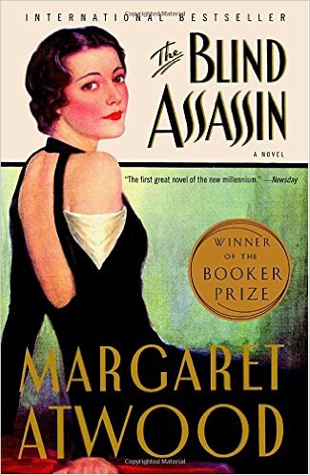
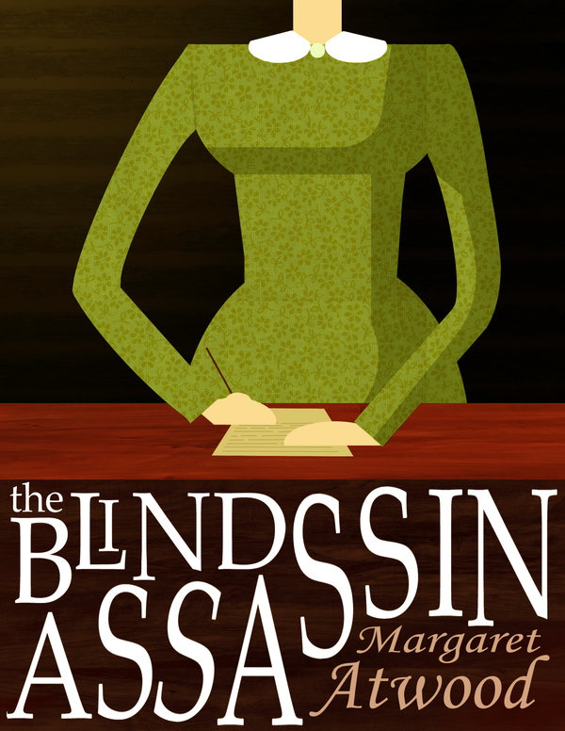
Margaret Atwood’s ‘The Blind Assassin’
What does the title of the book tell us about the ideas and themes? What might the book be about?

Slide 2
What is the passage about?
Read the extract and complete the two Q1s on your sheet.
You have 15 minutes.

Slide 3
Paper One: Question 2
Look in detail at the fourth paragraph.
How does the writer use language here to describe Iris’ reaction?
You could include the writer’s choice of:
words and phrases
language features and techniques
sentence forms.

Slide 4
How does the writer use language here to describe Iris’ reaction?
"I suppose you want someone to identify her," I said. "I'll come down as soon as I can." I could hear the calmness of my own voice, as if from a distance. In reality I could barely get the words out; my mouth was numb, my entire face was rigid with pain. I felt as if I'd been to the dentist. I was furious with Laura for what she'd done, but also with the policeman for implying that she'd done it. A hot wind was blowing around my head, the strands of my hair lifting and swirling in it, like ink spilled in water.

Slide 5
How does the writer use language here to describe Iris’ reaction?
Iris is really shocked her sister Laura has died. This is evidence in "In reality I could barely get the words out; my mouth was numb, my entire face was rigid in pain. I felt as if I'd been to the dentist." This proves that she felt very upset and like her mouth had been numbed, like when you have been to the dentist. This simile has a big effect on the reader and paints a picture in your mind.
How many marks would this answer get out of 8?
Level 1: Simple and limited- 1-2 marks

Slide 6
How does the writer use language here to describe Iris’ reaction?
Iris has a big reaction to the news that her sister has died. Her mouth is "numb" and she uses a simile to describe how she feels as if she has "been to the dentist". This could be because when you go to the dentist you are in lots of pain and now she feels as if she is in lots of emotional pain. This would make the audience feel sorry for her. This could be because she is sad her sister has died. This could be because she doesn't want to believe it. She said her mouth was "numb" this could be because when you go to the dentist they numb your mouth, and she feels like she can't speak, like when your mouth has been numbed. But she can't speak because she is so shocked that her sister has died.
She says she is "furious" with her sister, this word suggests extreme anger, and implies that Laura has really hurt her sister, and Iris is angry with her, but she also is angry at the policeman for suggesting she has committed suicide, so it shows that she loves her sister too, as she doesn't want people to think badly of her.
How many marks would this answer get out of 8?
Level 2: Some, attempts – 3-4 marks

Slide 7
How does the writer use language here to describe Iris’ reaction?
Iris' reaction to her sister's death is at first to feel disconnected to the events, she describes herself as hearing her own voice "in the distance". This literally means that her own voice sounded to her as if it was far away, metaphorically it mean that this behaviour of Laura's has made her question who she is, and if she ever really knew her sister- as if she is now a stranger to herself.
Iris feels conflicted by feeling "furious" with her sister for committing suicide and also with the detective for suggesting it. This mixture of emotions is reflected in the use of parallelism. "I use furious with Laura for what she'd done, but also with the policeman for suggesting she'd done it." This style reflects the way that Iris' anger comes from the actions of Laura- the way the sentence begins and then ends with the reference to the suicidal act reveals how Iris is struggling to move past it.
How many marks would this answer get out of 8?
Level 3: Clear, relevant – 5-6 marks

Slide 8
How does the writer use language here to describe Iris’ reaction?
How many marks would this answer get out of 8?
Iris' reaction to her sister's death is at first to feel disconnected to the events, she describes herself as hearing her own voice "in the distance". This literally means that her own voice sounded to her as if it was far away, figuratively it suggests that she is so shocked by what has happened, it feels as if it hasn't really happened to her, and symbolically it could mean that this behaviour of Laura's has made her question who she is, and if she ever really knew her sister- as if she is now a stranger to herself.
Iris feels conflicted by feeling "furious" with her sister for committing suicide and also with the detective for suggesting it. This mixture of emotions is reflected in the use of parallelism. "I use furious with Laura for what she'd done, but also with the policeman for suggesting she'd done it." This parallelism reflects the equal blame Iris places for the source of her fury- both her sister, and the policeman. The reader may feel that blaming the policeman is unfair, and could be a result of shock after hearing about her sister, or could be indicative of Iris' character, as someone who is upright and concerned about appearances.
Iris uses an image of ink swirling in water to describe her hair moving in the hot wind. This physical discomfort could be metaphorical for Iris' emotional confusion, and the simile comparison could symbolise how Iris' emotions are a mixture of different feelings, like the mixture of ink and water.
Level 4: Detailed, perceptive – 7-8 marks

Slide 9
Paper One: Question 2
Look in detail from lines 23 to 31.
How does the writer use language here to describe Laura and her accident?
You could include the writer’s choice of:
words and phrases
language features and techniques
sentence forms.

Slide 10
Paper One: Question 3
You now need to think about the whole of the source.
The text is from the beginning of a novel.
How has the writer structured the text to interest you as a reader?
You could write about:
What the writer focuses your attention on at the beginning
How and why the writer changes this focus as the extract develops
Any other structural features that interest you

Slide 11
How has the writer structured the text to interest the reader?
How many marks would this answer get out of 8?
The writer makes us wonder first of all if Laura had killed herself, because we aren't sure, because we know the car went over the side but we don't know if she has died. This would make the reader question themselves and ask themselves I wonder if she is dead, and then you find out that yes she is dead but we have to wait to hear it and they have done that on purpose, maybe because she didn't like her sister so she didn't want to say it straight away.
It also uses dramatic irony. This is when the reader knows something and the characters think they know but actually they're wrong. Like with the Titanic.
It opens with us finding out her sister has died, this grabs your attention because it makes you sad.
Level 1: Simple and limited- 1-2 marks

Slide 12
How has the writer structured the text to interest the reader?
How many marks would this answer get out of 8?
The extract opens with the dramatic news that Laura has driven her car off of a cliff. This is gripping and grabs the reader's attention and would make them want to read on. Perhaps you would ask yourself, has she died? However, it is a sensible guess to assume she has died, and that is correct, and we find that out when she says "charred smithereens". This creates a strong image in your mind, as it is a horrid idea that someone has burned to death.
We see the sister, Iris (who is telling the story and is the sister of Laura, the girl who has killed herself, though we aren't sure if she did it on purpose though we can assume she probably did). And Iris is getting more and more upset, we see her change from being very calm, to being upset. This grabs our attention as we are interested to see what her reaction is going to be and how upset she will be, because she has just heard her sister has died that is something that people normally get upset about.
Level 2: Some, attempts – 3-4 marks

Slide 13
How has the writer structured the text to interest the reader?
How many marks would this answer get out of 8?
By opening with the dramatic news that her sister has driven her car off a cliff. By using understatement, and a cold reaction that slowly grows in her upset, the reader is engaged and would be intrigued as to how she her reaction will change next.
The writer also uses a motif of religion and forgiveness. Laura is described as wearing gloves like "Pontius Pilate", and clothes that are "penitential" colours. These religious references could engage the reader, as they would wonder what Laura had done to be sorry for, and why Iris is describing her like this.
The extract ends with a mysterious reference to letters that Laura put in Iris' drawer. These letters must be important, and Laura would have left them for a good reason, and could be linked to her suicide.
Level 3: Clear, relevant – 5-6 marks

Slide 14
How has the writer structured the text to interest the reader?
How many marks would this answer get out of 8?
Atwood opens the chapter quietly, by breaking the news that her sister has driven her car off the cliff. Her reaction begins to be focused on the damage to the car, and then shifts to her emotional and physical reaction to her sister's death. This growing tension reveals the complex feelings she has about her death, and interests the reader, as they would be intrigued as to the motivations for Laura's death (that Iris hints at, but never explicitly reveals) and Iris' growing upset, that seems to be getting out of control.
When describing Laura, Atwood uses a motif of religious imagery. Laura is described as wearing gloves like "Pontius Pilate", and clothes that are "penitential" colours. These religious references could engage the reader, as they would wonder what Laura had done to be sorry for, and why Iris is describing her like this. Pontius Pilate did not want to be associated with the death of Jesus, therefore this religious allusion could suggest that Iris believes Laura did not want to be associated with her.
The extract ends with a mysterious reference to letters that Laura put in Iris' drawer. These letters must be important, and Laura would have left them for a good reason, and could be linked to her suicide. The fact that they were left in her "stocking" drawer implies a certain level of intimacy, and the reader can infer that Laura would have wanted only Iris to find them, and that they must be very important. This image of Laura, compared to the opening, suggests someone who is very calculating and cautious- not wild, reckless and selfish.
Level 4: Detailed, perceptive – 7-8 marks

Slide 15
How has the writer structured the text to interest the reader?
Sequence through a passage- where does it start, what happens next, are there any links?
Characters- how are they introduced? Are we told their names straight away? How are we supposed to react to them?
Direct speech- who talks? Who doesn’t?
Repetitions, threads, patterns- are any ideas developed? Repeated?
The opening- what happens?
The ending- does it link back to anything? Does it build on anything?
Shifts of focus- does the setting get bigger? Smaller?
Connections and links across paragraphs
What about the timing of the day? Month? Year?

Slide 16
Paper One: Question 3
You now need to think about the whole of the source.
The text is from the beginning of a novel.
How has the writer structured the text to interest you as a reader?
You could write about:
What the writer focuses your attention on at the beginning
How and why the writer changes this focus as the extract develops
Any other structural features that interest you

Slide 17
One of the ways Hill structures the opening chapter is... Another way the passage is structured is... The writer begins by telling us about... Another structural point is …
Q
}
W
E
This is shown when it says, “___”...
An example of this is when Hill writes, “___”...
For example, “___”
R
This makes the reader think...
This suggests to the reader... The reader will think... This implies... This suggests...
T
The use of the direct speech... The use of the paragraphs ...The repetition of... This setting… The use of time…The shift in focus from…to…
Y
This links to ... This connects to ... This builds an atmosphere of...

Slide 18
Paper One: Question 4
Focus this part of your answer on the first part of the source.
A student, having read this section of the text, said: “This part of the story, re-telling a devastating moment in Laura's life, reveals a distance between the two sisters.”
To what extent do you agree?
In your response, you could:
• consider your own impressions of Iris
• evaluate how the writer shows that Iris feels distant from her sister
• support your opinions with references to the text.

Slide 19
Genre
Is the text part of a recognisable genre?
Reader Response
What response does the writer provoke – and how?
Atmosphere
How does the writer create a particular mood?
Description
Of character – How does the description give us an insight into the character?
Of location – How does the description of place add to the reader’s appreciation of the atmosphere?
= Evaluation

Slide 20
‘This part of the text reveals a distance between the two sisters’
How many marks would this answer get out of 20?
Iris finds out that her sister Laura has killed herself by driving her car off a cliff. She doesn't know for sure if she killed herself, but that is what the policemen thinks who called her to tell her that she has died. She was seen by two different people driving off the cliff, so we know she probably did kill herself. Laura killed herself in Iris' car. That is why the policeman called her to tell her. And now Iris needs to identify the body. We know this because it says "do you need me to identify the body". This suggests that there is a distance between them as she doesn't seem to be very upset. However, she could be in shock and that would explain why she isn't crying or is very emotional. Because Laura used Iris' car we know that they must be quite close because she borrowed her car.
Level 1: Simple and limited- 1-5 marks

Slide 21
‘This part of the text reveals a distance between the two sisters’
How many marks would this answer get out of 20?
Iris is very detached when she describes finding out her sister has died. She simply states "Laura drove a car off a bridge." The abruptness of the sentence, and the lack of description suggests the two sisters aren't close.
Iris also spends lots of time describing the car, and how her car was destroyed. This suggests she cares more about the car than her sister.
"She was completely ruthless in that way." This shows how Iris doesn't like her sister.
"my entire face was rigid with pain" this implies that although what Iris is saying doesn't show she cares, she is still upset at the news.
Level 2: Some, attempts – 6-10 marks

Slide 22
‘This part of the text reveals a distance between the two sisters’
How many marks would this answer get out of 20?
Iris is very detached when she describes finding out her sister has died. She simply states "Laura drove a car off a bridge." The abruptness of the sentence, and the lack of description suggests the two sisters aren't close. Iris also opens with the timing of when Laura died, revealing she died in the second clause of the sentence, as if the timing was more important than her death.
Iris also spends lots of time describing the car, and how her car was destroyed. This suggests she cares more about the car than her sister. Iris describes the car "smashing" through "feathery new leaves". This deathly image is softened by the natural beauty of the leaves- it is an unusual way to describe your sister dying, and implies that there is something not right in their relationship.
Once Iris finds out it was suicide, she reflects "She was completely ruthless in that way." This reaction implies that Iris wasn't surprised that her sister did this deliberately, and possibly feels angry with her. The adjective "ruthless" implies that Laura was a cruel person who didn't care about other people.
As Iris processes the information, she observes that "my entire face was rigid with pain" this implies that although what Iris is saying doesn't show she cares, she is still upset at the news. This reveals that as a person she perhaps tries to conceal her real feelings, possibly because she feels protective.
Level 3: Clear, relevant – 11-15 marks

Slide 23
‘This part of the text reveals a distance between the two sisters’
How many marks would this answer get out of 20?
Iris is very detached when she describes finding out her sister has died. Iris opens with the timing of when Laura died, revealing she died in the second (main) clause of the sentence, as if the timing was more important than her death. Then, she simply states "Laura drove a car off a bridge." The abruptness of the sentence, and the lack of description suggests that Iris feels a level of detachment to this event, focusing on the action of what Laura did (drive the car) over the result of that action (her death).
Iris describes the car falling and it's destruction is detail. This suggests she cares more about the car than her sister. Iris describes the car as it "fell", "smashing", "rolled" and "burst into flames". These verb choices imply a level of violence in how Laura died- but instead of describing her in the car, she describes the car itself. This literal separation metaphorically symbolises the way Iris has separated the two things in her mind, and reveals that her relationship with her sister was fraught with tension. Iris casually comments that all that was left of her sister was "charred smithereens", almost dehumanising her, and treating her dead body as if it was just another part of the car.
Once Iris finds out it was suicide, she reflects "She was completely ruthless in that way." This reaction implies that Iris wasn't surprised that her sister did this deliberately, and possibly feels angry with her. The adjective "ruthless" implies that Laura was a cruel person who didn't care about other people. At this point, we are beginning to understand Iris' unusual reaction to her sister's death, it is being implied that Iris has taken her method of suicide personally, that because she destroyed her car, Laura was in some way trying to hurt Iris, or send her a message.
As Iris processes the information, she observes that "my entire face was rigid with pain" this implies that although what Iris is saying doesn't show she cares, she is still upset at the news. This reveals that as a person she perhaps tries to conceal her real feelings, possibly because she feels as if she has to because who she is. We know that her husband Richard is important, as the policeman may have "recognised his name".
Level 4: Detailed, perceptive – 16-20 marks

Slide 24
Paper One: Question 4
Focus this part of your answer on the second part of the source from line 35 to the end.
A student, having read this section of the text, said: “This part of the text presents the narrator, Iris Chase, as a careful and deliberate woman but also as someone who is devastated and all alone.”
To what extent do you agree?
In your response, you could:
• consider your own impressions of Iris Chase, how she behaves and what she remembers
• evaluate how the writer creates these impressions of Iris Chase
• support your opinions with references to the text.

Slide 25
Genre
Is the text part of a recognisable genre?
Reader Response
What response does the writer provoke – and how?
Atmosphere
How does the writer create a particular mood?
Description
Of character – How does the description give us an insight into the character?
Of location – How does the description of place add to the reader’s appreciation of the atmosphere?
= Evaluation

Slide 26
The language of evaluation – don’t just say ‘good’!
Powerful
Memorable
Intriguing
Engaging
Vivid
Life-like
Insightful
Specific
Impressive
Striking
You will have 20 minutes in the exam to write this answer.
Don’t always say it’s ‘good.’ Think about the different ways you can describe something as ‘good’.
Let’s have a go…
Effective
Dramatic
Engaging
Concise

Slide 27
Paper One: Question 4
Focus this part of your answer on the second part of the source from line 35 to the end.
A student, having read this section of the text, said: “This part of the text presents the narrator, Iris Chase, as a careful and deliberate woman but also as someone who is devastated and all alone.”
To what extent do you agree?
In your response, you could:
• consider your own impressions of Iris Chase, how she behaves and what she remembers
• evaluate how the writer creates these impressions of Iris Chase
• support your opinions with references to the text.

