Slide 1
Learning Objective To study Chapter 8 of the novel

Slide 2
Learning Objective: To study Chapter 8 of the novel
What is the effect of this chapter title? Remember that there are two more chapters left after this one…

Slide 3
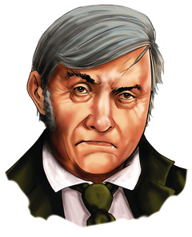
Learning Objective: To study Chapter 8 of the novel
The importance of Poole
During Poole’s brief appearances in the novel so far, he has simply been ‘Poole, the butler’, calmly carrying out his duties. In Chapter 8, however, Stevenson describes Poole’s emotions and behaviour. Here, he becomes an important witness to events that have occurred in Jekyll’s house.
Re-read the account of Poole’s arrival at Utterson’s house. Match up details from the text with the statements about Poole.
Poole’s arrival shocks Utterson.
Poole’s appearance and manner make him seem ill.
Poole is unwilling or unable to explain what is wrong.
Poole is very frightened.

Slide 4
Learning Objective: To study Chapter 8 of the novel
1. Utterson exclaims ‘Bless me!’ when ‘he was surprised’ at Poole’s visit.
3. Poole ‘daren’t say’ what he means. He does not answer Utterson directly.
2. Utterson asks, ‘What ails you?’; ‘Poole’s manner was altered for the worse.’
4. Poole says that he has been afraid for, ‘about a week’.
Re-read the account of Poole’s arrival at Utterson’s house. Match up details from the text with the statements about Poole.
Poole’s arrival shocks Utterson.
Poole’s appearance and manner make him seem ill.
Poole is unwilling or unable to explain what is wrong.
Poole is very frightened.

Slide 5
Learning Objective: To study Chapter 8 of the novel
AO3: Domestic servants were divided into upper and lower classes. Only a handful of households were able to employ the stereotypical assortment of 'upper' servants such as butler,, skilled cook, housekeeper and lady's maid, as well as the 'lower' servants: kitchen-maid, scullery-maid, laundress etc. For smaller households the priority was to employ female 'lower' servants to perform the dirty, heavy work.
Read your handout on Class and Behaviour in Victorian Times. How does this add to our understanding of Poole’s discomfort?

Slide 6
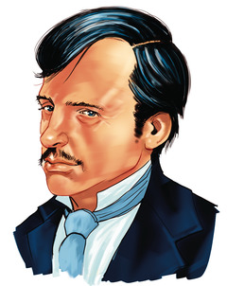
Learning Objective: To study Chapter 8 of the novel
‘The hall, when they entered it, was brightly lighted up; the fire was built high; and about the hearth the whole of the servants, men and women, stood huddled together like a flock of sheep. […] ‘What, what? Are you all here?’ said the lawyer peevishly. ‘Very irregular, very unseemly; your master would be far from pleased.’
‘They’re all afraid,’ said Poole.’
The disordered natural world that Stevenson presents in this chapter is foreshadowed by the disordered state of Jekyll’s house – the servants are all huddled together in a way that Utterson calls ‘very unseemly’. They are breaking the natural Victorian way of things – the reason Poole gives for this is their fear.
Poole and the servants defer to Utterson because he has higher social status. He quickly takes charge, putting himself at the centre of the action.

Slide 7
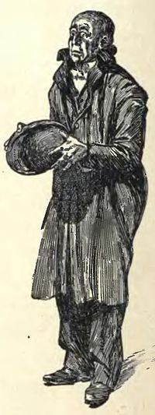
Learning Objective: To study Chapter 8 of the novel
Find a quote that shows the following:
Poole and the servants are relieved to see Utterson.
They use respectful language.
Utterson speaks with authority.

Slide 8
Learning Objective: To study Chapter 8 of the novel
Find a quote that shows the following:
Poole and the servants are relieved to see Utterson.
‘Bless God! It’s Mr Utterson!’
They use respectful language.
‘Sir’
Utterson speaks with authority.
‘Very irregular, very unseemly; your master would be far from pleased.’

Slide 9
Learning Objective: To study Chapter 8 of the novel
Poole as a loyal servant
Poole is a witness to the appearance, habits and behaviour of both Dr Jekyll and Mr Hyde. He has worked for Jekyll for many years and has been in the house to see Hyde’s comings and goings. At the beginning of the chapter, there is evidence to suggest that Poole feels he is being disloyal to his master: ‘[he] had not once looked the lawyer in the face.’ Later, when Utterson says they must be frank with each other and ‘make a clean breast of their suspicions’, Poole gives his opinion of Mr Hyde and says he was the ‘masked figure’ in the laboratory.
These details mean that we can consider Poole a ‘reliable witness’ or ‘reliable narrator’ – i.e. we believe what he tells us.

Slide 10
Learning Objective: To study Chapter 8 of the novel
Poole on Hyde
Metaphors express physical reactions and create an impression of horror around Hyde.
‘…there was something queer about that gentleman – something that gave a man a turn […] you felt it in your marrow kind of cold and thin.
‘Well, when that masked thing like a monkey jumped from among the chemicals and whipped into the cabinet, it went down my spine like ice.’
What other ideas could you add to an analysis of this extract?
A simile compares Hyde to an animal, making him sound primitive and dangerous.

Slide 11
Learning Objective: To study Chapter 8 of the novel
Poole on Jekyll
‘My master […] is a tall, fine build of a man […] do you think I do not know my master after twenty years? Do you think I do not know where his head comes to in the cabinet door, where I saw him every morning of my life?’
Look for ways that Poole shows his respect for Jekyll.

Slide 12
Learning Objective: To study Chapter 8 of the novel
Diaphanous: light, delicate, and translucent
‘It was a wild, cold, seasonable night of March, with a pale moon, lying on her back as though the wind had tilted her, and flying wrack of the most diaphanous and lawny texture. The wind made talking difficult, and flecked the blood into the face. It seemed to have swept the streets unusually bare of passengers, besides; for Mr. Utterson thought he had never seen that part of London so deserted. He could have wished it otherwise; never in his life had he been conscious of so sharp a wish to see and touch his fellow-creatures; for struggle as he might, there was borne in upon his mind a crushing anticipation of calamity. The square, when they got there, was full of wind and dust, and the thin trees in the garden were lashing themselves along the railing.’
Stevenson uses pathetic fallacy to describe a stormy scene, filled with foreboding. Annotate the extract you have been given with ideas about the effect of the language used on the reader. Try to identify and analyse examples of:
Adjectives
Personification
Sense descriptions
Onomatopoeia
Wrack: A mass of high, thick, fast-moving cloud
Lawn: A fine fabric used for making clothes

Slide 13
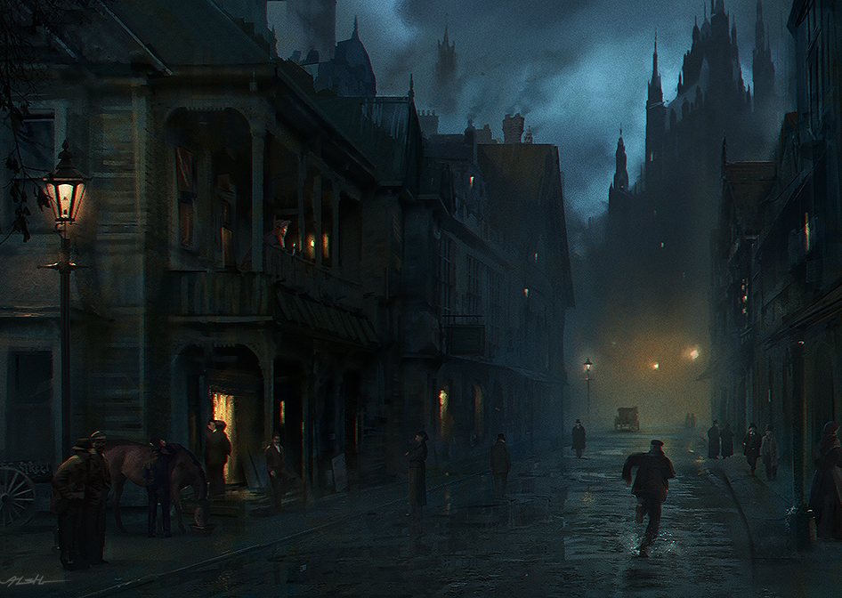
Learning Objective: To study Chapter 8 of the novel
Scud: a mass of vapoury clouds or spray driven fast by the wind
These are typical features of gothic literature. As Poole and Utterson prepare to break into the cabinet, Stevenson again describes the weather:
‘The scud had banked over the moon, and it was now quite dark. The wind, which only broke in puffs and draughts into that deep well of building, tossed the light of the candle to and fro about their steps, until they came into the shelter of the theatre, where they sat down silently to wait. London hummed solemnly all around; but nearer at hand, the stillness was only broken by the sounds of a footfall moving to and fro along the cabinet floor.’
How does the weather reflect the events of the novel? What effect would the language used have on the reader? Annotate your copy of this extract with your ideas.
AO3: Gothic novels, which became popular in the c18th, explored ideas about death and passionate feelings that were often linked to the supernatural. Their settings were wild, dark and eerie and they dealt with terrifying elements.

Slide 14
Learning Objective: To study Chapter 8 of the novel
Mottled: marked with spots or smears of colour
The events of this chapter seem dangerous and terrifying. Stevenson shows us the physical effect fear has.
‘Mr Utterson’s nerves […] gave a jerk that nearly threw him from his balance.’
Write these quotes into your book and then find them in the chapter. What causes each reaction in the men?
‘The hair stood up on my head like quills.’
‘[The butler turned] a sort of mottled pallor.’
‘Something that gave the man a turn […] felt in your marrow kind of cold and thin’
‘a sudden chill of horror’
‘with bated breath’

Slide 15
Learning Objective: To study Chapter 8 of the novel
‘And see here, sir, if by any
chance he was to ask you in, don’t go’
‘He looked up when I came in, gave a kind of cry, and whipped upstairs into the
cabinet.’
‘that thing was not my master, and there’s the truth’
‘Mr Utterson’s nerves […] gave a jerk that nearly threw him from his balance.’
‘The hair stood up on my head like quills.’
‘…if you mean, was it
Mr. Hyde? Why, yes, I think it was!’
‘[The butler turned] a sort of mottled pallor.’
‘Once I heard it weeping!’
‘Something that gave a man a turn […] felt in your marrow kind of cold and thin’
‘the candle was set upon the nearest table to light them to the attack; and they drew near…’
‘a sudden chill of horror’
‘with bated breath’

Slide 16
Learning Objective: To study Chapter 8 of the novel
The steps fell lightly and oddly, with a certain swing, for all they went so slowly; it was different indeed from the heavy creaking tread of Henry Jekyll. Utterson sighed. ‘Is there never anything else?’ he asked.
Poole nodded. ‘Once,’ he said. ‘Once I heard it weeping!’
‘Weeping? how that?’ said the lawyer, conscious of a sudden chill of horror.
‘Weeping like a woman or a lost soul,’ said the butler. ‘I came away with that upon my heart, that I could have wept too.’
Who is weeping?
How does Poole describe the weeping? How does he describe the person doing the weeping?
What reasons might there be for the person behind the door to weep?
Why does Stevenson include this detail, do you think?

Slide 17
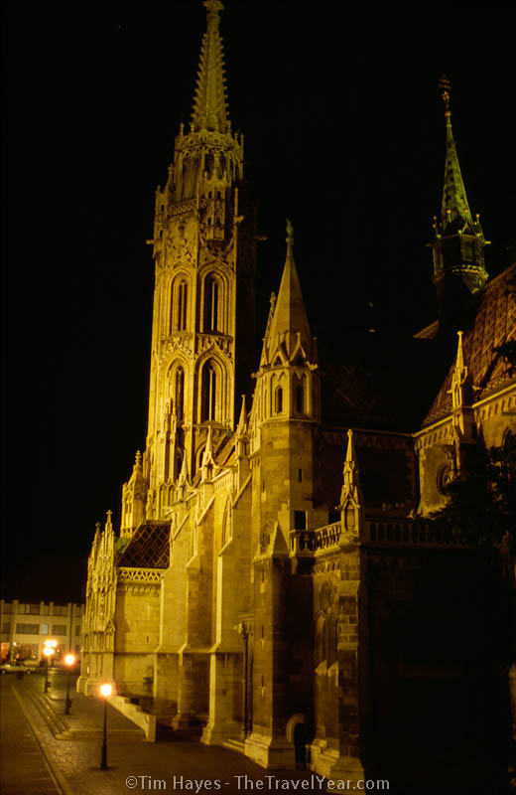
Learning Objective: To study Chapter 8 of the novel
Stevenson’s use of religious language reflects the context of England in the c19th. Afraid of what is happening behind the closed doors of Jekyll’s laboratory, the characters call on God for courage and help.
Who says these lines?
‘God grant there be nothing wrong.’
‘God grant that he be not deceived.’
‘God grant I have no cause for it!’
‘Bless me!’
‘Amen’
‘For God’ sake…’
‘Bless God!’
‘… a thing that cries to Heaven.’

Slide 18
Learning Objective: To study Chapter 8 of the novel
Stevenson’s use of religious language reflects the context of England in the c19th. Afraid of what is happening behind the closed doors of Jekyll’s laboratory, the characters call on God for courage and help.
Who says these lines?
Poole as he and Utterson arrive at Jekyll’s house.
Utterson, referring to Jekyll.
Utterson, hoping that there will be no reason for his deep fear.
‘God grant there be nothing wrong.’
‘God grant that he be not deceived.’
‘God grant I have no cause for it!’
Utterson
‘Bless me!’
Utterson
‘Amen’
Jekyll, pleading with the chemist
‘For God’ sake…’
The cook
‘Bless God!’
Poole, referring to the creature in the cabinet
‘… a thing that cries to Heaven.’

Slide 19
Learning Objective: To study Chapter 8 of the novel
How do you think these references to God and religion might add to ideas about good and evil in the novel?
Poole as he and Utterson arrive at Jekyll’s house.
Utterson, referring to Jekyll.
Utterson, hoping that there will be no reason for his deep fear.
‘God grant there be nothing wrong.’
‘God grant that he be not deceived.’
‘God grant I have no cause for it!’
Utterson
‘Bless me!’
Utterson
‘Amen’
Jekyll, pleading with the chemist
‘For God’ sake…’
The cook
‘Bless God!’
Poole, referring to the creature in the cabinet
‘… a thing that cries to Heaven.’

Slide 20
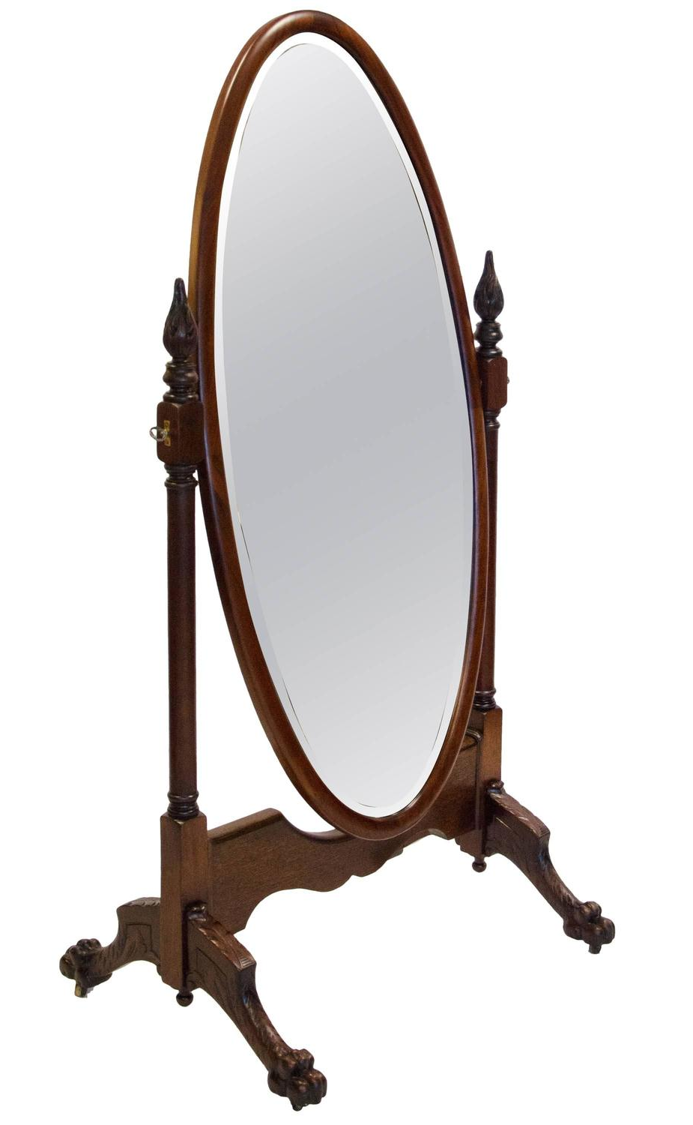
Learning Objective: To study Chapter 8 of the novel
Next, in the course of their review of the chamber, the searchers came to the cheval-glass, into whose depths they looked with an involuntary horror. But it was so turned as to show them nothing but the rosy glow playing on the roof, the fire sparkling in a hundred repetitions along the glazed front of the presses, and their own pale and fearful countenances stooping to look in.
"This glass has seen some strange things, sir," whispered Poole.
"And surely none stranger than itself," echoed the lawyer in the same tones. "For what did Jekyll"--he caught himself up at the word with a start, and then conquering the weakness--"what could Jekyll want with it?" he said.
What is the significance of the cheval glass?
Annotate your copy of the extract then write a paragraph summarising your ideas.

