Slide 1
Learning Objective To study Chapter 3 of the novel

Slide 2
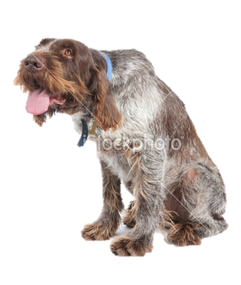
Learning Objective: To study Chapter 3 of the novel
Looking for parallels – Candy’s Dog
Candy’s dog is old, weak and effectively useless. In what way is Candy’s life symbolised by that of his dog? Find a quote to back up this idea.
In what way could the way that Candy keeps his old, useless dog be similar to the way that George goes around with Lennie? Find a quote to back up this idea.
What do you think of the reasons given for killing the dog?
What do you think of Candy's reaction to the other men wanting to kill the dog?
How do we know the men feel a sense of guilt?
What do you think is important / significant about Slim’s behaviour in this section of the book? How does it show his power?
The killing of the dog is described as foreshadowing later events – what do you think could happen later, that this incident is foreshadowing?

Slide 3
Learning Objective: To study Chapter 3 of the novel
Looking for parallels – Candy’s Dog
It is significant that Lennie is the only man (other than Carlson, who shoots the dog) not in the bunk house.
How does this add to the idea of Candy’s dog’s death as a metaphor for what George must ultimately do to Lennie?
Why is this quote important? “I ought to of shot that dog myself, George. I shouldn’t ought to of let no stranger shoot my dog.”
The dog could be seen as a metaphor for how disposable life is in this existence. Therefore, the characters’ reactions to the situation are important:
In pairs, consider the behaviour/reactions of:
George
Slim
Carlson
Candy
Who do you think has the most/least appropriate reaction?

Slide 4
Learning Objective: To study Chapter 3 of the novel
In the world Of Mice and Men describes, Candy’s dog represents the …………awaiting anyone who has outlived his or her…….. Once a fine sheepdog, useful on the ranch, Candy’s mutt is now …………by age. Candy’s …………………….to the animal—his plea that Carlson let the dog live for no other reason than that Candy raised it from a puppy—means nothing at all on the ranch. Although Carlson promises to kill the dog painlessly, his …………..that the old animal must die supports a cruel…………… that the………….. will dispose of the…….. Candy ……………this lesson, for he fears that he himself is nearing an age when he will no longer be …………….at the ranch, and therefore no longer welcome.
internalizes
useful
natural law
purpose
fate
insistence
debilitated
sentimental attachment
weak
strong

Slide 5
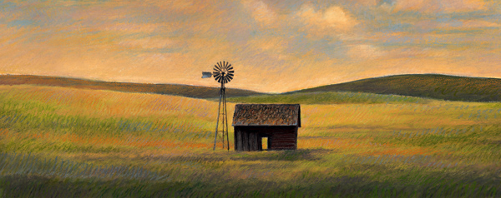
Learning Objective: To study Chapter 3 of the novel
Lennie said, “Tell about that place, George.”
“I jus’ tol’ you, jus’ las’ night.”
“Go on—tell again, George.”
“Well, it’s ten acres,” said George. “Got a little win’mill. Got a little shack
on it, an’ a chicken run. Got a kitchen, orchard, cherries, apples, peaches, ‘cots,
nuts, got a few berries. They’s a place for alfalfa and plenty water to flood it.
They’s a pig pen—”
“An’ rabbits, George.”
“No place for rabbits now, but I could easy build a few hutches and you
could feed alfalfa to the rabbits.”“Damn right, I could,” said Lennie. “You God damn right I could.”
George’s hands stopped working with the cards. His voice was growing
warmer. “An’ we could have a few pigs. I could build a smoke house like the
one gran’pa had, an’ when we kill a pig we can smoke the bacon and the hams,
and make sausage an’ all like that. An’ when the salmon run up river we could
catch a hundred of ‘em an’ salt ‘em down or smoke ‘em. We could have them
for breakfast. They ain’t nothing so nice as smoked salmon. When the fruit
come in we could can it—and tomatoes, they’re easy to can. Ever’ Sunday we’d
kill a chicken or a rabbit. Maybe we’d have a cow or a goat, and the cream is so
God damn thick you got to cut it with a knife and take it out with a spoon.”
Lennie watched him with wide eyes, and old Candy watched him too. Lennie
said softly, “We could live offa the fatta the lan’.”
“Sure,” said George. “All kin’s a vegetables in the garden, and if we want a
little whisky we can sell a few eggs or something, or some milk. We’d jus’ live
there. We’d belong there. There wouldn’t be no more runnin’ round the country
and gettin’ fed by a Jap cook. No, sir, we’d have our own place where we
belonged and not sleep in no bunk house.”
“Tell about the house, George,” Lennie begged.
“Sure, we’d have a little house an’ a room to ourself. Little fat iron stove, an’
in the winter we’d keep a fire goin’ in it. It ain’t enough land so we’d have to
work too hard. Maybe six, seven hours a day. We wouldn’t have to buck no
barley eleven hours a day. An’ when we put in a crop, why, we’d be there to
take the crop up. We’d know what come of our planting.”
“An’ rabbits,” Lennie said eagerly. “An’ I’d take care of ‘em. Tell how I’d do
that, George.”
“Sure, you’d go out in the alfalfa patch an’ you’d have a sack. You’d fill up
the sack and bring it in an’ put it in the rabbit cages.”
“They’d nibble an’ they’d nibble,” said Lennie, “the way they do. I seen
‘em.”
“Ever’ six weeks or so,” George continued, “them does would throw a litter
so we’d have plenty rabbits to eat an’ to sell. An’ we’d keep a few pigeons to go
flyin’ around the win’mill like they done when I was a kid.” He looked raptly at
the wall over Lennie’s head. “An’ it’d be our own, an’ nobody could can us.
If we don’t like a guy we can say, ‘Get the hell out,’ and by God he’s got to do it.
An’ if a fren’ come along, why we’d have an extra bunk, an’ we’d say, ‘Why
don’t you spen’ the night?’ an’ by God he would. We’d have a setter dog and a
couple stripe cats, but you gotta watch out them cats don’t get the little rabbits.”
Lennie breathed hard. “You jus’ let ‘em try to get the rabbits. I’ll break their
God damn necks. I’ll . . . . I’ll smash ‘em with a stick.” He subsided, grumbling
to himself, threatening the future cats which might dare to disturb the future
rabbits.
George sat entranced with his own picture
Find the re-telling of the dream in your books.
How does Steinbeck show that George is finally beginning to believe in the dream? (Compare his telling of the dream here to that in Chapter 1 – what’s different?)
Note down some key quotations from the section that follows. Does the dream look like it might come true?

Slide 6
Learning Objective: To study Chapter 3 of the novel
Curley attacks Lennie
Why do you think Curley chooses to attack Lennie rather than anyone else?
What makes Lennie react and break Curley’s hand?
Why do you think Slim makes up the story about Curley’s hand being crushed in a machine?
What is ironic about the timing of this incident? Why does Steinbeck structure the story in this way?
Copy down the verbs that Steinbeck uses to describe the fight. Which are particularly effective at conveying the violence?
Copy down any quotations relating to animal imagery. What does the imagery tell us about the characters here?

Slide 7
Pages and task | analysis
Page 78 Whit has a lot to say about Curley’s wife. What quotes are significant? Pick out key words and analyse them.
Page 79 We find out here about the way that women are perceived and treated What quotes are significant? Pick out key words and analyse them.
Page 80 - 81 Curley comes back and we see him looking for his wife What quotes are significant? Pick out key words and analyse them.
Page 82 - 83 George is worried about Lennie for two reasons here What quotes are significant? What is he worried about?
Page 83 -88 This is a turning point in the book. What quotes are significant? Why is it a turning point?
Page 89- 90 Lots of very significant things happen here. What are they? Look at What Candy says to George- what could be forshadowed? Look at how Slim treats Curley How does Curley behave?
Page 91 – 94 What do we find out here about Lennie? What quotes are significant? Pick out key words and analyse them.

