Slide 1
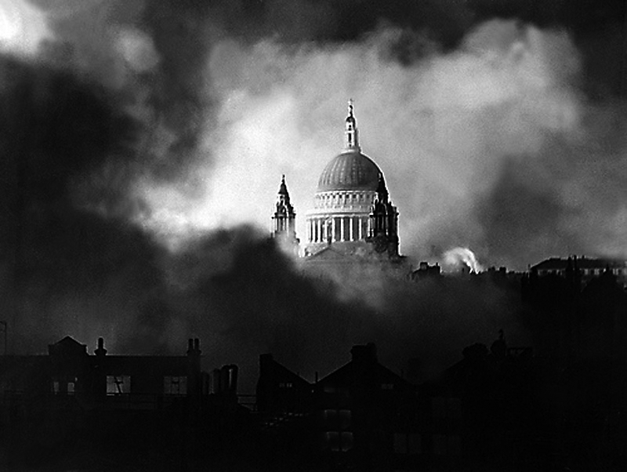
London
By William Blake

Slide 2
Learning Objective To understand the context and subject matter of the poem.

Slide 3
Learning Objective: To understand the context and subject matter of the poem
William Blake was a prolific English poet and artist who is considered to have made a very important contribution to the history of art and the Romantic movement, despite being largely unrecognised in his lifetime.
He produced some of the most memorable pieces of art and poetry ever created, and is widely remembered as ‘a man of extremes’ – his comments about his society were often rejected by his contemporaries and only valued by critics later. He was able to express social comment and philosophy through his creativity.
Much of Blake’s work reflects the influences of religion and revolution on eighteenth-century society. Although highly religious, he was critical of the Church of England and used some of his poems to pass comment and judgement on the role of the Church in society.
During the late eighteenth century the French Revolution was taking place, and a sense of uprising against authority (the monarchy and the Church) was spreading. In 1792 (when ‘London’ was written) revolutionary mobs were invading Paris to overthrow the king. Blake openly supported this rebellion, and despite the government putting in place a law to outlaw writings of a disloyal nature, Blake still manages to reveal his discontent through the negative voice that he uses so well in ‘London’.
Stick the biographical information about William Blake into your exercise book. Underneath, list four things that you learn about William Blake.

Slide 4
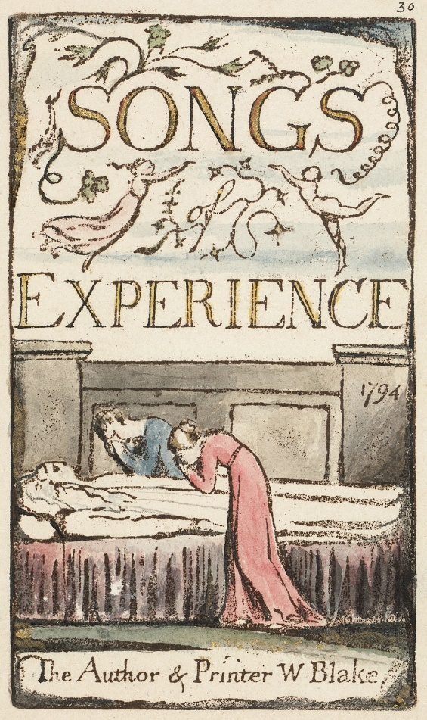
Learning Objective: To understand the context and subject matter of the poem
The poem ‘London’ is from Blake’s collection ‘Songs of Innocence and Experience’.
The ‘Innocence’ section is positive in tone and celebrates love, childhood and nature.
The ‘Experience’ section illustrates the negative side effects of modern life upon nature and people. It views the modern condition as dangerous and corrupt, promoting poverty, child labour and prostitution.
In ‘London’ Blake uses snapshots of the city to depict his negative view of society at the time. As with some of his other works, the poem forms a sort of social protest. It reflects Blake’s disillusionment with religion and authority.

Slide 5
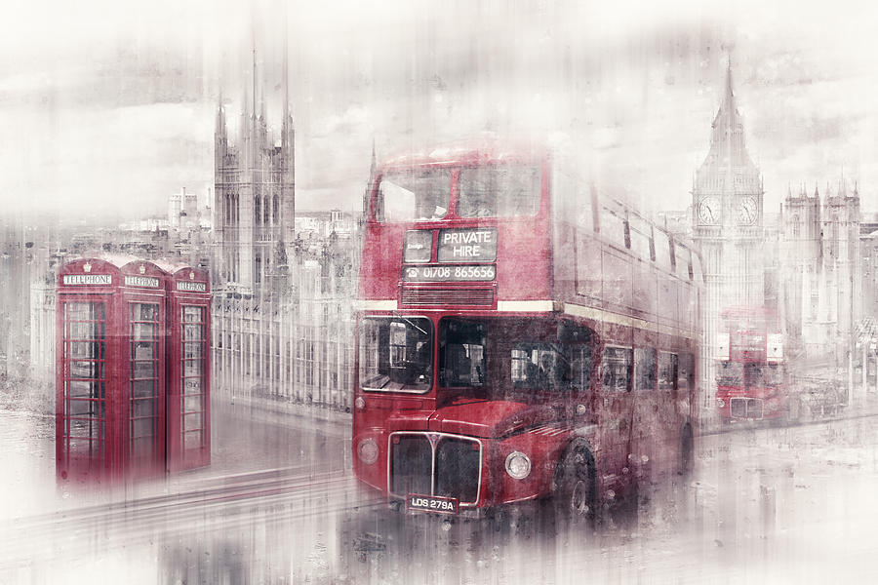
Learning Objective: To understand the context and subject matter of the poem
What impressions do you have of London?
Write down three adjectives to describe your impressions.
busy
busy
busy
crowded
historical
bustling
modern
old
dirty

Slide 6
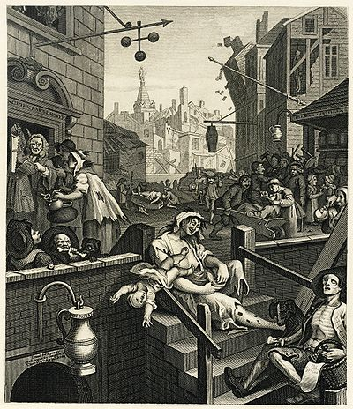
What does this
picture say
about London in
18th century?
Poverty
Lawlessness
Immoral behaviour
Drunkenness
?
Hogarth’s ‘Gin Lane’ (1751)

Slide 7
‘S Gripe Pawn Broker’
The skeletal man suggests…

Slide 8
Learning Objective: To understand the context and subject matter of the poem
I wander through each chartered street,
Near where the chartered Thames does flow,
And mark in every face I meet
Marks of weakness, marks of woe.
In every cry of every man,
In every infant’s cry of fear,
In every voice, in every ban,
The mind-forged manacles I hear:
How the chimney-sweeper’s cry
Every black’ning church appalls,
And the hapless soldier’s sigh
Runs in blood down palace walls.
But most through midnight streets I hear
How the youthful harlot’s curse
Blasts the new-born infant’s tear,
And blights with plagues the marriage hearse.

Slide 9
Learning Objective: To understand the context and subject matter of the poem
Find definitions for the following words:
I wander through each chartered street,
Near where the chartered Thames does flow,
And mark in every face I meet
Marks of weakness, marks of woe.
In every cry of every man,
In every infant’s cry of fear,
In every voice, in every ban,
The mind-forged manacles I hear:
How the chimney-sweeper’s cry
Every black’ning church appalls,
And the hapless soldier’s sigh
Runs in blood down palace walls.
But most through midnight streets I hear
How the youthful harlot’s curse
Blasts the new-born infant’s tear,
And blights with plagues the marriage hearse.
woe
chartered
manacles
forged
ban
hapless
harlot
blights
appalls
hearse
?
?

Slide 10
Learning Objective: To understand the context and subject matter of the poem
Find definitions for the following words:
given over to the use of business; rented; licensed
worry or anxiety
woe
shaped by heating or hammering; a fraudulent imitation
chartered
handcuffs
manacles
forged
hopeless; helpless
hapless
public announcement
ban
plant disease caused by insects; ugly urban area; spoils
harlot
blights
prostitute
appalls
hearse
greatly dismay or horrify
?
?
A vehicle which conveys a coffin

Slide 11
Learning Objective: To understand the context and subject matter of the poem
First Impressions:
How does Blake’s impression of London compare to Hogarth’s?

Slide 12
Learning Objective To explore how the poet uses theme, language and structure to present a place.

Slide 13
Learning Objective: To explore how the poet uses theme, language and structure to present a place
I wander through each chartered street,
Near where the chartered Thames does flow,
And mark in every face I meet
Marks of weakness, marks of woe.
In every cry of every man,
In every infant’s cry of fear,
In every voice, in every ban,
The mind-forged manacles I hear:
How the chimney-sweeper’s cry
Every black’ning church appalls,
And the hapless soldier’s sigh
Runs in blood down palace walls.
But most through midnight streets I hear
How the youthful harlot’s curse
Blasts the new-born infant’s tear,
And blights with plagues the marriage hearse.
Types of words: make a list of words that fit into the categories below and comment on their effect on the reader.
 | Words | Effect
Negative
Positive
Repeated

Slide 14
Learning Objective: To explore how the poet uses theme, language and structure to present a place
Repetition: each and every street is controlled; even the powerful and natural River Thames is affected
‘Wander’ = purposeless. Is the poet able to change what is happening?
Contrast of ‘flow’ reminds us of how a river is supposed to act
I wander through each chartered street,
Near where the chartered Thames does flow,
And mark in every face I meet
Marks of weakness, marks of woe.
Repetition: mark here means to notice, but also that everyone he sees is ‘marked’ by this feeling of bleakness and despair
Alliteration of ‘weakness’ and ‘woe’ ties these ideas together

Slide 15
Learning Objective: To explore how the poet uses theme, language and structure to present a place
This verse focuses on sound. The speaker hears distressing noises, adding a nightmarish quality to the description
Repetition of ‘every’ = no-one is free
In every cry of every man,
In every infant’s cry of fear,
In every voice, in every ban,
The mind-forged manacles I hear:
Key Image:
‘mind-forged manacles’
What does this key image suggest about the people Blake describes?
They are trapped in every way, even by their thoughts and attitudes. Blake suggests that their freedom of thought has been removed; the mind-set of industrialisation (the ‘chartered’ streets and rivers) also controls them.

Slide 16
Learning Objective: To explore how the poet uses theme, language and structure to present a place
Chimney sweeps were usually young orphans in the care of the church so this is a repetition of the sound of children’s cries; an emotive image of child labour
What different connotations could this image hold?
1. That the church is spiritually or morally ‘blackened’ – it is corrupt (e.g. it is ‘appalling’ that they allow the abuse of children by child labour)
2. That the church is ‘blackening’ the children by sending them up chimneys
3. A visual image of the ugliness caused by the industrial revolution
How the chimney-sweeper’s cry
Every black’ning church appalls,
And the hapless soldier’s sigh
Runs in blood down palace walls.
Possibly a reference to the French Revolution; is he suggesting that ordinary people suffer whilst the rich and royal are protected behind palace walls?

Slide 17
Learning Objective: To explore how the poet uses theme, language and structure to present a place
Key Image:
And the hapless soldier’s sigh
Runs in blood down palace walls.
Think about the word ‘hapless’. How is a soldier usually presented? How does this contrast?
2. Why is the soldier sighing? Is this accusatory?
3. Why might the ‘soldier’s sigh’ (i.e. an expression of his concerns and feelings) be represented in a metaphor of blood running down palace walls?
Hint: think about soldiers who feel treated poorly by the country they have served. How could their blood be seen as a ‘stain’?

Slide 18
Learning Objective: To explore how the poet uses theme, language and structure to present a place
Key Image:
And the hapless soldier’s sigh
Runs in blood down palace walls.
“The expression of both his discontent and powerlessness (the sigh) turns to blood and runs down the palace walls. The Palace is marked by the bloodshed that the soldier would be forced to carry out. This image, then, is another reminder of the "manacles" the speaker mentions in line 8. He says that these restrictions are everywhere, but now in this stanza he's giving us two examples to prove his point: the suffering chimney sweep and the soldier—who as a tool of the "Palace" (or government), is powerless to prevent himself from causing the suffering ("blood") of others.” (Shmoop)

Slide 19
Learning Objective: To explore how the poet uses theme, language and structure to present a place
Contrast between the innocence of youth and the sordidness (experience) of prostitution
A continued focus on sound
But most through midnight streets I hear
How the youthful harlot’s curse
Blasts the new-born infant’s tear,
And blights with plagues the marriage hearse.
1. They swear (at babies crying?)
2. They are a curse on London
The innocence of newborns is immediately lost; alliteration links ‘blasts’ and ‘blights’ – this is destructive; their curses are linked to illness and disease (‘plague’)
An oxymoron linking the happy image of marriage with death. Everything has been destroyed.

Slide 20
Form, structure and tone: ‘London’
Why does Blake use four stanzas?
Stanza 1: The narrator is walking through the streets of London, he comments that all of the streets and the river Thames are “chartered”, this means owned by the government. He “marks” (meaning observes) lots of people in the streets, all with “marks” (meaning expressions) of sadness or “weakness”.
Stanza 2: (Hint: Think about how the narrator is still using his senses – what does this reveal about 18th century London?)
Stanza 3: (Hint: Who is to blame? Use your contextual knowledge!)
Stanza 4: (Hint: What is the narrator’s view/message regarding children?)

Slide 21
Form, structure and tone: ‘London’
Why does Blake use four stanzas?
Stanza 1: The narrator is walking through the streets of London, he comments that all of the streets and the river Thames are “chartered”, this means owned by the government. He “marks” (meaning observes) lots of people in the streets, all with “marks” (meaning expressions) of sadness or “weakness”.
Stanza 2: This stanza shifts from what the speaker sees to what he hears. These sounds suggest that the misery of the city affects everyone: the people themselves are trapped by their own attitudes: “mind forged manacles”.
Stanza 3: The speaker now focuses on the institutions he holds responsible for the state of the city. He singles out the powerful church and state who could do something but don’t.
Stanza 4: This stanza returns to focus on people and the effect of the corruption on them, even on newborn babies. Nothing pure remains.

Slide 22
Form, structure and tone: ‘London’
This is a dramatic monologue – the first person narrator speaks about the suffering he himself sees. The ABAB rhyme scheme is unbroken and seems to echo the relentless misery of the city. The regular rhythm could also reflect the sound of his footsteps as he walks.
The rhyme and rhythm of the poem is reinforced by the use of repetition. Notice how many words appear two or more times ("charter'd," "marks," “infant," "cry," "street"). The repetition of sound suggests that what the speaker sees around him is cyclical or repetitive—that the evils of London will continue to persist.
This is nowhere more evident than in the fact that the lone E rhyming sound of lines 6, 8, 14, and 16 ("fear," "hear," "hear," "tear") occurs in both the second and fourth stanzas. The structure of the poem therefore echoes its message.

Slide 23
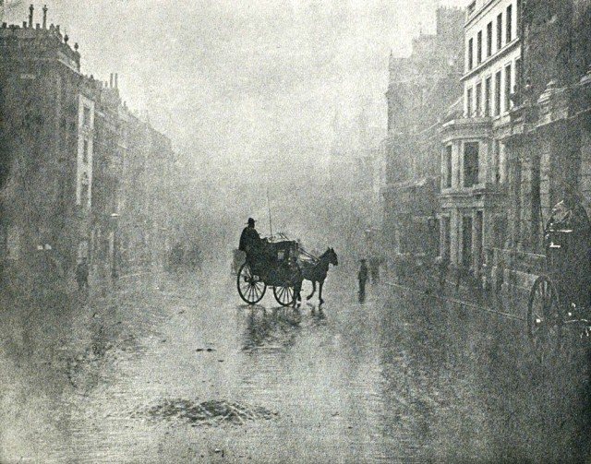
Learning Objective: To explore how the poet uses theme, language and structure to present a place
How does Blake present London in this poem?

Slide 24
Learning Objective: To explore how the poet uses theme, language and structure to present a place
Look closely at the poem and choose three quotations to explore Blake’s presentation of London. Write your quotations into a table like the one below and fill in the other column to explain your interpretation of the language Blake uses.

Slide 25
It’s time to summarise! We’re going to make a note of the poem’s VITALS.

Slide 26
Poetry VITALS…
Voice: Who is speaking in the poem?
Imagery: What imagery is being created? How is it effective?
Theme: What are the main themes featured in the poem?
Address: Who is the poem addressed to? Why?
Language (Features): What type of language/ devices are used?
What is their effect?
Structure: How is the poem laid out? What is the effect of this?
Notes:
This is the acronym that we will use on each poem to look at all the different aspects

