Slide 1
Learning Objective To study Chapter 5 of the novel

Slide 2
Learning Objective: To study Chapter 5 of the novel
Write the following on the slip of paper in front of you. Do not let anyone see and when you are finished, fold the paper in half. Do not sign your paper.
“Jekyll and Hyde is the best novel I’ve ever read! English is so much fun!”
Now put your folded papers into a pile in the middle of the table. Pick one out and see if you can identify who wrote it – just by looking at their handwriting!
Did you get it right?
Now do it again – but this time disguise your handwriting.
Can you still identify who wrote what?

Slide 3
Learning Objective: To study Chapter 5 of the novel

Slide 4
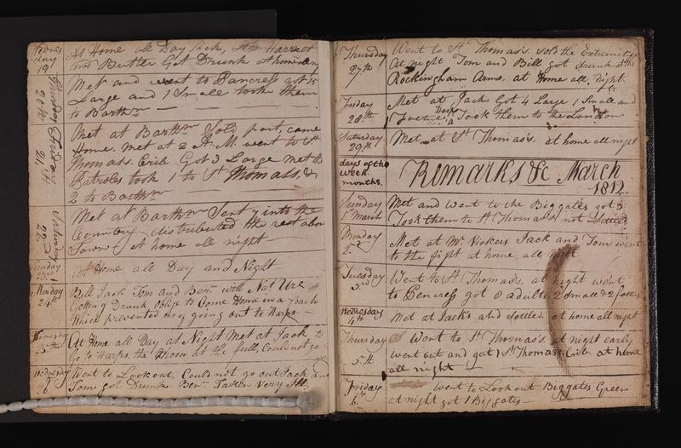
Learning Objective: To study Chapter 5 of the novel
When Mr Utterson visits Dr Jekyll, he is taken to a room he has not seen before – the dissecting room of the surgeon who used to live there. He feels a, ‘distasteful sense of strangeness’ as he passes through the room.
Diary of Joseph Naples, ‘Resurrection Man’
AO3: Until 1832, only the corpses of executed criminals could legally be used to study and learn about the human body. There were not enough of these, so an illegal trade in bodies developed – ‘Resurrection Men’ would steal bodies from graveyards and even deathbeds. The public were simultaneously outraged and fascinated. In 1832, the Anatomy Act changed the law, allowing doctors to dissect unclaimed corpses from hospitals, workhouses and prisons.
Read your information sheet on ‘The Rise of the Body Snatchers’.
List four things that you learn about the practice of body snatching.

Slide 5
Learning Objective: To study Chapter 5 of the novel
Cupola:
A dome like structure on the top of a building.
‘It was the first time that the lawyer had been received in that part of his friend’s quarters; and he eyed the dingy, windowless structure with curiosity, and gazed round with a distasteful sense of strangeness as he crossed the theatre, once crowded with eager students and now lying gaunt and silent, the tables laden with chemical apparatus, the floor strewn with crates and littered with packing straw, and the light falling dimly through the foggy cupola. At the further end, a flight of stairs mounted to a door covered with red baize; and through this, Mr. Utterson was at last received into the doctor’s cabinet. It was a large room fitted round with glass presses, furnished, among other things, with a cheval-glass and a business table, and looking out upon the court by three dusty windows barred with iron. The fire burned in the grate; a lamp was set lighted on the chimney shelf, for even in the houses the fog began to lie thickly; and there, close up to the warmth, sat Dr. Jekyll, looking deathly sick. He did not rise to meet his visitor, but held out a cold hand and bade him welcome in a changed voice.’
Cheval glass:
A tall mirror fitted at its middle to an upright frame so that it can be tilted.
Bearing in mind the AO3 information you have just studied, annotate this extract with ideas about the atmosphere or impression that is created by this setting.
What genre does this passage fit into?
What is the writer’s purpose here?
Baize:
A type of fuzzy fabric (like that on a snooker table) attached to doors to deaden noise.

Slide 6
Learning Objective: To study Chapter 5 of the novel
Cupola:
A dome like structure on the top of a building.
‘It was the first time that the lawyer had been received in that part of his friend’s quarters; and he eyed the dingy, windowless structure with curiosity, and gazed round with a distasteful sense of strangeness as he crossed the theatre, once crowded with eager students and now lying gaunt and silent, the tables laden with chemical apparatus, the floor strewn with crates and littered with packing straw, and the light falling dimly through the foggy cupola. At the further end, a flight of stairs mounted to a door covered with red baize; and through this, Mr. Utterson was at last received into the doctor’s cabinet. It was a large room fitted round with glass presses, furnished, among other things, with a cheval-glass and a business table, and looking out upon the court by three dusty windows barred with iron. The fire burned in the grate; a lamp was set lighted on the chimney shelf, for even in the houses the fog began to lie thickly; and there, close up to the warmth, sat Dr. Jekyll, looking deathly sick. He did not rise to meet his visitor, but held out a cold hand and bade him welcome in a changed voice.’
Cheval glass:
A tall mirror fitted at its middle to an upright frame so that it can be tilted.
Bearing in mind the AO3 information you have just studied, annotate this extract with ideas about the atmosphere or impression that is created by this setting.
What genre does this passage fit into?
What is the writer’s purpose here?
Baize:
A type of fuzzy fabric (like that on a snooker table) attached to doors to deaden noise.

Slide 7
Learning Objective: To study Chapter 5 of the novel
‘… a large, low-roofed, comfortable hall, paved with flags, warmed (after the fashion of a country house) by a bright, open fire, and furnished with costly cabinets of oak.’
Now look at the description of the front of Jekyll’s home from Chapter 2. How does it compare with the description we have just read of the back of the house?
1. Copy down the description above.
2. Bullet point the differences between the front and back of the house.
3. Why does Stevenson show such different sides of the same house? Write down your ideas. [Hint: don’t forget the key theme of duality!]

Slide 8
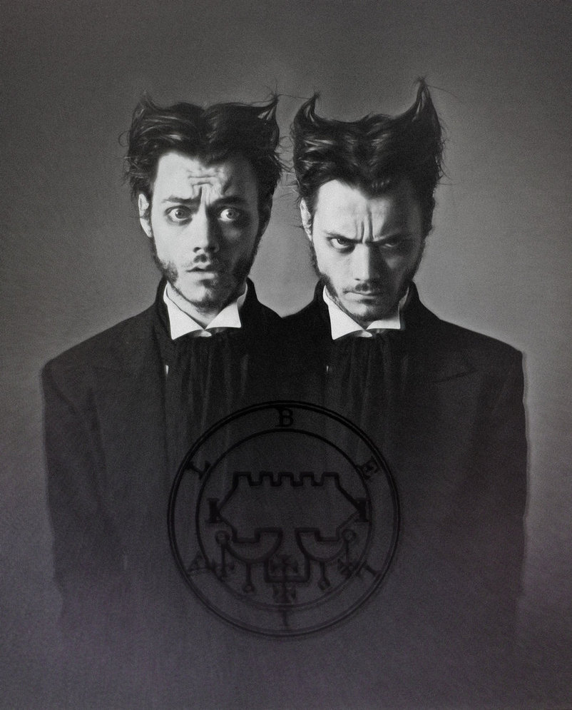
Learning Objective: To study Chapter 5 of the novel
Stevenson also shows a change in the character of Dr Jekyll.
The last time we saw Jekyll was in Chapter 3. He was very different.

Slide 9
Learning Objective: To study Chapter 5 of the novel
Which descriptions are from Ch3 and which from Ch5? Copy them under the correct heading in your book.
‘a large well-made man’
‘every mark of capacity and kindness’
‘looking deadly sick’
‘sincere and warm affection’
‘seized with a qualm of faintness’
‘He did not rise to meet his visitor’
‘carried it off gaily’
‘he shut his mouth tight and nodded’
‘[Utterson] was surprised at his friend’s selfishness’

Slide 10
Learning Objective: To study Chapter 5 of the novel
Chapter 3
Chapter 5
‘a large well-made man’
‘looking deadly sick’
‘sincere and warm affection’
‘seized with a qualm of faintness’
‘every mark of capacity and kindness’
‘He did not rise to meet his visitor’
‘carried it off gaily’
‘he shut his mouth tight and nodded’
‘[Utterson] was surprised at his friend’s selfishness’
What is the purpose of showing this change?

Slide 11
Learning Objective: To study Chapter 5 of the novel
Jekyll shows Utterson a letter, signed by Hyde, which he says was delivered to the house that morning.
What does the letter tell us?
Write the statements opposite into your book, in the order they are revealed in the chapter.
a) Jekyll says he burned the envelope.
b) The letter is written in an, ‘odd, upright hand’.
c) The letter reassures Mr Utterson about the relationship between Jekyll and Hyde.
d) Jekyll says the letter was handed in at the house, not posted.
e) Utterson shows the letter to his chief clerk, who says the handwriting could be Jekyll’s.
f) Jekyll tells Utterson he has received a letter from Hyde and wonders whether to show it to the police.
g) Poole tells Utterson that no letters arrived at the house that day.
Correct order: f, b, c, a, d, g, e.

Slide 12
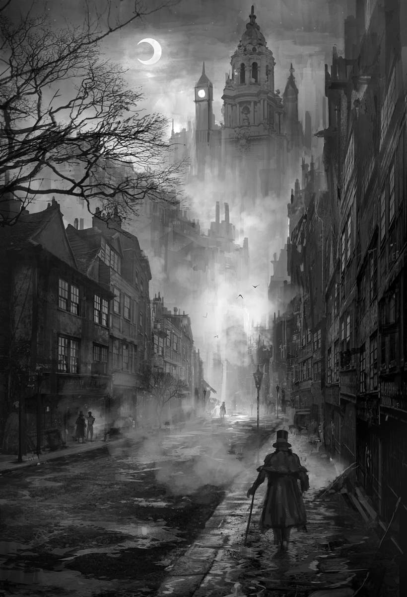
Learning Objective: To study Chapter 5 of the novel
Carbuncle:
A glowing or bright gem; an infected boil or abscess.
The return of the fog!
Stevenson once again uses the fog as a backdrop to the events of the chapter.
Find this extract:
‘The fog still slept on the wing above the drowned city, where the lamps glimmered like carbuncles; and through the muffle and smother of these fallen clouds, the procession of the town’s life was still rolling in through the great arteries with a sound as of a mighty wind.’

Slide 13
Learning Objective: To study Chapter 5 of the novel
Match the fog-related quote to the appropriate analysis/comment. Add your own ideas where you can.
A sense description (sound) that uses almost-violent images.
‘even in the house, the fog began to lie thickly’
A bird-like metaphor to show fog as a living thing.
‘foggy cupola’
The fog masks even the features that should let in the light.
‘The fog still slept on the wing above the drowned city’
‘the muffle and smother of these fallen clouds’
The fog is everywhere; it cannot be stopped.

Slide 14
Learning Objective: To study Chapter 5 of the novel
Match the fog-related quote to the appropriate analysis/comment. Add your own ideas where you can.
The fog is everywhere; it cannot be stopped.
‘even in the house, the fog began to lie thickly’
The fog masks even the features that should let in the light.
‘foggy cupola’
A bird-like metaphor to show fog as a living thing.
‘The fog still slept on the wing above the drowned city’
‘the muffle and smother of these fallen clouds’
A sense description (sound) that uses almost-violent images.

Slide 15
Learning Objective: To study Chapter 5 of the novel
What do you think the fog represents? What is its purpose?
The fog is everywhere; it cannot be stopped.
‘even in the house, the fog began to lie thickly’
The fog masks even the features that should let in the light.
‘foggy cupola’
A bird-like metaphor to show fog as a living thing.
‘The fog still slept on the wing above the drowned city’
‘the muffle and smother of these fallen clouds’
A sense description (sound) that uses almost-violent images.

Slide 16
Q
W
E
R
T
Y
How does Stevenson use fog to convey ideas in the novel so far?
Think about:
Examples of images of fog in the novel and what they represent
The significance of fog in 19th-century London (AO3)
The link between fog and mystery and confusion
The link between fog and nightmares or concealment
You can use your notes to answer this question, but not the novel!
Try to use the words ‘metaphor’ and ‘symbol’ in your answer.

Slide 17
One of the ways Stevenson... Another way... The fog is also shown to be... The writer suggests... When the fog is first described...
Q
}
W
E
This is shown when it says, “___”... An example of this is when Stevenson writes, “___”... For example, “___”
R
This makes the reader think... This suggests to the reader... The reader will think... This implies... This suggests...
T
The word order of this sentence suggests... The writer’s word choice... The simile “___”... The repetition of... This word has strong connotations of...
Y
This suggests... This implies... This links to...

Slide 18
Peer-Assess: WWW/ EBI
Band 6
Critical/exploratory response to task
Precise references used to support interpretation
Analysis of writer’s methods and their effects on the reader, with subject terminology used accurately
Exploration of contextual factors
How well has (s)he:
Responded to the question?
Used relevant quotes?
Analysed the effect of the writer’s methods?
Explored the effect on the reader?
Included contextual references?
Band 5
Thoughtful/developed response to task
Apt references integrated into interpretations
Examination of writer’s methods and their effects on the reader, with subject terminology used effectively
Thoughtful consideration of contextual factor
Band 4
Clear/explained response to task
Effective use of references to support explanation
Clear explanation of writer’s methods and their effects on the reader, with relevant subject terminology
Clear understanding of contextual factors

Slide 19
Response to feedback:
Band 6
Critical/exploratory response to task
Precise references used to support interpretation
Analysis of writer’s methods and their effects on the reader, with subject terminology used accurately
Exploration of contextual factors
Add to, change or extend one idea in your work in response to your partner’s feedback.
Band 5
Thoughtful/developed response to task
Apt references integrated into interpretations
Examination of writer’s methods and their effects on the reader, with subject terminology used effectively
Thoughtful consideration of contextual factor
Band 4
Clear/explained response to task
Effective use of references to support explanation
Clear explanation of writer’s methods and their effects on the reader, with relevant subject terminology
Clear understanding of contextual factors

