Slide 1
Learning Objective To study Chapter 4 of the novel

Slide 2
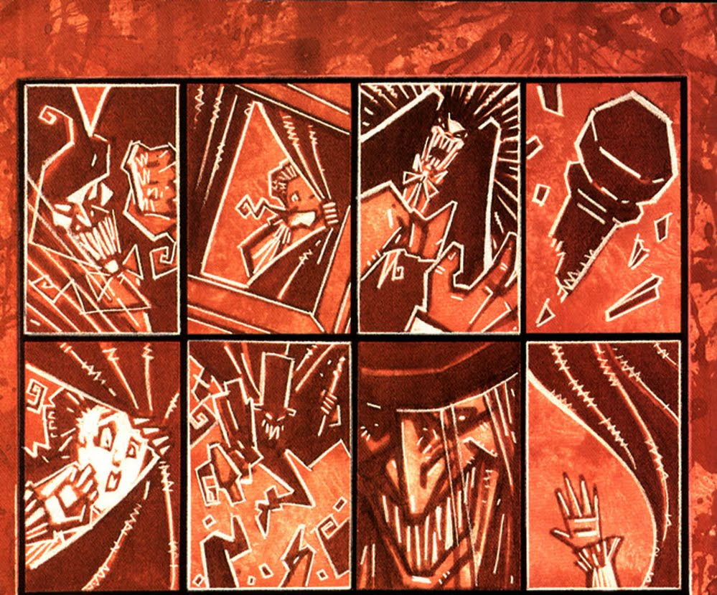
Learning Objective: To study Chapter 4 of the novel
The Carew Murder Case

Slide 3
Learning Objective: To study Chapter 4 of the novel
There are three characters at the murder scene: Mr Hyde (the murderer), Sir Danvers Carew (the victim) and the maidservant (the witness). Which character is described by each of the following quotes?
at peace with all men
very small gentleman
streaming tears
innocent and old-world
kindness
white hair

Slide 4
Learning Objective: To study Chapter 4 of the novel
There are three characters at the murder scene: Mr Hyde (the murderer), Sir Danvers Carew (the victim) and the maidservant (the witness). Which character is described by each of the following quotes?
The maidservant
at peace with all men
very small gentleman
Mr Hyde
The maidservant
streaming tears
innocent and old-world
Sir Danvers Carew
kindness
Sir Danvers Carew
Sir Danvers Carew
white hair

Slide 5
Learning Objective: To study Chapter 4 of the novel
There are three characters at the murder scene: Mr Hyde (the murderer), Sir Danvers Carew (the victim) and the maidservant (the witness). Which character is described by each of the following quotes?
at peace with all men
Stevenson’s words make the maidservant seem…
very small gentleman
The purpose of this is…
streaming tears
Stevenson’s words make the Sir Danvers Carew seem…
innocent and old-world
kindness
The purpose of this is…
white hair

Slide 6
Learning Objective: To study Chapter 4 of the novel
There are three characters at the murder scene: Mr Hyde (the murderer), Sir Danvers Carew (the victim) and the maidservant (the witness). Which character is described by each of the following quotes?
at peace with all men
The maidservant’s fear and emotional reaction are designed to heighten the sense of horror at the crime.
very small gentleman
streaming tears
The purity, innocence and respectability of Sir Danvers Carew seem to stand for all the things that Hyde is not.
innocent and old-world
kindness
white hair

Slide 7
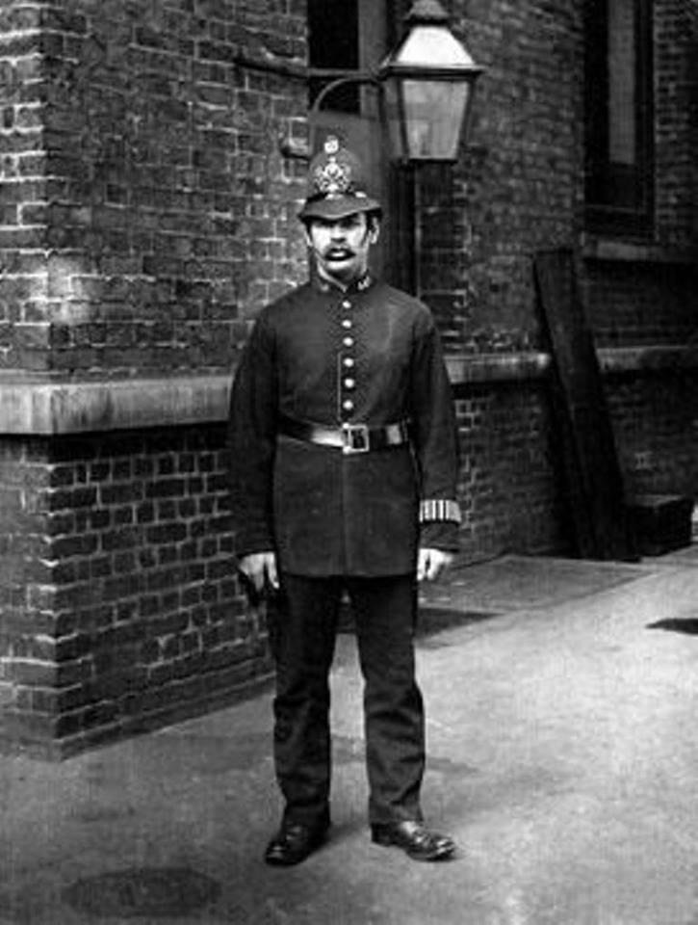
Learning Objective: To study Chapter 4 of the novel
In Chapter 4, the police are involved for the first time. The Inspector from Scotland Yard seems pleased to discover information that will lead to the arrest of the murderer.
Are the following statements true or false?

Slide 8
True or false?
The murderer has been positively identified as Mr Hyde.
The maidservant recognised him

Slide 9
True or false?
The murder took place in broad daylight.
It was about 11pm

Slide 10
True or false?
The motive for the murder was robbery
The victim’s purse and gold watch were found on him

Slide 11
True or false?
The murder weapon has a link to Dr Jekyll.
Utterson recognises the stick as one he gave to Jekyll

Slide 12
True or false?
The murder weapon has a link to Mr Hyde.
The other half of the broken stick was found behind Hyde’s door

Slide 13
True or false?
There are signs that Hyde has run away.
The rooms were ransacked and documents burned

Slide 14
True or false?
The police inspector will recognise Hyde when he sees him
Hyde has never been photographed and witnesses gave only vague details of his appearance

Slide 15
Learning Objective: To study Chapter 4 of the novel

Slide 16
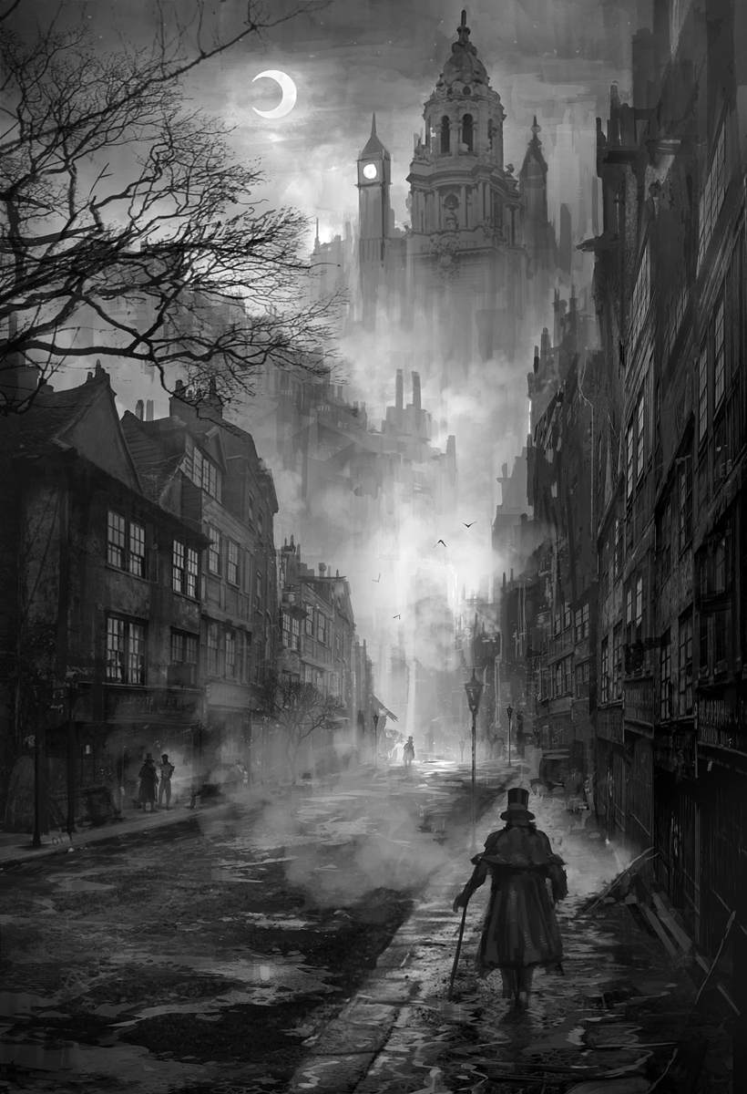
Learning Objective: To study Chapter 4 of the novel
Setting and Atmosphere
Stevenson describes the London fog during Utterson’s journey to Soho. What atmosphere is created by the fog? [Hint: think about Utterson’s state of mind as he makes his journey.]
AO3: Fog was a big problem in c19th London, and smoke and pollution from coal fires made things worse. The result was a dismal brown smog that hung over the city – so dense that people often had to light lamps during the day. It also crept into buildings and caused health problems. In 1873 alone, 273 people died because of it.

Slide 17
Learning Objective: To study Chapter 4 of the novel
Blackguard:
Foul-mouthed or unprincipled
As the cab drew up before the address indicated, the fog lifted a little and showed him a dingy street, a gin palace, a low French eating house, a shop for the retail of penny numbers and twopenny salads, many ragged children huddled in the doorways, and many women of many different nationalities passing out, key in hand, to have a morning glass; and the next moment the fog settled down again upon that part, as brown as umber, and cut him off from his blackguardly surroundings. This was the home of Henry Jekyll’s favourite; of a man who was heir to a quarter of a million sterling.
What do the adjectives ‘dingy’, ‘low’, ‘ragged’, and ‘blackguardly’ describe?
What impression do they create of this setting?
Find at least two other details from this paragraph that support your interpretation and explain what their effect is on the reader.
Look at the final line of the extract. What effect does ending the extract this way have on the reader?
Hint 1: look at the contrast between ‘a quarter of a million sterling’ and the scene described earlier in the extract.
Hint 2: why does Stevenson use ‘Henry Jekyll’s favourite’ instead of just ‘Mr Hyde’?

Slide 18
Learning Objective: To study Chapter 4 of the novel
As the cab drew up before the address indicated, the fog lifted a little and showed him a dingy street, a gin palace, a low French eating house, a shop for the retail of penny numbers and twopenny salads, many ragged children huddled in the doorways, and many women of many different nationalities passing out, key in hand, to have a morning glass; and the next moment the fog settled down again upon that part, as brown as umber, and cut him off from his blackguardly surroundings. This was the home of Henry Jekyll’s favourite; of a man who was heir to a quarter of a million sterling.
Ending the extract in this way conveys surprise and puzzlement, reminding us again of the mystery of the relationship between Jekyll and Hyde. The contrast between ‘a quarter of a million’ and the earlier scene highlights the extremes of wealth and poverty as well as the social difference between Jekyll and Hyde. Stevenson ends with ‘Jekyll’s favourite’ to emphasise the link between the two and convey, again, a sense of surprise – highlighting the contrast between the two men.

Slide 19
Learning Objective: To study Chapter 4 of the novel
Mr. Hyde had only used a couple of rooms; but these were furnished with luxury and good taste. A closet was filled with wine; the plate was of silver, the napery elegant; a good picture hung upon the walls, a gift (as Utterson supposed) from Henry Jekyll, who was much of a connoisseur; and the carpets were of many plies and agreeable in colour.
Stevenson makes another contrast with the external setting when he describes Hyde’s rooms.
Copy this quote into your book and circle, highlight or underline any words that suggest luxury.
We have a better idea than the original reader why Hyde might live this way.
What impression do you think it would have on someone who doesn’t know the connection between Jekyll and Hyde?

Slide 20
Learning Objective: To study Chapter 4 of the novel
Mr. Hyde had only used a couple of rooms; but these were furnished with luxury and good taste. A closet was filled with wine; the plate was of silver, the napery elegant; a good picture hung upon the walls, a gift (as Utterson supposed) from Henry Jekyll, who was much of a connoisseur; and the carpets were of many plies and agreeable in colour.
Stevenson makes another contrast with the external setting when he describes Hyde’s rooms.
Copy this quote into your book and circle, highlight or underline any words that suggest luxury.
We have a better idea than the original reader why Hyde might live this way.
What impression do you think it would have on someone who doesn’t know the connection between Jekyll and Hyde?

Slide 21
Learning Objective: To study Chapter 4 of the novel
Key Theme: Duality
Duality: the state or quality of being two or in two parts; dichotomy
How does Stevenson create duality in the character of the housekeeper?

Slide 22
Learning Objective: To study Chapter 4 of the novel
‘Ivory-faced and silver haired old woman’
Surround the outline of the housekeeper with any words or phrases which suggest duality or hypocrisy.

Slide 23
Learning Objective: To study Chapter 4 of the novel
‘ivory-faced and silver haired old woman’
She seems like an ordinary old woman but...
‘flash of odious joy’
Oxymoron – highlights the contrasts in her character.
‘an evil face, smoothed by hypocrisy’
She has excellent manners, but hides an evil disposition.
‘He is in trouble! What has he done?’
‘but her manners were excellent’
She has no loyalty to Hyde, despite being his paid housekeeper.

Slide 24
Learning Objective: To study Chapter 4 of the novel
Key Theme: Duality
Duality: the state or quality of being two or in two parts; dichotomy
How does Stevenson create duality in the character of the housekeeper?
Write a response to this question in your book.

