Slide 1
Learning Objective To study Chapter 2 of the novel

Slide 2
Learning Objective: To study Chapter 2 of the novel

Slide 3
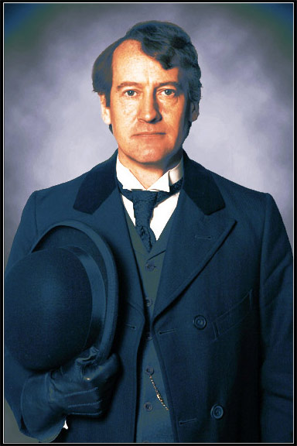
Learning Objective: To study Chapter 2 of the novel
Utterson as Investigator
Stevenson uses the character of Utterson to guide the reader through the mystery. He sets about his investigations like a detective:
“If he be Mr Hyde […] I shall be Mr Seek”
‘In the morning before office hours, at noon when business was plenty and time scarce, at night under the face of the fogged city moon, by all lights and at all hours of solitude and concourse, the lawyer was to be found at his chosen post.’
What does this quote suggest? Annotate it with your ideas.

Slide 4
Learning Objective: To study Chapter 2 of the novel
After a little rambling talk, the lawyer led up to the subject which so disagreeably preoccupied his mind. ‘I suppose, Lanyon,’ said he, ‘you and I must be the two oldest
friends that Henry Jekyll has?’
‘I wish the friends were younger,’ chuckled Dr. Lanyon. ‘But I suppose we are. And what of that? I see little of him now.’
‘Indeed?’ said Utterson. ‘I thought you had a bond of common interest.’
‘We had,’ was the reply. ‘But it is more than ten years since Henry Jekyll became too fanciful for me. He began to go wrong, wrong in mind; and though of course I continue to take an interest in him for old sake’s sake, as they say, I see and I have seen devilish little of the man. Such unscientific balderdash,’ added the doctor, flushing suddenly purple, ‘would have estranged Damon and Pythias.’
This little spirit of temper was somewhat of a relief to Mr. Utterson. ‘They have only differed on some point of science,’ he thought; and being a man of no scientific passions (except in the matter of conveyancing), he even added: ‘It is nothing worse than that!’ He gave his friend a few seconds to recover his composure, and then approached the question he had come to put. ‘Did you ever come across a protégé
of his. One Hyde?’ he asked.
‘Hyde?’ repeated Lanyon. ‘No. Never heard of him. Since my time..’
Damon and Pythias:
Damon was condemned to death by the king and pleaded for time to return home and put his affairs in order. Pythias offered to stay in his place, dying instead of him if Damon did not return. Damon did return and the king pardoned him for his loyal friendship.
What does he find out from Lanyon? Make a note in your book.

Slide 5
Learning Objective: To study Chapter 2 of the novel
‘I saw Mr. Hyde go in by the old dissecting room, Poole,’ he said. ‘Is that right, when Dr. Jekyll is from home?’
‘Quite right, Mr. Utterson, sir,’ replied the servant. ‘Mr. Hyde has a key.’
‘Your master seems to repose a great deal of trust in that young man, Poole,’ resumed the other musingly.
‘Yes, sir, he does indeed,’ said Poole. ‘We have all orders to obey him.’
‘I do not think I ever met Mr. Hyde?’ asked Utterson.
‘O, dear no, sir. He never dines here,’ replied the butler. ‘Indeed we see very little of him on this side of the house; he mostly comes and goes by the laboratory.’
‘Well, good-night, Poole.’
‘Good-night, Mr. Utterson.’
2. What does he find out from Poole? Make a note in your book.

Slide 6
Learning Objective: To study Chapter 2 of the novel
Utterson expresses his thoughts about Jekyll and considers why (as he believes) Hyde may be able to blackmail him.
This metaphor suggests he is in trouble by creating the impression that he is in danger of drowning.
“He is in deep waters!”
“It must be […] the ghost of some old sin”
“…the cancer of some concealed disgrace.”
Copy the quotes into your book and write down some ideas as to what they suggest about Jekyll’s situation.

Slide 7
Learning Objective: To study Chapter 2 of the novel
Utterson expresses his thoughts about Jekyll and considers why (as he believes) Hyde may be able to blackmail him.
This metaphor suggests he is in trouble by creating the impression that he is in danger of drowning.
“He is in deep waters!”
“It must be […] the ghost of some old sin”
This holds connotations of being haunted or troubled by the past. ‘Sin’ expresses the idea of religion and wrongdoing.
“…the cancer of some concealed disgrace.”
This implies something growing that is hard to eradicate. The adjective ‘concealed’ suggests secrets or mystery.
Copy the quotes into your book and write down some ideas as to what they suggest about Jekyll’s situation.

Slide 8
Learning Objective: To study Chapter 2 of the novel
We are told that Jekyll’s will has ‘long been the lawyer’s eyesore’, i.e. Utterson has been troubled by it for a long time. What is so troubling?
(1) The will is ‘holographic’ (handwritten).
(2) ‘disappearance or unexplained absence for any period exceeding three calendar months’
In pairs, discuss each quotation and note down what it suggests. Why is each detail significant?
(3) ‘the name was but a name of which he could learn no more’
(4) ‘out of the shifting, insubstantial mists that had so long baffled his eyes, there leaped up the sudden, definite presentiment of a fiend.’
(5) ‘… his friend and benefactor, Edward Hyde.’

Slide 9
Learning Objective: To study Chapter 2 of the novel
Jekyll wrote it himself, implying Utterson had refused to do it for him.
Wills usually only deal with what happens after someone dies; this extra clause is disturbing and suggests Jekyll may disappear.
(1) The will is ‘holographic’ (handwritten).
(2) ‘disappearance or unexplained absence for any period exceeding three calendar months’
Utterson has never heard of Hyde; nor have other close friends of Jekyll.
(3) ‘the name was but a name of which he could learn no more’
Now that Utterson has heard Enfield’s story about Hyde, he is even more concerned.
(4) ‘out of the shifting, insubstantial mists that had so long baffled his eyes, there leaped up the sudden, definite presentiment of a fiend.’
Hyde is described as a benefactor, suggesting Jekyll regards him highly – or owes him something.
(5) ‘… his friend and benefactor, Edward Hyde.’

Slide 10
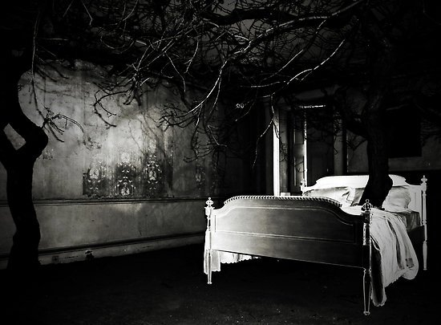
Learning Objective: To study Chapter 2 of the novel
‘Six o'clock stuck on the bells of the church that was so conveniently near to Mr. Utterson's dwelling, and still he was digging at the problem. Hitherto it had touched him on the intellectual side alone; but now his imagination also was engaged, or rather enslaved; and as he lay and tossed in the gross darkness of the night and the curtained room, Mr. Enfield's tale went by before his mind in a scroll of lighted pictures. He would be aware of the great field of lamps of a nocturnal city; then of the figure of a man walking swiftly; then of a child running from the doctor's; and then these met, and that human Juggernaut trod the child down and passed on regardless of her screams. Or else he would see a room in a rich house, where his friend lay asleep, dreaming and smiling at his dreams; and then the door of that room would be opened, the curtains of the bed plucked apart, the sleeper recalled, and lo! there would stand by his side a figure to whom power was given, and even at that dead hour, he must rise and do its bidding. The figure in these two phases haunted the lawyer all night; and if at any time he dozed over, it was but to see it glide more stealthily through sleeping houses, or move the more swiftly and still the more swiftly, even to dizziness, through wider labyrinths of lamplighted city, and at every street corner crush a child and leave her screaming. And still the figure had no face by which he might know it; even in his dreams, it had no face, or one that baffled him and melted before his eyes…’
The description of Utterson’s nightmare reflects the romantic belief that imagination and emotion can overcome rational behaviour. Utterson’s deep concerns about Jekyll and Hyde surface in a nightmare.

Slide 11
Learning Objective: To study Chapter 2 of the novel
‘The man trampled calmly over the child’s body and left her screaming on the ground’
‘A little man who was stumping along eastward at a good walk’
‘Like some damned Juggernaut’
‘Running as hard as she was able down a cross street’
‘…street after street, all lighted up’
Match the description of Utterson’s nightmare to the details of Enfield’s account of meeting Mr Hyde in Chapter 1.

Slide 12
Learning Objective: To study Chapter 2 of the novel
Enfield’s troubling story has stayed with Utterson and echoes of it show in his dream.

Slide 13
Learning Objective: To study Chapter 2 of the novel
‘…if at any time he dozed over, it was but to see it glide more stealthily through sleeping houses, or move the more swiftly and still the more swiftly, even to dizziness, through wider labyrinths of lamplighted city, and at every street corner crush a child and leave her screaming. And still the figure had no face by which he might know it; even in his dreams, it had no face, or one that baffled him and melted before his eyes…’
Exam Style question: How does the figure in Utterson’s nightmare build up suspense about Hyde’s face?

Slide 14
Self-Assess: WWW/ EBI
Band 6
Critical/exploratory response to task
Precise references used to support interpretation
Analysis of writer’s methods and their effects on the reader, with subject terminology used accurately
Exploration of contextual factors
How well have you:
Responded to the question?
Used relevant quotes?
Analysed the effect of the writer’s methods?
Explored the effect on the reader?
Included contextual references?
Band 5
Thoughtful/developed response to task
Apt references integrated into interpretations
Examination of writer’s methods and their effects on the reader, with subject terminology used effectively
Thoughtful consideration of contextual factor
Band 4
Clear/explained response to task
Effective use of references to support explanation
Clear explanation of writer’s methods and their effects on the reader, with relevant subject terminology
Clear understanding of contextual factors

Slide 15
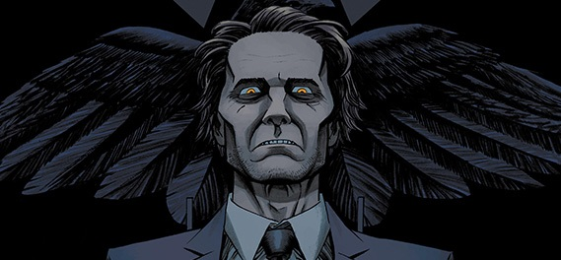
Learning Objective: To study chapter 2 of the novel
Re-read from ‘The steps grew swiftly nearer…’ to ‘…it is on that of your new friend.’
Mr Hyde
When we (along with Utterson) see Mr Hyde for the first time, we notice Stevenson frequently uses inhuman or animal imagery to describe Mr Hyde.
Complete a table to explain the imagery and the impression it creates of Mr Hyde. You can add to this table as you read through the rest of the novel.

Slide 16
Learning Objective: To study chapter 2 of the novel
Mr Hyde
When we (along with Utterson) see Mr Hyde for the first time, we notice Stevenson frequently uses inhuman or animal imagery to describe Mr Hyde.
Complete a table to explain the imagery and the impression it creates of Mr Hyde. You can add to this table as you read through the rest of the novel.

Slide 17
Q
W
E
R
T
Y
Your last question asked you to focus on an extract; now let’s try a wider text response.
What impression does Stevenson create of Mr Hyde in Chapters 1 and 2?
You can use your notes to answer this question, but not the novel!
Think about:
The description of his size and appearance
His quick movements
The effect he has on people who see him
The build up to our first viewing of him

Slide 18
One of the ways Stevenson... Another way... Hyde is also shown to be... The writer suggests... When Hyde is first described...
Q
}
W
E
This is shown when it says, “___”... An example of this is when Stevenson writes, “___”... For example, “___”
R
This makes the reader think... This suggests to the reader... The reader will think... This implies... This suggests...
T
The word order of this sentence suggests... The writer’s word choice... The simile “___”... The repetition of... This word has strong connotations of...
Y
This suggests... This implies... This links to...

Slide 19
Peer-Assess: WWW/ EBI
Band 6
Critical/exploratory response to task
Precise references used to support interpretation
Analysis of writer’s methods and their effects on the reader, with subject terminology used accurately
Exploration of contextual factors
How well has (s)he:
Responded to the question?
Used relevant quotes?
Analysed the effect of the writer’s methods?
Explored the effect on the reader?
Included contextual references?
Band 5
Thoughtful/developed response to task
Apt references integrated into interpretations
Examination of writer’s methods and their effects on the reader, with subject terminology used effectively
Thoughtful consideration of contextual factor
Band 4
Clear/explained response to task
Effective use of references to support explanation
Clear explanation of writer’s methods and their effects on the reader, with relevant subject terminology
Clear understanding of contextual factors

Slide 20
Response to feedback:
Band 6
Critical/exploratory response to task
Precise references used to support interpretation
Analysis of writer’s methods and their effects on the reader, with subject terminology used accurately
Exploration of contextual factors
Add to, change or extend one idea in your work in response to your partner’s feedback.
Band 5
Thoughtful/developed response to task
Apt references integrated into interpretations
Examination of writer’s methods and their effects on the reader, with subject terminology used effectively
Thoughtful consideration of contextual factor
Band 4
Clear/explained response to task
Effective use of references to support explanation
Clear explanation of writer’s methods and their effects on the reader, with relevant subject terminology
Clear understanding of contextual factors

