Slide 1
Learning Objective To explore some of the characters of the novel

Slide 2
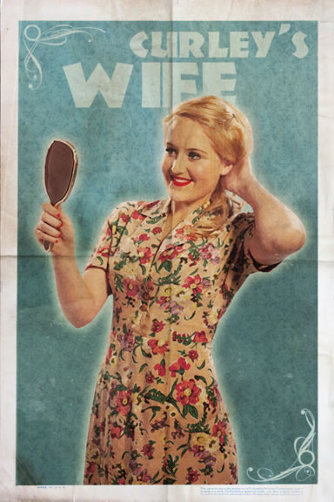
Learning Objective: To explore some of the characters of the novel
Exam questions often feature a character study. For that reason, you should be able to provide key quotes and character. So far, we’ve looked at Crooks, Slim and Curley in some detail. We’re now going to spend some time looking at one of the more controversial figures in the novel – Curley’s wife.
‘bitch’
‘a tramp’
‘tart’
‘good-lookin’’
‘jail bait’
‘got the eye’
‘purty’
‘rattrap’
What do the men in the novel think of Curley’s wife?
What do you think of her?

Slide 3
Learning Objective: To explore some of the characters of the novel
Some context – women in the 1930s
Women started to play a growing role in the American economy, both as consumers and workers. Between 1920 and 1929 the number of working women over the age of 15 increased by 50% to c.10 million (25% of the female population over 15). However, women’s wages were usually considerably lower than those of men, even where they were doing the same or similar jobs. Women were subject to criticism for the way they dress and act as skirts and hair got shorter, cosmetics got cheaper and women became more economically independent. Women drove and smoked – a shock for some! Fashionable clothes became cheaper and easier to obtain with a massive increase in chain stores throughout the USA.
1. What women appear or are referred to in the novella?
2. According to the male view on the ranch, what limited roles / functions does this show a woman can provide?
3. What do the men on the ranch think of Curley’s wife?

Slide 4
Learning Objective: To explore some of the characters of the novel
First impressions
We hear the men talk about Curley’s wife before we actually see her.
Whose opinion of Curley’s wife does Steinbeck give us first?
What impression does he give us?
3. Match each impression with a quotation from the text, e.g. Flirtatious and unfaithful. ‘Well - she got the eye’ p. 49.
Steinbeck never uses his narrative voice to tell us what to think. Just like in real life we are given the other characters’ opinions, and images of how Curely’s wife looks physically. We are shown how she treats others, what she actually says and how she says it. We are then left to form our own opinions.
Might accepting Candy’s view of Curley’s wife be unfair? Why?
What might influence his opinion of her?

Slide 5
George cut the cards and began turning them over, looking at each one and throwing it down on a pile. He said, “This guy Curley sounds like a son-of-a-bitch to me. I don’t like mean little guys.”
“Seems to me like he’s worse lately,” said the swamper. “He got married a couple of weeks ago. Wife lives over in the boss’s house. Seems like Curley is cockier’n ever since he got married.”
George grunted, “Maybe he’s showin’ off for his wife.”
The swamper warmed to his gossip. “You seen that glove on his left hand?”
“Yeah. I seen it.”
“Well, that glove’s fulla vaseline.”
“Vaseline? What the hell for?”
“Well, I tell ya what—Curley says he’s keepin’ that hand soft for his wife.”
George studied the cards absorbedly. “That’s a dirty thing to tell around,” he said.
The old man was reassured. He had drawn a derogatory statement from George. He felt safe now, and he spoke more confidently. “Wait’ll you see Curley’s wife.”
George cut the cards again and put out a solitaire lay, slowly and deliberately. “Purty?” he asked casually.
“Yeah. Purty . . . . but—”
George studied his cards. “But what?”
“Well—she got the eye.”
“Yeah? Married two weeks and got the eye? Maybe that’s why Curley’s pants is full of ants.”
“I seen her give Slim the eye. Slim’s a jerkline skinner. Hell of a nice fella. Slim don’t need to wear no high-heeled boots on a grain team. I seen her give Slim the eye. Curley never seen it. An’ I seen her give Carlson the eye.”
George pretended a lack of interest. “Looks like we was gonna have fun.”
The swamper stood up from his box. “Know what I think?” George did not answer. “Well, I think Curley’s married . . . . a tart.”

Slide 6
Learning Objective: To explore some of the characters of the novel
First look - foreshadowing
“Both men glanced up, for the rectangle of sunshine in the doorway was cut off. A girl was standing there looking in.”
Sunshine – like with pathetic fallacy, sunshine is used to represent hope and happiness. As she stands in the doorway, she “cuts” off the sunshine.
What is Steinbeck suggesting that she will cut short?
Now look at the sheet you have been given and complete the work on the significance of the language used in this section. What are we being told about Curley’s wife? What do we feel about her?
Is Steinbeck suggesting Curley’s wife is bad news?

Slide 7
Both men glanced up, for the rectangle of sunshine in the doorway was cut off. A girl was standing there looking in. She had full, rouged lips and wide-spaced eyes, heavily made up. Her fingernails were red. Her hair hung in little rolled clusters, like sausages. She wore a cotton house dress and red mules, on the insteps of which were little bouquets of red ostrich feathers. “I’m lookin’ for Curley,” she said. Her voice had a nasal, brittle quality.
George looked away from her and then back. “He was in here a minute ago, but he went.”
“Oh!” She put her hands behind her back and leaned against the door frame so that her body was thrown forward. “You’re the new fellas that just come, ain’t ya?”
“Yeah.”
Lennie’s eyes moved down over her body, and though she did not seem to be looking at Lennie she bridled a little. She looked at her fingernails. “Sometimes Curley’s in here,” she explained.
George said brusquely. “Well he ain’t now.”
“If he ain’t, I guess I better look some place else,” she said playfully.
Lennie watched her, fascinated. George said, “If I see him, I’ll pass the word you was looking for him.”
She smiled archly and twitched her body. “Nobody can’t blame a person for lookin’,” she said. There were footsteps behind her, going by. She turned her head. “Hi, Slim,” she said.
Slim’s voice came through the door. “Hi, Good-lookin’.”
“I’m tryin’ to find Curley, Slim.”
“Well, you ain’t tryin’ very hard. I seen him goin’ in your house.”
She was suddenly apprehensive. “’Bye, boys,” she called into the bunk house, and she hurried away.

Slide 8
Learning Objective: To explore some of the characters of the novel
Dislike?
Collect quotes which show the following aspects of Curley’s wife and make notes about how they make us feel about her.
Her dress and appearance – she is out of place on a working ranch. Her image suggests that the way she is living is not the way she would like to live
Her provocative body language
Her reaction when Slim tells her where Curley is. Why do you think she is here in the men’s bunkhouse? Look carefully!
George’s feelings about her and his warnings to Lennie after she leaves and after Curley has been looking for her.

Slide 9
As we read on, it is possible to feel sorry for Curley’s wife. After all, as the only woman on the ranch she is lonely and sad. She is the only female character who appears in the novella. As a woman, and because she is a woman, she cannot live the life she dreams of. Indeed, she has precious little control over her own life.
Arrange the points on your sheet in the Venn diagram in order to decide whether you think that her actions are a reaction to how she is treated, or if her character is just petty, cruel and self-obsessed.
Reasons to feel unsympathetic towards Curley’s Wife
Reasons to feel sympathetic towards Curley’s Wife
Collect some quotes for those you placed in the ‘sympathetic’ section of the Venn diagram.

Slide 10
Learning Objective: To explore some of the characters of the novel
Sympathy?
She is never given a name – she’s referred to only as ‘Curley’s wife’. What does this suggest about her status on the ranch?

Slide 11
Learning Objective: To explore some of the characters of the novel
Sympathy?
Read Steinbeck’s letter to Claire Luce, an actress who was playing Curley’s wife.
Does this change the way you interpret the quotes on your sheet?

Slide 12
Learning Objective: To explore some of the characters of the novel
Sympathy?
“I get lonely,” she said. “You can talk to people, but I can’t talk to nobody but Curley. Else he gets mad. How’d you like not to talk to anybody?”
“Wha’s the matter with me?” she cried. “Ain’t I got a
right to talk to nobody? Whatta they think I am, anyways? You’re a nice guy. I don’t know why I can’t talk to you. I ain’t doin’ no harm to you.”
“And then her words tumbled out in a passion of communication, as though she hurried before her listener could be taken away.”
“I don’ like Curley. He ain’t a nice fella.”
“You’re nuts,” she said. “But you’re a kinda nice fella. Jus’ like a big baby. But a person can see kinda what you mean.
What do these quotes tell us about the sort of life Curley’s wife leads?

Slide 13
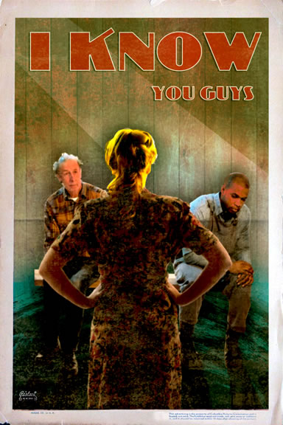
Learning Objective: To explore some of the characters of the novel
Sympathy?
In light of this, why might Curley’s wife have reacted the way she did when she found Crooks, Lennie and Candy talking in the barn?
Try to take a sympathetic stance.

Slide 14
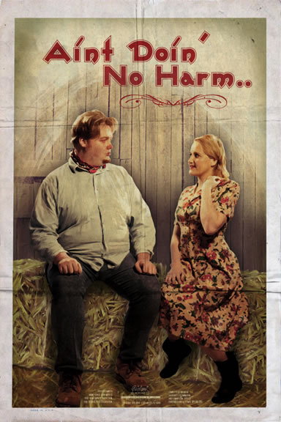
Learning Objective: To explore some of the characters of the novel
Death
Do we feel any sympathy for Curley’s wife in her death?
“She struggled violently under his hands. Her feet battered on the hay and she writhed to be free; and from under Lennie’s hand came a muffled screaming.”

Slide 15
Learning Objective: To explore some of the characters of the novel
Death
Do we feel any sympathy for Curley’s wife in her death?
“And she continued to struggle, and her eyes were wild with terror.”

Slide 16
Learning Objective: To explore some of the characters of the novel
Death
Do we feel any sympathy for Curley’s wife in her death?
“And the meanness and the plannings and the discontent and the ache for attention were all gone from her face. She was very pretty and simple, and her face was sweet and young. Now her rouged cheeks and her reddened lips made her seem alive and sleeping very lightly.”

Slide 17
Learning Objective: To explore some of the characters of the novel
Death
Do we feel any sympathy for Curley’s wife in her death?
“You God damn tramp”, he said viciously. “You done it, di’n’t you? I s’pose you’re glad. Ever’body knowed you’d mess things up. You wasn’t no good. You ain’t no good now, you lousy tart.”

Slide 18
Learning Objective: To explore some of the characters of the novel
Death
Do we feel any sympathy for Curley’s wife in her death?
“Slim stood looking down at Curley’s wife. He said, “Curley—maybe you
better stay here with your wife.”
Curley’s face reddened. “I’m goin’,” he said.”

Slide 19
Learning Objective: To explore some of the characters of the novel
Have a go at the exam question on Curley’s wife.
Part (a)
In this passage, what methods does Steinbeck use to present Curley’s wife and the attitudes of others to her? Refer closely to the passage in your answer.
and then Part (b)
How does Steinbeck present attitudes to women in the society in which the novel is set?
(30 marks)
SPaG: (4 marks)
Make links to other sections which deal with Curley’s wife as well as the role of other women in the novel, e.g. Aunt Clara. Write about these within the context of the time.

Slide 20
Learning Objective: To understand how the study of ‘Of Mice and Men’ fits into your Literature exam; to understand the AOs
AO1: respond to texts critically and imaginatively; select and evaluate relevant textual detail to illustrate and support interpretations
AO2: explain how language, structure and form contribute to writers’ presentation of ideas, themes and settings
AO4: relate texts to their social, cultural and historical contexts; explain how texts have been influential and significant to self and other readers in different contexts and at different times
AO1 = 5%
AO2 = 5%
AO4 = 10%
An understanding of context is really important for this unit of work. It is the only literature exam in which it is assessed.

Slide 21
Ideas.
Quotes.
Analysis.
Explore.

Slide 22
Learning Objective: To explore some of the characters of the novel
Using the notes you have been given, as well as your own research, create a character profile. This should include:
1. The key episodes in which the character is involved - select episodes that typify the character and show different sides of him/her
2. What the character says and does, and what others say about him/her
3. The character’s relationship with others
4. What Steinbeck makes the reader feel about the character – how does he do that? (Consider: what the character does/says; the language (s)he uses; the language used to describe him/her)
5. The character’s purpose or role in the novel
6. Key quotes with analysis for each of the above sections

Slide 23
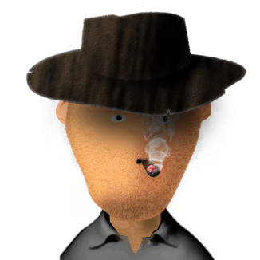
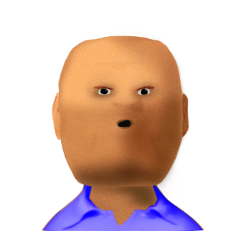
Learning Objective: To explore some of the characters of the novel
The Boss
The stocky, well-dressed man in charge of the ranch, and Curley’s father. He is never named and appears only once, but seems to be a fair-minded man. Candy happily reports that the boss once delivered a gallon of whiskey to the ranch-hands on Christmas Day.
Carlson
A ranch-hand, Carlson complains bitterly about Candy’s old, smelly dog. He convinces Candy to put the dog out of its misery. When Candy finally agrees, Carlson promises to execute the task without causing the animal any suffering. Later, George uses Carlson’s gun to shoot Lennie.

Slide 24
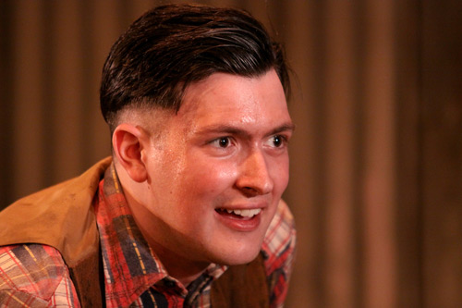
Learning Objective: To explore some of the characters of the novel
Whit
Whit is young and has not yet become bitter or cynical.
He is aware of the danger Curley's wife poses however and he tells George to come into town with them and 'get it all out his system'.
Whit shows Slim a letter from Bill Tanner in a magazine – Bill worked on the ranch briefly and he clearly represents the closest thing to friendship Whit has had.

Slide 25
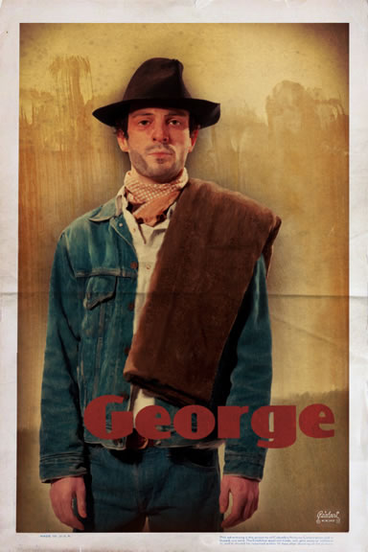
He is a small man, but has brains and a quick wit.
He has been a good friend to Lennie, ever since he promised Lennie's Aunt Clara that he would care for him. He looks after all Lennie's affairs, such as carrying his work card, and tries to steer him out of potential trouble.
He needs Lennie as a friend, not only because Lennie's strength helps to get them both jobs, but so as not to be lonely. His threats to leave Lennie are not really serious. He is genuinely proud of Lennie.
He shares a dream with Lennie to own a piece of land and is prepared to work hard to build up the money needed to buy it.
"...with us it ain't like that. We got a future. We got somebody to talk to that gives a damn about us. We don't have to sit in no bar room blowin' in our jack 'jus because we got no place else to go. If them other guys gets in jail they can rot for all anybody gives a damn. But not us."
He is honest with people he trusts. For example, he tells Slim that he used to play tricks on Lennie when they were young, but now feels guilty about it as Lennie nearly drowned.

Slide 26
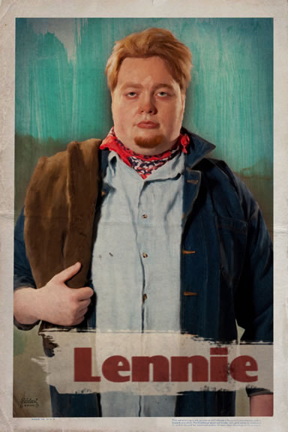
He is a big man, in contrast to his name.
He has limited intelligence, so he relies on George to look after him. He copies George in everything George does and trusts George completely.
"Behind him (George) walked his opposite, a huge man, shapeless of face, with large, pale eyes, with wide, sloping shoulders; and he walked heavily, dragging his feet a little, the way a bear drags his paws. His arms did not swing at his sides, but hung loosely."
He shares a dream with George to own a piece of land. Lennie's special job would be to tend the rabbits.
He likes to pet soft things, like puppies and dead mice. We know this got him into trouble in Weed when he tried to feel a girl's soft red dress: she thought he was going to attack her.
He can be forgetful - George continually has to remind him about important things.
He is very gentle and kind, and would never harm anyone or anything deliberately.
He is extremely strong: he can work as well as two men at bucking barley.
He is often described as a child or an animal - he drinks from the pool like a horse and his huge hands are described as paws.

Slide 27
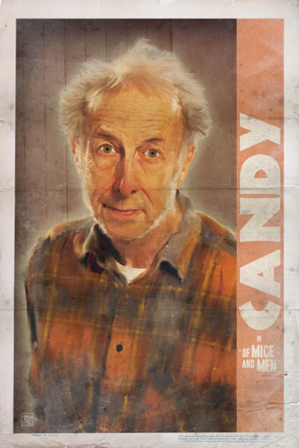
Candy is the oldest ranch hand. He lost his right hand in an accident at work.
He is the 'swamper' - the man who cleans the bunkhouse. He knows he will be thrown out and put 'on the county' when he is too old to work.
Because of this, he accepts what goes on and doesn't challenge anything: he can't afford to lose his job.
He has a very old dog, which he has had from a pup. It is his only friend and companion.
"The old man came slowly into the room. He had his broom in his hand. And at his heels there walked a drag-footed sheep dog, gray of muzzle, and with pale, blind old eyes."
Carlson insists on shooting the dog because he claims it is too old and ill to be of any use. Candy is devastated.
He is lonely and isolated, but makes friends with George and Lennie and offers his compensation money to help them all to buy a ranch together and achieve their dream.
When he finds Curley's wife dead, he is furious, as he knows instantly that Lennie was involved and that they have lost their chance of achieving their dream.

Slide 28
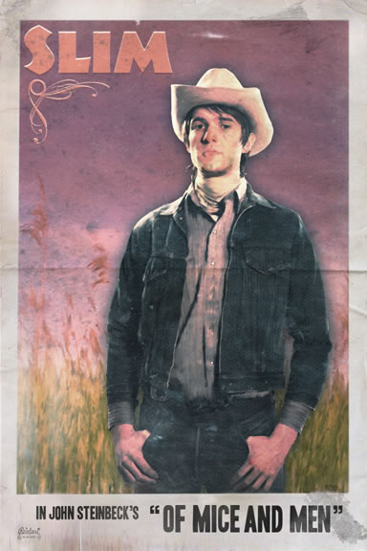
Slim is the jerkline skinner (lead mule-team driver) at the ranch. He is excellent at his job.
He is the natural leader at the ranch. Everyone respects his views and looks up to him.
He has a quiet dignity: he doesn't need to assert himself to have authority.
"there was a gravity in his manner and a quiet so profound that all talked stopped when he spoke. His authority was so great that his word was taken on any subject, be it politics or love."
He understands the relationship between George and Lennie. He helps George at the end and reassures George that he did the right thing.
We know little else about him, which gives him a slightly mysterious quality. Do you think he is too good to be true?

Slide 29
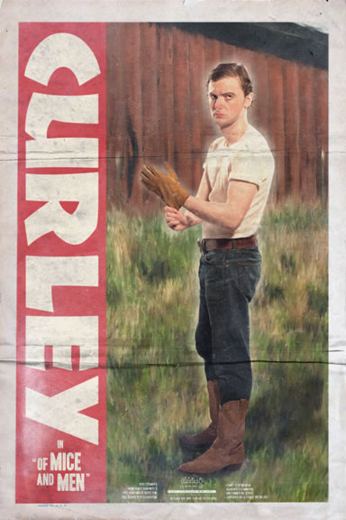
Learning Objective: To explore some of the characters of the novel
Curley is the boss's son, so he doesn't need to work like the ordinary ranch hands, and he has time to kill.
He's little - so he hates big guys.
He is a prize-fighter and looks for opportunities for a fight.
"He glanced coldly at George and then at Lennie. His arms gradually bent at the elbows and his hands closed into fists. He stiffened and went into a slight crouch. His glance was at once calculating and pugnacious."
He is newly-married and is very possessive of his wife - but he still visits brothels.
There is a rumour that he wears a glove filled with Vaseline to keep his hand soft for his wife.

Slide 30
Learning Objective: To explore some of the characters of the novel
She is newly married to Curley.
We never know her name - she is merely Curley's 'property' with no individual identity.
She is young, pretty, wears attractive clothes and curls her hair.
She seems flirtatious and is always hanging around the bunk-house.
She is lonely - there are no other women to talk to and Curley is not really interested in her.
"What kinda harm am I doin' to you? Seems like they ain't none of them cares how I gotta live. I tell you I ain't used to livin' like this. I coulda made somethin' of myself."
She doesn't like Curley - she tells Lennie that she only married him when she didn't receive a letter she'd been promised to get into Hollywood.
She is naive.

Slide 31
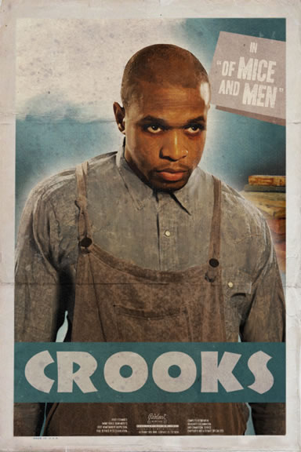
Crooks is the black stable hand or buck.
He is the only permanent employee at the ranch, since he injured his back in an accident. His back gives him constant pain.
He is the only black man around and is made to be isolated by his colour - he can't go into the bunk-house or socialise with the men.
He is always called the 'nigger' by the men, which shows how racism is taken for granted. The men don't mean to insult Crooks every time they call him this, but they never think to use his name
All this has made him proud and aloof.
He is lonely.
"S'pose you didn't have nobody. S'pose you couldn't go into the bunk house and play rummy 'cause you were black... A guy needs somebody - to be near him... I tell ya a guy gets too lonely an' he gets sick."
The only time he mixes with the ranch hands socially is when they pitch horseshoes - and then he beats everyone!
He has his own room near the stables and has a few possessions. He has books, which show he is intelligent and an old copy of the California Civil Code, which suggests he is concerned about his rights.
He has seen many men come and go, all dreaming of buying a piece of land, but is now cynical, as no one has ever achieved it.

Slide 32
Learning Objective: To explore some of the characters of the novel
Think you know everything there is to know about all the characters?
Let’s put it to the test!

Slide 33
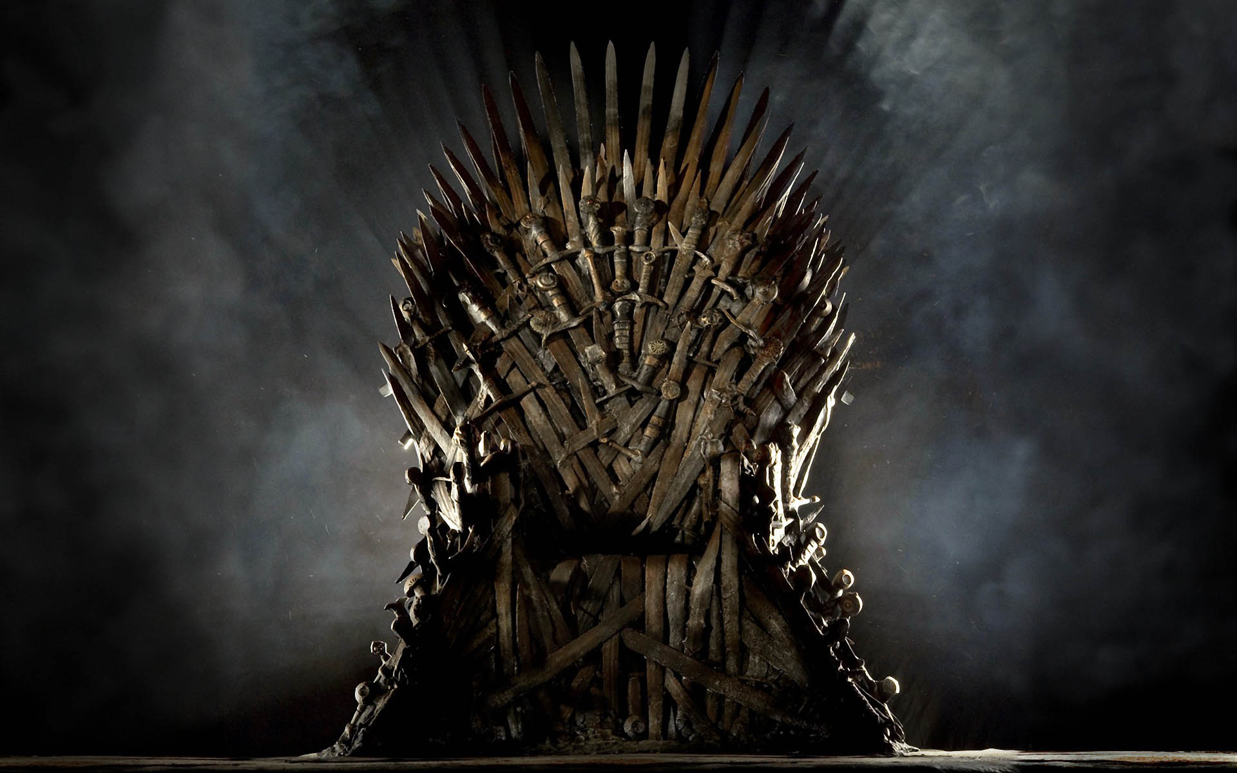
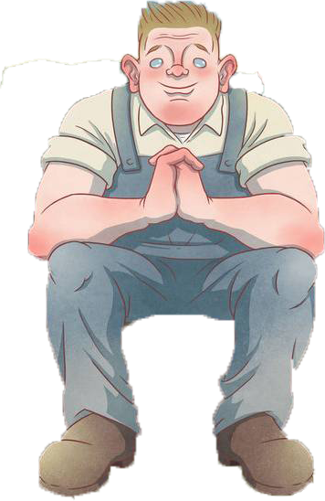
How is ‘Of Mice and Men’ like ‘Game of Thrones’?

Slide 34
It’s all to do with the characters!
The characters are archetypes which can be found in many novels.

Slide 35
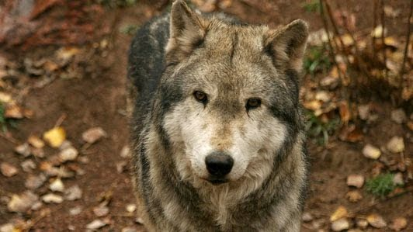
The direwolves are the Stark children's companions and protectors. They are killed, leaving the child bereft and grieving. This is like...
Candy's dog!

Slide 36
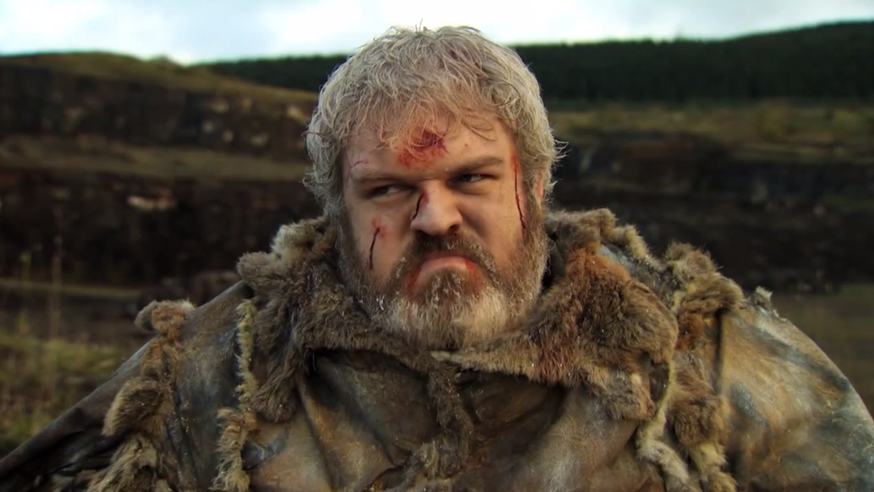
Hodor is a gentle giant who only hurts people accidentally or when told to by Bran. His vocabulary is limited and he can't think for himself but will do what ever he is told. This is like...
Lennie!

Slide 37
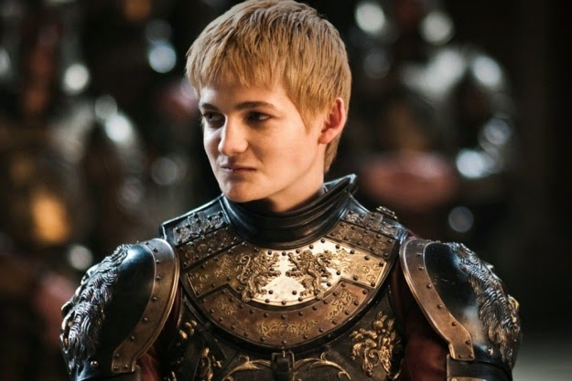
Joffrey is short, annoying and pugnacious. He is unpleasant to his wife who he treats like a possession. This is like...
Curley!

Slide 38
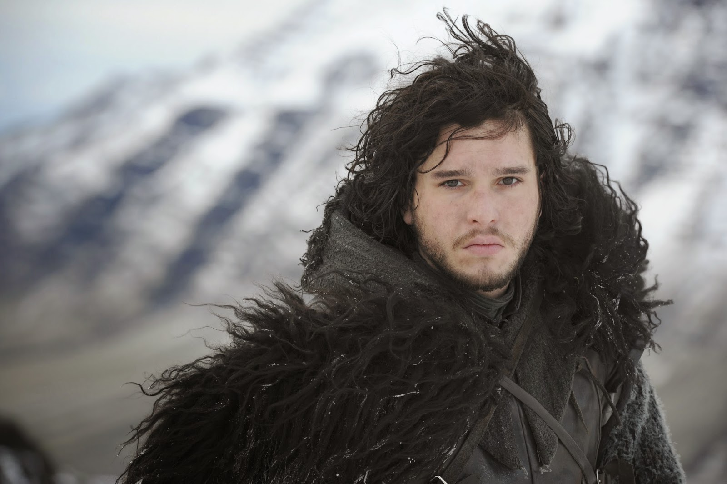
John Snow is noble and trustworthy. He does the right thing, is a skilled fighter and is a natural born leader of men. This is like...
Slim!

Slide 39
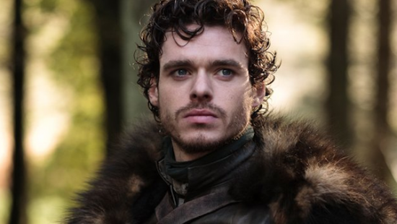
Robb Stark didn't ask for responsibility, but he does his best. He believes in doing the right thing but can be brutal when dealing with his enemies. This is like...
George!

Slide 40
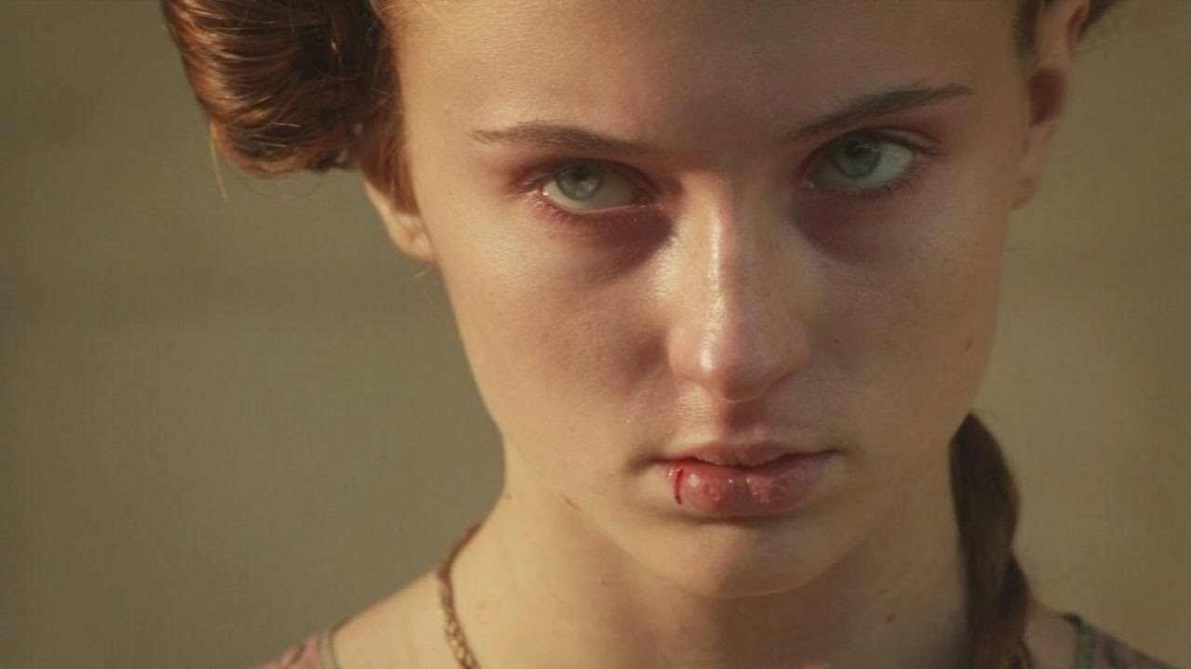
Sansa was a spoiled, silly girl when younger. She dreamed of being a queen and falling in love. Instead, she finds herself abused and mistreated by Joffrey, surrounded by strangers in his kingdom. This is like...
Curley’s wife!

Slide 41
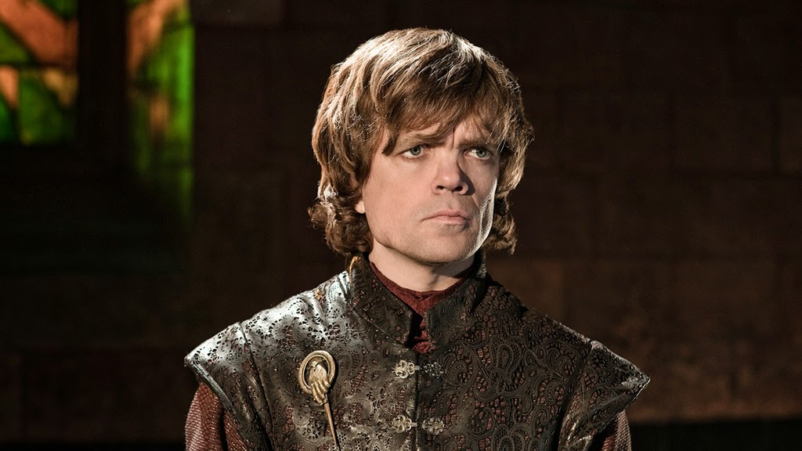
Tyrion is realist who doesn't believe in fairy tales. He is considered deformed and is treated like an outsider. However he is clever and a survivor. This is like...
Crooks!

Slide 42
The point?
Don’t forget that the characters are constructions. They serve a purpose and play a role. Make sure you are aware of this when you analyse them.

