Slide 1
Learning Objective To study Chapter 4 of the novel

Slide 2
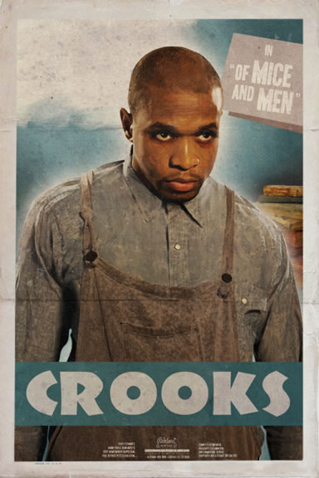
Learning Objective: To study Chapter 4 of the novel
"…You go on get outta my room. I ain’t wanted ... "
"Why ain’t you wanted?" Lennie asked. "’Cause I’m black."
Some contextual information
The consumer goods boom did not affect all people equally. By 1929 over 50% of Americans earned less than $2000 a year, with 40% below the poverty line. Black and immigrant workers were particularly likely to be affected by low wages and unemployment. By 1929 farm incomes were roughly 40% of the national average. During the boom times of the 1920s c.1 million black farm workers lost their jobs.

Slide 3
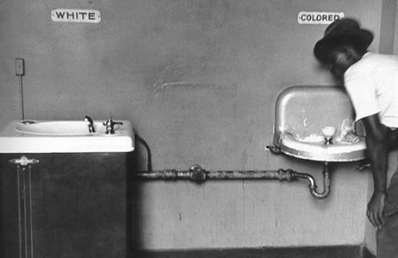
Learning Objective: To study Chapter 4 of the novel
What does this image tell us about the treatment and status of black people?
Does this fit with what we’ve read in the novel?
What is Crooks’ real name?
Read the rest of the contextual information you have been given. What does this information tell us about Crooks’ situation on the ranch?

Slide 4
Crooks expresses his feelings about racism and loneliness on several occasions. In some ways, he provides insight to the reality of the American Dream and the loneliness of the ranchers. Look at the following quotes from Crooks and analyse what his words say about his feelings towards his status in society:
"If I say something, why it's just a nigger sayin' it"
"You got no right to come in my room... You go on get outa my room. I ain't wanted in the bunkhouse and you ain't wanted in my room."
"Sure, you could play horseshoes till it got dark, but then you got to read books. Books ain't no good. A guy needs someone - to be near him. A guys goes nuts if he ain't got nobody. Don't make no difference who the guy is, long's he's with you. I tell ya, a guy gets too lonely, an' he gets sick."
"I seen hundreds of men come by on the road an' on the ranches with their bindles on their backs an' that same damn thing in their heads. Hundreds of them. They come, an' they quit an' go on... An' never a god-damn one of 'em gets it."
"I remember when I was a little kid... had a strawberry patch. Had an alfalfa patch… Used to turn the chickens out on the alfalfa on a sunny morning"

Slide 5
Learning Objective: To study Chapter 4 of the novel
How does Crooks try to hold power over Lennie by teasing him about George not coming back? Why do you think he does this?
Some people may describe Crooks as being cynical, resentful and even cold-hearted. Make some notes, responding to the questions below. Include quotes to support your answers.
1 - Why do you think people may think this way?
2 - How do you respond to Crooks?
3 - Where can we see that Crooks is actually vulnerable?
4 - Does he have reasons to be cynical? If so, what are the reasons?

Slide 6
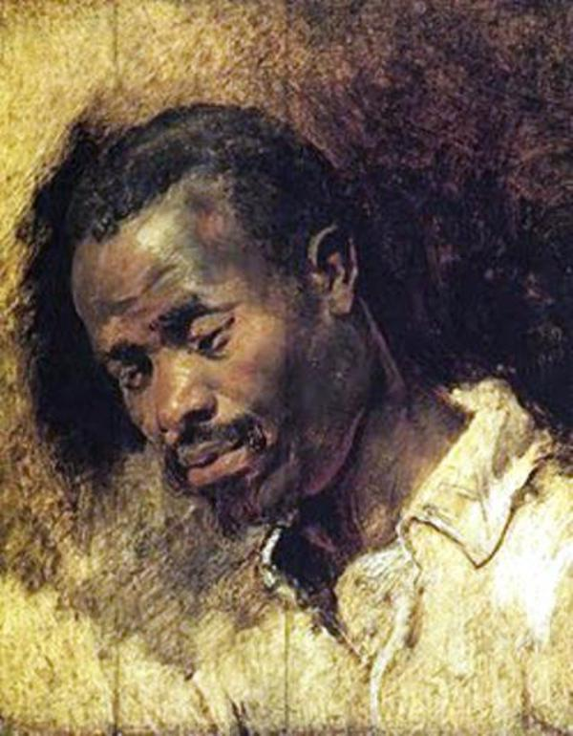
Learning Objective: To study Chapter 4 of the novel
You have been given a quotation about or by Crooks. Annotate your quote with ideas about the following:
1. Effective or significant language or structural techniques
2. Whether your quote creates sympathy for Crooks and how
3. Whether your quote creates dislike for Crooks and how

Slide 7
[When Crooks stands up to Curley’s Wife] She closed on him. “You know what I could do?” Crooks seemed to grow smaller, and he pressed himself against the wall. “Yes, ma’am.” “Well, you keep your place then, Nigger. I could get you strung upon a tree so easy it ain’t even funny.” Crooks had reduced himself to nothing. There was no personality, no ego—nothing to arouse either like or dislike. He said, “Yes, ma’am,” and his voice was toneless.
What is happening in this quotation? Where does it fit into the novel?
What does it show us about the power between the two characters?
Look for words that show Crooks being reduced to nothing...
Why has Steinbeck done this? What is he showing us about the context?
How does Steinbeck present Crooks’ character in Section 4?

Slide 8
[When Crooks stands up to Curley’s Wife] She closed on him. “You know what I could do?” Crooks seemed to grow smaller, and he pressed himself against the wall. “Yes, ma’am.” “Well, you keep your place then, Nigger. I could get you strung upon a tree so easy it ain’t even funny.” Crooks had reduced himself to nothing. There was no personality, no ego—nothing to arouse either like or dislike. He said, “Yes, ma’am,” and his voice was toneless.
How does Steinbeck present Crooks’ character in Section 4?
Q
W
E
R
T
Y

Slide 9
[When Crooks stands up to Curley’s Wife] She closed on him. “You know what I could do?” Crooks seemed to grow smaller, and he pressed himself against the wall. “Yes, ma’am.” “Well, you keep your place then, Nigger. I could get you strung upon a tree so easy it ain’t even funny.” Crooks had reduced himself to nothing. There was no personality, no ego—nothing to arouse either like or dislike. He said, “Yes, ma’am,” and his voice was toneless.
How does Steinbeck present Crooks’ character in Section 4?
Steinbeck shows Crooks as a victim of the racism of society. We see him stand up to Curley’s Wife, showing confidence and pride, but the reader is immediately reminded that because Crooks is black, he can never escape prejudice.
Q
W
E
R
T
Y

Slide 10
[When Crooks stands up to Curley’s Wife] She closed on him. “You know what I could do?” Crooks seemed to grow smaller, and he pressed himself against the wall. “Yes, ma’am.” “Well, you keep your place then, Nigger. I could get you strung upon a tree so easy it ain’t even funny.” Crooks had reduced himself to nothing. There was no personality, no ego—nothing to arouse either like or dislike. He said, “Yes, ma’am,” and his voice was toneless.
How does Steinbeck present Crooks’ character in Section 4?
Steinbeck shows Crooks as a victim of the racism of society. We see him stand up to Curley’s Wife, showing confidence and pride, but the reader is immediately reminded that because Crooks is black, he can never escape prejudice.
When Curley’s Wife threatens Crooks, calling him “Nigger” and telling him that she could “get you strung upon a tree so easy it ain’t even funny” the reader is powerfully reminded how cruel society was. Steinbeck describes Crooks’ reaction by using lots of words to do with him disappearing, “Crooks seemed to grow smaller... Crooks had reduced himself to nothing... No personality, no ego- nothing.” He effectively disappears, showing that Curley’s Wife has the power to make him seem invisible, no longer human and unimportant.
Q
W
E
R
T
Y

Slide 11
How does Steinbeck present Crooks’ character in Section 4?
Q
W
E
R
T
Y

Slide 12
Self-Assess
Band 6
Insightful/exploratory response to themes/ideas
Close analysis of detail to support interpretation
Evaluation of writer’s uses of language and/or form and/or structure and effects on readers
Band 5
Exploratory response to themes/ideas
Analytical use of details to support interpretation
Analysis of writer’s uses of language and/or form and/or structure and effects on readers
How well have you:
Responded to the ideas/themes in the extract
Used relevant quotes?
Analysed the effect of language?
Band 4
Thoughtful consideration response to themes/ideas
Details linked to interpretation
Appreciation/consideration of writer’s uses of language and/or form and/or structure and effects on readers

Slide 13
Q
W
E
R
T
Y
Let’s have a go at a section (b) style question, linking the events of the chapter with the context of the time.
How does Steinbeck show the racial inequality through this section, particularly with Curley’s wife’s threats?

Slide 14
Self-Assess
Band 6
Insightful/exploratory response to context(s)
Insightful exploration of a range of telling detail to support response to context(s)
Band 5
Exploratory response to context(s)
Exploration of a range of telling detail to support response to context(s)
How well have you:
Responded to the context(s) in the extract?
Used relevant quotations to support your points?
Band 4
Considered/ qualified response to context(s)
Thoughtful selection and consideration of details to support response to context(s)

