Slide 1
Macbeth Act 2

Slide 2
Learning Objective Act 2 Scene 1 To explore Macbeth’s thoughts and feelings

Slide 3
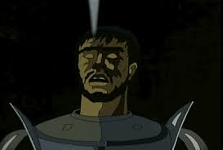
The Tragic Hero?
Learning Objective: To explore Macbeth’s thoughts and feelings
“A tragic hero is a literary character who makes a judgment error that inevitably leads to his/her own destruction”
“A great or virtuous character, who is destined for downfall”
“They possess a fatal flaw”
How do you think Macbeth is going to be a ‘tragic hero’?
Do you think he fits the characteristics of a ‘tragic hero’?

Slide 4
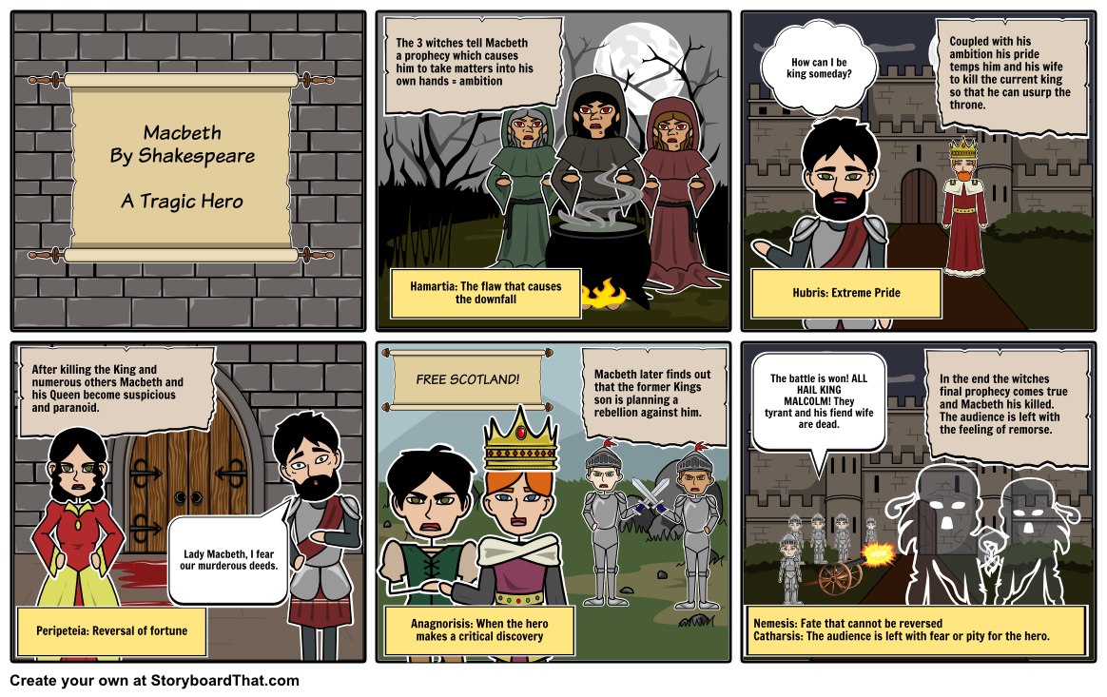
Use these examples to help you fill in your grid – is Macbeth a tragic hero?

Slide 5
Motif: ‘Done’
Motif: ’Blood’
Theme: Supernatural
Device: Imagery, allusion, personification
Device: Foreshadowing
Act 2, Scene 1
Macbeth and Banquo agree to discuss the witches’ prophecies at a later time. In the darkened hall, Macbeth has a vision of a dagger floating in the air. The night around him seems thick with horror and witchcraft, but Macbeth stiffens and decides to do his bloody work. A bell tolls—Lady Macbeth’s signal that the chamberlains are asleep—and Macbeth strides toward Duncan’s chamber.

Slide 6
Learning Objective: To explore Macbeth’s thoughts and feelings
References to darkness:
‘The moon is down’
‘Their candles are all out’
‘A heavy summons lies like lead upon me’ – what connotations do these words have?
‘I would not sleep’ – what atmosphere does this create?
How do these lines set the scene for what is to come?

Slide 7
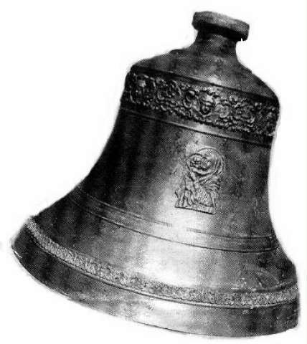
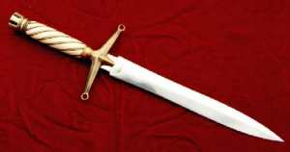
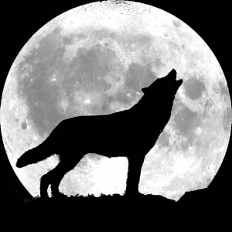
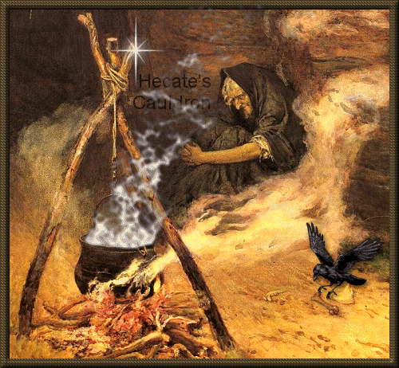
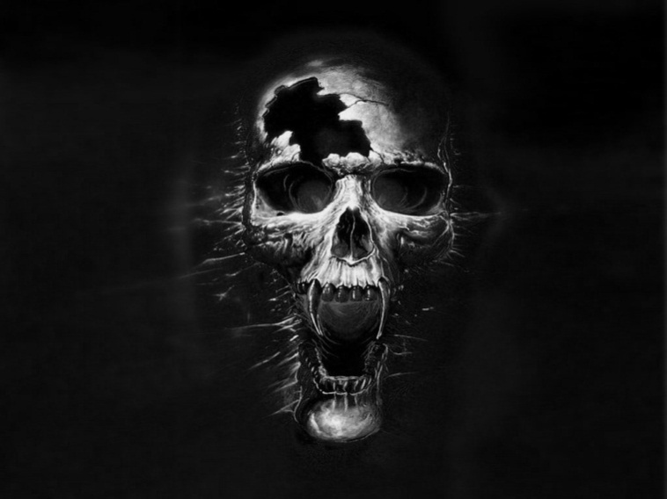
Learning Objective: To explore Macbeth’s thoughts and feelings
What connotations (meanings or suggestions) do the following images have?

Slide 8
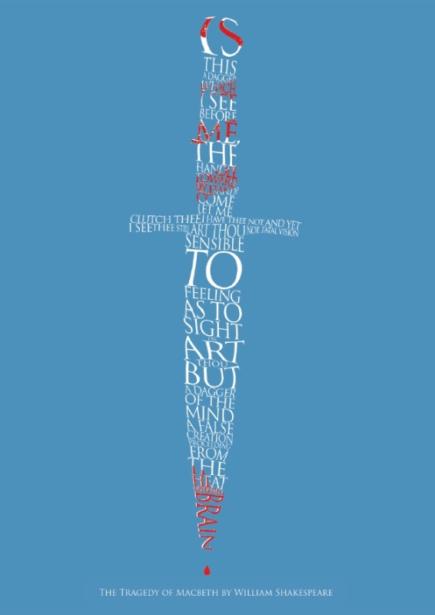
Watch the video of this scene. What does Macbeth think he sees?

Slide 9
Learning Objective: To explore Macbeth’s thoughts and feelings
Is this a dagger which I see before me, The handle toward my hand? Come, let me clutch thee. I have thee not, and yet I see thee still. Art thou not, fatal vision, sensible To feeling as to sight? or art thou but A dagger of the mind, a false creation, Proceeding from the heat-oppressed brain? I see thee yet, in form as palpable As this which now I draw. Thou marshall'st me the way that I was going; And such an instrument I was to use. Mine eyes are made the fools o' the other senses, Or else worth all the rest; I see thee still, And on thy blade and dudgeon gouts of blood, Which was not so before. There's no such thing: It is the bloody business which informs Thus to mine eyes. - Now o'er the half-world
Nature seems dead, and wicked dreams abuse
The curtain'd sleep; witchcraft celebrates Pale Hecate's offerings, and wither'd murder, Alarum'd by his sentinel, the wolf, Whose howl's his watch, thus with his stealthy pace. With Tarquin's ravishing strides, towards his design Moves like a ghost. Thou sure and firm-set earth, Hear not my steps, which way they walk, for fear Thy very stones prate of my whereabout, And take the present horror from the time, Which now suits with it. Whiles I threat, he lives: Words to the heat of deeds too cold breath gives.
A bell rings
I go, and it is done; the bell invites me. Hear it not, Duncan; for it is a knell That summons thee to heaven or to hell.
Work with your partner on your section of this speech.
What does Macbeth see?
How does he explain it?
What images of evil are present?
What are Macbeth’s thoughts and feelings?

Slide 10
Learning Objective: To explore Macbeth’s thoughts and feelings
Is this a dagger which I see before me, The handle toward my hand? Come, let me clutch thee. I have thee not, and yet I see thee still. Art thou not, fatal vision, sensible To feeling as to sight? or art thou but A dagger of the mind, a false creation, Proceeding from the heat-oppressed brain? I see thee yet, in form as palpable As this which now I draw. Thou marshall'st me the way that I was going; And such an instrument I was to use. Mine eyes are made the fools o' the other senses, Or else worth all the rest; I see thee still, And on thy blade and dudgeon gouts of blood, Which was not so before. There's no such thing: It is the bloody business which informs Thus to mine eyes. - Now o'er the half-world
Nature seems dead, and wicked dreams abuse
The curtain'd sleep; witchcraft celebrates Pale Hecate's offerings, and wither'd murder, Alarum'd by his sentinel, the wolf, Whose howl's his watch, thus with his stealthy pace. With Tarquin's ravishing strides, towards his design Moves like a ghost. Thou sure and firm-set earth, Hear not my steps, which way they walk, for fear Thy very stones prate of my whereabout, And take the present horror from the time, Which now suits with it. Whiles I threat, he lives: Words to the heat of deeds too cold breath gives.
A bell rings
I go, and it is done; the bell invites me. Hear it not, Duncan; for it is a knell That summons thee to heaven or to hell.
Annotate Macbeth’s soliloquy with answers to the following questions:
What does Macbeth see?
How does he explain it?
What images of evil are present?
What are Macbeth’s thoughts and feelings?

Slide 11
Learning Objective: To explore Macbeth’s thoughts and feelings
A question = he’s confused and uncertain
Is this a dagger which I see before me,
The handle toward my hand? Come, let me clutch thee –
I have thee not and yet I see thee still!
Art thou not, fatal vision, sensible
To feeling as to sight? Or art thou but
A dagger of the mind, a false creation,
Proceeding from the heat-oppressed brain?
I see thee yet, in form as palpable
As this which now I draw.
Thou marshall'st me the way that I was going;
And such an instrument I was to use. -
Mine eyes are made the fools o'th’ other senses,
Or else worth all the rest: I see thee still;
And, on thy blade and dudgeon, gouts of blood,
Which was not so before. - There's no such thing.
It is the bloody business which informs
Thus to mine eyes. - Now o'er the half-world
Nature seems dead, and wicked dreams abuse
The curtain'd sleep:
His mind is ‘oppressed’ = he feels burdened/ under pressure
A violent image (“bloody”) = he feels... ?
An horrific vision = he’s scared and disgusted at himself
What he’s doing is so evil that it’s making people have nightmares and killing nature = he feels... ?

Slide 12
Learning Objective: To explore Macbeth’s thoughts and feelings
Murder is personified, moving towards Duncan, heralded by the wolf = how does Macbeth feel?
Witchcraft celebrates
Pale Hecate's offerings; and withered Murder,
Alarum'd by his sentinel, the wolf,
Whose howl's his watch, thus with his stealthy pace,
With Tarquin's ravishing strides, towards his design
Moves like a ghost. - Thou sure and firm-set earth,
Hear not my steps, which way they walk, for fear
Thy very stones prate of my where-about,
And take the present horror from the time,
Which now suits with it. - Whiles I threat, he lives:
Words to the heat of deeds too cold breath gives.
A bell rings.
I go, and it is done; the bell invites me.
Hear it not, Duncan, for it is a knell
That summons thee to Heaven or to hell.
Tarquin was a Roman god who committed a crime in the shadows of night = Macbeth feels like…
Why does Macbeth fear the stones telling of his whereabouts? (Think of consequences – look at the last line!)
His courage is waning the more he talks of it = he feels…

Slide 13
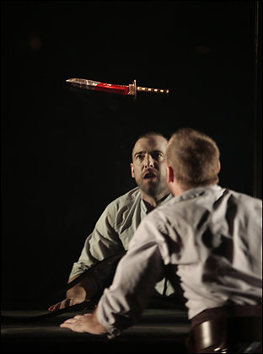
Learning Objective: To explore Macbeth’s thoughts and feelings
Should the dagger be shown on stage?
Vote now! Explain how your choice affects the audience’s response to Macbeth’s words.

Slide 14
Learning Objective Act 2 Scene 2 Who is more powerful in this scene?

Slide 15
Motif: ‘Done’
Motif: ’Blood’
Character: Lady Macbeth & Macbeth
Plot: Pivotal moment, breakdown of relationship
Device: Imagery
Device: Foreshadowing
Act 2, Scene 2
Lady Macbeth imagines Macbeth is killing Duncan. Hearing Macbeth cry out, she worries the chamberlains have woken. Macbeth emerges, his hands covered in blood, and says that the deed is done. Lady Macbeth becomes angry when she notices that he has forgotten to leave the daggers with the sleeping chamberlains so as to frame them for Duncan’s murder. As Lady Macbeth does it for him, Macbeth hears a mysterious knocking.

Slide 16
Learning Objective: Who is more powerful in this scene?
Look at the following things that Macbeth days to Lady Macbeth in Act 2 Scene 2, just after he has murdered Duncan.
‘I have done the deed’
‘This is a sorry sight’
‘I could not say ‘Amen’’
‘Macbeth shall sleep no more’
‘I am afraid to think what I have done’
‘How is’t with me when every noise appals me?’
‘Wake Duncan with thy knocking: I would thou couldst’
How does Macbeth feel at this point in the play? Write a quick QWERTY paragraph to explain your ideas, based on these quotations.
What does each comment suggest about his state of mind at this point in the play?

Slide 17
Learning Objective: Who is more powerful in this scene?
LADY MACBETH Go get some water, And wash this filthy witness from your hand. Why did you bring these daggers from the place? They must lie there: go carry them; and smear The sleepy grooms with blood.
MACBETH I'll go no more: I am afraid to think what I have done; Look on't again I dare not.
LADY MACBETH Infirm of purpose! Give me the daggers: the sleeping and the dead Are but as pictures: 'tis the eye of childhood That fears a painted devil. If he do bleed, I'll gild the faces of the grooms withal; For it must seem their guilt.
Exit. Knocking within
MACBETH Whence is that knocking? How is't with me, when every noise appals me? What hands are here? ha! they pluck out mine eyes. Will all great Neptune's ocean wash this blood Clean from my hand? No, this my hand will rather The multitudinous seas in incarnadine, Making the green one red.
Re-enter LADY MACBETH
LADY MACBETH My hands are of your colour; but I shame To wear a heart so white.
‘witness’ draws attention to Macbeth’s bloody hands; connotations of a crime and guilt.
‘Go’ as a command shows her control over him
Who is most powerful here?
Annotate each section with your ideas. Consider:
How does Macbeth react to his murder of Duncan?
How does Lady Macbeth react to Macbeth’s murder of Duncan?
How does each affect the other?

Slide 18
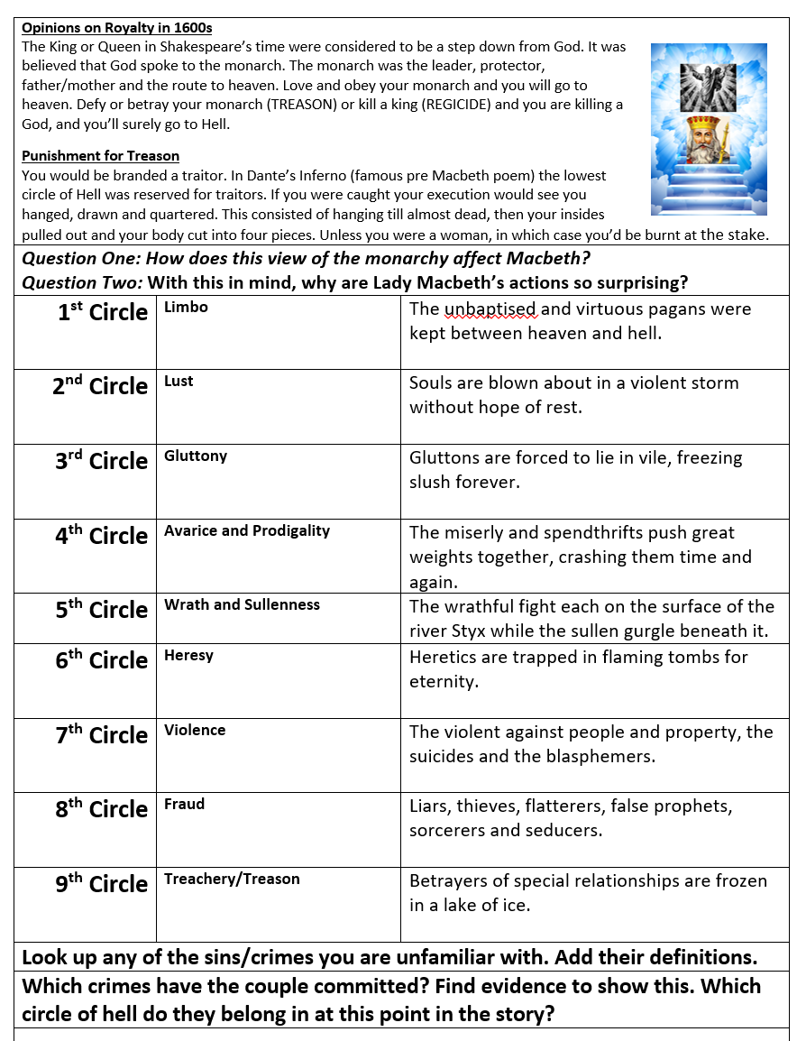
Learning Objective: Who is more powerful in this scene?
AO3: Read and complete the sheet on Royalty in the 1600s.

Slide 19
Learning Objective Act 2 Scene 3 Why introduce Macduff here?

Slide 20
Act 2, Scene 3
A porter stumbles through the hallway to answer the knocking. Macbeth enters, and Macduff asks him if the king is awake. As Macduff enters the king’s chamber, Lennox describes the terrible storms that raged the previous night. The king’s sons, Malcolm and Donalbain, arrive. They are told that their father has been killed, most likely by his chamberlains, who were found with bloody daggers. Macbeth declares that in his rage he has killed the chamberlains. Lady Macbeth suddenly faints. Duncan’s sons decide to flee.
Plot: Dark comedy
Device: Allusion
Device: Pathetic fallacy
Device: Foreshadowing

Slide 21
Learning Objective: Why introduce Macduff here?
MACDUFF O horror, horror, horror! Tongue nor heart
Cannot conceive nor name thee!
MACBETH LENNOX What's the matter.
MACDUFF Confusion now hath made his masterpiece!
Most sacrilegious murder hath broke ope
The Lord's anointed temple, and stole thence
The life o' the building!
MACBETH What is 't you say? the life?
LENNOX Mean you his majesty?
MACDUFF Approach the chamber, and destroy your sight
With a new Gorgon: do not bid me speak;
See, and then speak yourselves.
Exeunt MACBETH and LENNOX
Awake, awake!
Ring the alarum-bell. Murder and treason!
Banquo and Donalbain! Malcolm! awake!
Shake off this downy sleep, death's counterfeit,
And look on death itself! up, up, and see
The great doom's image! Malcolm! Banquo!
As from your graves rise up, and walk like sprites,
To countenance this horror! Ring the bell.
Why has Shakespeare given Macduff the job of finding the murdered king?
What does his reaction tell us about him? (Think about AO3, attitudes to royalty.)
How does it place him structurally - against Macbeth?

Slide 22
Learning Objective: Why introduce Macduff here?
MACDUFF
Your royal father 's murder'd. [...]
LENNOX
Those of his chamber, as it seem'd, had done 't: Their hands and faces were an badged with blood; So were their daggers, which unwiped we found Upon their pillows:
MACBETH
O, yet I do repent me of my fury, That I did kill them.
MACDUFF
Wherefore did you so?
MACBETH
Who can be wise, amazed, temperate and furious, Loyal and neutral, in a moment? No man: The expedition my violent love Outrun the pauser, reason. Here lay Duncan, His silver skin laced with his golden blood; And his gash'd stabs look'd like a breach in nature For ruin's wasteful entrance: there, the murderers, Steep'd in the colours of their trade, their daggers Unmannerly breech'd with gore: who could refrain, That had a heart to love, and in that heart Courage to make's love known?
How does Macbeth’s reaction compare to Macduff’s?
Look carefully at the language and structure of his speech. What comparisons can we make?
(Why did Macbeth really kill the guards?)

Slide 23
Learning Objective Act 2 Scene 4 To explore Shakespeare’s use of pathetic fallacy

Slide 24
Act 2, Scene 4
Ross, a thane, walks outside the castle with an old man. They discuss the strange and ominous happenings of the past few days. Macduff emerges from the castle and tells Ross that Macbeth has been made king by the other lords, and that he now rides to Scone to be crowned.
Motif: Garments
Device: Personification
Device: Pathetic fallacy, Imagery
Device: Foreshadowing

Slide 25
Learning Objective: To explore Shakespeare’s use of pathetic fallacy
The shocking events taking place inside the castle seen to be mirrored in the events in the wider world – how does this use of pathetic fallacy reflect them?
by the clock, 'tis day,
And yet dark night strangles the travelling lamp:
Is't night's predominance, or the day's shame,
That darkness does the face of earth entomb,
When living light should kiss it?
What other examples can you find in this scene?
(Hint: look for horses and falcons!)

Slide 26
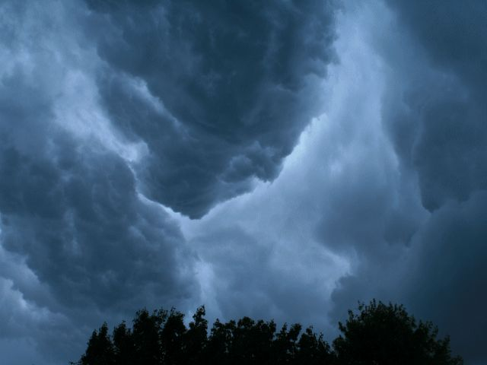
Learning Objective: To explore Shakespeare’s use of pathetic fallacy
Homework: Write a paragraph about how the weather has been important in the play so far. You should refer to other parts of the play as well as this scene.

Slide 27
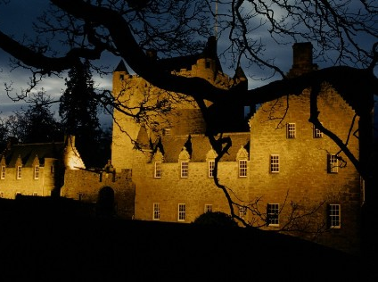
Write a description of Macbeth’s castle the night that Duncan is murdered.
200 words
25 minutes
• A link to an event from earlier in the play
• A quotation from the play
• A simile or metaphor
• Pathetic fallacy
Onerous: involving a great deal of effort or difficulty

