Slide 1
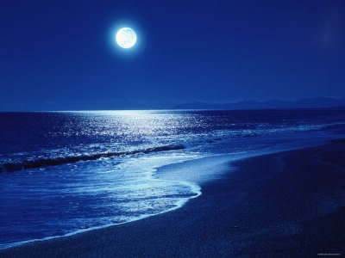
Literature Paper 2 Section B: Poetry
Power and Conflict

Slide 2
Literature Paper 2 Section B: Poetry
This year we will be looking at a selection of poems from the AQA Poetry Anthology. The selection of poems that we will be looking at is titled POWER AND CONFLICT.
Some of the main themes include…
The ower of humans, the power of nature, the effects of conflict, the reality of conflict, loss and absence, memory, anger, guilt, fear, pride, identity, and individual experiences.
REMEMBER!!
In the exam you will be expected to compare/contrast two poems from this cluster; this is why we will be looking at the similarities/differences between them.

Slide 3
This unit will be externally examined.
In Section B, you have to answer one question.
You will have to write an essay in which you compare a named
poem with a poem of your choice.
This section will be marked out of thirty using AO1, AO2 and
AO3. This is worth about 20% of your final Literature mark.
You will have 45 minutes to complete your essay comparing the
poems. You are not allowed to take your anthology or any notes
about the poems into the exam, so you should try to get to know
them well!

Slide 5
Section B Mark Scheme

Slide 6
Section B Mark Scheme

Slide 7
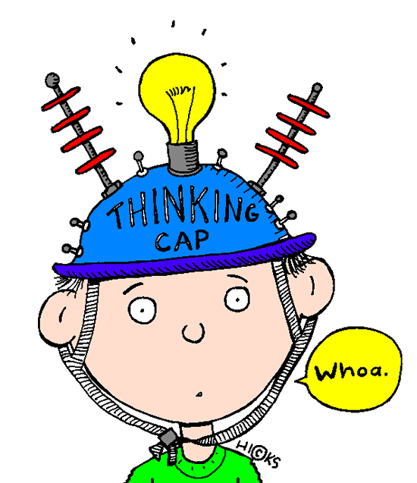
Things to think about...
Character: someone specific or a representation of something more general?
Voice: whose it is? Who is it speaking to? How is it created?
Perspective: whose point of view is being explored? Is it the poet’s?
Ideas and attitudes: why has the poet written this poem? What ideas does it express?
Techniques: how does the poet use language, structure and form to communicate or create effects?

Slide 8
Poetry VITALS…
Voice: Who is speaking in the poem?
Imagery: What imagery is being created? How is it effective?
Theme: What are the main themes featured in the poem?
Address: Who is the poem addressed to? Why?
Language (Features): What type of language/ devices are used?
What is their effect?
Structure: How is the poem laid out? What is the effect of this?
Notes:
This is the acronym that we will use on each poem to look at all the different aspects

