Slide 1
Unseen Poetry –
Walking Talking Mock

Slide 2
Timings:
AIC – 45 mins
Conflict Poetry – 45 mins
Unseen Poetry – 30 mins, then 15 mins
Conflict poetry
Your Literature Paper 2 exam will contain a question on Conflict poetry and a question on unseen poetry.
Unseen
Both questions ask you to compare.

Slide 3
Timings:
AIC – 45 mins
Conflict Poetry – 45 mins
Unseen Poetry – 30 mins, then 15 mins
Conflict poetry
Your Literature Paper 2 exam will contain a question on Conflict poetry and a question on unseen poetry.
Unseen
The unseen poetry question is in two parts:
1. You analyse one unseen poem (24 marks)
2. You compare it to a second unseen poem (8 marks)

Slide 4
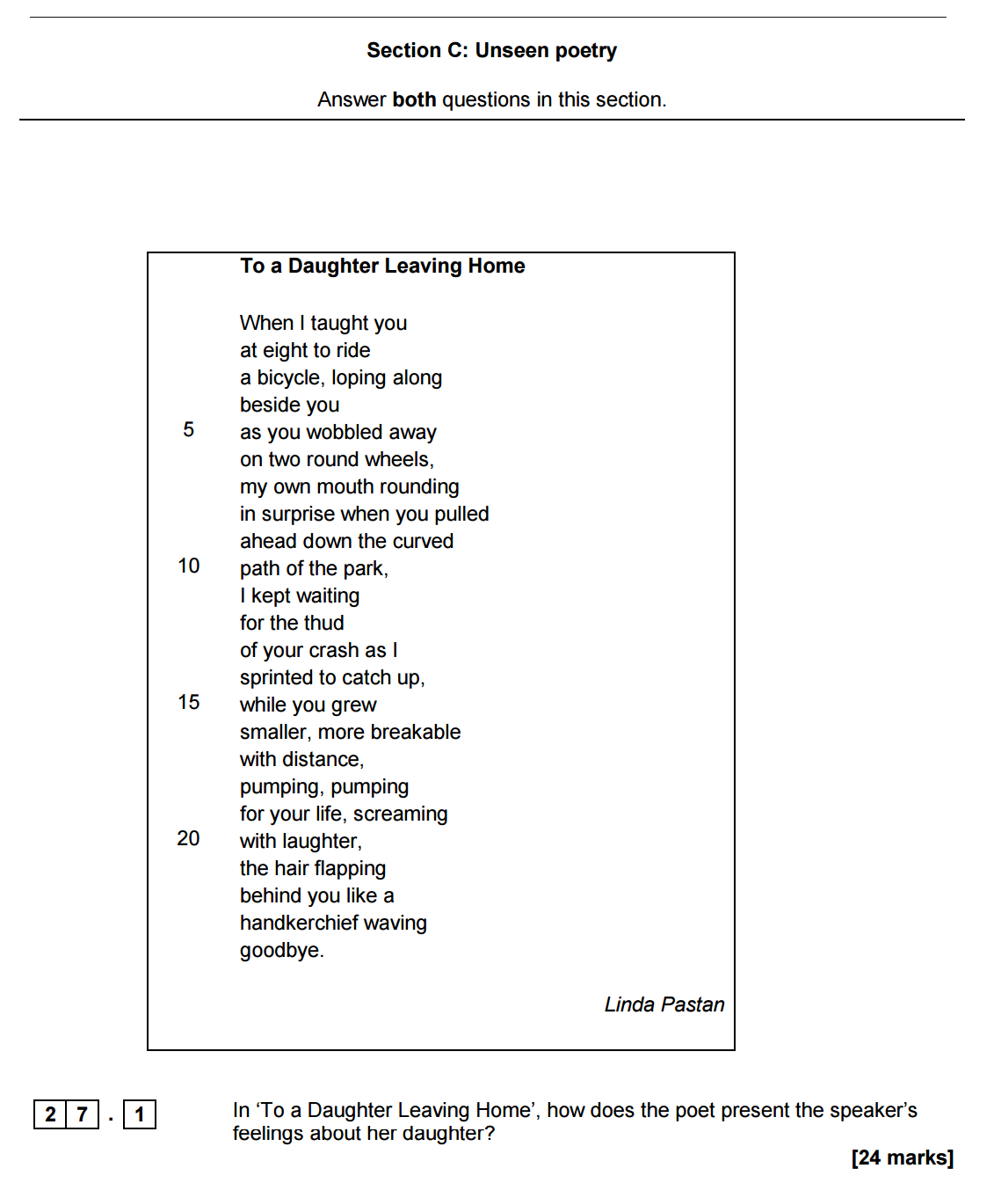
Spend 30 mins on this section – 10 mins reading and planning; 20 mins writing

Slide 5
Part 1 Mark Scheme
Level 6 Convincing, critical analysis and exploration 21-24 marks (8+) | • Critical, exploratory conceptualised response to task and text • Judicious use of precise references to support interpretation(s) • Analysis of writer’s methods with subject terminology used judiciously • Exploration of effects of writer’s methods on reader
Level 5 Thoughtful, developed consideration 17-20 marks (6+) | • Thoughtful, developed response to task and text • Apt references integrated into interpretation(s) • Examination of writer’s methods with subject terminology used effectively to support consideration of methods • Examination of effects of writer’s methods on reader
Level 4 Clear understanding 13-16 marks (4+) | • Clear, explained response to task and text • Effective use of references to support explanation • Clear explanation of writer’s methods with appropriate use of relevant subject terminology • Understanding of effects of writer’s methods on reader
Level 3 Explained, structured comments 9-12 marks (3+) | • Some explained response to task and text • References used to support a range of relevant comments • Explained/relevant comments on writer’s methods with some relevant use of subject terminology • Identification of effects of writer’s methods on reader

Slide 6
In other words:
Write about language
Write about structure
Write about form
Use subject terminology
Write about the poem as a whole – write in order, from the title to the end.
Structure your response – PLANNING IS CRUCIAL.

Slide 7
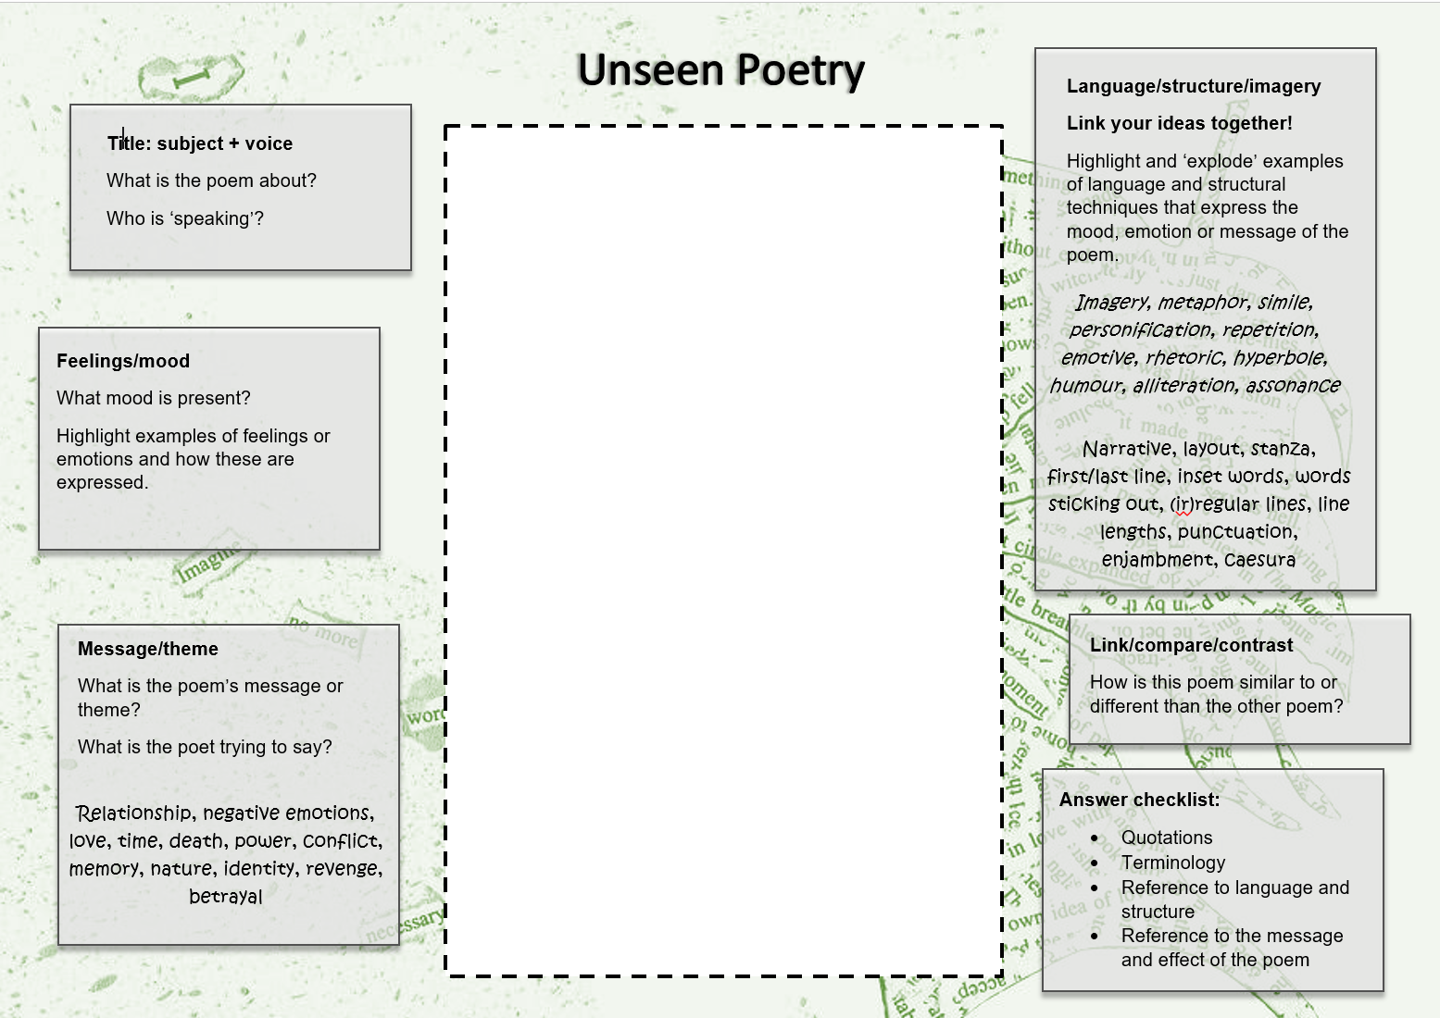
Step 1 – have some ideas about poem 1!
Hint: use the focus of section (b) to help you figure out what to look for!
Spend 10 minutes reading and planning

Slide 8
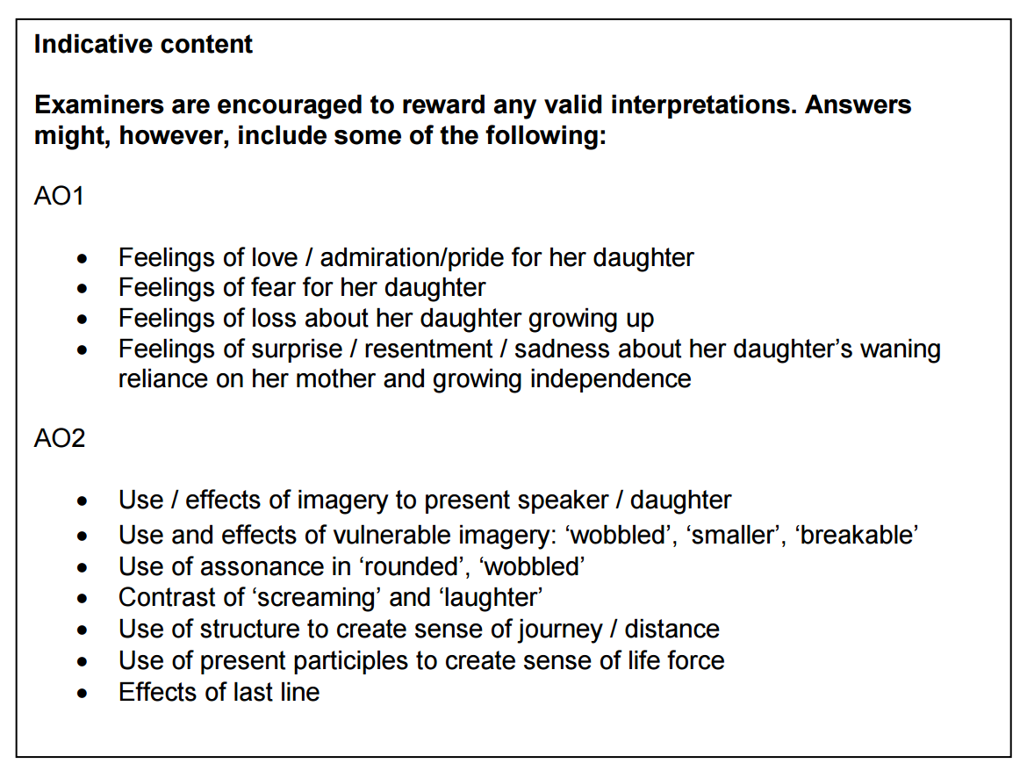
Spend 10 minutes reading and planning

Slide 9
Step 2 – write up your ideas about poem 1
Spend 20 minutes writing up your answer
Consider:
Title, subject and voice
Feelings/mood
Message/theme
How are these created by language; structure; imagery?

Slide 10
Introduction: Title, subject and voice.
Address the question. Include key word from the question [here: the speaker’s feelings about her daughter].
At the start of the poem, the speaker…
The writer uses [T]… to convey…
An example of this is "........"
In ‘To a Daughter Leaving Home’ the poet shows…
As the poem progresses, the speaker portrays…
The poet could be suggesting…
This implies…
Literally... metaphorically... symbolically...
This makes the reader feel…
The reader is told…
Consider:
Title, subject and voice
Feelings/mood
Message/theme
How are these created by language; structure; imagery?

Slide 11
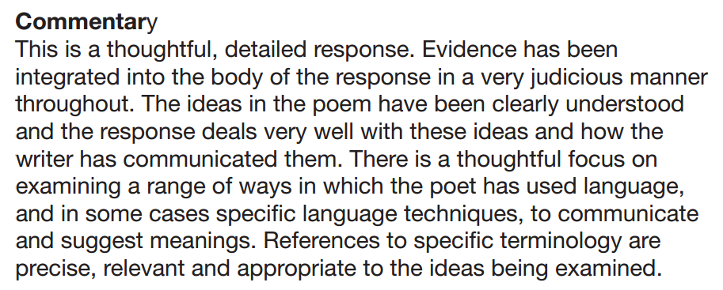
In this poem, the speaker is the voice of a parent, describing a memory of watching her daughter learn to ride a bike. The mother describes her fear of her daughter coming to harm with the use of ‘loping along beside you’, as if she is terrified of letting go and letting her daughter move away from her. This is then reinforced with the use of ‘wobbled’ to suggest the daughter’s vulnerability and fear that she may come to harm. However, the daughter is confident and shows this through ‘pulled away’ and ‘screaming with laughter’ – she doesn’t appear to have any fear of her new skill and is excited by the ability to ‘pull ahead’.
The contrast between the parent and the child is shown through the language used to describe them; the mother’s mouth ‘rounds in surprise’ whereas the daughter is ‘pumping, pumping for your life’ There is a tension between the mother’s reaction to the event and the daughter’s. The use of repetition in ‘pumping, pumping’ suggests the daughter’s desire for independence and freedom, with ‘for your life’ used ambiguously to suggest that the daughter is not only desperate to learn to ride a bike, but also to be an independent person in the world, leading her own ‘life’. While the mother is ‘waiting for the thud’, which is clearly a metaphor for the daughter coming up against a hurdle in her life, the daughter is ‘screaming with laughter’ which suggests that she has a very different attitude towards becoming independent. This phrase almost works as an oxymoron, contrasting ‘screaming’ (which hints at the mother’s internal fear and anxiety) with the daughter’s ‘laughter’. The clash between these two words intensifies the difference between the mother and the daughter’s attitude towards becoming independent.

Slide 12
Note:
This seems like a more difficult question, but you’ve done all of the hard work already!
All you need to do is compare. Make three or four clear points and back them up with reference to the poems.

Slide 13
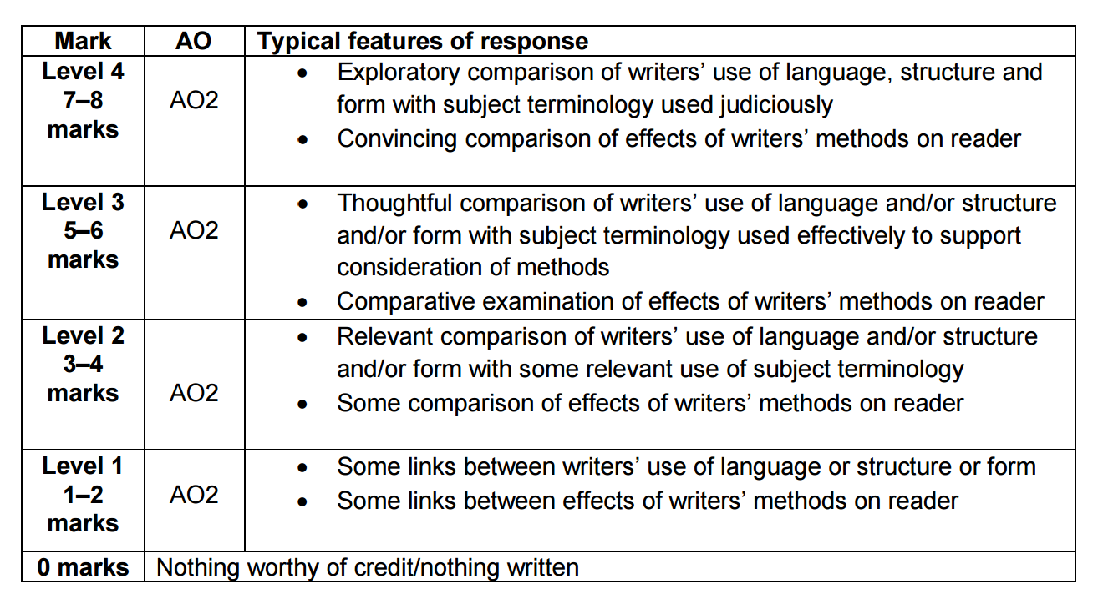
Part 2 Mark Scheme
(5+)

Slide 14
Step 3 – have some ideas about the way poem 2 compares to poem 1
You’re only looking for links, nothing else.
Hint: Use your points from section (a) to help you focus.
Spend 5 minutes reading and planning

Slide 15
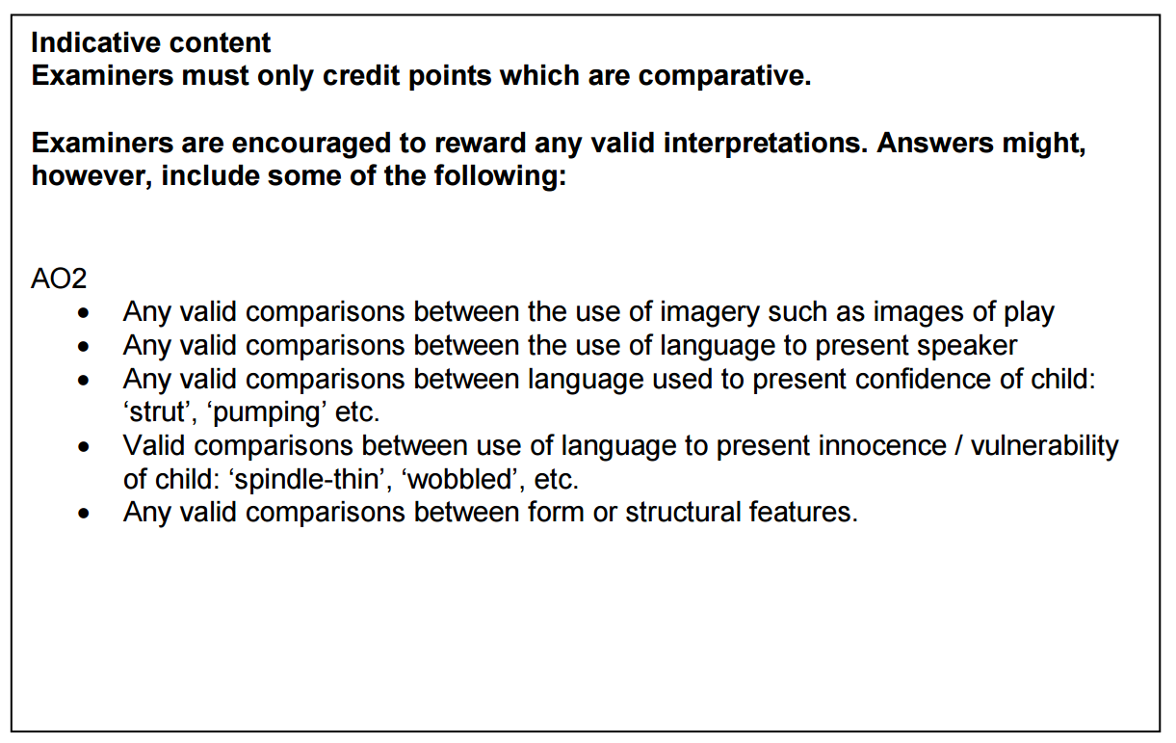
Spend 5 minutes reading and planning

Slide 16
Step 2 – write up your comparison
Spend 10 minutes writing up your answer
Compare:
Title, subject and voice
Feelings/mood
Message/theme
How are these created by language; structure; imagery?

Slide 17
Introduction: Title, subject and voice.
Address the question and link both poems together. Include key word from the question [here: feelings about watching loved ones grow up].
In both poems the writers feel… although…
In poem 1, the writer uses [T]… to convey…
Similarly, in poem 2, the writer uses [T]…
An example of this is "........"
In ‘Poem for My Sister’ the poet shows… whereas in ‘To a Daughter Leaving Home’ the speaker suggests…
Both poems include…
Likewise…
In contrast…
This implies…
Literally... metaphorically... symbolically...
This makes the reader feel…
The reader is told…

Slide 18
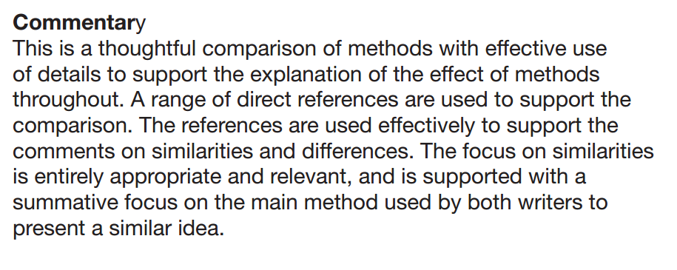
Both of these poems are about the relationship with a young child. However, one of the differences is that in To a Daughter the speaker is her mother, whereas in For my Sister the speaker is the older sister. What the poems have in common is that both of them show that they are worried about the young person and don’t want them to grow up. This is the main similarity between them.
Both of the poems show that the adult world is possibly dangerous. They both use metaphors to show this, with riding a bicycle in the first one and wearing high-heeled shoes in the second one. Both of these metaphors are for ordinary things, but both show that there is danger: ‘wobbled’ is an idea used in both poems to show how innocent and vulnerable the young girls are.
Also, both poems describe the young people as being full of life and enjoying playing. In the first one she is ‘screaming with laughter’ whereas in the second one she is ‘playing hopscotch’. Both of the girls are also shown by the poet to be independent and looking after themselves. The main difference is that one is a mother and one is a sister. However, both of the poems have the same theme and use a metaphor to express this idea of being afraid for the young person as they grow up’.

