Slide 1
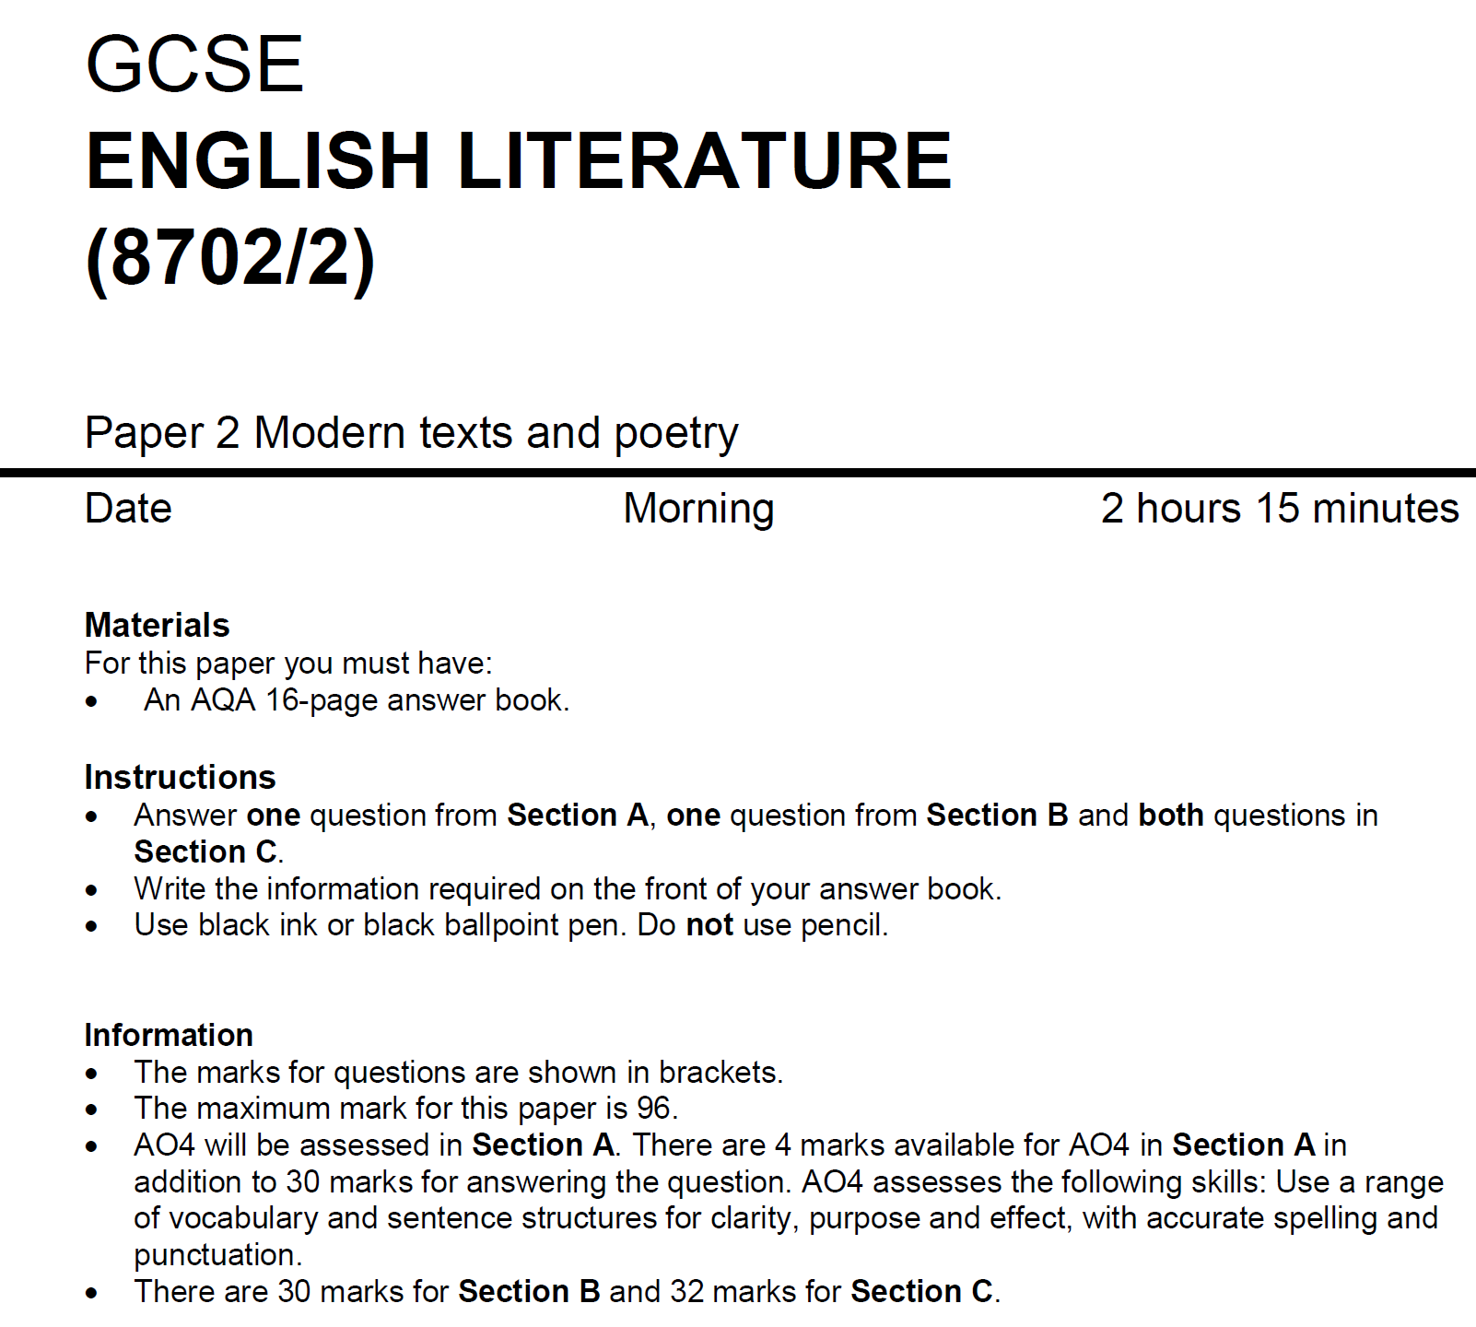
SPaG

Slide 2
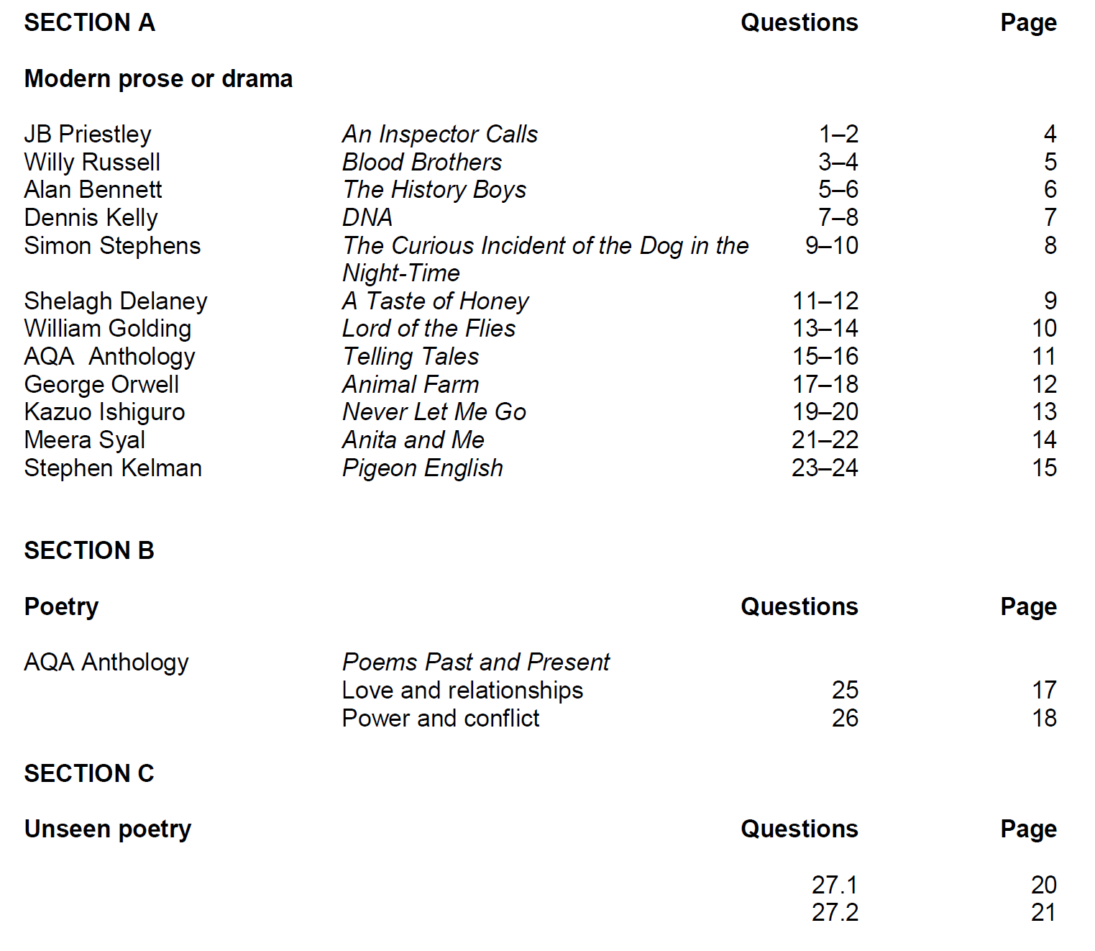

Slide 3
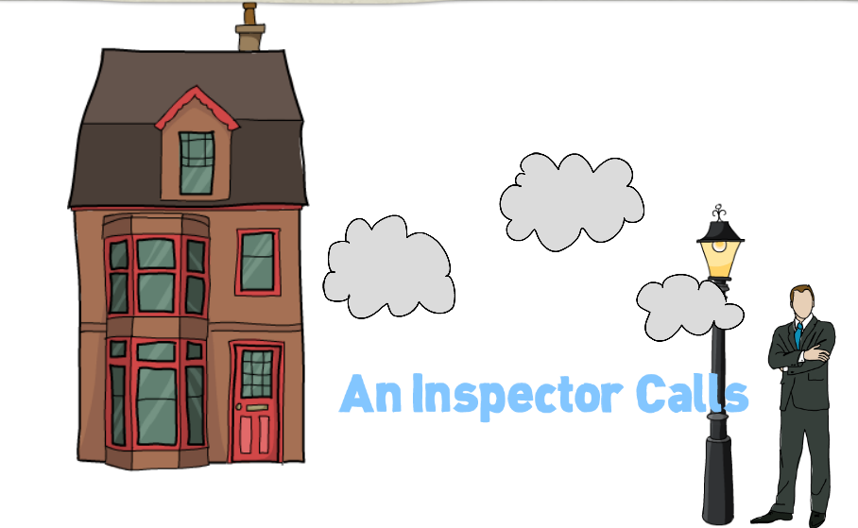

Slide 4
Character based question
Theme based question

Slide 5
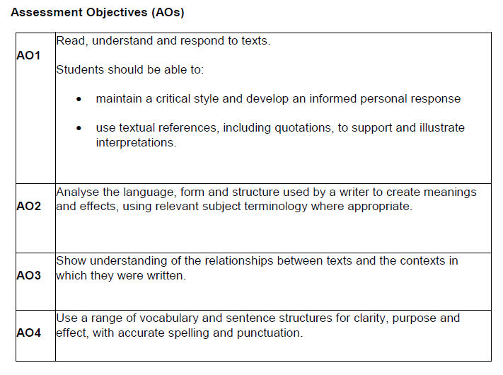
Q
W
E
R
T
SPaG=4 marks
Y

Slide 6
Birling
Mrs Birling
The Inspector
Sheila
Eric
Gerald (?)
Eva/Daisy

Slide 7
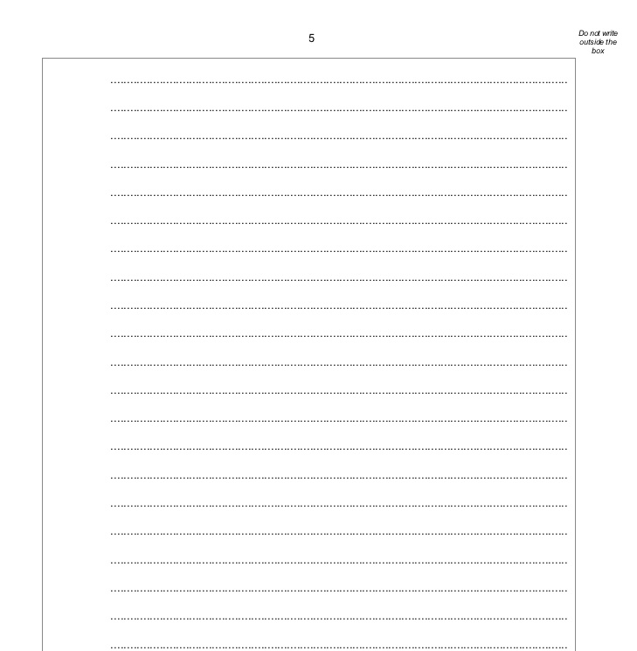
Intro to difference: older generation doesn’t learn from actions; younger one does
Mr Birling’s arrogance and attitude to society
(1) Younger generation presented negatively initially- materialistic and extravagant (Eric & Sheila)
(2) Sheila’s learns: changes her relationship with Gerald, sense of responsibility; Eric & Sheila’s attitude towards parents
(3) Mr & Mrs Birling unchanged by events
Conclusion: Inspector used to convey JBP’s message- Socialism
For each bullet point on the plan, add micro-quotations and textual references that you could use to support and illustrate interpretations

Slide 8


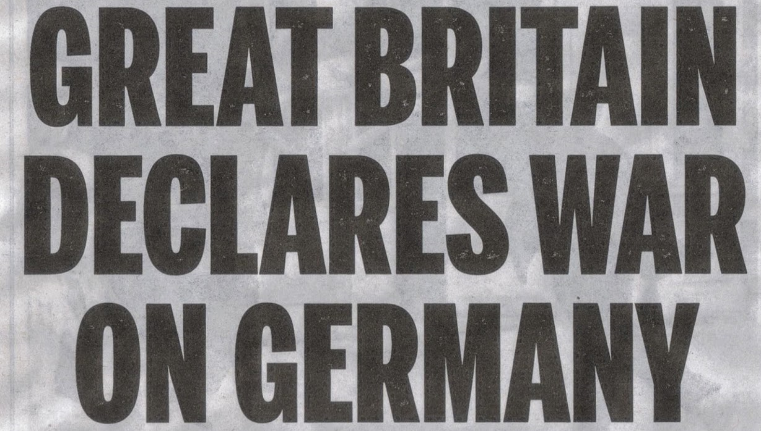

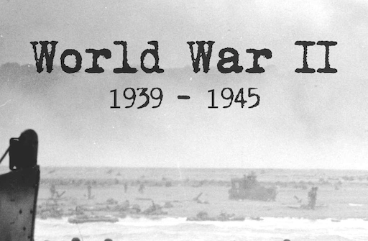
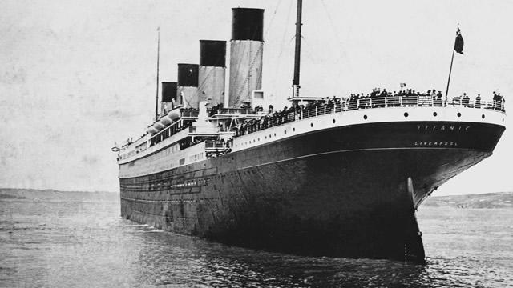
When was the play written? When was the play set?
Capitalism
Socialism
Relationship between the text and its context:
How can you incorporate these ideas into your answer?

Slide 9
Example of a student’s plan…

Slide 10
Plan your answer to this question: key points and micro quotations
Hint: the importance of the ending is created through the play’s beginning and key events. You can discuss these as part of your analysis of the play’s ending.

Slide 11
AGREE?
The play is about male lust and sexual exploitation of the weak by the powerful.
DISAGREE?

Slide 12
AGREE?
Priestley’s main aim is to present a symbolic confrontation between socialism and capitalism.
DISAGREE?

Slide 13
AGREE?
There is no hope for change at the end of An Inspector Calls because the hubristic nature of man is not fully destroyed.
DISAGREE?

Slide 14
AGREE?
The weakest character in the play is Mr Birling, not Eva Smith.
DISAGREE?

Slide 15
Complete the planning table for one of the following questions:
In what way is the play one about male lust and sexual exploitation of the weak by the powerful?
In what way does Priestley’s main aim appear to be writing about the symbolic confrontation between socialism and capitalism?
The hubristic nature of man is not fully destroyed by the end of the play; do you think there is any hope for change?
In what way does Priestley present Mr Birling as the weakest character in the play, and not Eva Smith?
Use ideas from the debate to inform your planning.

Slide 16
Paragraph: | What I will write about: | Quotation I could use and/or link to context (Edwardian era)
Intro (brief summary of my view/ argument).
1
2
3

Slide 17
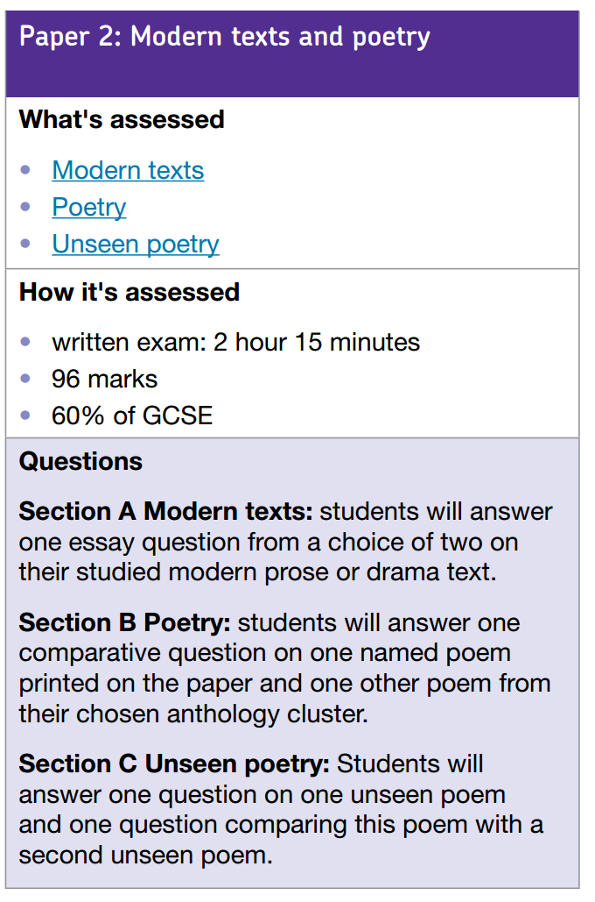
Timings:
AIC – 45 mins
Conflict Poetry – 45 mins
Unseen Poetry – 30 mins, then 15 mins
Conflict poetry
Unseen
Your Literature Paper 2 exam will contain a question on Conflict poetry and a question on unseen poetry.
The poetry question asks you to compare the poem on the paper in front of you to one other poem from the anthology. (30 marks)

Slide 18
Timings:
AIC – 45 mins
Conflict Poetry – 45 mins
Unseen Poetry – 30 mins, then 15 mins
Conflict poetry
Unseen
Your Literature Paper 2 exam will contain a question on Conflict poetry and a question on unseen poetry.
The unseen poetry question is in two parts:
1. You analyse one unseen poem (24 marks)
2. You compare it to a second unseen poem (8 marks)

Slide 19
Timings:
AIC – 45 mins
Conflict Poetry – 45 mins
Unseen Poetry – 30 mins, then 15 mins
Conflict poetry
Unseen
Your Literature Paper 2 exam will contain a question on Conflict poetry and a question on unseen poetry.
Both questions ask you to compare.

Slide 20
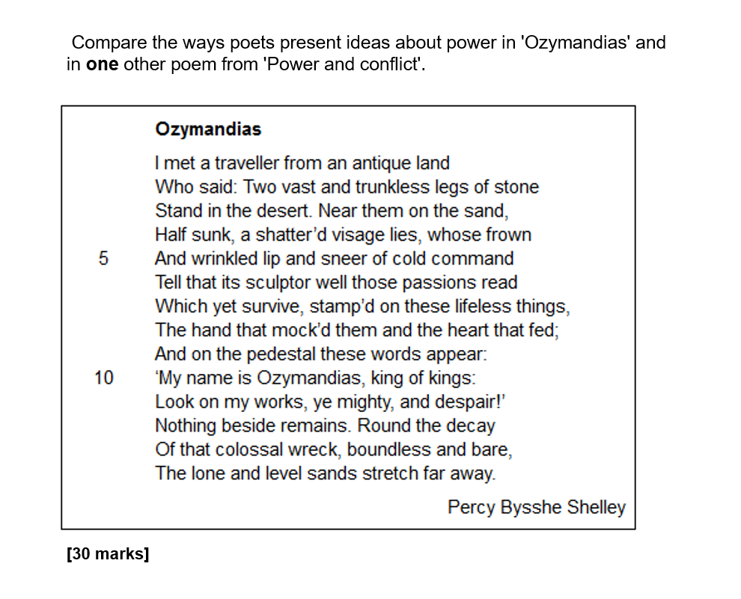
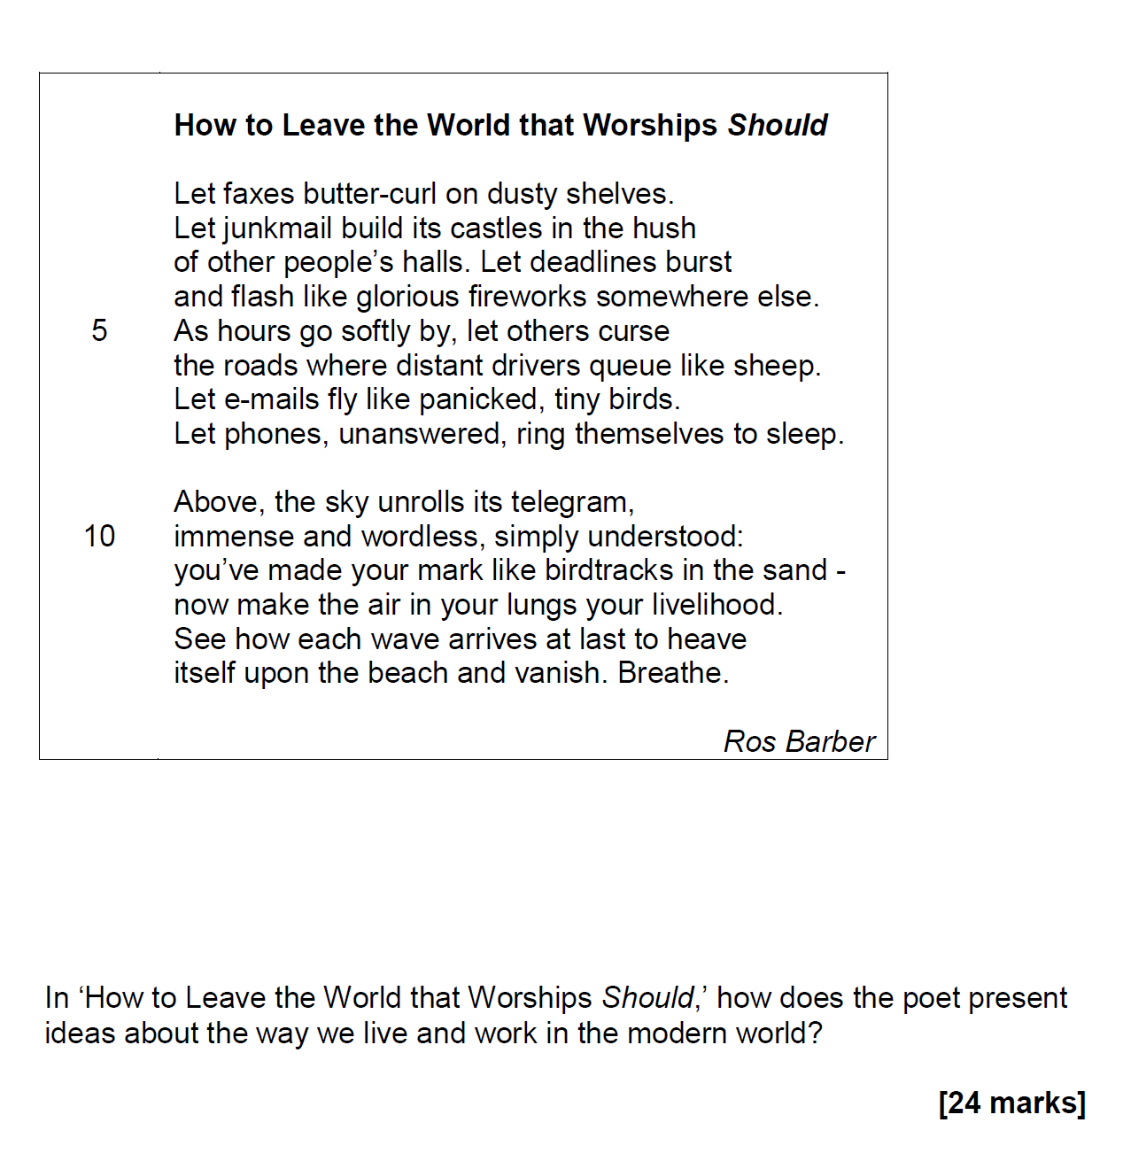
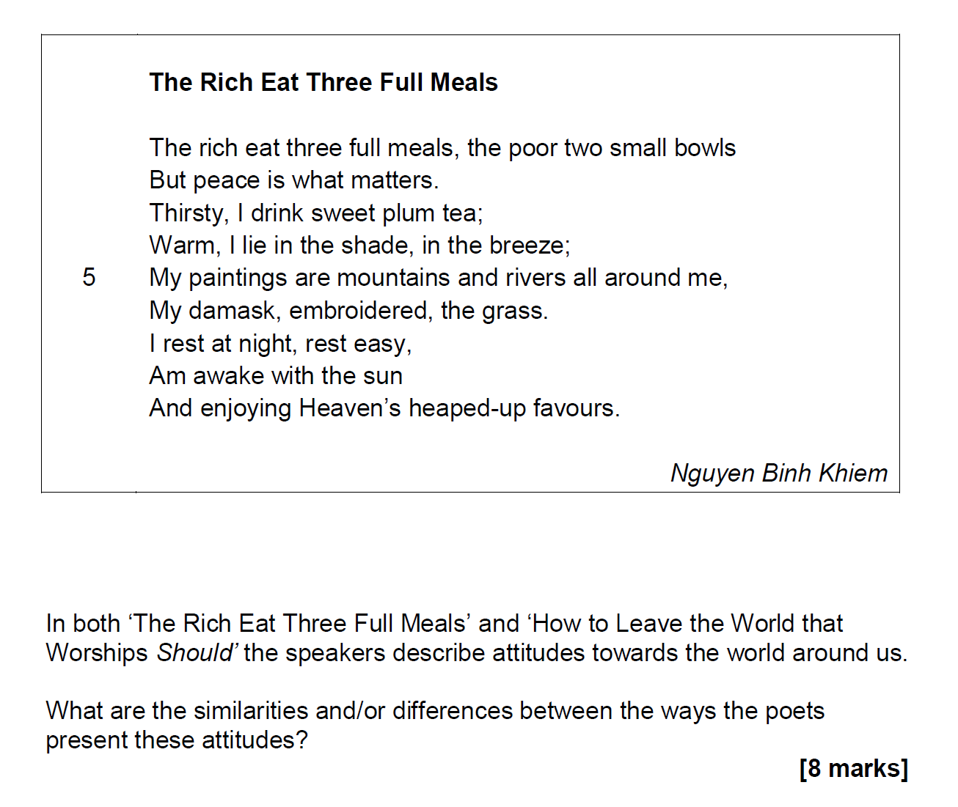
Section B:
‘Compare the ways…’
Section C:
‘How does the poet present…?
‘What are the similarities and/or differences…?’
+

Slide 21
Comparing Poems
(Or, ‘How to plan your poetry answers’)

Slide 22
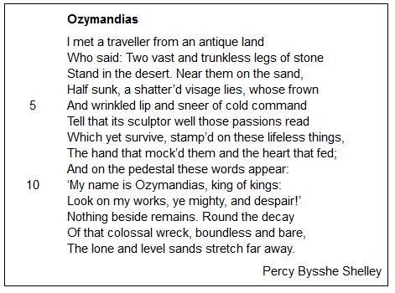
What am I looking for?
Compare the ways poets present ideas about power in 'Ozymandias' and
in one other poem from 'Power and conflict'.
[30 marks]

Slide 23
What am I looking for?

Slide 24
What am I looking for?

Slide 25
In other words:
Write about language
Write about structure
Write about form
Use subject terminology
Write about the poem as a whole – write in order, from the title to the end.
Structure your response – PLANNING IS CRUCIAL.
Note: for Section B you need to support your ideas with context.

Slide 26
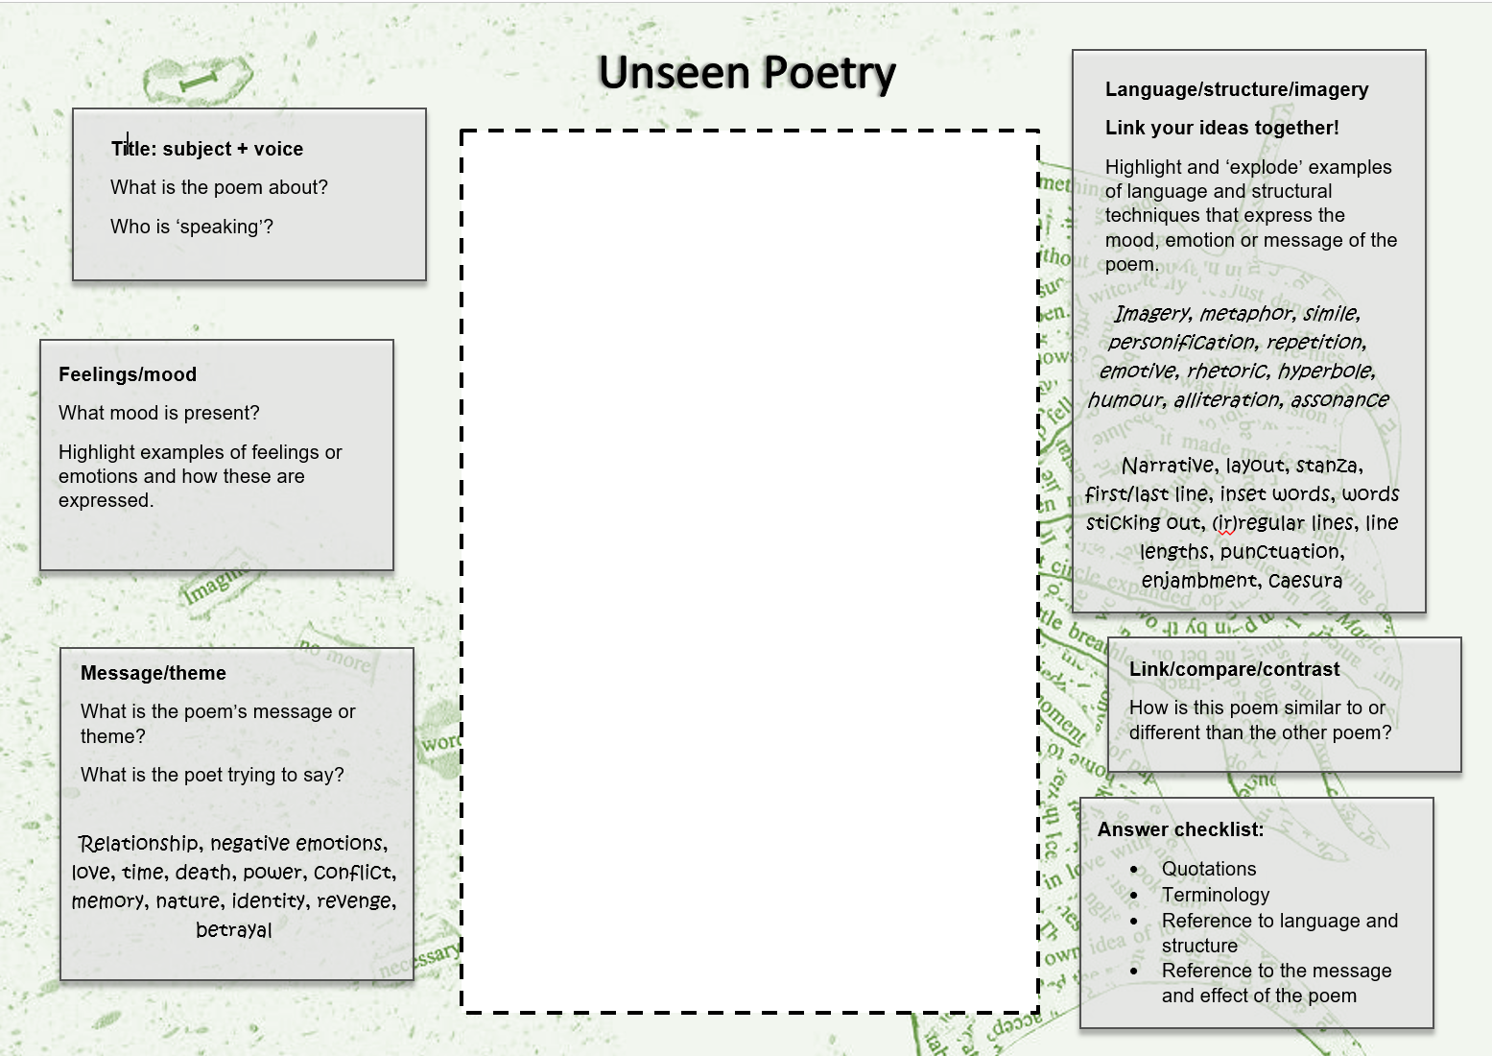
Plan for Poem 1
Come up with three points you can make about the poem in response to the question:
1.
2.
3.
Hint for Section C: use the focus of part (b) to help you figure out what to look for!
Feelings and attitudes
Language, structure and imagery
Volta
Message/theme

Slide 27
Plan for the way poem 2 compares to poem 1
You’re only looking for links, nothing else.
Come up with three links you can make to the first poem in response to the question:
1.
2.
3.
Hint for Section C: Use your points from part (a) to help you focus.
Feelings and attitudes
Language, structure and imagery
Volta
Message/theme

Slide 28

A reminder for Section B.
Candidates are expected to use textual references, including quotations, to support and illustrate interpretations. Textual references can be:
quoting
summarising the text
paraphrasing
referencing single words

Slide 29
Which place?
Which war?
Which time?
Modern or old?
Autobiographical?
Context for Conflict poetry?
Male or female voice?
Real-life events?
Cultural beliefs?

Slide 30
Writing up your answer
Section B: Write about both poems at once. Start with an introduction that explains what the two poems are about and makes links between them, explaining why you have chosen the second poem. Your first sentence should start with the word ‘both’.
Section C: Deal with each part of the question separately. Part (a) is worth a lot more marks than part (b) (24 as opposed to 8) – bear this in mind when writing up your answer. Only make links in part (b).

Slide 31
Introduction: Title, subject and voice.
Address the question. Link both poems together (Section B and Section C Part (b) only). Include key word from the question.
In both poems the writers feel… although…
In [name of poem], the writer uses [T]… to convey…
Similarly, in [name of poem], the writer uses [T]…
An example of this is "........"
In ‘[name of poem]’ the poet shows… whereas in ‘[name of poem]’ the speaker suggests…
Both poems include…
Likewise…
In contrast…
This implies…
Literally... metaphorically... symbolically...
This makes the reader feel…
The reader is told…
AND for Section B you need to support your ideas with context.

