Slide 1
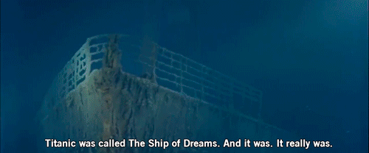
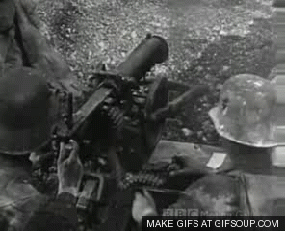
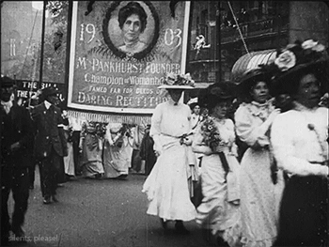
Thematic Links in ‘AIC’
An Inspector Calls

Slide 2
Link the image of the titanic to a theme in ‘An Inspector Calls’. Think… Who or what does it represent?

Slide 3
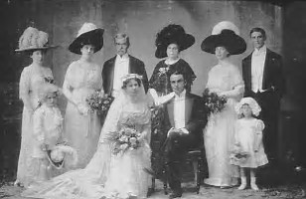
What is the connection here?

Slide 4
Link this image to a theme and/or character.

Slide 5
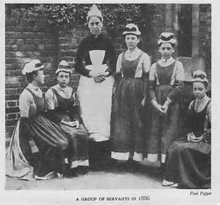
Final one – how about this?

Slide 6
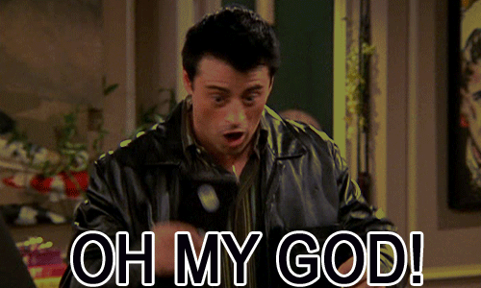
Why are thematic links so important?
You will be asked either to write an essay on:
A character.
A theme OR
How a theme is presented through a character.
That’s a lot to prepare for!

Slide 7
Themes to explore
As a group you will research this theme, look through the play and collect a set of around 5 key quotations.
AS A GROUP – you will present your findings and quotations to the rest of the class.
You will present your work on a poster that will be copied and put into people’s books.
Britain and change 1910 onwards -
Social Class –
Men and women, sexual inequality and change –
Responsibility –
Judgment –
Young and old -

Slide 8
Exit… In your books write down one piece of new information from each group.

