Slide 1
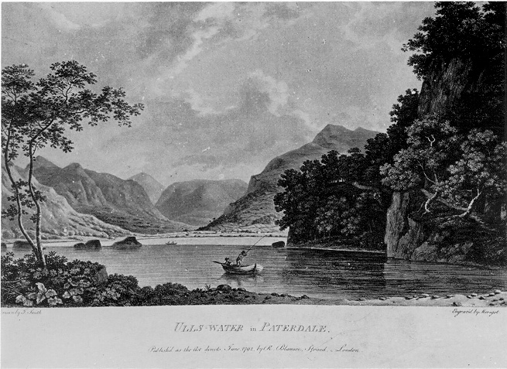
The Prelude: Stealing a Boat
By William Wordsworth

Slide 2
Learning Objective To understand the context and subject matter of the poem.

Slide 3
Starter: Wordsworth also wrote this poem. What does he like to write about ?
I wandered lonely as a Cloud That floats on high o'er Vales and Hills, When all at once I saw a crowd A host of dancing Daffodils; Along the Lake, beneath the trees, Ten thousand dancing in the breeze.

Slide 4
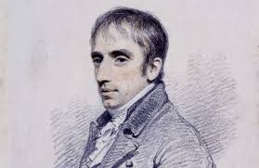
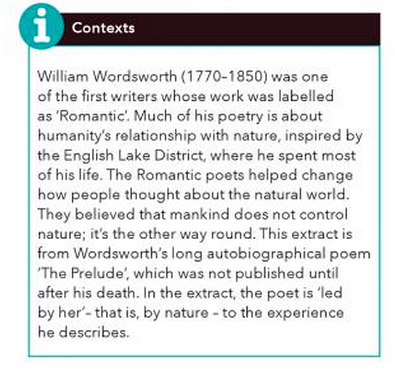
Learning Objective: To understand the context and subject matter of the poem
Summarise the context information.
Put the sub-heading ‘context’ and write down 5 bullet points.

Slide 5
Romanticism
Summarise the context information.
AO3 Text-Context Link
Romanticism was a school of thinking which believed in restoring the balance between man and nature. They believed that emotion was a key element to poetry.
Romantic poets were influenced by the French Revolution. They detested the absolute power of monarchies (kings) . They instead focused on the the power of nature.
A key idea in Romantic poetry is the concept of the sublime. This term conveys the feelings people experience when they see awesome landscapes, or find themselves in extreme situations which elicit both fear and admiration

Slide 6
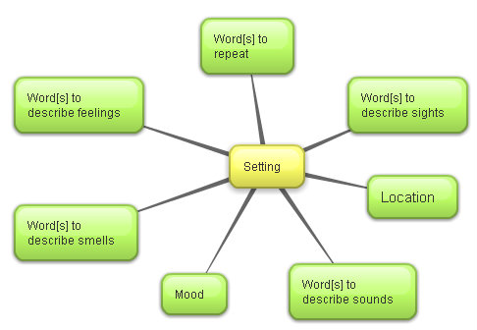
Learning Objective: To understand the context and subject matter of the poem
Here are some images of the poem’s setting (The Lake District).
Write down some key words to describe the setting.
Write them under the heading ‘setting ideas’

Slide 7
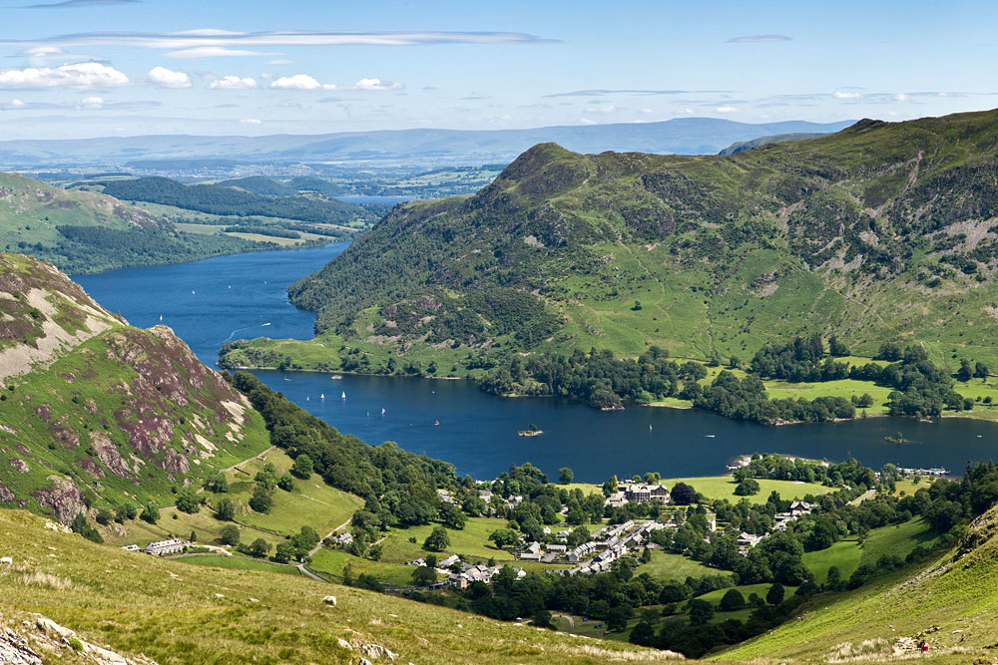
Learning Objective: To understand the context and subject matter of the poem

Slide 8
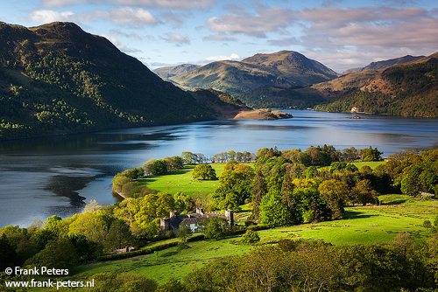
Learning Objective: To understand the context and subject matter of the poem

Slide 9
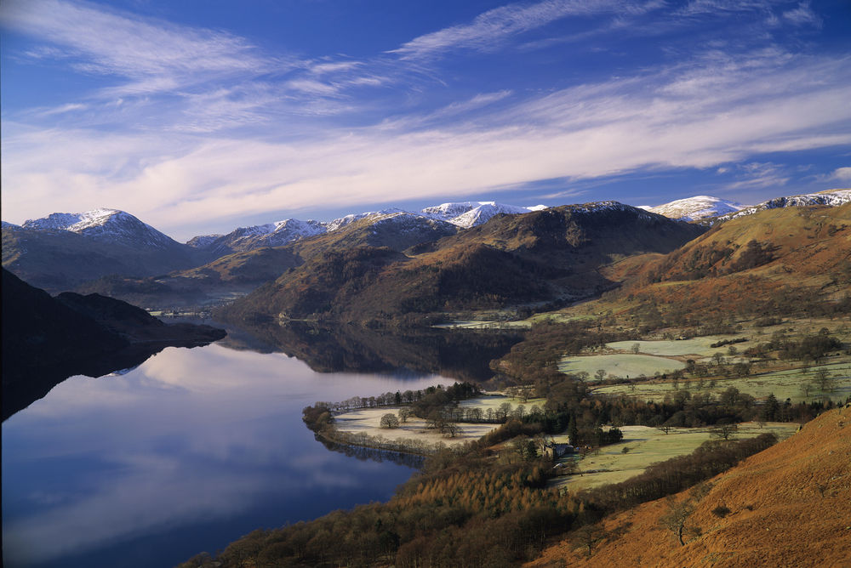
Learning Objective: To understand the context and subject matter of the poem

Slide 10
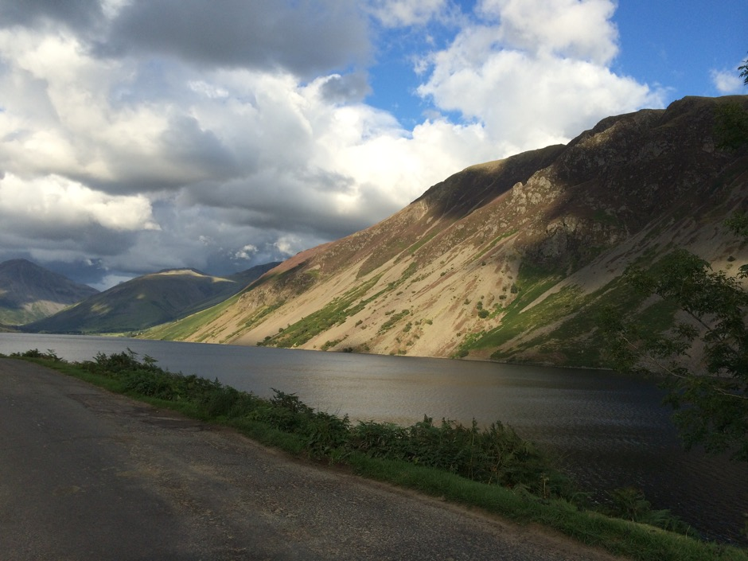
Learning Objective: To understand the context and subject matter of the poem

Slide 11
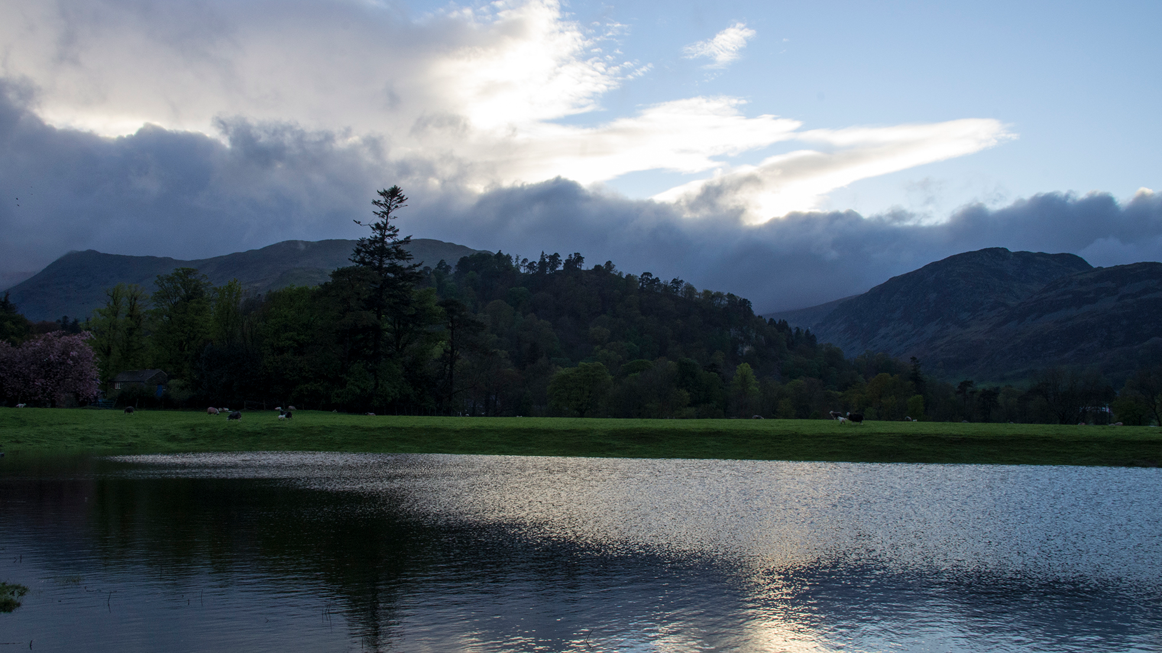
Learning Objective: To understand the context and subject matter of the poem

Slide 12
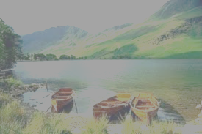
First reading: Slowly read the poem and answer the following
What is happening in the poem?
What are the feelings of the poet at the beginning, middle and end? Pick out a line/word to illustrate your answer.

Slide 13
Re-read the poem. Then read the following summary, choosing what you think are the most appropriate words where there is a choice.
Learning Objective: To understand the context and subject matter of the poem
The boy steals/borrows/takes the boat and rows out into the lake. He rows slowly/skillfully/lustily, keeping a straight course by aiming for a ridge’s summit/huge peak/grim shape. The growing size of one of the peaks terrifies/unnerves/disturbs him and he turns around. He leaved the boat where he found it and returns home, but for days afterwards is disturbed by nightmares/ghostly images/dark thoughts.

Slide 14
Learning Objective: To understand the context and subject matter of the poem
Compare your choices with a partner and agree on a version of the text. Some of the choices are quite similar in meaning, so you are not trying to find the right answer but the best answer.
Top grade booster extension:
Is there anything missing from the summary? Expand it.

Slide 15
Learning Objective To explore how the poet uses theme, language and structure

Slide 16
Extract from The Prelude by William Wordsworth
One summer evening (led by her) I found
A little boat tied to a willow tree
Within a rocky cove, its usual home.
Straight I unloosed her chain, and stepping in 360
Pushed from the shore. It was an act of stealth
And troubled pleasure, nor without the voice
Of mountain-echoes did my boat move on;
Leaving behind her still, on either side,
Small circles glittering idly in the moon, 365
Until they melted all into one track
Of sparkling light. But now, like one who rows,
Proud of his skill, to reach a chosen point
With an unswerving line, I fixed my view
Upon the summit of a craggy ridge, 370
The horizon’s utmost boundary; far above
Was nothing but the stars and the grey sky.
She was an elfin pinnace; lustily
I dipped my oars into the silent lake,
And, as I rose upon the stroke, my boat 375
Went heaving through the water like a swan;
When, from behind that craggy steep till then
The horizon’s bound, a huge peak, black and huge,
As if with voluntary power instinct,
Upreared its head. I struck and struck again, 380
And growing still in stature the grim shape
Towered up between me and the stars, and still,
For so it seemed, with purpose of its own
And measured motion like a living thing,
Strode after me. With trembling oars I turned, 385
And through the silent water stole my way
Back to the covert of the willow tree;
There in her mooring-place I left my bark, –
And through the meadows homeward went, in grave
And serious mood; but after I had seen 390
That spectacle, for many days, my brain
Worked with a dim and undetermined sense
Of unknown modes of being; o’er my thoughts
There hung a darkness, call it solitude
Or blank desertion. No familiar shapes 395
Remained, no pleasant images of trees,
Of sea or sky, no colours of green fields;
But huge and mighty forms, that do not live
Like living men, moved slowly through the mind 400
By day, and were a trouble to my dreams.

Slide 17
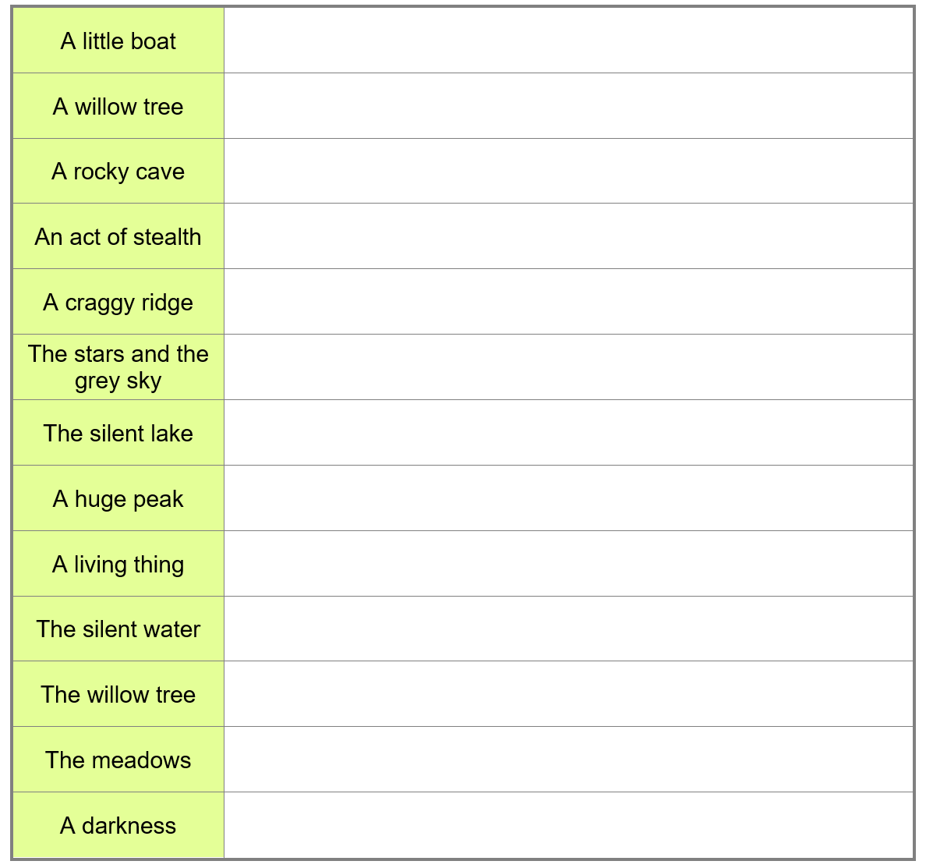
Learning Objective: To explore how the poet uses theme, language and structure
Here is a list of phrases from the poem.
Make notes beside each one:
the feelings and emotions that these images suggest;
any other connotations of the words.

Slide 18
Perhaps nature itself being personified
Serene, bucolic, pastoral image
One summer evening (led by her) I found
A little boat tied to a willow tree
Within a rocky cove, its usual home.
Straight I unloosed her chain, and stepping in
Pushed from the shore. It was an act of stealth
And troubled pleasure, nor without the voice
Of mountain-echoes did my boat move on;
Leaving behind her still, on either side,
Small circles glittering idly in the moon,
Until they melted all into one track
Of sparkling light.
Confident tone
Hint of something amiss
Oxymoron hints at his guilt
Repeated ‘L’ sound , makes it seem like the boat is moving gently. This imagery creates a feeling of confidence and peace

Slide 19
Learning Objective: To explore how the poet uses theme, language and structure
Explain how, at lines 365-367, Wordsworth uses verbs and adjectives to portray the beauty of the lake.

Slide 20
These two lines are used to emphasise the scale of the mountain through contrasting with the later description
The narrator seems arrogant. This contrasts with his later mood
. But now, like one who rows,
Proud of his skill, to reach a chosen point
With an unswerving line, I fixed my view
Upon the summit of a craggy ridge,
The horizon’s utmost boundary; far above
Was nothing but the stars and the grey sky.
She was an elfin pinnace; lustily
I dipped my oars into the silent lake,
And, as I rose upon the stroke, my boat
Went heaving through the water like a swan;
Metaphor of ‘ a fairy boat’ used to make the scene seem otherworldly, but not threatening
This simile emphasises that he is confident and in control. It contrasts sharply with the following line

Slide 21
Learning Objective: To explore how the poet uses theme, language and structure
2. Select an adjective that shows how Wordsworth initially felt as he rowed out in the stolen boat.
3.Explain which words show Wordsworth’s determination.
4. Select an adverb that conveys Wordsworth’s passion for rowing out and a verb that conveys his strength. Explain what might be giving him the strength.

Slide 22
Turing point (Volta) indicates change in tone. Simple word is emphasised by the caesura
Dark and threatening language. Contrasts with earlier description
When, from behind that craggy steep till then
The horizon’s bound, a huge peak, black and huge,
As if with voluntary power instinct,
Upreared its head. I struck and struck again,
And growing still in stature the grim shape
Towered up between me and the stars, and still,
For so it seemed, with purpose of its own
And measured motion like a living thing,
Strode after me. With trembling oars I turned,
And through the silent water stole my way
Back to the covert of the willow tree;
Personification: Contrasts with beautiful imagery of the boat ‘swan’ ‘elfin’
Sibilance creates sinister mood
Description seems like a person
The calm mountain contrasts with his fear
He is afraid and guilty . He wants to hide

Slide 23
Learning Objective: To explore how the poet uses theme, language and structure
5. Consider Wordsworth’s use of personification as you read through this section:
And growing still in stature the grim shape
Towered up between me and the stars, and still,
For so it seemed, with purpose of its own
And measured motion like a living thing,
Strode after me.
Highlight the words that make the mountain seem as though it is a living thing.

Slide 24
‘Grave’ means serious- suggesting the event has had a big impact. It also suggests his own mortality
There in her mooring-place I left my bark, –
And through the meadows homeward went, in grave
And serious mood; but after I had seen
That spectacle, for many days, my brain
Worked with a dim and undetermined sense
Of unknown modes of being; o’er my thoughts
There hung a darkness, call it solitude
Or blank desertion. No familiar shapes
Remained, no pleasant images of trees,
Of sea or sky, no colours of green fields;
But huge and mighty forms, that do not live
Like living men, moved slowly through the mind
By day, and were a trouble to my dreams.
The event had a long lasting impact
The narrator is left feeling alone and unsettled
Nature is described as powerful. It can affect the lives of men
The narrator no longer sees nature in terms of pretty images
Unsettling image helps us empathise with him. Huge contrast to the start of the poem

Slide 25
Learning Objective: To explore how the poet uses theme, language and structure
6.From line 385 select an adjective that portrays what effect this image had on Wordsworth.
7. Select two more adjectives (from lines 389-9) that reinforce the effect on Wordsworth.
8. Select a phrase that shows the prolonged effect the image of this peak had on Wordsworth.

Slide 26
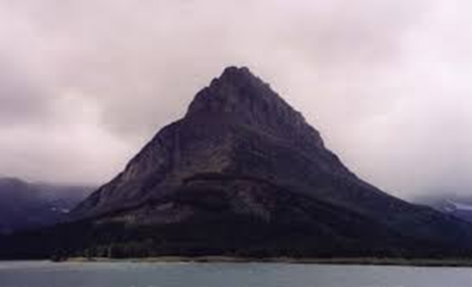
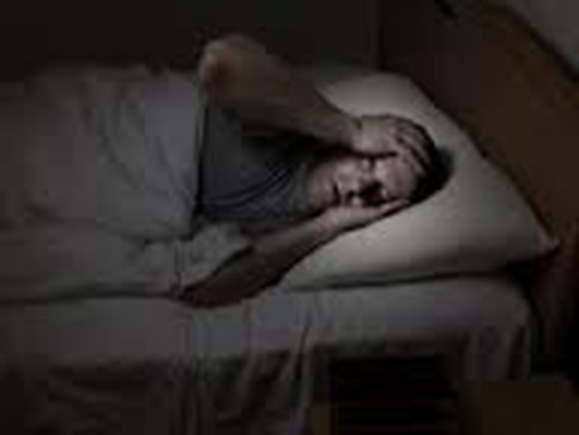
Structure: There are three main sections in the extract .
In the first section the tone is light and carefree. The scene is bucolic and the poet employs pretty, pastoral imagery
In the second section , there is a volta, or distinct change in mood. The tone becomes darker and more fearful
In the final section, the narrator reflects on how the experience has changed him

Slide 27
Learning Objective: To explore how the poet uses theme, language and structure
Form
Like some other poems in the cluster, this extract is written using lines of ten syllables with a regular pattern of strong and weak beats in each line. What is this called?
Unlike, for example, Ozymandias, this poem is unrhymed. The name of this form is…?

Slide 28
Learning Objective To compare ‘The Prelude’ to ‘Storm on the Island’

Slide 29
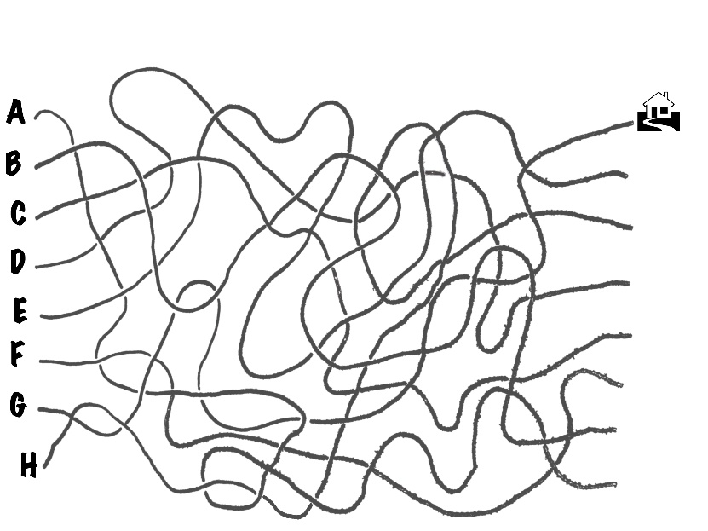
Learning Objective: To compare ‘The Prelude’ to ‘Storm on the Island’
Compare how poets present the power of nature in ‘The Prelude’ and ‘Storm on the Island’.
You have been given an answer to this question. Working in pairs, your task is to deconstruct the answer and produce a plan.

Slide 30
How do I structure a response for Section B of the exam?
Select question.
Planning
Highlight key words in the question.
Mind map ideas and plan your response.
Write your opening paragraph explaining what the two poems are about and making links between them. Start your 1st sentence with ‘both’.
Introduction
Explore key point 1 in both poems using QWERTY: write about feelings and attitudes.
Main body
Explore key point 2 in both poems using QWERTY: write about the effect of language techniques.
Explore key point 3 in both poems using QWERTY: write about effect of structure/form.
Possible key point 4 in both poems using QWERTY: write about shift/change in poem (look at the end).
Concluding paragraph – refer back to the question and summarise the similarities and differences between the two poems, making sure you answer the overall question. Add in your own opinion of the poems.
Conclusion

Slide 31
A reminder of what a good plan looks like:
BC: action, terror
E: inactivity, boredom
BC: patriotic ideals dropped
E: soldiers ambivalent – question purpose
Same WWI context; writers from different times; different situations and emotions
Reality vs. ideal
Introduction
Feelings and attitudes
Negative views of conflict; suggest war can’t be justified
Poem 1: Bayonet Charge
Poem 2: Exposure
Conclusion
Structure/form
Language
BC: third person singular
E: first person plural
BC: movement, violent imagery
E: bleak, hopeless language
BC: enjambment, irregular line length, punctuation, show soldier’s confusion
E: regular rhyme scheme shows monotony; half-rhymes and short lines show hopelessness
BC: nature as victim of conflict
E: nature personified as the enemy

Slide 32
And don’t forget the quotations…
“etcetera”
“dropped like luxuries”
BC: patriotic ideals dropped
E: soldiers ambivalent – question purpose
“on us the doors are closed”
Reality vs. ideal
Feelings and attitudes
Poem 1: Bayonet Charge
Poem 2: Exposure
Language
“a threshing circle”
”shot-slashed furrows”
BC: nature as victim of conflict
E: nature personified as the enemy
“merciless iced east winds” “knive”

