Slide 1
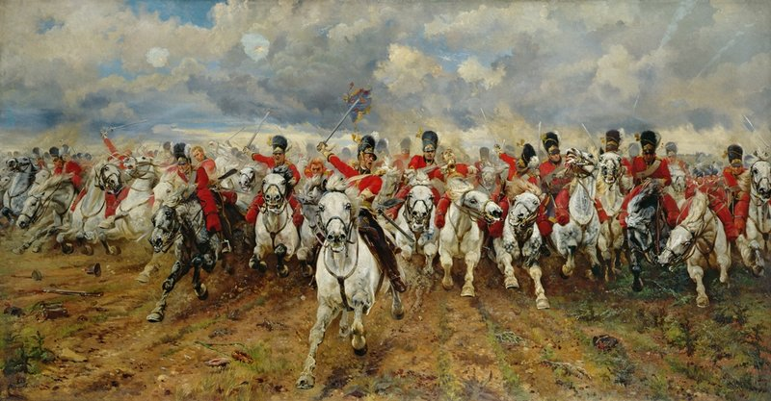
The Charge of the Light Brigade
By Alfred Lord Tennyson

Slide 2
Learning Objective To understand the context and subject matter of the poem.

Slide 3
This poem is about a battle in a war.
In pairs, make a list of all the wars that you can think of. Mark those that involved British soldiers.
Make list of five things that would be positive about being a member of the armed forces and five things that would be negative. In your view, would it be a good job?

Slide 4
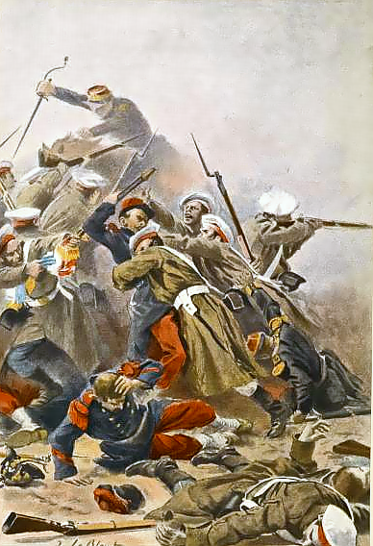
The war in this poem was over 150 years ago. It was called the Crimean War.

Slide 6
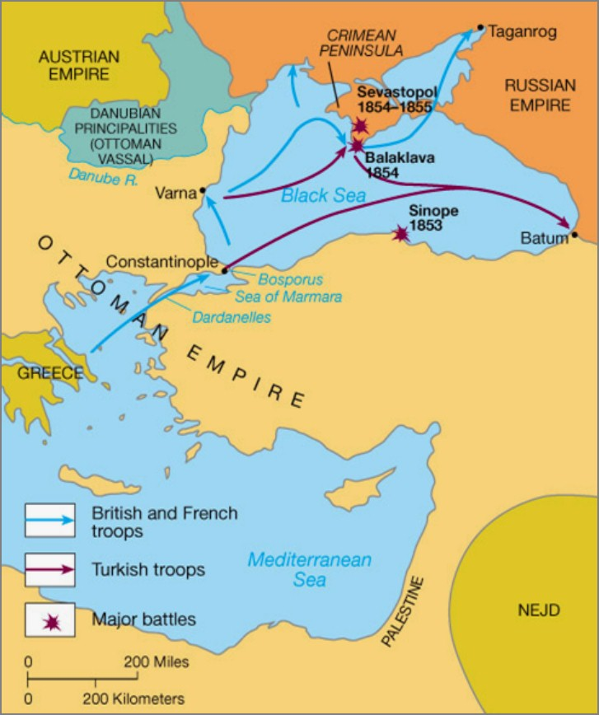
On one side there was Russia. On the other side there was Turkey, Britain and France.

Slide 7
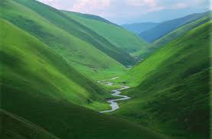
The battle took place in a valley.

Slide 8
If you were having a battle in a valley where would you want to be positioned?

Slide 9
What is a cavalry man?

Slide 10
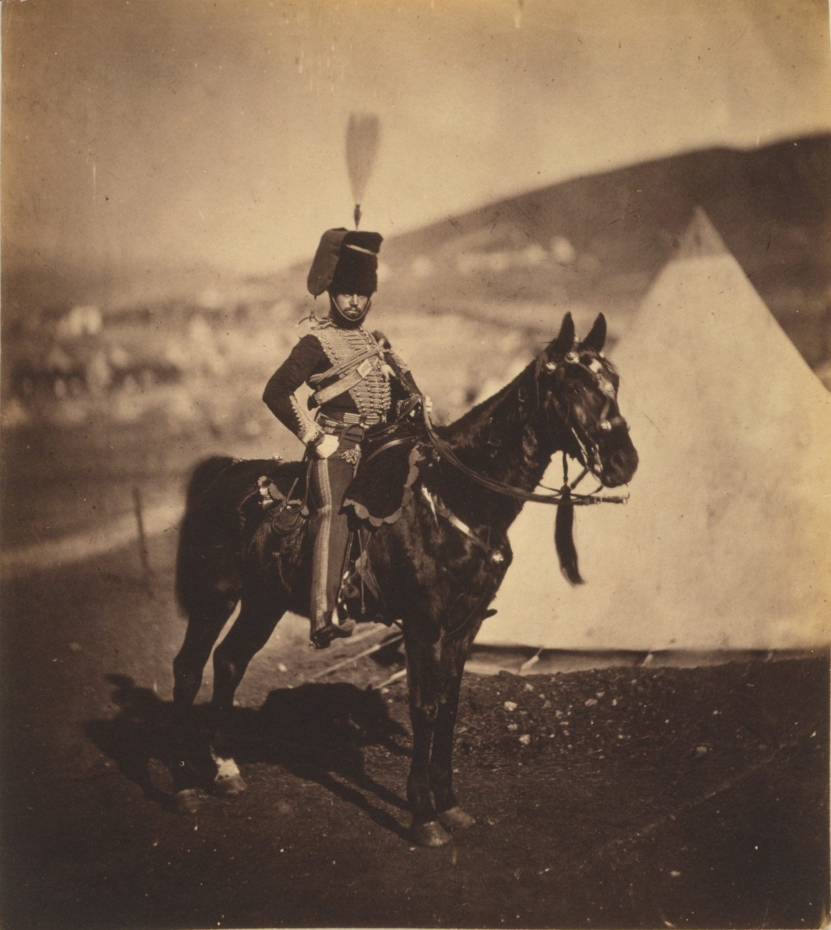
Cavalry Man =
A soldier on a horse, armed only with a sword.

Slide 11
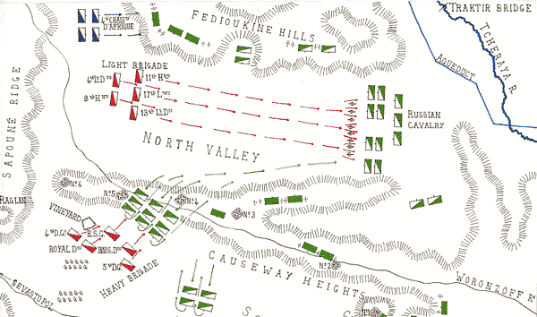
The British cavalry ended up at one end of the valley.
What’s the problem?

Slide 12
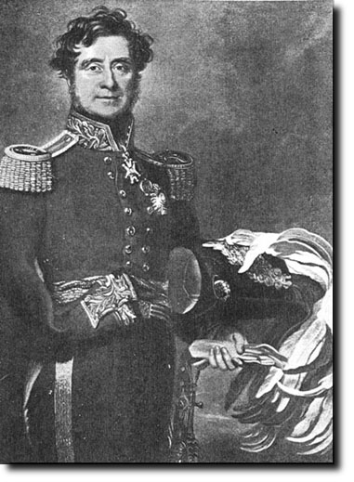
A British commander called Lord Raglan decided to attack the Russians.

Slide 13
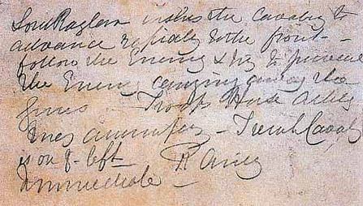
His order wasn’t very clear at all. It said: ‘…advance rapidly to the front…’
Why is this unclear?

Slide 14
‘…advance rapidly to the front…’
Why is this unclear?

Slide 15
The order was misinterpreted and over 600 soldiers were sent charging down the valley. They were surrounded by Russian guns on three sides.

Slide 16
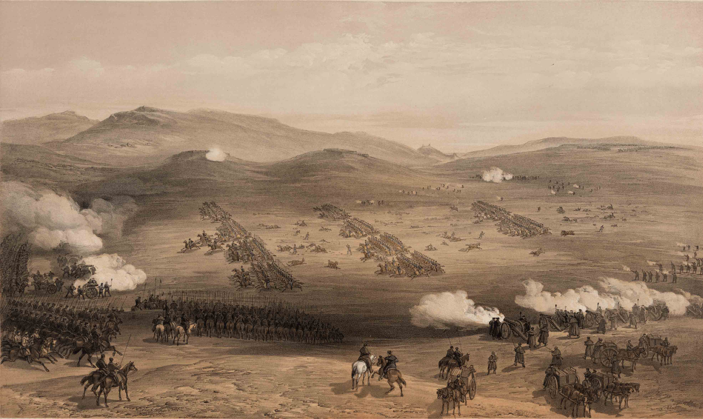
What do you think happened to the men?

Slide 17
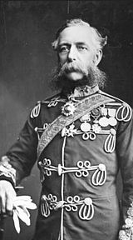
We entered the battery – we went through the battery – the two leading regiments cutting down a great number of the Russian gunners in their onset. In the two regiments which I had the honour to lead, every officer, with one exception, was either killed or wounded, or had his horse shot under him or injured. Those regiments proceeded, followed by the second line, consisting of two more regiments of cavalry, which continued to perform the duty of cutting down the Russian gunners. Then came the third line, formed of another regiment, which endeavoured to complete the duty assigned to our brigade. …’
(Lord Cardigan’s address to the House of Commons, 29 March 1855)

Slide 18
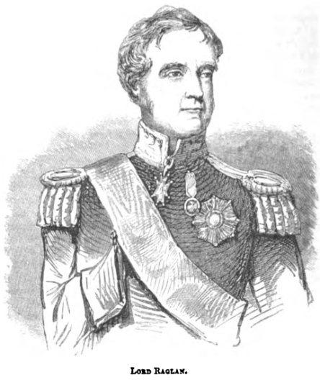
Lots of people think Raglan is to blame for the deaths of so many men because his order was unclear.

Slide 19
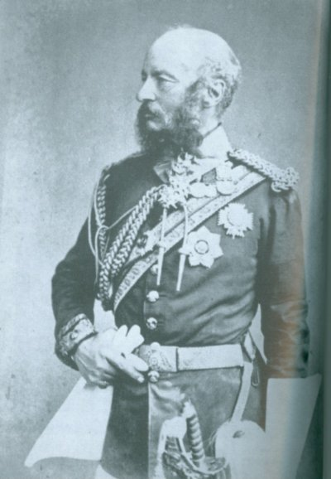
Other people say that the officer (Lord Lucan) who received the unclear order should’ve checked before ordering the 600 men to charge.

Slide 21
Write a brief summary of the battle, using these word banks to help you…
The Charge of the Light Brigade
War
150 years ago
Crimean
Russia
Turkey
Britain
France
Valley
Command
Cavalry Men
600
Lord Raglan
Lord Lucan
Misinterpreted
Surrounded
‘advance rapidly’
…More challenging…

Slide 22
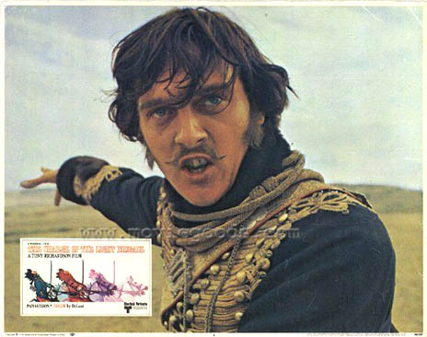
Watch this extract from a film re-enacting the battle to help you understand the events...

Slide 23
Why was this event remembered?
http://www.bbc.co.uk/learningzone/clips/reporting-the-charge-of-the-light-brigade-pt-1-3/1280.html

Slide 25
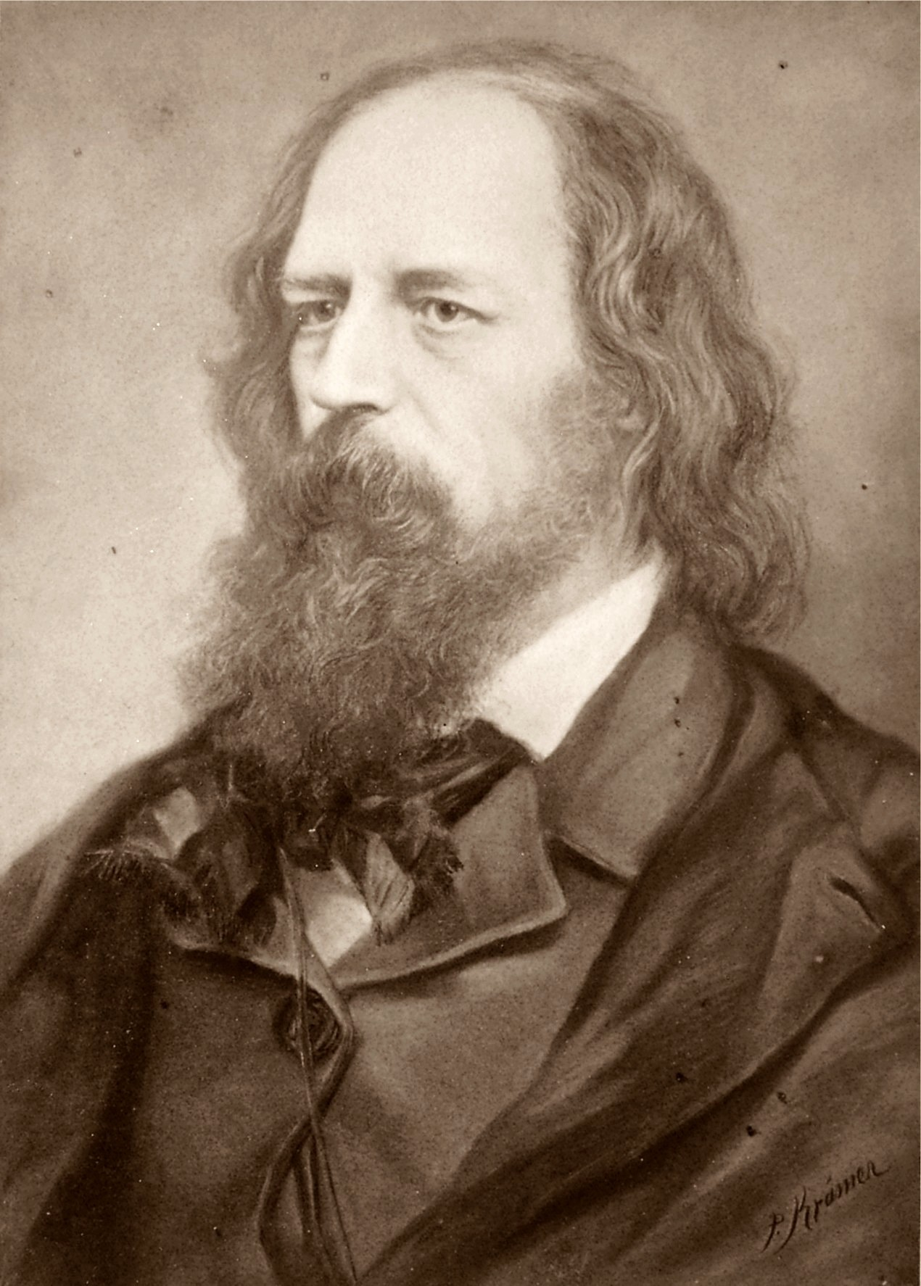
Who wrote the poem?
Alfred, Lord Tennyson was one of the most important poets of the Victorian period. He became Poet Laureate of the United Kingdom in 1850 following the death of William Wordsworth and in 1884 wrote 'The Charge of the Light Brigade' as a dramatic tribute to the 673 British cavalrymen at the Battle of Balaclava in the Crimean War.
For a long time, he was concerned about his mental state, fearing the 'black blood' of the Tennysons. This darkness informed much of his poetry, leading him to focus on loss and mortality.
http://www.bbc.co.uk/learningzone/clips/the-charge-of-the-light-brigade-pt-2-3/1284.html

Slide 26
Let’s read the poem...

Slide 27
4.
Flash’d all their sabres bare,
Flash’d as they turn’d in air
Sabring the gunners there,
Charging an army, while
All the world wonder’d:
Plunged in the battery-smoke
Right thro’ the line they broke;
Cossack and Russian
Reel’d from the sabre-stroke
Shatter’d and sunder’d.
Then they rode back, but not
Not the six hundred.
1.
Half a league, half a league,
Half a league onward,
All in the valley of Death
Rode the six hundred.
‘Forward, the Light Brigade!
Charge for the guns!’ he said:
Into the valley of Death
Rode the six hundred.
2.
‘Forward, the Light Brigade!’
Was there a man dismay’d?
Not tho’ the soldier knew
Some one had blunder’d:
Theirs not to make reply,
Theirs not to reason why,
Theirs but to do and die:
Into the valley of Death
Rode the six hundred.
3.
Cannon to right of them,
Cannon to left of them,
Cannon in front of them
Volley’d and thunder’d;
Storm’d at with shot and shell,
Boldly they rode and well,
Into the jaws of Death,
Into the mouth of Hell
Rode the six hundred.
5.
Cannon to right of them,
Cannon to left of them,
Cannon behind them
Volley’d and thunder’d;
Storm’d at with shot and shell,
While horse and hero fell,
They that had fought so well
Came thro’ the jaws of Death
Back from the mouth of Hell,
All that was left of them
Left of six hundred.
6.
When can their glory fade?
O the wild charge they made!
All the world wonder’d.
Honour the charge they made!
Honour the Light Brigade,
Noble six hundred!

Slide 28
Try to match each word with its definition. Add any other words from the poem you don’t know, along with a definition, to the bottom of your table. You will probably want to use a dictionary to help you.

Slide 29
For each of the images representing the battle, choose a line of the poem to accompany it...

Slide 30
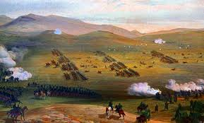

Slide 31
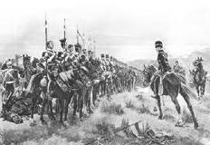

Slide 32
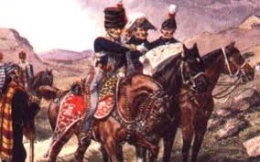

Slide 33
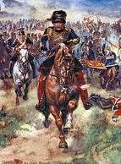

Slide 34
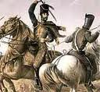

Slide 35
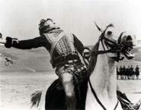

Slide 36
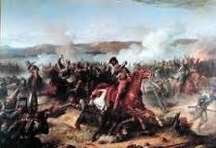

Slide 37
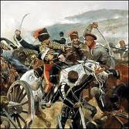

Slide 38
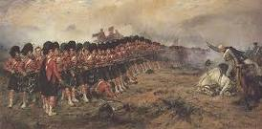

Slide 39
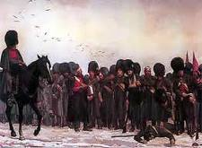

Slide 40
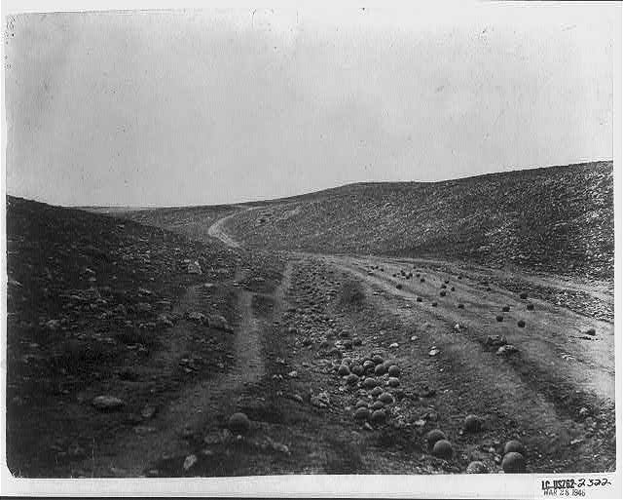

Slide 41
Learning Objective To explore how the writer uses theme, language and structure to present the battle.

Slide 42
Look at your word cloud.
What do you notice about the patterns in word choice?
Which words are biggest? Which are smallest?
Why?

Slide 43
4.
Flash’d all their sabres bare,
Flash’d as they turn’d in air
Sabring the gunners there,
Charging an army, while
All the world wonder’d:
Plunged in the battery-smoke
Right thro’ the line they broke;
Cossack and Russian
Reel’d from the sabre-stroke
Shatter’d and sunder’d.
Then they rode back, but not
Not the six hundred.
1.
Half a league, half a league,
Half a league onward,
All in the valley of Death
Rode the six hundred.
‘Forward, the Light Brigade!
Charge for the guns!’ he said:
Into the valley of Death
Rode the six hundred.
2.
‘Forward, the Light Brigade!’
Was there a man dismay’d?
Not tho’ the soldier knew
Some one had blunder’d:
Theirs not to make reply,
Theirs not to reason why,
Theirs but to do and die:
Into the valley of Death
Rode the six hundred.
3.
Cannon to right of them,
Cannon to left of them,
Cannon in front of them
Volley’d and thunder’d;
Storm’d at with shot and shell,
Boldly they rode and well,
Into the jaws of Death,
Into the mouth of Hell
Rode the six hundred.
5.
Cannon to right of them,
Cannon to left of them,
Cannon behind them
Volley’d and thunder’d;
Storm’d at with shot and shell,
While horse and hero fell,
They that had fought so well
Came thro’ the jaws of Death
Back from the mouth of Hell,
All that was left of them
Left of six hundred.
6.
When can their glory fade?
O the wild charge they made!
All the world wonder’d.
Honour the charge they made!
Honour the Light Brigade,
Noble six hundred!

Slide 44
Do you think Tennyson is critical of the charge or is he paying tribute to the men? (Remember: he was Poet Laureate)

Slide 45
How many syllables does ‘Half a league’ have?
What does this suggest the rhythm of?
1.
Half a league, half a league,
Half a league onward,
All in the valley of Death
Rode the six hundred.
‘Forward, the Light Brigade!
Charge for the guns!’ he said:
Into the valley of Death
Rode the six hundred.
What impression does ‘valley of Death’ give?
Why does the poet repeat ‘Valley of Death’? What does this suggest about the brigade’s fate?
What impression does ‘the six hundred’ give of the men?
Who is the ‘he’ issuing the order?

Slide 46
Tennyson is trying to show the dedication and bravery of the soldiers, following orders without question. He makes it seem as though less brave men would have questioned the order and not been as noble. What technique does Tennyson use to do this? [Hint: look at the first two lines of the stanza.]
2.
‘Forward, the Light Brigade!’
Was there a man dismay’d?
Not tho’ the soldier knew
Some one had blunder’d:
Theirs not to make reply,
Theirs not to reason why,
Theirs but to do and die:
Into the valley of Death
Rode the six hundred.
Who is ‘some one’?
Why does Tennyson not mention the person by name?
Which other technique does Tennyson use to show the men’s bravery and the fact that they didn’t question the order?
There is a line in the Bible that says, “Yea, though I walk through the valley of the shadow of death, I will fear no evil.” (Psalm 23)
What effect does this link to the Bible have on our impression of the soldiers and of the poem itself?

Slide 47
Colour any dramatic and violent words in this stanza.
Why has Tennyson used this vocabulary? What does it make us think about the soldiers?
3.
Cannon to right of them,
Cannon to left of them,
Cannon in front of them
Volley’d and thunder’d;
Storm’d at with shot and shell,
Boldly they rode and well,
Into the jaws of Death,
Into the mouth of Hell
Rode the six hundred.

Slide 48
3.
Cannon to right of them,
Cannon to left of them,
Cannon in front of them
Volley’d and thunder’d;
Storm’d at with shot and shell,
Boldly they rode and well,
Into the jaws of Death,
Into the mouth of Hell
Rode the six hundred.
Why does Tennyson use repetition to describe the cannons?
Alliteration emphasises the idea of ammunition flying towards them
Why does Tennyson end every stanza with this line? What does it show about the soldiers? (Does he mention individuals?)
These images personify death and hell, making them seem like monsters the soldiers cannot escape

Slide 49
4.
Flash’d all their sabres bare,
Flash’d as they turn’d in air
Sabring the gunners there,
Charging an army, while
All the world wonder’d:
Plunged in the battery-smoke
Right thro’ the line they broke;
Cossack and Russian
Reel’d from the sabre-stroke
Shatter’d and sunder’d.
Then they rode back, but not
Not the six hundred.
Colour any dramatic and violent words in this stanza.
Why has Tennyson used this vocabulary? What does it make us think about the soldiers and what they experienced?

Slide 50
4.
Flash’d all their sabres bare,
Flash’d as they turn’d in air
Sabring the gunners there,
Charging an army, while
All the world wonder’d:
Plunged in the battery-smoke
Right thro’ the line they broke;
Cossack and Russian
Reel’d from the sabre-stroke
Shatter’d and sunder’d.
Then they rode back, but not
Not the six hundred.
The repetition of flash’d and the rhyme of bare/air create a powerful image of the cavalry using their swords
Reminds us that the cavalry only had swords against the Russian guns
What does the alliteration of ‘world wonder’d’ do to the pace of the poem?
How does this show the difference between the war and the rest of the world?
The sibilance here sounds vicious
Several lines begin with verbs, emphasising the action and increasing the pace of the poem
How and why has the last line changed?
Think about the effect of the enjambment of ‘not/Not’ – how does this make the speaker sound?

Slide 51
These lines have been used earlier in the poem. Which word has been changed to show that the soldiers are coming back?
Powerful, onomatopoeic verbs suggest the noise from the cannons
5.
Cannon to right of them,
Cannon to left of them,
Cannon behind them
Volley’d and thunder’d;
Storm’d at with shot and shell,
While horse and hero fell,
They that had fought so well
Came thro’ the jaws of Death
Back from the mouth of Hell,
All that was left of them
Left of six hundred.
The sense of admiration is touched with sadness
What is the effect of the alliteration of ‘sh’?
What is the effect of the repetition of ‘left of’?

Slide 52
Colour any words linked to bravery in this stanza.
This rhetorical question challenges the reader
6.
When can their glory fade?
O the wild charge they made!
All the world wonder’d.
Honour the charge they made!
Honour the Light Brigade,
Noble six hundred!
Which imperative does Tennyson use?
What is the effect of this?
What is the message and purpose of the poem?

Slide 53
Form, structure and tone: ‘The Charge of the Light Brigade’
Which is the longest stanza? What is this stanza about?
Which is the shortest stanza? What is this stanza about?
The majority of the lines in the poem are long/ short. These make the action of the poem seem fast/ slow and dramatic/ boring. This shows the brigade’s relentless/ relaxed charge forwards. Even though the pace never lessened/ increased, the soldiers never/ always hesitated. Tennyson is trying to show their bravery/ cowardice.

Slide 54
Form, structure and tone: ‘The Charge of the Light Brigade’
The poem is narrated in third person, making it seem more like a story.
The regular, relentless rhythm creates a fast pace, imitating the cavalry’s advance and the energy of the battle. Rhyming couplets and triplets drive the poem forwards. In places, Tennyson has used dactylic metre – the pattern of one stressed syllable followed by two unstressed syllables. E.g.
/ ں ں / ں ں
Half a league, half a league,
/ ں ں / ں ں Cannon to right of them,
This metre helps to convey the sound of charging horses but the momentum is broken by unrhymed lines, which could mirror the horses stumbling and the soldiers falling. The overall lack of rhyme scheme hints at the chaos of war.

Slide 55
The poem could be said to show a balance between the bravery and nobleness of the soldiers and the horror of war. Find words that indicate this balance.

Slide 56
Theirs not to make reply,
Theirs not to reason why,
Theirs but to do and die.
How could these three lines be used to justify a positive view of soldiers and war, or a negative view?

Slide 57
The Charge of the Light Brigade has been criticised for glorifying war and the duty to die for one’s country. Do you think that criticism is justified?

Slide 58
It’s time to summarise! We’re going to make a note of the poem’s VITALS.

Slide 59
Poetry VITALS…
Voice: Who is speaking in the poem?
Imagery: What imagery is being created? How is it effective?
Theme: What are the main themes featured in the poem?
Address: Who is the poem addressed to? Why?
Language (Features): What type of language/ devices are used?
What is their effect?
Structure: How is the poem laid out? What is the effect of this?
Notes:
This is the acronym that we will use on each poem to look at all the different aspects

Slide 60
You have been given some extracts from William Howard Russell’s reports in The Times, published on 13 and 14 November 1854 respectively. He was the war correspondent for the newspaper and it was these accounts that inspired Tennyson to write his poem.
We are going to use these extracts to practise some exam-style questions.
Don’t worry! It’s just a first go…
Language Paper 2 Section A

Slide 61
Initial Discussion Questions:
In groups, compare Russell’s eye-witness account of the charge with the way that the charge is portrayed in Tennyson’s poem.
You will need to consider:
What is the purpose of each account?
Who is the audience for each account?
How would you describe the writer’s attitude towards the event that took place?
Which details do both accounts have in common?
Which details are different?
How has each writer used language for effect?
Which account do you find the most dramatic and powerful?
What impact do you think the newspaper report would have had on its audience?
What impact do you think Tennyson’s poem would have had on its audience?
Why do you think that Tennyson’s poem is the best known account of the event?
Summarise the main points of your discussion and prepare to share your ideas with the rest of the class.

Slide 62
AO1
• Identify and interpret explicit and implicit information and ideas.
• Select and synthesise evidence from different texts.
Sample Question 1:
Re-read the first three paragraphs of the text.
Choose four statements below which are TRUE.
• Shade the statements that you think are true
• Choose a maximum of four statements.
A The order was given verbally.
B Captain Nolan was a coward.
C Three hundred guns were drawn up along the Russian line.
D The order was given to Captain Nolan.
E The order was to be given to Lord Cardigan.
F Captain Nolan died in the battle.
G Brigadier Airey did not think that the Light Cavalry had gone far enough in front.
H The Russians placed some guns on the heights over their position, on the left of the gorge.
[4 marks]

Slide 63
AO1
• Identify and interpret explicit and implicit information and ideas.
• Select and synthesise evidence from different texts.
Sample Question 1:
Re-read the first three paragraphs of the text.
Choose four statements below which are TRUE.
• Shade the statements that you think are true
• Choose a maximum of four statements.
A The order was given verbally.
B Captain Nolan was a coward.
C Three hundred guns were drawn up along the Russian line.
D The order was given to Captain Nolan.
E The order was to be given to Lord Cardigan.
F Captain Nolan died in the battle.
G Brigadier Airey did not think that the Light Cavalry had gone far enough in front.
H The Russians placed some guns on the heights over their position, on the left of the gorge.
[4 marks]

Slide 64
AO2
Explain, comment on and analyse how writers use language and structure to achieve effects and influence readers, using relevant subjects terminology to support their views.
Sample Question 3:
Re-read the rest of the text.
This question assesses Language i.e. Words / Phrases / Language Features / Language Techniques / Sentence Forms
How does William Howard Russell use language to make you, the reader, feel proud of the soldiers?
[12 marks]

Slide 65
AO2
Explain, comment on and analyse how writers use language and structure to achieve effects and influence readers, using relevant subjects terminology to support their views.
How does William Howard Russell use language to make you, the reader, feel proud of the soldiers?
Level 4 Perceptive, Detailed 10-12 marks | Shows detailed and perceptive understanding of language • Analyses the effects of the writer’s choices of language • Selects a range of judicious examples • Uses sophisticated subject terminology accurately
Level 3 Clear, relevant 7-9 marks | Shows clear understanding of language • Clearly explains the effects of the writer’s choices of language • Selects a range of relevant examples • Uses subject terminology accurately
Level 2 Some, attempts 4-6 marks | Shows some understanding of language • Attempts to comment on the effect of language • Selects some relevant examples • Uses some subject terminology, not always appropriately
Level 1 Simple, limited 1-3 marks | Shows some understanding of language • Offers simple comment on effect of language • Simple references or examples • Simple mention of subject terminology

Slide 66
Q
W
E
R
T
Y
QUESTION - link your answer to the focus of the task
WRITER - remember that the characters only do what the writer makes them do!
EVIDENCE - Use quotations from the text
READER - what effect do the events/ issues have on the reader?
TECHNIQUES - language/ structure
YOUR RESPONSE - explore your own ideas/ your reaction to the text

Slide 67
Q
W
E
R
T
Y
How does William Howard Russell use language to make you, the reader, feel proud of the soldiers?
They swept proudly past, glittering in the morning sun in all the pride and splendour of war. We could hardly believe the evidence of our senses!

Slide 68
Q
W
E
R
T
Y
How does William Howard Russell use language to make you, the reader, feel proud of the soldiers?
Russell’s use of the adjective ‘glittering’ in ‘glittering in the morning sun’ creates an image of the soldiers heroically going into battle, like medieval knights with the sun bouncing off their armour. This romantic image is reinforced by the phrase ‘swept proudly past’. The adverb ‘swept’ makes the soldiers seem like they are superior to the spectators and that they are proud of their status. It suggests to the reader that we too should be proud and admiring of them. The repetition of ‘pride’ in ‘all the pride and splendour of war’ reinforces the idea that they are doing something special, whilst Russell’s use of the first person plural ‘we’ in the next sentence reminds us that we are not part of their ranks and should therefore be respectful and admiring of them.

Slide 69
Q
W
E
R
T
Y
How does William Howard Russell use language to make you, the reader, feel proud of the soldiers?
With diminished ranks, thinned by those thirty guns, which the Russians had laid with the most deadly accuracy, with a halo of flashing steel above their heads, and with a cheer which was many a noble fellow’s death cry, they flew into the smoke of the batteries; but ere they were lost from view, the plain was strewed with their bodies and with the carcasses of horses.

Slide 70
Q
W
E
R
T
Y
How does William Howard Russell use language to make you, the reader, feel proud of the soldiers?
Through the clouds of smoke we could see their sabres flashing as they rode up to the guns and dashed between them, cutting down the gunners as they stood. The blaze of their steel, as an officer standing near me said, was ‘like the turn of a shoal of mackerel’.

Slide 71
AO2
Explain, comment on and analyse how writers use language and structure to achieve effects and influence readers, using relevant subjects terminology to support their views.
Sample Question 3:
Re-read the rest of the text.
This question assesses Language i.e. Words / Phrases / Language Features / Language Techniques / Sentence Forms
How does William Howard Russell use language to make you, the reader, feel proud of the soldiers?

Slide 72
AO2
Explain, comment on and analyse how writers use language and structure to achieve effects and influence readers, using relevant subjects terminology to support their views.
How does William Howard Russell use language to make you, the reader, feel proud of the soldiers?
Level 4 Perceptive, Detailed 10-12 marks | Shows detailed and perceptive understanding of language • Analyses the effects of the writer’s choices of language • Selects a range of judicious examples • Uses sophisticated subject terminology accurately
Level 3 Clear, relevant 7-9 marks | Shows clear understanding of language • Clearly explains the effects of the writer’s choices of language • Selects a range of relevant examples • Uses subject terminology accurately
Level 2 Some, attempts 4-6 marks | Shows some understanding of language • Attempts to comment on the effect of language • Selects some relevant examples • Uses some subject terminology, not always appropriately
Level 1 Simple, limited 1-3 marks | Shows some understanding of language • Offers simple comment on effect of language • Simple references or examples • Simple mention of subject terminology

Slide 73
AO1
• Identify and interpret explicit and implicit information and ideas.
• Select and synthesise evidence from different texts.
WWW:
EBI:
AO2
Explain, comment on and analyse how writers use language and structure to achieve effects and influence readers, using relevant subjects terminology to support their views.
WWW:
EBI:

