Slide 1
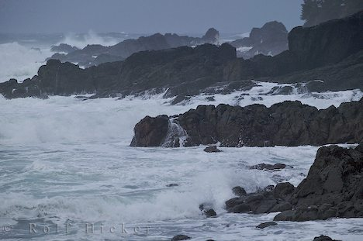
Storm on the Island by Seamus Heaney

Slide 2
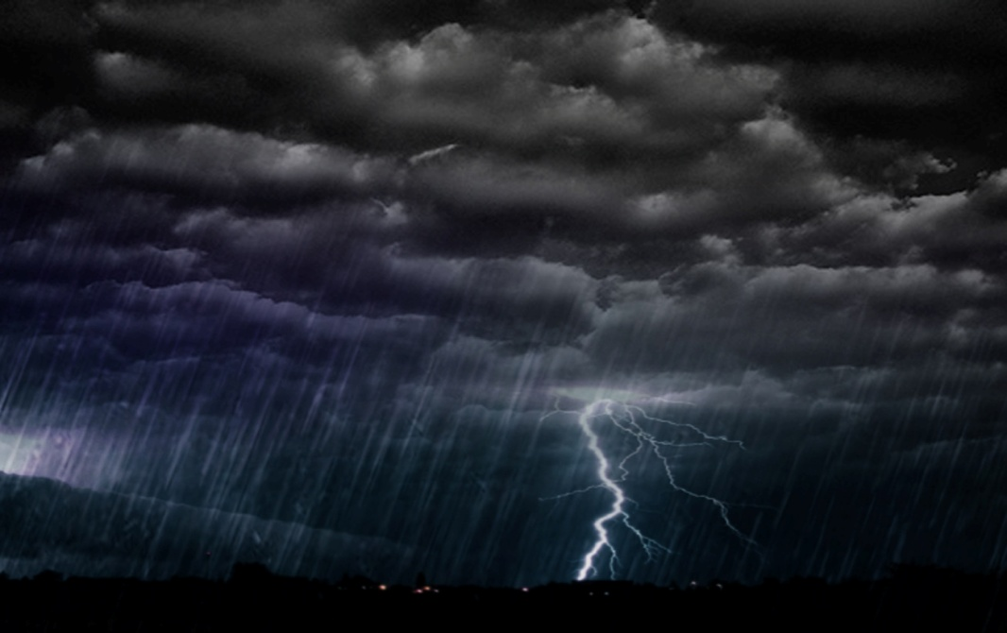
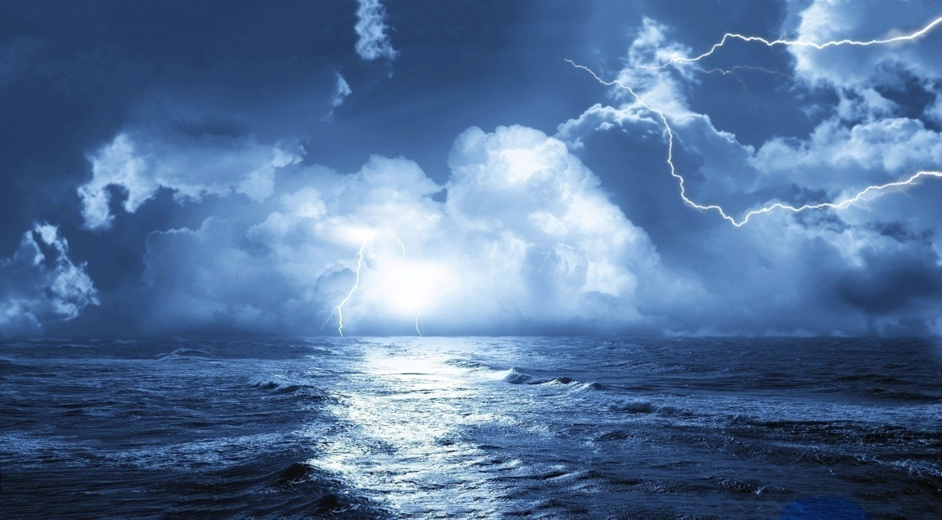
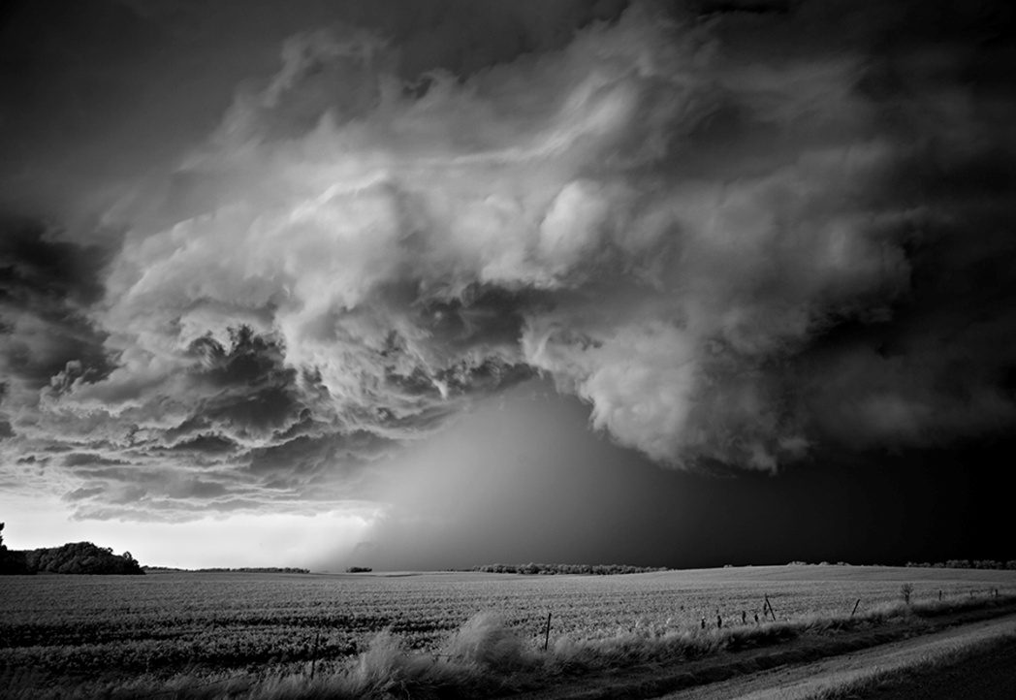
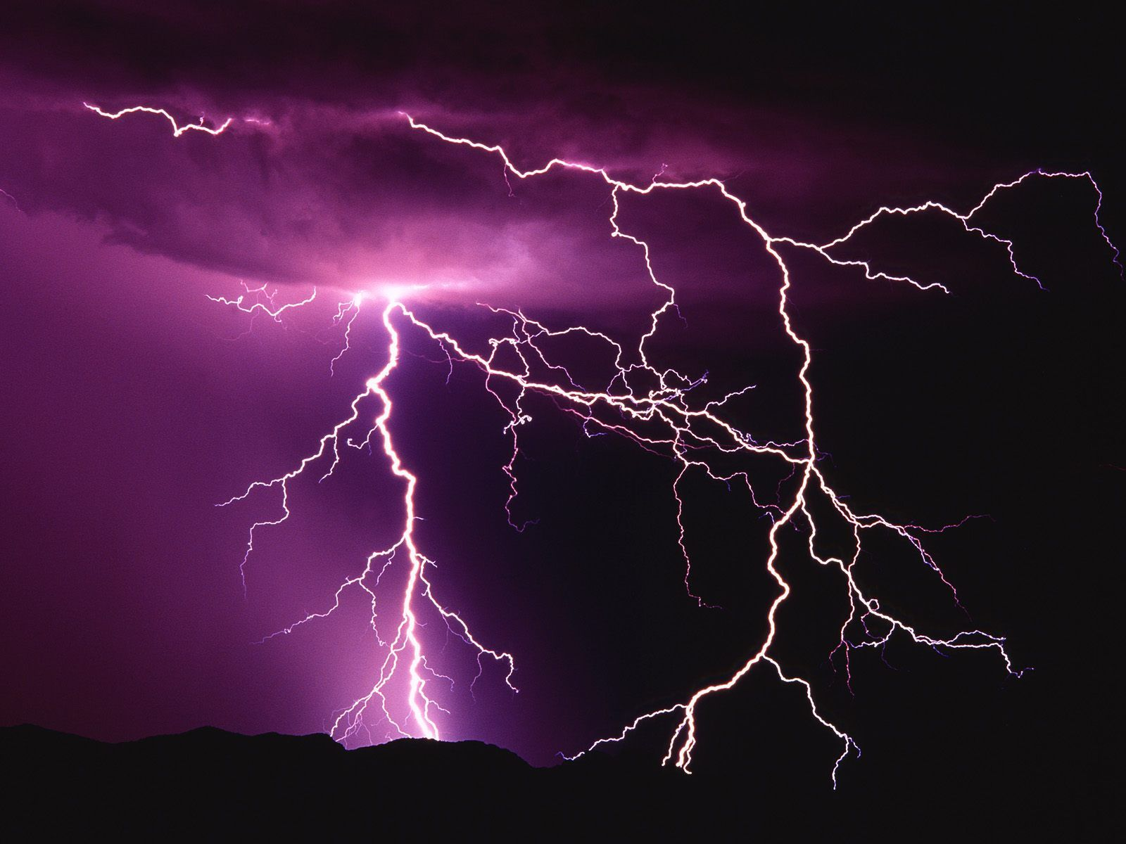
How many similes / metaphors / personification can you think of to describe a storm?
Challenge – can you link your examples to the theme of power and conflict? 

Slide 3

Learning Objective
To understand the context and subject matter of the poem.

Slide 4
Seamus Heaney
Seamus Heaney was born in Northern Ireland in 1939, the eldest of nine children. His father was a farmer in rural County Derry and much of Heaney's poetry is about the countryside and farm life of his childhood. At the age of 12 Heaney won a scholarship to the boarding school of St Columb's College in the city of Derry, forty miles from his rural home.

Slide 5
Storm on the Island: Content/meaning
Present tense. What effect does this have on the reader?
We are prepared: we build our houses squat,
Sink walls in rock and roof them with good slate.
The wizened earth has never troubled us
With hay, so as you can see, there are no stacks
Or stooks that can be lost. Nor are there trees
Which might prove company when it blows full
Blast: you know what i mean - leaves and branches
Can raise a tragic chorus in a gale
So that you can listen to the thing you fear
Forgetting that it pummels your house too.
But there are no trees, no natural shelter.
You might think that the sea is company,
Exploding comfortably down on the cliffs
But no: when it begins, the flung spray hits
The very windows, spits like a tame cat
Turned savage. We just sit tight while wind dives
And strafes invisibly. Space is a salvo.
We are bombarded by the empty air.
Strange, it is a huge nothing that we fear.
Old and shrivelled. Also experienced.
What is the poet describing. How does he feel about it?
5
Corn sheaves bundled up
10
15
Rapid, simultaneous firing of artillery
http://www.bbc.co.uk/schools/gcsebitesize/english_literature/poetry_slideshow/storm/photoplayer.shtml

Slide 6
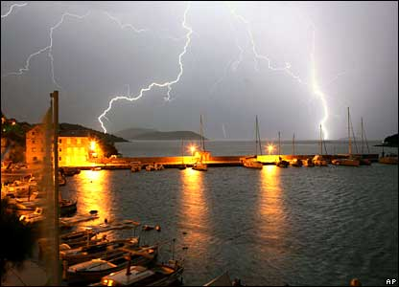
First Impressions
Draw a picture of how Heaney presents the island.
Notes:
Students should realise there isn’t much in the poem to help them do this – a lot of the poem is about what is not there. Students to then list examples of things which are absent or negative.

Slide 7
What’s going on?
In this poem Heaney describes the violence of a storm as it hits a small island community but can you say exactly what is happening?
Lines | What Happens?
1 - 5 | Heaney describes how the community prepares for the storm
6 - 13
14 - 19

Slide 8
What’s going on?
In this poem Heaney describes the violence of a storm as it hits a small island community but can you say exactly what is happening?
Lines | What Happens?
1 - 5 | Heaney describes how the community prepares for the storm
6 - 13 | There is a change in tone from safety to danger. The violence and noise of the storm is described.
14 - 19 | The fear of the islanders is conveyed through images of war.

Slide 9
Check Your Understanding
How much do you know about Seamus Heaney and the poem Storm on the Island?
Where are many of Heaney’s poems set?
What happened to Heaney at the age of 12?
How do the islanders prepare for the storm?
What other poem from the anthology describes a storm at sea?
What animal is the storm compared to?
Why is the animal simile effective?
What words suggest that the storm-hit island is like a battle zone?

Slide 10
Learning Objective
To explore how the poet uses theme, language and structure

Slide 11
Glossary
Learning Objective: To explore how the poet uses theme, language and structure
Match the vocabulary from the poem
with the correct definition:
wizened (line 3) bombard with artillery shells
stacks / stooks (lines 4/5) continuous firing of artillery
strafes (line 17) dried up & shrivelled
salvo (line 17) haystacks / bundles of corn

Slide 12
Glossary
Learning Objective: To explore how the poet uses theme, language and structure
How many did you work out correctly?
wizened (line 3) dried up & shrivelled
stacks / stooks (lines 4/5) haystacks / bundles of corn
strafes (line 17) bombard with artillery shells
salvo (line 17) Continuous firing of artillery

Slide 13
Learning Objective: To explore how the poet uses theme, language and structure
Storm on the Island: Language
Simple, comforting statement of strength. Sets the tone as secure and safe.
‘We’ → togetherness, community
‘squat’ low down, immediate suggestion of the strength of the wind
We are prepared: we build our houses squat,
Sink walls in rock and roof them with good slate.
The wizened earth has never troubled us
With hay, so as you can see, there are no stacks
Or stooks that can be lost. Nor are there trees
‘roof’ ‘good’ these words have assonance. Emphasising the connection between the people and nature
5
The earth is like an old friend, saving them the bother of harvesting and the pain of lost crops
Alliteration stresses the solidarity, strength of togetherness

Slide 14
Learning Objective: To explore how the poet uses theme, language and structure
How does the opening line suggest that the storm was no surprise?
In the first part of the poem is the idea that the narrator is not too concerned about the storm. Explain, with judiciously chosen quotations, why he feels initially safe.

Slide 15
Learning Objective: To explore how the poet uses theme, language and structure
Storm on the Island: Language
Caesura forces the reader to pause in the comfort of this statement
End-stopping forces the reader to dwell on the feeling of safety/solidity
We are prepared: we build our houses squat,
Sink walls in rock and roof them with good slate.
The wizened earth has never troubled us
With hay, so as you can see, there are no stacks
Or stooks that can be lost. Nor are there trees
Which might prove company when it blows full
Blast: you know what i mean - leaves and branches
5
Enjambment: the blast comes at the start of the line, possibly suggesting a sharp, unexpected gust of wind.
Safe and comfortable tone is disrupted and the poem becomes more fearful. Caesura used to ‘break’ the rhythm throughout the rest of the poem.

Slide 16
Learning Objective: To explore how the poet uses theme, language and structure
Storm on the Island: Language
Conversational style (there are other examples). Draws the reader in. Does it emphasise the poet’s isolation?
Chorus is sustained and incessant.
Blast: you know what i mean - leaves and branches
Can raise a tragic chorus in a gale
So that you can listen to the thing you fear
Forgetting that it pummels your house too.
10
‘pummels’ violent, painful image and personifies the wind
End of the line but not end-stopped, the fear hasn’t taken hold yet

Slide 17
Learning Objective: To explore how the poet uses theme, language and structure
Storm on the Island: Language
Therefore, no ‘tragic chorus’. Nature has spared them that.
No shelter, emphasises how barren this place is in contrast to the poet’s earlier, positive view.
10
Forgetting that it pummels your house too.
But there are no trees, no natural shelter.
You might think that the sea is company,
Exploding comfortably down on the cliffs
But no:
How can the sea be company? What doesn’t he have if it is?
‘might think’ i.e. you don’t know
Oxymoron: The poet is used to these sounds because the storms are a part of life. It’s familiar therefore comfortable.

Slide 18
Learning Objective: To explore how the poet uses theme, language and structure
3. At line 13 identify the oxymoron used to describe the sea and explain why Heaney uses it.

Slide 19
Learning Objective: To explore how the poet uses theme, language and structure
Storm on the Island: Language
Caesura: The pause makes the reader consider the absence of safety and comfort
But there are no trees, no natural shelter.
You might think that the sea is company,
Exploding comfortably down on the cliffs
But no: when it begins, the flung spray hits
The very windows, spits like a tame cat
Turned savage. We just sit tight while wind dives
And strafes invisibly. Space is a salvo.
We are bombarded by the empty air.
Strange, it is a huge nothing that we fear.
15
Violent language runs throughout the final 6 lines emphasising the danger and fear. Military language (“salvo”, “strafe”, “bombardment”) personifies the weather as attacking them.

Slide 20
Learning Objective: To explore how the poet uses theme, language and structure
4. At lines 14 and 15 identify two examples of powerful verbs and explain what idea of the sea they convey.
5. Next, a simile is used to describe the changeability of the sea. Explain what image of the sea this conveys.

Slide 21
Learning Objective: To explore how the poet uses theme, language and structure
Storm on the Island: Language
Enjambment: suggests surprise at the sudden change in the ‘cat’/sea
Simile: ‘like a tame cat’ a pet, friend, something the poet is comfortable with
But there are no trees, no natural shelter.
You might think that the sea is company,
Exploding comfortably down on the cliffs
But no: when it begins, the flung spray hits
The very windows, spits like a tame cat
Turned savage. We just sit tight while wind dives
And strafes invisibly. Space is a salvo.
We are bombarded by the empty air.
Strange, it is a huge nothing that we fear.
15
Caesura: forces the reader to dwell on the savage nature of the weather
There’s nothing they can do. Nature has all of the power

Slide 22
Learning Objective: To explore how the poet uses theme, language and structure
Storm on the Island: Language
Their fear is not of anything they can see or fight. Emphasises their powerlessness.
“fear.” is a repetition of the end of line 9 only this time it is end-stopped. Fear has taken hold and the reader is left to consider this at the end
But there are no trees, no natural shelter.
You might think that the sea is company,
Exploding comfortably down on the cliffs
But no: when it begins, the flung spray hits
The very windows, spits like a tame cat
Turned savage. We just sit tight while wind dives
And strafes invisibly. Space is a salvo.
We are bombarded by the empty air.
Strange, it is a huge nothing that we fear.
15
“nothing”, could also suggest a fear of losing everything; having it destroyed by the storm

Slide 23
Learning Objective: To explore how the poet uses theme, language and structure
6. At lines 16 and 17, identify two more examples of powerful verbs and explain how these are effective in conveying the destructive force of the wind.
7. Between lines 12 and 18, identify four words in the semantic field of warfare and explain why Heaney has used these - the effect they create.

Slide 24
Language
Storm on the Island is full of images of fear and violence. Although the poem begins with images of safety and security (‘we are prepared’) the tone changes from line 6 and a sense of loneliness and fear takes over. Nature becomes violent as the usually pleasant trees and the sea become frightening and dangerous forces. To emphasise the violence of the storm Heaney uses descriptive words and phrases usually associated with war such as blast, bombarded, salvo, etc. To involve the reader in his fear of the storm the poet uses direct address (2nd person) ‘you’ throughout to bring us closer to the experience.

Slide 25
Imagery
Find examples from the poem which suggest that the storm is like an enemy attack.
Quote | Explanation
It pummels your house | The word pummel means to hit somebody or something with repeated blows, this conveys the image of the house being attacked by an aggressive force.

Slide 26
Storm on the Island: Structure and Form
Learning Objective: To explore how the poet uses theme, language and structure
Why is there no article (‘the’ or ‘a’)? What does that suggest about the storm?
No rhyming pattern, this is called ______ verse
We are prepared: we build our houses squat,
Sink walls in rock and roof them with good slate.
The wizened earth has never troubled us
With hay, so as you can see, there are no stacks
Or stooks that can be lost. Nor are there trees
5
Iambic metre which mirrors the speech patterns of English and makes the poem feel like a conversation

Slide 27
Learning Objective: To explore how the poet uses theme, language and structure
The final line of the poem is unusual and ambiguous. In what way could the ‘storm’ be a ‘huge nothing’?

Slide 28
Learning Objective: To explore how the poet uses theme, language and structure
Storm on the Island: Structure and Form
“like a tame cat/ Turned savage”: this line mirrors the whole poem.
Starts safe, comfortable, known → frightening, violent.
Use this to compare the first and last lines
like a tame cat/ Turned savage
We are prepared: we build our houses squat
Strange, it is a huge nothing that we fear

Slide 29
HIDDEN MEANING
The first 8 letters of the title spell ‘Stormont’.
This is where the Northern Ireland Executive meet; a building which has long been associated with politics.
Does this add a different dimension to the poem and its meaning? Can you link the idea of a storm and its effect to politics?
Notes:
On another level Storm on the Island refers to the troubles in Northern Ireland that took place in the latter years of the twentieth century. Images of terrorist violence can be found throughout the poem. Words such as blast, exploding, fear, bombarded don’t just describe the literal storm but also represent the storm of violence happening in Northern Ireland during the Troubles. The first 8 letters of the poem spell out the word Stormont – the name of the Government buildings of Northern Ireland in Belfast. The word island also has an obvious phonetic similarity to the word Ireland. Therefore the poem works on two levels: as a description of a storm and as an extended metaphor for the political situation in Northern Ireland.

Slide 30

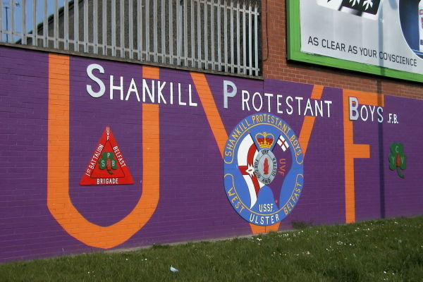
Divided Loyalties
During the troubles Protestant and Catholics were intolerant of one another. Each gave their allegiance to different countries. Protestants wanted to continue to be part of the United Kingdom whereas Catholics wanted Northern Ireland reunited with the Republic of Ireland. Protestants feared the idea of union with the Republic of Ireland and believed that
Catholics would not be tolerant of Protestant beliefs. Catholics could not forget the persecution they suffered during England’s conquest of Ireland and deeply mistrust the Protestants.

Slide 31
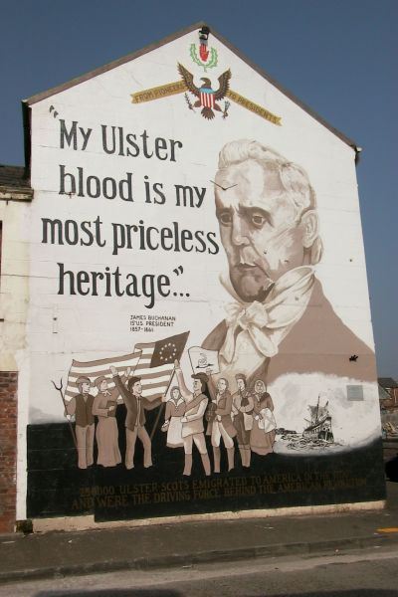


Slide 32
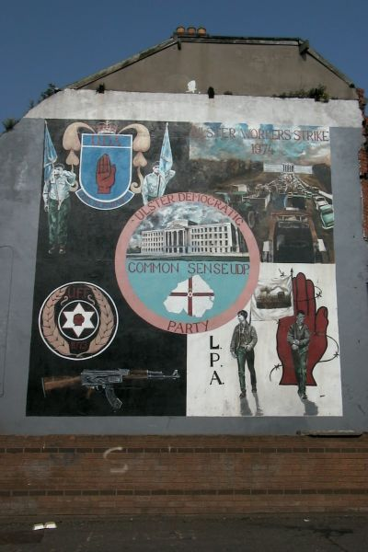
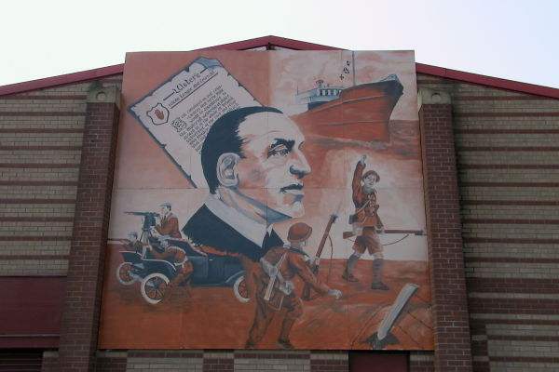

Slide 33
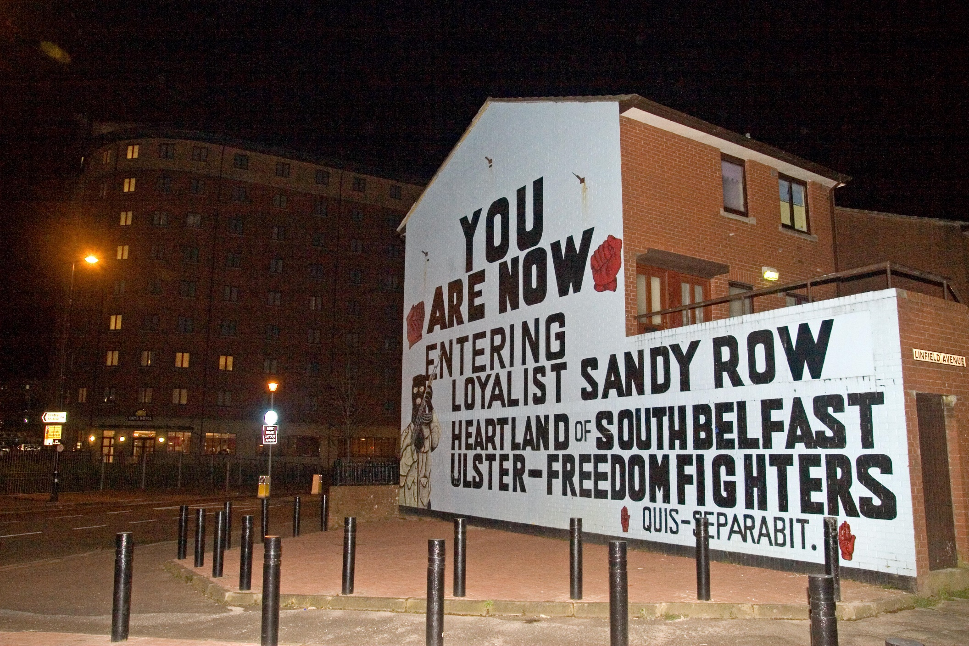

Slide 34
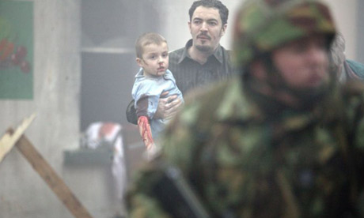
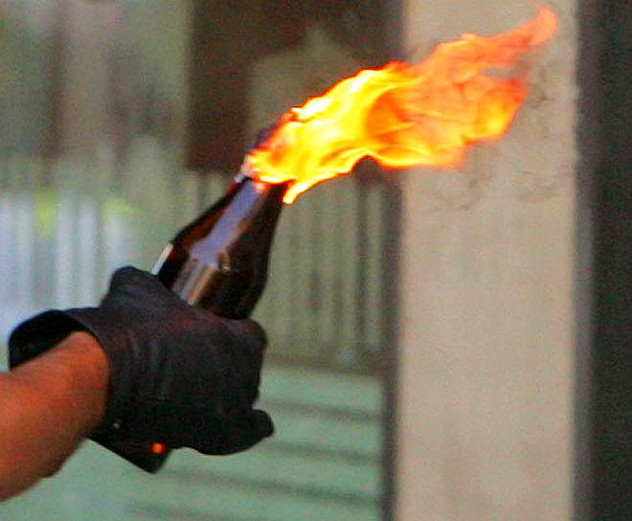
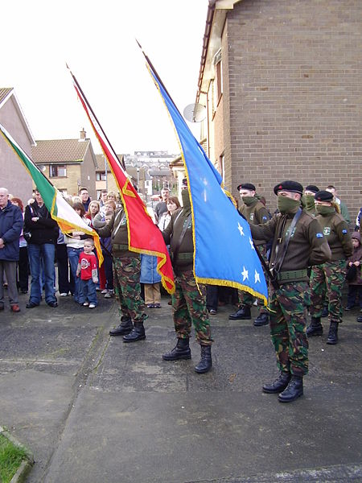
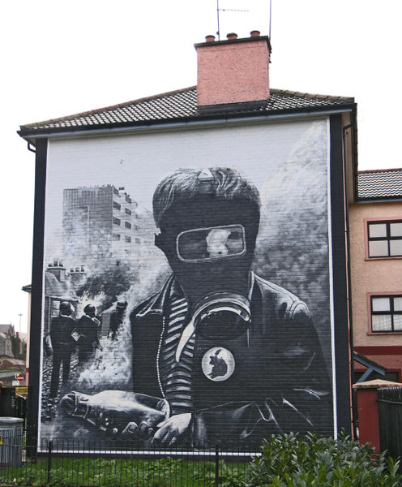
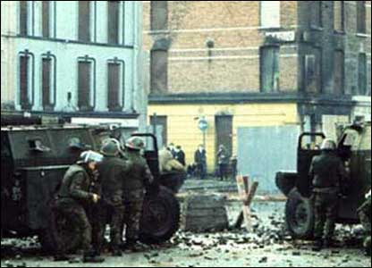

Slide 35
Storm on the Island
In what way could the poem be a metaphor?
On another level Storm on the Island refers to the troubles in Northern Ireland that took place in the latter years of the twentieth century. Images of terrorist violence can be found throughout the poem. Words such as blast, exploding, fear, bombarded don’t just describe the literal storm but also represent the storm of violence happening in Northern Ireland during the Troubles. The first 8 letters of the poem spell out the word Stormont – the name of the Government buildings of Northern Ireland in Belfast. The word island also has an obvious phonetic similarity to the word Ireland. Therefore the poem works on two levels: as a description of a storm and as an extended metaphor for the political situation in Northern Ireland.

Slide 36

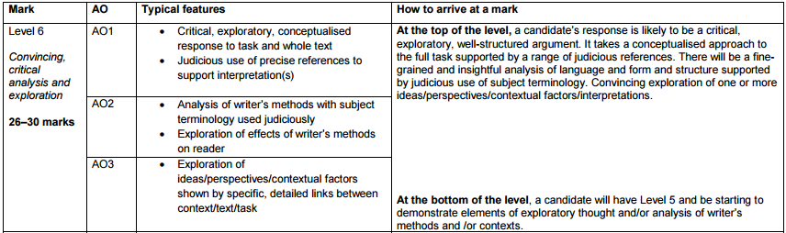
How does Heaney use language and structure to convey ideas about power?
Create a success criteria for this question: what needs to be included?
Notes:
Using the mark scheme, create a success criteria for the question

