Slide 1
CA: GCSE English Language Unit 3 part c: Spoken Language Study Spoken Genres: Explore some of the ways people adapt their spoken language when at work.

Slide 2
Learning Objective To understand the AOs and task

Slide 3
Controlled Assessment Tasks for GCSE English Language Unit 3 part c:
Spoken Language Study
You will have up to 2 hours controlled assessment time
Aim to write 3 sides of A4
The piece is worth 10% of your English Language GCSE
AO2 Candidates should be able to:
(i) understand variations in spoken language, explaining why language changes in relation to contexts
(i.e., why spoken language alters according to things like people you are with, person being spoken to, place, situation, purpose, mood)
(ii) evaluate the impact of spoken language choices in their own and others’ use
(i.e., the various possible responses people might make to spoken language in different situations)

Slide 4
Learning Objective: To understand the AOs and task
“explanation”
“exploration”
“confident”
“analysis and reflection”

Slide 5
Learning Objective: To understand the AOs and task
Spoken Language Study: Explore some of the ways people adapt their spoken language when at work.
Copy this into your book and highlight any key words. A key word is something which gives you important information or ideas about the task.

Slide 6
Learning Objective: To understand the AOs and task
Explore: analyse and evaluate; have an opinion about
Key words:
Spoken Language Study: Explore some of the ways Marco Pierre White adapts his spoken language in different work contexts.
different work contexts: a particular context; influences; purposes
MPW adapts: different ways of using language in different circumstances or contexts
spoken language: the way we use words when we speak

Slide 7
Learning Objective: To understand the AOs and task
Spoken Language Study: Explore some of the ways Marco Pierre White adapts his spoken language in different work contexts.
We will explore this task by looking at the way the chef, Marco Pierre White, uses spoken language in different work contexts:
His ‘Hell’s Kitchen’ set, with celebrity contestants
His ‘home kitchen’ set, giving recipe instructions to home cooks making an omelette
We will consider: power, gender, use of jargon
and
social attitudes towards this language use

Slide 8
Learning Objective: To understand the AOs and task
Spoken Language Study: Spoken Language Study: Explore some of the ways Marco Pierre White adapts his spoken language in different work contexts.
You will explore:
How his spoken language varies in different situations
Why his language changes in different contexts (e.g. who he is speaking to; where he is speaking; what purpose his speech has)
How he uses language for specific situations/effect – i.e. what is the specific purpose of his language?
What the stereotypes of chefs’ language use are and public attitudes to language in the kitchen – does he fit these stereotypes? Why? Why not?
The impact of the language used, i.e. what does it achieve? How does it affect those it is aimed at? Is it appropriate? Does it fit your expectations?

Slide 9
Learning Objective: To understand the AOs and task
So, what’s the difference between spoken and written language?
1. Watch the video
2. Colour code the features on your sheet: one colour for spoken language; another for written

Slide 10
Learning Objective: To understand the AOs and task
4. Make a list of spoken language features in your book.
What are the main differences between speech and writing?

Slide 11
Learning Objective To understand how power and power relationships shape our language use

Slide 12
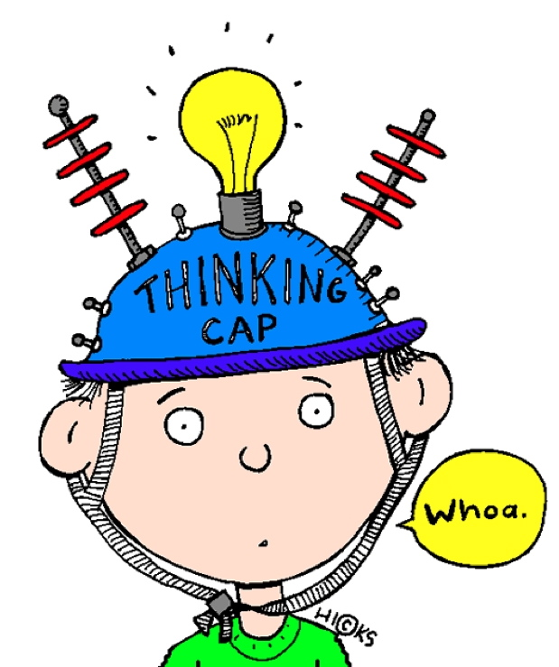
Learning Objective: To understand how power and power relationships shape our language use
What is verbal and non-verbal behaviour?
What is meant by ‘status’, ‘power’ and ‘powerlessness’?

Slide 13
Learning Objective: To understand how power and power relationships shape our language use
Get into pairs and carry out the tasks on your worksheet. Be prepared to act!

Slide 14
Learning Objective: To understand how power and power relationships shape our language use
Time to feed back your ideas...

Slide 15
Learning Objective: To understand how power and power relationships shape our language use
You are going to look at talk between staff in a branch of Sainsbury’s. Read the descriptions of the people you are going to watch and think about what you expect their power relationship to be. Give each a ranking out of 1-10, with 10 being the most powerful.
Jason, the manager: Jason started with Sainsbury’s 23 years ago collecting trolleys. He worked his way up and is now the well-respected manager of the Sydenham branch, the largest Sainsbury’s in the country. His store deals with 65,000 customers a week and he manages 800 staff.
Joseph, the trainee: Joseph has been with Sainsbury’s for less than a year. He works in a small convenience store with 8 other staff. His entry for an internal competition impressed head office so much that he is being given the chance to train to be a manager in only 3 weeks. This kind of fast-track scheme is only usually available to people who are deputy managers. The first part of his training involves spending two weeks at the Sydenham store, working with Jason.

Slide 16
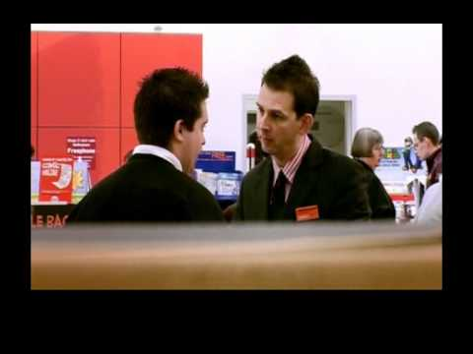
Learning Objective: To understand how power and power relationships shape our language use
Now watch the clips. You have been given a particular focus. Use your note sheet to help.
How is power expressed through verbal and non-verbal behaviour?
Joseph
Jason

Slide 17
Learning Objective: To understand how power and power relationships shape our language use
Non-verbal behaviour:
Facial expressions
Head movement (e.g. nodding, holding head to one side)
Eye gaze/ eye movement (Where is the person looking? Are they making eye contact with the person they are speaking to/listening to?)
Gestures
Posture
Tone of voice
Smiling/laughing
Verbal behaviour:
Who interrupts whom? Does the other person give way or keep talking?
Who speaks most? Who speaks at length while the other listens (holding the floor)? Who decides what is going to be talked about (agenda setting)?
Apologising
Who gives instructions, and how?
?

Slide 18
Learning Objective: To understand how power and power relationships shape our language use
How is the language chefs use affected by power and power relationships?

Slide 19
Learning Objective To understand how and why chefs use jargon

Slide 20
Learning Objective: To understand how and why chefs use jargon
What is jargon?
Why do people use it?
What effect does jargon have on those who don’t understand it?

Slide 21
Learning Objective: To understand how and why chefs use jargon
Complete the task on your worksheet, listing the specialist language – or jargon – used by these groups.
Be prepared to share your ideas.

Slide 22
Learning Objective: To understand how and why chefs use jargon
Why might chefs use specialist language?
Who might this language include?
Who might it exclude?

Slide 23
Learning Objective: To understand how and why chefs use jargon
Why might chefs use specialist language?
Chefs need to talk about a huge variety of different foods and cooking techniques – jargon helps them to be precise
Shows expert knowledge – others will respect this
Can help avoid confusion when giving instructions
Chefs tend to be perfectionists
This is a profession, so they need to know the right terms

Slide 24
Learning Objective: To understand how and why chefs use jargon
Homework: semantic fields
A semantic field is the typical words, phrases and terms associated with an area of life, e.g. a particular job. This includes jargon.
What is the semantic field of chefs? Come up with as many examples of words and phrases as you can.

Slide 25
Learning Objective To understand how gender shapes our language use

Slide 26
Learning Objective: To understand how gender shapes our language use
What is the difference between sex and gender?

Slide 27
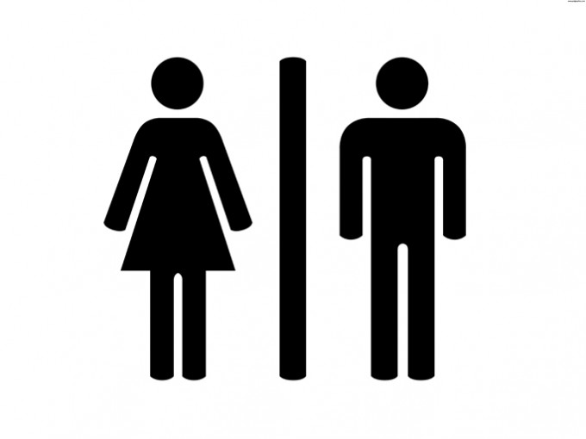
Learning Objective: To understand how gender shapes our language use
Sex = biological differences between men and women
Gender = the kinds of behaviour or characteristics we expect of someone based on their sex

Slide 28
Learning Objective: To understand how gender shapes our language use
Do you think there’s a difference between the way men and women talk?

Slide 29
Learning Objective: To understand how gender shapes our language use
A lot of research has been done on male and female talk, particularly in the 1970s, sometimes leading to some sweeping assumptions about differences between the way men and women talk.
On your worksheet, there are some assumptions commonly made about male and female talk. Do you agree with them?

Slide 30
Learning Objective: To understand how gender shapes our language use
Do you agree?
Women choose to talk about more personal or emotional topics.
Men swear more.
Men are more competitive in conversation.
Men use insults more, especially when talking to other men.
Men interrupt women more than the other way round.
Women ask more questions of the person they are speaking to.
Women give more verbal and non-verbal feedback when listening, e.g. by raising eyebrows, smiling, nodding, or saying ‘mm’, ‘uh-huh’, or ‘yeah’.
Women use more hedges, or words which make them sound less certain, such as ‘sort of’, ‘like’, ‘kind of’.
Men use more humour when talking to each other.
In conversation between a woman and a man, the man tends to talk more.

Slide 31
Learning Objective: To understand how gender shapes our language use
What assumptions might we have about the way chefs’ language use is affected by gender?

Slide 32
Learning Objective To set the context for our language study, considering power, jargon and gender

Slide 33
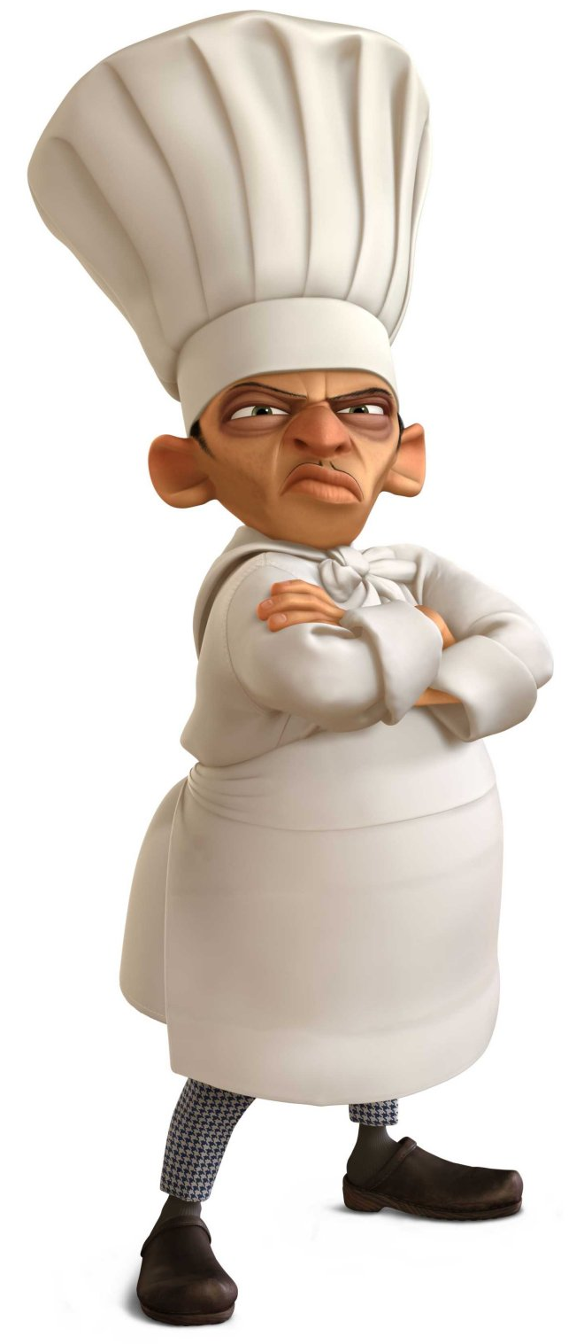
Learning Objective: To set the context for our language study, considering power, jargon and gender
What is a chef?
Highly skilled professional proficient in all areas of food preparation
The ‘head’ of the kitchen
Must be aware of all things happening at all times
In charge of:
Menu creation
Management of kitchen staff
Ordering and purchasing of inventory
Plating design
Budgeting
Responsible for the food that comes out of the kitchen
Doesn’t usually cook

Slide 34
Learning Objective: To set the context for our language study, considering power, jargon and gender
Social Attitudes: what stereotypes of chefs exist?
Draw a ‘typical’ chef in your book and label your drawing with the characteristics you expect a chef to have.
What type of language do you expect them to use? Try to consider power, gender, jargon etc.

Slide 35
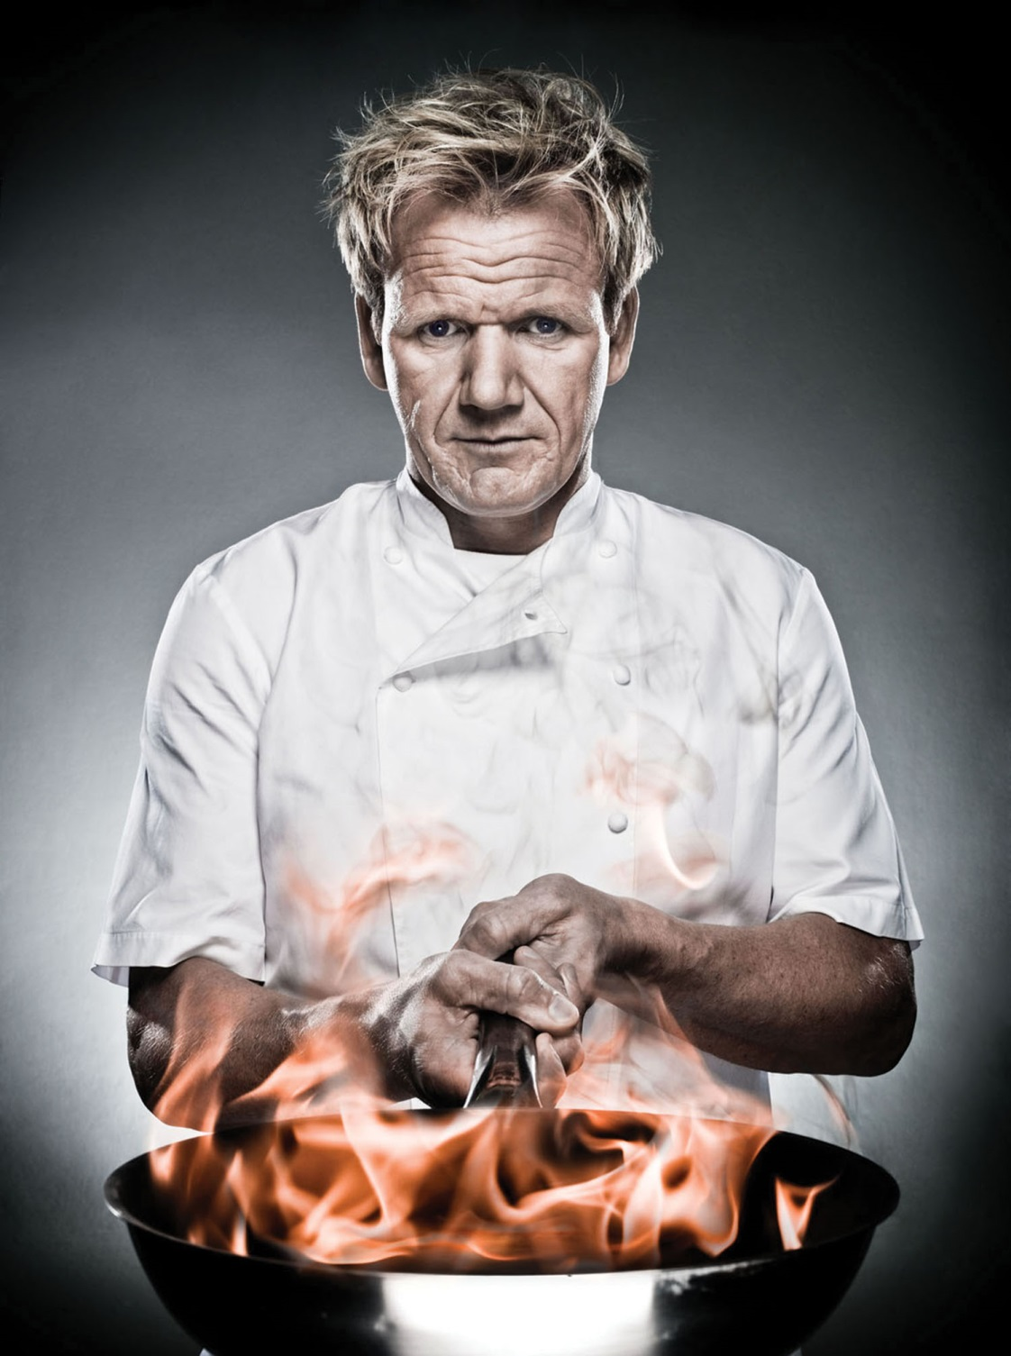
Learning Objective: To set the context for our language study, considering power, jargon and gender
What is Gordon Ramsay known for?

Slide 36
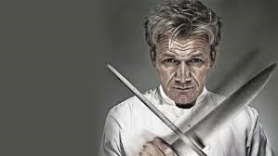
How does Gordon Ramsay use language to show his disrespect for the owner and respect for the kitchen staff?
Learning Objective: To set the context for our language study, considering power, jargon and gender

Slide 37
Am I seeing right? You’ve got a three burner wok there (2.0) Is that a pizza oven?
Learning Objective: To set the context for our language study, considering power, jargon and gender

Slide 38
Shelley (1.0) how can you cook soul food in a wok?
Learning Objective: To set the context for our language study, considering power, jargon and gender

Slide 39
Tell me what’s working (.) apart from you
Learning Objective: To set the context for our language study, considering power, jargon and gender

Slide 40
I mean this (.) is a joke
Learning Objective: To set the context for our language study, considering power, jargon and gender

Slide 41
How does he show his authority and earn respect from the viewers at home?
Learning Objective: To set the context for our language study, considering power, jargon and gender

Slide 42
First off (.) get your roasting tray
Learning Objective: To set the context for our language study, considering power, jargon and gender

Slide 43
Put your tray on the gas (.) pork ribs 60% meat (.) 35 40% fat
Learning Objective: To set the context for our language study, considering power, jargon and gender

Slide 44
Give them a really good season (1.0) salt (1.0) and pepper
Learning Objective: To set the context for our language study, considering power, jargon and gender

Slide 45
And the nice thing about this cut is that they stays incredibly moist when you cook them (1.0) on the bone (1.0) and the longer you cook them (.) the more delicious they become
Learning Objective: To set the context for our language study, considering power, jargon and gender

Slide 46
And I really want that nice sort of caramelisation taking place on the pork
Learning Objective: To set the context for our language study, considering power, jargon and gender

Slide 47
Ginger (2.0) you can’t beat fresh ginger with sticky pork ribs
Learning Objective: To set the context for our language study, considering power, jargon and gender

Slide 48
Place it down nice and firmly and (.) slice (2.0) the thinner you slice the ginger (.) the more fragrant the ribs (1.0) garlic
Learning Objective: To set the context for our language study, considering power, jargon and gender

Slide 49
Don’t rush it (1.0) turn them over (1.0) that’s what I want
Learning Objective: To set the context for our language study, considering power, jargon and gender

Slide 50
Braising is just a chef’s term for cooking something slowly in liquid
Learning Objective: To set the context for our language study, considering power, jargon and gender

Slide 51
How does Gordon Ramsay use language to show his disrespect for the owner and respect for the kitchen staff?
Learning Objective: To set the context for our language study, considering power, jargon and gender

Slide 52
Am I seeing right? You’ve got a three burner wok there (2.0) Is that a pizza oven?
Learning Objective: To set the context for our language study, considering power, jargon and gender
Questions: he’s asking what kitchen equipment is, but he knows what a pizza oven is… He’s trying to show his shock and disbelief. He’s trying to make the owner justify herself.

Slide 53
How does Gordon Ramsay use language to show his disrespect for the owner and respect for the kitchen staff?
Q
Gordon Ramsay asks the restaurant owner questions to show his power over her and disrespect for her. He asks, “Am I seeing right?... Is that a pizza oven?” Being a famous and successful chef, the viewers would expect that he would know what a pizza oven looks like, but he is not asking because he doesn’t know, he is asking because he can’t believe what he is seeing. He is shocked. By asking the questions, he is also making the restaurant owner justify herself and explain why she has that equipment. This shows that he is challenging her and doesn’t respect how she runs her restaurant.
W
E
R
T
Y

Slide 54
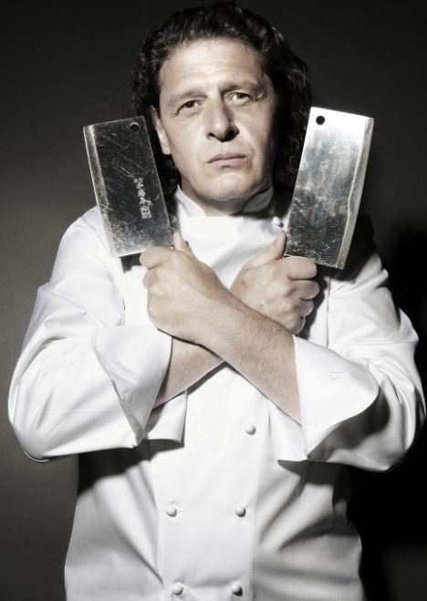
Learning Objective: To set the context for our language study, considering formality, power, jargon and gender
Marco Pierre White
Noted for his contributions to international cuisine and exceptional culinary skills
The first ‘celebrity chef’ (dubbed the ‘Godfather’ of modern cooking)
Youngest chef (at the time) to be awarded three Michelin stars
Trained Gordon Ramsey, Heston Blumenthal and other high profile chefs
Regularly ejected patrons from his restaurant if he didn’t like their comments - when a customer asked if he could have a side order of chips with his lunch, White hand-cut and personally cooked the chips but charged the customer £25 for his time

Slide 55
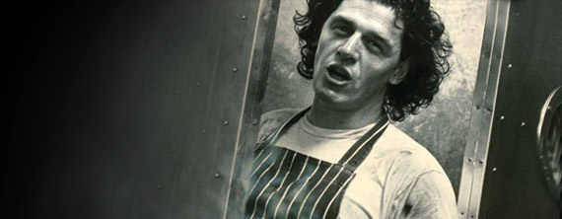
Learning Objective: To set the context for our language study, considering formality, power, jargon and gender
Does he fulfil your expectations of a ‘typical’ chef? Why?
What type of language do you expect him to use?

Slide 56
Learning Objective: To set the context for our language study, considering power, jargon and gender
1. Context
For each clip, write a short paragraph/some notes on context.
‘Where’s my crab?’
What situation is the chef in?
What is the purpose of his speech?
Who is he speaking to?
How does this fit your expectations?
‘Spanish omelette’
What situation is the chef in?
What is the purpose of his speech?
Who is he speaking to?
How does this fit your expectations?

Slide 57
Learning Objective: To set the context for our language study, considering power, jargon and gender
1. Context
For each clip, write a short paragraph/some notes on context.
‘Where’s my crab?’
Professional kitchen but for entertainment show. Expectation of audience but does not talk to them directly.
‘Spanish omelette’
‘Home cooking’ atmosphere, with expectation of an audience who are cooking along at home. More personal. Talking directly to audience.

Slide 58
Learning Objective: To set the context for our language study, considering power, jargon and gender
2. Power and power relationships
Who do we expect to have the power/higher status in each context given?
Who displays this power/higher status?
How?
Using the transcripts to help you, note down as many verbal and non-verbal traits that show power as you can.
Is this what you expected? Why/why not?

Slide 59
Learning Objective: To set the context for our language study, considering power, jargon and gender
Transcript key:
| = people talking at the same time
(.) = brief pause
Number notes amount of seconds within pause
? = voice raised at the end of the sentence as a question has been asked
We are going to make some notes on your copy of the transcript for each clip. Make sure you write down everything we mention/talk about. You will need to be able to write about these observations in the controlled assessment.

Slide 60
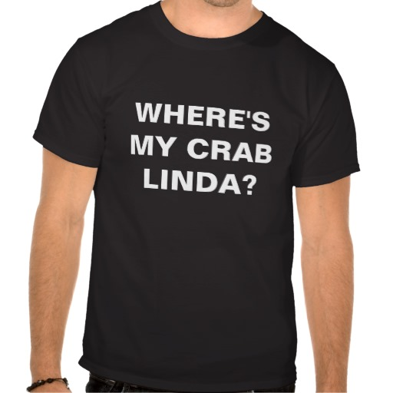
Learning Objective: To set the context for our language study, considering power, jargon and gender
Transcript #1:
‘Where’s my crab?’

Slide 61
Learning Objective: To set the context for our language study, considering formality, power, jargon and gender- Transcript 1: Marco Pierre White (MPW), Linda (L) and Miss Dynamite (MD)
Pauses = ‘floor holding’; everyone is kept waiting for details
MPW: first order (2) two crab (1) turbot Ade (1) two crab (1) in one minute (2) season nicely (1) present nicely (1)
MD: shall I help her do the crab?
MPW: do you want to win this competition?
MD: yeah |
MPW: then let her sink |
imperatives
she sees him as the authority- asks permission
she imperative ‘let’ suggests an order; ‘then’ implies a logical outcome
Powerful stance: he has his hands on his hips

Slide 62
Learning Objective: To set the context for our language study, considering power, jargon and gender- Transcript 1: Marco Pierre White (MPW), Linda (L) and Miss Dynamite (MD)
(inaudible talking from contestants in the kitchen)
MPW: more bread
This is a fragment of a sentence – he is simply shouting a noun (“bread”) but the implied understanding from the rest of the kitchen that he wants more bread turns it into an imperative; this shows his power and status.
[‘Can I have more bread?’ would undermine this power- there is no option offered.]

Slide 63
Learning Objective: To set the context for our language study, considering power, jargon and gender- Transcript 1: Marco Pierre White (MPW), Linda (L) and Miss Dynamite (MD)
MPW: one parfait (1) one crab two shrimp
MD: yes Marco |
MPW: Linda? |
L: yes
MPW: what did I say?
Use of Linda’s name to direct his question to her- he is singling her out of the team; isolates her linguistically by using her name then directing the question at her. This shows his power over her.
Use of question to isolate her; assuming she hasn’t listened/understood. He is about to correct her misunderstanding, showing his status.

Slide 64
Learning Objective: To set the context for our language study, considering power, jargon and gender- Transcript 1: Marco Pierre White (MPW), Linda (L) and Miss Dynamite (MD)
‘but’ implies he is disagreeing with her; he is pointing out her mistake
L: You have one crab coming
MPW: but that’s on order this is away |
L: oh |
oh this is away
MPW: so you need another one |
L: oh |
Non verbal: he points to emphasise what he is saying
“so” suggests logic – he is clarifying her mistake; he is the authority

Slide 65
Learning Objective: To set the context for our language study, considering formality, power, jargon and gender- Transcript 1: Marco Pierre White (MPW), Linda (L) and Miss Dynamite (MD)
imperatives
MPW: so stay there until it’s been three minutes I said three minutes when I’ve called then take it back (1) please do not confuse Linda
Repetition: “I said three minutes” – he is talking about what he has said (meta-linguistic), emphasising the status of what he is saying.
“please” – first incidence of polite language but also patronising so face threatening; he is undermining Linda.
Non-verbal displays of power:
(i) tone of voice (shouting – doesn’t change tone of voice even when talking close up to MD – implies control)
(ii) frequent pauses for attention; the pacing of his voice implies control
(iii) he physically paces the room, also emphasising his control of the room
(iv) his head-dress is also a symbol of status/power

Slide 66
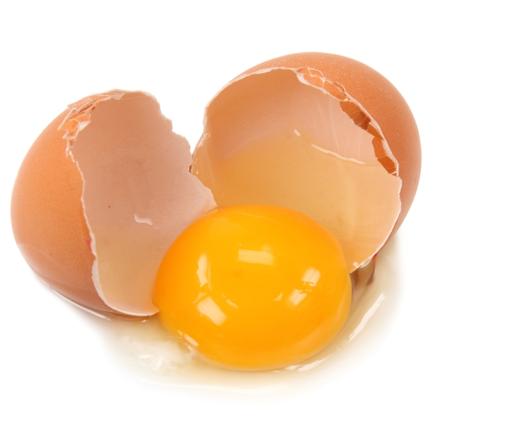
Learning Objective: To set the context for our language study, considering power, jargon and gender
Transcript #2:
Spanish omelette

Slide 67
Learning Objective: To set the context for our language study, considering power, jargon and gender- Transcript 2: Marco Pierre White (MPW)
MPW: what I’m gonna make now is one of my favourite things to eat is a tortilla or a Spanish omelette.
“gonna” = a more informal use of language; home cook context versus professionalism of other clip. MPW relates to it personally (“one of my favourite things”) this makes it less formal- shifts context from professional to home kitchen.
This reduction in formality is more attractive for a wider audience and means less of a focus on MPW’s own power. He is not trying to catch anyone out; he wants to make his cooking accessible.

Slide 68
Learning Objective: To set the context for our language study, considering power, jargon and gender- Transcript 2: Marco Pierre White (MPW)
basically all it is is potatoes onions and eggs (.) it’s not as simple as it looks but it is simple (.) you know, a few trial and errors and you’ll get there in the end
“basically” implies simplicity (adverb) “all it is” implies it is simple, not complicated etc.
“you know” – relates to audience; involves and enables audience
However: “it’s not a simple as it looks” – doesn’t want to put people off but doesn’t want it to look too easy (he is the expert!)
Links to “you’ll get there in the end”, suggesting this recipe is manageable for the audience
“you” = pronoun – targets the audience directly
(contrast to earlier context: errors are allowed here whereas they were not before)
“you will” = modal verb – shows his certainty that they will achieve it; his authority is to be trusted

Slide 69
Learning Objective: To set the context for our language study, considering power, jargon and gender- Transcript 2: Marco Pierre White (MPW)
we gotta peel the potatoes (4) (sight and sound of potatoes being peeled) there’s no recipe (.) it’s just (.)
“we” = plural pronoun - implies him and viewing audience (nobody else is visible in the kitchen) so a sense of working together.
MPW looks off camera rather than into it (does he not want to relate too much to the audience? Is it less intrusive?)
It is as if he’s at home being filmed; although he does have a professional pinny on to stress professionalism – no headdress so not as intimidating. Is this also why he doesn’t look down the camera? He is identifying his authority without imposing his powerful status on the audience.
“just” – minimiser to emphasise simplicity

Slide 70
Learning Objective: To set the context for our language study, considering power, jargon and gender- Transcript 2: Marco Pierre White (MPW)
let’s have a guess (.) sometimes you get it right, sometimes you ged it wrong (.) I always tend to do more than I need (1) so then we gotta peel the onions (1) I reckon three onions is enough (.) just take some arachis oil or some sunflower oil (1) and I reckon (.) that’s about right (.) oh might as well put it all in there.
“oh might as well” deliberately makes this more casual and approximate to put viewer at ease
Approximate with measurements/guidance “about” “let’s have guess” “I reckon” – this stresses his professional status and power (his judgement is right) but also it doesn’t have to be exact/ it is simple – the viewer feels they can also do this.
Contrast this with the precision of the previous context.
“I always tend to do more than I need” – personal experience, putting viewer at ease; close to admitting a mistake but in a safe context

Slide 71
Learning Objective: To set the context for our language study, considering power, jargon and gender- Transcript 2: Marco Pierre White (MPW)
so while that’s heating what we’re gonna do is jus’ (1) chop up our potatoes (.) not too thin not too thick but don’t wash them once you’ve peeled them and washed them never wash them again (2) and then just yer onions (2)
“we’re” “our” – inclusive pronoun; trust in his authority and help
“gonna” “jus’” = informal, making it sound simple
MPW continually balances his power and authority with a need for an inclusive, reassuring tone. Mistakes are okay here.
“never wash them again” – imperative, showing his power/expertise

Slide 72
Learning Objective: To set the context for our language study, considering power, jargon and gender- Transcript 2: Marco Pierre White (MPW)
they’re quite big things when they’re cooked, I mean, you’ll see (2) I reckon that’s about enough (.) let’s see (1) not hot enough yet (.) we’re gonna shallow fry the potatoes and the onions in there and you’ve gotta get it very hot for the simple reason is once you put that into there it takes a tremendous amount of heat out of it (.) so here goes.
This is MPW trying to relate to the audience. Compare this with the Hell’s Kitchen audience, watching for entertainment; here the audience is watching for information/education.
“you’ll see” = modal verb, implying a certainty that the audience will see that he is right.

Slide 73
Learning Objective: To set the context for our language study, considering power, jargon and gender- Transcript 2: Marco Pierre White (MPW)
Non-verbal features:
MPW uses the potato as a measure. This shows his status and professionalism (power) and ability to make a judgement, but in a simple way to include his audience
MPW’s pauses in Hell’s Kitchen were dramatic and floor-holding (i.e. about power) but here they are to enable him to comment on what he is doing (e.g. cutting onions)
He uses a lower tone of voice, more conversational, even though this is a monologue.
He uses his hands to emphasise points (e.g. “it’s quite big”); counts off points on his fingers; uses his arms and gestures to express simplicity or size – lots of open body language (compare this to his closed-off pacing in HK)

Slide 74
Learning Objective: To set the context for our language study, considering power, jargon and gender
3. Jargon
Chefs need to talk about a huge variety of different foods and cooking techniques – jargon helps them to be precise
Shows expert knowledge – others will respect this
Can help avoid confusion when giving instructions
Chefs tend to be perfectionists
This is a profession, so they need to know the right terms
Does Marco Pierre-White use jargon or specialist language in these clips?
Using the transcripts to help you, note down as many uses of jargon as you can. This includes any words in the semantic field of food.
Is this what you expected? Why/why not?

Slide 75
Learning Objective: To set the context for our language study, considering power, jargon and gender
Transcript #1:
‘Where’s my crab?’

Slide 76
Learning Objective: To set the context for our language study, considering power, jargon and gender- Transcript 1: Marco Pierre White (MPW), Linda (L) and Miss Dynamite (MD)
MPW: one parfait (1) one crab two shrimp
MD: yes Marco |
MPW: Linda? |
L: yes
MPW: what did I say?
jargon of parfait is part of the semantic field of food- fulfils expectations; French borrowing is standard

Slide 77
Learning Objective: To set the context for our language study, considering power, jargon and gender- Transcript 1: Marco Pierre White (MPW), Linda (L) and Miss Dynamite (MD)
L: You have one crab coming
MPW: but that’s on order this is away |
L: oh |
oh this is away
MPW: so you need another one |
L: oh |
jargon – ‘away’ & ‘on order’ have specific meanings

Slide 78
Learning Objective: To set the context for our language study, considering power, jargon and gender- Transcript 1: Marco Pierre White (MPW), Linda (L) and Miss Dynamite (MD)
MPW: so stay there until it’s been three minutes I said three minutes when I’ve called then take it back (1) please do not confuse Linda
“do not confuse” is a reference to his use of jargon. He expects the others to understand it; Linda doesn’t so he clarifies but humiliates her when he does so, showing off his authority. Jargon is used to exclude Linda and show his own power/knowledge.

Slide 79
Learning Objective: To set the context for our language study, considering power, jargon and gender
Transcript #2:
Spanish omelette

Slide 80
Learning Objective: To set the context for our language study, considering power, jargon and gender- Transcript 2: Marco Pierre White (MPW)
MPW: what I’m gonna make now is one of my favourite things to eat is a tortilla or a Spanish omelette.
Jargon of ‘tortilla’ but gives more familiar option of ‘spanish omelette’ for a wider audience.

Slide 81
Learning Objective: To set the context for our language study, considering power, jargon and gender- Transcript 2: Marco Pierre White (MPW)
let’s have a guess (.) sometimes you get it right, sometimes you ged it wrong (.) I always tend to do more than I need (1) so then we gotta peel the onions (1) I reckon three onions is enough (.) just take some arachis oil or some sunflower oil (1) and I reckon (.) that’s about right (.) oh might as well put it all in there.
Jargon of ‘arachis oil’ (peanut oil) but gives more familiar option of ‘sunflower oil for a wider audience. Jargon stresses his professionalism but he is careful not to make it exclusive; by allowing alternatives he makes sure his audience can all understand.

Slide 82
Learning Objective: To set the context for our language study, considering power, jargon and gender
4. Gender
Did you expect Marco Pierre-White to display any stereotypical male traits in his language use?
Using the transcripts to help you, note down as many verbal and non-verbal traits that are linked to gender as you can. Is this what you expected? Why/why not?

Slide 83
Learning Objective: To set the context for our language study, considering power, jargon and gender
Transcript #1:
‘Where’s my crab?’

Slide 84
Learning Objective: To set the context for our language study, considering power, jargon and gender- Transcript 1: Marco Pierre White (MPW), Linda (L) and Miss Dynamite (MD)
(inaudible talking from contestants in the kitchen)
MPW: more bread
This directness and brevity is a characteristic of male speech
Also note:
Frequent use of ‘so’, ‘but’ and ‘then’ to imply logic, a quality stereotypically associated with men
Non-verbal:
MPW’s stance (hands on hips, hands behind back) and pacing of the room is typically ‘male’, expressing confidence and power.

Slide 85
Learning Objective: To set the context for our language study, considering power, jargon and gender
Transcript #2:
Spanish omelette

Slide 86
Learning Objective: To set the context for our language study, considering power, jargon and gender- Transcript 2: Marco Pierre White (MPW)
they’re quite big things when they’re cooked, I mean, you’ll see (2) I reckon that’s about enough (.) let’s see (1) not hot enough yet (.) we’re gonna shallow fry the potatoes and the onions in there and you’ve gotta get it very hot for the simple reason is once you put that into there it takes a tremendous amount of heat out of it (.) so here goes.
He means the omelette – link to power/masculinity (making something substantial not fancy)

Slide 87
Learning Objective: To set the context for our language study, considering power, jargon and gender
Spoken Language Study: Explore some of the ways Marco Pierre White adapts his spoken language in different work contexts.
Look at both contexts and MPW’s language use:
How are they similar? How are they different?
Why are they similar? Why are they different?
Pick out examples of different language use, analyse these, and explain why they have occurred.
Consider the different contexts, purposes and pressures.
Do they fit our expectations of chefs’ language?

Slide 88
Learning Objective: To set the context for our language study, considering power, jargon and gender
Spoken Language Study: Explore some of the ways Marco Pierre White adapts his spoken language in different work contexts.
Make sure your notes are complete and start to plan for your CA. Use the handout to help you.
Remember, you can have your clean transcripts with you during the CA, but not your annotated ones. You will have to put any notes on your planning sheet.

Slide 89
Controlled Assessment Tasks for GCSE English Language Unit 3 part c:
Spoken Language Study
You will have up to 2 hours controlled assessment time
Aim to write 3 sides of A4
The piece is worth 10% of your English Language GCSE
AO2 Candidates should be able to:
(i) understand variations in spoken language, explaining why language changes in relation to contexts
(i.e., why spoken language alters according to things like people you are with, person being spoken to, place, situation, purpose, mood)
(ii) evaluate the impact of spoken language choices in their own and others’ use
(i.e., the various possible responses people might make to spoken language in different situations)

Slide 90
Learning Objective To plan for your controlled assessment

Slide 91
Controlled Assessment Tasks for GCSE English Language Unit 3 part c:
Spoken Language Study
You will have up to 2 hours controlled assessment time
Aim to write 3 sides of A4
The piece is worth 10% of your English Language GCSE
AO2 Candidates should be able to:
(i) understand variations in spoken language, explaining why language changes in relation to contexts
(i.e., why spoken language alters according to things like people you are with, person being spoken to, place, situation, purpose, mood)
(ii) evaluate the impact of spoken language choices in their own and others’ use
(i.e., the various possible responses people might make to spoken language in different situations)

Slide 92
Learning Objective: To plan for your CA
“explanation”
“exploration”
“confident”
“analysis and reflection”

Slide 93
Learning Objective: To plan for your CA
Spoken Language Study: Spoken Language Study: Explore some of the ways Marco Pierre White adapts his spoken language in different work contexts.
You will explore:
How his spoken language varies in different situations
Why his language changes in different contexts (e.g. who he is speaking to; where he is speaking; what purpose his speech has)
How he uses language for specific situations/effect – i.e. what is the specific purpose of his language?
What the stereotypes of chefs’ language use are and public attitudes to language in the kitchen – does he fit these stereotypes? Why? Why not?
The impact of the language used, i.e. what does it achieve? How does it affect those it is aimed at? Is it appropriate? Does it fit your expectations?

Slide 94
Learning Objective: To plan for your CA
Spoken Language Study: Spoken Language Study: Explore some of the ways Marco Pierre White adapts his spoken language in different work contexts.
Make sure your notes are complete and start to plan for your CA. Use the handout to help you.
Remember, you can have your clean transcripts with you during the CA, but not your annotated ones. You will have to put any notes on your planning sheet.

Slide 95
Learning Objective: To plan for your CA
Spoken Language Study: Spoken Language Study: Explore some of the ways Marco Pierre White adapts his spoken language in different work contexts.
Introduction – Explain what context each clip takes place in and how formal they are.
Main essay – choose at least three different language features to analyse. Explain how MPW uses these in each clip and why. Explain the different effects they have.
Conclusion – do these fit our attitudes and expectations of how a chef will speak? How do we respond to MPW’s use of language?

Slide 96
Learning Objective: To plan for your CA
Spoken Language Study: Explore some of the ways Marco Pierre White adapts his spoken language in different work contexts.
Feature of language | What effect does it have in ‘Where’s My Crab?’? | What effect does it have in ‘Spanish Omelette’?
Pauses | Purpose is floor holding – everyone must wait to hear what MPW is going to say. Stresses his power. | Purpose is social – MPW fills the gaps between instructions with irrelevant observations to reduce his power and include the viewing audience.

Slide 97
Feature of language | What effect does it have in ‘Where’s My Crab?’? | What effect does it have in ‘Spanish Omelette’?
Pauses Questions Jargon Sentence length Imperatives ‘But’ ‘so’ etc. Use of ‘we’ or ‘I’ Repetition Simplifiers or informal language Paralinguistic features (i.e. body language) Stereotype of gender Anything else...
Explore some of the ways Marco Pierre White adapts his spoken language in different work contexts.

Slide 98
Learning Objective: To plan for your CA
Spoken Language Study: Spoken Language Study: Explore some of the ways Marco Pierre White adapts his spoken language in different work contexts.
Introduction – Explain what context each clip takes place in and how formal they are.
Main essay – choose at least three different language features to analyse. Explain how MPW uses these in each clip and why. Explain the different effects they have.
Conclusion – do these fit our attitudes and expectations of how a chef will speak? How do we respond to MPW’s use of language?

