Slide 1
Language Unit 1 Exam Understanding and producing non-fiction texts: Section A – Reading Section B - Writing

Slide 2
Learning Objective To understand the format and overall structure of the writing section of the Unit 1 exam To understand what each question will ask of you

Slide 3
2 hour exam + 15 minutes reading time
1 hour on each section
60% of your GCSE grade
Mock exam at the end of this half term

Slide 4
Learning Objective: To understand the format and overall structure of the writing section of the Unit 1 exam
This half term, you will revise Section A skills, based on your performance in the mock exam and the targets you set for yourself.
You will also revise writing skills and practise for Section B, which requires you to write effectively and accurately.
What does this mean?
What styles of writing have you learned so far?

Slide 5
Learning Objective: To understand the format and overall structure of the writing section of the Unit 1 exam
Section B: Writing
1 hour.
You will be asked two questions and should answer them both.
Q5: Inform / explain / describe, based on personal details: 16 marks. 25 minutes.
Q6: Argue / persuade / create a viewpoint which must be sustained: 24 marks. 35 minutes.

Slide 6
Learning Objective: To understand the format and overall structure of the writing section of the Unit 1 exam
Assessment Objectives for Section B:
(i) Write to communicate clearly and effectively using and adapting forms and selecting VOCABULARY appropriate to task and purpose in ways that engage the reader.
(ii) Organise information and ideas into structured and sequenced sentences, PARAGRAPHS and whole texts, using a variety of structural features to support cohesion and overall coherence.
(iii) Use a range of SENTENCE STRUCTURES for clarity, purpose and effect, with accurate SPELLING and PUNCTUATION.
These are the same skills you have practised in your controlled assessments.

Slide 7
Make sure that you…
Show that you have understood the Type, Audience and Purpose for the writing
Use appropriate language, structure and presentational devices for the genre you have been given
Use appropriate and interesting vocabulary
Use a variety of appropriate connectives to link your ideas, sentences, and paragraphs
Use a variety of sentences effectively, varying your sentence openings
Make sure your work is accurate, using a full range of punctuation
Use paragraphs to help make your meaning clear

Slide 8
Learning Objective: To understand the format and overall structure of the writing section of the Unit 1 exam
Q5: Inform / explain / describe, based on personal details: 16 marks. 25 minutes.
10 marks – use of language and detail; writing appropriately for audience and purpose; use of paragraphs
6 marks – spelling, punctuation, and sentence structure; use of standard English

Slide 9
Learning Objective: To understand the format and overall structure of the writing section of the Unit 1 exam
Q6: Argue / persuade / create a viewpoint which must be sustained: 24 marks. 35 minutes.
16 marks – use of language and detail; writing appropriately for audience and purpose; use of paragraphs
8 marks – spelling, punctuation, and sentence structure; use of standard English

Slide 10
Learning Objective To revise and practise writing to inform, explain and describe (Q5)

Slide 11
Learning Objective: To revise and practise writing to inform, explain and describe (Q5)
Q5: Inform / explain / describe
How would you define each of these words?

Slide 12
Learning Objective: To revise and practise writing to inform, explain and describe (Q5)
Q5: Inform / explain / describe
How would you define each of these words?
Imagine Frazer and Megan have had a fight in the corridor outside G06.
Person/Pair A: you have to inform your table (then me) about the fight.
Person/Pair B: you have to describe the fight to your table (then me).
Person/Pair C: you have to explain why the fight happened.
Think carefully about the type of vocabulary you should use, as well as about audience and purpose.

Slide 13
Writing to inform
Learning Objective: To revise and practise writing to inform, explain and describe (Q5)
Purpose: to give details about something
(Hint: Who? What? Where? When? Why? How)
Structure: Paragraphs organised by topic, beginning with clear topic sentences
Language:
Clear and factual but lively!
Technical/specialist vocabulary
Third person/formal
Honest and trustworthy tone?

Slide 14
Writing to Inform = Giving the facts.
Learning Objective: To revise and practise writing to inform, explain and describe (Q5)
What FACTS can you tell me about these book covers?

Slide 15
Fact Finders
Learning Objective: To revise and practise writing to inform, explain and describe (Q5)
Watch the trailer for ‘The Hunger Games’ Film (we will watch it twice):
Listen carefully to find out:
The name of the lead character
The district he/she is from
Why the lead character is taking part in the games
What The Hunger Games are
How many people take part in the games
What ages the ‘tributes’ can be
The tagline of the film
When the film is out at the cinema

Slide 16
Writing to Inform
Learning Objective: To revise and practise writing to inform, explain and describe (Q5)
This means giving facts to another person.
Always think about TAPS:
Type – should it be instructions, a recipe, directions, a manual?
Audience – who is going to read it?
Purpose - to give unbiased information which is reliable and factual
Style - formal
Top Tips:
When writing to inform, make sure language is clear, factual and impersonal. Use short and clear sentences. Break up the writing with diagrams, illustrations, pictures and subheadings.

Slide 17
Learning Objective: To revise and practise writing to inform, explain and describe (Q5)
You MUST write a review of ‘The Hunger Games’ which informs nervous parents about the content of the film. This is to help them decide whether or not to let their children go to the cinema. (It is rated )
You SHOULD include facts which will inform the parents about the characters, plot and themes.
You COULD include facts about the nature of the games which the characters have to take part in.
Tip: you SHOULD NOT include your opinion of the film.
First, run the TAPS:
T
A
P
S
SS: The Hunger Games is a film about……starring…..

Slide 18
‘The Hunger Games’: Introduction
Learning Objective: To revise and practise writing to inform, explain and describe (Q5)
The film is set in a place called Panem. Panem is split into 12 districts. Every year, each district must choose two tributes at random (one boy, one girl) to take part in the games. ‘The Hunger Games’ is a film about a young girl called Katniss Everdeen. She is chosen to take part in ‘The Hunger Games’ as a tribute for District 12. After the tributes names are drawn out of a bowl they are taken from their homes to compete...

Slide 19
Learning Objective: To revise and practise writing to inform, explain and describe (Q5)
Swap your book with your partner.
Has your partner:
Used short and clear sentences?
Have they remained unbiased (no opinions)?
Included facts from the trailer?
Used a formal style?
Considered their audience (nervous parents)?
Bearing this in mind, you are going to give your partner a mark out of 10 for AO (i) and (ii). The mark scheme is on the next slide. Ready?

Slide 20
Learning Objective: To revise and practise writing to inform, explain and describe (Q5)
Peer-assess: which band and why? Target?

Slide 21
Learning Objective: To revise and practise writing to inform, explain and describe (Q5)
Peer-assess: what about AO (iii)? Which band and why? Target?

Slide 22
Writing to explain
Learning Objective: To revise and practise writing to inform, explain and describe (Q5)
Purpose: giving more than details about something; justify and give the reason
(Moving into analysis)
Structure: Paragraphs (open and then give evidence)
Sequential/logical order
Language:
Connectives to show sequence, cause and effect
Technical/specialist vocabulary
Clear and authoritative in tone
Personal (emotional/subjective) OR factual and balanced

Slide 23
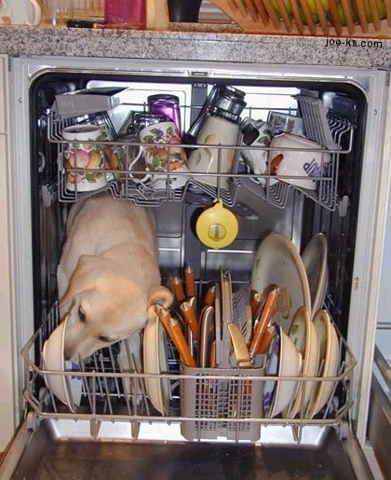
Writing to Explain
Learning Objective: To revise and practise writing to inform, explain and describe (Q5)
Giving facts but with EXTRA DETAILS
Explain how this dog came to be inside this dishwasher. You MUST give reasons.
SS: The dog is inside the dishwasher because…

Slide 24
Learning Objective: To revise and practise writing to inform, explain and describe (Q5)
Writing to explain is like writing to inform, but with extra. You still need to include the facts, but you also need to:
Give reasons
Break down the topic in more detail
Be either balanced and factual or emotional and subjective – but not both!
Use evidence to support your points
Use connectives
Consider your audience

Slide 25
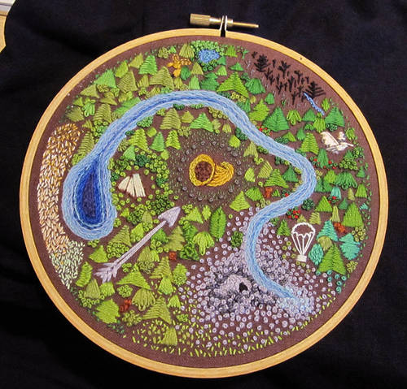
Learning Objective: To revise and practise writing to inform, explain and describe (Q5)
...The Hunger Games Arena
Tall trees
Cornucopia
River
Parachutes
Berry field
Caves

Slide 26
Learning Objective: To revise and practise writing to inform, explain and describe (Q5)
This is where the games begin. The yellow shape on the map is called the Cornucopia – it is full of food and weapons. This is when the most number of contestants are killed at one time as they all fight over the goods.
This is the river – it is your ONLY source of water in the Arena. You can also catch fish here. Beware, you are very visible to others here.
The trees are very high – if you are a good climber you could hide up them for days and watch out for enemies.

Slide 27
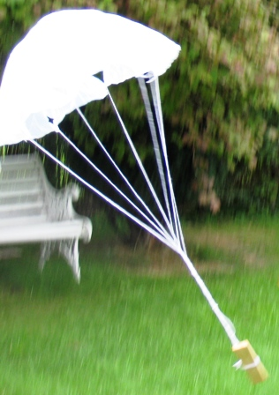
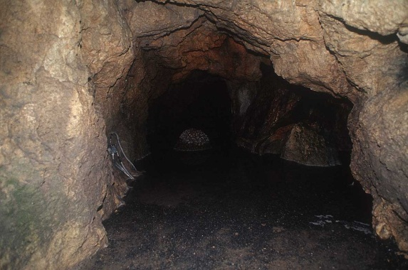
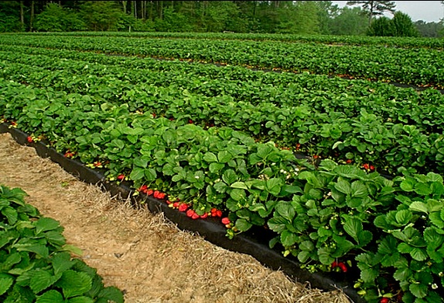
Learning Objective: To revise and practise writing to inform, explain and describe (Q5)
Each contestant has a sponsor who will give them supplies. They will only be given the supplies if the sponsor thinks they are playing the game well…
These are the caves. They will provide good shelter but if you stay here it will be difficult for you to spot other contestants who are on their way to kill you.
These are the fields where you can find berries to eat. Be careful though as some are poisonous.

Slide 28
Learning Objective: To revise and practise writing to inform, explain and describe (Q5)
Each contestant in the Hunger Games has a coach who helps them to win. You MUST write a guide in which you explain to Katniss how to survive the Hunger Games.
You SHOULD base your guide on the different parts of the arena and explain why Katniss should trust your judgement.
(e.g. you should hide in the caves because this will offer you shelter..)
You COULD split the guide into different survival sections (food, shelter, weapons)
Top Tips:
Give reasons
Break down the topic in more detail
Be either balanced and factual or emotional and subjective – but not both!
Use evidence to support your points
Use connectives
Consider your audience
SS: The first thing to do when entering the arena is….

Slide 29
Learning Objective: To revise and practise writing to inform, explain and describe (Q5)
Swap your book with your partner.
Has your partner:
Given reasons?
Broken down the topic in more detail?
Been either balanced and factual or emotional and subjective – but not both!
Used evidence to support his or her points?
Used connectives?
Considered his or her audience (Katniss)?
Bearing this in mind, you are going to give your partner a mark out of 10 for AO (i) and (ii). The mark scheme is on the next slide. Ready?

Slide 30
Learning Objective: To revise and practise writing to inform, explain and describe (Q5)
Peer-assess: which band and why? Target?

Slide 31
Learning Objective: To revise and practise writing to inform, explain and describe (Q5)
Peer-assess: what about AO (iii)? Which band and why? Target?

Slide 32
Writing to describe
Learning Objective: To revise and practise writing to inform, explain and describe (Q5)
Purpose: to paint a picture in words, to make something real for the reader
Structure: Paragraphs which cover different areas of the description
Language:
Adjectives and adverbs
Use of verbs to give power and movement
Imagery
Variety of sentence length and structure
Appealing to reader’s different senses

Slide 33
Learning Objective: To revise and practise writing to inform, explain and describe (Q5)
How would you describe this image?
EXT: write a simile to describe the colours.

Slide 34
Writing to Describe
Learning Objective: To revise and practise writing to inform, explain and describe (Q5)
When writing to describe, use:
Adjectives: "He wore a sparkly jacket".
Similes:"He is acting like a fool,"
Metaphors:"That girl is a star".
Most importantly, appeal to the readers' senses:
What does it look like?
What does it feel like?
What does it sound like?
What does it smell like?
What does it taste like?

Slide 35
Adverbs
Learning Objective: To revise and practise writing to inform, explain and describe (Q5)
Adverbs are describing words.
In pairs, create a list of adverbs which could be used to describe the following:
Running
Crying
Climbing
Speaking
Looking
Waiting
Top Tip:
Adverbs often end in ‘ly’
e.g. calmly

Slide 36
Learning Objective: To revise and practise writing to inform, explain and describe (Q5)
Imagine you are Katniss.
You are standing in the woods near the edge of the arena.
Use your SENSES to describe your surroundings.
(see, hear, feel, smell, taste)

Slide 37
Learning Objective: To revise and practise writing to inform, explain and describe (Q5)
Use a simile to describe the expression on Katniss’ face.

Slide 38
Learning Objective: To revise and practise writing to inform, explain and describe (Q5)
Katniss enters the arena via a plastic tube. She has to wait on her spot for 30 seconds before either a) fighting for supplies at the cornucopia or b) grabbing something nearby and running to the woods…..
Katniss decides to grab a backpack and run away….

Slide 39
Learning Objective: To revise and practise writing to inform, explain and describe (Q5)
onomatopoeia
simile
The rain beat down like a drum. It left pools on the ground like mysterious, ever increasing crop circles. It felt as if the world was going to be washed away. The stormy sky had darkened to inky black.
metaphor
simile
alliteration
simile
power word

Slide 40
Learning Objective: To revise and practise writing to inform, explain and describe (Q5)
Let’s put it all together...
You MUST write 3 paragraphs to describe Katniss’ arrival in the arena.
You SHOULD use the senses and adjectives to describe how she feels, and her surroundings.
You COULD use similes and metaphors to describe the scene.
SS: As I stand on the podium, waiting for the gong, all I can think is……

Slide 41
Learning Objective: To revise and practise writing to inform, explain and describe (Q5)
Let’s do some green pen marking of your description...
1. Vocabulary
Review your use of language.
verbs
adjectives
nouns
alliteration
metaphors and similes
sense descriptions
imagery

Slide 42
Use this bank of connectives to link your sentences together as paragraphs... And then structure your paragraphs together into a coherent text...
2. Structure - connectives
For example | Therefore | So | Consequently | As a result
In contrast | Similarly | For instance | On the other hand | First(ly)
Second(ly) | Last(ly) | Finally | To begin with | At the outset
But | Still | However | Nevertheless | Yet
On the contrary | In spite of this | In other words | Rather | Moreover
Furthermore | What is more | In addition | …also.. | Naturally
Of course | Certainly | Strangely enough | Oddly enough | Luckily
Admittedly | (Un)fortunately | Undoubtedly | Finally | In conclusion

Slide 43
2. Structure - openings
Learning Objective: To revise and practise writing to inform, explain and describe (Q5)
If you vary how you open your sentences, you will automatically vary the different sentence types you use... And get a higher grade!

Slide 44
Change some of your sentence openers using the following…
AN ‘ED’ WORD
Exhausted, the man slumped onto the chair.
AN ‘ING’ WORD
Looking through the window, the girl gazes out at the world.
A CONNECTIVE (LINKING WORD)
Because he has been wounded, the soldier lies on the battlefield beneath the rearing horses.
A SUBORDINATE CLAUSE
As it was every day, the train was jam packed with commuters.
AN ADVERB (USUALLY ENDS IN –LY)
Hurriedly turning away, the man shoves the money into his pocket.
A PREPOSITIONAL PHRASE (IN, ON, THROUGH, UNDER, BEHIND)
Underneath the tree, two men are deep in discussion.

Slide 45
3. Punctuation
Learning Objective: To revise and practise writing to inform, explain and describe (Q5)
Do you know what each of these punctuation marks does... And how you could use it?
. , ? ! ... ; : ’ “ ” ( ) -
Try to include some of these punctuation marks in your work...

Slide 46
Learning Objective: To revise and practise writing to inform, explain and describe (Q5)
Have you improved your descriptive writing?
Is the first word of your writing ‘the’ or ‘this’?
Is the second word of your writing a noun (naming word)?
Is the third word of your writing ‘is’?
Is your writing in more than one section or paragraph?
Have you used ‘and’ or ‘but’ more than three times?
Have you used a range of sentence openers?
Have you used a range of interesting vocabulary?
Have you used a range of connectives?
Have you used a range of punctuation?

Slide 47
Learning Objective: To revise and practise writing to inform, explain and describe (Q5)
Peer-assess: which band and why? Target?

Slide 48
Learning Objective: To revise and practise writing to inform, explain and describe (Q5)
Peer-assess: what about AO (iii)? Which band and why? Target?

Slide 49
Learning Objective To have a go at an exam question under exam conditions (Q5)

Slide 50
Learning Objective: To have a go at an exam question under exam conditions (Q5)
A new website called Outdoor Exploring for Kids has just been set up.
Write a short article for the website describing a place you have explored and the most interesting thing you found there.
Remember to:
• write an article
• use language to describe
Try to write approximately one side of your answer booklet.
Write the question into your exercise book and underline or highlight any key words.
What do you need to do to answer this question successfully?
Let’s plan together...

Slide 51
Learning Objective: To have a go at an exam question under exam conditions (Q5)
A new website called Outdoor Exploring for Kids has just been set up.
Write a short article for the website describing a place you have explored and the most interesting thing you found there.
Remember to:
• write an article
• use language to describe
Try to write approximately one side of your answer booklet.
You have 25 minutes to write your answer.

Slide 52
Learning Objective: To have a go at an exam question under exam conditions (Q5)
Self-assess: which band and why? Target?

Slide 53
Learning Objective: To have a go at an exam question under exam conditions (Q5)
Self-assess: what about AO (iii)? Which band and why? Target?

Slide 54
Learning Objective To revise and practise writing to argue and persuade (Q6)

Slide 55
Learning Objective: To revise and practise writing to argue and persuade (Q6)
Q6: Argue / persuade / create a viewpoint which must be sustained: 24 marks. 35 minutes.
16 marks – use of language and detail; writing appropriately for audience and purpose; use of paragraphs
8 marks – spelling, punctuation, and sentence structure; use of standard English

Slide 56
Learning Objective: To revise and practise writing to argue and persuade (Q6)
Q6: Argue / persuade / create a viewpoint
How would you define each of these words?

Slide 57
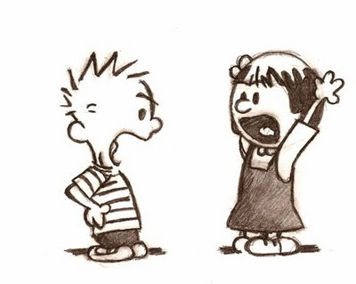
Learning Objective: To revise and practise writing to argue and persuade (Q6)
The word argument suggests an animated disagreement - but a written argument is rather different. It requires that you...
put forward a clearly stated and well-considered point of view;
provide support for this view;
create a sense of balance by referring to other equally valid points of view;
tactfully counter these
Your aim in this kind of writing is not necessarily to 'win' the argument; instead, it is to put forward evidence that is logical and
well-considered and which acts to support your point of view and to
counter the main alternative views.

Slide 58
Learning Objective: To revise and practise writing to argue and persuade (Q6)
Although
If
While/whilst
Unless
Even though
Words for arguing:

Slide 59
Learning Objective: To revise and practise writing to argue and persuade (Q6)
You use these words to argue against the main viewpoint given.
Statement: Fast food is bad for your health.
Although fast food is said to be unhealthy, if it is eaten in moderation it doesn’t affect our health.
While fast food can be unhealthy if eaten too often, it is totally harmless when eaten in moderation.
Fast food is harmless, unless you eat too much.
Even though fast food can be bad for your health, it is safe if eaten in moderation.

Slide 60
Let’s take it step by step...
Learning Objective: To revise and practise writing to argue and persuade (Q6)
Type?
Audience?
Purpose?
Write an article for The Student Speaker in which you argue either for or against Educating Cumbria being filmed at Keswick School.

Slide 61
Step 1: collecting ideas
Learning Objective: To revise and practise writing to argue and persuade (Q6)
Where might the cameras go?
What effect would they have on student behaviour?
What would be the benefits and drawbacks of our school being on TV?
Mind map your ideas.

Slide 62
Step 2: key points
Learning Objective: To revise and practise writing to argue and persuade (Q6)
List five or more key points that you want to make and number them.
List any arguments that could be made against what you want. Number these too.
Next to each argument for b) write down a response (or counter-argument) that you could use to overcome the problem.

Slide 63
For example:
Learning Objective: To revise and practise writing to argue and persuade (Q6)
a) Key Point | b) Arguments against | c) Counter-argument
Cameras in classrooms would be an invasion of our privacy. | Anyone who doesn’t want to be shown will have their face blurred out. | They’ll still be recognisable, though, and may not feel comfortable around school.

Slide 64
Learning Objective: To revise and practise writing to argue and persuade (Q6)
It’s a bit like a burger...
KEY POINT
ARGUMENT
AGAINST
Cameras in classrooms would be
an invasion of our privacy.
COUNTER
ARGUMENT
Anyone who doesn’t want to be shown will have their face blurred out.
They’ll still be recognisable, though, and may not feel comfortable around school.
The middle of the burger (the other
person’s point of view) is always
surrounded by your arguments.

Slide 65
Stuck on what to include? Think about a forest:
Learning Objective: To revise and practise writing to argue and persuade (Q6)

Slide 66
Learning Objective: To revise and practise writing to argue and persuade (Q6)
Go through A FOREST:
A: ANECDOTES - A personal experience & story as proof.
F: FACTS – Don’t know any? Then borrow some from Section A of the exam or invent them!
O: OPINION - Strong words, such as, ‘It is outrageous that…’
R: RHETORICAL QUESTIONS - Express yourself powerfully with questions that don’t need an answer, but remember to add question marks.
E: EXAMPLES & EXPERTS - Give examples as support. Invent an expert and quote from them: for example, ‘Professor Jane Morris of Oxford University says that…’
S: STATISTICS – Invent them! E.g. “In a recent survey conducted by York University, 73%…”
T: TRIPLES - Lists of three –maybe with alliteration? For example, “It is cruel, callous and criminal to…”

Slide 67
Learning Objective: To revise and practise writing to argue and persuade (Q6)
Come up with three more burgers on your worksheet.

Slide 68
Step 3:thinking about structure and form
Learning Objective: To revise and practise writing to argue and persuade (Q6)
Now you have your key points, arguments and counter-arguments, you need to decide how you’re going to structure your article.
Remember, you get marks for organisation, grammar and spelling so you need to think about what sort of language you’ll use too.
Look at the reminder on the next slide:

Slide 69
Learning Objective: To revise and practise writing to argue and persuade (Q6)
The purpose of this style of writing is to present a case for or against a point of view to convince the reader.
You need to…
Use the present tense
Use a formal tone
Write about counter arguments and say why they are wrong
Clearly state your point of view in the introduction

Slide 70
Learning Objective: To revise and practise writing to argue and persuade (Q6)
Writing to Argue Continued…
Develop your paragraphs logically
You also need to…
Use connectives to link paragraphs and within paragraphs
Conclude by restating your opinion
Use modal verbs to show options (could, should, would...)
Think about form: an article
will need a heading and subheadings

Slide 71
With all this in mind, have a go at writing your article
Learning Objective: To revise and practise writing to argue and persuade (Q6)
Heading and subheadings
Present tense
Formal tone
Use paragraphs and connectives
Use modal verbs (could, should, would...)
Use the burger structure to deal with arguments against your idea
End by re-stating your point of view clearly

Slide 72
Learning Objective: To revise and practise writing to argue and persuade (Q6)
Self-assess: which band and why? Target?

Slide 73
Learning Objective: To revise and practise writing to argue and persuade (Q6)
Self-assess: what about AO (iii)? Which band and why? Target?

Slide 74
Learning Objective: To revise and practise writing to argue and persuade (Q6)
Read the texts below. Which devices do they use to persuade?
Imagine waking up and being cold, lonely and frightened.
Imagine living in fear of being insulted, abused or attacked.
Imagine being hungry and thirsty.
For the thousands of homeless on Britain’s streets, they don’t need to imagine – this is their reality.
Good evening. Today, our fellow citizens, our way of life, our very freedom came under attack in a series of deliberate and deadly terrorist attacks.

Slide 75
Learning Objective: To revise and practise writing to argue and persuade (Q6)
Annotate, highlight or colour code the speech on your handout to show the following persuasive features:
rhetorical questions
exaggeration
rule of three
repetition
personal pronouns
alliteration

Slide 76
Learning Objective: To revise and practise writing to argue and persuade (Q6)

Slide 77
Learning Objective: To revise and practise writing to argue and persuade (Q6)
When you are writing to PERSUADE; your aim is to convince your reader.
TASK: Write the script for a persuasive speech.
Jelly versus Ice Cream
It is without a doubt on of the most complicated, contentious and controversial issues of all time: an issue fraught with difficulties; but an issue that we can no longer hide away from. Guaranteed to split the nation like an axe: the joust of jelly versus ice-cream.
Plan ideas
Plan structure
Plan techniques
Write speech

Slide 78
RHETORICAL QUESTION
LIST OF THREE
REPETITION
‘I’ OR ‘WE’
EMOTIVE LANGUAGE (WORDS THAT MAKE YOU FEEL)
WORDS THAT CREATE IMAGES (IMAGERY)
CONTRASTS
DIRECTLY ADDRESSING THE AUDIENCE
STATISTICS/FACTS & FIGURES
?

Slide 79
Learning Objective: To revise and practise writing to argue and persuade (Q6)
Self-assess: which band and why? Target?

Slide 80
Learning Objective: To revise and practise writing to argue and persuade (Q6)
Self-assess: what about AO (iii)? Which band and why? Target?

Slide 81
Learning Objective To have a go at an exam question under exam conditions (Q6)

Slide 82
Learning Objective: To have a go at an exam question under exam conditions (Q6)
“Young people today waste too much time watching TV and playing computer games.”
Write an article for a magazine of your choice arguing for or against this statement.
Remember to:
● write an article
● use language to argue.
Try to write approximately two pages.
Write the question into your exercise book and underline or highlight any key words.
What do you need to do to answer this question successfully?
Let’s plan together...

Slide 83
Learning Objective: To have a go at an exam question under exam conditions (Q6)
“Young people today waste too much time watching TV and playing computer games.”
Write an article for a magazine of your choice arguing for or against this statement.
Remember to:
● write an article
● use language to argue.
Try to write approximately two pages.
You have 35 minutes to write your answer.

Slide 84
Learning Objective: To have a go at an exam question under exam conditions (Q6)
Self-assess: which band and why? Target?

Slide 85
Learning Objective: To have a go at an exam question under exam conditions (Q6)
Self-assess: what about AO (iii)? Which band and why? Target?

