Slide 1
The poem we’re going to look at today is called ‘Remains’. What do you think it might be about?
Write down the connotations of the word ‘Remains’

Slide 2
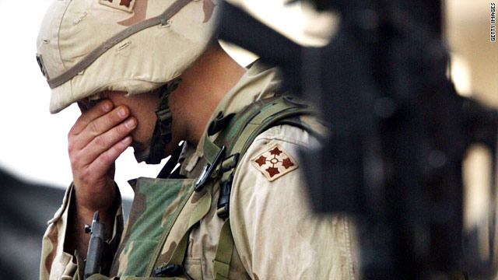
Look at the poem with some of the words missing. Summarise what you think it is about in a few sentences or in bullet points.
Notes:
See cloze sheet, not full poem in anthology!

Slide 3
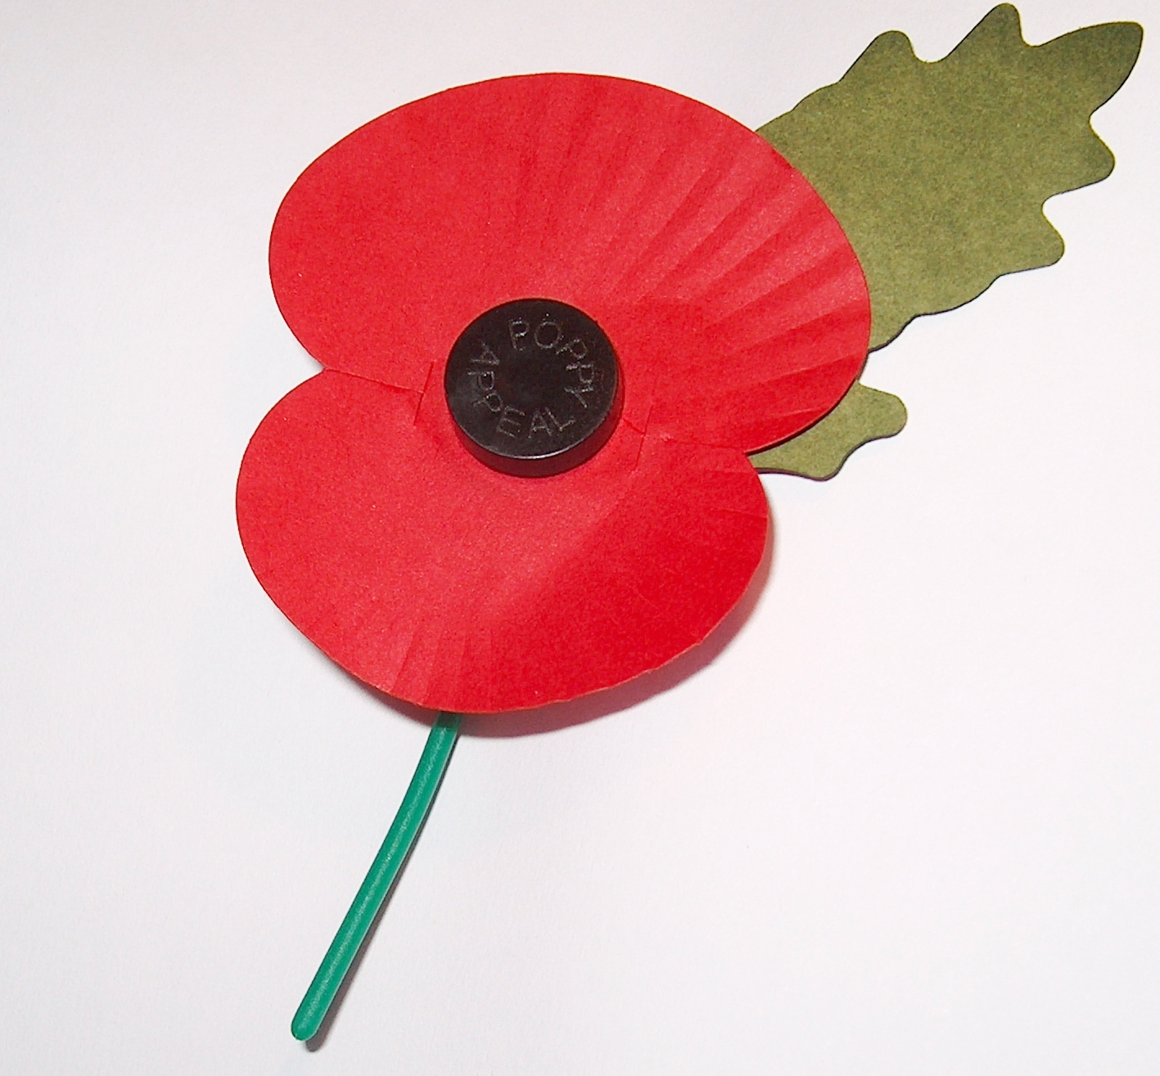
What ideas come to mind when you look at this image?

Slide 4
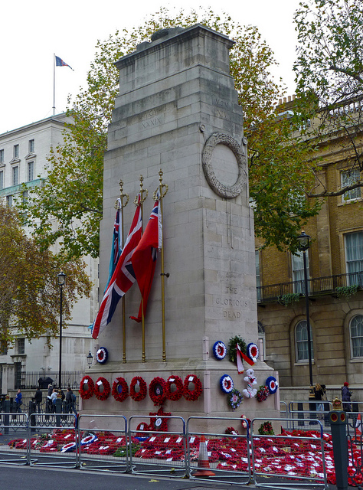
What ideas come to mind when you look at this image of the Cenotaph War Memorial?

Slide 5
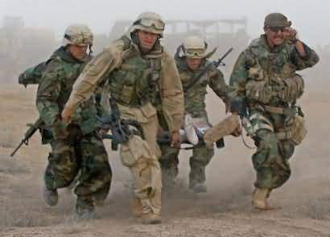
What ideas come to mind when you look at this image?

Slide 6
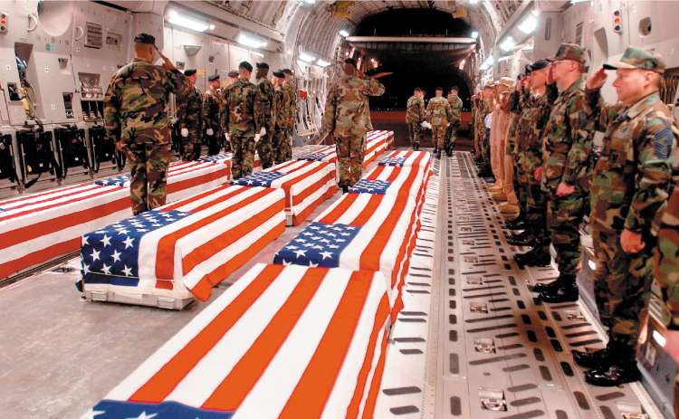
What ideas come to mind when you look at this image of soldiers showing their respects to colleagues who have died?

Slide 7
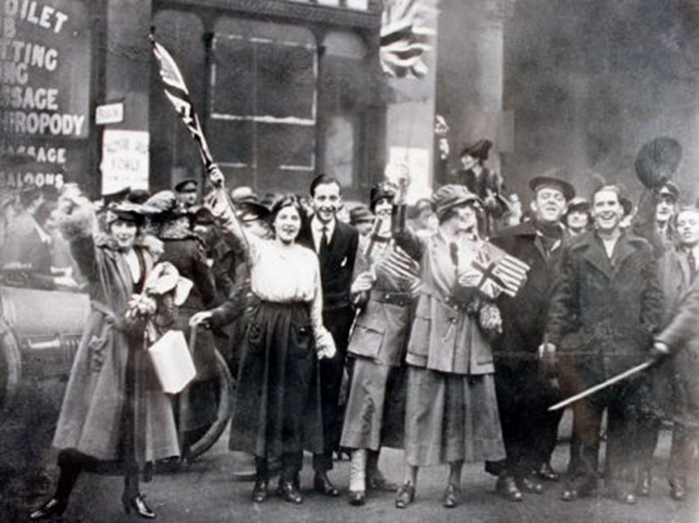
What ideas come to mind when you look at this image of crowds celebrating soldiers’ return from war?

Slide 8
Do you know why Bradley Cooper’s character in ‘American Sniper’ behaves like this? In what way is he similar to the speaker of the poem?

Slide 9
What about these words – what does this semantic field make you think of?
1. anxiety
7. severe
4. distress
2. fear
5. upset
8. stress
3. flashbacks
6. traumatic
Notes:
All of these words are connected to mental health or PTSD. The idea here is to encourage students to consider the prolonged mental impact of war and the veterans who have to cope with their experiences once they return home/leave the conflict.

Slide 10
Post-traumatic stress disorder (PTSD) is an anxiety disorder caused by very stressful, frightening or distressing events.
PTSD can develop immediately after someone experiences a disturbing event or it can occur weeks, months or even years later.
PTSD is estimated to affect about 1 in every 3 people who have a traumatic experience.
Someone with PTSD will often relive the traumatic event through nightmares and flashbacks, and may experience feelings of isolation, irritability and guilt.
They may also have problems sleeping, such as insomnia, and find concentrating difficult.
These symptoms are often severe and persistent enough to have a significant – and often extremely damaging – impact on the person’s day-to-day life.

Slide 11
Over to you! Now that you understand the poem and its tone, fill in the gaps with words that YOU think fit best. I’m not looking for you to pick the exact words that Armitage chose, but to show your understanding of the poem through your own language choices. Be ready to share them and discuss them.

Slide 12
Now let’s look at Armitage’s choices. Why has he made these choices? Annotate each choice with an ideas to its effect on the reader. Can you identify any techniques he has used?
tosses
blood-shadow
bursts
sun-stunned
sand-smothered
bloody
Notes:
Encourage HAPs to think about the juxtaposition of the horrific and serious nature of the poem with the colloquial use of language. Why would Armitage choose this?

Slide 13
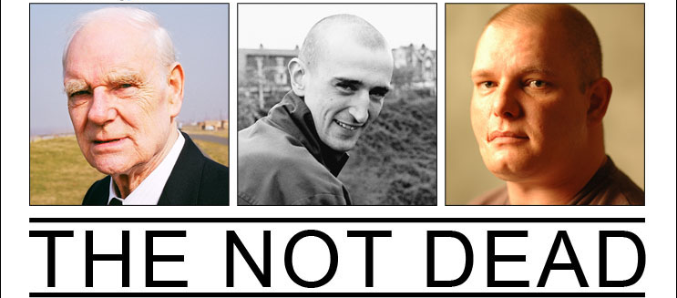
What the poet said…
From a collection of poetry called ‘The Not Dead’.
Inspired by a Channel 4 documentary of the same name (youtube) about soldiers who returned from conflicts (Malaysia, Afghanistan and Bosnia) and how they coped.
Notes:
Could discuss the connotations of ‘The Not Dead’.
There is also an article in the Staff Only folder which you could read and discuss with students.

Slide 14
What the poet said…
“These are poems of survivors – the damaged, exhausted men who return from war in body but never, wholly, in mind.”

Slide 15
“These are poems of survivors – the damaged, exhausted men who return from war in body but never, wholly, in mind.”
Notes:
These are photographs taken of soldiers before, during and after conflict.

Slide 16
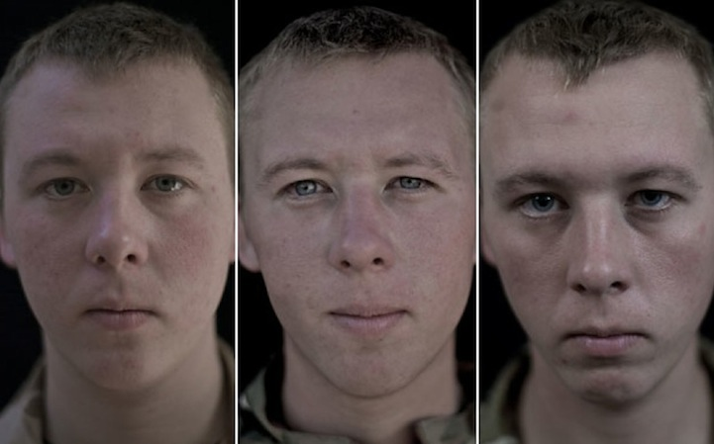
“These are poems of survivors – the damaged, exhausted men who return from war in body but never, wholly, in mind.”
Notes:
These are photographs taken of soldiers before, during and after conflict.

Slide 17
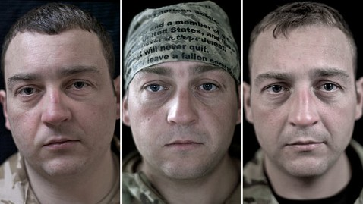
“These are poems of survivors – the damaged, exhausted men who return from war in body but never, wholly, in mind.”
Notes:
These are photographs taken of soldiers before, during and after conflict.

Slide 18
Sense of repeated scenario
On another occasion, we got sent out
to tackle looters raiding a bank.
And one of them legs it up the road,
probably armed, possibly not.
Conversational feel/tone
Parallelism: uncertainty
Why does the speaker shift from past to present tense in the third line?

Slide 19
Conversational
Vague – why no names?
Well myself and somebody else and somebody else
are all of the same mind,
so all three of us open fire.
Three of a kind all letting fly, and I swear
I see every round as it rips through his life -
I see broad daylight on the other side.
So we've hit this looter a dozen times
and he's there on the ground, sort of inside out,
pain itself, the image of agony.
One of my mates goes by
and tosses his guts back into his body.
Then he's carted off in the back of a lorry.
Why does he repeat ‘all’ and ‘three’ so often?
Horrific imagery
‘sort of’ – is he unable to articulate the sight?
He is more graphic and serious here.
But this is informal/casual - juxtaposition
There is a lack of respect- they get rid of the body quickly, like rubbish.

Slide 20
Well myself and somebody else and somebody else
are all of the same mind,
so all three of us open fire.
Three of a kind all letting fly, and I swear
I see every round as it rips through his life -
I see broad daylight on the other side.
So we've hit this looter a dozen times
and he's there on the ground, sort of inside out,
pain itself, the image of agony.
One of my mates goes by
and tosses his guts back into his body.
Then he's carted off in the back of a lorry.
Enjambment = the poem feels conversational and relaxed, a juxtaposition with the horrific content, suggesting the ongoing struggle in the mind of the soldier who ‘remains’.
Full stop. Sense of finality.

Slide 21
Physical remains have gone – but what else remains?
End of story, except not really.
His blood-shadow stays on the street, and out on patrol
I walk right over it week after week.
Then I'm home on leave. But I blink
and he bursts again through the doors of the bank.
Sleep, and he's probably armed, and possibly not.
Dream, and he's torn apart by a dozen rounds.
And the drink and the drugs won't flush him out -
Long vowel sounds emphasise remains for a long time; contrasts with how quickly they disposed of the body.
Mental effects begin to be felt/ described. Dramatic and quick.
Repetition of this line = recurrence of memories.
More brutal than before.
‘Flush’ suggests the memory is a sickness.
He cannot escape these images and thoughts.

Slide 22
End of story, except not really.
His blood-shadow stays on the street, and out on patrol
I walk right over it week after week.
Then I'm home on leave. But I blink
and he bursts again through the doors of the bank.
Sleep, and he's probably armed, and possibly not.
Dream, and he's torn apart by a dozen rounds.
And the drink and the drugs won't flush him out -
Caesura = contrasts with earlier enjambment. What is the effect of this? What does it suggest?

Slide 23
Enjambment: continuation of the idea that he cannot escape these images and thoughts.
he's here in my head when I close my eyes,
dug in behind enemy lines,
not left for dead in some distant, sun-stunned, sand-smothered land
or six-feet-under in desert sand,
but near to the knuckle, here and now,
his bloody life in my bloody hands.
War term. Permanence.
The ‘sun’ and ‘sand’ are ruined by war. Sibilance links them to ‘six feet under’.
References to Afghanistan, Iraq – reminder of the extent of the impact of conflict. He can’t switch off the soldier in him even when he’s home.
Escape seems impossible.
Both a literal description and an expletive.
Link to Macbeth:
‘A little water clears us of this deed’; ‘Out, damned spot!’

Slide 24
Look back to the title ‘Remains’. Why do you think Armitage chose it? Could it be interpreted in more than one way?

