Slide 1
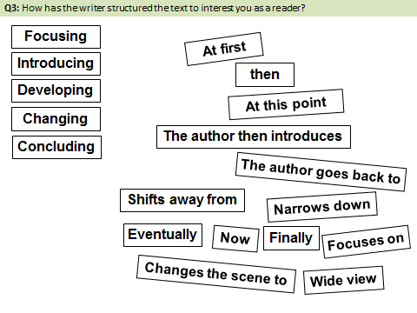
Whole class feedback
Simile
Dig in to evidence.
Always comment on the effect of a technique.
Avoid generalisations/vague statements – you get no credit for these.
Revise structural terminology.
Find your Paper 1 books and use them!
Far too much Paper 1 homework was done in the wrong book or on paper. You must use the resources you have already created!

Slide 2
What to expect in the exam
Question 4 refers to the whole text and is worth 20 marks (more than twice the value of questions 1 and 2 together) The question assesses your ability to:
Evaluate texts critically and support this with appropriate textual references
This means that you will be asked to consider what the writer intended to achieve in the passage. Then you will need to say how far you feel that he or she has achieved it. You must support your ideas with relevant quotations.
Understanding what the writer has sought to achieve in the passage.
Evaluating the effectiveness of the writer’s choices.
Selecting relevant quotations and textual references to support your views.

Slide 3
The Giver...
As we read through the text think about the following:
What do I think or feel about the characters and events?
How does the writer make me think or feel these things?
How well does she do it?

Slide 4
Exam question
Focus this part of your answer on the whole of the extract.
A student, having read this section of the text said: “The writer creates a tense atmosphere and we are left with many questions.”
To what extent do you agree?
In your response, you could:
• write about your own impressions of the atmosphere
• evaluate how the writer has created these impressions
• support your opinions with quotations from the text.
[20 marks]

Slide 5
Genre
Is the text part of a recognisable genre?
Reader Response
What response does the writer provoke – and how?
Atmosphere
How does the writer create a particular mood?
Description
Of character – How does the description give us an insight into the character?
Of location – How does the description of place add to the reader’s appreciation of the atmosphere?
= Evaluation

Slide 6
The language of evaluation – don’t just say ‘good’!
Powerful
Memorable
Intriguing
Engaging
Vivid
Life-like
Insightful
Specific
Impressive
Striking
You will have 20 minutes in the exam to write this answer.
Don’t always say it’s ‘good.’ Think about the different ways you can describe something as ‘good’.
Let’s have a go…
Effective
Dramatic
Engaging
Concise

Slide 7
Exam question
Focus this part of your answer on the whole of the extract.
A student, having read this section of the text said: “The writer creates a tense atmosphere and we are left with many questions.”
To what extent do you agree?
In your response, you could:
• write about your own impressions of the atmosphere
• evaluate how the writer has created these impressions
• support your opinions with quotations from the text.
[20 marks]

