Slide 1
PAPER 1
PAPER 2

Slide 2
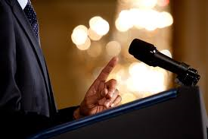
Can you think of 3 situations where your ability to express your viewpoints is important?
Pointless Challenge: Can you come up with situations which no one else has?

Slide 3
What you say…
How you say it…

Slide 4
Stuck on what to include in persuasive writing? Think about a forest:

Slide 5
TECHNIQUE | DEFINITION | EXAMPLE
Direct address | Referring to the reader directly using the pronouns ‘we’ or ‘you’. | ‘You need to do some revision.'
Alliteration | A group of words beginning with the same letter or sound. | ‘Revision rules!'
Facts | Something which can be proven to be true. | ‘80% of teens perform better if they revise.'
Opinions | A belief which cannot be proven to be true – someone’s own ideas. | ‘People who don't revise are lazy.’
Rhetorical Questions | Any question in a piece of writing which does not require an answer. | ‘Do you want to fail your exams?’
Emotive Language | Words which elicit a powerful response. | ‘Failing exams is painful and demoralising.’
Statistics | Numerical facts and data used to support a point. | ‘8/10 students have tried to revise.’
Three (rule of) | Lists of three things in a sentence. | ‘Revising is sensible, productive and smart.’

Slide 6
Direct address
Alliteration
Facts
Opinions
Rhetorical Questions
Emotive Language
Statistics
Three (rule of)
Dogs or Cats?
Persuade an audience to share your views.
Let’s look at an example…

Slide 7
Direct Address
Alliteration
Facts
Opinions
Rhetorical Questions
Emotive Language
Statistics
Three (rule of)

Slide 8
Direct address
Alliteration
Facts
Opinions
Rhetorical Questions
Emotive Language
Statistics
Three (rule of)
Dogs or Cats?
Persuade an audience to share your views.
Aim to use all of these techniques…

Slide 9
Direct address
Alliteration
Facts
Opinions
Rhetorical Questions
Emotive Language
Statistics
Three (rule of)
Dogs or Cats?
Persuade an audience to share your views.
Used them all?

Slide 10
PAPER 1
PAPER 2

Slide 11
Stuck on what to include in persuasive writing? Think about a forest:

Slide 12
TASK: Argue for or against the school canteen serving chips everyday. Write a sentence that uses the rhetorical device mentioned in each box.
1) Rhetorical Question | 2) Fact | 3) Emotive words
4) Three (Rule of) | 5) Direct Address | 6) Imperative
7) Alliteration | 8) Statistic | 9) Opinion

Slide 13
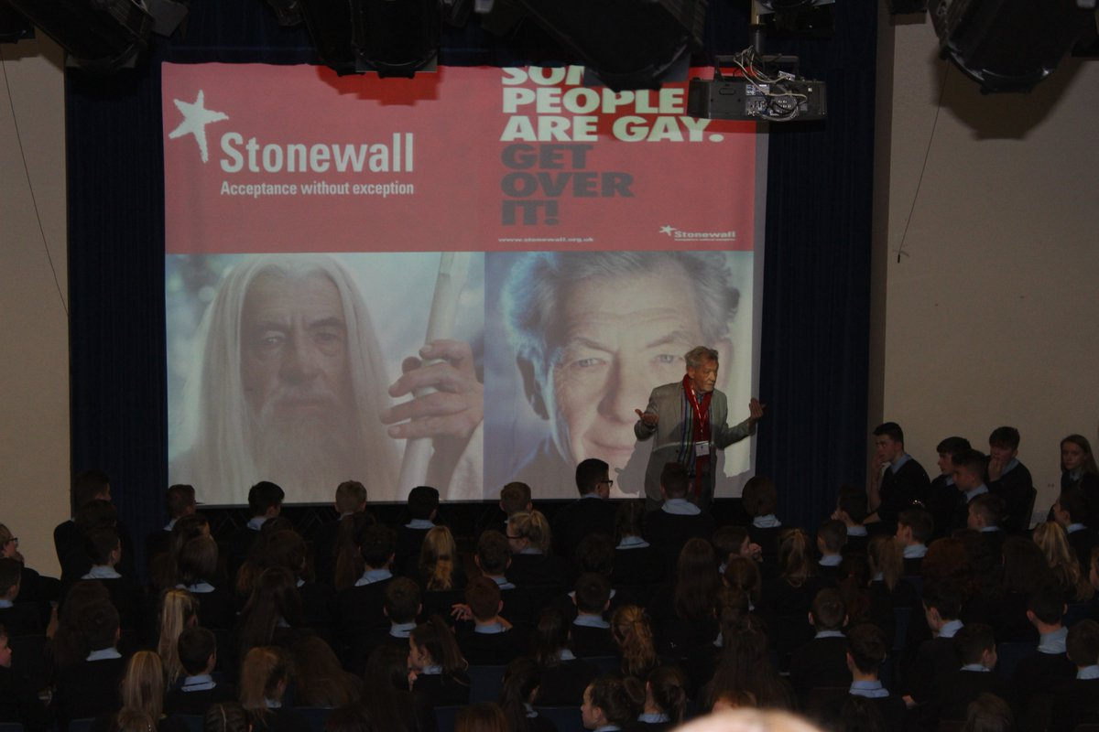
Two weeks ago, Sir Ian McKellen visited us and shared Stonewall’s powerful message: ‘acceptance without exception’.
Write an article for the school newsletter, promoting Stonewall’s message about kindness, tolerance and acceptance.

