Slide 1
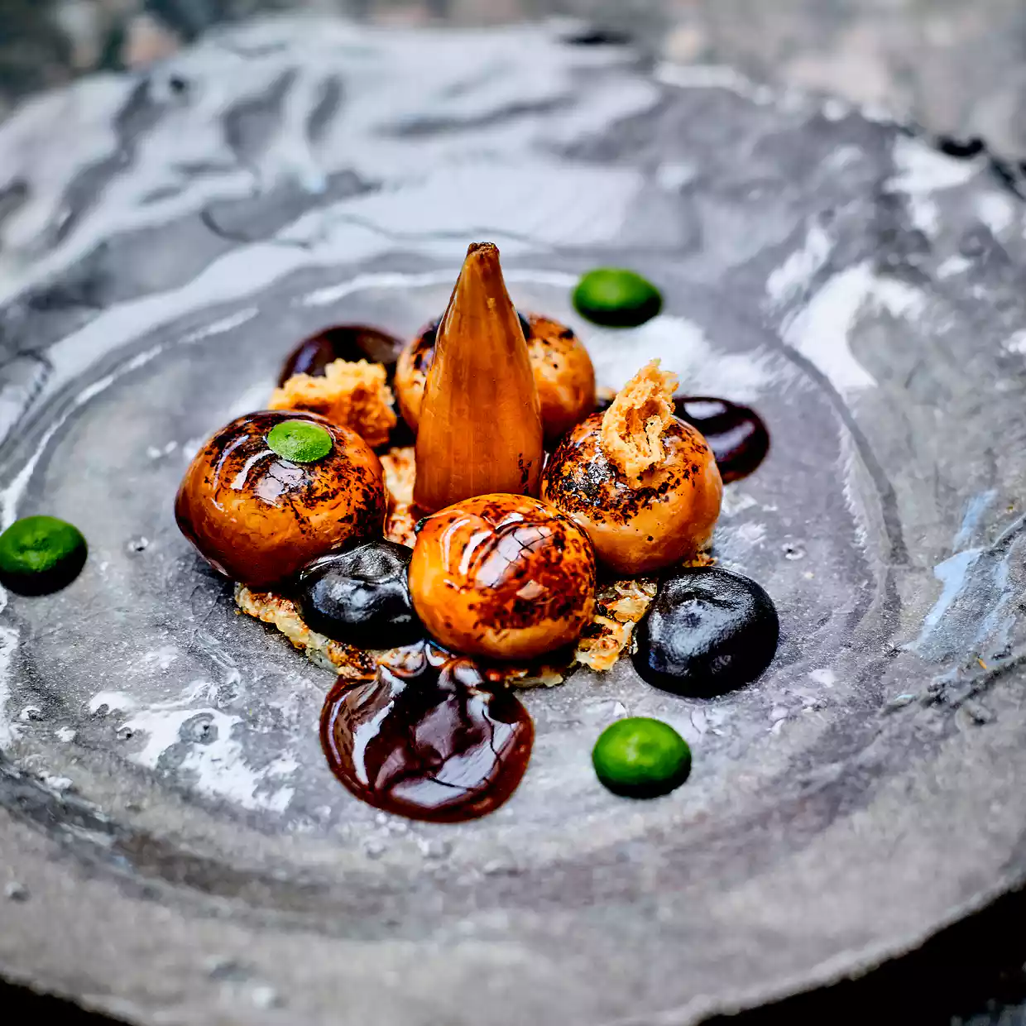
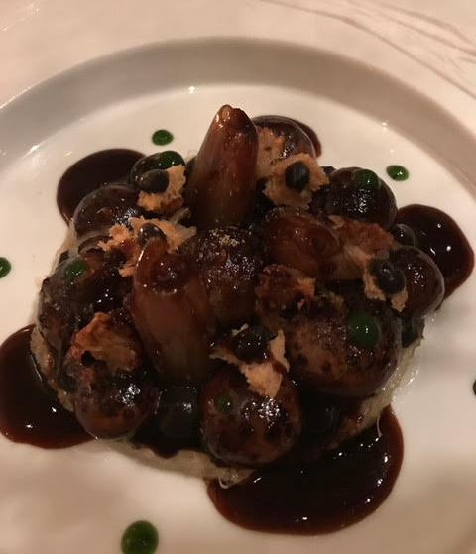
Write a summary of the differences between these two plates of food.
Paper 2 – Food
Q2 and Q4 revision

Slide 2
Same Picture Different Perspective

Slide 3
Same Picture Different Perspective

Slide 4
Same Picture Different Perspective

Slide 5
Same Picture Different Perspective

Slide 6
Thinking About Differences: Comparing

Slide 7
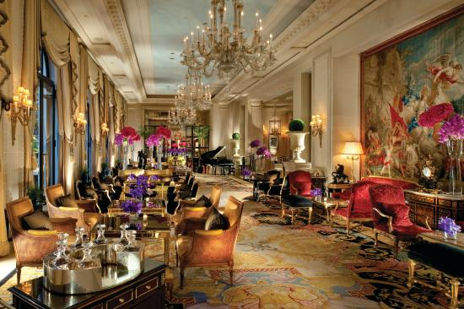
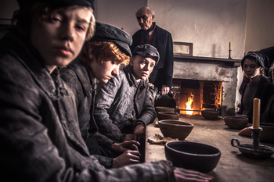
Summarise the differences between these two dining rooms

Slide 8
SECTION A: READING
4 marks
Read the text
Q1
Q2
Q3
Q4
16 marks
8 marks
12 marks

Slide 9
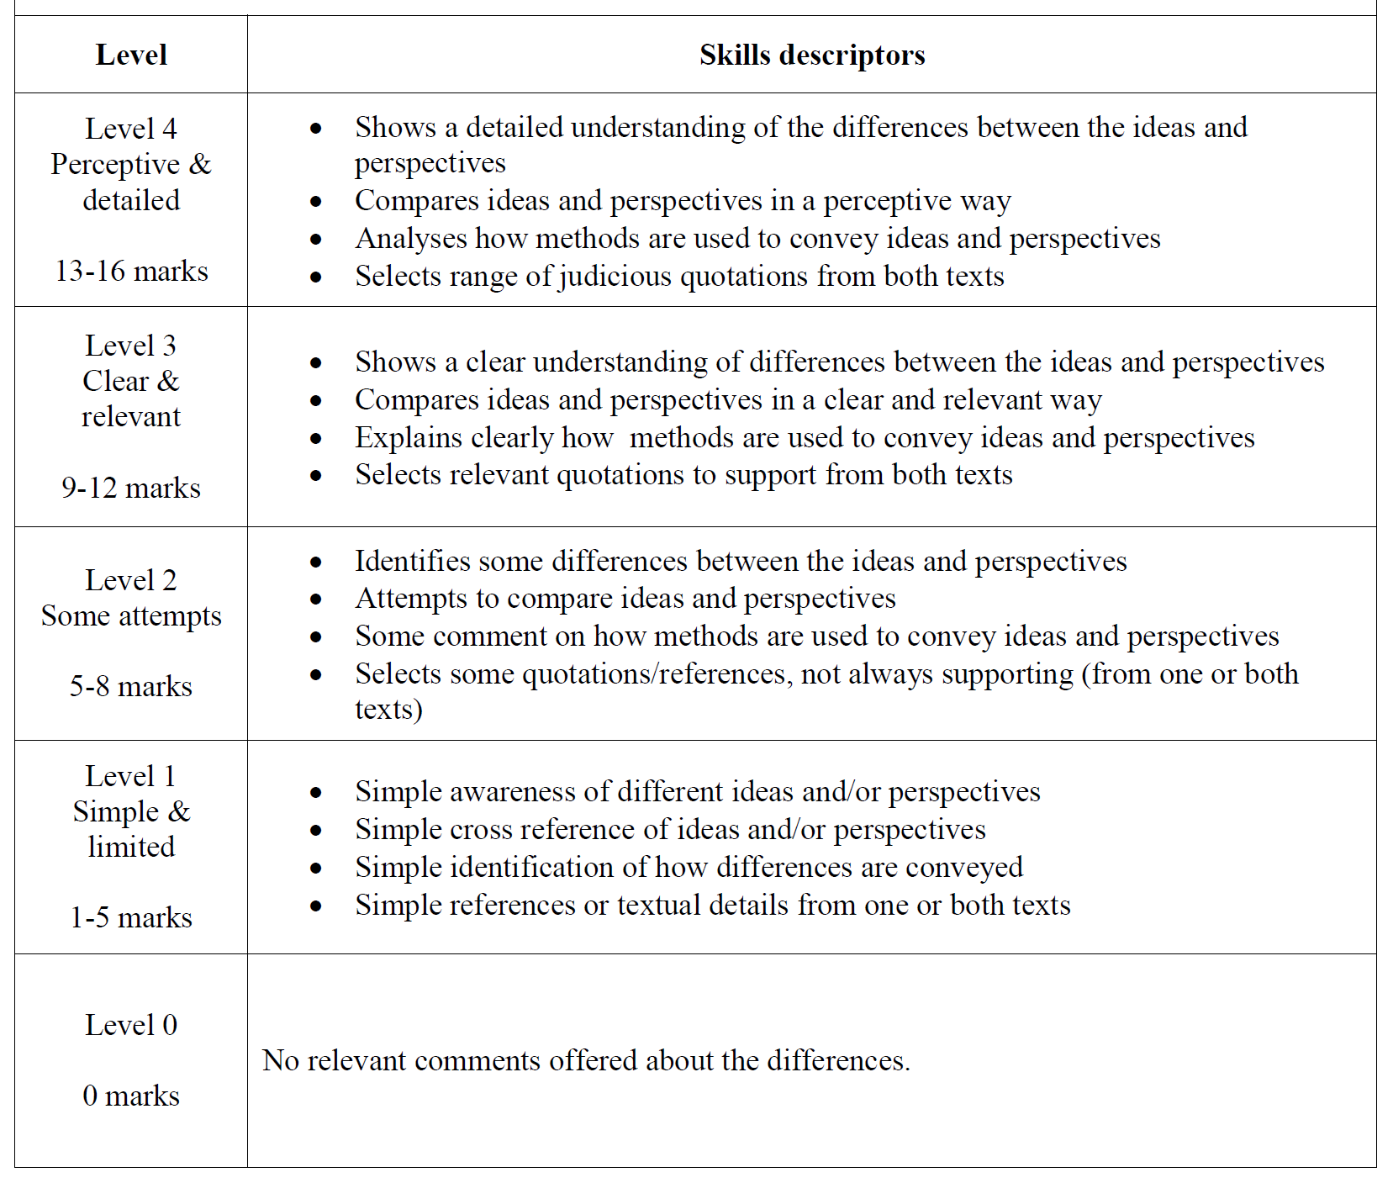

Slide 10
Source A
Jay Rayner, restaurant critic for the Guardian newspaper, eats at the flagship Michelin three-star restaurant of the George V Hotel in Paris. (2017)
Source B
In his book, Robert Blincoe's Memoir (1828) John Brown recounts Blincoe's first experience of eating food in the factory apprentice house.

Slide 11
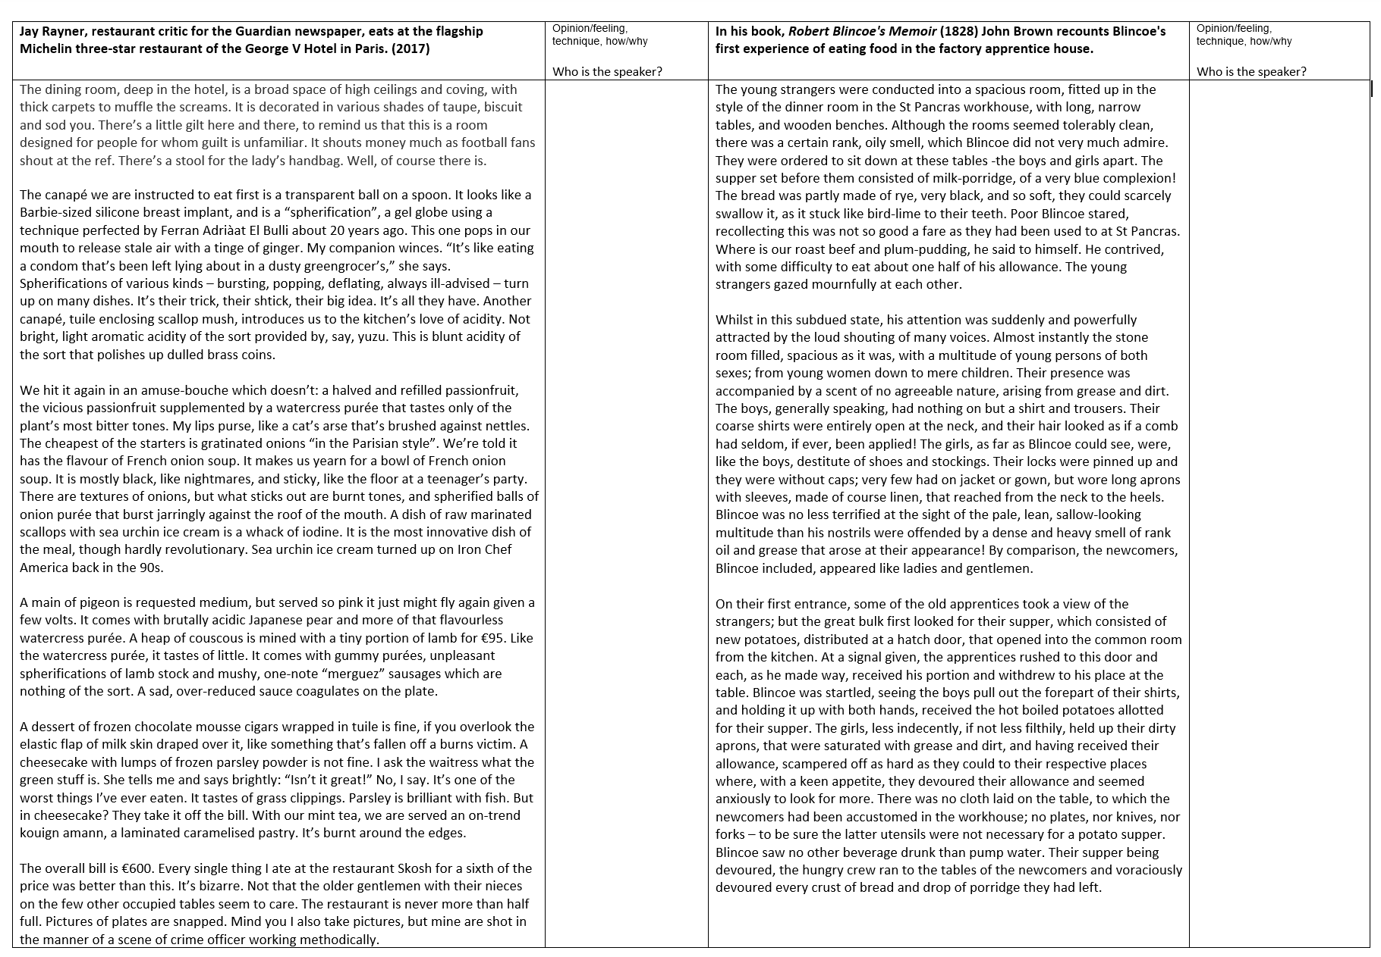
What’s the difference between an article and a memoir?
What’s the difference between 2017 and 1860?
What’s the difference between Jay Rayner and John Brown?
What’s the difference between the two texts?

Slide 12
Walking Talking Reading…

Slide 13
Look at his role: what are your expectations?
Look at where he’s eating: what are your expectations?
Source A
Jay Rayner, restaurant critic for the Guardian newspaper, eats at the flagship Michelin three-star restaurant of the George V Hotel in Paris. (2017)
Source B
In his book, Robert Blincoe's Memoir (1828) John Brown recounts Blincoe's first experience of eating food in the factory apprentice house.
Look at where he’s eating: what are your expectations?
Does this suggest that he’s there for pleasure?

Slide 14
As you’re reading, look for two differences between the eating places.
[Q1: True or False]
4 marks
Q2: Write a summary of the differences in the eating places
8 marks
[Q3: Analyse Language]
12 marks
Q4: For this question, you need to refer to the whole of Source A, together with Source B.
Compare how the two writers convey their different attitudes towards their eating experiences.
In your answer, you could:
compare their different perspectives
compare the methods they use to convey their perspectives
support your ideas with references to both texts
16 marks
Read and highlight the text: pick out the differences and attitudes…
As you’re reading, look for the attitudes towards their eating experiences.

Slide 15
What is the attitude towards the eating experience?
What techniques has he used to convey his viewpoint?
The dining room, deep in the hotel, is a broad space of high ceilings and coving, with thick carpets to muffle the screams. It is decorated in various shades of taupe, biscuit and sod you.
The young strangers were conducted into a spacious room, fitted up in the style of the dinner room in the St Pancras workhouse, with long, narrow tables, and wooden benches. Although the rooms seemed tolerably clean, there was a certain rank, oily smell, which Blincoe did not very much admire.

Slide 16
What is the attitude towards the eating experience?
What techniques has he used to convey his viewpoint?
The canapé we are instructed to eat first is a transparent ball on a spoon. It looks like a Barbie-sized silicone breast implant, and is a “spherification”, a gel globe using a technique perfected by Ferran Adriàat El Bulli about 20 years ago. This one pops in our mouth to release stale air with a tinge of ginger. My companion winces. “It’s like eating a condom that’s been left lying about in a dusty greengrocer’s,” she says.
The supper set before them consisted of milk-porridge, of a very blue complexion! The bread was partly made of rye, very black, and so soft, they could scarcely swallow it, as it stuck like bird-lime to their teeth.

Slide 17
Look for:
Differences between the eating places (Q2)
Differences in the writer’s attitudes towards food (Q4)
The way these attitudes are conveyed (Q4)

Slide 19
Write a summary of the differences in the eating places.
Q
One thing we learn…
The writer says…
…which suggests…
E
LINK
Y
Q
One thing we learn…
The writer describes…
This suggests…
E
Y
Note! These all show differences.
To make sure you synthesize, you will need to use linking words such as ‘whereas’, ‘unlike’, ‘but’, ‘however’, ‘on the other hand’…

Slide 20
Question 4: For this question, you need to refer to the whole of Source A, together with Source
B.
Compare how the two writers convey their different attitudes towards food.
In your answer, you could:
compare their different perspectives
compare the methods they use to convey their perspectives
support your ideas with references to both texts.

Slide 21
Examiner Feedback…
Q4- COMPARATIVE- (almost mirrors Q4 on paper 1 but x2 texts) Need to identify WHAT Need to identify HOW
Problems/patterns - not identifying writers' views - not identifying what writer has done or method used to convey view - most students just identify a technique but don't say why or how -don't compare -don't plan!
What we don’t need to do:
We don’t need to describe what the texts are about in our opinion
We NEED TO focus on the writers’ views

Slide 22
Comparison
The writer’s viewpoint/perspective/attitude
how they convey this viewpoint/perspective/attitude
This could be through:
Words! (Word classes)
Direct address,
Emotive language,
Hyperbole,
Facts/opinion
Dialogue,
Imagery (metaphors, etc.)
Emphasis (punctuation),
Emphasis (repetition),
Emphasis (lists),
semantic fields,
etc…!

Slide 23
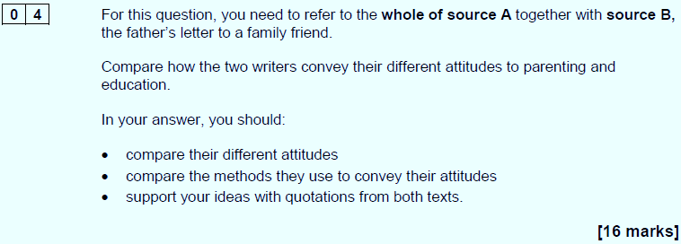
…
…
Compare how the two writers convey their different attitudes towards food and eating.
Attitude in article
Attitude in memoir

Slide 24
Compare how the two writers convey their different attitudes towards food and eating.
Whilst the author of Source A clearly feels (link to question)…, the author of Source B has the idea that…
This is seen in Source A through (method + quotation)...
This connotes/depicts/conveys/suggests that they think…
Whereas/however/on the other hand…
The writer believes that…
The writer feels that …
The writer thinks …

Slide 25
In Source A, the writer describes the ‘scar on one of my shins’, a result of a hoop being ‘driven… deliberately’ by a group of children. He clearly shows disdain for the children here as the tone of his comments is damning and antagonistic. The use of the word ‘deliberately’ suggests he feels he was the victim of a calculated attack by a group of children, ‘even girls.’ On the contrary, the writer from Source B has an entirely different attitude; he describes the ‘graciousness of modern day youth’, here implying that children are kind and caring – indeed the word ‘graciousness’ suggests that children are accommodating and compassionate.

Slide 26
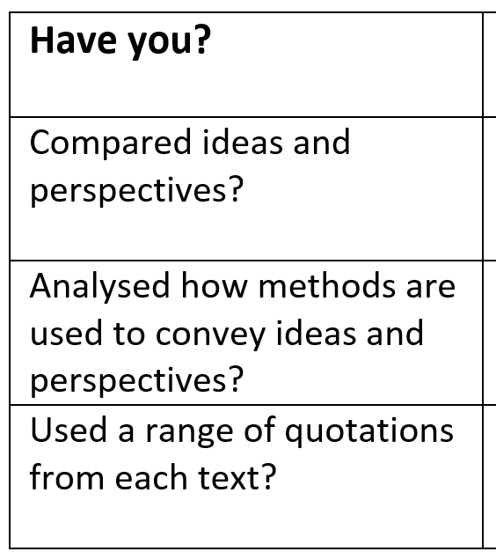
Q
W
E
R
T
Y
W
E
R
T
Y
Level 4 Perceptive, Detailed 13-16 marks | Shows a detailed understanding of the differences between the ideas and perspectives • Compares ideas and perspectives in a perceptive way • Analyses how methods are used to convey ideas and perspectives • Select a range of judicious quotations from both texts
Level 3 Clear, relevant 9-12 marks | Shows a clear understanding of the differences between ideas and perspectives • Compares ideas and perspectives in a clear and relevant way • Explains clearly how methods are used to convey ideas and perspectives • Selects relevant quotations to support from both texts
Level 2 Some, attempts 5-8 marks | Identifies some differences between the ideas and perspectives • Attempts to compare ideas and perspectives • Some comment on how methods are used to convey ideas and perspectives • Selects some quotations/references, not always supporting (from one or both texts)
Level 1 Simple, limited 1-4 marks | Simple awareness of different ideas and/or perspectives • Simple cross reference of ideas and/or perspectives • Simple identification of how differences are conveyed • Simple references or textual details from one or both texts

Slide 27
Q2. You need to refer to Source A and Source B for this question.
Both sources give details about the use of slaves.
Use details from both Sources to write a summary of the differences between slavery in the 19th Century America and slavery in modern Britain.
[8 marks]
Q4. For this question, you need to refer to the whole of Source A, together with the whole of Source B.
Compare how the writers convey their different ideas and perspectives of slavery
In your answer, you could:
• compare their different ideas and perspectives
• compare the methods they use to convey their ideas and perspectives
• support your response with references to both texts.
[16 marks]

Slide 28
The writer of source A uses a dismissive tone to ridicule the idea of freeing slaves, ‘regardless of the injury herby inflicted on them’. He clearly believes that slavery is good for society and the slaves themselves. The use of the word ‘regardless’ highlights the fact that the writer believes that the abolitionists are not thinking clearly about the consequences of freeing slaves. However, the writer of source B believes differently, suggesting that setting modern day slaves free should be the concern of everyone. She emphasis this by using the opinion of an expert to strengthen her argument, ‘It really is that close to us all’. By using an expert, the writer is able to show that it isn’t just her personal opinion that modern day slavery is a problem, but an opinion shared by other people.

