Slide 1
Learning Objective To understand Q4: compare writers’ ideas and perspectives

Slide 2
Paper 2, Question 4 (AO3) 16 marks Looks something like this:
Learning Objective: Q4: compare writers’ ideas and perspectives
For this question, you need to refer to the whole of source A together with source B.
Compare how the two writers convey their different attitudes to parenting and education.
In your answer, you should:
• compare their different attitudes
• compare the methods they use to convey their attitudes
• support your ideas with quotations from both texts.
Compare writers’ ideas/ perspectives and how they are conveyed to us.

Slide 3
Learning Objective: Q4: compare writers’ ideas and perspectives
Level 4 Perceptive, Detailed 13-16 marks | Shows a detailed understanding of the differences between the ideas and perspectives • Compares ideas and perspectives in a perceptive way • Analyses how methods are used to convey ideas and perspectives • Select a range of judicious quotations from both texts
Level 3 Clear, relevant 9-12 marks | Shows a clear understanding of the differences between ideas and perspectives • Compares ideas and perspectives in a clear and relevant way • Explains clearly how methods are used to convey ideas and perspectives • Selects relevant quotations to support from both texts
Level 2 Some, attempts 5-8 marks | Identifies some differences between the ideas and perspectives • Attempts to compare ideas and perspectives • Some comment on how methods are used to convey ideas and perspectives • Selects some quotations/references, not always supporting (from one or both texts)
Level 1 Simple, limited 1-4 marks | Simple awareness of different ideas and/or perspectives • Simple cross reference of ideas and/or perspectives • Simple identification of how differences are conveyed • Simple references or textual details from one or both texts

Slide 4
Learning Objective: Q4: compare writers’ ideas and perspectives
To answer this question successfully, you need to include four things:
Viewpoint: what is being said in the text
Perspective: how the writer’s context affects their ideas
Method: how the ideas are expressed
Quotations: to support your ideas

Slide 5
Learning Objective: Q4: compare writers’ ideas and perspectives
Statement linking the perspectives and attitudes in the texts
Q
E
T
W
R
Y
LINK
Dig into HOW the writers do this?
(They will do this differently)
E
T
W
R
Y

Slide 6
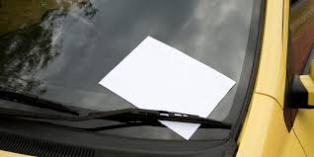
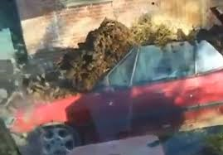
Learning Objective: Q4: compare writers’ ideas and perspectives
Both residents find people parking outside their house annoying
Q
E
T
W
R
Y
Dig into HOW the writers do this?
(They will do this differently)
LINK
E
T
W
R
Y

Slide 7
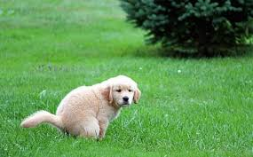
Learning Objective: Q4: compare writers’ ideas and perspectives
Both neighbours are irritated by the dog poo on the pavement
Q
E
T
W
R
Y
Dig into HOW the writers do this?
(They will do this differently)
LINK
E
T
W
R
Y

Slide 8
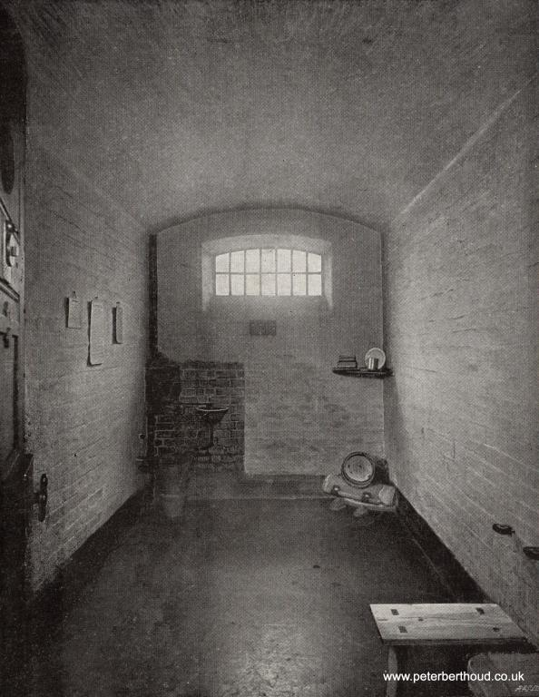
Learning Objective: Q4: compare writers’ ideas and perspectives
Let’s revisit some texts we compared previously. Our question this time is:
Compare how the two writers present their views of the experience of prison.
Statement linking the perspectives and attitudes in the texts
Q
E
T
W
R
Y
LINK
Dig into HOW the writers do this?
(They will do this differently)
E
T
W
R
Y

Slide 9
Learning Objective: Q4: compare writers’ ideas and perspectives
Strong and stony as the prison seems to passers-by, it looks much stonier and stronger to the men who enter it. The multiplicity of heavy walls, of iron gates and doorways; of huge locks, of bolts, spikes and bars of every imaginable shape and size, make of the place a very nightmare dungeon. I followed the gruff under- warden, through some dark and chilly vaulted passages, now turning to the right, now to the left. We crossed a large hall, in the centre of which is a glass room for the use of prisoners when they are giving instructions to their lawyers.
Still following; I was led into another large recess or chamber, on one side of which was a huge boiler with a furnace glowing under it, and on another side a large stone bath. On the third wall there were a couple of round towels on a roller, with a wooden bench beneath them.
"Stop," cried the warden, "take your clothes off." I hesitated. "Take off your clothes, do you hear?" My clothes were soon laid on the bench, and a hot bath filled, and I went in. The officer had then his opportunity of taking up my garments one by one, searching their pockets and their linings, feeling them about and holding them against the light. My boots appeared to be especially suspicious. After he had put his hands into them, he thumped them violently on the stone floor; but there rolled nothing out.
Many people think that prison must be a terrifying place with lots of violent women locked behind bars. It isn’t. My arrival at Holloway was smooth, humane and expertly carried out, involving quick fingerprinting and the BOSS chair (Body Orifice Security Scanner), essentially a metal detector.
There was no strip search but there are rules. It was clear I had brought in far too many clothes. I was allowed to keep just 12 tops (shirts, T-shirts and jumpers) and six bottoms (trousers, tracksuit bottoms and pyjamas).
No toiletries were allowed but I was given an emergency bag with prison issue and I bought a ‘welcome’ bag for £2.99, which would be subtracted from the cash I brought in with me.
It contained a bottle of orange squash, biscuits, a bar of milk chocolate, deodorant, toothbrush and toothpaste, a comb and some tea bags and sugar. I had the choice of that or a smoker’s bag. But I could take in my books, all 18 of them and many given to me by my children, as well as my writing pads and a couple of pens. The welcome group and prison guards helped me and some other new inmates move our personal belongings, which had been transferred into transparent prison plastic bags, to landing A3, the reception landing, which ended up being my home for the next few days.
The lovely girl who had secured the food for me told me on the way that she had two more years to do but enjoyed doing the reception work because it kept her out of her cell until quite late in the evening.
That night was bitterly cold and I soon realised that the windows in Holloway cells do little to keep the chill out. At first I was shown a cell with no curtains and my helpers tried to fasten an orange blanket on to the railings, without much success. Fortunately there was another single cell available with curtains, this time near the guards’ office, but the TV was not working so there was another quick changeover.
Viewpoints:
First impressions
People’s assumptions about prisons
Impressions of other people

Slide 10
Learning Objective: Q4: compare writers’ ideas and perspectives
Both of the writers present and challenge people’s assumptions about prisons. The Newgate prisoner explains how, “Strong and stony as the prison seems to passers-by, it looks much stonier and stronger to the men who enter it.” He uses the adjectives “strong” and “stony” to describe how people see the prison. These adjectives are negative and imply its hardness and brutality. As a prisoner, he agrees with their view, but uses the comparative adjectives “stronger” and “stonier” to show the reader that this hardness and brutality becomes much more severe and terrifying to an actual prisoner. This shows the reader that the experience of being an actual inmate is unimaginable. The Holloway prisoner also presents the idea that “Many people think that prison must be a terrifying place with lots of violent women locked behind bars.” The adjectives “terrifying” and “violent” show the extremely negative perspective that people have of prisons. However the writer then contradict this perspective, disagreeing with this impression by saying simply, “It isn’t.” This simple, short sentence dismisses the impression clearly, dramatically and absolutely for the reader before the prisoner goes on to explain prison life quite positively.
Q
W
E
R
T
Y
W
E
R
T
Y

Slide 11
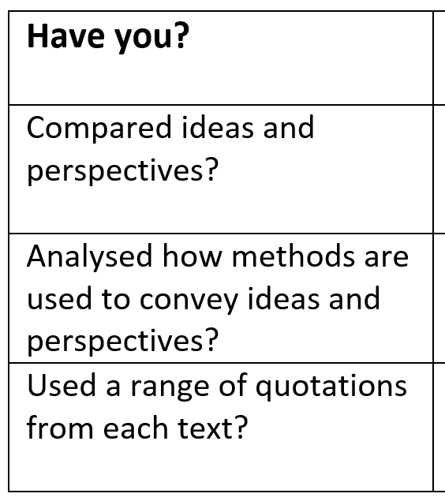
Learning Objective: Q4: compare writers’ ideas and perspectives
Compare how the two writers present their views of the experience of prison.
Q
W
E
R
T
Y
W
E
R
T
Y
Your turn:
Use the other quotations to write another QWERTY/WERTY paragraph

Slide 12
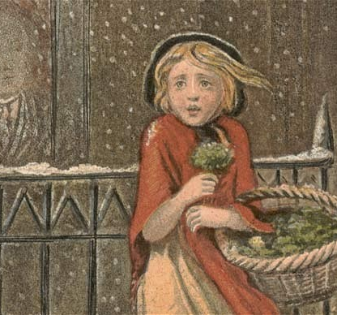
Learning Objective: Q4: compare writers’ ideas and perspectives
Compare how the different views of childhood are expressed in the two texts.
Q
W
E
R
T
Y
W
E
R
T
Y
Work on A4 – do not put your name on the sheet!
The writer in text A clearly feels…
This is seen in…
The writer used… because…
This would make the reader feel… and could suggest...

Slide 13
Learning Objective: Q4: compare writers’ ideas and perspectives
Read out your selection and tell us which number it came from!
Put your number on your sheet and stick it to the wall.
You have 10 minutes to look at the answers on the wall. Don’t just stick to your friends’ work!
Write down the best parts of the answers you read. Make a note of the number you got them from!

Slide 14
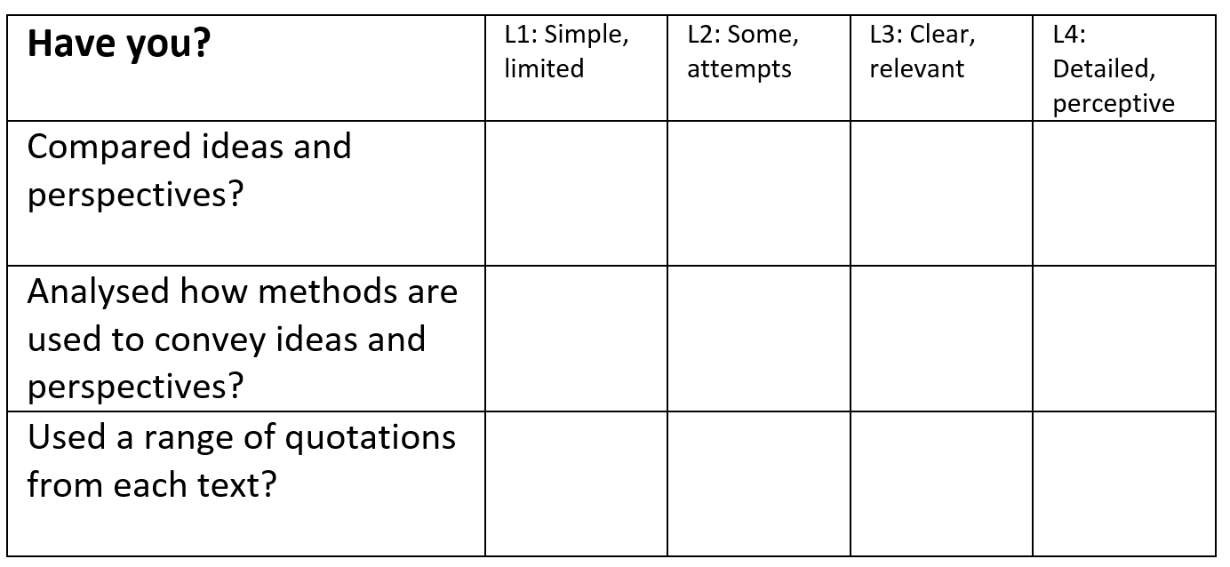
Learning Objective: Q4: compare writers’ ideas and perspectives
Peer-Assess
Take one text off the wall to
Q
W
E
R
T
Y
W
E
R
T
Y
they?
WWW
EBI

Slide 15
Learning Objective: Q4: compare writers’ ideas and perspectives
EBI Action
Reclaim your work!
Q
W
E
R
T
Y
W
E
R
T
Y

Slide 16
Learning Objective: Q4: compare writers’ ideas and perspectives
Self-Assess
Q
W
E
R
T
Y
W
E
R
T
Y
Have you improved?

Slide 17
Learning Objective: Q4: compare writers’ ideas and perspectives
How confident are you with Q4 skills?
Skills | I am confident that I can do this. | I think I can do this but I need a bit more practice. | This is one of my weaker areas, so I need more practice.
I can identify ideas and perspectives in both texts.
I can explain the differences between the ideas and perspectives of two texts.
I can comment on and analyse the methods writers use to convey their ideas.
I can support my ideas with relevant quotations.

Slide 18
Learning Objective: Q4: compare writers’ ideas and perspectives
Let’s revisit some texts we compared previously. Our question this time is:
Compare how the two writers present their views of the experience of shopping.

Slide 19
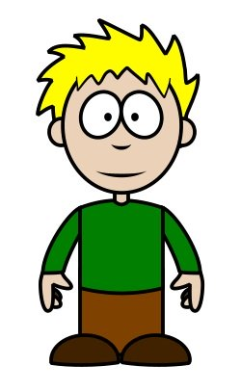
Learning Objective: Q4: compare writers’ ideas and perspectives
Source A: London and the London poor
He’s really trying to paint a picture for the reader, isn’t he?
Yes, but why? Wouldn’t they have seen it for themselves?

Slide 20
Learning Objective: Q4: compare writers’ ideas and perspectives
Source A: London and the London poor
Maybe not. Maybe he’s writing for people who don’t live in London.
Or for rich people who would never go to a night market – because it says this market is for poor people.

Slide 21
Learning Objective: Q4: compare writers’ ideas and perspectives
Source A: London and the London poor
But he’s making it sound beautiful. Perhaps his readers would be surprised. They would think that a market for poor people would be dirty and ugly. Mayhew is describing poor people – the boys with the onions are almost begging – but he makes it so attractive.
He does it by picking individual stallholders to describe – ‘one man shows off his yellow haddock with a candle stuck in a bunch of firewood’. They’re like individual paintings almost. We get colours too – it’s poetic.

Slide 22
Learning Objective: Q4: compare writers’ ideas and perspectives
Source A: London and the London poor
I think, though, if we saw it ourselves we might be shocked by the poverty. He’s so used to it because there was a lot of poverty in London then, so perhaps he’s not so shocked.
And I’ve just noticed it’s written in the present tense! That makes it seem as if it’s happening now. He’s sort of conjuring it up for his readers so they can see it and hear it.

Slide 23
Learning Objective: Q4: compare writers’ ideas and perspectives
Source A: London and the London poor
It sounds like a fun way to shop. I’d love it – especially at night with all the lights!
Shopping these days is quite boring, really. Supermarkets are so impersonal.

Slide 24
Learning Objective: Q4: compare writers’ ideas and perspectives
Can you identify these ideas in the students’ discussion?
Viewpoint: what is being said in the text
Perspective: how the writer’s context affects their ideas
Method: how the ideas are expressed
Quotations: to support your ideas
Now have the same sort of discussion about Source B!

Slide 25
Learning Objective: Q4: compare writers’ ideas and perspectives
Compare how the two writers present their views of the experience of shopping.
Q
W
E
R
T
Y
W
E
R
T
Y
In pairs, write a paragraph to answer this question.
The writer in text A clearly feels…
This is seen in…
The writer used… because…
This would make the reader feel… and could suggest...

Slide 26
Learning Objective: Q4: compare writers’ ideas and perspectives
Compare how the two writers present their views of the experience of shopping.
Q
W
E
R
T
Y
W
E
R
T
Y
they?
WWW
EBI
Peer-Assess

