Slide 1
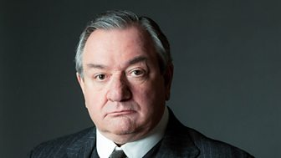
Arthur Birling
My voice is ‘provincial’ – what does this suggest about me?
What is the name of my company?
What two things did I say would not happen, that then do?
Why do I mention to Gerald about my ‘knighthood’?
What did I describe Eva as when the strikes were happening?
How much did my son steal from my office?
Why do I tell the Inspector that I was an alderman?
How do I react when I realise that the Inspector was not real?
I am a social climber – what does this mean I think is important?
Do I learn anything by the end of the play?

Slide 2
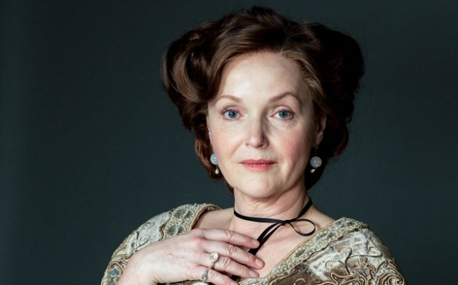
Sybil Birling
I am described as ‘cold’. What does this suggest about my personality?
I am of a higher class than my husband – how do I view the lower classes?
How do I expect my daughter to behave towards her husband?
I work for a women’s charity, but why did I not help Eva?
Who did I say was responsible and should be blamed for her situation?
Did I feel at all responsible for Eva’s fate?
How did I react when the Inspector was interrogating me?
What did my daughter tell me not to ‘build’ up?
How did I react when I found out that the Inspector was not real?
Did I learn anything by the end of the play?

Slide 3
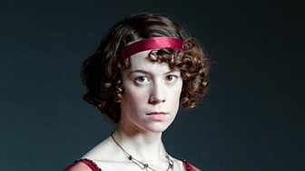
Sheila Birling
Why would I have been treated differently to my brother growing up?
What would my expectations for life have been? My main roles?
How did I feel when Eva looked better than I did?
What did I threaten to do because of the way I felt?
Do I see the working class in the same way as my parents?
How did I react when I realised what I had done?
Who did I agree with at the end of the play?
Did I feel that anything had changed when the Inspector was discovered to be a fake?
Why is my attitude at the end of the play so important?
Do you think I will change the way I approach responsibility?

Slide 4
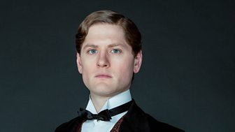
Gerald Croft
I am described as “not quite a dandy” – what does this mean?
Am I of a higher or lower class to the Birlings?
What is my family’s business called?
Why might Mr Birling want our businesses to work together?
Why did I not decide to marry Eva instead of Sheila?
What did I give to Eva during our affair?
Did Eva feel the same way about me as I felt about her?
Did I feel guilty or responsible for what happened to Eva?
Who did I speak to that started the conversational about how real the Inspector was?
Did I learn anything at the end of the play?

Slide 5
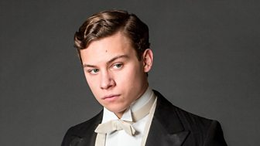
Eric Birling
What is quickly evident that I have a problem with whilst we are all at dinner?
Why might there be a bit of tension between Sheila and me?
How much did I steal from my father and why?
How do I feel about my father – has he been there for me as I grew up?
I threatened to make a “row” if Daisy didn’t what…?
Why might my upbringing have effected the way I treat women?
What did I tell my mother that she did when I realised that Daisy was pregnant?
Who did I side with when we were discussing responsibility?
Did I change my mind when we discovered that the Inspector wasn’t real?
Why is my attitude important for equality in society?

Slide 6
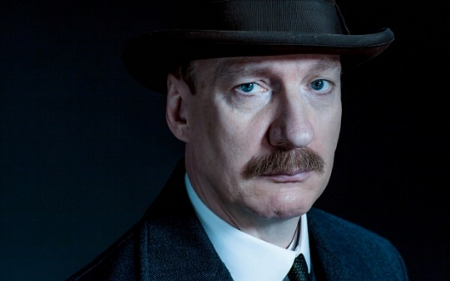
Inspector Goole
How does the lighting change when I enter the room? What does this suggest?
How do I change the atmosphere in the dining room?
Why does Mr Birling tell me that he was an alderman?
Why do you think I only show the photo of Eva to one person at a time?
What is the effect on the audience of interviewing one character at a time?
What is my main message?
Am I a socialist or a capitalist? Why?
My speech at the end of the play references ‘fire, blood and’ what? What is this referring to that happens in the future (of the play)?
Which characters do I have most impact on?
Why am I called ‘Goole’? Why is this relevant at the end of the play?

Slide 7
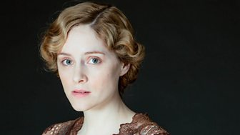
Eva Smith
Why is my name Eva Smith? What does that make you think of?
Why do I campaign for higher wages?
Which class do I belong to?
Why am I not able to be listened to or heard?
Why did Mrs Birling judge me for being pregnant?
What was life like for me as a woman?
Why might I have turned to Gerald for support?
Why might I have turned to Eric for support?
What would life have been like for me as a single mother?
Why did I decide to take my own life?

Slide 8
AGREE?
The play is about male lust and sexual exploitation of the weak by the powerful.
DISAGREE?

Slide 9
AGREE?
Priestley’s main aim is to present a symbolic confrontation between socialism and capitalism.
DISAGREE?

Slide 10
AGREE?
There is no hope for change at the end of An Inspector Calls because the hubristic nature of man is not fully destroyed.
DISAGREE?

Slide 11
AGREE?
The weakest character in the play is Mr Birling, not Eva Smith.
DISAGREE?

Slide 12
Complete the planning table for one of the following questions:
In what way is the play one about male lust and sexual exploitation of the weak by the powerful?
In what way does Priestley’s main aim appear to be writing about the symbolic confrontation between socialism and capitalism?
The hubristic nature of man is not fully destroyed by the end of the play; do you think there is any hope for change?
In what way does Priestley present Mr Birling as the weakest character in the play, and not Eva Smith?
Use ideas from the debate to inform your planning.

Slide 13
Paragraph: | What I will write about: | Quotation I could use and/or link to context (Edwardian era)
Intro (brief summary of my view/ argument).
1
2
3

