Slide 1
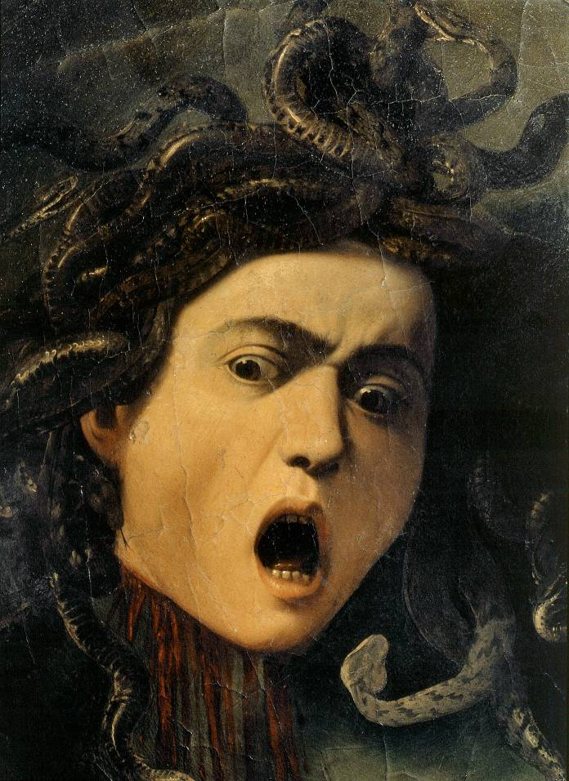
Medusa
Carol Ann Duffy

Slide 2
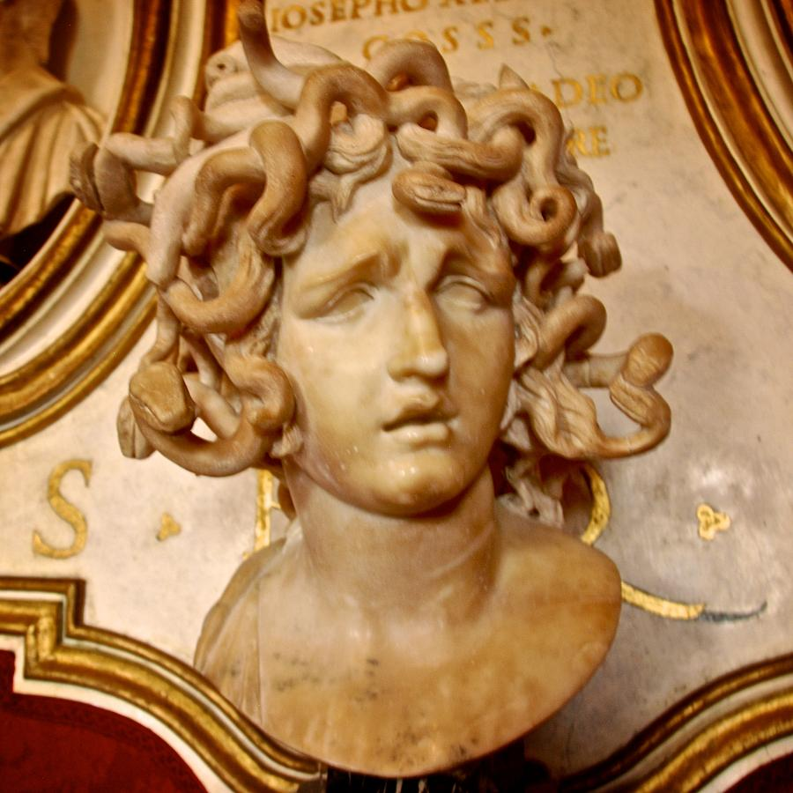
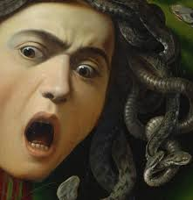
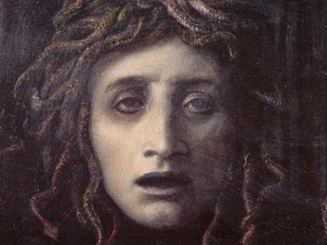
Who is Medusa?
http://www.bbc.co.uk/learningzone/clips/anthony-horowitz-the-gorgon-s-head/6877.html
What words would you pick to describe Medusa?
lonely
vulnerable
man-hater
EVIL
jealous
sensitive

Slide 3
Medusa was a gorgon – a sort of monster, but she was also a beautiful woman whose hair was her most striking feature. The goddess Athena made Medusa a priestess of her temple, but while Medusa was carrying out her duties in the temple she was either seduced or raped by the god Poseidon. (Perhaps the two of them had different stories.) Medusa became pregnant. Athena was jealous of Medusa’s beauty and outraged by her behaviour in the temple. To punish her, Athena turned Medusa’s hair into snakes and made her appearance so frightening that if anyone looked at her they turned to stone. (‘Petrified’ literally means ‘turned to stone’.) Athena was still not satisfied and told Perseus to bring Medusa’s head to her. Athena gave Perseus a mirrored shield so that he could see Medusa’s reflection and thus avoid being turned to stone. Perseus used his curved sword to behead Medusa.
Does this version of the story add to or change your ideas about Medusa?

Slide 4
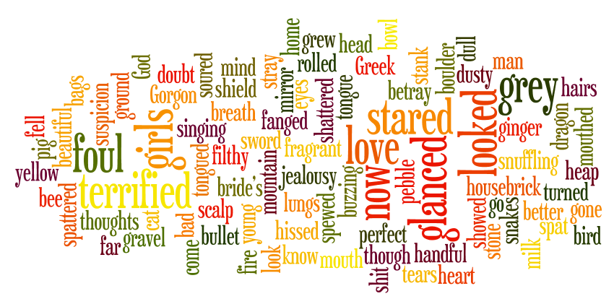
Read and consider the words on the word cloud. What do you think the poem is going to be about? What do you think the mood or atmosphere is?

Slide 5
A suspicion, a doubt, a jealousy
grew in my mind,
which turned the hairs on my head to filthy snakes,
as though my thoughts
hissed and spat on my scalp.
My bride’s breath soured, stank
in the grey bags of my lungs.
I’m foul mouthed now, foul tongued,
yellow fanged.
There are bullet tears in my eyes.
Are you terrified?
Be terrified.
It’s you I love,
perfect man, Greek God, my own;
but I know you’ll go, betray me, stray
from home.
So better by far for me if you were stone.
I glanced at a buzzing bee,
a dull grey pebble fell
to the ground.
I glanced at a singing bird,
a handful of dusty gravel
spattered down.
Listen to the poem and think of something to say about:
The tone of the poem
The meaning of the poem
The techniques used in the poem
I looked at a ginger cat,
a housebrick
shattered a bowl of milk.
I looked at a snuffling pig,
a boulder rolled
in a heap of shit.
I stared in the mirror.
Love gone bad
showed me a Gorgon.
I stared at a dragon.
Fire spewed
from the mouth of a mountain.
And here you come
with a shield for a heart
and a sword for a tongue
and your girls, your girls.
Wasn’t I beautiful?
Wasn’t I fragrant and young?
Look at me now.

Slide 6
This poem is a dramatic monologue. A dramatic monologue is a piece of verse that gives the speaker a voice to EXPRESS his / her feelings to a silent audience.
In the case of ‘Medusa’, Carol Ann Duffy is giving a voice to Medusa.
In this poem, Medusa expresses her bitter feelings about becoming old and, in a sense, unwanted. She is directing the poem to her husband, her Greek God.
free verse (lines and verses of varying lengths and compositions, often with no consistent rhyme scheme) – structured around Medusa’s transformation and the scale of the things she turns to stone (bee -> dragon -> her husband)
despite the free verse, the stanzas are of equal length until the last one – a single line stanza to underline it and create a sense of menace and ambiguity

Slide 7
Find an example of each of the following in the poem. What is the purpose and effect of each?
alliteration
assonance
metaphor
verbs
repetition
questions
imperative sentences
pleasant images
ugly images
one line stanza

Slide 8
A group of three: builds up rhythm; shows gradual progression of emotions and sets the tone for the poem
A suspicion, a doubt, a jealousy
grew in my mind,
which turned the hairs on my head to filthy snakes,
as though my thoughts
hissed and spat on my scalp.
Length of line symbolises the snakes on her head
Alliteration and sibilance used to suggest the sound of the snakes; also hard sounds emphasised to represent her anger – her thoughts are becoming something real
What can we infer about the speaker from this opening stanza?

Slide 9
Images of old age?
More sibilance
My bride’s breath soured, stank
in the grey bags of my lungs.
I’m foul mouthed now, foul tongued,
yellow fanged.
There are bullet tears in my eyes.
Are you terrified?
What two meanings are there for ‘foul mouthed’?
‘tongued’ and ‘fanged’ also refer to the snakes in her hair
1. Bullets could represent war; danger; death; revenge
2. Her tears are literally turning to stone as they fall from her eyes
How do ‘sour’, ‘grey’ and ‘foul’ contrast with the more traditional image of a bride? What might this suggest about the speaker?
Why should Medusa’s husband be terrified?

Slide 10
Imperative: suggests her power
Semi-repetition creates a sinister, emphatic quality to her statement
Is this sarcastic in tone?
Be terrified.
It’s you I love,
perfect man, Greek God, my own;
but I know you’ll go, betray me, stray
from home.
So better by far for me if you were stone.
She will possess him at all costs. Rhyme scheme intensifies the impact of ‘stone’
What is the effect of the internal rhyme in ‘you’ll go, betray me, stray from home’?
Why is it better if he is stone? What does that allow Medusa to do? Hint: Think about how she is feeling.

Slide 11
Bee = symbol of carefree summer days/ happiness. It is turned into a ‘dull grey pebble’ by her jealousy
I glanced at a buzzing bee,
a dull grey pebble fell
to the ground.
I glanced at a singing bird,
a handful of dusty gravel
spattered down.
Repetition of personal pronoun ‘I’ – she is in control/ indulging in her power?
Bird = the beauty of nature
What does she do to the bee and the bird?
What might this represent?
Hint: look at what they are doing.
Why is it significant that she only ‘glanced’?

Slide 12
Cat = pets and home, symbols of domestic bliss which she has lost
Links with spattered’ in previous stanza, demonstrating the strength of her power to destroy
Pig = symbol of fertility
I looked at a ginger cat,
a housebrick
shattered a bowl of milk.
I looked at a snuffling pig,
a boulder rolled
in a heap of shit.
Emphasises the innocence/ unsuspecting nature of her victim
Why is the phrase, ‘a heap of shit’ so powerful? What might it represent?
Why is it significant that she now ‘looked’?

Slide 13
What does Medusa see in the mirror?
What does she feel about her reflection?
Both mythological creatures; she identifies with them – she is both Gorgon and dragon. Dragon = power/ anger
I stared in the mirror.
Love gone bad
showed me a Gorgon.
I stared at a dragon.
Fire spewed
from the mouth of a mountain.
Her mouth is like a volcano ‘spewing’ fire
What does ‘fire spewed’ represent?
Why is it significant that she now ‘stared’? (Another group of three!)

Slide 14
In what tone of voice is the opening line said? Anger? Threatening? Resigned? Sad? How does the speaker feel? How do we feel about her?
And here you come
with a shield for a heart
and a sword for a tongue
and your girls, your girls.
Wasn’t I beautiful?
Wasn’t I fragrant and young?
Repetition of ‘your girls’ – she is no longer ‘his’ nor a ‘girl’
Repetition of
question displays
her insecurity
Fragrant = delicate, beautiful, feminine
How do the ‘shield’ and ‘sword’ fit into the Medusa story? What might they represent here?
How will this end?

Slide 15
Why is this line alone?
What different meanings might it hold?
Look at me now.
Do the meanings change if the speaker is:
the actual Medusa?
a woman identifying with the mythological Medusa?

Slide 16
Development in the attitudes and feelings of the speaker
Have a go at the task on your worksheet, tracking the attitudes and feelings of Medusa throughout the poem.

Slide 17
Rhyme and near rhyme
The first full rhyme comes in the fourth line of stanza 3. Unusually, Duffy uses rhyme within the line:
‘but I know you'll go, betray me, stray’
She uses near rhymes much more often. For example, in stanza 2 she pairs 'tongued' with 'fanged'. These two words do not rhyme completely, but they are close in sound; they are near rhymes.
On a copy of the poem underline all the rhymes and near rhymes. Draw lines between the words that belong together in terms of their sound.
Here is an example for stanza 2:
My bride’s breath soured, stank
in the grey bags of my lungs.
I’m foul mouthed now, foul tongued,
yellow fanged.
There are bullet tears in my eyes.
Are you terrified?
How do the rhymes support the mood of the poem and the speaker?

Slide 18
Discussion Time!
What is your overall impression of the poem?
Do you feel sympathy for Medusa? Why or why not?
What words would you now use to describe Medusa? Have your thoughts changed from your original perspective or could you add any more words?
Do you think men go through the same feelings of rejection when they grow older? Why or why not? What do you think Duffy’s overall message is?
Discuss your ideas on your tables.
lonely vulnerable man-hater EVIL
jealous
sensitive

Slide 19
Diamond themes: ‘Medusa’
Here are various things that people have said ‘Medusa’ is about. Decide how much each one really is a theme of the poem. Choose nine themes and write them in appropriate positions in a diamond formation. Use the top of the diamond for the theme you feel the poem is mostly about. The lower you place a theme, the less you feel it describes what the poem is about. Feel free to use one or two themes that are not included in the list but which you think are relevant to the poem.
Possession |  | Madness |  | Being funny
Self-loathing |  | Men’s unjust treatment of women |  | How love and violence combine
Hatred of men |  | Monsters |  | Greek mythology
How beauty doesn't last |  | Men’s selfishness and vanity

Slide 20
It’s time to summarise! We’re going to make a note of the poem’s VITALS.

Slide 21
Poetry VITALS…
Voice: Who is speaking in the poem?
Imagery: What imagery is being created? How is it effective?
Theme: What are the main themes featured in the poem?
Address: Who is the poem addressed to? Why?
Language (Features): What type of language/ devices are used?
What is their effect?
Structure: How is the poem laid out? What is the effect of this?
Notes:
This is the acronym that we will use on each poem to look at all the different aspects

