Slide 1
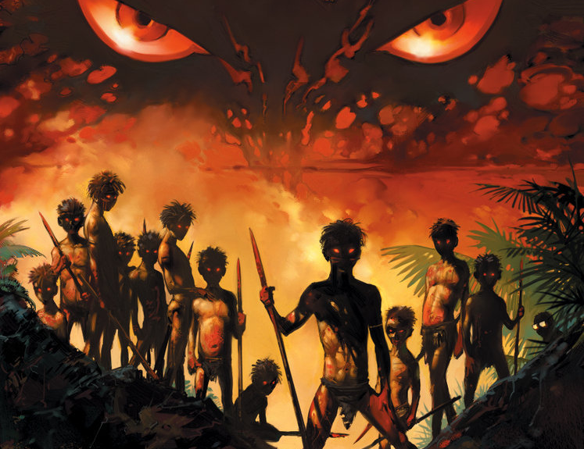
Lord of the Flies

Slide 2
simile
S M P A O I R
Write these letters in your book. Next to each, write down as many language techniques as you can that begin with this letter.
An example has been given to get you started.

Slide 3
Possible answers:
S M P A O I R
• Similes
• Metaphors
• Personification
• Alliteration
• Sibilance
• Onomatopoeia
• Irony
• Repetition
In pairs, write a definition of each of these terms, then give an example.

Slide 4
“You said you wanted a small fire and you been and built a pile like a hayrick. If I say anything,” cried Piggy, with bitter realism, “you say shut up; but if Jack or Maurice or Simon–”
He paused in the tumult, standing, looking beyond them and down the unfriendly side of the mountain to the great patch where they had found dead wood. Then he laughed so strangely that they were hushed, looking at the flash of his spectacles in astonishment. They followed his gaze to find the sour joke.
“You got your small fire all right.”
Smoke was rising here and there among the creepers that festooned the dead or dying trees. As they watched, a flash of fire appeared at the root of one wisp, and then the smoke thickened. Small flames stirred at the trunk of a tree and crawled away through leaves and brushwood, dividing and increasing. One patch touched a tree trunk and scrambled up like a bright squirrel. The smoke increased, sifted, rolled outwards. The squirrel leapt on the wings of the wind and clung to another standing tree, eating downwards. Beneath the dark canopy of leaves and smoke the fire laid hold on the forest and began to gnaw. Acres of black and yellow smoke rolled steadily toward the sea. At the sight of the flames and the irresistible course of the fire, the boys broke into shrill, excited cheering. The flames, as though they were a kind of wild life, crept as a jaguar creeps on its belly toward a line of birch-like saplings that fledged an outcrop of the pink rock. They flapped at the first of the trees, and the branches grew a brief foliage of fire. The heart of flame leapt nimbly across the gap between the trees and then went swinging and flaring along the whole row of them. Beneath the capering boys a quarter of a mile square of forest was savage with smoke and flame. The separate noises of the fire merged into a drum-roll that seemed to shake the mountain.
“You got your small fire all right.”
Startled, Ralph realized that the boys were falling still and silent, feeling the beginnings of awe at the power set free below them. The knowledge and the awe made him savage.

Slide 5
SECTION A: READING
4 marks
Read the text
Q1
Q2
Q3
Q4
20 marks
8 marks
8 marks

Slide 6
AO1: Identify and interpret explicit and implicit information and ideas.
Select and synthesise evidence from different texts.
AO2: Explain, comment on and analyse how writers use language to achieve effects and influence readers, using relevant subject terminology to support their views

Slide 7
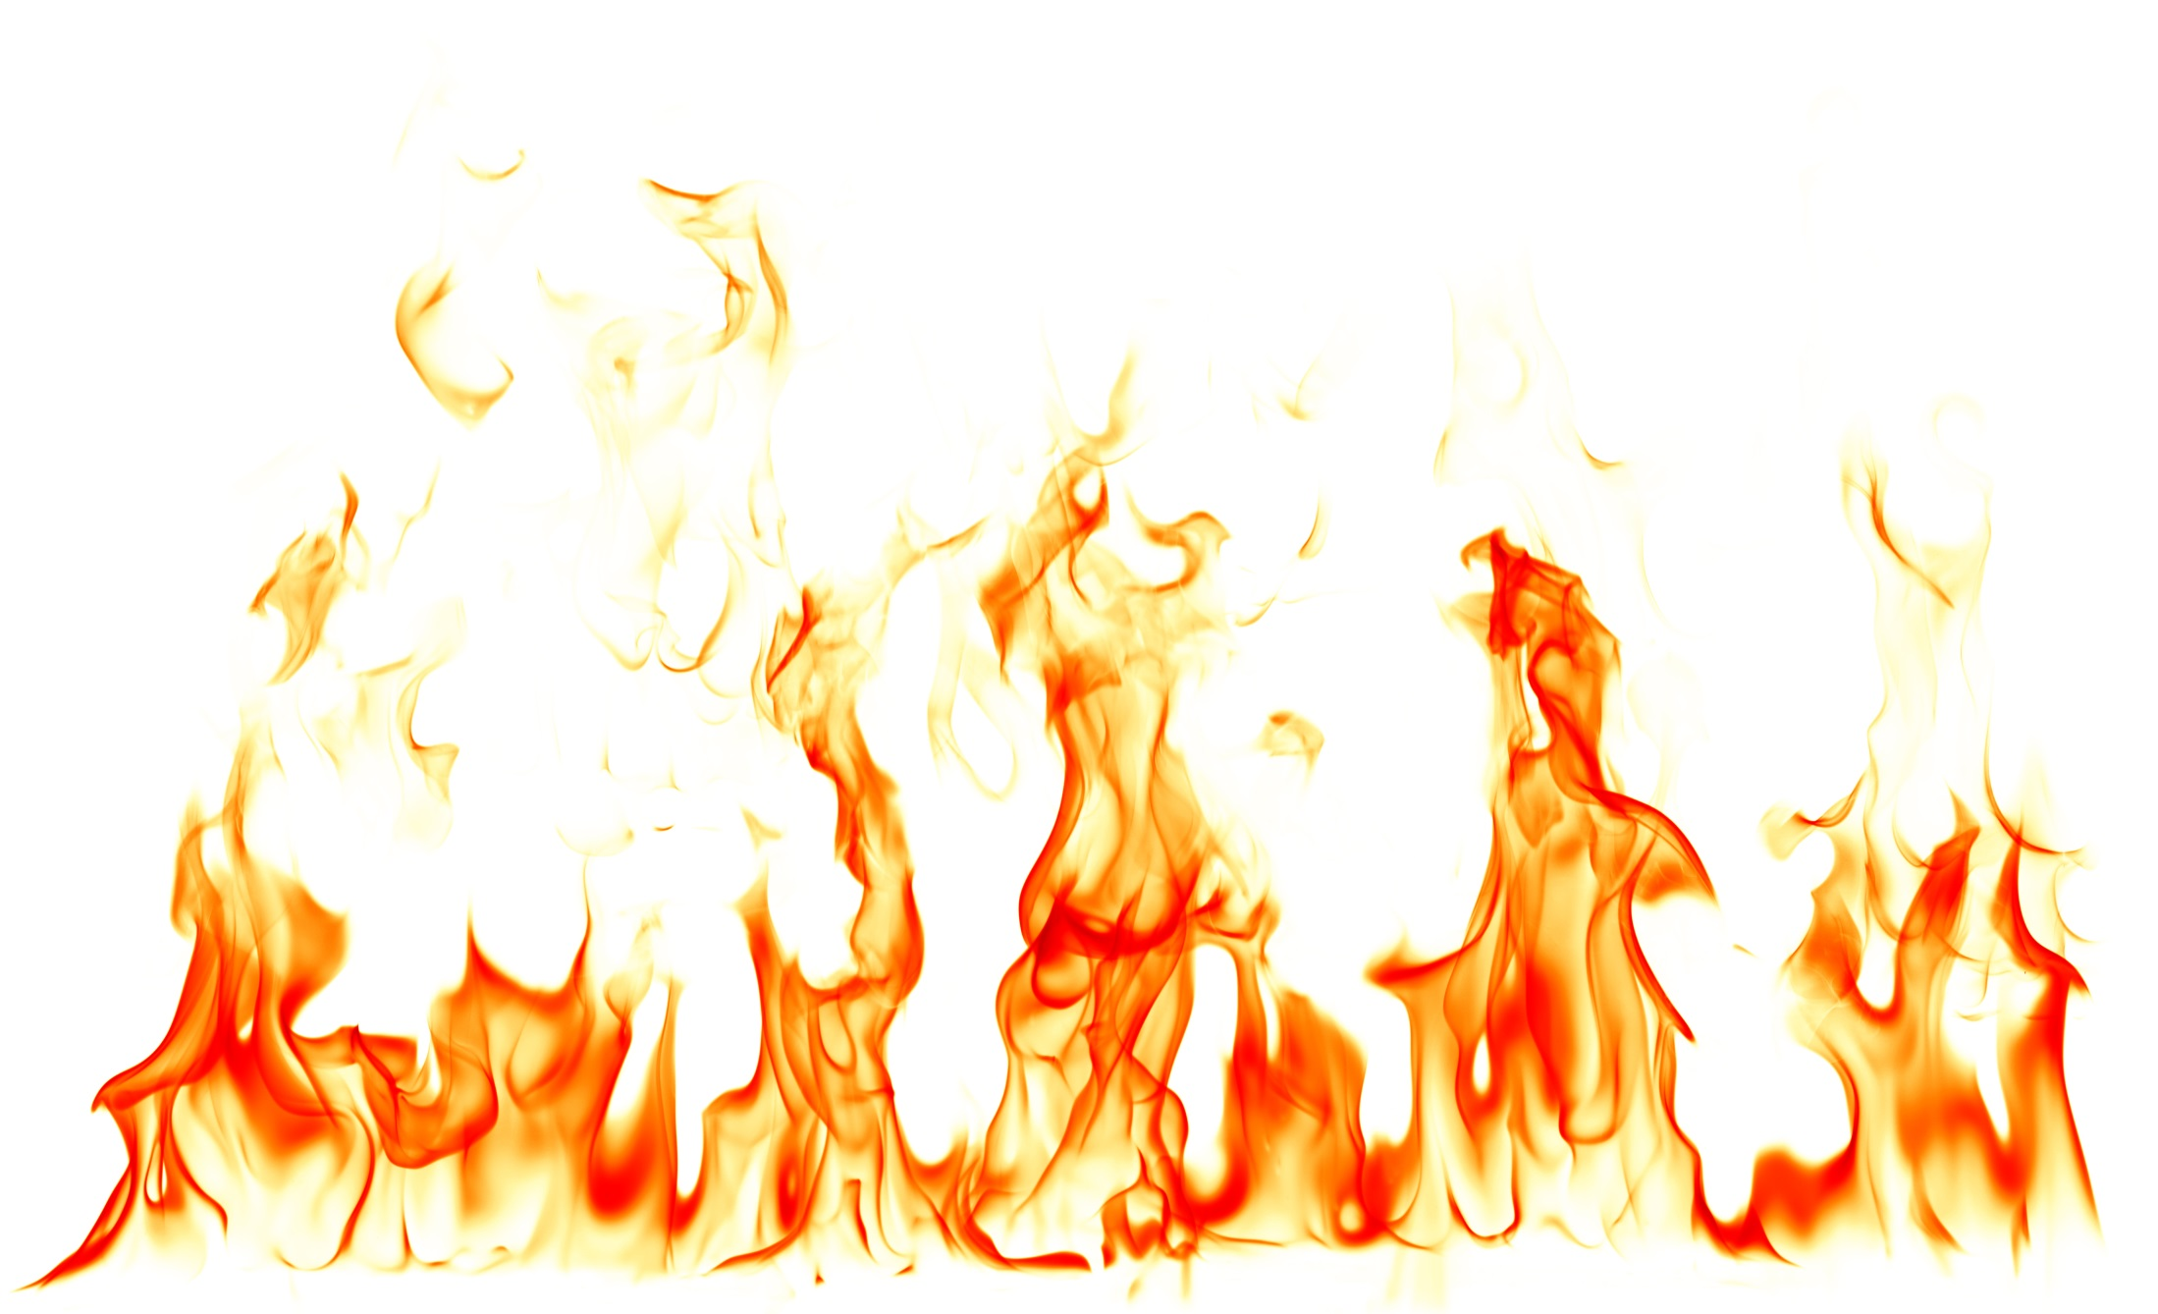
Read again the first part of the source, lines 7 to 13.
List four things from this part of the text about the fire.
[4 marks]

Slide 8
Q1: List four things from this part of the text about the fire.
Smoke was rising here and there among the creepers that festooned the dead or dying trees. As they watched, a flash of fire appeared at the root of one wisp, and then the smoke thickened. Small flames stirred at the trunk of a tree and crawled away through leaves and brushwood, dividing and increasing. One patch touched a tree trunk and scrambled up like a bright squirrel. The smoke increased sifted, rolled outwards. The squirrel leapt on the wings of the wind and clung to another standing tree, eating downwards. Beneath the dark canopy of leaves and smoke the fire laid hold on the forest and began to gnaw. Acres of black and yellow smoke rolled steadily toward the sea.

Slide 9
Responses must be drawn from lines 7-13 of the text
Responses must be true statements from the extract
Responses must relate to the fire
Candidates may quote or paraphrase – each is acceptable
A paraphrased response covering more than one point should be credited for each point made.

Slide 10
Responses can include but are not restricted to:
The fire is described as ‘small’ – a ‘flash’ to start off
The fire generates ‘smoke’
It started to become powerful and spread across the forest as ‘smoke increased’ and it ‘laid hold of the forest’
The fire is quick- it’s described as a ‘squirrel’ leaping on the ‘wings of the wind’ from tree to tree
It spreads through the forest- ‘crawls’ on the forest floor
It is destructive ‘gnaws’.

Slide 11
Look in detail at this extract from lines 7 to 19 of the source. How does the writer use language here to describe the effects of the fire?
[8 marks]
You could include the writer’s choice of:
words and phrases
language features and techniques
sentence forms

Slide 12
Can you identify the language devices used below?
The cotton wool clouds floated carelessly
The teacher was as angry as a bear
He wore his heart on his sleeve
The wind screamed through the trees
Write each example in your book.
Underline and identify the technique used.
Annotate each example with an idea about the effect of each technique.

Slide 13
Now read the text again. Identify and annotate any language techniques you find, making sure you comment on the effect of each one.

Slide 14
Q2: How does the writer use language here to describe the effects of the fire?
Smoke was rising here and there among the creepers that festooned the dead or dying trees. As they watched, a flash of fire appeared at the root of one wisp, and then the smoke thickened. Small flames stirred at the trunk of a tree and crawled away through leaves and brushwood, dividing and increasing. One patch touched a tree trunk and scrambled up like a bright squirrel. The smoke increased, sifted, rolled outwards. The squirrel leapt on the wings of the wind and clung to another standing tree, eating downwards. Beneath the dark canopy of leaves and smoke the fire laid hold on the forest and began to gnaw. Acres of black and yellow smoke rolled steadily toward the sea. At the sight of the flames and the irresistible course of the fire, the boys broke into shrill, excited cheering. The flames, as though they were a kind of wild life, crept as a jaguar creeps on its belly toward a line of birch-like saplings that fledged an outcrop of the pink rock. They flapped at the first of the trees, and the branches grew a brief foliage of fire. The heart of flame leapt nimbly across the gap between the trees and then went swinging and flaring along the whole row of them. Beneath the capering boys a quarter of a mile square of forest was savage with smoke and flame. The separate noises of the fire merged into a drum-roll that seemed to shake the mountain.

Slide 15
Q2: How does the writer use language here to describe the effects of the fire?
Q
W
E
R
T
Y
Golding employs a range of language devices to engage the reader. At the start of the piece the fire is described as a ‘flash of fire’ which suggests that it is small and insignificant. However, as the paragraph develops the fire ‘scramble[s] up like a bright squirrel’. The simile use is effective as the reader is able to visualise how the fire is moving rapidly from tree to tree on the ‘wings of the wind’ the use of personification also allows the reader to create mental images of how the fire is almost flying across the air and gains ground, becoming more powerful.

Slide 16
Look in detail at this extract from lines 7 to 19 of the source. How does the writer use language here to describe the effects of the fire?
[8 marks]
You could include the writer’s choice of:
words and phrases
language features and techniques
sentence forms

Slide 17
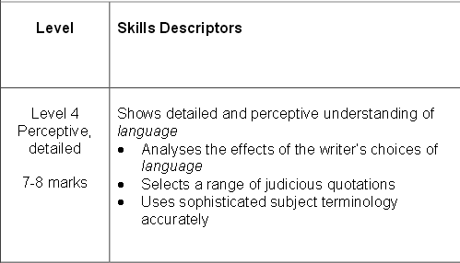
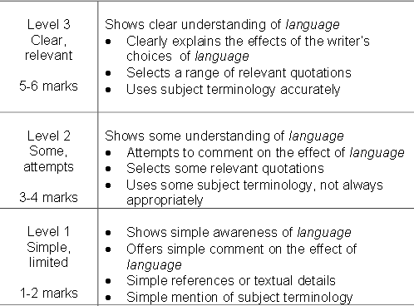
WWW/EBI
Peer assess each other’s work, marking WWW/EBI onto the text as you read.
What band would you award for this answer?

Slide 18
You now need to think about the whole of the source. This text is from Chapter Two in Lord of the Flies.
How has the writer structured the text to interest you as a reader? [8 marks]
You could write about:
what the writer focuses your attention on at the beginning
how and why the writer changes this focus as the extract develops
any other structural features that interest you.

Slide 19
Q3: How has the writer structured the text to interest you as a reader?
In pairs, re-read the text and highlight all the short snappy sentences the writer uses when describing the fire.
Look at when and where these short sentences are used and what the effect of these sentences is. Now look around them: are there any longer, more complex sentences nearby? How is the text structured?
What might these sentences suggest about the fire? How does this interest us as a reader?
See if you can identify:
Complex sentences which create pace and reflect the speed of the fire
Short, simple sentences to reflect the cracking, sudden movements of the fire
Compound sentences to highlight the fire’s longevity and perseverance

Slide 20
Q3: How has the writer structured the text to interest you as a reader?
Now think about how punctuation is used for effect. In pairs, highlight all the parts of the text where punctuation is deliberately used for effect.
See if you can find and comment on:
the impact of the dash
the way direct speech is highlighted
repeated use of commas for pace
the absence of punctuation in some sentences to show the fire is uncontrollable

Slide 21
Q3: How has the writer structured the text to interest you as a reader?
Now let’s think about how the text develops – and why.
What impact does this structure have?
How does it engage the reader?
How does it guide us through the text?

Slide 22
Q3: How has the writer structured the text to interest you as a reader?
dialogue
description
comment from Piggy
more description
repeated comment from Piggy
inside Ralph’s head

Slide 23
Q3: How has the writer structured the text to interest you as a reader?
Now let’s think about how the text develops – and why.
What impact does this structure have?
How does it engage the reader?
How does it guide us through the text?

Slide 24
You now need to think about the _____ of the source. This text is from Chapter Two in Lord of the Flies.
How has the writer _______ the text to _______ you as a reader? [ ____ marks]
You could write about:
what the writer focuses your attention on at the ________
how and _____ the writer changes this focus as the extract develops
any other _______ features that interest you.

Slide 25
You now need to think about the whole of the source. This text is from Chapter Two in Lord of the Flies.
How has the writer structured the text to interest you as a reader? [8 marks]
You could write about:
what the writer focuses your attention on at the beginning
how and why the writer changes this focus as the extract develops
any other structural features that interest you.

Slide 26
Q3: How has the writer structured the text to interest you as a reader?
Q
W
E
R
T
Y
Golding starts the piece off with lively dialogue; Piggy expresses his annoyance at Ralph; “You said you wanted a small fire and you been and built a pile like a hayrick. If I say anything,” cried Piggy, with bitter realism, “you say shut up; but if Jack or Maurice or Simon–” However, he pauses and the dash indicates the dramatic pause, as if he is distracted, and he does not elaborate. The dramatic pause indicates to the reader that he is noticing something and that something is wrong. In addition, the fact that he does not provide any other information adds to the tension of what he is to reveal next and grips the reader’s attention.

Slide 27
You now need to think about the whole of the source. This text is from Chapter Two in Lord of the Flies.
How has the writer structured the text to interest you as a reader? [8 marks]
You could write about:
what the writer focuses your attention on at the beginning
how and why the writer changes this focus as the extract develops
any other structural features that interest you.

Slide 28
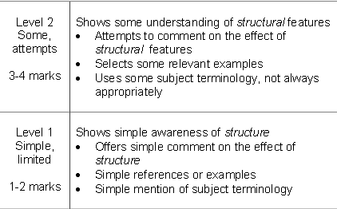
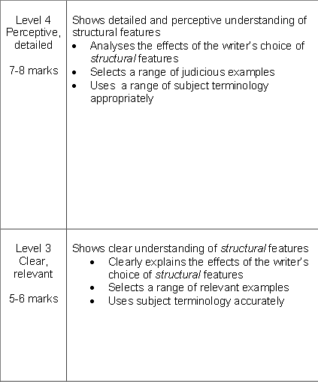
WWW/EBI
Peer assess each other’s work, marking WWW/EBI onto the text as you read.
What band would you award for this answer?

Slide 29
SECTION A: READING
4 marks
Read the text
Q1
Q2
Q3
Q4
20 marks
8 marks
8 marks

Slide 30
Based on everything we have discussed so far… what makes this an interesting piece of writing?
1. What does ‘interesting’ or ‘exciting’ mean in the context of an exam question about readers’ reactions?
2. What do you do if you, yourself, don’t find anything about the text ‘interesting’ ?
Answer: you focus on what you think was supposed to be interesting or exciting. The text has been chosen for a reason. There has to be something to write about! Try to move outside of your own personal preferences and think about what a wider audience might find interesting, what the writer meant to be interesting… or even what the exam board thinks is interesting!

Slide 31
Bearing this in mind…
Skim through the text one more time, highlighting all the images that make the piece exciting.

Slide 32
Question 4:
A student, having read this section of the text said: “The writer brings the very different characters to life for the reader. It is as if you are on the island with them.” To what extent do you agree?
In your response, you should:
write about your own impressions of the characters
evaluate how the writer has created these impressions
support your opinions with quotations from the text.

Slide 33
Q4: To what extent do you agree?

Slide 34
CLEAR
RELEVANT
EVALUATION
What do these words mean?
What does an examiner expect from a L3 candidate?

Slide 35
PERCEPTIVE
DETAILED
EVALUATION
What do these words mean?
What does an examiner expect from a L4 candidate?

Slide 36
Bearing this in mind…
Skim through the text one more time, highlighting all the images that make the piece exciting.
Go back to your answers to this task. Can you improve or add anything to them now that you have looked at the L3 and L4 criteria?

Slide 37
Question 4:
A student, having read this section of the text said: “The writer brings the very different characters to life for the reader. It is as if you are on the island with them.” To what extent do you agree?
In your response, you should:
write about your own impressions of the characters
evaluate how the writer has created these impressions
support your opinions with quotations from the text.
Don’t ignore the bullet points! Try to come up with 2-3 in depth ideas, addressing each bullet point when you write about them.

Slide 38
In pairs, try to come up with an idea you could write about … for example:
Impressions of the characters:
Ralph is angry and frustrated that the boys are so easily excited by the fire.
How the writer has created this impression:
The extract ends with Ralph’s response to the boys’ cheering the fire. He is ‘startled’ but also ‘savage’.
Evidence to support this idea:
“The knowledge and the awe made him savage.”

Slide 39
Now look at your idea.
Remember that you are being asked to evaluate, so don’t just present the examiner with the obvious.
Reflect on why ideas are presented in a certain way. Develop your ideas in more detail by digging in to your quote, considering what the reader is learning from each of these points and quotes. You can comment on language and on structure in your answer.

Slide 40
Q4: To what extent do you agree?
Q
W
E
R
T
Y
Golding shows the reader that Ralph realises that the boys are mesmerised by the fire and ‘[t]he knowledge and the awe made him savage.’ The fact that the boys are so easily distracted and impressed by the wrong things frustrates him. He is disappointed that they are impressed by the fire (‘excited cheering’) rather than horrified by the consequences of their actions; the adjective ‘savage’ suggests that he is furious at them, revealing a dark side to his personality as well as a moral outrage that the boys are cheering the fire. On the other hand, ‘startled’ shows us that he did not expect this and was taken by surprise. That this happens at the end of the extract, focuses us on Ralph’s reaction and makes it important, bringing him to life for the reader.

Slide 41
Question 4:
A student, having read this section of the text said: “The writer brings the very different characters to life for the reader. It is as if you are on the island with them.” To what extent do you agree?
In your response, you should:
write about your own impressions of the characters
evaluate how the writer has created these impressions
support your opinions with quotations from the text.

Slide 42
Q4: To what extent do you agree?
WWW/EBI
Peer assess each other’s work, marking WWW/EBI onto the text as you read.
What band would you award for this answer?

