Slide 1
Based on this image, what can you denote about today’s poem and the themes/issues it may explore?
How do you think this poem may link to greater ideas of ‘Power’ and ‘Conflict’?

Slide 2
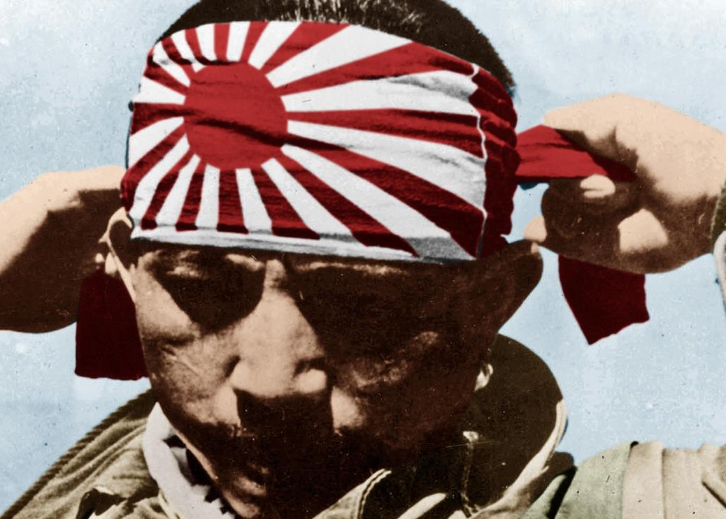
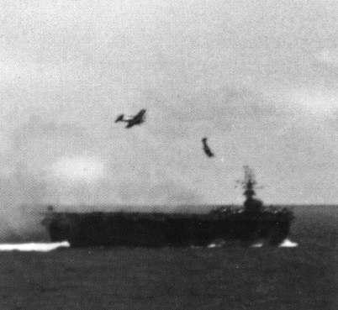
LO: To have a secure understanding of Garland’s ‘Kamikaze’. To show an understanding of the relationship between a poem and its context
Read and retrieve
Read the information sheet provided.
Create a spider diagram with key information about who/what Kamikaze pilots were.
Notes:
http://www.history.com/topics/world-war-ii/world-war-ii-history/videos/kamikaze-pilots

Slide 3
LO: To have a secure understanding of Garland’s ‘Kamikaze’. To show an understanding of the relationship between a poem and its context
Watch and retrieve
Now we are going to watch a short clip.
As you watch, add any extra information to your spider diagram

Slide 4
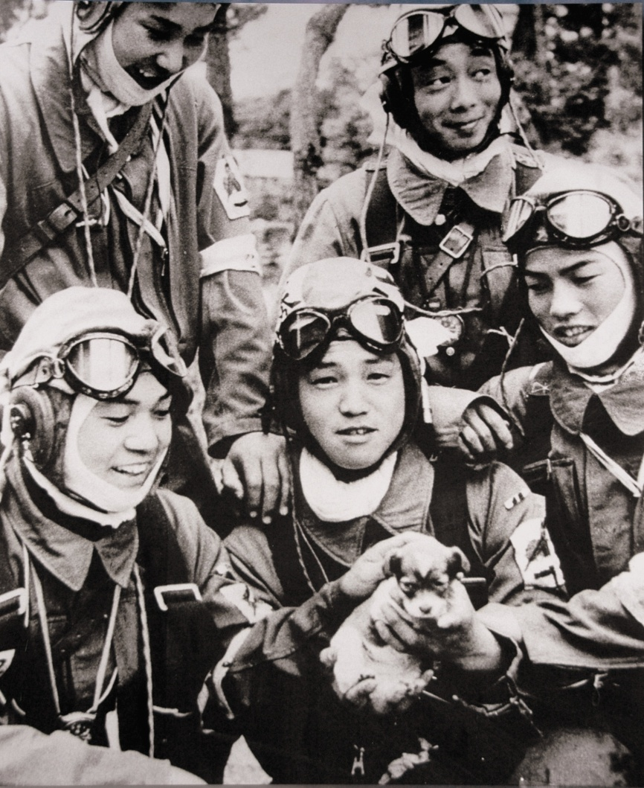
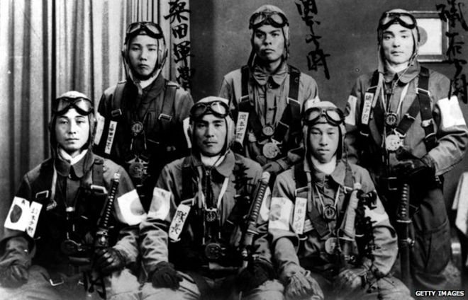
LO: To have a secure understanding of Garland’s ‘Kamikaze’. To show an understanding of the relationship between a poem and its context
Think, pair, share
Q. Is someone who is willing to take their own life and the lives of others ‘inhuman’?
Notes:
What were these men like?
What sorts of personalities would they have had?

Slide 5
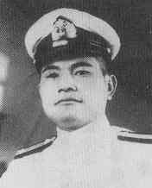
LO: To have a secure understanding of Garland’s ‘Kamikaze’. To show an understanding of the relationship between a poem and its context
You have been given final letters to loved ones from Kamikaze pilots.
Listen to the summaries of the letters and jot down ideas on how you think these young men present themselves
(This can be key words/phrases)
“I go in good spirits”
Lieutenant Junior Grade Seiichi Maebashi

Slide 6
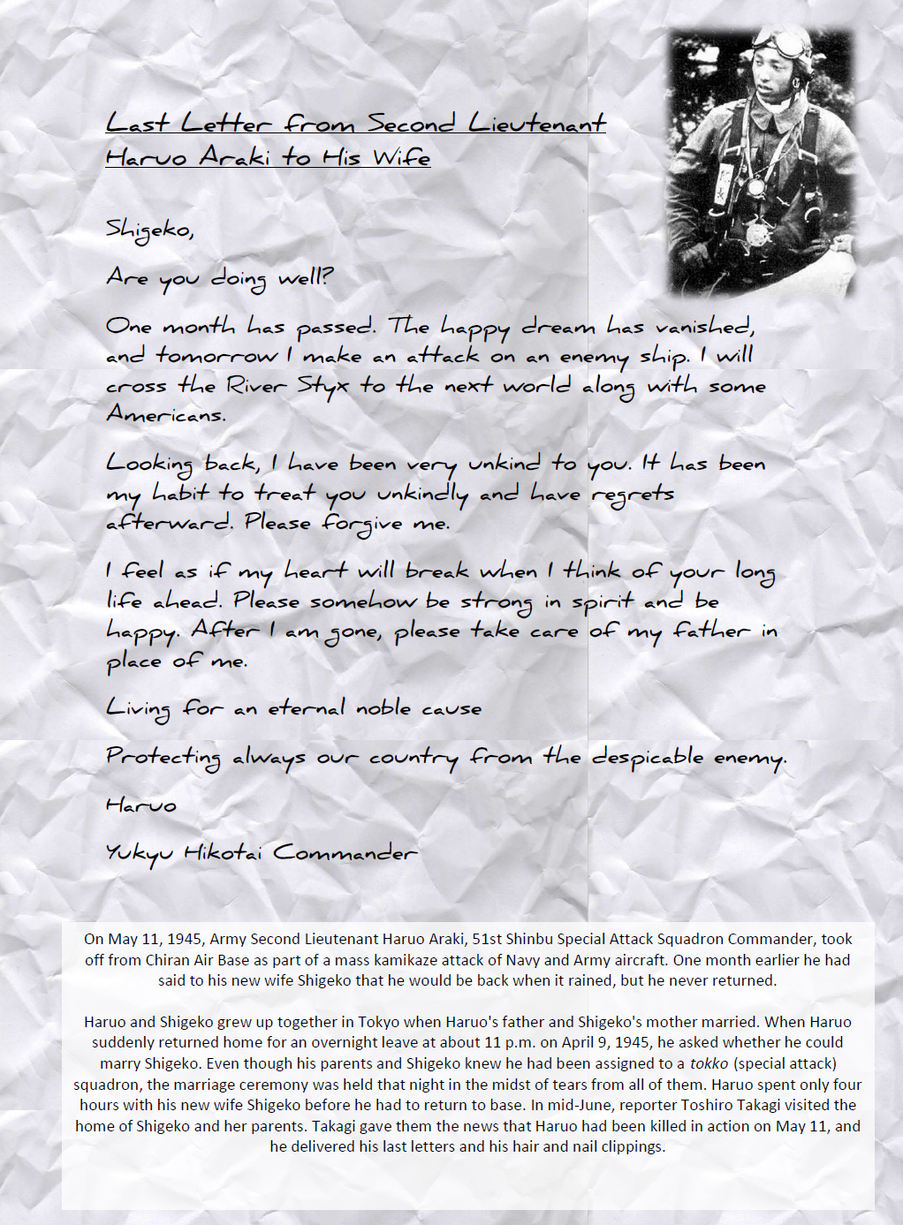
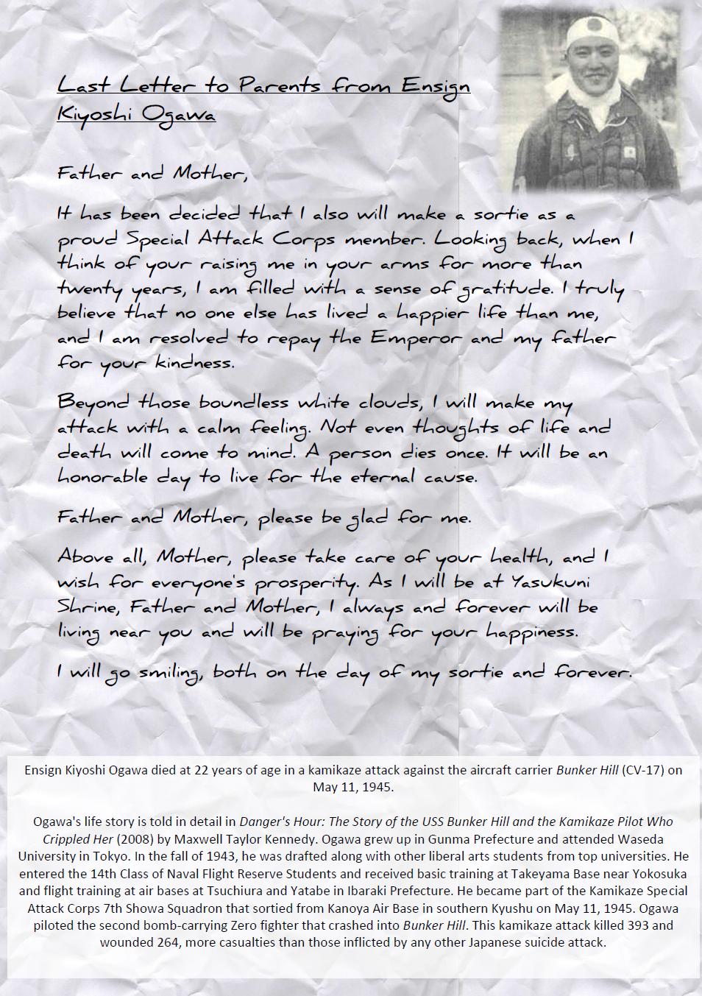
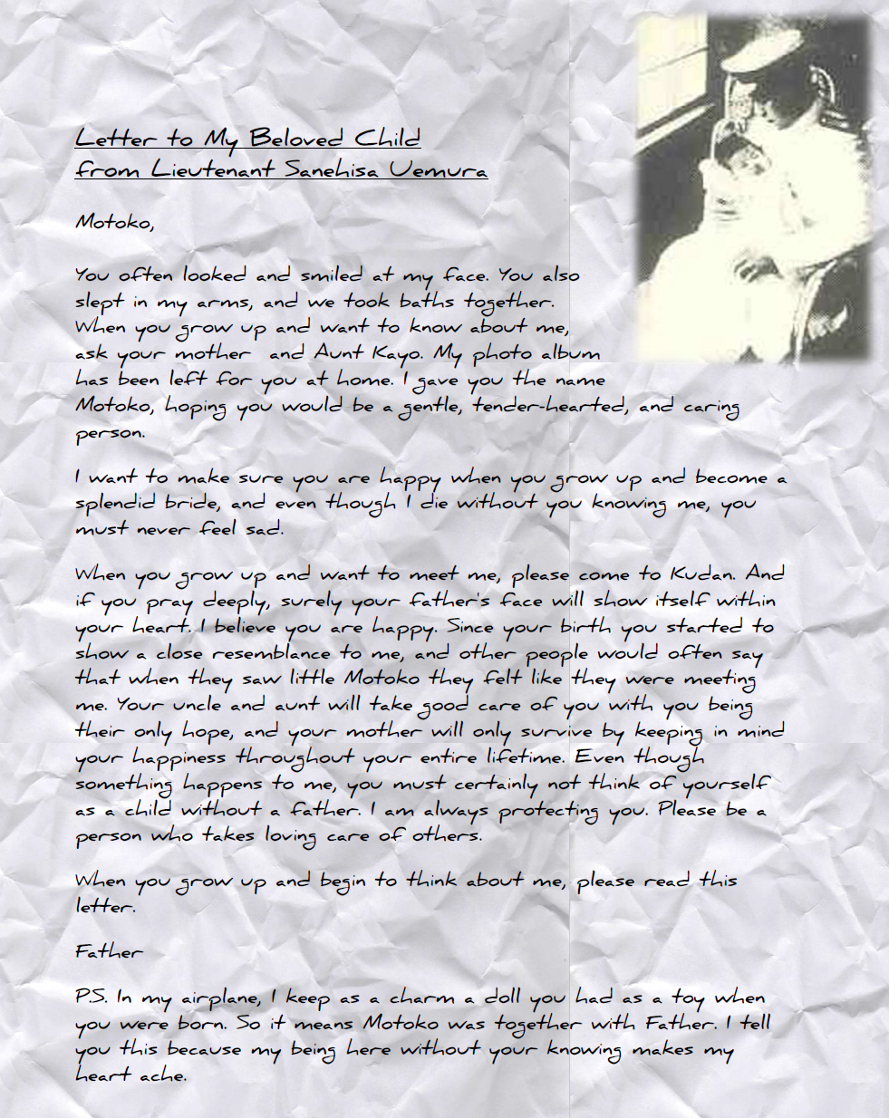
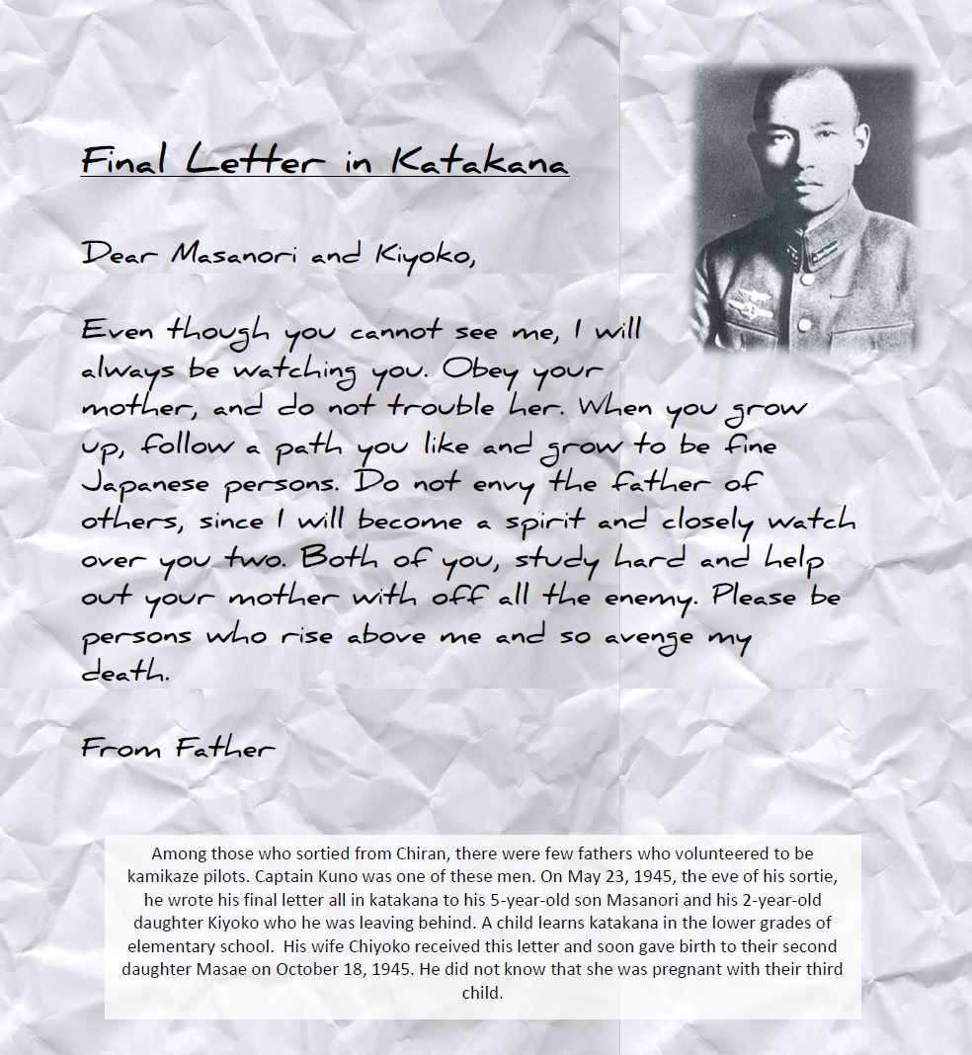

Slide 7
What does this true story reveal about power?
Commander Asaiki Tamai asked a group of 23 talented student pilots, all of whom he had trained, to volunteer for the special attack force. All of the pilots raised both of their hands, volunteering to join the operation.
Later, Tamai asked Lieutenant Yukio Seki to command the special attack force. Seki is said to have closed his eyes, lowered his head and thought for 10 seconds, before saying: "Please do appoint me to the post." Seki became the 24th kamikaze pilot to be chosen.
However, Seki later said: "Japan's future is bleak if it is forced to kill one of its best pilots." and "I am not going on this mission for the Emperor or for the Empire... I am going because I was ordered to."

Slide 8
Beatrice Garland - Kamikaze
Her father embarked at sunrise with a flask of water, a samurai sword in the cockpit, a shaven head full of powerful incantations and enough fuel for a one-way journey into history
but half way there, she thought, recounting it later to her children, he must have looked far down at the little fishing boats strung out like bunting on a green-blue translucent sea
and beneath them, arcing in swathes like a huge flag waved first one way then the other in a figure of eight, the dark shoals of fishes flashing silver as their bellies swivelled towards the sun
and remembered how he and his brothers waiting on the shore built cairns of pearl-grey pebbles to see whose withstood longest the turbulent inrush of breakers bringing their father’s boat safe

Slide 9
– yes, grandfather’s boat – safe to the shore, salt-sodden, awash with cloud-marked mackerel, black crabs, feathery prawns, the loose silver of whitebait and once a tuna, the dark prince, muscular, dangerous.
And though he came back my mother never spoke again in his presence, nor did she meet his eyes and the neighbours too, they treated him as though he no longer existed, only we children still chattered and laughed
till gradually we too learned to be silent, to live as though he had never returned, that this was no longer the father we loved. And sometimes, she said, he must have wondered which had been the better way to die.

Slide 10
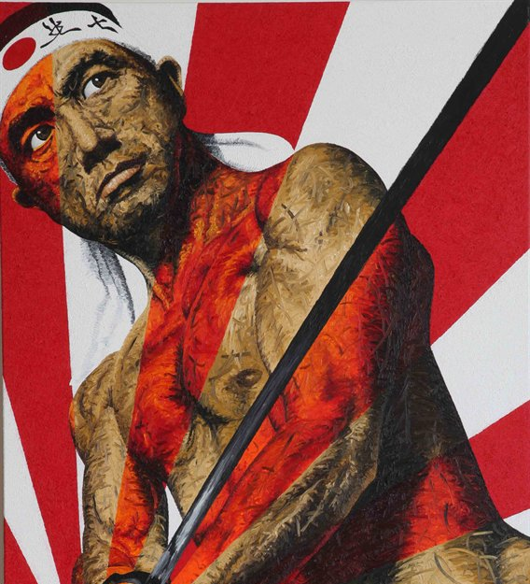
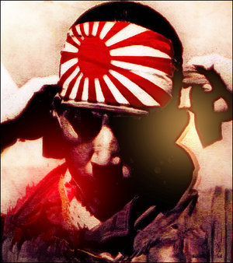
“Her father embarked at sunrise with a flask of water, a samurai sword in the cockpit…”
Why do you think Garland has said that the pilot had a “samurai sword”? Why not a gun?
Why is the verb ‘embark’ significant? Why at sunrise?

Slide 11
Possible double meaning. Literal meaning to board a plane. Or ‘embark’ on a new adventure – positive connotations, done willingly.
Japan = ‘land of the rising sun’
“Her father embarked at sunrise with a flask of water, a samurai sword in the cockpit…”
Link to warrior samurai and seppuku – ritual honour suicide by stabbing self in the abdomen.

Slide 12
LO: To analyse Garland’s use of language, form and structure to generate meaning
Soldiers shaved their heads as part of a ritual to demonstrate their readiness as well as remaining dignified, even in death.
Her father embarked at sunrise with a flask of water, a samurai sword in the cockpit, a shaven head full of powerful incantations and enough fuel for a one-way journey into history
What is the significance of the noun ‘incantations’?
Implies death
Highlights the honour and recognition the pilots received. They would never be forgotten.

Slide 13
LO: To analyse Garland’s use of language, form and structure to generate meaning
Volta: shift/change in tone
Pilot’s experience is only interpreted by others. Generations have speculated but the pilot does not have a voice.
but half way there, she thought, recounting it later to her children, he must have looked far down at the little fishing boats strung out like bunting on a green-blue translucent sea
Modal verb: she is trying to justify the pilot’s actions and understand his plight. The narrator shows sympathy towards him and his experience.
Simile: bunting is for celebration. This is ironic. Why might this simile be used here?

Slide 14
LO: To analyse Garland’s use of language, form and structure to generate meaning
Consonance: The repetition of ‘s’ and ‘f’ sounds creates pace and could mimic the motion of the aircraft. It also echoes the sea.
and beneath them, arcing in swathes like a huge flag waved first one way then the other in a figure of eight, the dark shoals of fishes flashing silver as their bellies swivelled towards the sun
‘Flag’ extends the metaphor begun by ‘bunting’. Is this celebration or surrender?
Extends metaphor of the ‘flag’: the fish show their bellies to the sun (seppuku). Shame of surrender – die first. Sibilance reinforces this.
Past tense verb: recalls the fatal spiral pilots used to hit their targets.
Images of celebration, surrender and death are mixed into the beauty of nature which surround him.

Slide 15
LO: To analyse Garland’s use of language, form and structure to generate meaning
It is his memory which causes him to stop. Why is this important?
A mound of rough stone built as a memorial or landmark. Why is this ironic?
and remembered how he and his brothers waiting on the shore built cairns of pearl-grey pebbles to see whose withstood longest the turbulent inrush of breakers bringing their father’s boat safe
Contrast ‘turbulent’ with ‘safe’ – he and his brother worked to bring the boat to safety. This is not possible for the pilot on his current mission.
Notice the lack of punctuation. Does this enjambment suggest the pilots decision was not a conscious one? That his childhood memories get the better of him?

Slide 16
LO: To analyse Garland’s use of language, form and structure to generate meaning
Italics: spoken words (‘recounting it later to her children’
Repetition of this key word.
Sibilance: echoes sea; gives impression of reading like a nursery rhyme – why?
– yes, grandfather’s boat – safe to the shore, salt-sodden, awash with cloud-marked mackerel, black crabs, feathery prawns, the loose silver of whitebait and once a tuna, the dark prince, muscular, dangerous.
Alone. Removed from the rest of the group. How does this relate to the pilot?
Notice the care taken to describe the fish: what profession might the pilot have had in peacetime?
The images of the fish the pilot sees and the fish in his memory are linked in his mind – one triggers the other.

Slide 17
LO: To analyse Garland’s use of language, form and structure to generate meaning
Italics: spoken words (‘recounting it later to her children’
And though he came back my mother never spoke again in his presence, nor did she meet his eyes and the neighbours too, they treated him as though he no longer existed, only we children still chattered and laughed
Sense of betrayal and shame.
Why might the children be the only ones to acknowledge the pilot?
What is the conflict in this stanza?

Slide 18
LO: To analyse Garland’s use of language, form and structure to generate meaning
till gradually we too learned to be silent, to live as though he had never returned, that this was no longer the father we loved. And sometimes, she said, he must have wondered which had been the better way to die.
Why not?
Long line: contains a big question. No answer is given. The reader must form their own.
What does she mean?
How does this link to conflict?
The modal verb ‘must’ creates a bond between the pilot and the narrator. There is a hint of desperation in the tone as though the narrator wants the reader to also show him mercy.

Slide 19
LO: To analyse Garland’s use of form and structure to generate meaning
Structure/Form
Free Verse: poetry that does not rhyme or have a regular rhythm
Enjambment: the continuation of a sentence without a pause beyond the end of a line, couplet, or stanza.
Technique | Why?
Free Verse
Enjambment
Hyphenated asides
Use of italics
Lack of structure/rigidity reflects the lack of control the pilot now has, reflects the loss of control of his thoughts – reflects his internal conflict
Creates a sense of breathlessness – like the pilot
Reflects stream of consciousness
Heightens realism
Makes it more intimate and personal
Signify change in: time, speaker, generation
Reflects numerous conflicts

Slide 20
LO: To analyse Garland’s use of language, form and structure to generate meaning
Power & Conflict in
Kamikaze
Prompt questions:
Who holds power in this poem?
Where is the conflict?
Is there internal conflict?
Is there external conflict?

