Slide 1
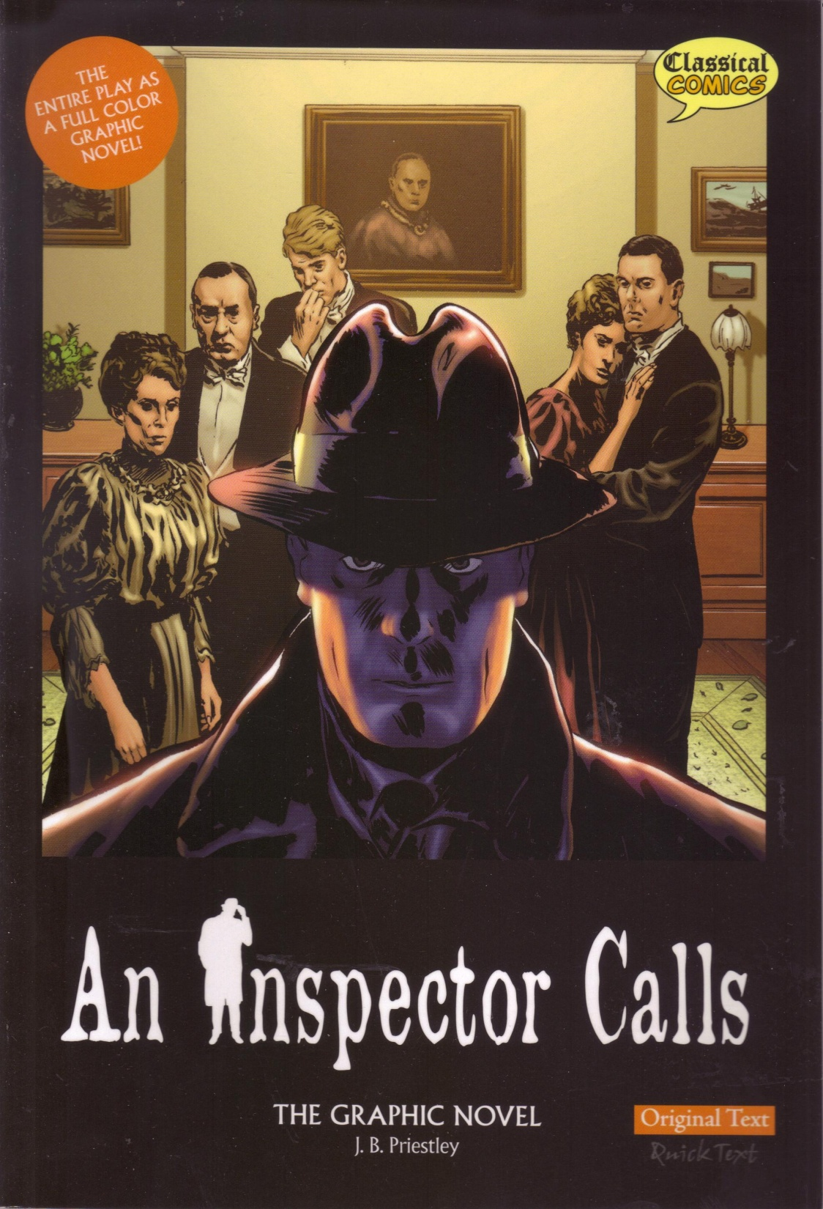
An Inspector Calls
By J.B. Priestley
Unit 3a: Understanding written texts (extended reading)

Slide 2
Learning Objective To know what this CA is all about and understand the AOs. To read and engage with the play itself

Slide 3
Controlled Assessment Tasks for GCSE English Language Unit 3 part a:
Understanding Written Texts (extended reading)
You will have up to 4 hours controlled assessment time
Aim for an upper word limit of 1200 words
The piece is worth 15% of your English GCSE
The writer’s ideas and attitudes (i.e. what is he saying?)
AO3
(i) Read and understand texts, selecting material appropriate to purpose.
(ii) Develop and sustain interpretations of writers’ ideas and perspectives.
(iii) Explain and evaluate how writers use linguistic, grammatical, structural and presentational features to achieve effects and engage and influence the reader.
Include and analyse quotations and support your points with detailed textual evidence.
How the writer uses language and structure to achieve effects and engage the audience.

Slide 4
How does Priestley use the character of the Inspector to present his ideas about society?
Band 5
(i) Sophisticated interpretation of texts.
(ii) Sophisticated engagement with writer’s ideas and attitudes.
(iii) Uses imaginatively selected supporting textual detail.
(iii) Sophisticated analysis of aspects of language and structure.
Ideas. Purpose. Quotes. Analysis.
But don’t worry about this yet. First, we’re going to read the play.

Slide 5
As we read ‘An Inspector Calls’, try to keep these questions in mind...
What kind of person is the Inspector?
Which characters are powerful? Which are weak?
What would this look like on stage?
What is the writer trying to say?

Slide 6
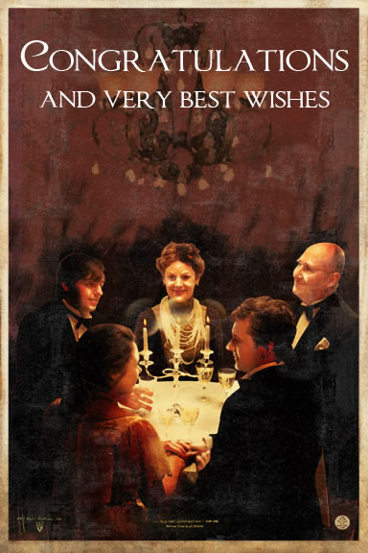
Pick a Part! – Act 1
Stage directions:
Mr Birling:
Mrs Birling:
Gerald:
Sheila:
Eric:
Edna:
The Inspector:

Slide 7
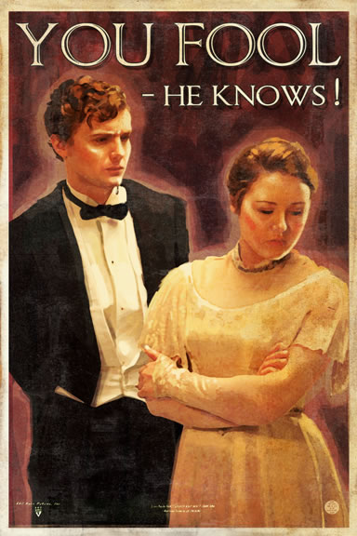
Pick a Part! – Act 2
Stage directions:
Mr Birling:
Mrs Birling:
Gerald:
Sheila:
Eric:
Edna:
The Inspector:

Slide 8
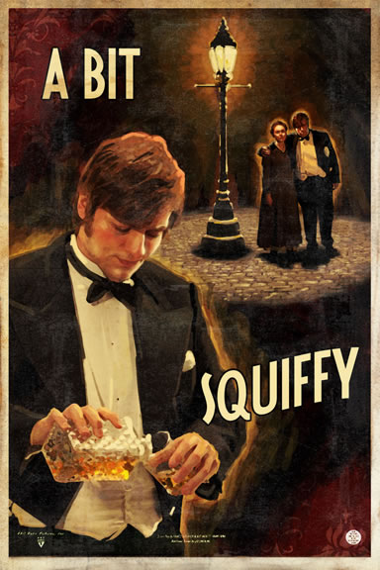
Pick a Part! – Act 3
Stage directions:
Mr Birling:
Mrs Birling:
Gerald:
Sheila:
Eric:
Edna:
The Inspector:

Slide 9
Learning Objective To understand the context of the play ‘An Inspector Calls’

Slide 10
Develop and sustain interpretations of writers’ ideas and perspectives
Who was J B Priestley?
To understand how Priestley used his characters to express ideas and attitudes about society, we need to know something about the writer himself – and the society he lived in.
You will all be given a paper ‘domino’, on which is a question and an answer to (another) question. You task is to find a) the question that you can answer and b) the answer to your question.
The first question is ‘When was John Boynton Priestley born?’. Whomever has the answer to this question should come and stand next to me! That person will then read out his/her question, and so on...

Slide 11
Develop and sustain interpretations of writers’ ideas and perspectives
Who was J B Priestley?
To understand how Priestley used his characters to express ideas and attitudes about society, we need to know something about the writer himself – and the society he lived in.
You have been given a copy of the answers to the dominoes task. Stick this in your book and highlight any details which you can link to the ideas and attitudes in ‘An Inspector Calls’. Which details of Priestley’s life might have influenced this play?

Slide 12
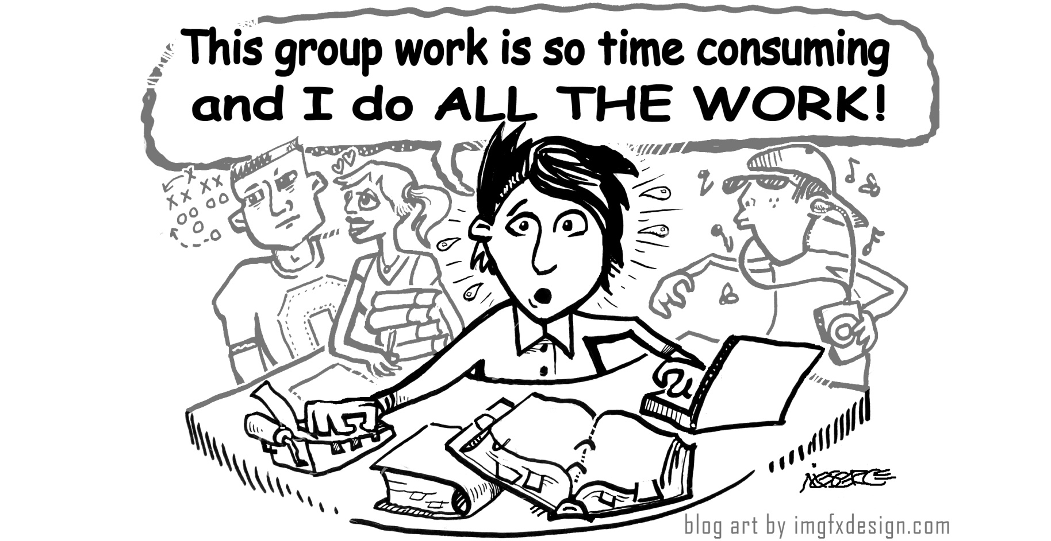
Develop and sustain interpretations of writers’ ideas and perspectives
You have been given a pack of information about the time and society that Priestley lived in. As a group, you should divide the sources and collect information to help you answer the questions on your ‘Ideas and Perspectives’ sheet. Make sure that everyone takes their fair share and that all sources are read and explained to the rest of the group.

Slide 13
Develop and sustain interpretations of writers’ ideas and perspectives
What ideas did Priestley have about society?
From where might his ideas have first stemmed?
How are his ideas represented in ‘An Inspector Calls’? Think about how he engineers the play: what does Mr Birling say about workers and yet what are we supposed to think about Mr Birling’s opinions on anything? Why?
How are his ideas represented in ‘An Inspector Calls’? What does Mrs Birling say about “those kinds of girls”? But what do we think of Mrs Birling? Are we meant to support her ideas?
How does the character of the Inspector represent these views?

Slide 14
Develop and sustain interpretations of writers’ ideas and perspectives
Watch the documentary on the context of ‘An Inspector Calls’ and add any new ideas to your notes.

Slide 15
How does Priestley use the character of the Inspector to present his ideas about society?
Band 5
(i) Sophisticated interpretation of texts.
(ii) Sophisticated engagement with writer’s ideas and attitudes.
(iii) Uses imaginatively selected supporting textual detail.
(iii) Sophisticated analysis of aspects of language and structure.
Ideas. Purpose. Quotes. Analysis.
Now we have an idea about Priestley’s ideas and attitudes (purpose) we can start to collect ideas and quotes for you to analyse and write about.

Slide 16
Learning Objective The Inspector’s Entrance: how and why does Priestley create a sense of conflict?

Slide 17
The Inspector’s Entrance: how and why does Priestley create a sense of conflict?
JB Priestley creates a sense of conflict between the Inspector and the Birlings from the beginning of the play.
Ideas: why? Quotes: when? Analysis: how?
The Inspector’s sense of timing is important throughout the play. He arrives in the middle of Mr Birling’s speech. What is the last thing Mr Birling says before he arrives?
“a man has to mind his own business and look after himself and his own – and –”
Why is this significant? What effect does this have on the audience?

Slide 18
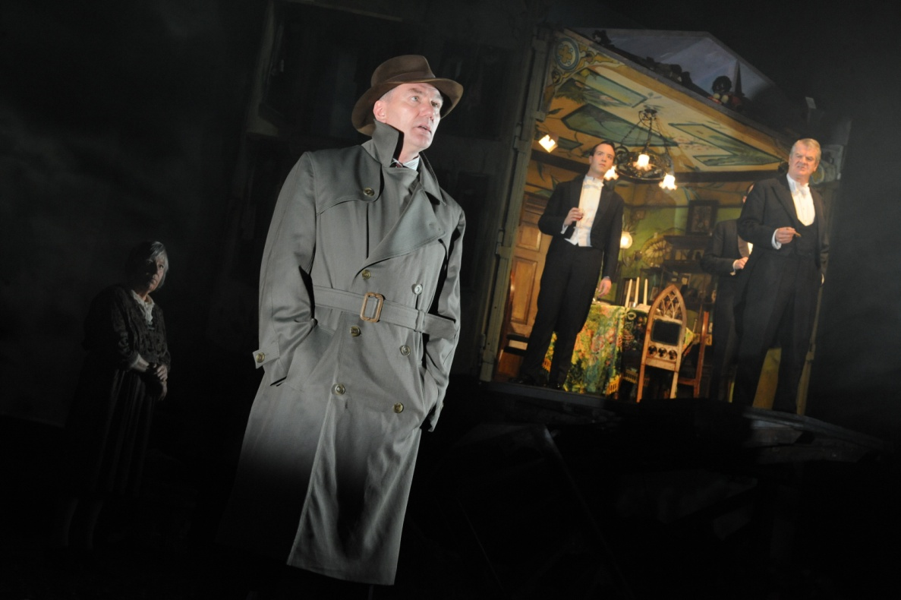
The Inspector’s Entrance: how and why does Priestley create a sense of conflict?
From the moment the Inspector arrives, he seems different. His sombre appearance and the news he brings are a contrast with the happy and elegant air of celebration.

Slide 19
The Inspector’s Entrance: how and why does Priestley create a sense of conflict?
Look at the stage directions surrounding his entrance. How does Priestley create a sense of difference?
Write down your ideas on your sheet. Think about:
class/status
power

Slide 20
The Inspector’s Entrance: how and why does Priestley create a sense of conflict?
‘sharp ring of a front door bell’
“Give us some more light”
‘an impression of massiveness, solidity and purposefulness’
‘a disconcerting habit of looking hard at the person he addresses before actually speaking’
How do these stage directions create a sense of difference/ conflict/ separation between the Inspector and the Birlings?
What is the Inspector there for?

Slide 21
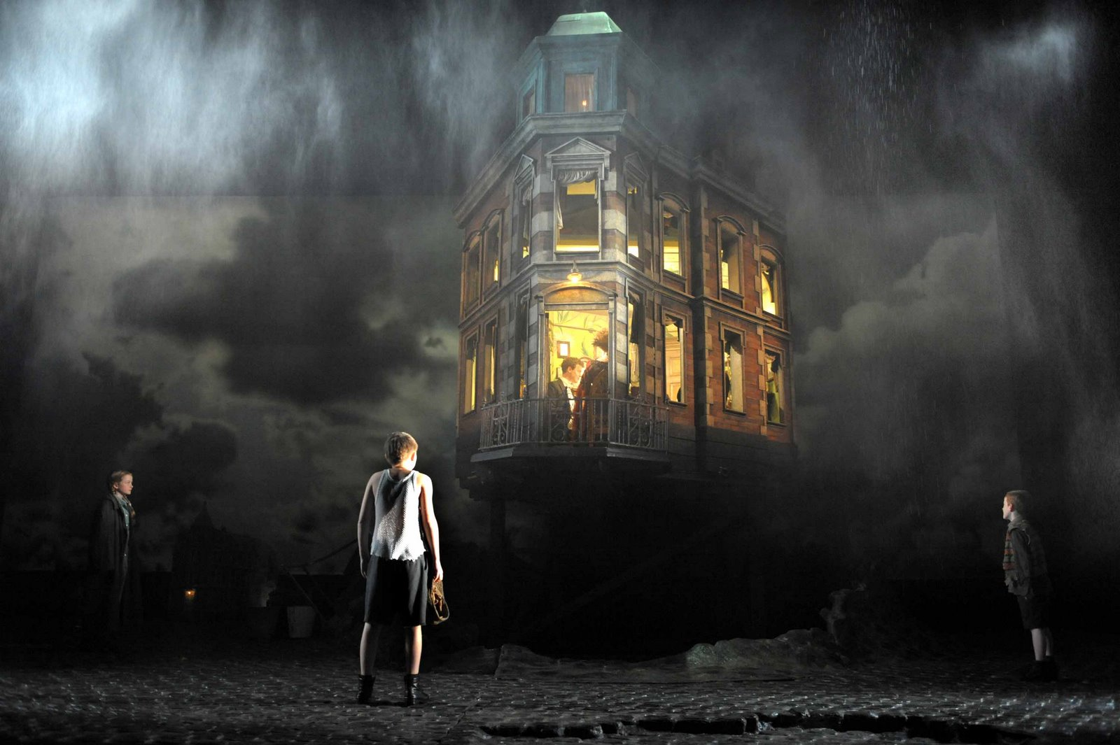
The Inspector’s Entrance: how and why does Priestley create a sense of conflict?
How was this contrast/arrival shown in the stage version of the play?
Make notes as you watch.

Slide 22
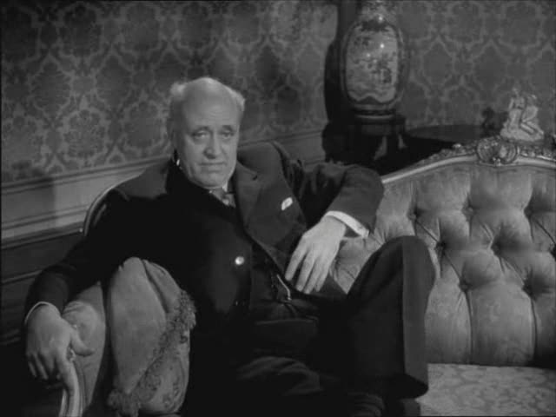
The Inspector’s Entrance: how and why does Priestley create a sense of conflict?
How was this contrast/arrival shown in the film version of the play?
Make notes as you watch.

Slide 23
The Inspector’s Entrance: how and why does Priestley create a sense of conflict?
Birling: It may be something about a warrant.
Gerald [lightly]: Sure to be. Unless Eric’s been up to something. [Nodding confidentially to Birling] And that would be very awkward, wouldn’t it?
Birling [humorously]: Very.
Eric [who is uneasy, sharply]: Here, what do you mean?
Gerald [lightly]: Only something we were talking about when you were out. A joke, really.
Eric [still uneasy]: Well, I don’t think it’s very funny.
Birling [sharply, staring at him]: What’s the matter with you?
Eric [defiantly]: Nothing.
Edna [opening door and announcing]: Inspector Goole.
Priestley could easily have had the Inspector right behind Edna when she announced him, so he would have walked straight into the room as she left. Why do you think Priestley put in this piece of dialogue?

Slide 24
The Inspector’s Entrance: how and why does Priestley create a sense of conflict?
A How and why does Mr Birling try to intimidate the Inspector? How does the Inspector respond?
Consider social class- an Inspector would normally be expected to defer to a man of Birling’s social status.
List some of the ways in which Birling tries to assert his own importance and to belittle the Inspector.
B How does the Inspector speak to the Birlings?
Consider social class- an Inspector would normally be expected to defer to a man of Birling’s social status.
In what tone/manner does he speak to the family?
In what way does he present the details of Eva’s death? Why does this create a sense of conflict?
Write down some quotes, annotating them for ideas and picking out significant words and/or phrases to analyse. Have at least one quote to share with the people on your table.

Slide 25
The Inspector’s Entrance: how and why does Priestley create a sense of conflict?
Consider the questions you have discussed and the quotes chosen by your group. Now use these to answer the following questions:
1. Why do you think it’s important to create a sense of conflict/tension from the Inspector’s first appearance?
2. What is the effect of this on the audience?
3. What is the purpose of the conflict? i.e. what message is Priestley setting out to convey in the conflict between the two men? [Hint: consider the society the play is set in, the society it was first shown in, and the way the inspector fits in with the ideas of the time. What is he there to do? How is this shown?]

Slide 26
The Inspector’s Entrance: how and why does Priestley create a sense of conflict?
You have been given the job of directing a new version of An Inspector Calls. Your producer wants you to bring out a sense of conflict between the Birlings and the Inspector from the start of the play.
How would you stage the Inspector’s entrance?
Consider:
When/how he arrives
What he wears, how he moves, how he speaks etc.
Setting, lighting, sound etc.
How the other characters respond to him
The original stage directions (these should be included)

Slide 27
Learning Objective The Inspector’s Methods – Sheila’s interview

Slide 28
The Inspector’s Methods – Sheila’s interview
“somehow he makes you”
- Sheila
Despite the importance in the local community of people like Gerald and the Birlings, the Inspector controls the development of events: who will speak and when; who may or may not leave; who will or will not see the photograph. He even seems to control what people say. He uses this control to create a sense of conflict or distance between himself and those he interviews.
Recap: why is this conflict or distance important in allowing Priestley to express his ideas and attitudes about class and society?

Slide 29
The Inspector’s Methods – Sheila’s interview
Looking at the Inspector’s interview with Sheila, analyse his use of language:
The Inspector’s Methods:
1. What questions does he ask? (open/closed, tone etc.)
2. What is the effect of these questions?
3. What type of language does he use?
4. How does he respond to what is said by Sheila?
Harsh/kind?
Rude?
Disregards social conventions?
Does he focus on what is moral or what is legal?
5. Does the way he responds change at all? Why?
The Birlings:
1. How does Sheila respond to the Inspector?
2. What emotions does she display (e.g. anger, guilt, remorse...)
3. How does this add to/resolve the conflict?
4. How does this affect the Inspector’s methods?
Staging:
1. How do stage directions and props add to the sense of conflict?
Think about:
the Inspector’s use of the photograph
doors slamming
entrances and exits
other stage directions in the text
Make sure you note down ideas and quotes as well as your analysis.

Slide 30
The Inspector’s Methods – Sheila’s interview
Ideas: Summarise your findings about the way the Inspector interviews Sheila.
Quotes: Pick out five key quotes to back up and illustrate your ideas.
Analyse: What is the effect of these on the audience? How do they make us respond to the Inspector and to Sheila?
Purpose: Why has Priestley done this? How does this interview represent his attitudes and ideas about society?

Slide 31
Q
W
E
R
T
Y
QUESTION - link your answer to the focus of the task
WRITER - remember that the characters only do what the writer makes them do!
EVIDENCE - Use quotations from the text
READER - what effect do the events/ issues have on the reader?
TECHNIQUES - language/ structure
YOUR RESPONSE - explore your own ideas/ your reaction to the text

Slide 32
Q
W
E
R
T
Y
Have a go at writing a QWERTY paragraph, using your notes so far.
How does Priestley use the character of the Inspector to present his ideas about society?
Answer using some key quotes from Sheila’s interview. You could include:
The way he creates conflict/ distance
His focus on what is moral over what is legal
His regard (or disregard!) for social conventions

Slide 33
One of the ways Priestley... Another way... Sheila is also shown to be... The writer suggests... When the Inspector is first described...
Q
}
W
E
This is shown when it says, “___”... An example of this is when Priestley writes, “___”... For example, “___”
R
This makes the reader think... This suggests to the reader... The reader will think... This implies... This suggests...
T
The use of the closed question... The writer’s word choice... The stage direction “___”... The repetition of... This word has strong connotations of...
Y
This suggests... This implies... This links to...

Slide 34
Learning Objective The Inspector’s Methods – Mrs Birling’s interview

Slide 35
The Inspector’s Methods – Mrs Birling’s interview
Looking at the Inspector’s interview with Mrs Birling, analyse his use of language:
The Inspector’s Methods:
1. What questions does he ask? (open/closed, tone etc.)
2. What is the effect of these questions?
3. What type of language does he use?
4. How does he respond to what is said by Mrs Birling?
Harsh/kind?
Rude?
Disregards social conventions?
Does he focus on what is moral or what is legal?
5. Does the way he responds change at all? Why?
The Birlings:
1. How does Mrs Birling respond to the Inspector?
2. What emotions does she display (e.g. anger, guilt, remorse...)
3. How does this add to/resolve the conflict?
4. How does this affect the Inspector’s methods?
Staging:
1. How do stage directions and props add to the sense of conflict?
Think about:
the Inspector’s use of the photograph
doors slamming
entrances and exits
other stage directions in the text
Make sure you note down ideas and quotes as well as your analysis.

Slide 36
The Inspector’s Methods – Mrs Birling’s interview
Ideas: Summarise your findings about the way the Inspector interviews Mrs Birling.
Quotes: Pick out five key quotes to back up and illustrate your ideas.
Analyse: What is the effect of these on the audience? How do they make us respond to the Inspector and to Mrs Birling?
Purpose: Why has Priestley done this? How does this interview represent his attitudes and ideas about society?

Slide 37
What is one difference between the way the Inspector interviews Sheila and the way he interviews Mrs Birling?

Slide 38
Why has the Inspector treated Sheila and Mrs Birling differently?

Slide 39
How has Sheila’s response to the Inspector made her different to her mother?

Slide 40
Why is this important when considering Priestley’s attitudes and ideas? What is he saying?
[Hint: think about age and society.]
“You began to learn something. And now you’ve stopped. You’re ready to go on in the same old way.”
Look at the reactions of the Birlings when they find out that Goole isn’t a real Inspector. How does this add to your ideas?

Slide 41
The Inspector’s Methods – Mrs Birling’s interview
Why is it important for the play that Sheila and Mrs Birling respond differently to the Inspector’s questioning? Think about:
The effect on audience
The way it creates tension/drama
JB Priestley’s own views: what was he trying to say?
Use the handout on the differences between the generations to help.

Slide 42
Learning Objective The Inspector’s Methods – a summary

Slide 43
[SUMMARY TASK] THE INSPECTOR AS A MORAL FIGURE
The way that the Inspector uses the information he has creates an impression of someone who is both an outsider and an all-knowing creature. This makes him appear mysterious and powerful. Yet Priestley can only use him as a catalyst, as someone who creates the possibility for others to face up to what they have done. They must decide for themselves whether to change or not. He is a character who represents Priestley’s strong moral view. His comments show a compassion which extends to those who recognise the wrong they have done. He does not forgive what they have done, but when they freely admit their faults he allows them to see that they can find forgiveness through future good behaviour. This moral dimension makes him different from an ordinary policeman. He is more concerned with right and wrong than with what is or is not legal. His lack of fear or favour, his determined question and control of events may be what is expected of a policeman, but towards the end of the play it is those same qualities (which Mrs Birling identifies as ‘rudeness’) which fuel suspicions about him. He is perhaps too abrasive, and he is clearly someone for whom social conventions count for nothing when weighed against the desire for truth and justice.
Try to find some places in the play where the Inspector focuses more on what is right than what is legal.
What sort of language does he use? When is he harsh or kind to the person he is interviewing?
Does he say anything which could be classed as rude?
When does he show a disregard for social conventions (consider status/class) or a lack of fear?

Slide 44
[SUMMARY TASK] THE INSPECTOR’S LANGUAGE
We are told that the Inspector speaks ‘carefully, weightily’ (Act 1, p.10). Find some examples of the Inspector speaking this way.
The Inspector uses a lot of questions and instructions. What effect do you think this has on his position of power/control? Find some examples of the Inspector speaking this way.
The Inspector frequently interrupts characters who are not going in the direction he wishes them to go in. How does this help the Inspector stay in control and shape the interviews? Find some examples of the Inspector speaking this way.
There are times when the Inspector produces dramatic results by the use of a short and isolated sentence – or even a single word. Find some examples of the Inspector speaking this way.
What is the effect of this way of speaking? How does it help to show the Inspector’s role in the play?

Slide 45
Learning Objective The Inspector’s Speech: how does this communicate ideas and attitudes to the audience?

Slide 46
The Inspector’s Speech
“But just remember this. One Eva Smith has gone – but there are millions and millions and millions of Eva Smiths and John Smiths still left with us, with their lives, their hopes and fears, their suffering and chance of happiness, all intertwined with our lives, with what we think and say and do. We don’t live alone. We are members of one body. We are all responsible for each other. And I tell you that the time will come when, if men will not learn that lesson, then they will be taught it in fire and blood and anguish. Good night.”
Try different ways of reading it aloud and annotate the speech to show what you would do to make this last speech powerful and memorable. Think about:
- speed
- volume
- pauses
- tone of voice and where they might change
- gestures, expression, stance, gaze etc.

Slide 47
The Inspector’s Speech
“But just remember this. One Eva Smith has gone – but there are millions and millions and millions of Eva Smiths and John Smiths still left with us, with their lives, their hopes and fears, their suffering and chance of happiness, all intertwined with our lives, with what we think and say and do. We don’t live alone. We are members of one body. We are all responsible for each other. And I tell you that the time will come when, if men will not learn that lesson, then they will be taught it in fire and blood and anguish. Good night.”
How many persuasive techniques can you find in this speech?
- lists of three
- use of contrasting pairs (e.g. one small step for man, one giant leap for mankind)
- talking about ‘we’ or ‘us’ (often positively)
- using powerful or memorable words and phrases
- talking about ‘them’ (often negatively)
- the use of ‘I’
- the rhythm of language used (e.g. length of sentences, pauses)

Slide 48
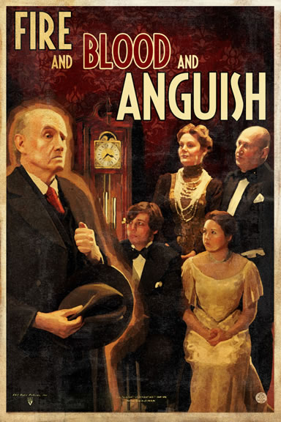
What might ‘fire and blood and anguish’ refer to?
Why has Priestley included this phrase?
What does it suggest about the Inspector’s role in the play?

Slide 49
Mr Birling’s Speech
How does the Inspector’s speech compare to Mr Birling’s speech earlier on in the play (the one the Inspector interrupts as he arrives)?
How does the Inspector’s speech create a conflict between Mr Birling’s belief system and that of the Inspector/JB Priestley?
What effect does the conflict between these two belief systems have on the audience?

Slide 50
What does Priestley want the audience to leave the theatre thinking/feeling?

Slide 51
Q
W
E
R
T
Y
Have a go at writing a QWERTY paragraph, using your notes so far.
How does Priestley use the Inspector’s final speech to present his ideas about society?
Answer using some key quotes from the Inspector’s speech. You could include:
His use of persuasive language
His shocking imagery
The intended response of the audience

Slide 52
One of the ways Priestley... Another way... Sheila is also shown to be... The writer suggests... When the Inspector is first described...
Q
}
W
E
This is shown when it says, “___”... An example of this is when Priestley writes, “___”... For example, “___”
R
This makes the reader think... This suggests to the reader... The reader will think... This implies... This suggests...
T
The use of the closed question... The writer’s word choice... The stage direction “___”... The repetition of... This word has strong connotations of...
Y
This suggests... This implies... This links to...

Slide 53
Learning Objective The Inspector – who is he?

Slide 54
So...
who is the Inspector?

Slide 55
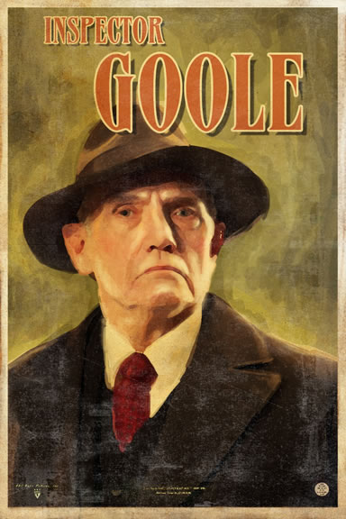
Who is the Inspector?
“...he’s giving us the rope – so that we’ll hang ourselves.”
We don’t know where the Inspector came from, and by the end of the play we’re not even sure if he’s real. We are told that he “need not be a big man but he creates at once an impression of massiveness, solidity and purposefulness”. The stage directions tell us he speaks “carefully, weightily, and has a disconcerting habit of looking hard at the person he addresses before actually speaking.”
Based on his questioning techniques and his treatment of the family, Sheila is the first to realise that there is more to the Inspector than meets the eye. At the beginning of Act 2 she says, “I don’t understand about you”. Who is he?
More importantly than who he is, or whether or not he’s a real inspector, what is his purpose in the play?

Slide 56
Questions to consider:
What is the role of the Inspector?
Who is he?
What does he represent?
What is his importance in the play?
How does Priestley use him?
Starting point: the Inspector’s name.
What does the title of ‘Inspector’ suggest that his role within the play will be?
‘Goole’ is a seaport town at the mouth of the River Humber, in East Yorkshire. Why might this be relevant to the Inspector? What does it suggest about his possible role? (Hint: think of the verbs ‘fish’ and ‘trawl’)
The Inspector’s name sounds like ‘ghoul’. Why might this be relevant? What does it suggest about the reasons behind the Inspector’s presence at the Birling household?

Slide 57
The mystery of the Inspector’s identity is one that the play never answers. One answer, of course, is that he is a dramatic device; without him the play could not happen. But given that the other characters are all believable and realistic, audiences often want to ask about the reality of the Inspector too.
It is Gerald who discovers that the Inspector is not who he claims to be. He helps the Birlings unpick the Inspector’s story of the girl until there seems to be nothing left of it. Sheila and Eric hang on to the conviction that it was ‘anything but a joke’ while accepting that there may have been more than one girl and that no girl may have committed suicide.
Some possibilities:
He’s a mouthpiece for Priestley’s ideas – or even Priestley himself
He’s God
He’s the voice of conscience, there to teach the audience of 1947 not to repeat the mistakes of the past (1912)
He’s the child Eva Smith was pregnant with
He’s a dream
He’s a time traveller
He’s a real police inspector

Slide 58
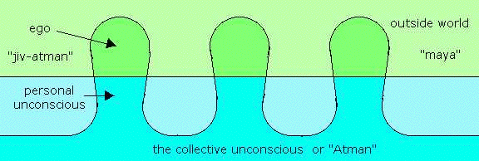
Some of the Inspector’s parting words are ‘We do not live alone. We are all members of one body’. Priestley himself was particularly interested in the ideas of the famous psychologist Jung, who believed that in our dreams we lose our identity and enter the world of the ‘collective unconscious’ where we all share ancient, universal experiences and the things we dream of have a common significance.
A particular passage in Jung struck Priestley because of a dream he himself had had. Jung stated that ‘dreams may give expression to… telepathic visions’. Priestley had dreamt of being shot in the person of a much younger man – “a student or something of that kind” – by uniformed officers. Describing this experience he said, “I will swear that… the blind weakness that washed over me there was somebody’s last moments and that my consciousness had relived them”.
It’s not a great step from such ideas to the notion of time and space travelling telepathically, but the more important idea is that telepathy is possible because, in our collective subconscious, we are “all members of one body”. The idea of an individual’s identity becomes more shadowy and less definite.

Slide 59
It is clear on a number of occasions that the Inspector knows what is going to happen.
Look again at these moments in the play and note down what they reveal about the Inspector:
at the end of Act 2 he says he is “waiting”, just before Eric enters.
from the beginning of Act 3 to his exit, it is quite clear that the Inspector is working under terrific time pressure, often looking at his watch or stating that he “hasn’t much time”. Is this because he knows that news of a girl’s suicide is about the reach the household? Or something else?
But he claims there are limits to his knowledge:
when he has shown Sheila the photograph he professes not to know why she is upsetting herself over it. “That’s something I have to find out”, he says.
has he ever actually lied to them about what he knows and how he knows it? Or about the identity of the girl?

Slide 60
Who do you think the Inspector is?

Slide 61
Learning Objective To plan your CA response and write some draft QWERTY paragraphs

Slide 62
Controlled Assessment Tasks for GCSE English Language Unit 3 part a:
Understanding Written Texts (extended reading)
You will have up to 4 hours controlled assessment time
Aim for an upper word limit of 1200 words
The piece is worth 15% of your English GCSE
The writer’s ideas and attitudes (i.e. what is he saying?)
AO3
(i) Read and understand texts, selecting material appropriate to purpose.
(ii) Develop and sustain interpretations of writers’ ideas and perspectives.
(iii) Explain and evaluate how writers use linguistic, grammatical, structural and presentational features to achieve effects and engage and influence the reader.
Include and analyse quotations and support your points with detailed textual evidence.
How the writer uses language and structure to achieve effects and engage the audience.

Slide 63
How does Priestley use the character of the Inspector to present his ideas about society?

Slide 64
How does Priestley use the character of the Inspector to present his ideas about society?
Band 5
(i) Sophisticated interpretation of texts.
(ii) Sophisticated engagement with writer’s ideas and attitudes.
(iii) Uses imaginatively selected supporting textual detail.
(iii) Sophisticated analysis of aspects of language and structure.
Ideas. Purpose. Quotes. Analysis.
To get a high band, you need to include all four aspects in your essay:
Have some strong personal ideas about the text.
Show you understand and have engaged with Priestley’s ideas and attitudes.
Include a range of quotes to support your points.
Analyse the language and structure of the play throughout.

Slide 65
Q
W
E
R
T
Y
Have a go at writing a QWERTY paragraph, using your notes so far.
How does Priestley use the character of the Inspector to present his ideas about society?
Purpose. Ideas. Quotes. Analysis.

Slide 66
One of the ways Priestley... Another way... Sheila is also shown to be... The writer suggests... When the Inspector is first described...
Q
}
W
E
This is shown when it says, “___”... An example of this is when Priestley writes, “___”... For example, “___”
R
This makes the reader think... This suggests to the reader... The reader will think... This implies... This suggests...
T
The use of the closed question... The writer’s word choice... The stage direction “___”... The repetition of... This word has strong connotations of...
Y
This suggests... This implies... This links to...

Slide 67
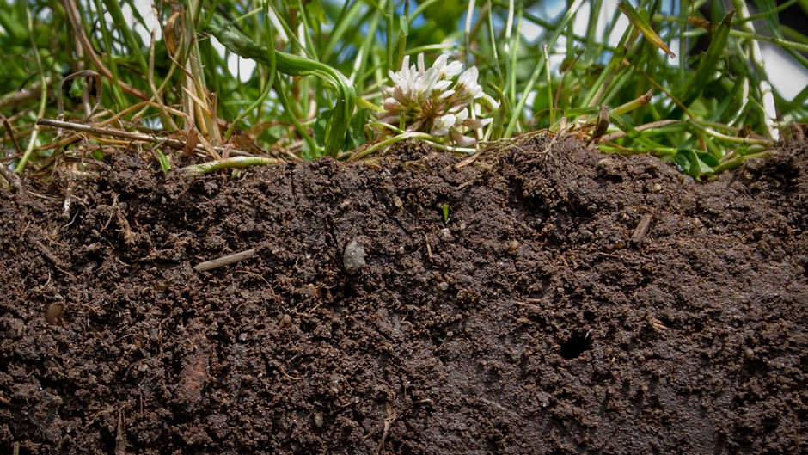
Where am I now?
Where do I need to be?
How do I get there?

Slide 68
Learning Objective: To respond to teacher feedback by identifying targets for progress and completing appropriate improvement tasks
Step 1: Look at your teacher’s feedback and read any comments he or she has made. What did you do well?
Step 2: Write down a summary of what you did well and how you feel about your teacher’s comments.
Step 3: Find the target code [A, B, C etc…] in your book and match it to the target code on the next slide.
Step 4: Write down your target and complete your improvement task.
Step 5: Make sure you highlight and annotate your work to show what you have improved and why it’s better than before.

Slide 69
Extended Reading (Unit 3) – QWERTY Target | Improvement Task – Highlight what you’ve done differently
Use all aspects of QWERTY consistently throughout your answer | Re-write your work, making sure you use all parts of QWERTY for each point you want to make.
Ensure all of your points link clearly to the question (Q) | Highlight any direct or implicit references to the question in your work. Add to each paragraph, ensuring your links to the question are explicit and well-explained.
Always use quotations to support points (E) | Highlight (E). Find and add in quotations to support any point which does not yet have one.
Ensure the effects of quotations are clearly explained with perceptive comments (R; Y) | Highlight (E), (R) and (Y). Expand (Y) to ensure you explain the effect of Priestley’s language on the reader.
Ensure subtle connotations (suggested meanings) of individual words are explored (T;Y) | Highlight (E), (T) and (Y). Expand (Y) by picking individual words from (E) and explaining their meaning, effect and the reason Priestley has used them.
Ensure you explain the effects of Priestley’s choice of sentence structure and punctuation (T) | Expand (or write a new) QWERTY paragraph, adding in ideas about the effects of sentence structure, word order or punctuation.
Explain the dramatic effects of character and action on the audience (R) | Highlight any references to the play as a drama or to an audience (rather than reader). Expand each point to consider the dramatic effects of character and action.
Ensure you refer to the social and historical context throughout your answer (AO4) | Highlight any references to context in your work. Expand each point to include a consideration of the significance of context.
Develop your answer in appropriate detail Develop an engaged personal response (Y) | Re-write or add to each paragraph, including detailed, thoughtful ideas that you have developed carefully.

Slide 70
Where am I now?
How have I improved?
What did I do better this time?

Slide 71
Learning Objective: To respond to teacher feedback by identifying targets for progress and completing appropriate improvement tasks
Have you completed all the steps?
Step 1: Look at your teacher’s feedback and read any comments he or she has made. What did you do well?
Step 2: Write down a summary of what you did well and how you feel about your teacher’s comments.
Step 3: Find the target code [A, B, C etc…] in your book and match it to the target code on the next slide.
Step 4: Write down your target and complete your improvement task.
Step 5: Make sure you highlight and annotate your work to show what you have improved and why it’s better than before.

Slide 72
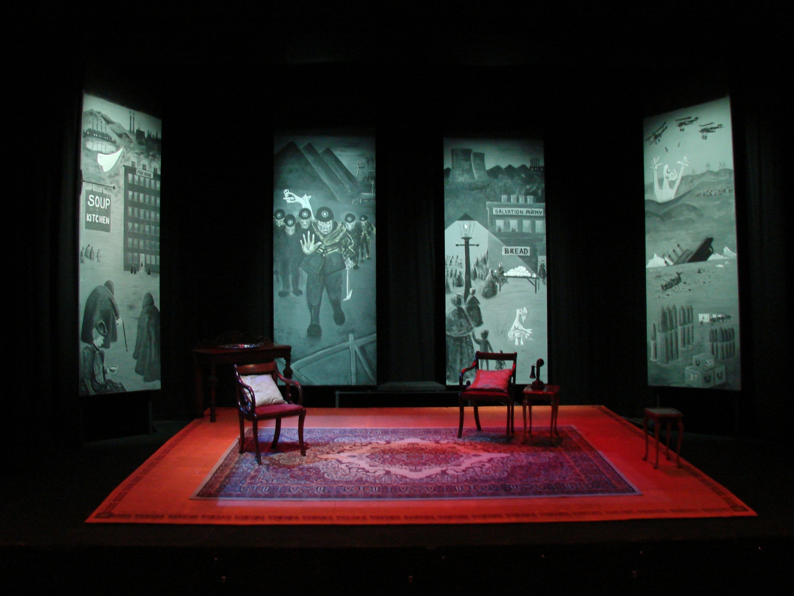
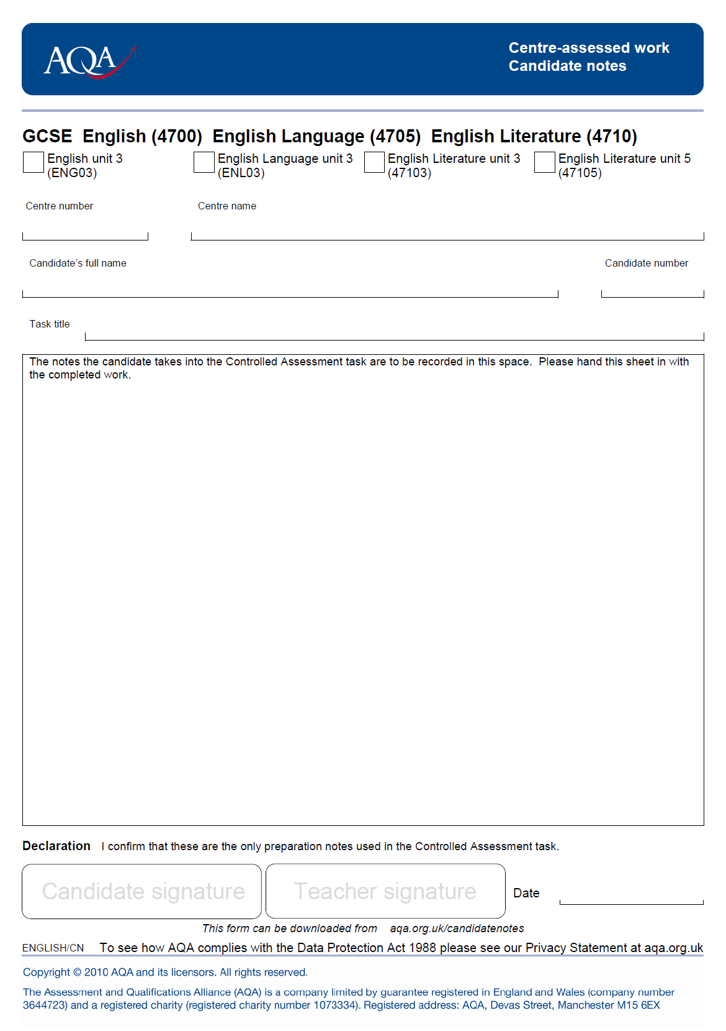
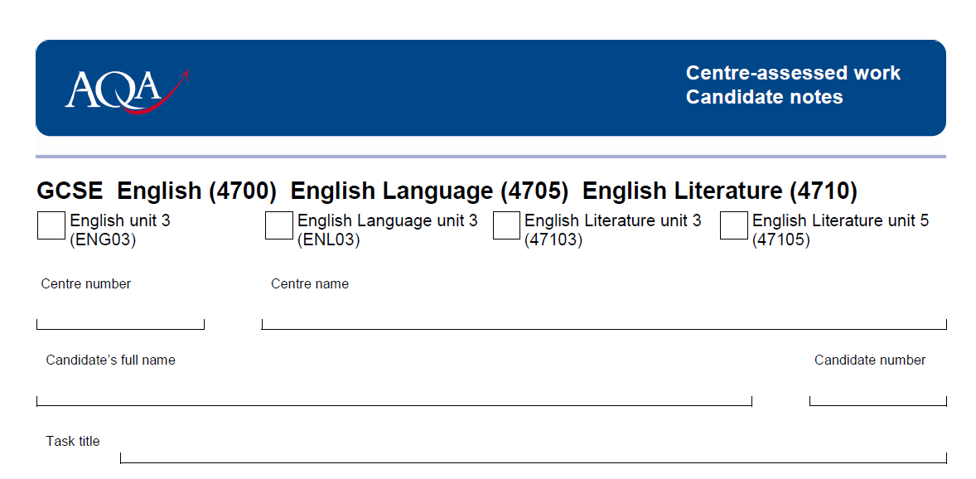
✓
42217
KESWICK SCHOOL
FULL NAME
How does Priestley use the character of the Inspector to present his ideas about society?

Slide 74
Introduction – a brief overview of the play.
Main – how Priestley uses the Inspector to express his ideas about society .
Purpose. Ideas. Quotes. Analysis.
How is the theme of conflict introduced by the Inspector’s arrival?
Explore how the Inspector treats Sheila during her interview.
Explore how the Inspector treats Mrs Birling during her interview.
Explore the conflict that exists and that is emphasised between Sheila and Mrs Birling.
How does the Inspector’s final speech create a conflict between Mr Birling’s belief system and that of the Inspector/JB Priestley?
Conclusion – who is the Inspector?

