Slide 1
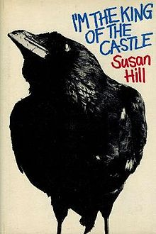
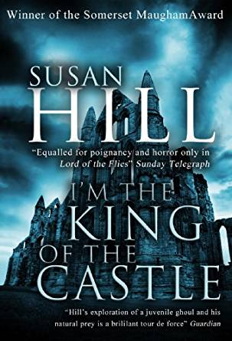
Susan Hill’s ‘I’m the King of the Castle’
What does the title of the book tell us about the ideas and themes? What might the book be about?

Slide 2
What is the passage about?
What do we learn about the characters?

Slide 3
What is the passage about?
What hints are we given about what will happen in the novel?

Slide 4
What is the passage about?
What impression is given about the mood and atmosphere at the start of the novel?

Slide 5
‘Three months ago, his grandmother died, and then they had moved to this house.’
Think:
Who is he?
What or where is ‘this house’?
What does the use of nouns and pronouns tell us?

Slide 6
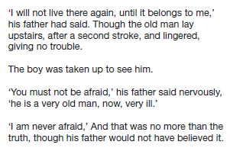
Underline or highlight the direct speech
“But what’s direct speech?”

Slide 7
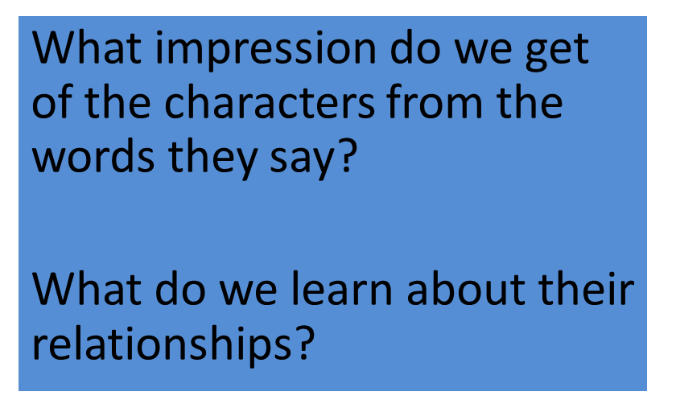
The direct speech…

Slide 8
‘I will not live there again, until it belongs to me’
What do we learn from this? What does it tell us about his character?

Slide 9
‘I am never afraid’

Slide 10
‘That is not the way to speak! You must show respect’

Slide 11
‘That won’t be anything new, will it?’

Slide 12
‘I shall see about getting you a friend’

Slide 13
‘Can I have the key now, then?’
What do you think about Edmund’s tone?
What word would you zoom in on?

Slide 14
‘Anyway, I don’t like cricket’
What does this tell us about their relationship? What does it tell us about how Edmund feels towards his father?

Slide 15
What do they call each other?
Look also at what they don’t call each other…
What do you learn?
Key Terminology to learn:
Nouns
Noun Phrases

Slide 16
The Hooper Family
What do we know about Edmund and Joseph Hooper?

Slide 17
How does the writer’s use of direct speech show us the distant relationship between Edmund and his father?
What good vocabulary can we use?
It’s not just a bad and distant relationship…

Slide 18
How does the writer’s use of direct speech show us the distant relationship between Edmund and his father?
And remember to dig, dig…, dig
This might suggest…
It could also suggest…
It also shows…

Slide 19
One of the ways Hill presents the relationship between Edmund and his father is ... Another way their relationship is shown to be... The writer suggests... When Edmund first speaks we begin to think…
Q
}
W
E
This is shown when it says, “___”...
An example of this is when Hill writes, “___”...
For example, “___”
R
This makes the reader think...
This suggests to the reader... The reader will think... This implies... This suggests...
T
The use of the direct speech... The use of the exclamation mark ...The repetition of... This word has strong connotations of...
Y
This suggests... This implies... This links to...

Slide 20
How does the writer’s use of direct speech show us the distant relationship between Edmund and his father?
How did you do?

Slide 21
How has the writer structured the text to interest the reader?
What are the key words from the question?
How would we answer this question?

Slide 22
Paper One: Question 3
You now need to think about the whole of the source.
The text is from the opening of a novel.
How has the writer structured the text to interest you as a reader?
You could write about:
What the writer focuses your attention on at the beginning
How and why the writer changes this focus as the extract develops
Any other structural features that interest you

Slide 23
How has the writer structured the text to interest the reader?
The text is written in paragraphs which make it easy to read. It is about a house at first and then it is about a boy called Edmund and his father. It then goes back to the house.
How many marks would this answer get out of 8?
Level One: Simple and limited- 1-2 marks
This answer shows a simple awareness of structure. It offers a simple comment on the use of paragraphs and then gives simple references about the topic of the paragraphs

Slide 24
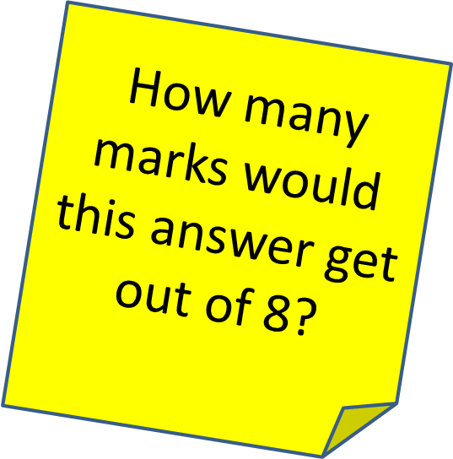
How has the writer structured the text to interest the reader?
The writer writes about the house in the first paragraph which makes the reader think it a strange and mysterious place. It then moves on to focus on some individual characters- Edmund and his father- making the reader feel even more mysterious and uncomfortable. So overall the writer changes the focus from the house to the characters.
Level Two: 3-4 marks – Some, attempts
This answer shows some understanding of structural features. In this answer they attempt to comment on the effect of the structural features.

Slide 25
How has the writer structured the text to interest the reader?
The text, about the Hoopers and their new home, is structured to create a sense of mystery and tension. The main structure of the chapter, which begins with ‘this house’, moves from the house to a single room ‘the red room’ within the house and the characters, Edmund and Joseph Hooper, that are within it. The description continues and shows Edmund’s determination to get into the locked ‘red room’ which creates a feeling of mystery and intrigue. As the extract develops, the writer focuses on the character and, through the use of direct speech, develops a strained relationship between father and son. The writer constantly hints that their relationship is a difficult one, making the reader feel uncomfortable and tense.
Level Four: 7 marks - Detailed, perceptive
This answer shows a perceptive understanding of structural features. In this answer they analyse the effects of the structural features and use a range of subject terminology
EBI: detail; range of examples

Slide 26
How has the writer structured the text to interest the reader?
Sequence through a passage- where does it start, what happens next, are there any links?
Characters- how are they introduced? Are we told their names straight away? How are we supposed to react to them?
Direct speech- who talks? Who doesn’t?
Repetitions, threads, patterns- are any ideas developed? Repeated?
The opening- what happens?
The ending- does it link back to anything? Does it build on anything?
Shifts of focus- does the setting get bigger? Smaller?
Connections and links across paragraphs
What about the timing of the day? Month? Year?

Slide 27
One of the ways Hill structures the opening chapter is... Another way the passage is structured is... The writer begins by telling us about... Another structural point is …
Q
}
W
E
This is shown when it says, “___”...
An example of this is when Hill writes, “___”...
For example, “___”
R
This makes the reader think...
This suggests to the reader... The reader will think... This implies... This suggests...
T
The use of the direct speech... The use of the paragraphs ...The repetition of... This setting… The use of time…The shift in focus from…to…
Y
This links to ... This connects to ... This builds an atmosphere of...

Slide 28
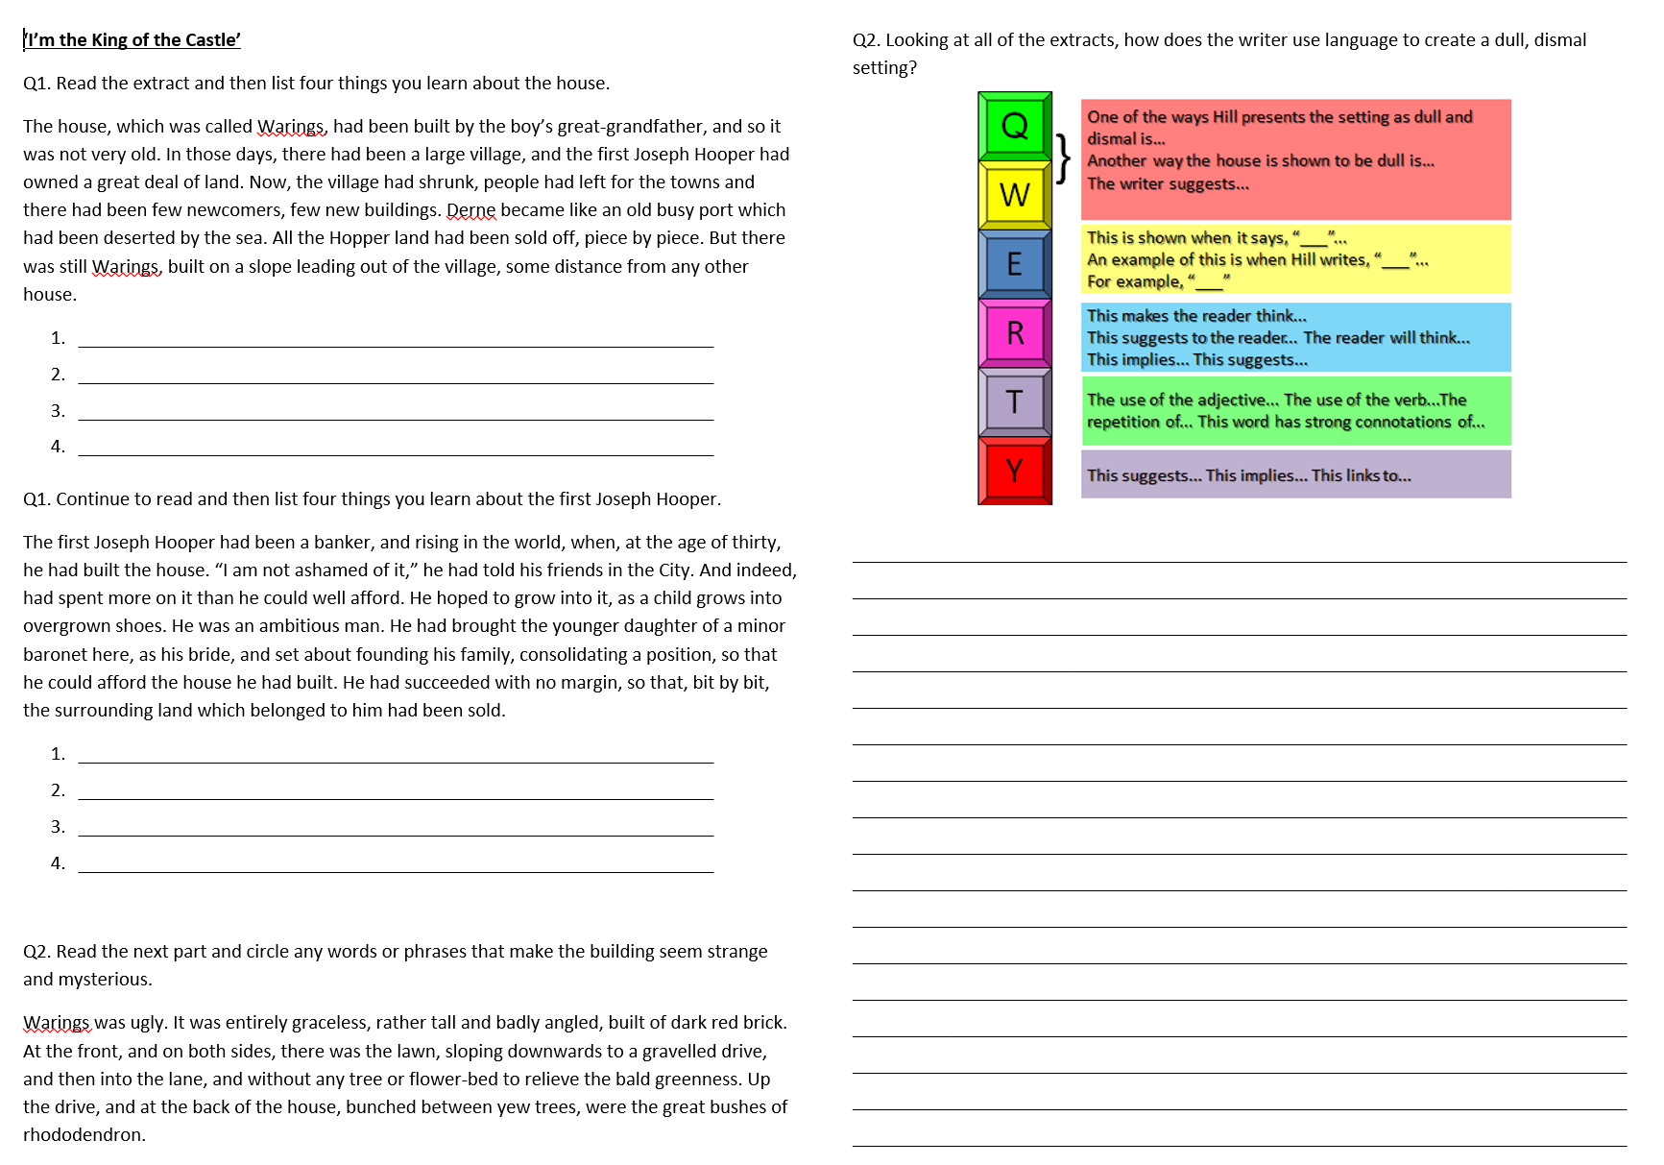
Timed Response – to be handed in at the end of the lesson

Slide 29
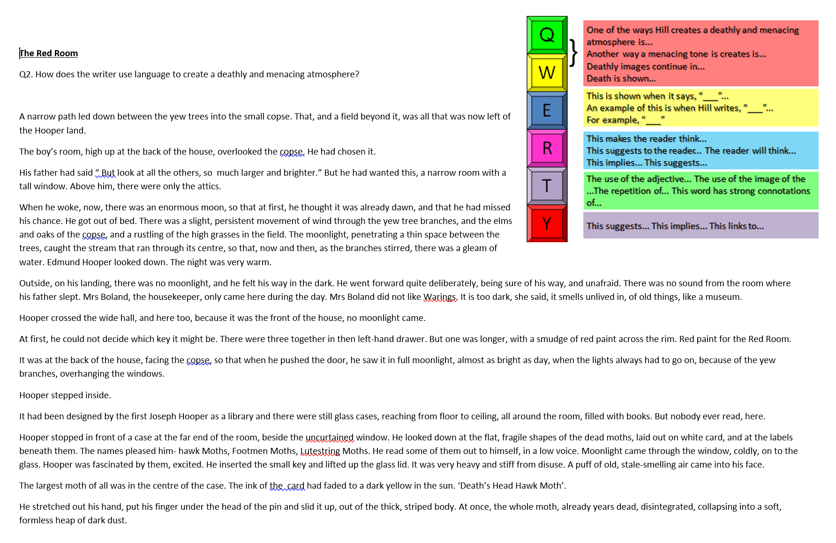
EBI Action work – how have you improved your response?

