Slide 1
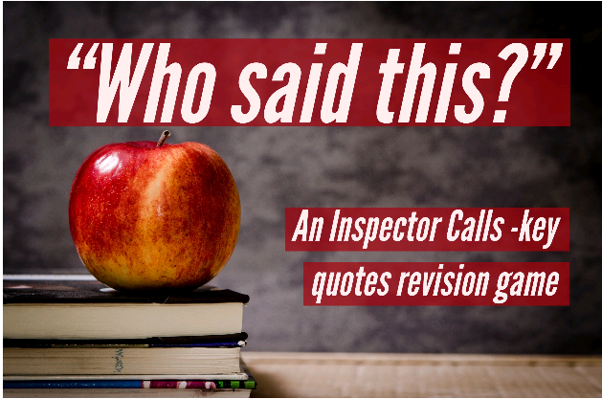
Take it in turns to pick up all the cards and ask your partner who said each of them. If they guess correctly within two guesses, they keep the card; if not, you do. For each card, ask your partner: 1. Who said this? Or, if stage directions, who is it about? 2. What is the context surrounding it? (Who do they say it to? Why do they say it? When do they say it?)

Slide 2
‘I gather there’s a very good chance of a knighthood’ Mr Birling
‘Probably a Socialist or some sort of crank’ Mr Birling
‘I know the Brumley police officers pretty well’ Mr Birling
‘A man has to make his own way – has to look after himself’ Mr Birling
‘you’ll hear some people say war is inevitable … fiddlesticks!’ Mr Birling
‘unsinkable, absolutely unsinkable’ Mr Birling

Slide 3
‘you’d think everybody has to look after everybody else, as if we were all mixed up like bees in a hive – community and all that nonsense’ Mr Birling
‘I’m talking as a hard-headed practical man of business’ Mr Birling
‘(rather impatiently) Horrid business. But I don’t understand why you should come here’ Mr Birling
‘there’s every excuse for what your mother and I did’ Mr Birling
‘Now look at the pair of them- the famous younger generation who know it all. And they can’t even take a joke-’ Mr Birling

Slide 4
‘girls of that class’ Mrs Sybil Birling
‘she only had herself to blame’ Mrs Sybil Birling
‘Go and look for the father of the child. It’s his responsibility’ Mrs Sybil Birling
‘She was giving herself ridiculous airs … simply absurd’ Mrs Sybil Birling
‘As if a girl of that sort would ever refuse money!’ Mrs Sybil Birling
‘he ought to be dealt with very severely- …make sure that he’s compelled to confess in public his responsibility’ Mrs Sybil Birling

Slide 5
‘I accept no blame at all’ Mrs Sybil Birling
‘he certainly didn’t make me confess – I had done no more than my duty’ Mrs Sybil Birling
‘I’ve done nothing wrong – and you know it.’ Mrs Sybil Birling

Slide 6
‘Yes, go on, Mummy’ Sheila Birling
‘But these girls aren’t cheap labour – they’re people.’ Sheila Birling
‘(rather distressed) I can’t help thinking about this girl- destroying herself so horribly - and I’ve been so happy tonight. Oh I wish you hadn’t told me’ Sheila Birling
‘I went to the manager and told him this girl had been very impertinent – and – and –’ Sheila Birling
‘And if I could help her now, I would-’ Sheila Birling
‘I’ll never, never do it again to anybody’ Sheila Birling

Slide 7
‘Why – you fool – he knows’ Sheila Birling
‘I hate to think how much he knows that we don’t know yet. You’ll see. You’ll see.’ Sheila Birling
‘You mustn’t try to build up a kind of wall between us and that girl. If you do the Inspector will just break it down.’ Sheila Birling
‘he’s giving us the rope- so that we’ll hang ourselves’ Sheila Birling
‘He inspected us all right’ Sheila Birling
‘It frightens me the way you talk’ Sheila Birling

Slide 8
‘(not quite at ease, half shy, half assertive)’ Eric Birling
‘Why shouldn’t they try for higher wages? We try for the highest possible prices’ Eric Birling
‘He could have kept her on instead of throwing her out.’ Eric Birling
‘I’d have let her stay’ Eric Birling
‘Well I was in that state when a chap easily turns nasty- and I threatened to make a row’ Eric Birling
‘I wasn’t in love with her or anything- but I liked her- she was pretty and a good sport’ Eric Birling

Slide 9
‘she didn’t want me to marry her. Said I didn’t love her- and all that’ Eric Birling
‘In a way, she treated me- as if I were a kid. Though I was nearly as old as she was’ Eric Birling
‘you’re not the kind of father a chap could go to when he’s in trouble- that’s why’ Eric Birling
‘Then- you killed her. She came to you to protect me- and you turned her away’ Eric Birling
‘you killed her- and the child she’d have had too- my child- your own grandchild- you killed them both- dam you, damn you-’ Eric Birling
‘(shouting) And I say the girl’s dead and we all helped to kill her- and that’s what matters’ Eric Birling

Slide 10
‘(very much the easy well-bred young man-about-town)’ Gerald Croft
‘after all, y’know, we’re respectable citizens and not criminals’ Gerald Croft
‘it’s a favourite haunt of women of the town’ Gerald Croft
‘[Daisy] gave me a glance that was nothing les than a cry for help’ Gerald Croft
‘I was sorry for her… I didn’t ask for anything in return’ Gerald Croft
‘I want you to understand that I didn’t install her there [in those rooms] so I could make love to her’ Gerald Croft

Slide 11
‘She was young and pretty and warm-hearted- and intensely grateful’ Gerald Croft
‘I became at once the most important person in her life- you understand?’ Gerald Croft
‘She told me she’d been happier than she’d ever been before’ Gerald Croft
‘Nearly any man would have done’ (adored being the ‘fairy prince’) Gerald Croft
‘We’ve no proof it was the same photograph and therefore no proof it was the same girl’ Gerald Croft
‘Everything’s all right now Sheila. What about this ring?’ Gerald Croft

Slide 12
‘(…he creates at once an impression of massiveness, solidity and purposefulness)’ Inspector Goole
‘([He] has a disconcerting habit of looking hard at the person he addresses before actually speaking)’ Inspector Goole
‘Burnt her inside out, of course.’ Inspector Goole
‘A chain of events’
(may have driven her to suicide) Inspector Goole
‘it’s better to ask for the Earth than to take it’ Inspector Goole
‘it would do us all a bit of good if sometimes we tried to put ourselves in the place of these young women counting their pennies in their dingy little back bedroom’ Inspector Goole

Slide 13
‘A girl died tonight. A pretty, lively sort of girl, who never did anybody any harm. But she died in misery and agony- hating life-’ Inspector Goole
‘If there’s nothing else we have to share our guilt’ Inspector Goole
‘Public men, Mr Birling, have responsibilities as well as privileges’ Inspector Goole
‘You slammed the door in her face’ Inspector Goole
‘be quiet for a moment and listen to me.’ Inspector Goole
‘But each of you helped to kill her. Remember that. Never forget it.’ Inspector Goole

Slide 14
‘I don’t need to know any more. Neither do you. This girl killed herself- and died a horrible death.’ Inspector Goole
‘One Eva Smith has gone- but there are millions and millions of Eva Smiths and John Smiths still left with us’ Inspector Goole
‘We don’t live alone. We are members of one body.’ Inspector Goole
‘We are responsible for each other.’ Inspector Goole
‘…if men will not learn that lesson, then they will be taught it in fire and bloody and anguish. Good night.’ Inspector Goole
‘…their lives, their hopes and fears, their suffering and chance of happiness, all intertwined with our lives, and what we think and say and do.’ Inspector Goole

Slide 15
‘Yes Ma’am.’ Edna (the parlour-maid)
‘Please, sir, an inspector’s called’ Inspector Goole

