Slide 1
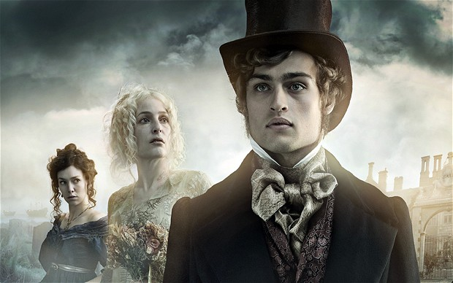
‘Great Expectations’

Slide 2
Learning Objective: To read and understand Chapter 1 of Great Expectations
Re-watch the opening of Great Expectations. As you watch, make notes on what sort of atmosphere is created. Write about:
images
sounds
language
events
What emotions is Pip experiencing?
What emotions is Magwitch experiencing?

Slide 3
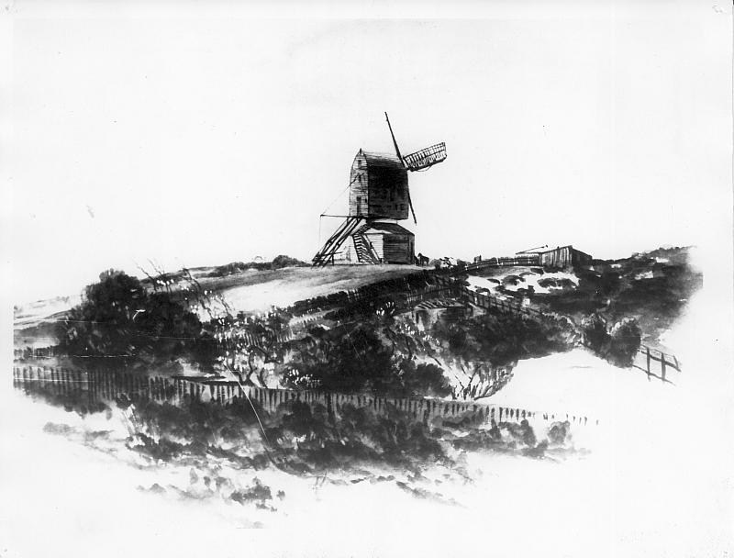
Learning Objective: To read and understand Chapter 1 of Great Expectations
Now let’s read Chapter 1 together.
Make a note of any words or phrases you don’t understand.

Slide 4
Learning Objective: To analyse the language of Chapter 1, including word choice, sentence structure and other language techniques
Now have a go at the close reading tasks on your sheet. Remember to link your ideas to:
the presentation of the characters
the effect this has on the reader
AO1: Respond to texts critically and imaginatively, select and evaluate textual detail to illustrate and support interpretations
AO2: Explain how language, structure and form contribute to writers’ presentation of ideas, themes and settings

Slide 5
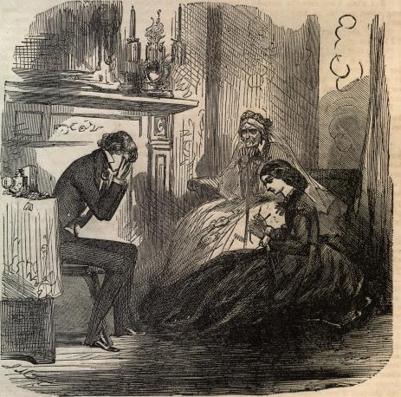
Language analysis of Chapter 1
In the opening of the novel, Dickens introduces Pip, repeating his name a number of times in the first two lines. Explore the meanings and connotations of the word, ‘Pip’.

Slide 6
Language analysis of Chapter 1
We learn about Pip’s family and that his parents and five brothers are all dead. Whilst this is tragic, how is it more tragic for Pip?

Slide 7
Language analysis of Chapter 1
“a memorable raw afternoon”

Slide 8
Language analysis of Chapter 1
“this bleak place”

Slide 9
Language analysis of Chapter 1
“overgrown with nettles”

Slide 10
Language analysis of Chapter 1
“the churchyard”

Slide 11
Language analysis of Chapter 1
“dark, flat wilderness”

Slide 12
Language analysis of Chapter 1
“distant savage lair from which the wind was rushing”

Slide 13
Language analysis of Chapter 1
“the small bundle of shivers growing afraid of it all and beginning to cry, was Pip.”

Slide 14
Language analysis of Chapter 1
The character of Magwitch is very powerful. From what you know about how ‘Great Expectations’ was published, why does Dickens create such strong character descriptions?

Slide 15
Language analysis of Chapter 1
Magwitch does not wear a hat. What does this tell both Pip and the reader?

Slide 16
Violent/ negative verbs
Language analysis of Chapter 1
“A fearful man, all in coarse grey, with a great iron on his leg. A man with no hat, and with broken shoes, and with an old rag tied round his head. A man who had been soaked in water, and smothered in mud, and lamed by stones, and cut by flints, and stung by nettles, and torn by briars; who limped, and shivered, and glared and growled; and whose teeth chattered in his head as he seized me by the chin.”

Slide 17
Words which link Magwitch to the environment
Language analysis of Chapter 1
“A fearful man, all in coarse grey, with a great iron on his leg. A man with no hat, and with broken shoes, and with an old rag tied round his head. A man who had been soaked in water, and smothered in mud, and lamed by stones, and cut by flints, and stung by nettles, and torn by briars; who limped, and shivered, and glared and growled; and whose teeth chattered in his head as he seized me by the chin.”

Slide 18
Alliteration of hard sounds
Language analysis of Chapter 1
“A fearful man, all in coarse grey, with a great iron on his leg. A man with no hat, and with broken shoes, and with an old rag tied round his head. A man who had been soaked in water, and smothered in mud, and lamed by stones, and cut by flints, and stung by nettles, and torn by briars; who limped, and shivered, and glared and growled; and whose teeth chattered in his head as he seized me by the chin.”

Slide 19
‘and’ as well as commas and semi colons to show how Dickens structures
Language analysis of Chapter 1
“A fearful man, all in coarse grey, with a great iron on his leg. A man with no hat, and with broken shoes, and with an old rag tied round his head. A man who had been soaked in water, and smothered in mud, and lamed by stones, and cut by flints, and stung by nettles, and torn by briars; who limped, and shivered, and glared and growled; and whose teeth chattered in his head as he seized me by the chin.”

Slide 20
Language analysis of Chapter 1
Imperatives/ commands
"O! Don't cut my throat, sir," I pleaded in terror. "Pray don't do it, sir." "Tell us your name!" said the man. "Quick!"
"Pip, sir."
"Once more," said the man, staring at me. "Give it mouth!"
"Pip. Pip, sir."
"Show us where you live," said the man. "Pint out the place!"
[...]
"You young dog," said the man, licking his lips, "what fat cheeks you ha' got." [...]
"Darn me if I couldn't eat em," said the man, with a threatening shake of his head, "and if I han't half a mind to't!"
[...]
"Now lookee here!" said the man. "Where's your mother?"
"There, sir!" said I.
[...]
"There, sir!" I timidly explained. "Also Georgiana. That's my mother."
"Oh!" said he, coming back. "And is that your father alonger your mother?" "Yes, sir," said I; "him too; late of this parish."
"Ha!" he muttered then, considering. "Who d'ye live with - supposin' you're kindly let to live, which I han't made up my mind about?" "My sister, sir - Mrs. Joe Gargery - wife of Joe Gargery, the blacksmith, sir." "Blacksmith, eh?" said he. And looked down at his leg.
[...]
"Now lookee here," he said, "the question being whether you're to be let to live. You know what a file is?"
"Yes, sir."
"And you know what wittles is?"
"Yes, sir."
[...]
"You bring me, to-morrow morning early, that file and them wittles. You bring the lot to me, at that old Battery over yonder. You do it, and you never dare to say a word or dare to make a sign concerning your having seen such a person as me, or any person sumever, and you shall be let to live. You fail, or you go from my words in any partickler, no matter how small it is, and your heart and your liver shall be tore out, roasted and ate. Now, I ain't alone, as you may think I am. There's a young man hid with me, in comparison with which young man I am a Angel. That young man hears the words I speak. That young man has a secret way pecooliar to himself, of getting at a boy, and at his heart, and at his liver. It is in wain for a boy to attempt to hide himself from that young man. A boy may lock his door, may be warm in bed, may tuck himself up, may draw the clothes over his head, may think himself comfortable and safe, but that young man will softly creep and creep his way to him and tear him open. I am a-keeping that young man from harming of you at the present moment, with great difficulty. I find it wery hard to hold that young man off of your inside. Now, what do you say?"
[...]
"Say Lord strike you dead if you don't!" said the man.
I said so, and he took me down.
"Now," he pursued, "you remember what you've undertook, and you remember that young man, and you get home!"
"Goo-good night, sir," I faltered.
"Much of that!" said he, glancing about him over the cold wet flat. "I wish I was a frog. Or a eel!“

Slide 21
Language analysis of Chapter 1
Exclamation marks
"O! Don't cut my throat, sir," I pleaded in terror. "Pray don't do it, sir." "Tell us your name!" said the man. "Quick!"
"Pip, sir."
"Once more," said the man, staring at me. "Give it mouth!"
"Pip. Pip, sir."
"Show us where you live," said the man. "Pint out the place!"
[...]
"You young dog," said the man, licking his lips, "what fat cheeks you ha' got." [...]
"Darn me if I couldn't eat em," said the man, with a threatening shake of his head, "and if I han't half a mind to't!"
[...]
"Now lookee here!" said the man. "Where's your mother?"
"There, sir!" said I.
[...]
"There, sir!" I timidly explained. "Also Georgiana. That's my mother."
"Oh!" said he, coming back. "And is that your father alonger your mother?" "Yes, sir," said I; "him too; late of this parish."
"Ha!" he muttered then, considering. "Who d'ye live with - supposin' you're kindly let to live, which I han't made up my mind about?" "My sister, sir - Mrs. Joe Gargery - wife of Joe Gargery, the blacksmith, sir." "Blacksmith, eh?" said he. And looked down at his leg.
[...]
"Now lookee here," he said, "the question being whether you're to be let to live. You know what a file is?"
"Yes, sir."
"And you know what wittles is?"
"Yes, sir."
[...]
"You bring me, to-morrow morning early, that file and them wittles. You bring the lot to me, at that old Battery over yonder. You do it, and you never dare to say a word or dare to make a sign concerning your having seen such a person as me, or any person sumever, and you shall be let to live. You fail, or you go from my words in any partickler, no matter how small it is, and your heart and your liver shall be tore out, roasted and ate. Now, I ain't alone, as you may think I am. There's a young man hid with me, in comparison with which young man I am a Angel. That young man hears the words I speak. That young man has a secret way pecooliar to himself, of getting at a boy, and at his heart, and at his liver. It is in wain for a boy to attempt to hide himself from that young man. A boy may lock his door, may be warm in bed, may tuck himself up, may draw the clothes over his head, may think himself comfortable and safe, but that young man will softly creep and creep his way to him and tear him open. I am a-keeping that young man from harming of you at the present moment, with great difficulty. I find it wery hard to hold that young man off of your inside. Now, what do you say?"
[...]
"Say Lord strike you dead if you don't!" said the man.
I said so, and he took me down.
"Now," he pursued, "you remember what you've undertook, and you remember that young man, and you get home!"
"Goo-good night, sir," I faltered.
"Much of that!" said he, glancing about him over the cold wet flat. "I wish I was a frog. Or a eel!“

Slide 22
Language analysis of Chapter 1
Threats
"O! Don't cut my throat, sir," I pleaded in terror. "Pray don't do it, sir." "Tell us your name!" said the man. "Quick!"
"Pip, sir."
"Once more," said the man, staring at me. "Give it mouth!"
"Pip. Pip, sir."
"Show us where you live," said the man. "Pint out the place!"
[...]
"You young dog," said the man, licking his lips, "what fat cheeks you ha' got." [...]
"Darn me if I couldn't eat em," said the man, with a threatening shake of his head, "and if I han't half a mind to't!"
[...]
"Now lookee here!" said the man. "Where's your mother?"
"There, sir!" said I.
[...]
"There, sir!" I timidly explained. "Also Georgiana. That's my mother."
"Oh!" said he, coming back. "And is that your father alonger your mother?" "Yes, sir," said I; "him too; late of this parish."
"Ha!" he muttered then, considering. "Who d'ye live with - supposin' you're kindly let to live, which I han't made up my mind about?" "My sister, sir - Mrs. Joe Gargery - wife of Joe Gargery, the blacksmith, sir." "Blacksmith, eh?" said he. And looked down at his leg.
[...]
"Now lookee here," he said, "the question being whether you're to be let to live. You know what a file is?"
"Yes, sir."
"And you know what wittles is?"
"Yes, sir."
[...]
"You bring me, to-morrow morning early, that file and them wittles. You bring the lot to me, at that old Battery over yonder. You do it, and you never dare to say a word or dare to make a sign concerning your having seen such a person as me, or any person sumever, and you shall be let to live. You fail, or you go from my words in any partickler, no matter how small it is, and your heart and your liver shall be tore out, roasted and ate. Now, I ain't alone, as you may think I am. There's a young man hid with me, in comparison with which young man I am a Angel. That young man hears the words I speak. That young man has a secret way pecooliar to himself, of getting at a boy, and at his heart, and at his liver. It is in wain for a boy to attempt to hide himself from that young man. A boy may lock his door, may be warm in bed, may tuck himself up, may draw the clothes over his head, may think himself comfortable and safe, but that young man will softly creep and creep his way to him and tear him open. I am a-keeping that young man from harming of you at the present moment, with great difficulty. I find it wery hard to hold that young man off of your inside. Now, what do you say?"
[...]
"Say Lord strike you dead if you don't!" said the man.
I said so, and he took me down.
"Now," he pursued, "you remember what you've undertook, and you remember that young man, and you get home!"
"Goo-good night, sir," I faltered.
"Much of that!" said he, glancing about him over the cold wet flat. "I wish I was a frog. Or a eel!“

Slide 23
Language analysis of Chapter 1
Words written as they sound
"O! Don't cut my throat, sir," I pleaded in terror. "Pray don't do it, sir." "Tell us your name!" said the man. "Quick!"
"Pip, sir."
"Once more," said the man, staring at me. "Give it mouth!"
"Pip. Pip, sir."
"Show us where you live," said the man. "Pint out the place!"
[...]
"You young dog," said the man, licking his lips, "what fat cheeks you ha' got." [...]
"Darn me if I couldn't eat em," said the man, with a threatening shake of his head, "and if I han't half a mind to't!"
[...]
"Now lookee here!" said the man. "Where's your mother?"
"There, sir!" said I.
[...]
"There, sir!" I timidly explained. "Also Georgiana. That's my mother."
"Oh!" said he, coming back. "And is that your father alonger your mother?" "Yes, sir," said I; "him too; late of this parish."
"Ha!" he muttered then, considering. "Who d'ye live with - supposin' you're kindly let to live, which I han't made up my mind about?" "My sister, sir - Mrs. Joe Gargery - wife of Joe Gargery, the blacksmith, sir." "Blacksmith, eh?" said he. And looked down at his leg.
[...]
"Now lookee here," he said, "the question being whether you're to be let to live. You know what a file is?"
"Yes, sir."
"And you know what wittles is?"
"Yes, sir."
[...]
"You bring me, to-morrow morning early, that file and them wittles. You bring the lot to me, at that old Battery over yonder. You do it, and you never dare to say a word or dare to make a sign concerning your having seen such a person as me, or any person sumever, and you shall be let to live. You fail, or you go from my words in any partickler, no matter how small it is, and your heart and your liver shall be tore out, roasted and ate. Now, I ain't alone, as you may think I am. There's a young man hid with me, in comparison with which young man I am a Angel. That young man hears the words I speak. That young man has a secret way pecooliar to himself, of getting at a boy, and at his heart, and at his liver. It is in wain for a boy to attempt to hide himself from that young man. A boy may lock his door, may be warm in bed, may tuck himself up, may draw the clothes over his head, may think himself comfortable and safe, but that young man will softly creep and creep his way to him and tear him open. I am a-keeping that young man from harming of you at the present moment, with great difficulty. I find it wery hard to hold that young man off of your inside. Now, what do you say?"
[...]
"Say Lord strike you dead if you don't!" said the man.
I said so, and he took me down.
"Now," he pursued, "you remember what you've undertook, and you remember that young man, and you get home!"
"Goo-good night, sir," I faltered.
"Much of that!" said he, glancing about him over the cold wet flat. "I wish I was a frog. Or a eel!“

Slide 24
Language analysis of Chapter 1
Dialect words
"O! Don't cut my throat, sir," I pleaded in terror. "Pray don't do it, sir." "Tell us your name!" said the man. "Quick!"
"Pip, sir."
"Once more," said the man, staring at me. "Give it mouth!"
"Pip. Pip, sir."
"Show us where you live," said the man. "Pint out the place!"
[...]
"You young dog," said the man, licking his lips, "what fat cheeks you ha' got." [...]
"Darn me if I couldn't eat em," said the man, with a threatening shake of his head, "and if I han't half a mind to't!"
[...]
"Now lookee here!" said the man. "Where's your mother?"
"There, sir!" said I.
[...]
"There, sir!" I timidly explained. "Also Georgiana. That's my mother."
"Oh!" said he, coming back. "And is that your father alonger your mother?" "Yes, sir," said I; "him too; late of this parish."
"Ha!" he muttered then, considering. "Who d'ye live with - supposin' you're kindly let to live, which I han't made up my mind about?" "My sister, sir - Mrs. Joe Gargery - wife of Joe Gargery, the blacksmith, sir." "Blacksmith, eh?" said he. And looked down at his leg.
[...]
"Now lookee here," he said, "the question being whether you're to be let to live. You know what a file is?"
"Yes, sir."
"And you know what wittles is?"
"Yes, sir."
[...]
"You bring me, to-morrow morning early, that file and them wittles. You bring the lot to me, at that old Battery over yonder. You do it, and you never dare to say a word or dare to make a sign concerning your having seen such a person as me, or any person sumever, and you shall be let to live. You fail, or you go from my words in any partickler, no matter how small it is, and your heart and your liver shall be tore out, roasted and ate. Now, I ain't alone, as you may think I am. There's a young man hid with me, in comparison with which young man I am a Angel. That young man hears the words I speak. That young man has a secret way pecooliar to himself, of getting at a boy, and at his heart, and at his liver. It is in wain for a boy to attempt to hide himself from that young man. A boy may lock his door, may be warm in bed, may tuck himself up, may draw the clothes over his head, may think himself comfortable and safe, but that young man will softly creep and creep his way to him and tear him open. I am a-keeping that young man from harming of you at the present moment, with great difficulty. I find it wery hard to hold that young man off of your inside. Now, what do you say?"
[...]
"Say Lord strike you dead if you don't!" said the man.
I said so, and he took me down.
"Now," he pursued, "you remember what you've undertook, and you remember that young man, and you get home!"
"Goo-good night, sir," I faltered.
"Much of that!" said he, glancing about him over the cold wet flat. "I wish I was a frog. Or a eel!“

Slide 25
Language analysis of Chapter 1
Dickens creates a terrifying beginning for Pip, including him imagining the convict as a pirate as he passes the gibbet. How does the reader feel about Pip and his life at the beginning of the novel? Does the reader have ‘Great Expectations’ for Pip’s future? Why/why not?

Slide 26
Language analysis of Chapter 1
Magwitch literally turns Pip’s world upside down: “The man... turned me upside down, and emptied my pockets... When the church came to itself - for he was so sudden and strong that he made it go head over heels before me, and I saw the steeple under my feet - when the church came to itself, I say, I was seated on a high tombstone, trembling, while he ate the bread ravenously.”
How does he change his life in the future?

Slide 27
SECTION A: READING
4 marks
Read the text
Q1
Q2
Q3
Q4
20 marks
8 marks
8 marks

Slide 28
AO1: Identify and interpret explicit and implicit information and ideas.
Select and synthesise evidence from different texts.
AO2: Explain, comment on and analyse how writers use language to achieve effects and influence readers, using relevant subject terminology to support their views

Slide 29
What do you think you should read first in the exam?
The extract?
The questions?

Slide 30
Q3: You now need to think about the whole of the source. The text is from the opening of a novel. How has the writer structured the text to interest you as a reader?
You could write about:
• what the writer focuses your attention on at the beginning
• how and why the writer changes this focus as the extract develops
• any other structural features that interest you. (8 marks)
Q2: Look in detail at the extract from line 26 to line 87. How does the writer use language here to present the convict? You could include the writer’s choice of:
• Words and phrases
• Language features and techniques
• Sentence forms
• The use of direct speech (8 marks)
Q1 Read again the first part of the source, lines 1 to 13
List four things you learn about Pip (4 marks)

Slide 31
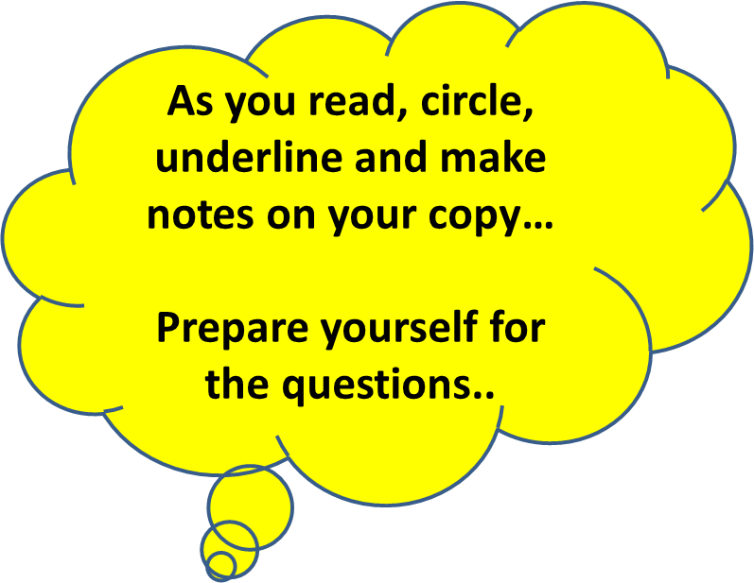
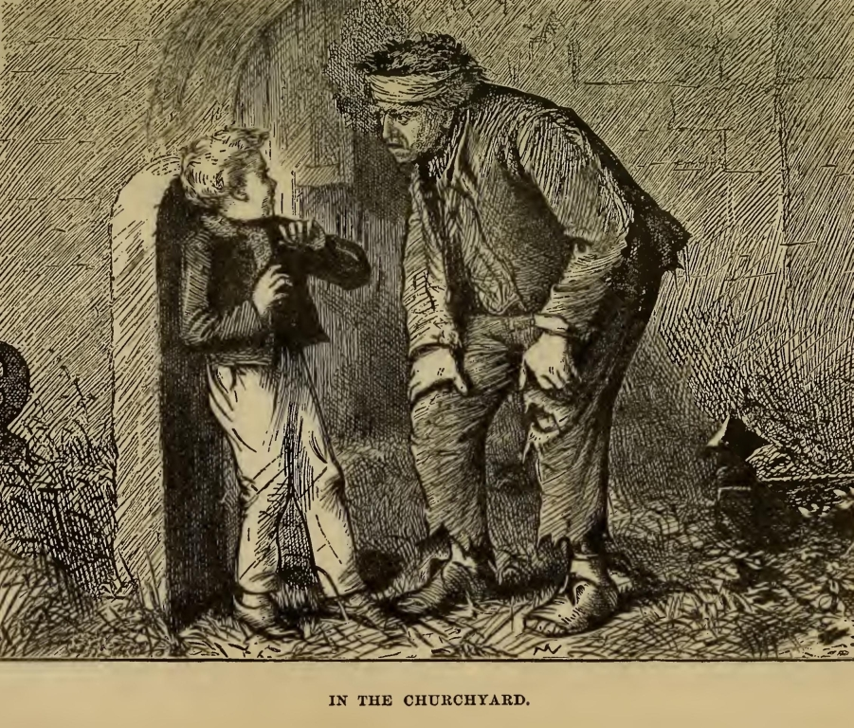
Let’s read…

Slide 32
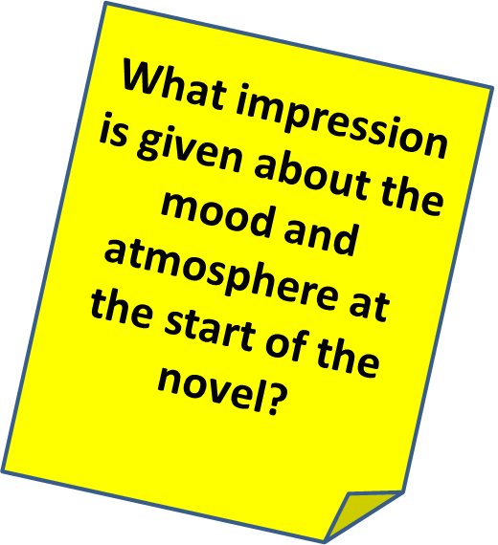
My father's family name being Pirrip, and my Christian name Philip, my infant tongue could make of both names nothing longer or more explicit than Pip. So, I called myself Pip, and came to be called Pip.
I give Pirrip as my father's family name, on the authority of his tombstone and my sister - Mrs. Joe Gargery, who married the blacksmith. As I never saw my father or my mother, and never saw any likeness of either of them (for their days were long before the days of photographs), my first fancies regarding what they were like, were unreasonably derived from their tombstones. The shape of the letters on my father's, gave me an odd idea that he was a square, stout, dark man, with curly black hair. From the character and turn of the inscription, "Also Georgiana Wife of the Above," I drew a childish conclusion that my mother was freckled and sickly. To five little stone lozenges, each about a foot and a half long, which were arranged in a neat row beside their grave, and were sacred to the memory of five little brothers of mine - who gave up trying to get a living, exceedingly early in that universal struggle - I am indebted for a belief I religiously entertained that they had all been born on their backs with their hands in their trousers-pockets, and had never taken them out in this state of existence.
Q1. Read again the first part of the source, lines 1- 13. List four things you learn about Pip.
(4 marks)

Slide 33
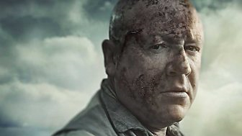
What is this passage about?
What do we learn about the convict in lines 26 to 87?

Slide 34
Question 1
Q1 Read again the first part of the source, lines 1- 13
List four things you learn about Pip (4 marks)

Slide 35
Q2: Look in detail at the extract from line 17 to line 50
Look in detail at the extract from line 26 to line 87. How does the writer use language here to present the convict? (8 marks)
You could include the writer’s choice of:
Words and phrases
Language features and techniques
Sentence forms
The use of direct speech

Slide 36
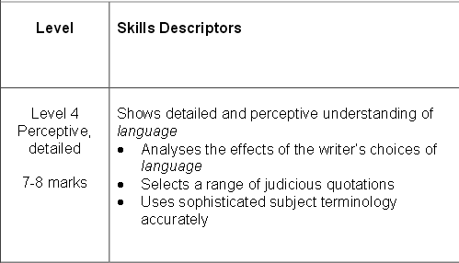
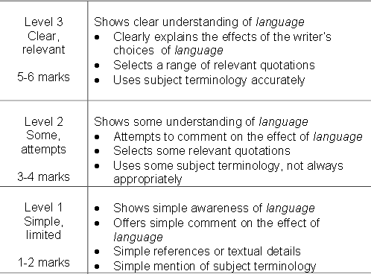
And what about the highest marks- what do you need to do?
What should you do to aim higher?
What are the key words?

Slide 37
One of the ways Dickens presents the convict is.. Another way the writer shows the convict... The writer suggests... The writer presents the convict as …
Q
}
W
E
This is shown when it says, “___”...
An example of this is when Dickens writes, “___”...
For example, “___”
R
This makes the reader think...
This suggests to the reader... The reader will think... This implies... This suggests...
T
The use of adjectives... The use of the verbs...The repetition of... This word has strong connotations of...
Y
This suggests... This implies... This links to...

Slide 38
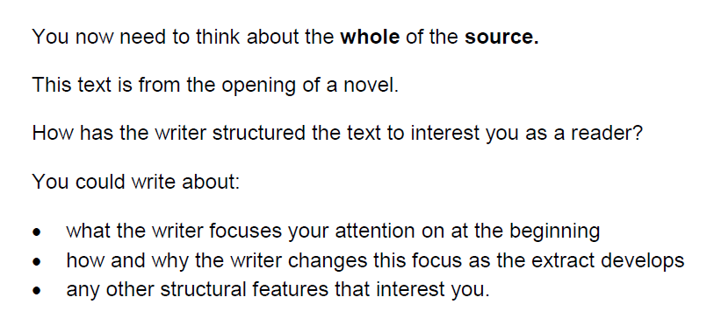
Q3: You now need to think about the whole of the source

Slide 39
What is structure?
Structure

Slide 40
Beginnings and Endings
Where are we placed?
What emotion is triggered?
What thought is offered?
What direction is set?
What do we walk away with?
What are we left to consider?
Have we journeyed somewhere or stayed in the same place?

Slide 41
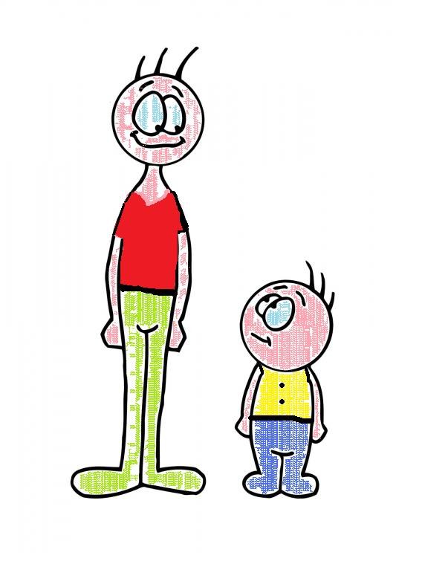
Contrast
Are there any opposites that are placed side by side for emphasis?
Is there any contrast between a character, place or idea at one point in the poem and then later? (the before/after effect)

Slide 42
Central images, ideas, settings
Is the text structured around a central image or idea?
This image may be described in great detail. Perhaps an extended metaphor or symbol.
Or perhaps the setting is the key thing that provides a structure for the writer to develop his/her ideas?

Slide 43
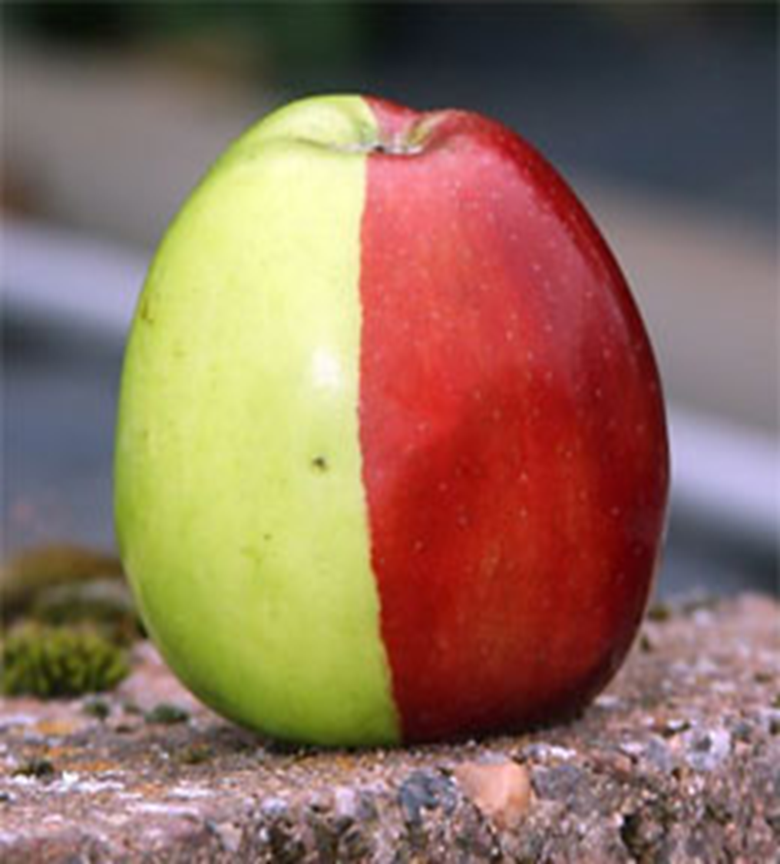
Distinct sections /
Pivotal moments
Is it clear that there are sections to this text that have been chosen by the writer on purpose?
What do each of these sections reveal / represent?
Is there a pivotal moment, a hinge, that seems to move the ideas in a new direction?

Slide 44
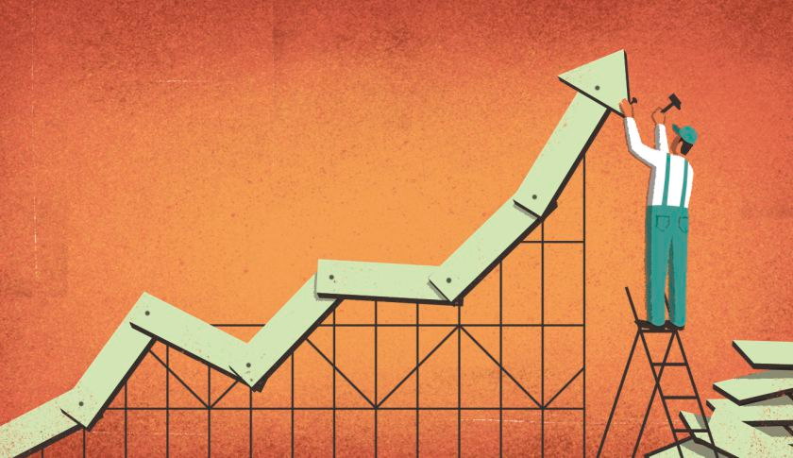
Build up of ideas, image, feeling
What is the build up?
Where is it heading?
What grows over the course of the text?
How does it grow?

Slide 45
Passages of time
How is time presented in the text?
Present tense, past tense?
Days, weeks, years?
History, present day, future?

Slide 46
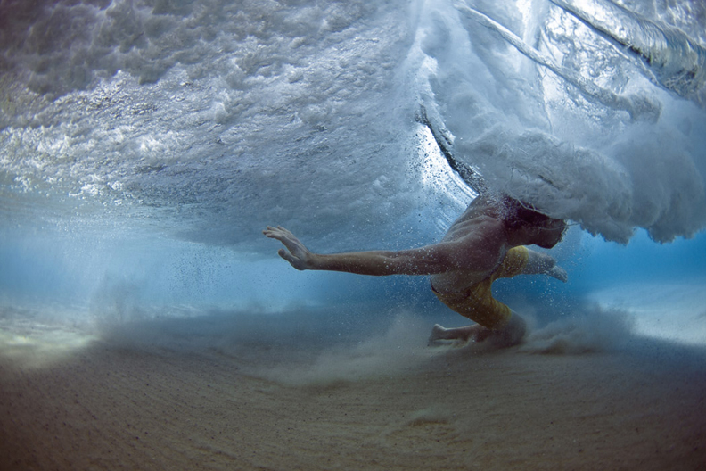
Movement (sentence types / punctuation)
What about sentence types? Are there many short ones? Long ones? A ‘stand out’ short or long sentence that marks something. Simple vs complex?
Look at the punctuation. Why does it stop where it does?
Are commas used to make lists – this may speed things up.
Does it seem ‘choppy’ or more smooth? What punctuation is creating that effect?

Slide 47
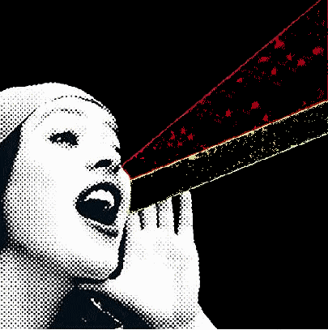
Voice
Who is speaking? What perspective are we offered? Who is the voice talking to?
Is there more than one voice? Is the tone the same or different?
Why are they speaking? Can they be trusted?
Is it first, second, third person? What’s the impact?
Is there any direct speech? What is the effect of this?

Slide 48
What is structure?
The writer chose a structure and form on purpose – it has meaning.
The examiner is not interested in a list of techniques – you need to make meaningful connections. Why has the writer chosen this technique?

Slide 49
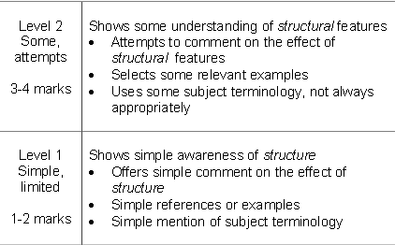
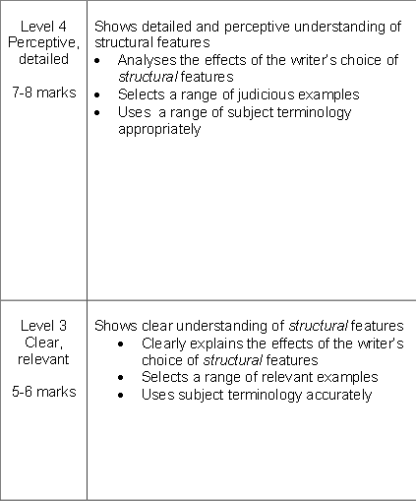
What are the key words?
What does the examiner want you to do?

Slide 50
One of the ways Dickens structures the chapter is... The opening sentence/ paragraph is... The writer begins by telling us about... Another structural point is … At the start of the extract we are told..
Q
}
W
E
This is shown when it says, “___”...
An example of this is when Dickens writes, “___”...
For example, “___”
R
This makes the reader think...
This suggests to the reader... The reader will think... This implies... This suggests...
T
The opening sentence… The writer uses repetition to…The use of the paragraphs ...The repetition of... This setting… The use of time…The shift in focus from…to… The use of the direct speech...
Y
This links to ... This connects to ... This builds an atmosphere of...

